Slide 1
Development of an Educational Tool for ReTI as a VS Code Extension
Presenter
Bachelorproject for the B. Sc. Informatik at University of Freiburg
Presenter: Malte Pullich
Chair of Computer Architecture
Examiner: Prof. Dr. Armin Biere
Adviser: M. Sc. Tobias Faller
Freiburg, 16.07.2025

Slide 2
Agenda
Motivation: State of the Art and Usage
Background: ReTI Architecture and Language
Approach: Improving on Interactivity and Adding Features
Results: Improvement on existing Features, new Features
Conclusion: Goals Reached & Future Work
Albert-Ludwigs-Universität Freiburg | Development of an Educational Tool for ReTI as a VS Code Extension |
July 12, 2025
2

Slide 3
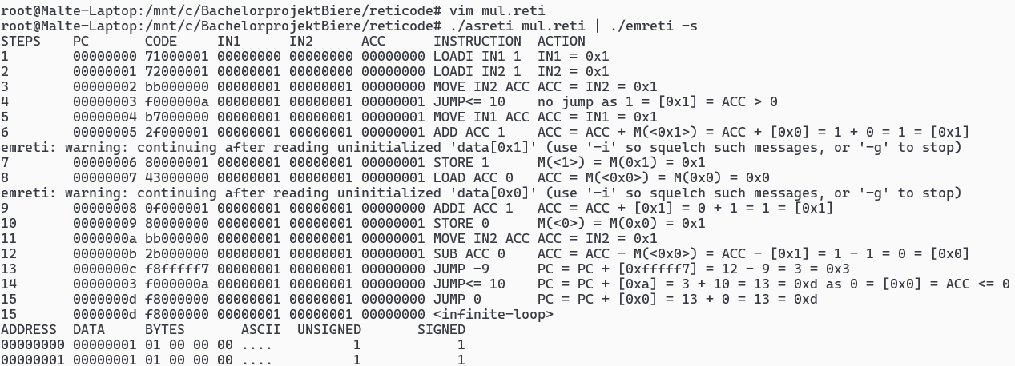
Motivation
Fig. 1: Screenshot of running an example ReTI-Program with Emulator by Prof. Dr. Biere [1]
Goal: Improve accessibility and responsiveness to provide a better educational experience.
Albert-Ludwigs-Universität Freiburg | Development of an Educational Tool for ReTI as a VS Code Extension |
July 12, 2025
3
Notes:
3

Slide 4
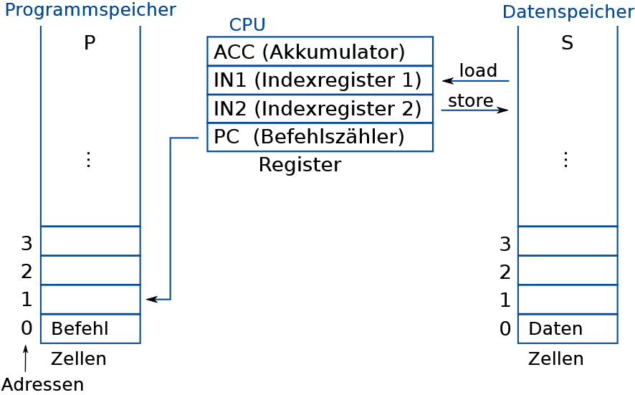
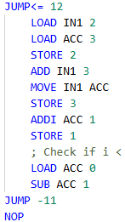
ReTi-Architecture
Fig: 2 Excerpt of a ReTI example program that calculates the Fibonacci number of 5
Fig 3: ReTI architecture [2]
Albert-Ludwigs-Universität Freiburg | Development of an Educational Tool for ReTI as a VS Code Extension |
July 12, 2025
4
Notes:
4

Slide 5
Approach
Goal: Improve accessibility and responsiveness to provide a better educational experience.
Build upon current features:
Additional features:
Quiz:
Rebuild a Website for the Quiz
Add Explanation to Result for each Question
Implement as VS Code Extension:
VS Code Extension API
Most used IDE
VS Code Webview →Easy integration of Quiz-Website
Integrate Emulator, Assembler, Disassembler
Debugger:
Improves programming flow
Enables experimentation
Microsoft Debug-Adapter-Protocol
Language Server:
Syntax Highlighting, Inline errors, Tooltips
Microsoft Language-Server-Protocol
Albert-Ludwigs-Universität Freiburg | Development of an Educational Tool for ReTI as a VS Code Extension |
13. Juli 2025
5

Slide 6
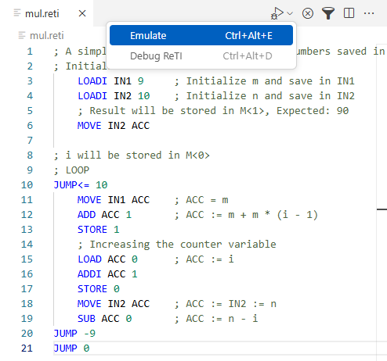
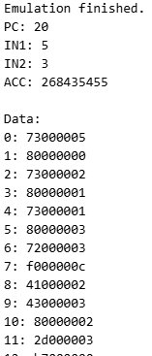
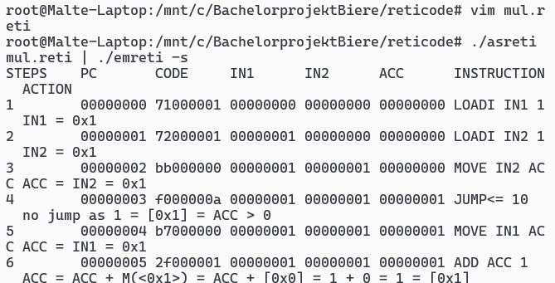
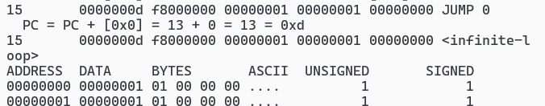
Results Integration of Old Features
Fig 3: Example Usage of the ReTI Emulation by Prof. Dr. Biere [1]
Fig 4: Output of the ReTI Emulation by Prof. Dr. Biere [1]
Fig 5: Example Usage of the ReTI Emulation in VS Code
Fig 3: Output of Emulation in VS Code
Albert-Ludwigs-Universität Freiburg | Development of an Educational Tool for ReTI as a VS Code Extension |
12. Juli 2025
6
Notes:
6

Slide 7
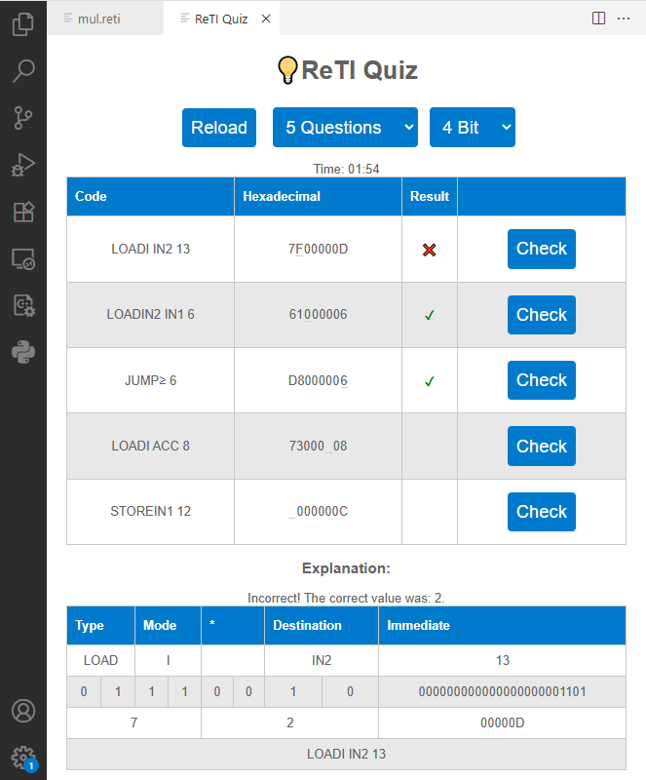
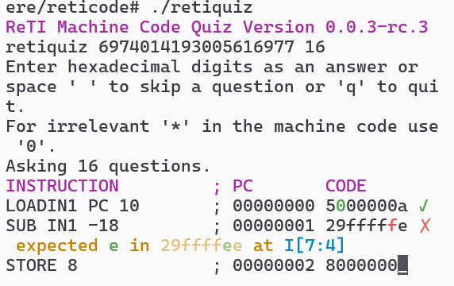
Results Integration of Old Features - Quiz
Fig 6: Screenshot of the old ReTI Quiz opened in Terminal
Fig 7: Screenshot of the new ReTI Quiz opened in VS Code
Albert-Ludwigs-Universität Freiburg | Development of an Educational Tool for ReTI as a VS Code Extension |
12. Juli 2025
7
Notes:
7

Slide 8
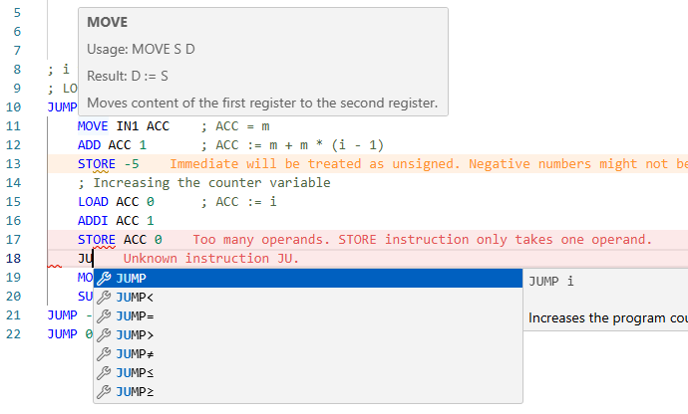
Results New Features – Language Server
Features:
Syntax Highlighting
Tooltips
Realtime compilation and checking
Autocomplete suggestions
Fig 8: Screenshot from VS Code highlighting LSP Features
Albert-Ludwigs-Universität Freiburg | Development of an Educational Tool for ReTI as a VS Code Extension |
12. Juli 2025
8
Notes:
8

Slide 9
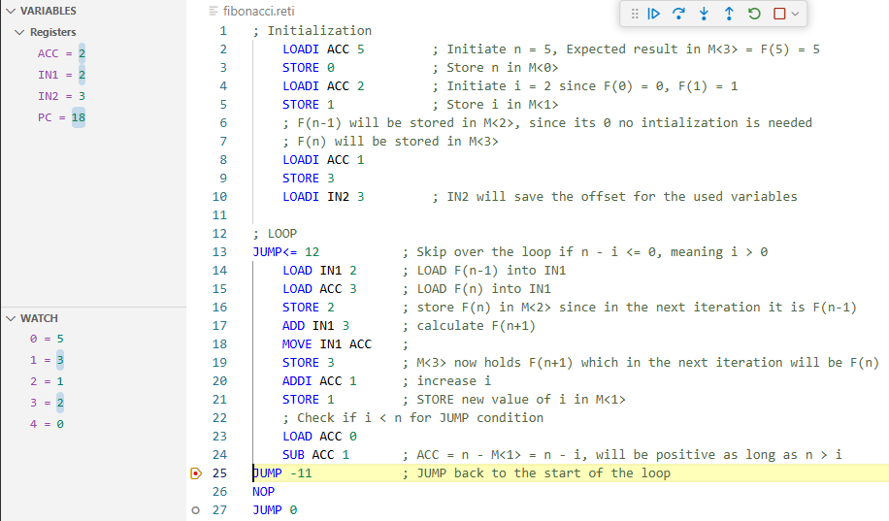
Results New Features – Debugger
Features:
Reading and writing register values
Reading memory
Breakpoints
Stepping
Fig 9: Screenshot of running ReTI-Debug session
Albert-Ludwigs-Universität Freiburg | Development of an Educational Tool for ReTI as a VS Code Extension |
12. Juli 2025
9
Notes:
9

Slide 10
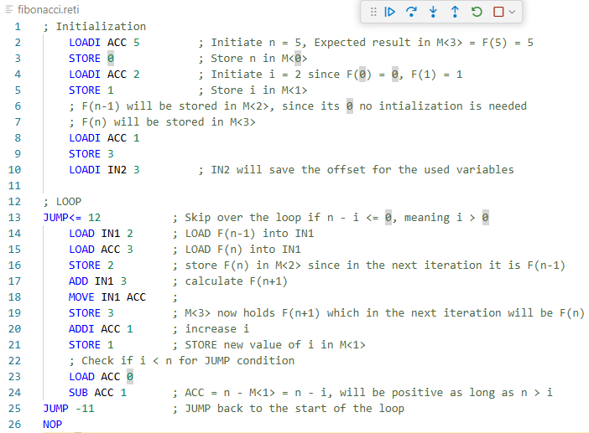







Results New Features – Debugger, Stepping
Call Stack
…
…
…
Call Stack
19
…
…
Fig. 10: Screenshot of running ReTI-Debug session
Fig. 3: Visual representation of the call stack
Albert-Ludwigs-Universität Freiburg | Development of an Educational Tool for ReTI as a VS Code Extension |
12. Juli 2025
10
Notes:
10

Slide 11
Conclusion
Goals Reached
Quiz more accessible both as website and in the extension
More Feedback in Quiz
All features (Assembler, Quiz, Emulator, RanReTi, Disassembler) accessible through extension
Extension provides familiar programming workflow
Debugger and Language Server offer
Syntax Highlighting
Realtime Compilation
Code Completion Suggestions
Executing Code and Inspecting/Manipulating ReTI State
Albert-Ludwigs-Universität Freiburg | Development of an Educational Tool for ReTI as a VS Code Extension |
12. Juli 2025
11
Notes:
11

Slide 12
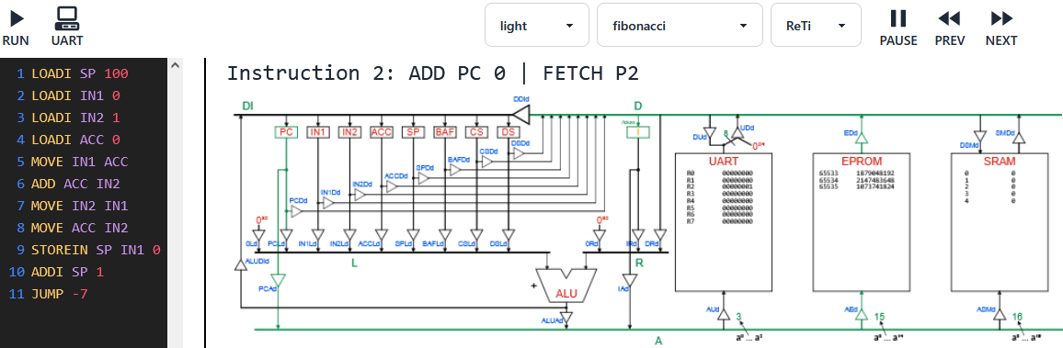
Conclusion
Limitations & Future Work
Expand to other versions of ReTI
Improve Memory View:
Using “watch expression” is cumbersome
Add datapaths visualization:
Same project also provides Pico-C to ReTI compiler
Fig. 11: Screenshot of ReTI-Emulator with Datapath-Visualization [3]
Albert-Ludwigs-Universität Freiburg | Development of an Educational Tool for ReTI as a VS Code Extension |
12. Juli 2025
12
Notes:
12

Slide 13
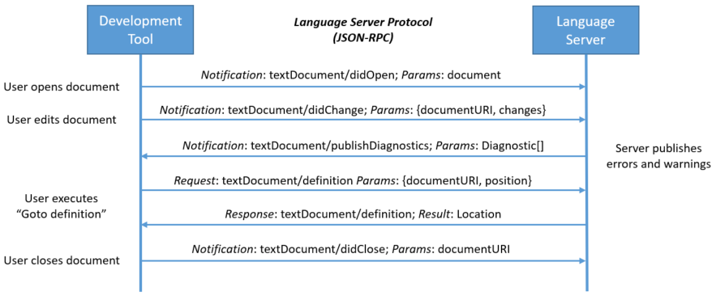
Extra: Language-Server-Protocol
Fig. 12: Example for Communication between Tool and Server in the Language-Server-Protocol [4]
Albert-Ludwigs-Universität Freiburg | Development of an Educational Tool for ReTI as a VS Code Extension |
13. Juli 2025
13
Notes:
13

Slide 14
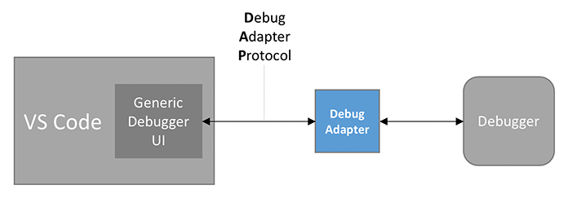
Extra: Debug-Adapter-Protocol
Fig. 13: VS Code Debug Architecture [5]
Albert-Ludwigs-Universität Freiburg | Development of an Educational Tool for ReTI as a VS Code Extension |
13. Juli 2025
14
Notes:
14

Slide 15
References
[1]: Screenshots taken of Reticode by Prof. Dr. Armin Biere, https://github.com/arminbiere/reticode
[2]: Technische Informatik – Kapitel 2 – Kodierung, Prof. Dr. Armin Biere, University of Freiburg, SS 2024
[3]: Screenshots taken of ReTI-Emulator, github.com/michel-giehl/Reti-Emulator
[4]: Microsoft Language Server Protocol - Sequence Diagram. Retrieved 13. July 2025, from https://microsoft.github.io/language-server-protocol/overviews/lsp/overview/
[5]:Microsoft. VS Code Debug Architecture. Retrieved 13. July 2025, from https://code.visualstudio.com/api/extension-guides/debugger-extension

