Slide 1
Development of an Educational Tool for ReTI as a VS Code Extension
Presenter
Bachelorproject for the B. Sc. Informatik at University of Freiburg
Chair of Computer Architecture
Prof. Dr. Armin Biere
Presenter: Malte Pullich
Supervisor: Tobias Faller
Freiburg, 16.07.2025

Slide 2
Agenda
Motivation
ReTI Architecture
ReTI Language
Implementation: ReTI Architecture, Emulator, Debugger, Language Server, Quiz
Albert-Ludwigs-Universität Freiburg | Development of an Educational Tool for ReTI as a VS Code Extension |
July 9, 2025

Slide 3
Motivation
Albert-Ludwigs-Universität Freiburg | Development of an Educational Tool for ReTI as a VS Code Extension |
July 9, 2025

Slide 4
Motivation
ReTI is frequently used at this university for teaching.
Quiz:
  Taking on the machines work deepens understanding.
  Quiz format adds a fun way with direct feedback to grasp internal operations.
Emulator:
  Allows hands-on experimentation to strengthen understanding of low-level language.
These features are already provided by Prof . Armin Biere at https://github.com/arminbiere/reticode.
Albert-Ludwigs-Universität Freiburg | Development of an Educational Tool for ReTI as a VS Code Extension |
July 9, 2025

Slide 5
Motivation
New Features
Debugger:
  Allows more experimentation (i.e. changing values in Registers).
  Helps in finding errors.
  Deepens understanding of ReTI.
Language Server:
  Syntax Highlighting improves workflow and reduces cognitive load.
  Spotting Errors/Warnings while writing increases workflow.
Why VS Code?
New features like the Debugger and Highlighting require an IDE
VS Code is most used IDE by far
Implementation as VS Code extension hopefully increases usage by providing ease of access
Albert-Ludwigs-Universität Freiburg | Development of an Educational Tool for ReTI as a VS Code Extension |
July 9, 2025

Slide 6
Introduction
Albert-Ludwigs-Universität Freiburg | Development of an Educational Tool for ReTI as a VS Code Extension |
July 9, 2025

Slide 7
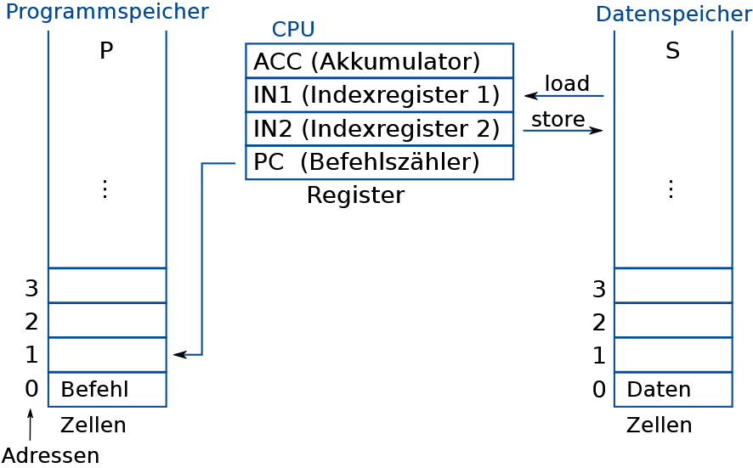
ReTI - Architecture
ReTI language consists of 4 types of instructions: LOAD, STORE, COMPUTE, JUMP
The ReTI language allows comments by typing a semicolon before the commented section.
Source: Technische Informatik – Kapitel 2 – Kodierung,
Prof. Dr. Armin Biere, University of Freiburg, SS 2024
Albert-Ludwigs-Universität Freiburg | Development of an Educational Tool for ReTI as a VS Code Extension |
July 9, 2025

Slide 8
ReTI - Language
ReTI language consists of 4 types of instructions: LOAD, STORE, COMPUTE, JUMP
The ReTI language allows comments by typing a semicolon before the commented section.
Albert-Ludwigs-Universität Freiburg | Development of an Educational Tool for ReTI as a VS Code Extension |
July 9, 2025

