Slide 1
Development of an Educational Tool for ReTI as a VS Code Extension
Presenter
Bachelorproject for the B. Sc. Informatik at University of Freiburg
Chair of Computer Architecture
Examiner: Prof. Dr. Armin Biere
Presenter: Malte Pullich
Adviser: M. Sc. Tobias Faller
Freiburg, 16.07.2025

Slide 2
Agenda
Motivation
Background: ReTI Architecture and Language
Approach
Results: Improvement on existing features, new features
Conclusion: Goals Reached & Future Work
Albert-Ludwigs-Universität Freiburg | Development of an Educational Tool for ReTI as a VS Code Extension |
July 10, 2025
2

Slide 3
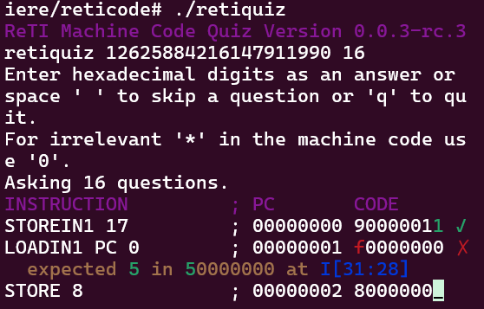
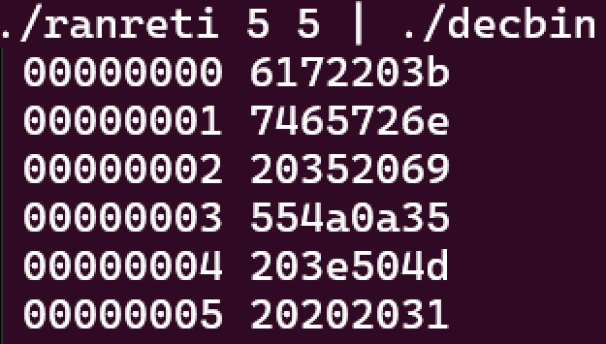
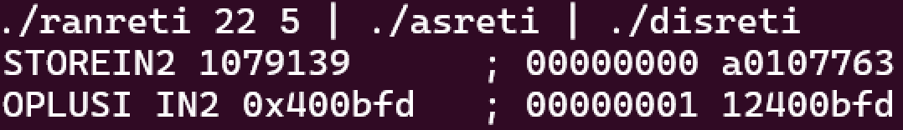
Motivation
Screenshots taken from reticode by Prof. Dr. Armin Biere, https://github.com/arminbiere/reticode
Goal: Improve accessibility and responsiveness to provide a better educational experience.
Albert-Ludwigs-Universität Freiburg | Development of an Educational Tool for ReTI as a VS Code Extension |
July 10, 2025
3
Notes:
3

Slide 4
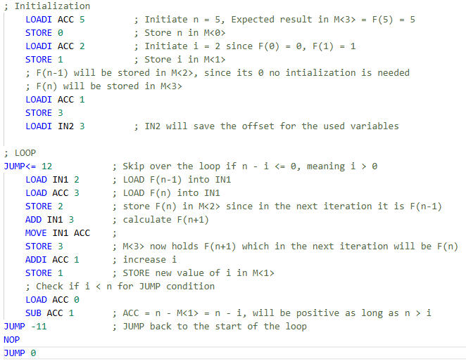
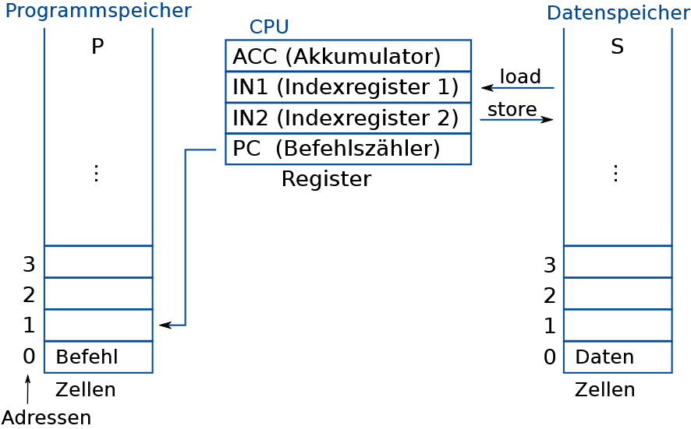
ReTi-Architecture
Source: Technische Informatik – Kapitel 2 – Kodierung,
Prof. Dr. Armin Biere, University of Freiburg, SS 2024
ReTI example program that calculates the Fibonacci number of 5
Albert-Ludwigs-Universität Freiburg | Development of an Educational Tool for ReTI as a VS Code Extension |
July 10, 2025
4
Notes:
4

Slide 5
Approach
Improving current features:
Additional features:
Quiz: Implement as a Website
Implement as VS Code Extension:
Most used IDE
VS Code Webview →Easy integration of Quiz-Website
Integrate Emulator, Assembler, Disassembler
VS Code Extension API
Debugger:
Improves programming flow
Enables experimentation
Microsoft Debug-Adapter-Protocol
Language Server:
Syntax Highlighting, Inline errors, Tooltips
Microsoft Language-Server-Plan
Albert-Ludwigs-Universität Freiburg | Development of an Educational Tool for ReTI as a VS Code Extension |
10. Juli 2025
5

Slide 6

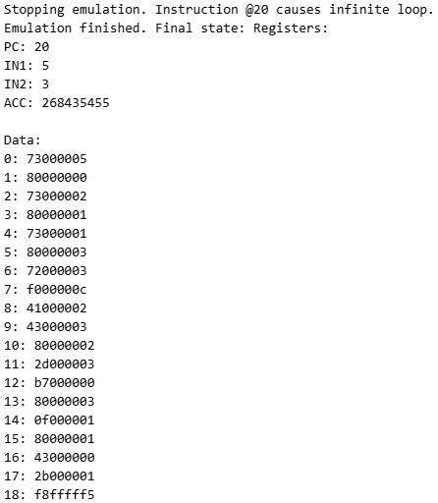
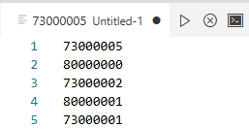
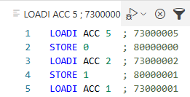
Results Improvement on Existing Features
Albert-Ludwigs-Universität Freiburg | Development of an Educational Tool for ReTI as a VS Code Extension |
10. Juli 2025
6
Notes:
6

Slide 7
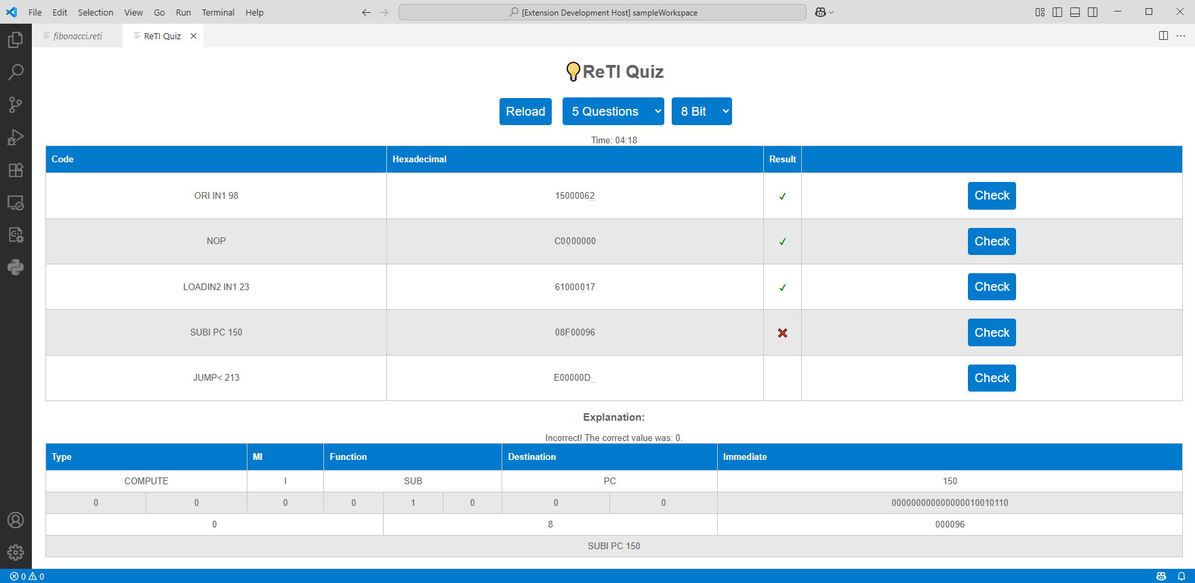


Results Improvement on Existing Features - Quiz
Albert-Ludwigs-Universität Freiburg | Development of an Educational Tool for ReTI as a VS Code Extension |
10. Juli 2025
7
Notes:
7

Slide 8
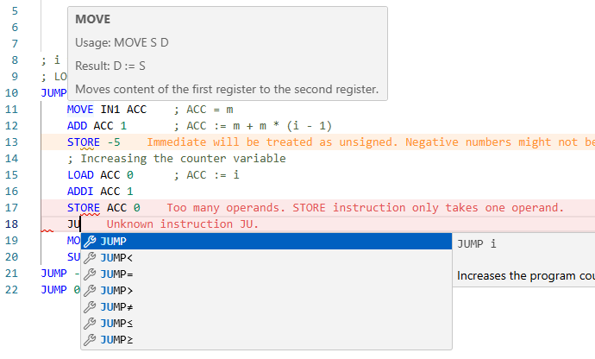
Results New Features – Language Server
Albert-Ludwigs-Universität Freiburg | Development of an Educational Tool for ReTI as a VS Code Extension |
10. Juli 2025
8
Notes:
8

Slide 9
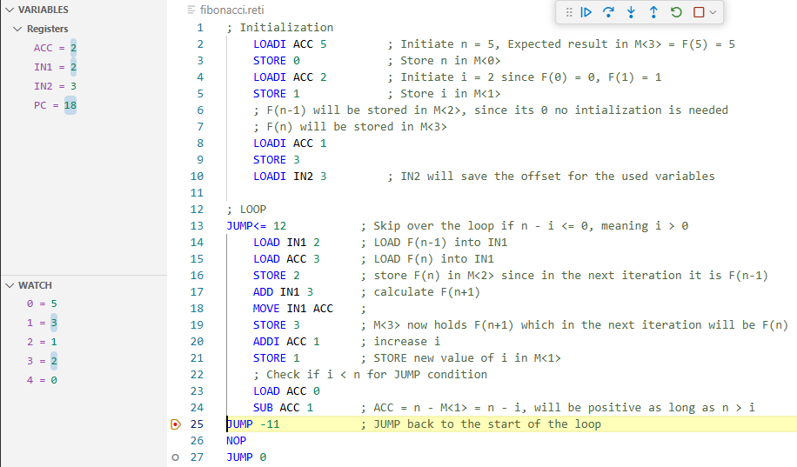
Results New Features – Debugger
Albert-Ludwigs-Universität Freiburg | Development of an Educational Tool for ReTI as a VS Code Extension |
10. Juli 2025
9
Notes:
9

Slide 10
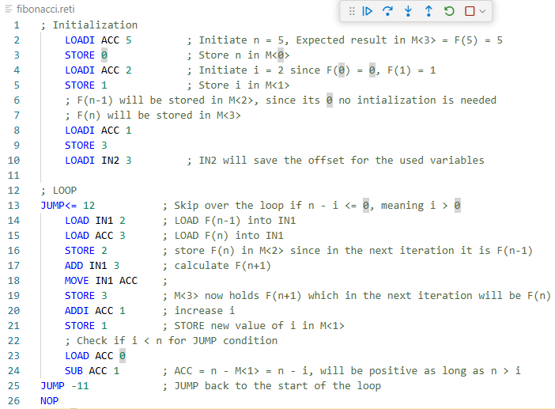







Results New Features – Debugger, Stepping
Call Stack
…
…
…
Call Stack
19
…
…
Albert-Ludwigs-Universität Freiburg | Development of an Educational Tool for ReTI as a VS Code Extension |
10. Juli 2025
10
Notes:
10

Slide 11
Conclusion
Goals Reached
Quiz more accessible both as website and in the extension
All features (Assembler, Quiz, Emulator, RanReTi, Disassembler) accessible through extension
Extension provides familiar programming workflow
Debugger and Language Server offer useful additions
Albert-Ludwigs-Universität Freiburg | Development of an Educational Tool for ReTI as a VS Code Extension |
10. Juli 2025
11
Notes:
11

Slide 12
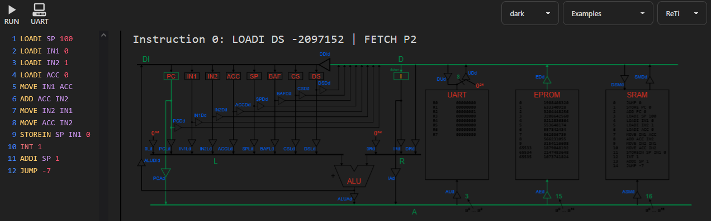
Conclusion
Limitations & Future Work
Expand to other versions of ReTI
Improve Memory View:
Using “watch expression” is cumbersome
Add datapaths visualization:
Same project also provides Pico-C to ReTI compiler
Screenshot taken from ReTI-Emulator, github.com/michel-giehl/Reti-Emulator
Albert-Ludwigs-Universität Freiburg | Development of an Educational Tool for ReTI as a VS Code Extension |
10. Juli 2025
12
Notes:
12

Slide 13
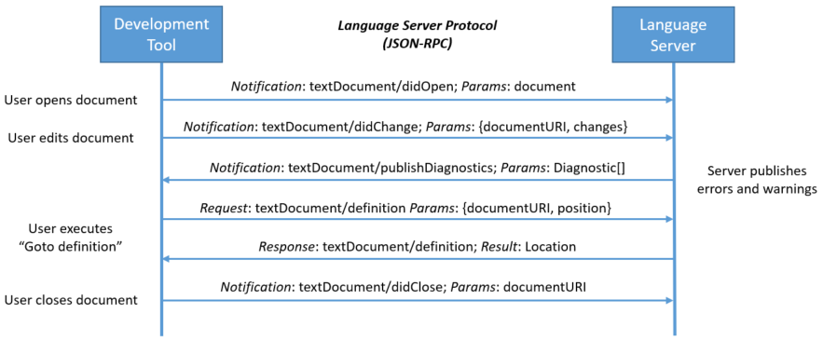
Language-Server-Protocol
Albert-Ludwigs-Universität Freiburg | Development of an Educational Tool for ReTI as a VS Code Extension |
10. Juli 2025
13
Notes:
13

Slide 14
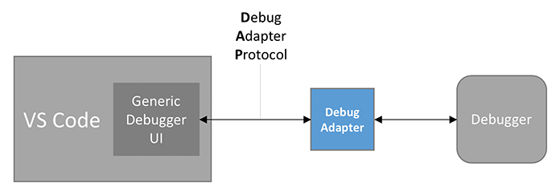
Debug-Adapter-Protocol
Albert-Ludwigs-Universität Freiburg | Development of an Educational Tool for ReTI as a VS Code Extension |
10. Juli 2025
14
Notes:
14

