Slide 1
ReTI-Tools: A VS Code Extension for
ReTI Assembly Programming
Presenter
Bachelorthesis for the B. Sc. Informatik at University of Freiburg
Presenter: Malte Pullich
Chair of Computer Architecture
Examiner: Prof. Dr. Armin Biere
Adviser: Dr. Mathias Fleury, Tobias Faller
Freiburg, 12.11.2025

Slide 2
Agenda
Background: ReTI Architecture and Differences between both Versions
Motivation: State of the Art and Usage
Approach: Improving on Interactivity and Adding Features
Results: Improvement on existing Features, new Features
Conclusion: Goals Reached & Future Work
Albert-Ludwigs-Universität Freiburg | ReTI-Tools: A VSCode Extension for ReTI Assembly Programming |
November 12, 2025
2

Slide 3
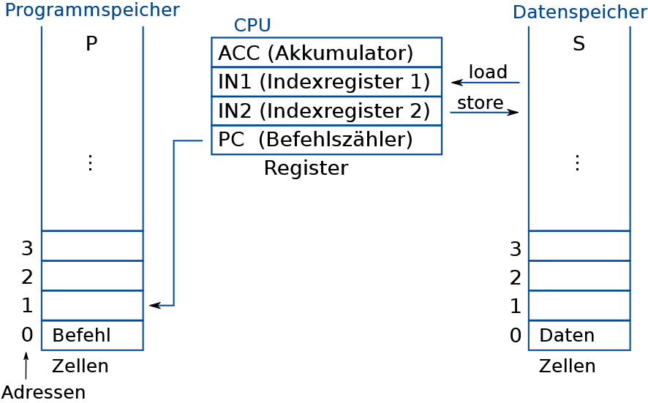
ReTi-Architecture
Fig 1: Abstract ReTI architecture [2]
Albert-Ludwigs-Universität Freiburg | ReTI-Tools: A VSCode Extension for ReTI Assembly Programming |
November 12, 2025
3
Notes:
3

Slide 4
Differences Between the ReTI Variants
ReTI-I (Technical Informatics):
Memory is single SRAM
1 new internal registers:
  I, Instruction Register
No Interrupts
ReTI-II (Operating Systems):
Memory split into SRAM, EPROM, UART
4 new user-visible registers:
  SP, Stack Pointer
  BAF, Begin Active Frame
  CS, (Begin of) Code Segment
  DS, (Begin of) Data Segment
Interrupts:
  Interrupt controller
  New register IVN
New instruction encoding (3 bits for registers)
New instructions (MUL, DIV, MOD)
Albert-Ludwigs-Universität Freiburg | ReTI-Tools: A VSCode Extension for ReTI Assembly Programming |
November 12, 2025
4
Notes:
4

Slide 5
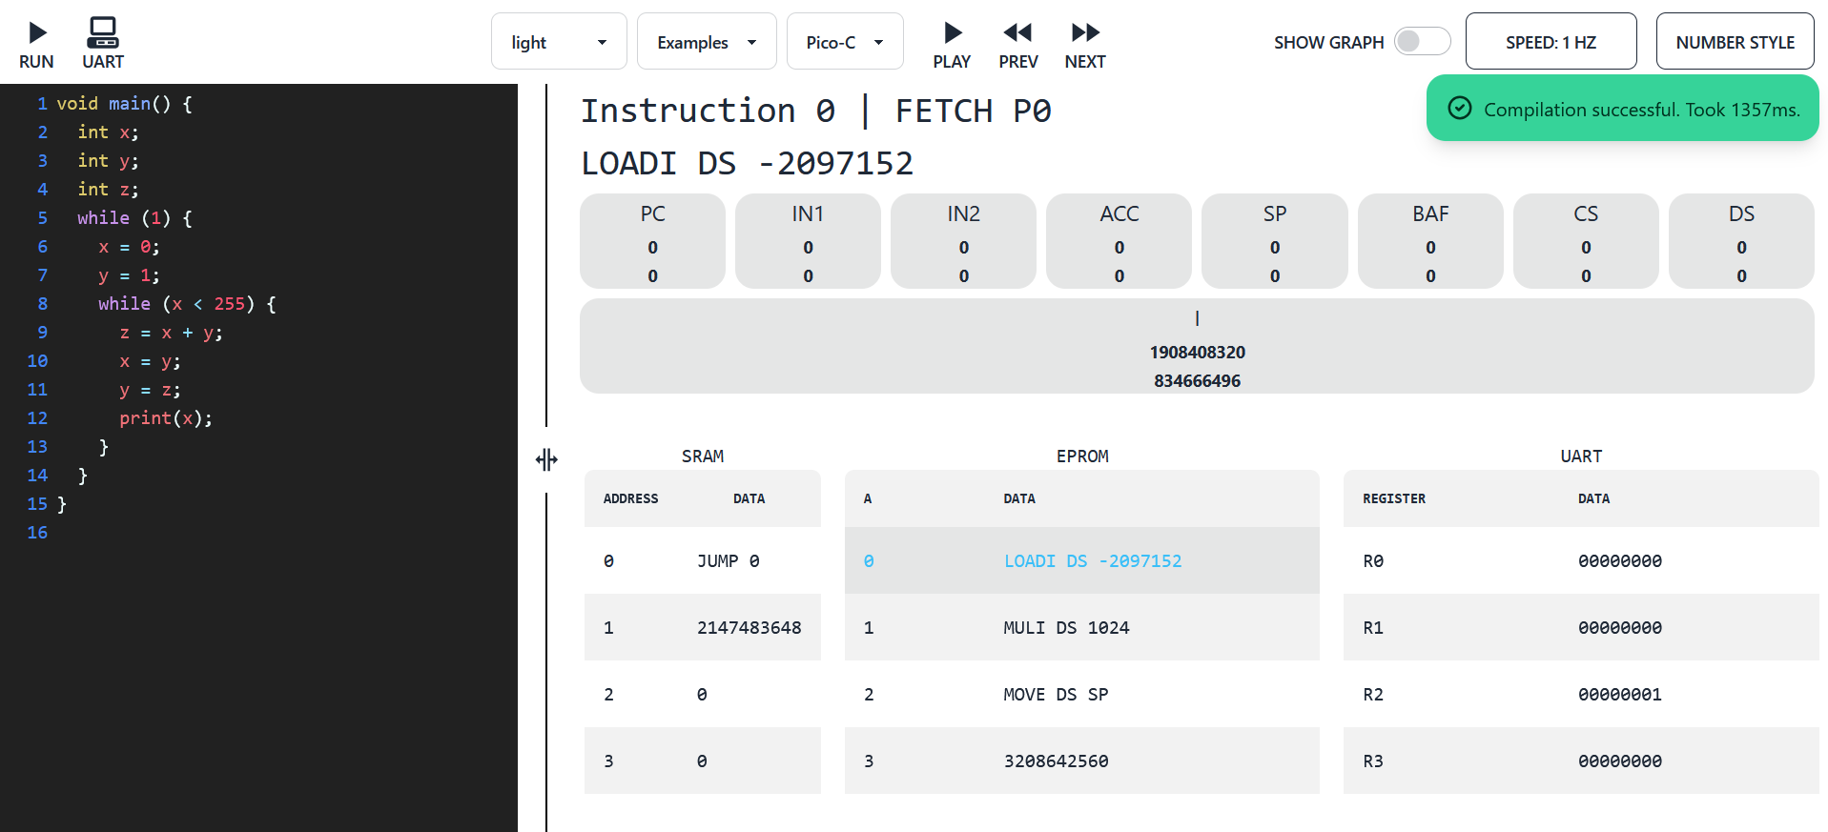
Motivation
Fig. 2 : Screenshot of the Emulator by Michel Giehl [3]
Emulator by Michel Giehl:
Web app, as of Monday 10th November, only accessible through Uni network
Doesn’t support interrupts
Albert-Ludwigs-Universität Freiburg | ReTI-Tools: A VSCode Extension for ReTI Assembly Programming |
November 12, 2025
5
Notes:
5

Slide 6
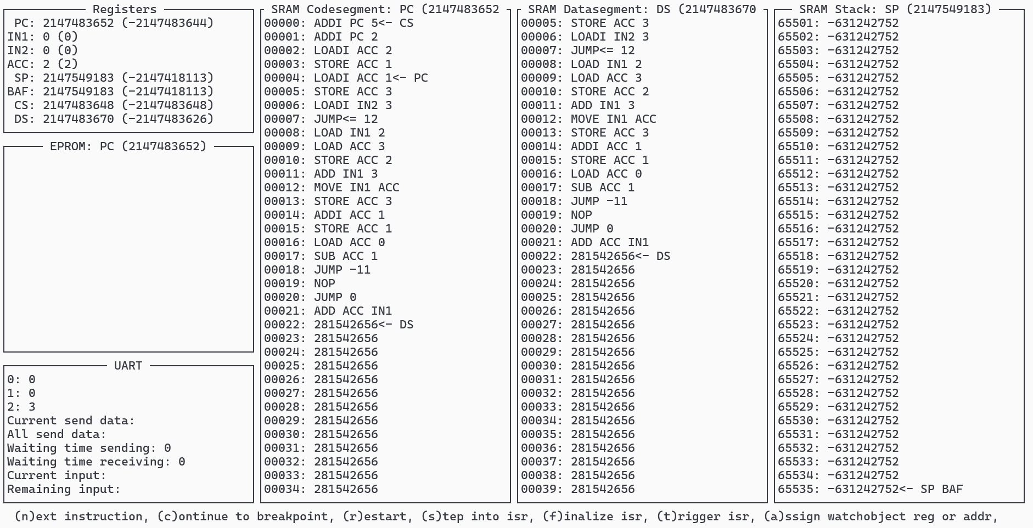
Motivation
Fig. 3 : Screenshot of the Emulator by Jürgen Mattheis [1]
Emulator by Jürgen Mattheis:
OS-dependent (only Linux support)
Workflow requires switching between editor and debugger
Albert-Ludwigs-Universität Freiburg | ReTI-Tools: A VSCode Extension for ReTI Assembly Programming |
November 12, 2025
6
Notes:
6

Slide 7
Approach
Goal: Improve accessibility and responsiveness to provide a better educational experience.
Extend existing VS Code extension [6]:
Most popular editor/IDE
OS-independent (available for Linux, Mac, Windows)
Make it a single tool supporting both lectures
Identified key features to extend:
Emulator (implement ReTI-II alongside ReTI-I)
Debugger (implement ReTI-II alongside ReTI-I)
Language Server (implement ReTI-II alongside ReTI-I)
Identified additional requirement:
Provide a memory view
Albert-Ludwigs-Universität Freiburg | ReTI-Tools: A VSCode Extension for ReTI Assembly Programming |
November 12, 2025
7

Slide 8
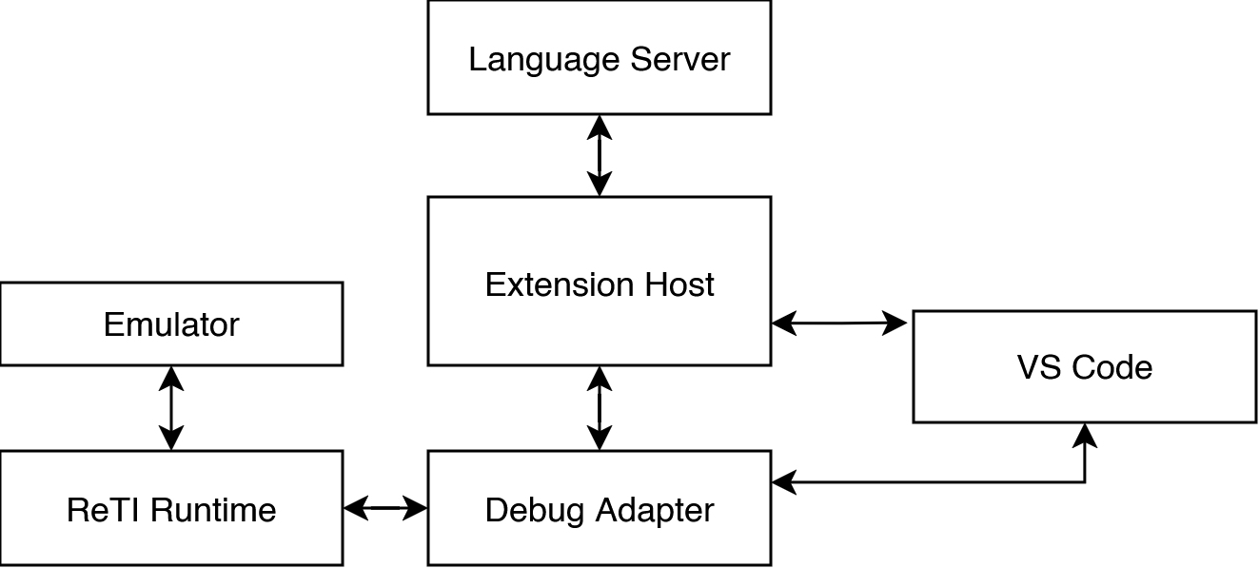
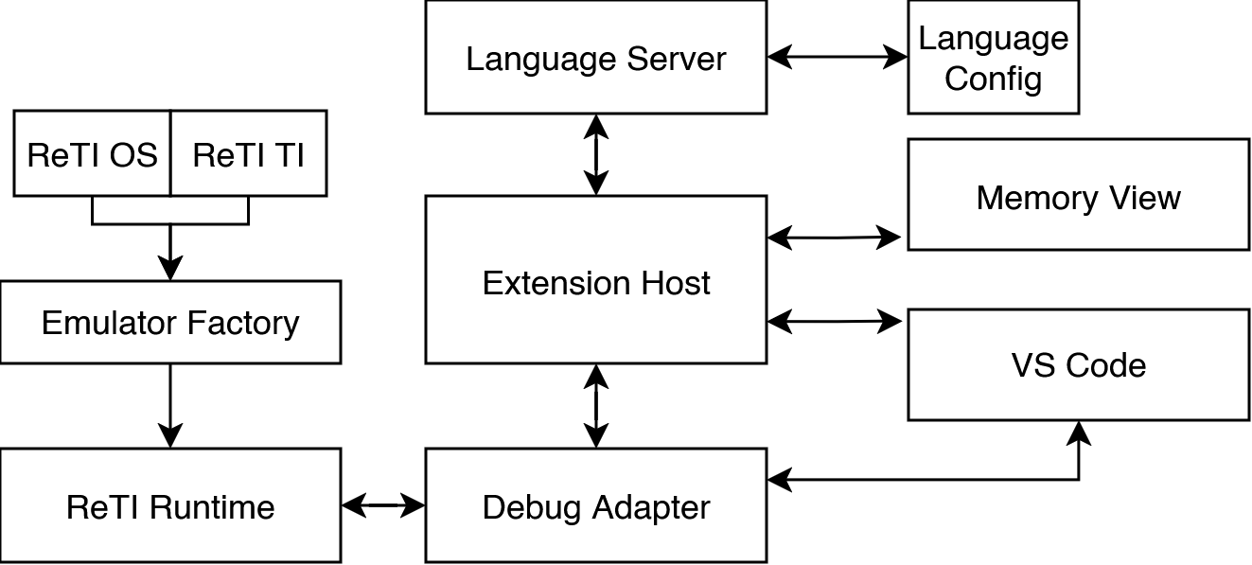
Approach
Extension’s Architecture
Fig. 4: Diagram illustrating the interaction between the different components of the extension.
Albert-Ludwigs-Universität Freiburg | ReTI-Tools: A VSCode Extension for ReTI Assembly Programming |
November 12, 2025
8
Notes:
8

Slide 9
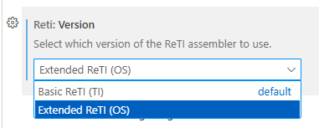
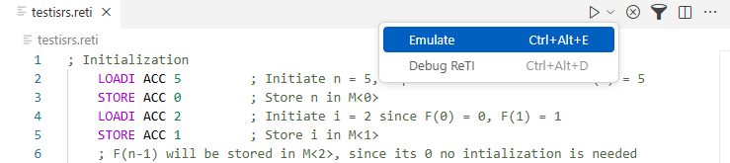
Results
Support for Both Architectures
Fig 5: Screenshot of the new setting in VS Code
Fig 6: Example Usage of the ReTI Emulation in VS Code
Added setting to specify desired version
Affects all features (emulator, debugger, language server) except quiz
Emulator now callable in .reti files for ReTI-II (OS)
Albert-Ludwigs-Universität Freiburg | ReTI-Tools: A VSCode Extension for ReTI Assembly Programming |
November 12, 2025
9
Notes:
9

Slide 10
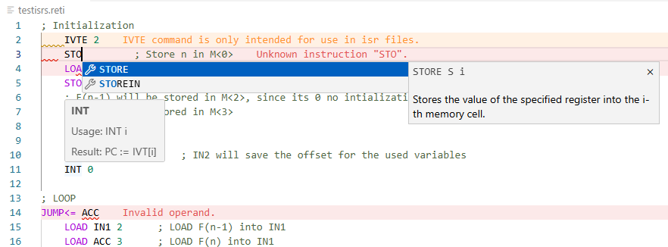
Results
Language Server
Fig 7: Screenshot from VS Code highlighting LSP Features
Features:
Syntax Highlighting
Autocomplete suggestions
Tooltips (syntax and documentation)
Realtime compilation and checking
Albert-Ludwigs-Universität Freiburg | ReTI-Tools: A VSCode Extension for ReTI Assembly Programming |
November 12, 2025
10
Notes:
10

Slide 11
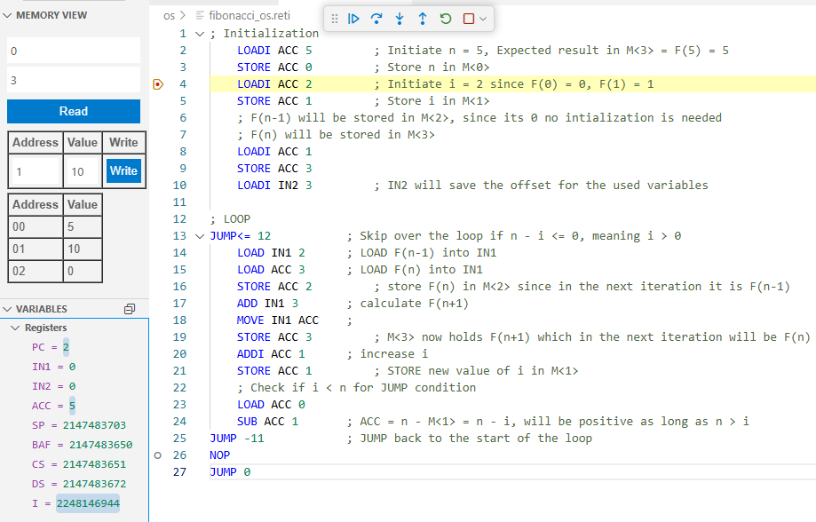
Results
Debugger and Memory View
Features both architectures:
Reading and writing register values
Reading and writing memory
Breakpoints
Features for the ReTI-II (OS):
Switching between main program and interrupt service routine file
Updated Stepping Logic to support interrupts
Fig 8: Screenshot of running ReTI-Debug session
Albert-Ludwigs-Universität Freiburg | ReTI-Tools: A VSCode Extension for ReTI Assembly Programming |
November 12, 2025
11
Notes:
11

Slide 12
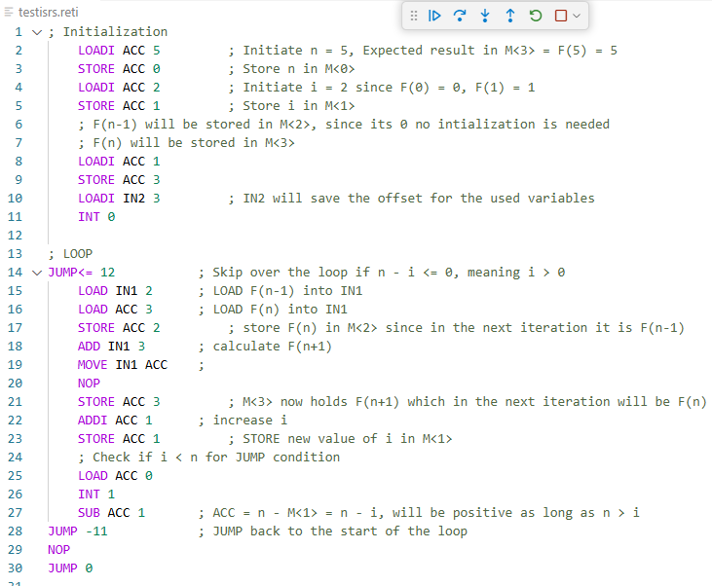
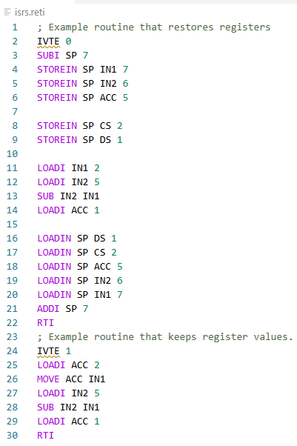
Results
Debugger, Stepping
Fig. 9: Screenshots of running ReTI-Debug session
Albert-Ludwigs-Universität Freiburg | ReTI-Tools: A VSCode Extension for ReTI Assembly Programming |
November 12, 2025
12
Notes:
12

Slide 13
Conclusion
Goals Reached
All features (emulator, debugger, language server) extended to cover both versions ✓
Memory view allows easier monitoring and manipulation of memory ✓
Debugger and Language Server offer
  Syntax Highlighting ✓
  Realtime Compilation ✓
  Code Completion Suggestions ✓
  Executing Code and Inspecting/Manipulating ReTI State ✓
Extension provides familiar programming workflow and OS-independent use ✓
Albert-Ludwigs-Universität Freiburg | ReTI-Tools: A VSCode Extension for ReTI Assembly Programming |
November 12, 2025
13
Notes:
13

Slide 14
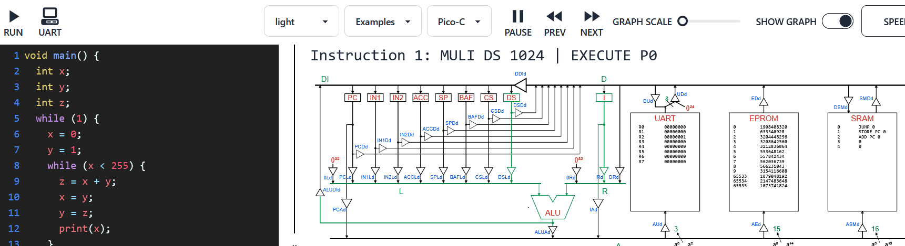
Conclusion
Limitations & Future Work
Emulate UART interface
Make debug adapter independent from VS Code (embedding in other editors/tools)
Integrate Pico-C compiler
Add datapaths visualization [3]:
Fig. 10: Screenshot of ReTI-Emulator with Datapath-Visualization [3]
Albert-Ludwigs-Universität Freiburg | ReTI-Tools: A VSCode Extension for ReTI Assembly Programming |
November 12, 2025
14
Notes:
14

Slide 15
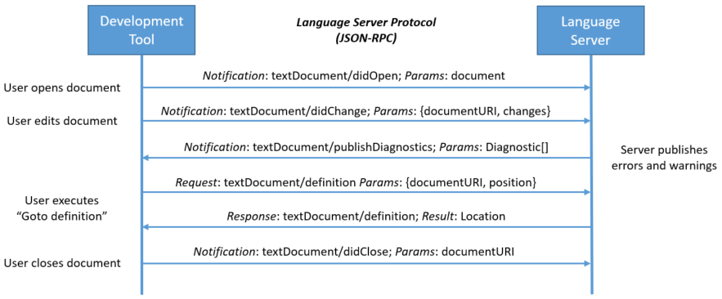
Extra:
Language-Server-Protocol
Fig. 11: Example for Communication between Tool and Server in the Language-Server-Protocol [4]
Albert-Ludwigs-Universität Freiburg | ReTI-Tools: A VSCode Extension for ReTI Assembly Programming |
November 12, 2025
15
Notes:
15

Slide 16
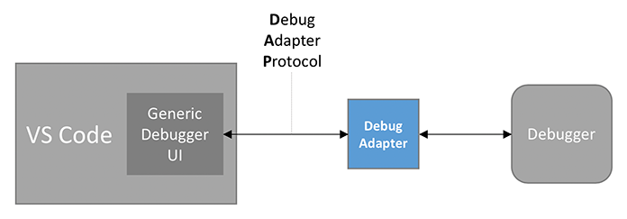
Extra:
Debug-Adapter-Protocol
Fig. 12: VS Code Debug Architecture [5]
Albert-Ludwigs-Universität Freiburg | ReTI-Tools: A VSCode Extension for ReTI Assembly Programming |
November 12, 2025
16
Notes:
16

Slide 17
References
[1]: RETI-Emulator by Jürgen Mattheis, https://github.com/matthejue/RETI-Emulator
[2]: Technische Informatik – Kapitel 2 – Kodierung, Prof. Dr. Armin Biere, University of Freiburg, SS 2024
[3]: RETI-Emulator by Michel Giehl, github.com/michel-giehl/Reti-Emulator
[4]: Microsoft Language Server Protocol - Sequence Diagram. Retrieved 13. July 2025, from https://microsoft.github.io/language-server-protocol/overviews/lsp/overview/
[5]:Microsoft. VS Code Debug Architecture. Retrieved 13. July 2025, from https://code.visualstudio.com/api/extension-guides/debugger-extension
[6]: ReTI-Tools by Malte Pullich, https://github.com/mlt279/vscode-reti

