Slide 1
Spatial Analysis and Modeling BIOL 4383/6383-02
Week 2:
Spatial Dependence, Autocorrelation, & Nearest Neighbor Analyses

Slide 2
Goals for the Week
Cover Basics About Spatial Relationships
Stationarity & Autocorrelation
Pairwise & Nearest Neighbor Analyses
Introduction to Analyses with R & QGIS
Visualize Spatial Dependence

Slide 3
Some Basic Statistics: Covariance and Correlation
Both are Metrics of How Linked/Related Two Variables Are.
Correlation is Standardized and Easier to Interpret
[-1, 1]; at extremes very precise relationships between variables
CORRELATION DOES NOT MEAN CAUSATION!!!

Slide 4
Tobler’s 1st Rule of Geography
Notes:
Couple minute discussion about Landscape Ecology

Slide 5
Autocorrelation
How correlated variable is with itself across a gradient (lags)

Slide 6
Spatial Dependence vs Autocorrelatiom

Slide 7
Stationarity
Data exhibit uniform patterns and relationships along gradients (e.g., across spatial areas, or throughout time)
MAJOR ASSUMPTION OF STATISTICS!!!
Often, we’re testing for lack of stationarity in a sense, but need to be careful when its driven by a factor we’re not considering

Slide 8
Visualizing Autocorrelation

Slide 9
Testing for Spatial Relationships
The simple case: Complete Samples (census)
Are entities in a “complete spatial random” arrangement?
Alternatives: clustered or hyperdispersed

Slide 10
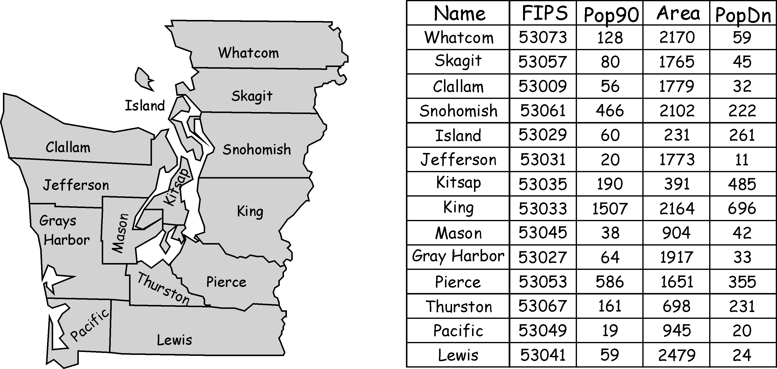
Fundamentals: Vector Data
Lines, Points, Polygons
Each Individual Element Referenced in an Attribute Table
Many Different Types of Data Can be Stored for each Record

Slide 11
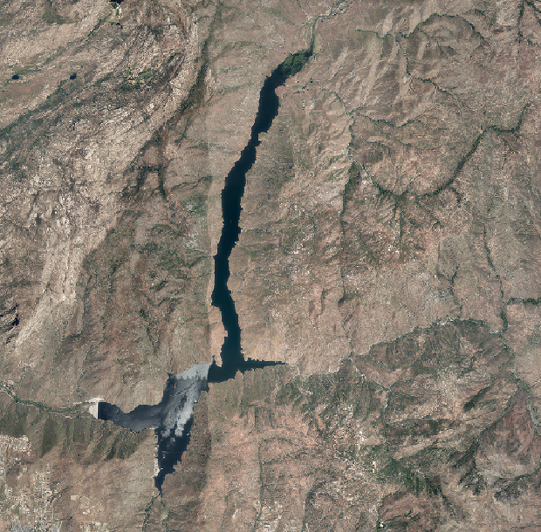

Fundamentals: Raster Data
Pixels [Picture Elements]
Think Digital Photograph

Slide 12
Fundamentals: Raster Data
One Datum Per Pixel Per Layer
Some Imagery is Multiple Layers (bands)
On Data-Type per Layer (e.g., Integer, Floating Point, etc.)
Examples:
Digital Elevation Model (Continuous Data)
Land Cover Classification (Categorical Data)

Slide 13
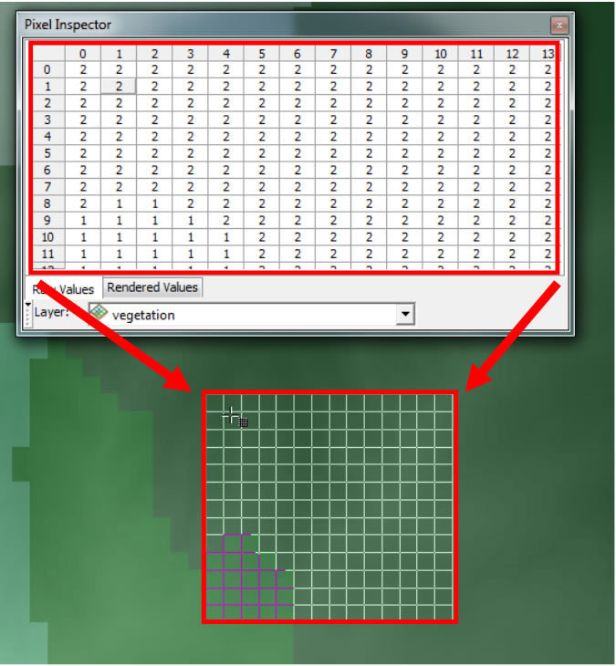
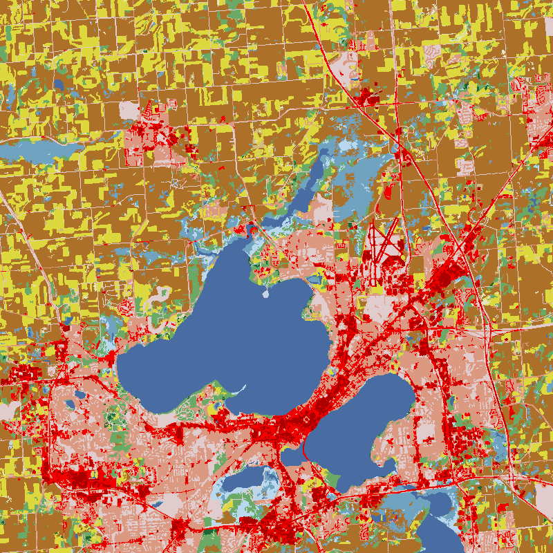
Fundamentals: Raster Data

Slide 14
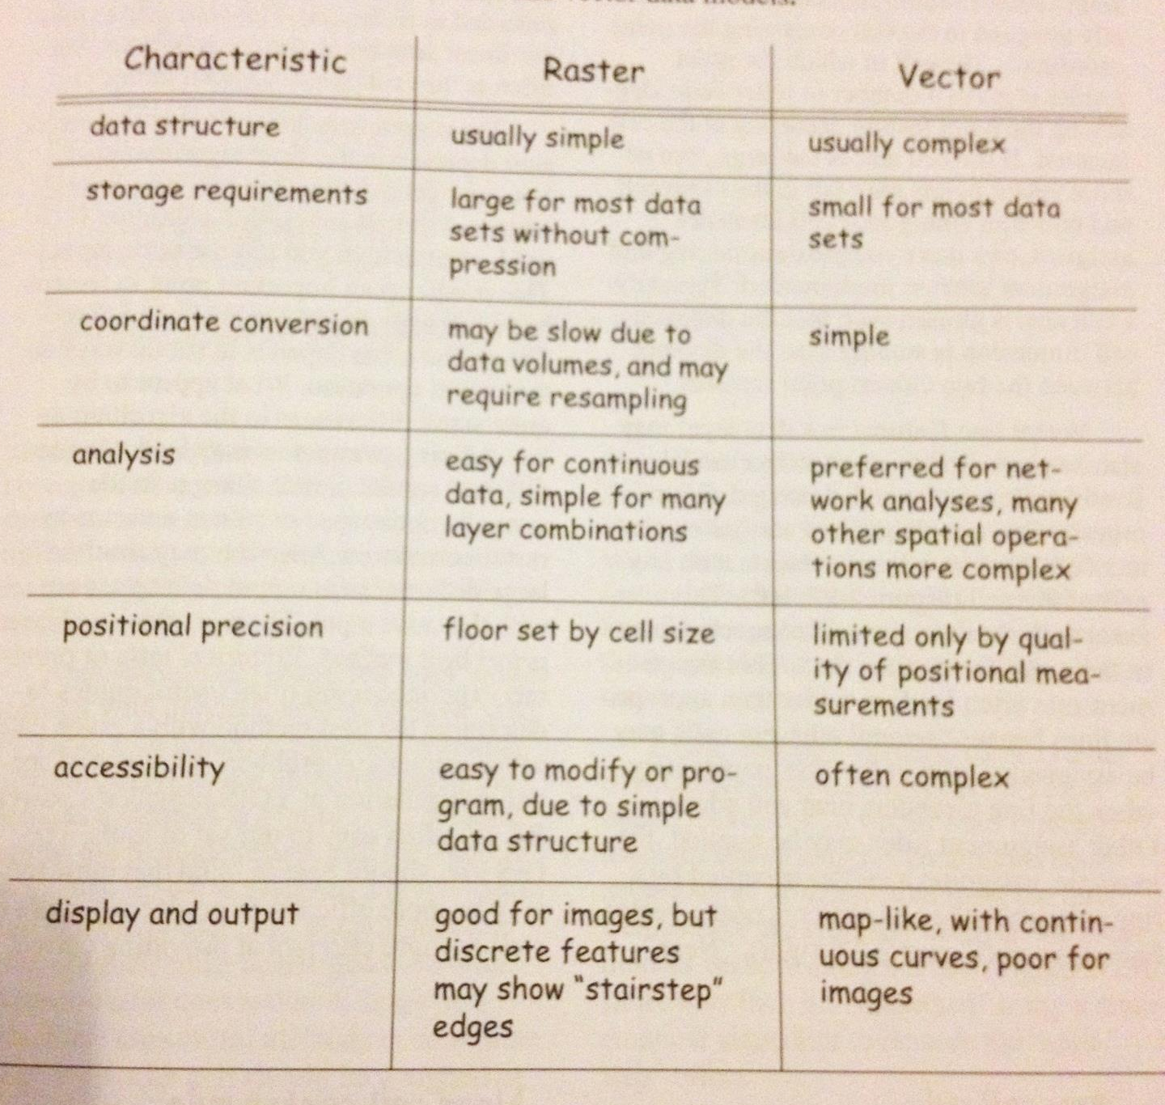
From Bolstad, GIS Fundamentals

Slide 15
Common Formats (There are Many More!)
Vector Data: Shapefiles (.shp); GPX; DXF
Raster Data: GeoTIFF; ECW; ASCII; .IMG
Raster or Vector: .GDB (ESRI Proprietary); KML (Google Earth); GeoPDF (Proprietary)

Slide 16
Coordinate/Spatial Reference Systems
3 Elements:
Geodetic Datums
Projections
Coordinate Systems

Slide 17
Geodetic Datums
Earth is NOT a Perfect Sphere
We have multiple representations of it based on an oblate spheroid and measured distances among known points on Earth (Geodetic Datums)
E.g., North American Datum 1927 (NAD27); NAD 83; World Geodetic Survey 1984 (WGS84).
Things are Mapped with GPS Units/Survey Equipment According to Specific Datums

Slide 18
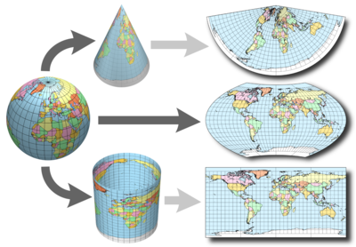
Projections
Maps are Flat Representations of Earth’s Surface
Many ways to Do This; each with pros/cons
Conic
Pseudocylindrical
Cylindrical

Slide 19
Coordinate Systems
WHERE ON EARTH ARE WE?!?!?!
Multiple Coordinate Systems to Represent This
E.g., Latitude/Longitude; UTMs
Goal is to Give Accurate Representation of Location Relative to Other Locations
Coordinate Systems are Associated with Specific Projections (generally Implicitly)

Slide 20
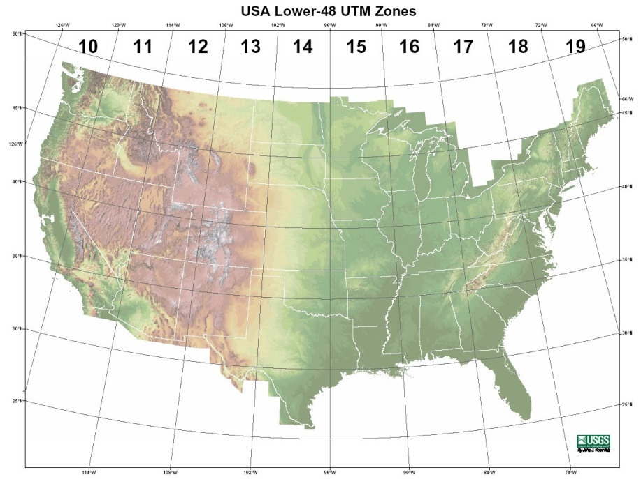
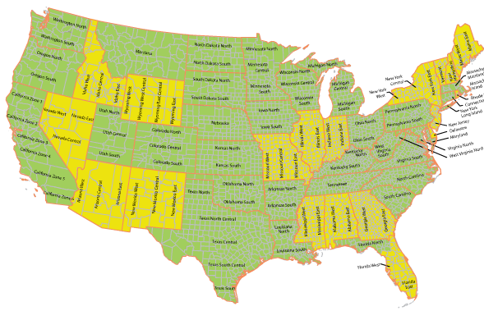
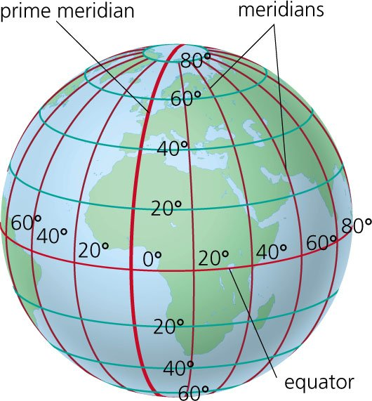
Coordinate Systems
UTM
-Meter-Based, from a Conformal Projection [preserves angles locally])
State Plane Coordinate Systems
Based on Lambert Conformic Conic or Universal Transverse Mercator Projction (Depends on State)
Latitude/Longitude
-Based on Specific Datums

Slide 21
Using Coordinate Systems in GIS
http://spatialreference.org/
We Often Need to Define or Transform Reference Systems
The Above Website Serves as a Clearinghouse for Spatial Reference Codes and Data, Based on Various Codes
THINGS CHANGE WHEN YOU DO THIS!!!
But We Don’t Always Have Alternatives…
http://bost.ocks.org/mike/simplify/
http://bost.ocks.org/mike/example/

Slide 22
Some Basic Manipulations
Vector Operations
Clipping
Spatial Join/Overlay
Create Centroids

Slide 23
Some Basic Manipulations
Raster Operations
Crop/Clip (change extent)
Rescale/Resample (change grain size)
Raster Algebra/Map Math

Slide 24









Some Common Software Tools
Paid Software
Free and Open Source (FOSS)
Many Integrate with Each Other

Slide 25
Lets Explore QGIS
(Before I Forget- Reading Assignment for Thursday)

