Slide 1
Individual Project
QA Consulting
Martin Tomlinson

Slide 2
Brief & Scope
OOP based application with CRUD functionality
Agile methodology
Databases
Java SE/EE
Front/Back End Development
Automated Testing
Cloud Computing
Continuous Integration
Version Control
Notes:
Just to go over the brief and scope of the project:
We were tasked with creating a OOP application with full CRUD functionality, and to utilise supporting tools.
This is a combination of all the modules we’ve done up to now, and includes:

Slide 3
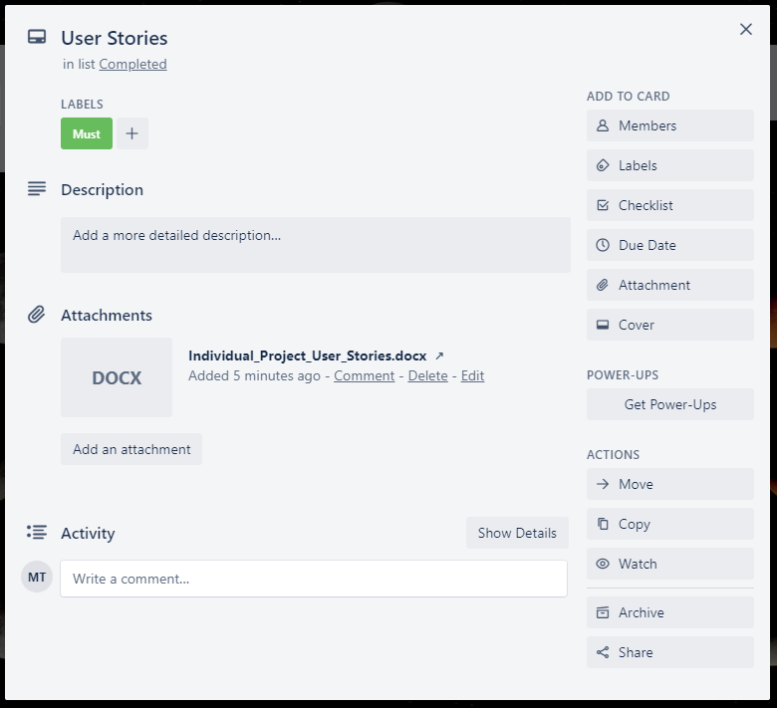
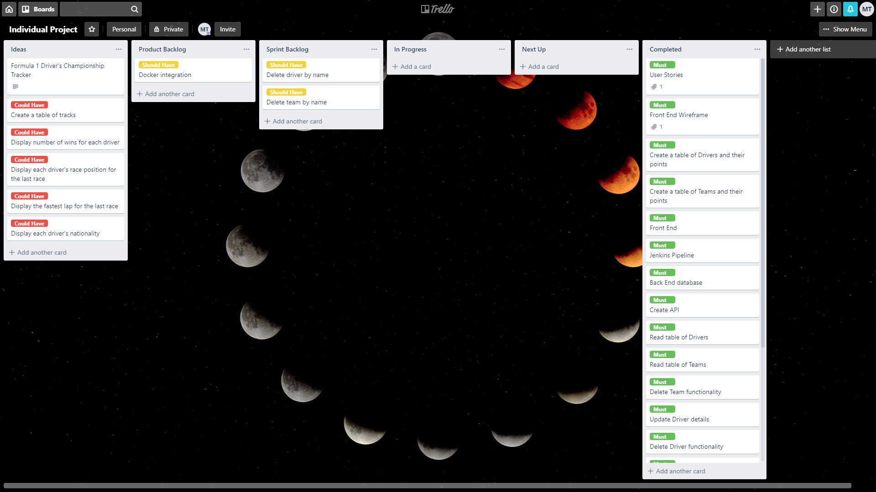
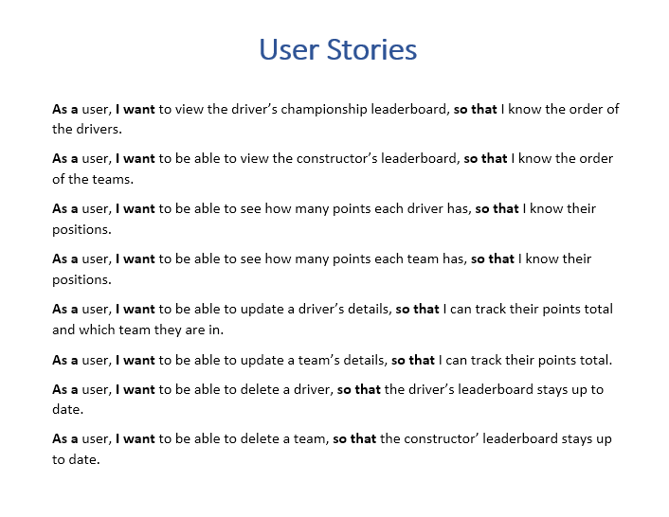
My Solution
Notes:
With that in mind, this is the start of my solution:
Here we have my Trello board as it is now, after developing the project over the last few weeks.
I’ve used the MOSCOW method to prioritise my tasks, Must have’s are green, Should have’s are yellow, Could have’s are red.
Initial ideas, these are now tasks for possible future improvements.
Product backlog, what I wanted to have done before this deadline.
Sprint backlog, what I was working on right before deadline.
Completed, everything I have done.
Over here I thought I’d highlight the way I did user stories. I wrote these originally in word instead of straight onto the Trello board, so they’re on the board as a single card and the word doc is attached.

Slide 4
Environment Setup – DevOps Approach
MySQL database
GitHub
Jenkins Pipeline
Spring Boot
GCP Virtual Machine
Notes:
So my next step was to set up a DevOps environment before doing any actual coding.
This involved:
Creating the MySQL database.
Setting up a git repo.
Setting up a simple Jenkins pipeline.
Creating a spring boot application to run the backend from.
Setting up a linux VM which would run the spring boot application.

Slide 5
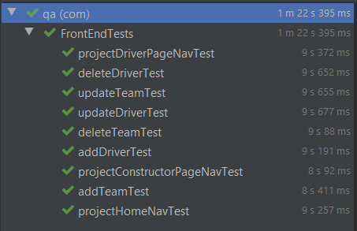
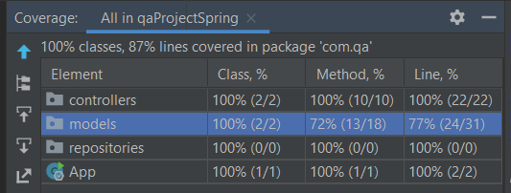
Testing
JUnit
Selenium
Codacy
Notes:
For unit testing I used JUnit along with various dependencies provided by Maven.
Automated testing of the front end was performed with Selenium.
Code quality was tested using Codacy.
Due to a couple of issues with merging these tests into my project, the Junit and selenium tests are in their own git repos.
So my project is 3 repos overall, up from the original one.
The Junit tests are testing the backend as you can see here, I’m currently at 87% coverage on the backend.
The selenium tests do all work and I’ve watched them test my front end, they’re just in their own separate project and not the main one, so I can’t show coverage here.

Slide 6
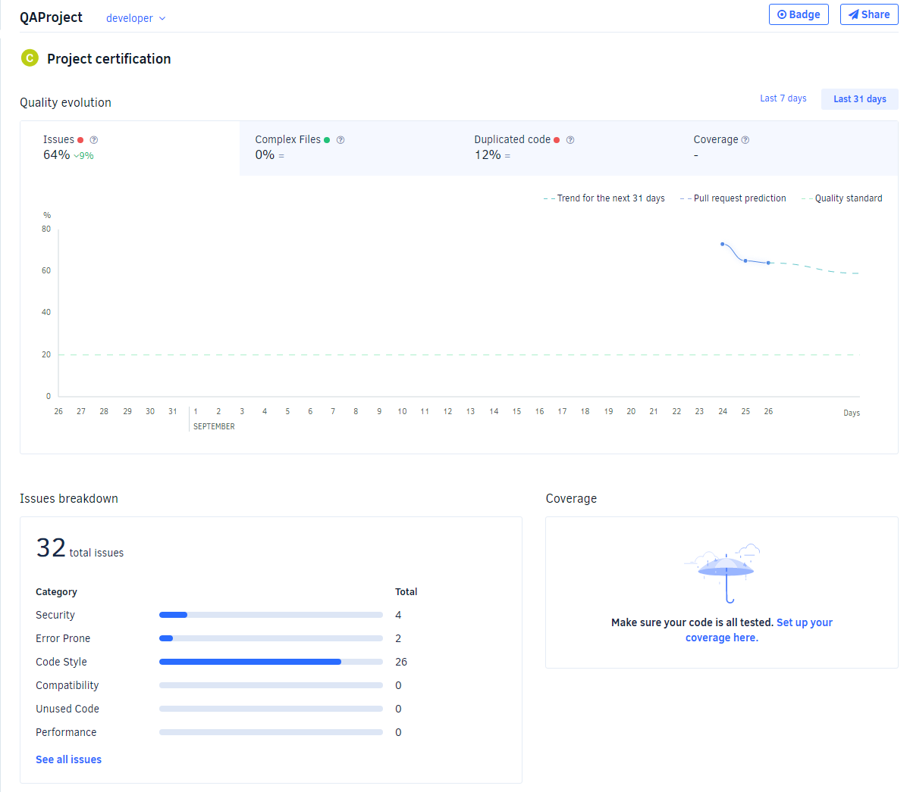
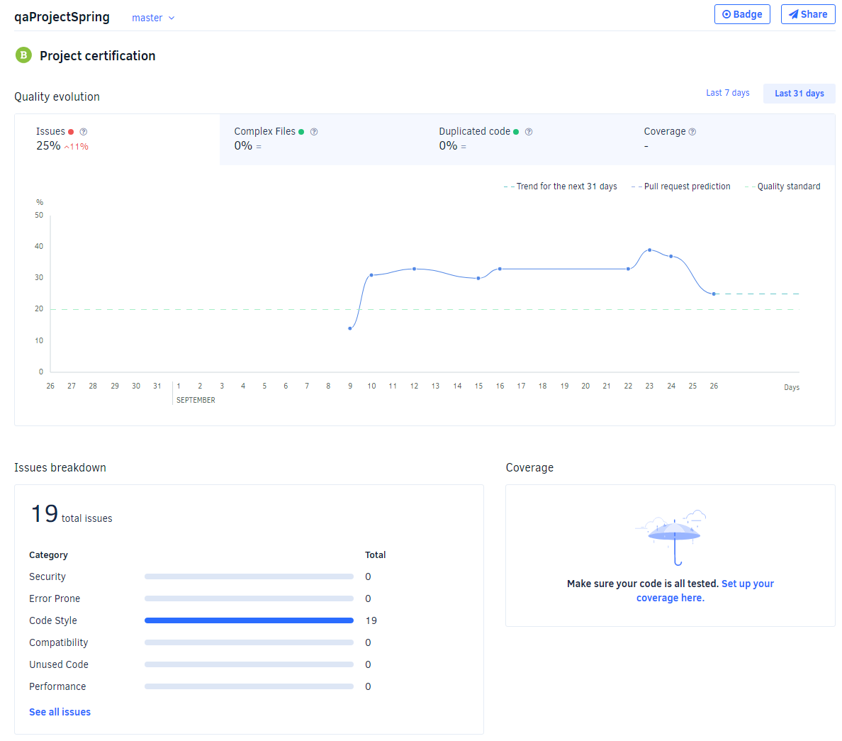

Testing cont.
Notes:
These are the Codacy reports for my project.
On the left is my original project repo, this contains all of the front end code. That’s the HTML, CSS, JS and is the largest project, hence the larger number of code issues.
For the sake of brevity I haven’t got screenshots of all the issues, don’t worry. But there is a link on my git hub where you can go through them and see exactly what’s wrong.
The middle one is a report for the backend, and has much fewer issues.
The last one is testing the code of the selenium tests and again, it’s less code so less problems.
I’ve looked through these issues and the majority are things like ‘unexpected console.log’, things like that. They’re mostly code style issues and something I would address as a future improvement.

Slide 7
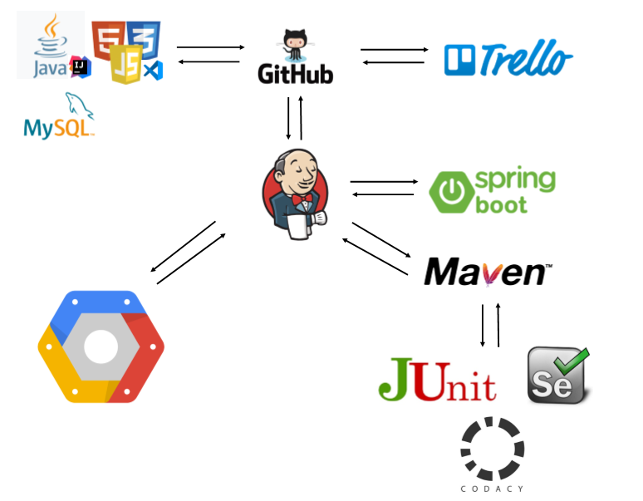
Continuous Integration
Project Tracking – Trello
VCS – Git
Source Code – IntelliJ, VSCode, MySQL
CI Pipeline – Jenkins
Build Tools, Spring Boot, Maven
Unit tests – Junit
Automated testing - Selenium
Code quality – Codacy
Deployment – Google Cloud Platform via a VM
Notes:
So let me take you through how I implemented CI into my project.
Git webhook into Jenkins to deploy a build whenever I pushed to the dev branch of the repo.

Slide 8
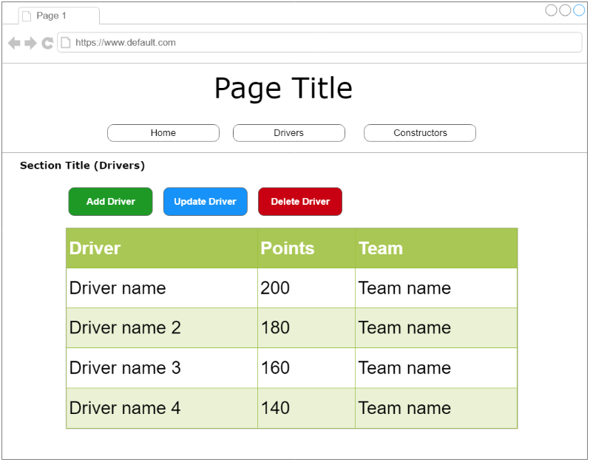
Wireframes
Drivers Page

Slide 9
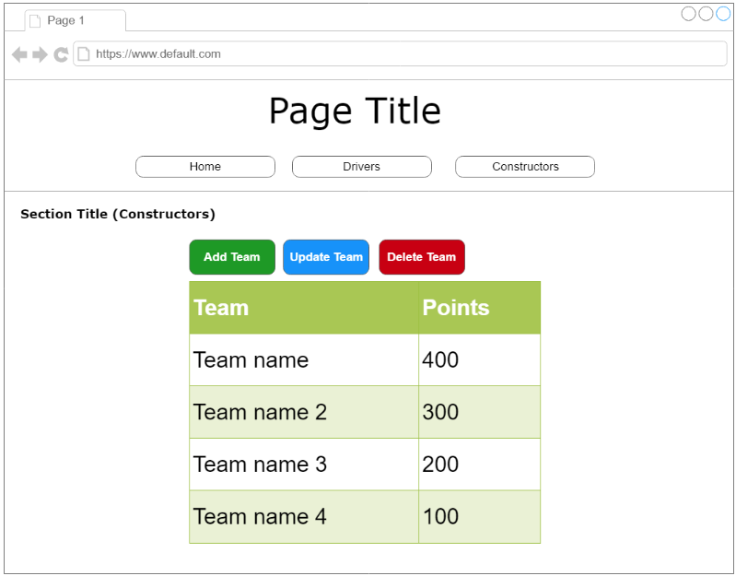
Wireframes
Constructors Page

Slide 10
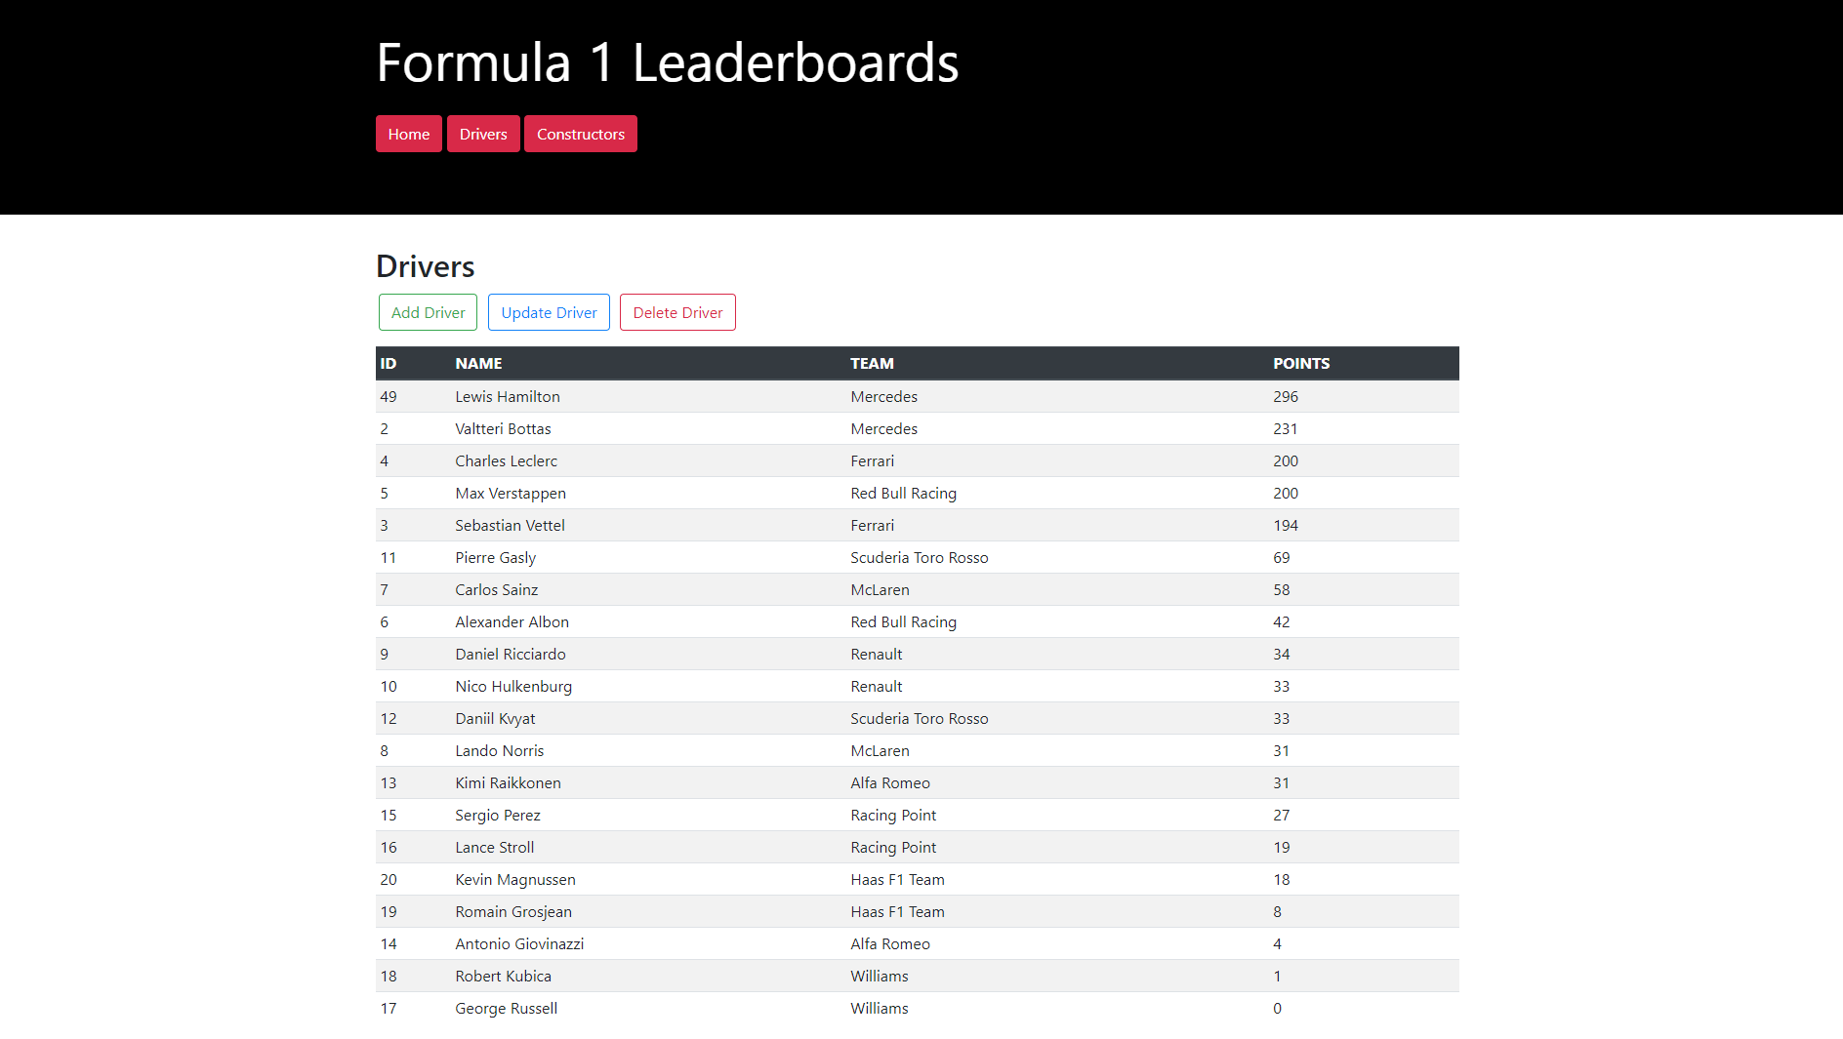
Front End

Slide 11
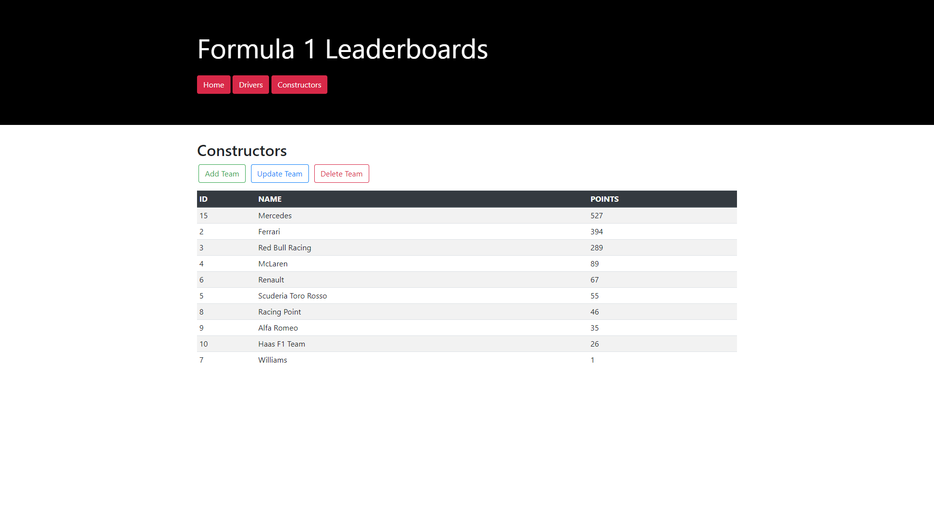
Front End

Slide 12

Image: http://www.instaview365.com

Slide 13
Any Questions?
Thank You for Listening

