Slide 1
Domestic beers & breweries
mSDS 6306-404 Case study 1
Notes:
Good Morning
Thank you for joining us today
We’re excited to share with you the results of our analysis of the domestic beers and breweries

Slide 2
Objective
Identify which states to host events for breweries

Slide 3
methodology
Performed exploratory data analysis of the provided lists of 2410 craft beers and 558 U.S. breweries
Quantified number of breweries in each state
Merged both lists of beers and breweries
Identified missing data values
Plotted the computed median ABV and IBU for each state
Identified the state with the maximum ABV and IBU
Summarized the ABV statistics
Determined relationship between ABV vs IBU
Provide recommendations of states to host events for breweries
Notes:
Our methodology is to perform an exploratory data analysis of the collected data
That is we wrangled with the data by quantifying, merging, plotting it to identify and determine relationships for insights

Slide 4
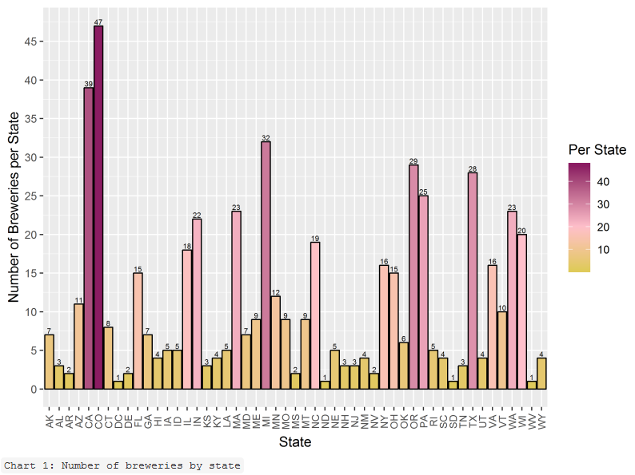
#1 number of Breweries in each state
The breweries in each state varied from one (1) each in Washington DC, North Dakota, South Dakota, West Virginia to
forty-seven (47) in Colorado.
Notes:
By quantifying the number of breweries in each state, we learned where the breweries were concentrated.
The majority of the states had less than 10 breweries in their state.

Slide 5
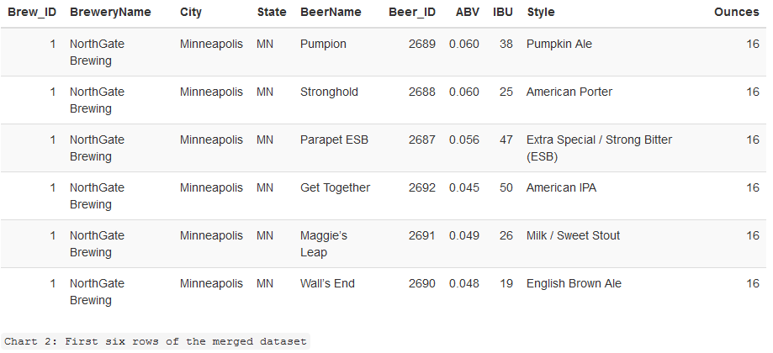
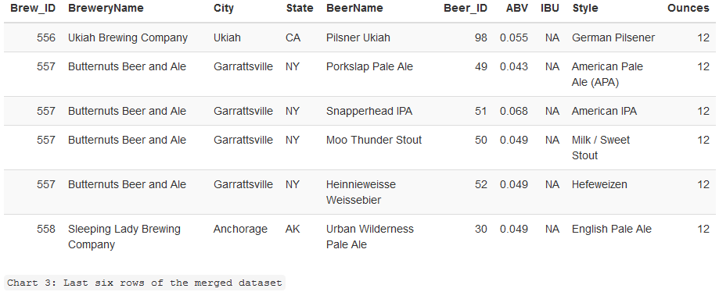
#2 Merged lists of beers and breweries
First six (6) rows of merged data lists
Last six (6) rows of merged data lists
Notes:
To better understand the relationships between the breweries and their products, we merged the separate lists beers and breweries

Slide 6
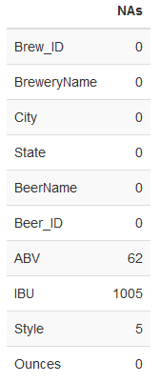
#3 Identified missing data values
Of the 2,410 beers contained in the dataset, sixty-two (62) beers have missing ABV and 1,005 have missing IBU values. There were five (5) beers where the Style values were blank that we treated them as NA (not available).
Notes:
To determine whether available values were significant in our analysis, we quantified the available missing data
Although a little less than half the beers had missing IBU values, we still felt the remaining values are an indicative trait in the beers being produced

Slide 7
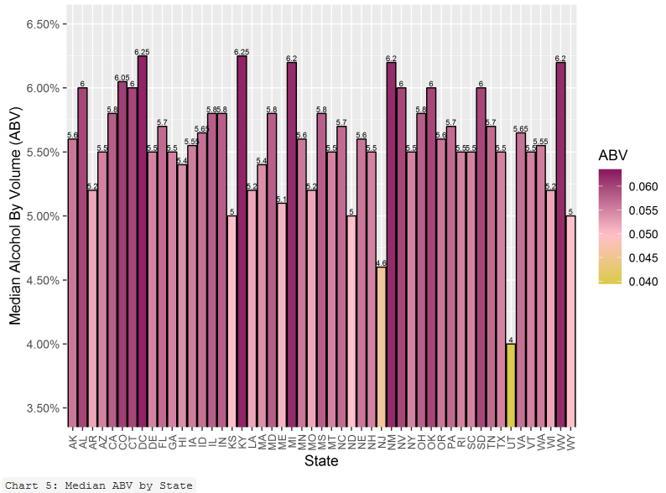
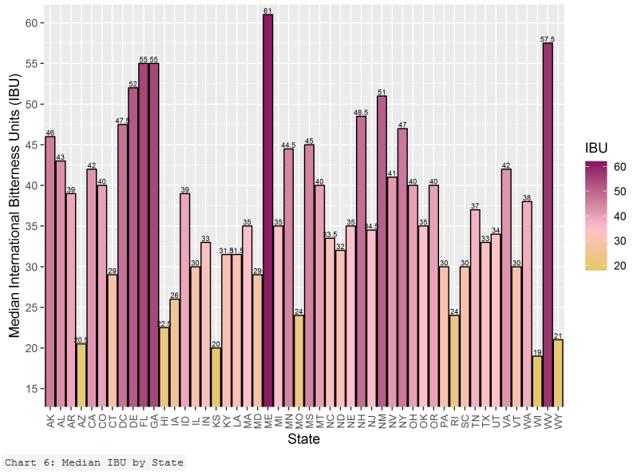
#4 MEDIAN ABV and IBU
Notes:
So, we graphed the median Alcohol by Volume and International Bitterness Units of beers in each state
In the left graph, it appears that the majority of the median ABV across states are between 5% to 6.25%
Whereas the majority of the median IBU across states is 35 or less.

Slide 8

#5 state with max abv and max ibu
Notes:
I’m sure it’s no surprise to you that CO has the state with highest ABV
But what did come as a surprise is that OR was the state with the highest OR
It must be the weather

Slide 9
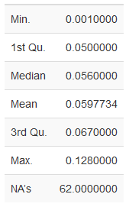
#6 ABV Statistics across beers
Delaware has a beer with a minimum ABV of 0.1%
The mean ABV across all the beers was almost 6%.
75% of the beers have an ABV greater than or equal to 6.7%
Notes:
With almost 98% availability of the ABV values in the data, we identified…

Slide 10
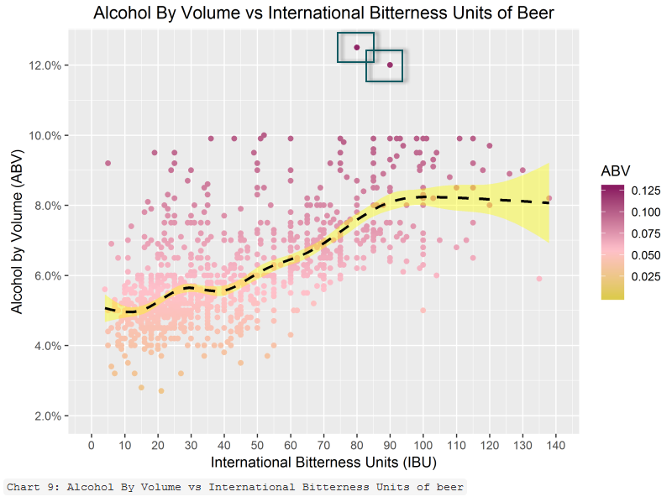
#7 relationship between abv and ibu
There is positive correlation between the ABV and IBU with a maximum ABV value peaking out around 10%.
Notes:
The black dotted line is the mean ABV at that value of IBU.
The yellow shading is the standard deviation.
There are two outliers that warrant further examination for inclusion or exclusion depending on additional questions of interest.

Slide 11
proposal
Host events in states:
With the most number of breweries ---
Colorado [47], California [39], Michigan [32], Oregon [29], Texas [28];
With the least amount of breweries ---
South Dakota [1], North Dakota [1], West Virginia [1]
With the highest median IBU ---
Maine [61], West Virginia [57.5], Florida [55], Georgia [55], and Delaware [52]
Notes:
After completing our analysis, we identified three options where events could be hosted for the breweries
In states with the most number of breweries to expand existing markets
In states with the least amount of breweries to create new markets
In states with the highest median IBU to introduce less bitter beers given the majority of the median beer IBU across the nation
We’re happy to refine this proposal further given your questions

Slide 12
CrEDITS
MAI LOAN TRAN & ZACKARY GILL
Bandicam.com
YouTube: https://youtu.be/huvwCVrRaWo

