Slide 1
Domestic beers & breweries
mSDS 6306-404 Case study 1

Slide 2
Objective
Identify which states to host events for breweries

Slide 3
methodology
Performed exploratory data analysis of the provided lists of 2410 craft beers and 558 U.S. breweries
Quantified number of breweries in each state
Merged both lists of beers and breweries
Identified missing data values
Plotted the computed median ABV and IBU for each state
Identified the state with the maximum ABV and IBU
Summarized the ABV statistics
Determined relationship between ABV vs IBU
Provide recommendations of states to host events for breweries

Slide 4
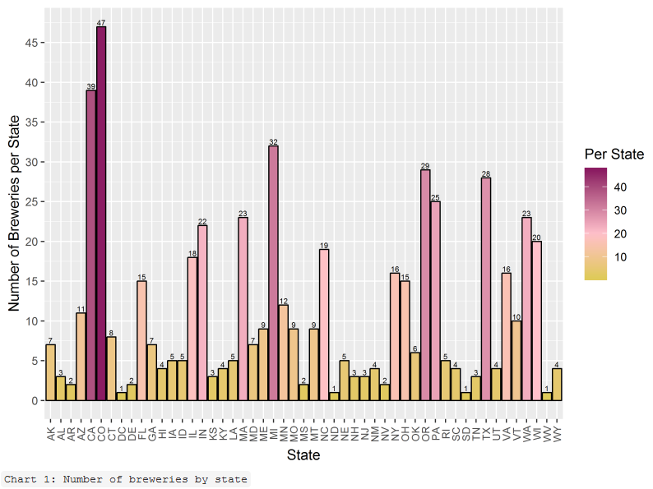
#1 number of Breweries in each state
The breweries in each state varied from one (1) each in Washington DC, North Dakota, South Dakota, West Virginia to
forty-seven (47) in Colorado.

Slide 5
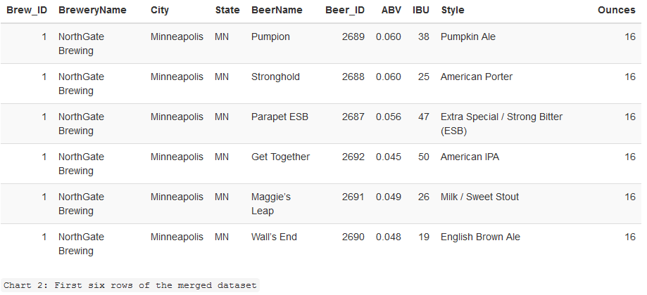
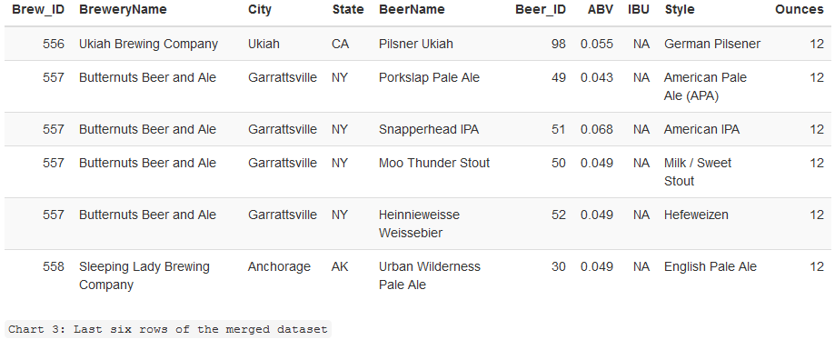
#2 Merged lists of beers and breweries
First six (6) rows of merged data lists
Last six (6) rows of merged data lists

Slide 6
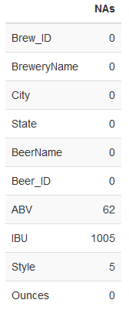
#3 Identified missing data values
Of the 2,410 beers contained in the dataset, sixty-two (62) beers have missing ABV and 1,005 have missing IBU values. There were five (5) beers where the Style values were blank that we treated them as NA (not available).

Slide 7
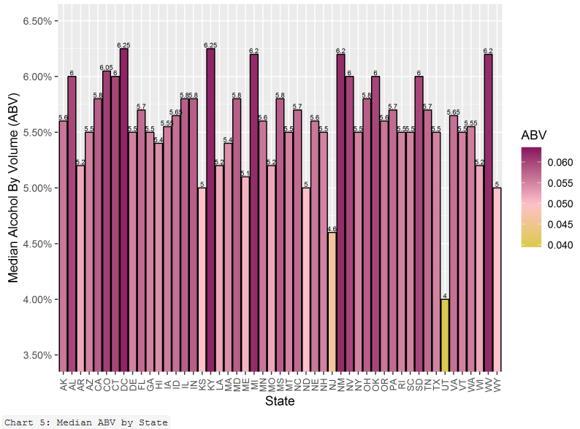
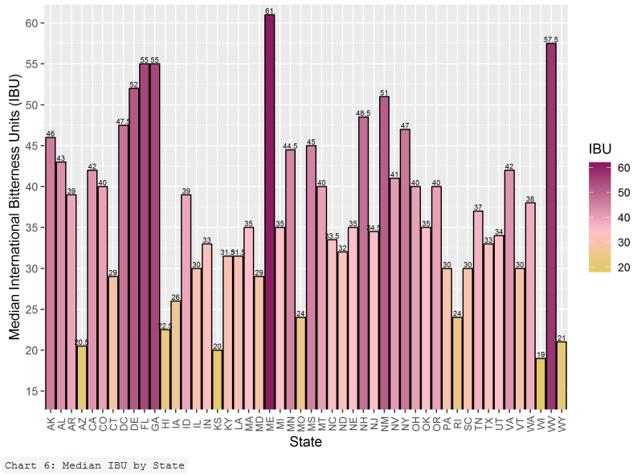
#4 MEDIAN ABV and IBU

Slide 8

#5 state with max abv and max ibu

Slide 9
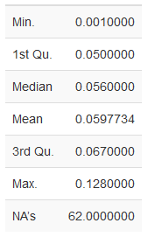
#6 ABV Statistics across beers
50% of the beers have an ABV between 5% and 6.7% with the minimum and maximum being 0.1% and 12.8%.

Slide 10
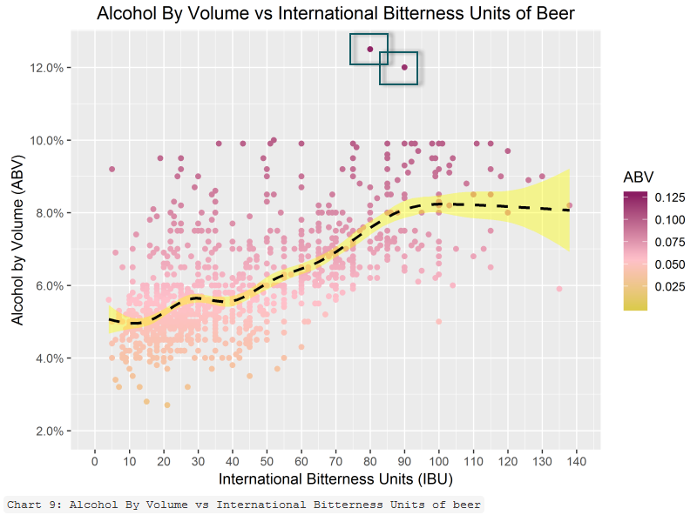
#7 relationship between abv and ibu
There is positive correlation between the ABV and IBU with a maximum ABV value peaking out around 10%.
Notes:
The black dotted line is the mean ABV at that value of IBU.
The yellow shading is the standard deviation.
There are two outliers that warrant further examination for inclusion or exclusion depending on additional questions of interest.

Slide 11
proposal
Host events in states:
With the most number of breweries --- Colorado [47], California [39], Michigan [32], Oregon [29], Texas [28];
Have the least amount of breweries --- South Dakota [1], North Dakota [1], West Virginia [1], which gives an opportunity to grow those markets; and/or,
Have the highest median IBU --- Maine [61], West Virginia [57.5], Florida [55], Georgia [55], and Delaware [52] to bring beer that have similar style/ABV to the local beers but with a lower IBU (tastes less bitter) in order to gain market share.

