Slide 1
Analysis of Beers and Breweries

Slide 2
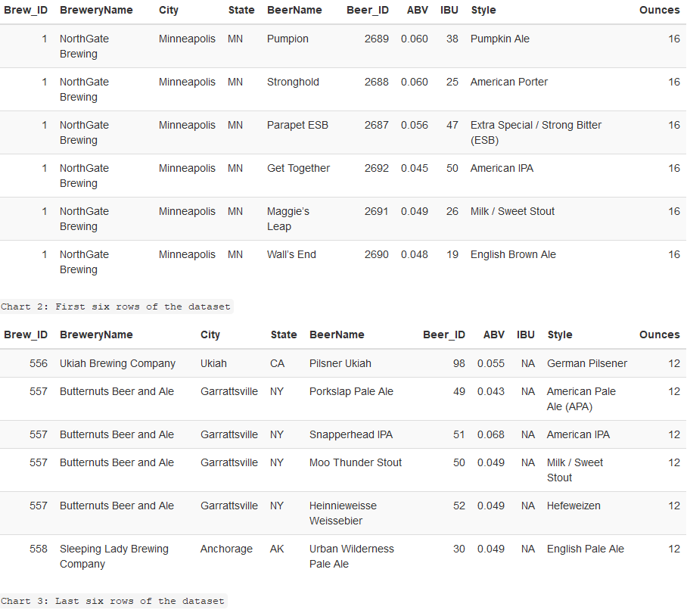
Data Contains
2410 Craft Beers
588 Breweries
Alcohol By Volume (ABV)
International Bitterness Units (IBU)

Slide 3
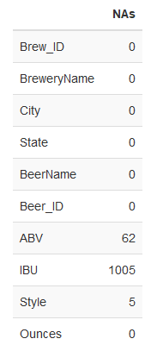
Alcohol By Volume (ABV)
International Bitterness Units (IBU)
Style

Slide 4
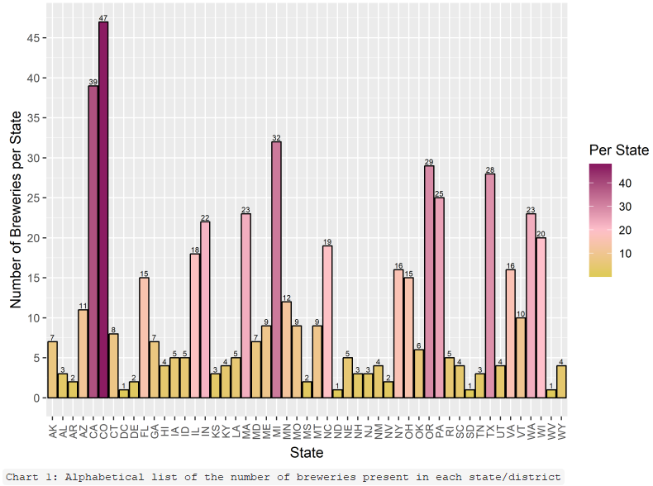
Lowest (1 per State)
ND, SD, WV
Highest (47)
CO

Slide 5
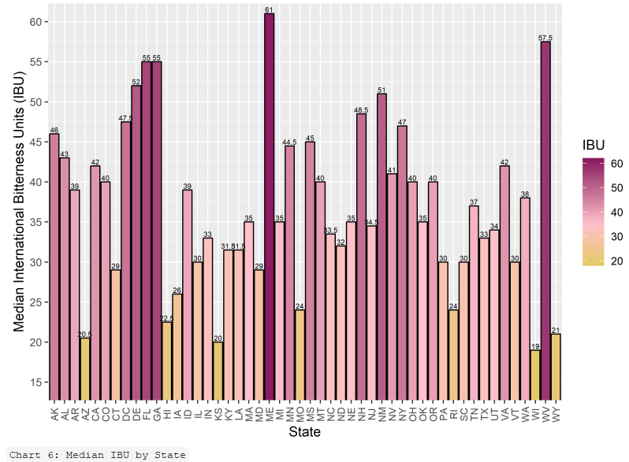
Top 5
ME, GA, FL, WV, NJ
Bottom 5
WI, KS, WY, AZ, HI
Maximum overall IBU
OR (138)

Slide 6
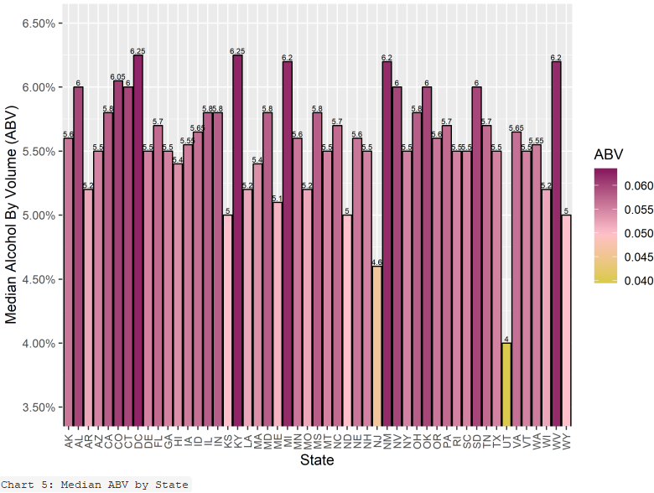
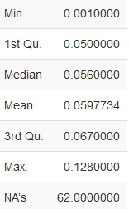
Maximum overall ABV
CO (12.8%)
50% Between
5% and 6.7%

Slide 7
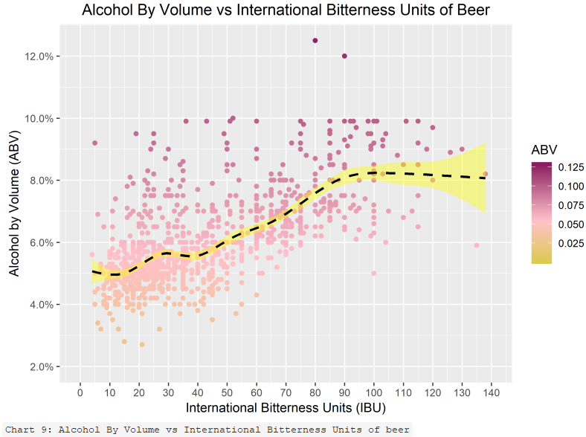
General Positive Correlation

Slide 8
Recommendations
States with the most Breweries
CO (47), CA (39), MI (32),
OR (29), TX (28)
States with the fewest Breweries
WV, SD, ND (1)
AR, DE, MS, NV (2)
States with highest median International Bitterness Units (IBU)
ME , WV, FL, GA, DE (61 to 52)

Slide 9
Credits
Mai Loan Tran
Zackary Gill
https://github.com/mltran2017/MSDS6306-404_CS1
https://youtu.be/zXqku5JSQ3Y
Presentation template by SlidesCarnival

