Slide 1
Java Servlets Session and Cookies

Slide 2
Creating Cookies
Three steps to creating a new cookie:
  Create a new Cookie Object
    Cookie cookie = new Cookie (name, value);
  Set any cookie attributes
    Cookie.setMaxAge (60);
  Add your cookie to the response object:
    Response.addCookie (cookie)
We will examine each of these steps in detail.

Slide 3
Sending Cookies to the Client
Create a Cookie object.
  Call the Cookie constructor with a cookie name and a cookie value, both of which are strings.
    Cookie c = new Cookie("userID", "a1234");
Set the maximum age.
  To tell browser to store cookie on disk instead of just in memory, use setMaxAge (argument is in seconds)
    c.setMaxAge(60*60*24*7); // One week
Place the Cookie into the HTTP response
  Use response.addCookie.
  If you forget this step, no cookie is sent to the browser!
    response.addCookie(c);

Slide 4
1. Cookie Constructor
You create a new cookie by calling the Cookie constructor and specifying:
  Name
  Value
Example:
  Cookie cookie = new Cookie (“MSRIT”, “CSE”);
Neither the name nor the value should contain whitespace or any of the following characters:
  [ ] ( ) = , “ / ? @ ;

Slide 5
2. Set Cookie Attributes
Before adding your cookie to the Response object, you can set any of its attributes.
Attributes include:
  Name/Value
  Domain
  Maximum Age
  Path
  Version

Slide 6
Cookie Age
public int getMaxAge ();
public void setMaxAge (int lifetime);
In general there are two types of cookies:
  Session Cookies: Temporary cookies that expire when the user exits the browser.
  Persistent Cookies: Cookies that do not expire when the user exits the browser. These cookies stay around until their expiration date, or the user explicitly deletes them.

Slide 7
Cookie Expiration
The setMaxAge () method tells the browser how long (in seconds) until the cookie expires.
Possible values:
  Negative Value (-1) (default): creates a session cookie that is deleted when the user exits the browser.
  0: instructs the browser to delete the cookie.
  Positive value: any number of seconds. For example, to create a cookie that lasts for one hour, setMaxAge (3600);

Slide 8
3. Add Cookies to Response
Once you have created your cookie, and set any attributes, you add it to the response object.
By adding it to the response object, your cookie is transmitted back to the browser.
Example:
  Cookie sc = new Cookie (“MSRIT”, “CSE”);
  sc.setMaxAge (3600);
  response.addCookie (sc);

Slide 9
Reading Cookies
To create cookies, add them to the response object.
To read incoming cookies, get them from the request object.
HttpServletRequest has a getCookies() method.
  Returns an array of cookie objects. This includes all cookies sent by the browser.
  Returns a zero-length array if there are no cookies.

Slide 10
Example 1: RepeatVisitor.java
This servlet checks for a unique cookie, named “repeatVisitor”.
  If the cookie is present, servlet says “Welcome Back”
  Otherwise, servlet says “Welcome aboard”.

Slide 11
Using Cookies to Detect
First-Time Visitors
public class RepeatVisitor extends HttpServlet {
public void doGet(HttpServletRequest request,
HttpServletResponse response)
throws ServletException, IOException {
boolean newbie = true;
Cookie[] cookies = request.getCookies();
if (cookies != null) {
for(int i=0; i<cookies.length; i++) {
Cookie c = cookies[i];
if((c.getName().equals("repeatVisitor"))&&
(c.getValue().equals("yes"))) {
newbie = false;
break; } } }

Slide 12
Using Cookies to Detect
First-Time Visitors (Continued)
String title;
if (newbie) {
Cookie returnVisitorCookie =
new Cookie("repeatVisitor", "yes");
returnVisitorCookie.setMaxAge(60*60*24*365);
response.addCookie(returnVisitorCookie);
title = "Welcome Aboard";
} else {
title = "Welcome Back";
}
response.setContentType("text/html");
PrintWriter out = response.getWriter();
… // (Output page with above title)

Slide 13
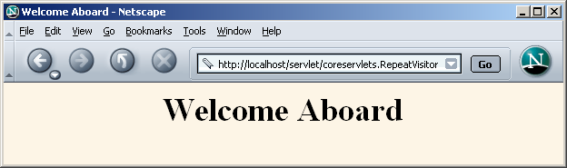
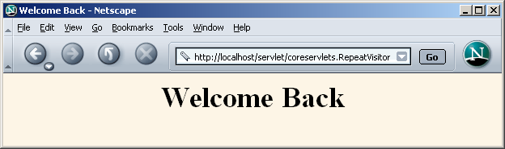

Slide 14
Example 2: CookieTest.java
Illustrates the differences between session and persistent cookies.
Creates a total of six cookies:
  Three are session cookies
  Three are persistent cookies
Servlet also uses request.getCookies() to find all incoming cookies and display them.

Slide 15
Differentiating Session Cookies from Persistent Cookies
public class CookieTest extends HttpServlet {
public void doGet(HttpServletRequest request,
HttpServletResponse response)
throws ServletException, IOException {
for(int i=0; i<3; i++) {
Cookie cookie =
new Cookie("Session-Cookie-" + i,
"Cookie-Value-S" + i);
// No maxAge (ie maxAge = -1)
response.addCookie(cookie);
cookie = new Cookie("Persistent-Cookie-" + i,
"Cookie-Value-P" + i);
cookie.setMaxAge(3600);
response.addCookie(cookie);
}

Slide 16
Differentiating Session Cookies from Persistent Cookies (Cont)
// Start an HTML table
Cookie[] cookies = request.getCookies();
if (cookies == null) {
out.println("<TR><TH COLSPAN=2>No cookies");
} else {
Cookie cookie;
for(int i=0; i<cookies.length; i++) {
cookie = cookies[i];
out.println
("<TR>\n" +
" <TD>" + cookie.getName() + "\n" +
" <TD>" + cookie.getValue());
}
}

Slide 17
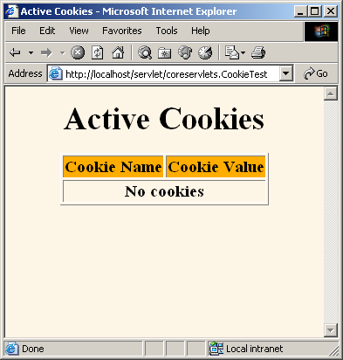
Differentiating Session Cookies from Persistent Cookies
Result of initial visit to CookieTest servlet
  Same result as when visiting the servlet, quitting the browser, waiting an hour, and revisiting the servlet.

Slide 18
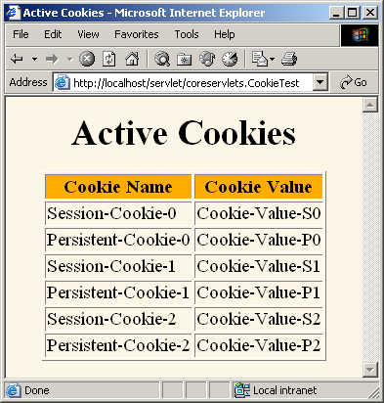
Differentiating Session Cookies from Persistent Cookies
Result of revisiting CookieTest within an hour of original visit (same browser session)
  I.e., browser stayed open between the original visit and the visit shown here

Slide 19
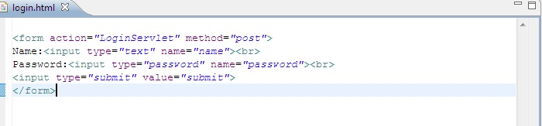
login.html

Slide 20

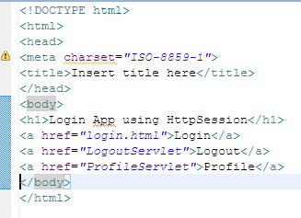
link.html
index.html

Slide 21
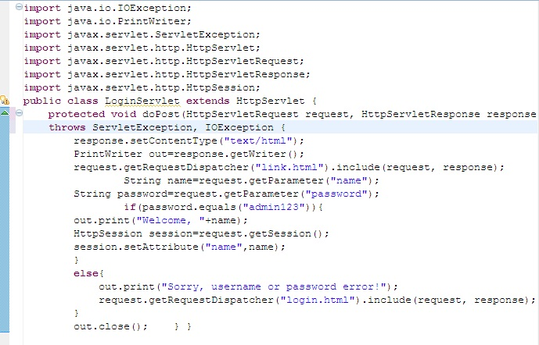
LoginServlet.java

Slide 22
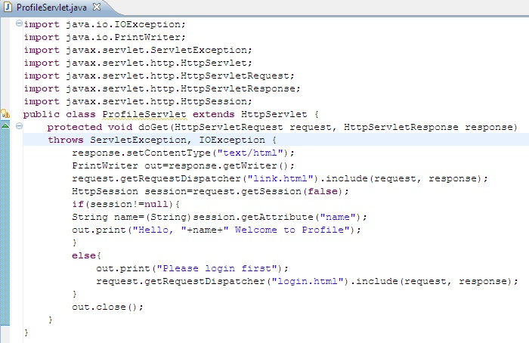
ProfileServlet.java

Slide 23
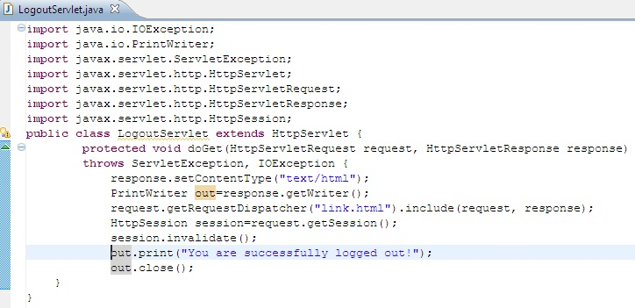
LogoutServlet

Slide 24
Java Servlets Cookies Example

Slide 25
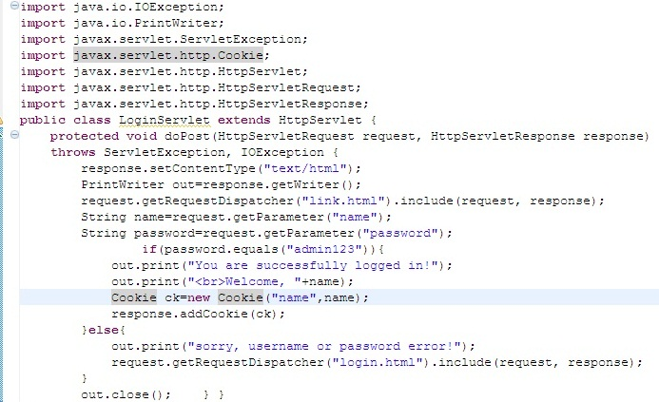
LoginServlet.java

Slide 26
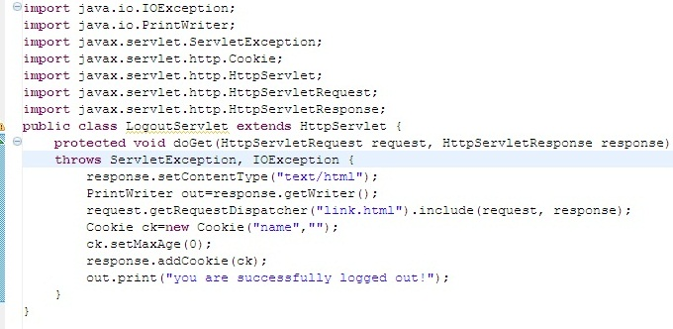
LogoutSevlet.java

Slide 27
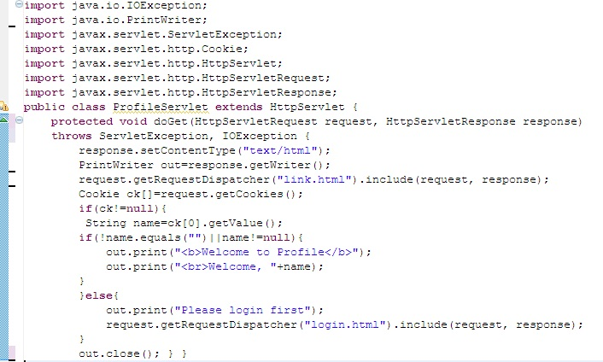
ProfileServlet.java

