Slide 1
Southern Water Corp – Technical Presentation
Date: 07/2020
Presenter: Michelle Stevens

Slide 2
With increased water demand from agricultural and residential usage, Southern Water Corp has had to maximize the availability of its desalination plants to meet continual demand which has resulted in increased cost for the calendar year
!
Through the increased demand for desalinated water, the maintenance operation costs will increase significatively
Increased demand leading to increased pump wear

Slide 3
Strategy: Statistical Analysis to identify Key Variable for Pump failure variables and predict signal of Failure
Descriptive Statistics Analysis
Inferential Statistics Analysis
Raw X Rolling stdev with interval of 30 seconds
Box Plot
Correlation
Analysis
Multivariate Regression Analysis
Outliers & Variance of pump readings from its Median. Among all variables, 3 had higher outliers and highly skewed distribution
3 Keys Variables:
i) Maximum Daily Pump
ii) Surjek Flow meter-2
iii) Surjek Pump Torque
3 Keys Variables:
i) Maximum Daily Pump
ii) Surjek Flow meter-2
iii) Surjek Pump Torque
(3) Major Failure signal was closely identical to actual failure with R-Squared 0.63

Slide 4
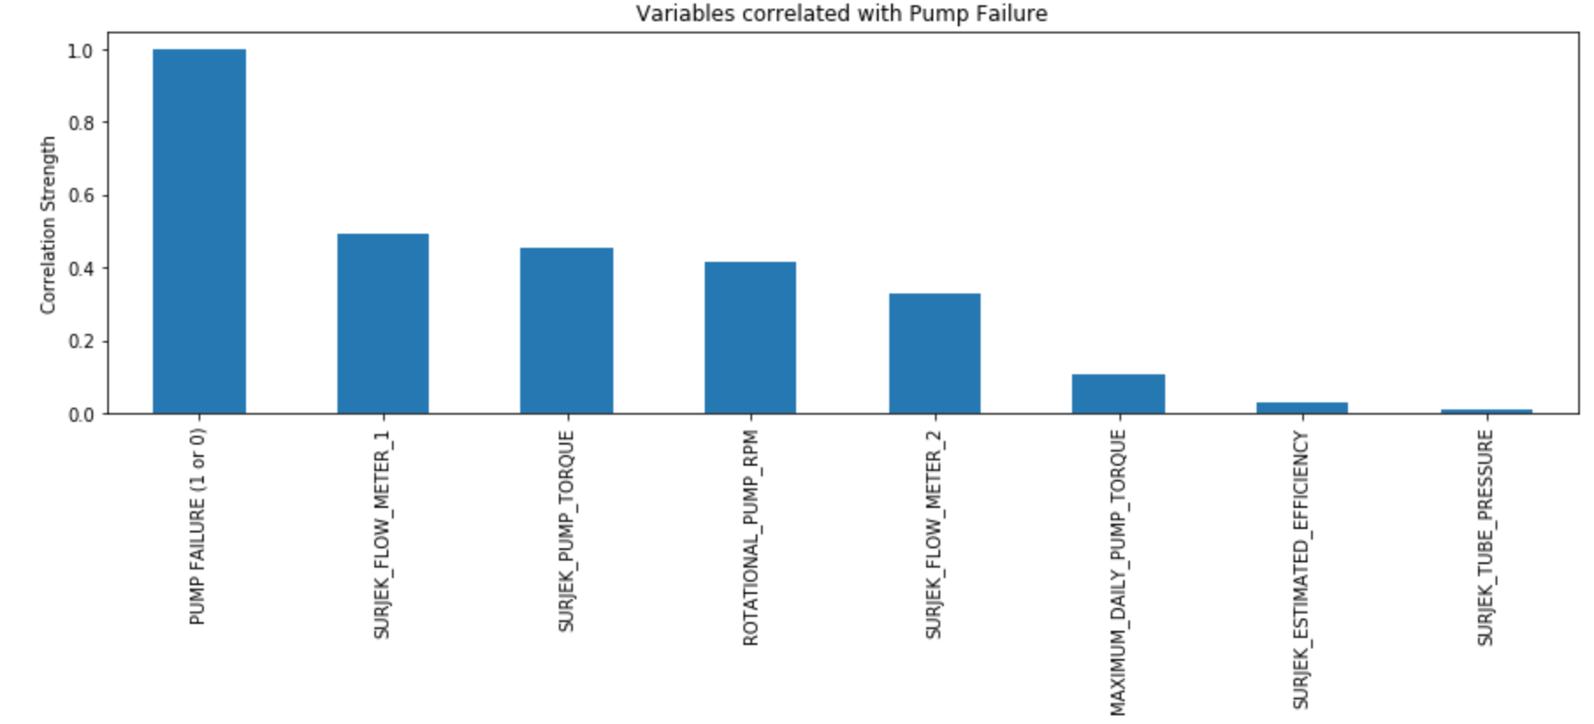
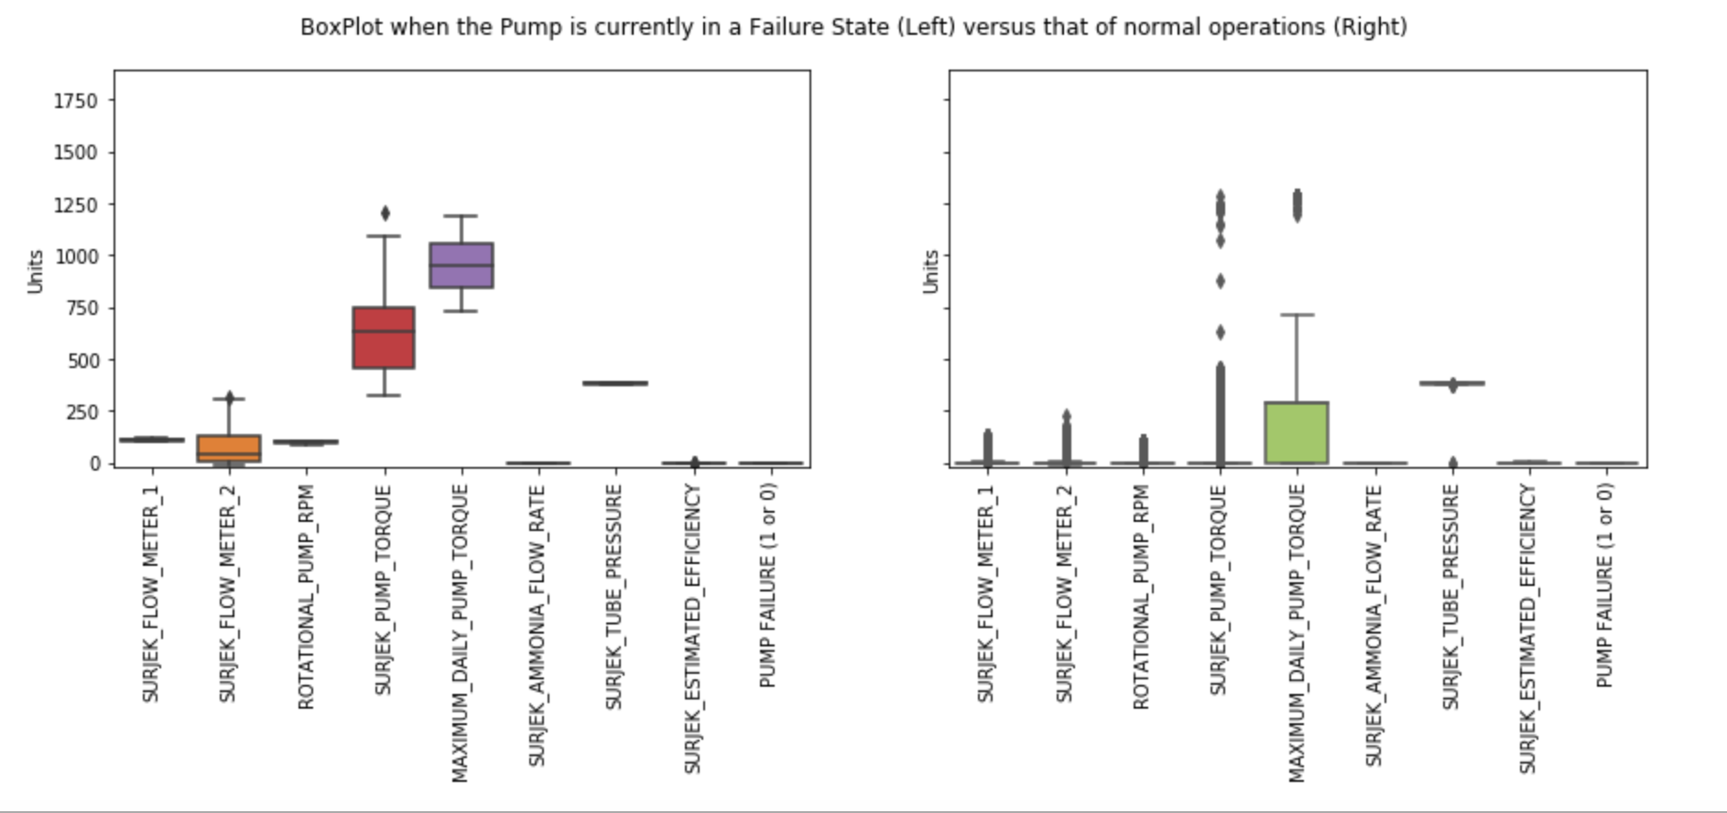
Splitting the data into tow different sets, indicating normal behavior and abnormal behavior, imply us the three variables that are shown by a boxplot , which indicate that METER 2, PUMP TORQUE AND MAXIMUM TORQUE are correlated to the pump failure

Slide 5
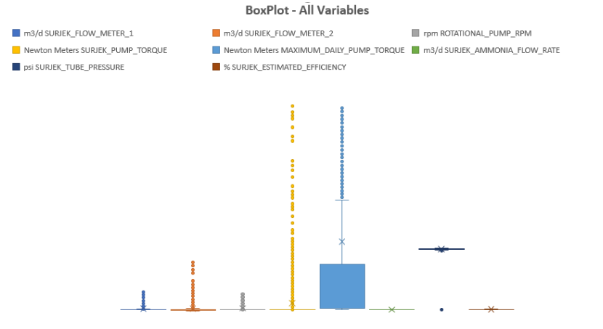
Further analysis of the dataset validate our confidence that those 3 variable are direct connect with the Pump Failure and we should take action towards them
Key Insights
Surjek_Flow_Meter_2
Maximum_Pump_Torque
Pump_Torque
Correlation and Boxplot say that the tree variable are strong correlated to the pump failure and we should investigate it closely.

Slide 6
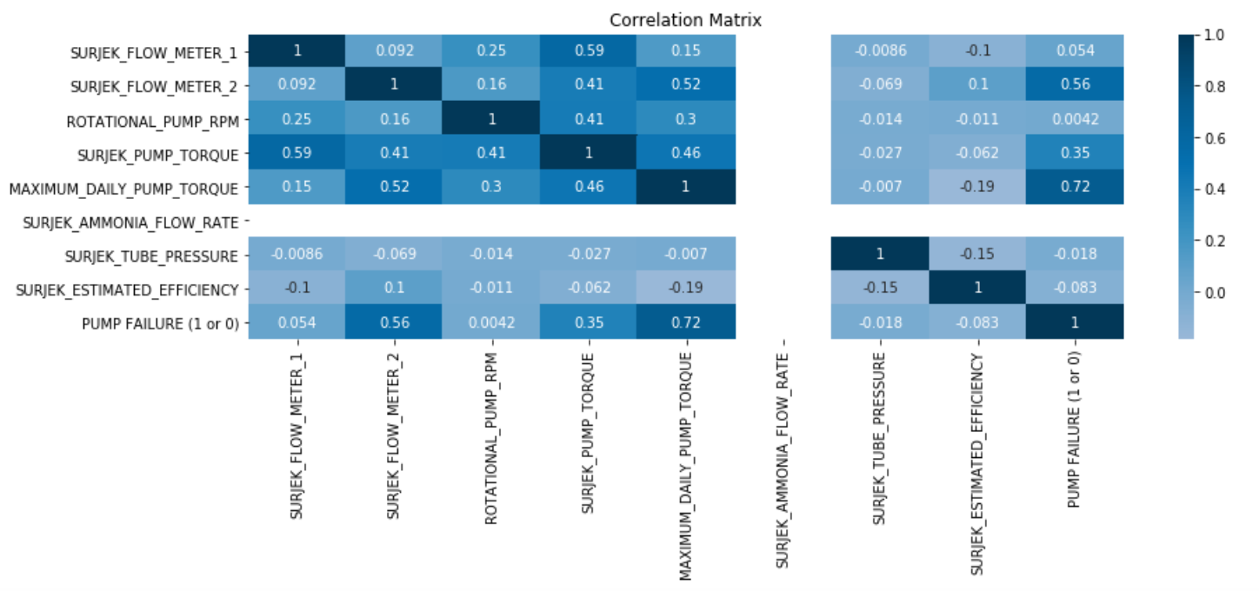
Using Seaborn's heatmap function, created a heatmap that clearly shows the correlations for all variables

Slide 7
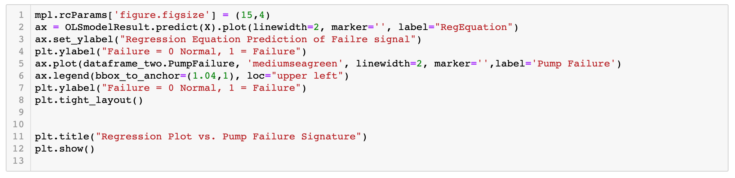
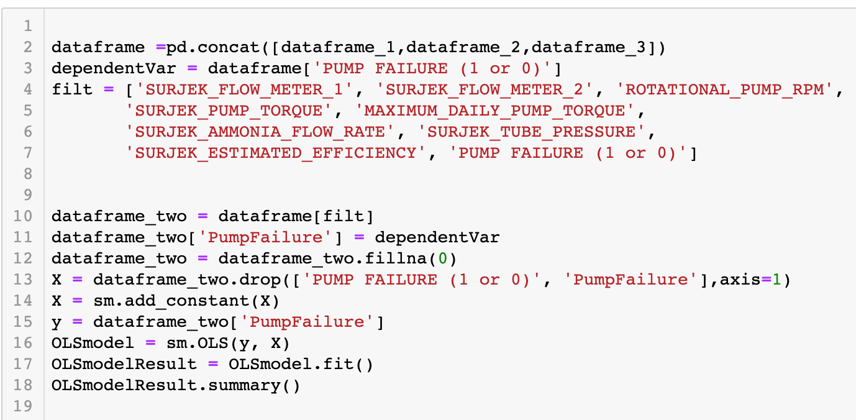
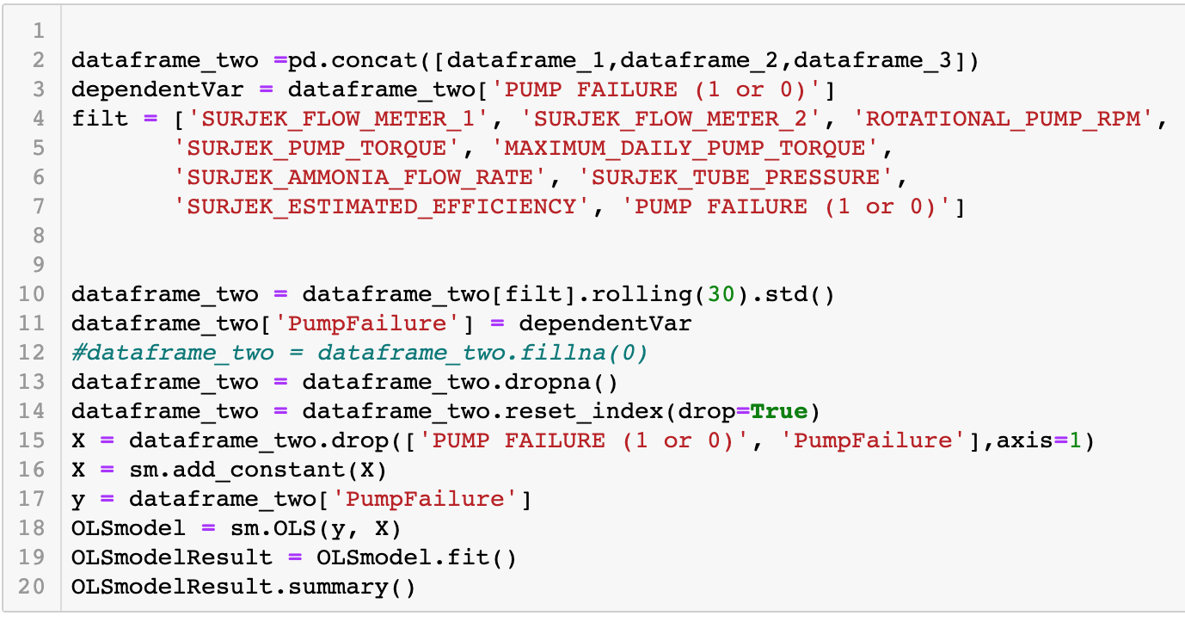
First for regression equation I applied the .predict() function to the dataframe to see whether or not the model 'picks' up the Pump Failure Event.
The regression equation I used the OLS (Ordinary Least Squares) Regression Model and a regression Model with a rolling(30).std()

Slide 8
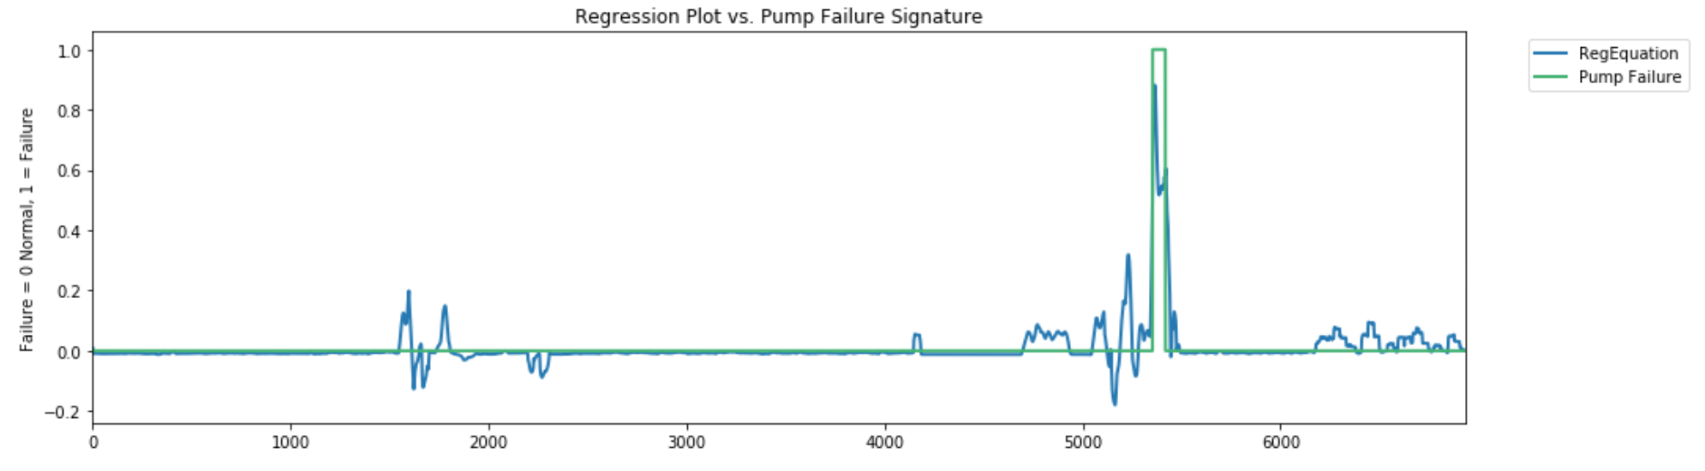
Through the analyse in the descriptive and inferential statistics, tree keys variable correlated strongly with the Pump Failure, enabling development of a multivariate equation capable of identifying abnormal Pump Failure
Source: Southern Water Corp Statistical Records

