Slide 1
Project 3 – World Facts (Our World in Data)
Adwoa Anto
Rehman Butt
Miggy Lacson
Azkya Said
Jose Eneas da Silva Maria
https://github.com/rehmanbt/Project-3-Group-3.git

Slide 2
Project 3 – World Facts (Our World in Data)
Project Description
This project intends to demonstrate some aspects of the World Population, such as GDP, Birth Rate and Age Range Distribution.
Project Technology
Technically the project is composed of 3 parts:
A program that deals with the ETL, taking CSV files, checking, cleaning, formatting and storing the data in a Relational Database (Postgres) for posterior utilization (visualization, reports, on demand queries, verifications, etc.). This program also prepares the data to be easily consumed by a web page, in JSON format.
A JavaScript that reads the JSON files and prepares Data Tables and Graphs for the 3 aspect of our research (World GDP over time, Country GDP over time and Population Age Ranges over time).
A HTML page that hold the visualization rendering (Tables and Graphs).
The CSS is embedded in the HTML page.

Slide 3
Project 3 – World Facts (Our World in Data)
Project Technical Components
1 Python Program, using libraries:
csv
pd
Json
Psycopg2 (Never used before in the Bootcamp) – used for Database access
colorama (Never used before in the Bootcamp) – used for rich colored print output.
1 JavaScript program, using libraries:
D3.js
Plotly.js
1 HTML page, with embedded CSS

Slide 4
Project 3 – World Facts (Our World in Data)
Data Source
Our World in Data
Population and Demography
Birth Rate
GDP Per Capita (Penn World Table)

Slide 5
Project 3 – World Facts (Our World in Data)
Proposed Questions
Are GDP and Birth Rate related factors? If so, how?
Is the World Population growth rate decreasing?
How is the world population divided in Age Ranges?
Is the world population getting older?

Slide 6
Project 3 – World Facts (Our World in Data)
DEMO

Slide 7
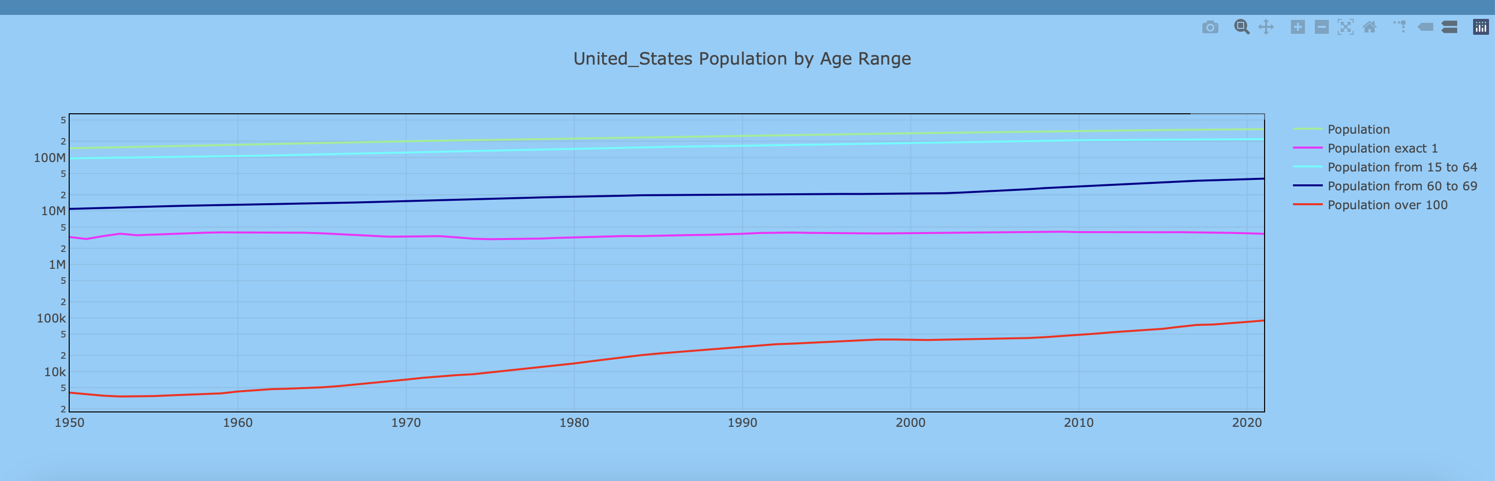
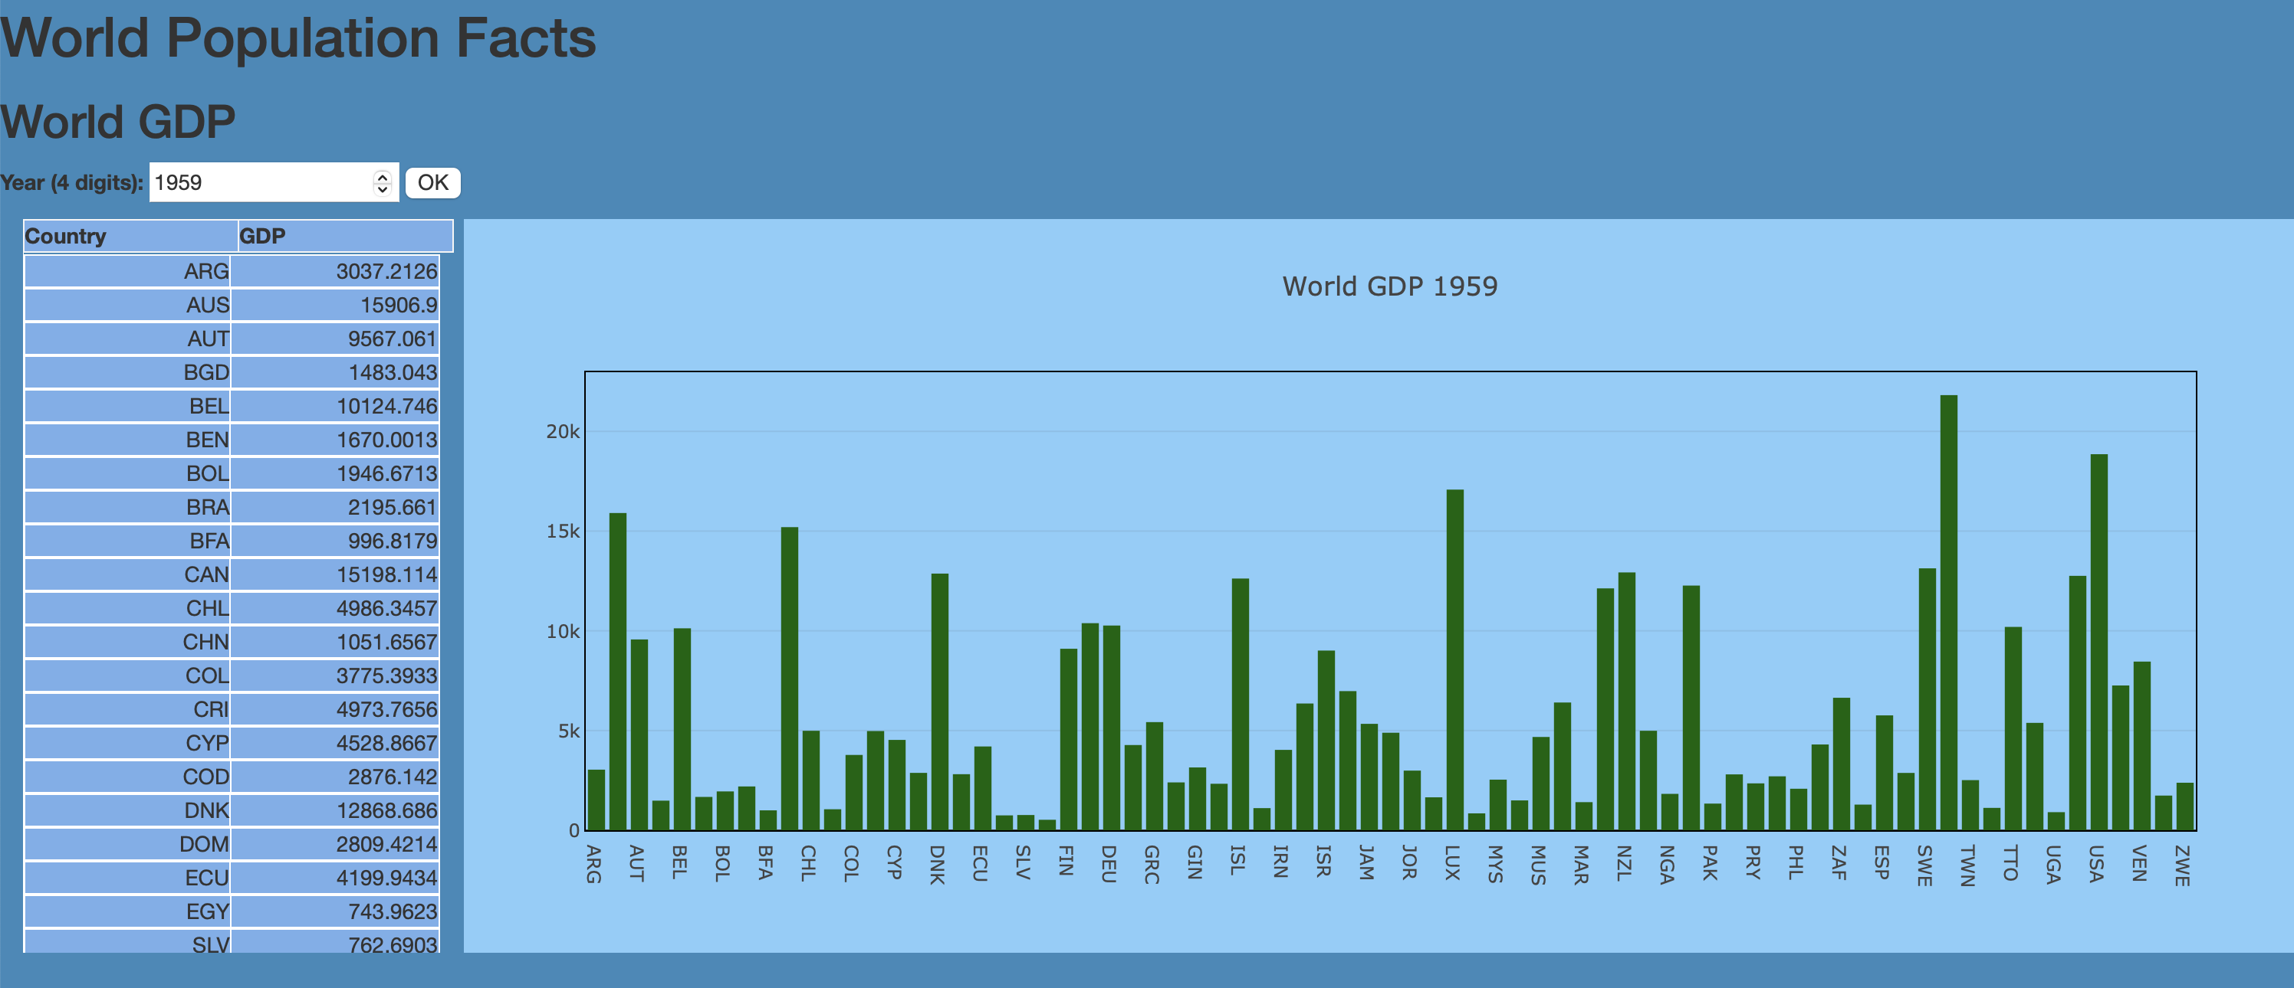
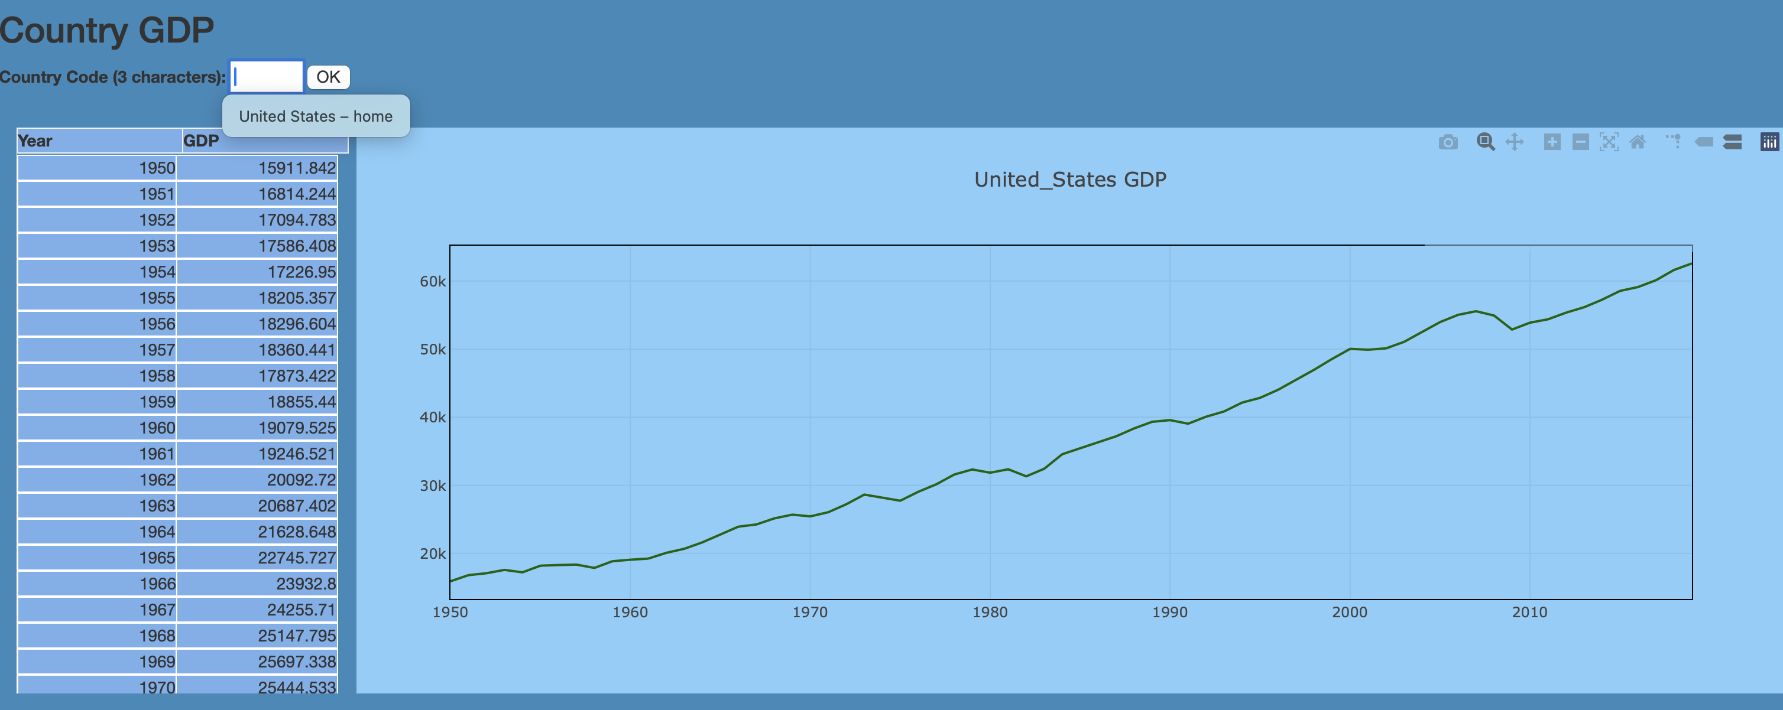
Project 3 – World Facts (Our World in Data)
Basic visualization layout
User interaction
Year selection
Country selection
Scrollable Tables
Interactive Graphs

