Slide 1
State machines in action
Stamina FSM lib
A testable divide and
conquer approach

Slide 2
FSM Design Goals
Natural “language” - easy to write and maintain
Easy and fast to unit test, without using threads
Split transition logic from actions
Single responsibility principle
Fast compilation and execution
Easy to document

Slide 3
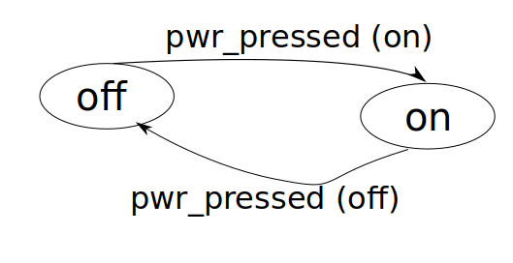
CD player example

Slide 4
States (enum class)
enum class state_type : unsigned {
off,
on,
(playing, paused,)
_END_, _NOT_HANDLED_
};

Slide 5
State machine definition
class cdplayer {
enum class state_type : unsigned {..};
struct inputs_type {...};
struct outputs_type {...};
void add_transitions (state_machine<cdplayer>& sm) {...}
void add_actions (state_machine<cdplayer>& sm) {...}
// --- PRIVATE: Members ---
time_point time_timeout_m = {}; // For example
};

Slide 6
Using your FSM
using SM = cas::state_machine<cdplayer>;
SM::inputs_type inputs;
..
SM sm;
While (…) {
SM::inputs_type inputs inputs_get();
sm.switch_state(inputs);
sm.execute_actions(inputs);
}

Slide 7
Example action function
void actions_in__closed(const inputs_type& inputs, outputs_type& outputs) {
if (inputs.has_disc == has_disc_sig::active){
outputs.disc_loaded_light = disc_loaded_sig::active;
}
else {
outputs.disc_loaded_light = disc_loaded_sig::none;
}
cout << "actions_in__closed" << endl;
}

Slide 8
Example transition function
state_type cdplayer::power_toggle__on(
const inputs_type& inputs)
{
if (inputs.action == input_action::power_btn_pressed) {
return state_type::on;
}
return state_type::_NOT_HANDLED_;
}
NOTE: This is a member function. One can also use lambdas.

Slide 9
Defining transitions
void cdplayer::add_transitions(estl::state_machine<cdplayer>& sm)
{
sm.transitions_from(state_type::on)
.switch_to(state_type::off).when(&cdplayer::power_toggle__off)
.switch_to(state_type::playing).when(&cdplayer::play_pressed__play)
.otherwise_loop();
…
}
NOTE: Here member functions are used for conditions.
One can also use lambdas.

Slide 10
Unit testing transitions
static const state_machine<cdplayer>::test_vec_type tvec1 = {
{
state_type::off, state_type::on,
input_action::power_btn_pressed,
"Switching on."
},
{
state_type::on, state_type::playing,
input_action::playpause_btn_pressed,
"Start playing."
}
};
// Run it
const auto all_ok = sm.test_transitions(tvec1, true);
cout << "sm.test_transitions(tv1):" << all_ok << "\n";

