Slide 1
LIGHT CSW 2023 Quantitative Analysis Workshop
Session 2: Basic Statistical Analysis Alexandra Richards, Marc Henrion

Slide 2
Introduction

Slide 3
Introduction: Preliminaries
Course website / GitHub: https://github.com/mlw-stats/LIGHT_CSW2
Housekeeping
Refreshments & lunch
Fire exits & bathrooms

Slide 4
Introduction: Learning outcomes
KNOW R: Explain know what R is & what it can do.
KNOW R RESOURCES: List useful R resources and access them.
DO R: Perform basic operations relevant for your research in R:
Read data into R & write data or results to the harddrive.
Manipulate & use different object types.
Write & use functions in R
Perform basic analyses on a dataset: mean, standard deviation, linear regression.
Produce various standard graphs and tables
UNDERSTAND STUDY DESIGNS: Recommend appropriate designs & analyses.
COMPREHEND OPEN SCIENCE: Summarise principles of open, reproducible research.
DO OPEN SCIENCE WITH R: Use R scripts, R markdown / quarto, & GitHub.

Slide 5
Introduction: Data for today’s session
Please download and read into R the 2 datasets from GitHub:
btTBreg.csv - TB registration data from Blantyre, Malawi
adolescent_small.csv - a dataset on adolescents admitted to a hospital in Malawi
stcp-Rdataset-birthweight_reduced.csv - a data containing data from 42 babies and their mothers in the UK
dfTb <- read.csv("dataAndSupportDocs/btTBreg.csv",header = TRUE) dfAdo <- read.csv("dataAndSupportDocs/adolescent_small.csv",header = TRUE) dfBw<-read.csv("dataAndSupportDocs/stcp-Rdataset-birthweight_reduced.csv") # Data contributed by Ellen Marshall, Sheffield Hallam University

Slide 6
Introduction: Data for today’s session
We are going to look at a subset of data taken from an electronic tuberculosis (TB) register of Blantyre which shows total number of TB registrations from April 2011 to December 2012. The dataset was constructed from available data that is routinely collected at the time of registering for TB drugs. Some variables have been simulated to allow specific statistical techniques in this workshop to be performed.
The dataset saved btTBreg.csv has the following variables:
id: ID number
sex: Gender 1=male; 2=female
age: of participants in years - numeric
hiv: HIV status 1=positive; 0=negative
bmi: Body mass index
ses: social economic status index; 1=poorest, 2=poor, 3=middle, 4=rich, 5=richest
cd41: CD4 count on entry - numeric
cd42: CD4 count on exit - numeric
hosp: code for central hospitals; 1=QECH, 2=KCH,3=ZCH,4=MCH,5=Mlambe

Slide 7
Probability theory

Slide 8
Probability theory: introduction
3 examples of sources of uncertainty:
inherent uncertainty / randomness of an experiment
measurement error
unobserved relevant variables
But these are just a few of many sources of uncertainty.
Statistical analysis aims to quantify uncertainty to allow inference from data.

Slide 9
Probability theory: introduction
PROBABILITY
To quantify uncertainty we need to use the tools of probability theory.
STATISTICS
To gain insights from observational data we need to make statistical inference.

Slide 10
Probability theory: probability
Classical definition of probability:
Let $\left|.\right|$ denote the operator measuring the size of an event. The probability of an event $A⊆Ω$ is defined as
$$P\left(A\right)=\frac{\left|A\right|}{\left|Ω\right|}$$
If all outcomes in the outcome space $Ω$ are equally likely, then this means the probability of $A$ is the ratio of the number of outcomes in $A$ and the number of outcomes in $Ω$.
If your outcome space is not discrete, then $\left|.\right|$ is a function mapping outcome sets to the positive real line.

Slide 11
Probability theory: random variables
A random variable $X$ is a variable such that
The values it can take correspond to the different outcomes of an experiment.
We do not know before we observe a realisation of the random process / experiment which value $X$ will take.
We may however know the distribution of possible values of $X$.
Once you have defined a random variable and derived its distribution, there are 2 important properties:
The mean or expectation $E\left[X\right]$ - the average value it will take.
The variance $Var\left(X\right)$ - a measure of how variable $X$ is around its mean.

Slide 12
Probability theory: random variables
Example:
Consider the experiment of tossing a coin 2 times. These are the possible outcomes:
$$\{\left(H,H\right),\left(H,T\right),\left(T,H\right),\left(T,T\right)\}$$
The number of heads turning up is a random variable $X$:
$$X_{\left(H,H\right)}=2$$
$$X_{\left(H,T\right)}=1$$
$$X_{\left(T,H\right)}=1$$
$$X_{\left(T,T\right)}=0$$

Slide 13
Probability theory: distributions
A probability mass function (pmf) $p$ assigns to each realisation $x$ of a discrete random variable $X$ the probability $P\left(X=x\right)=p\left(x\right)$.
df<-tibble(x=0:10,pmf=dbinom(0:10,size=10,prob=0.5)) ggplot(data=df,mapping=aes(x=x,y=pmf)) + geom_bar(stat="identity") + xlab("number of heads") + ylab("probability mass") + ggtitle("pmf of the random variable counting numbers of H in 10 coin tosses") + scale_x_continuous(breaks=0:10) + coord_cartesian(xlim=c(0,10)) + theme(text = element_text(size=20))

Slide 14
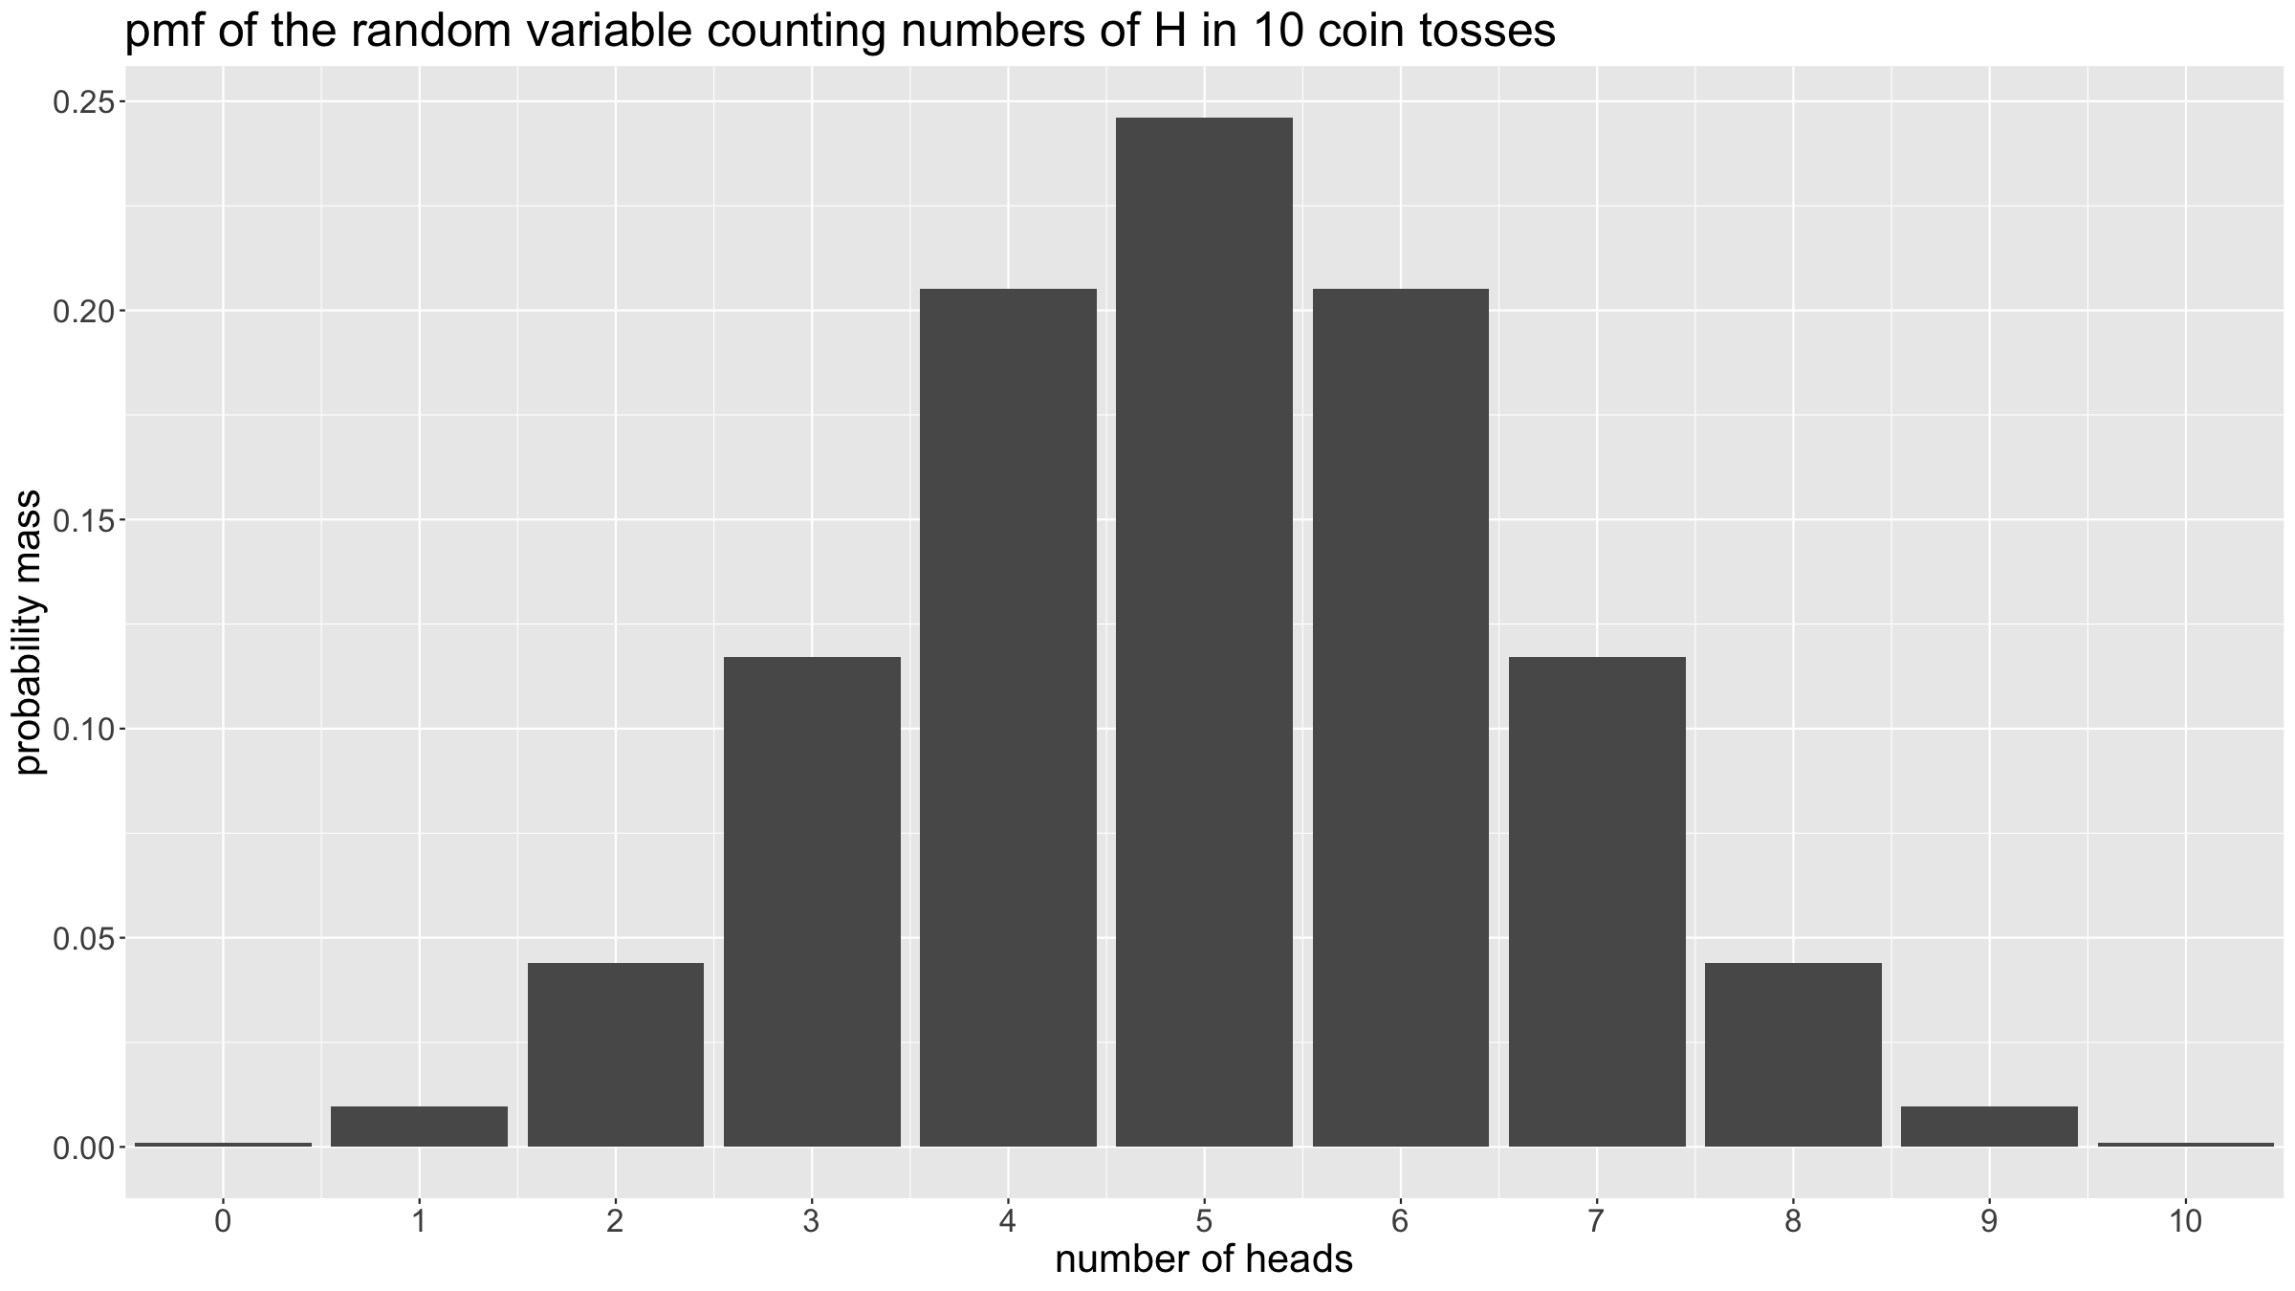
Probability theory: distributions

Slide 15
Probability theory: distributions
What about continuous random variables?
For a continuous random variable $X$, $P\left(X=x\right)=0$ for all values of x (the probability of exactly realising one value among an infinity of possible values is 0). Hence it makes little sense to define a pmf.
Instead, we will define probabilities of $X$ taking values in specific intervals. This allows us to define a continuous equivalent to the discrete probability mass function.
A probability density function (pdf) of a random variable $X$ is a function, the area under which defines the probability of $X$ taking a value within a specific range of values. Mathematically:
$$P\left(a<X≤b\right)=\int_{a}^{b}{p}\left(x\right)dx$$

Slide 16
Probability theory: distributions
x<-seq(-4,4,by=0.01) xArea <- seq(-2,0.5,by=0.01) yArea <- dnorm(xArea) par(mar=c(5,5,5,1)) plot(x, dnorm(x), main="pdf of the standard normal", xlab="x", ylab="density", type="l", cex.lab=2.5,cex.axis=2.5,cex.main=2.5) polygon(c(-2,xArea,0.5),c(0,yArea,0),col='steelblue',lty=0) text(cex=2.5,"P(-2<X<0.5)=0.67",x=-2.5,y=0.25,col="steelblue")

Slide 17
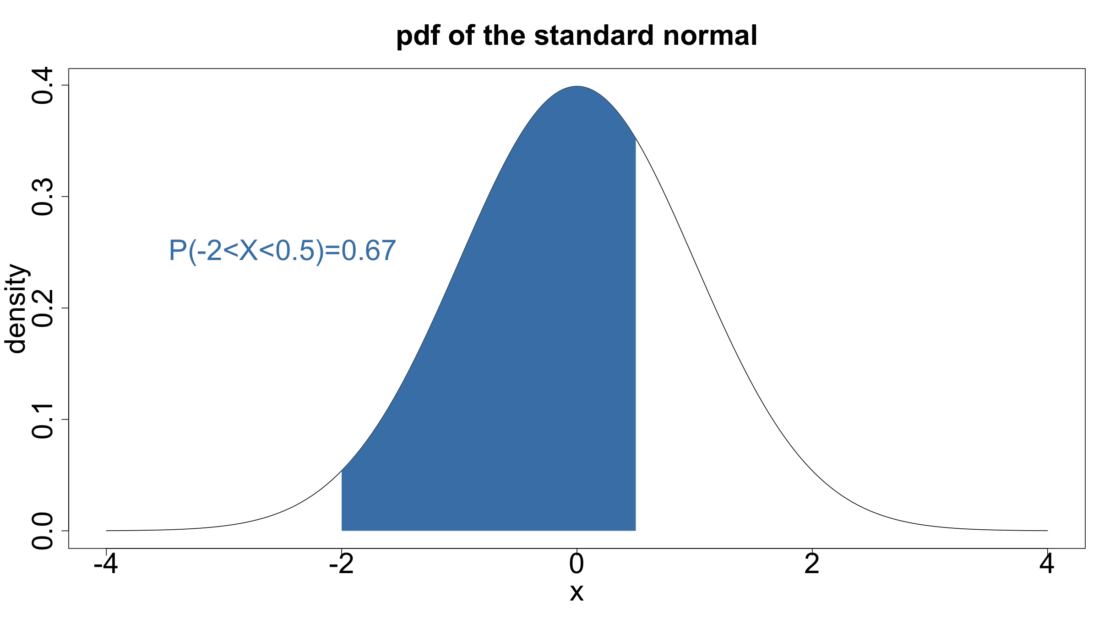
Probability theory: distributions

Slide 18
Probability theory: distributions
Bernoulli distribution
This Bernoulli distribution describes experiments with only 2 possible outcomes, one of which occurs with probability $p$.
$X∼\text{ Bern}\left(p\right)$ if
$$P\left(X=x\right)=\left\{\begin{matrix}p & \text{ if }x=1 \\ 1−p & \text{ if }x=0 \\ 0 & \text{ otherwise}\end{matrix}\right.$$
$$E\left(X\right)=p, Var\left(X\right)=p\left(1−p\right)$$
Example:
Coin tossing experiment.

Slide 19
Probability theory: distributions
plotBern<-function(p,col){ x<-seq(0,1,by=1) px<-dbinom(x,size=1,prob=p) df<-tibble(x=x,px=px) g<-ggplot(data=df,mapping=aes(x=x,y=px)) + geom_bar(stat="identity",fill=col) + ylab("P(X=x)") + theme(text = element_text(size=20)) + ggtitle(paste(sep="","Bernoulli with p=",p)) + scale_x_continuous(breaks=0:1) + coord_cartesian(xlim=c(-0.5,1.5),ylim=c(0,1)) return(g) } g1<-plotBern(0,"darkgrey"); g2<-plotBern(0.25,"steelblue") g3<-plotBern(0.5,"salmon"); g4<-plotBern(0.9,"orange") grid.arrange(g1,g2,g3,g4)

Slide 20
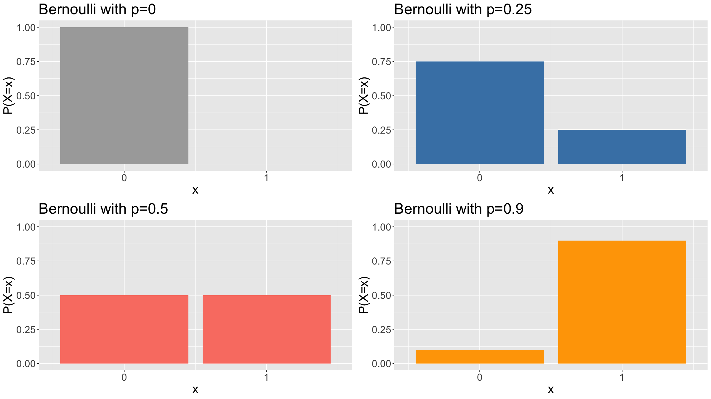
Probability theory: distributions

Slide 21
Probability theory: distributions
Binomial distribution
The binomial distribution arises when there is a finite number of repetitions of a Bernoulli experiment. It is the distribution that arises if you count the number of successes among $n$ independent Bernoulli trials, e.g. counting heads in 10 coin tosses. If $X_{1},X_{2},…,X_{n}$ are independent and identically distributed (iid) with $X_{i}∼\text{ Bern(p)}$, then $Y=\sum_{i=1}^{n}{X_{i}}∼\text{ Bin}\left(n,p\right)$.
$X∼\text{ Bin}\left(n,p\right)$ if
$$P\left(X=x\right)=\left\{\begin{matrix}\left({n \atop x}\right) p^{x} {\left(1−p\right)}^{n−x} & \text{ if }x∈\{0,1,…,n\} \\ 0 & \text{ otherwise}\end{matrix}\right.$$
$$E\left(X\right)=np, Var\left(X\right)=np\left(1−p\right)$$
The special case $n=1$ is the Bernoulli distribution.
Examples:
Number of survivors of a ship wreck.
Number of heads in 10 coin flips.
…

Slide 22
Probability theory: distributions
plotBin<-function(n,p,col,maxN=10){ x<-seq(0,n,by=1) px<-dbinom(x,size=n,prob=p) df<-tibble(x=x,px=px) g<-ggplot(data=df,mapping=aes(x=x,y=px)) + geom_bar(stat="identity",fill=col) + ylab("P(X=x)") + theme(text = element_text(size=20)) + ggtitle(paste(sep="","Binomial with n=",n,", p=",p)) + scale_x_continuous(breaks=0:maxN) + coord_cartesian(xlim=c(-0.5,maxN+0.5),ylim=c(0,1)) return(g) } g1<-plotBin(1,.2,"darkgrey"); g2<-plotBin(2,.2,"steelblue") g3<-plotBin(3,.2,"salmon"); g4<-plotBin(4,.2,"greenyellow") g5<-plotBin(5,.2,"mediumorchid"); g6<-plotBin(10,.2,"orange") grid.arrange(g1,g2,g3,g4,g5,g6,ncol=3)

Slide 23
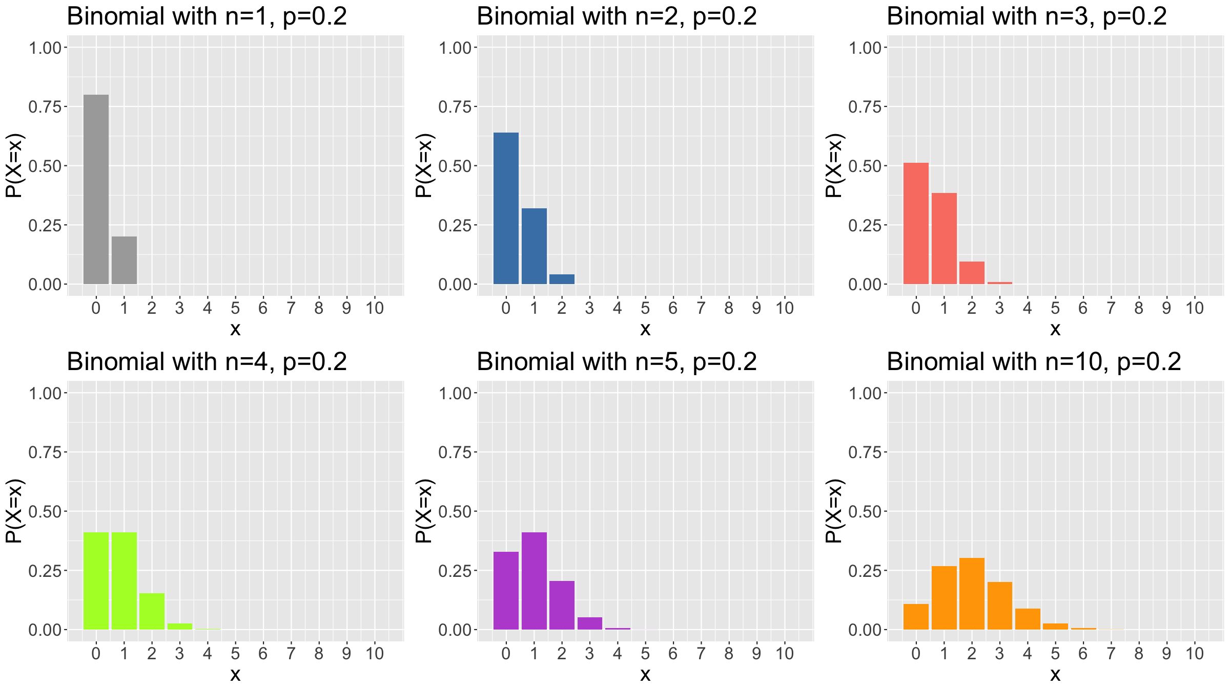
Probability theory: distributions

Slide 24
Probability theory: distributions
Poisson distribution
The Poisson distribution arises if you count the number of events that occur during a fixed interval, with $λ$ the rate with which events occur.
$X∼\text{ Poisson}\left(λ\right)$ if
$$P\left(X=x\right)=\left\{\begin{matrix}\frac{λ^{x}e^{−λ}}{x!} & \text{ if }x∈\{0,1,2,3…\} \\ 0 & \text{ otherwise}\end{matrix}\right.$$
$$E\left(X\right)=λ, Var\left(X\right)=λ$$
Examples:
number of mutations on strand of DNA per unit time,
number of asthma patient arrivals within a given hour of a walk-in clinic
number of births, deaths, …, over a given period
number of photons hitting a telescope image sensor
…

Slide 25
Probability theory: distributions
plotPois<-function(lambda,col,maxK=10){ x<-seq(0,maxK,by=1) px<-dpois(x,lambda=lambda) df<-tibble(x=x,px=px) g<-ggplot(data=df,mapping=aes(x=x,y=px)) + geom_bar(stat="identity",fill=col) + ylab("P(X=x)") + theme(text = element_text(size=20)) + ggtitle(paste(sep="","Poisson with rate=",lambda)) + scale_x_continuous(breaks=0:maxK) + coord_cartesian(xlim=c(-0.5,maxK+0.5),ylim=c(0,1)) return(g) } g1<-plotPois(0,"darkgrey"); g2<-plotPois(0.5,"steelblue") g3<-plotPois(1,"salmon"); g4<-plotPois(2,"greenyellow") g5<-plotPois(3,"mediumorchid"); g6<-plotPois(5,"orange") grid.arrange(g1,g2,g3,g4,g5,g6,ncol=3)

Slide 26
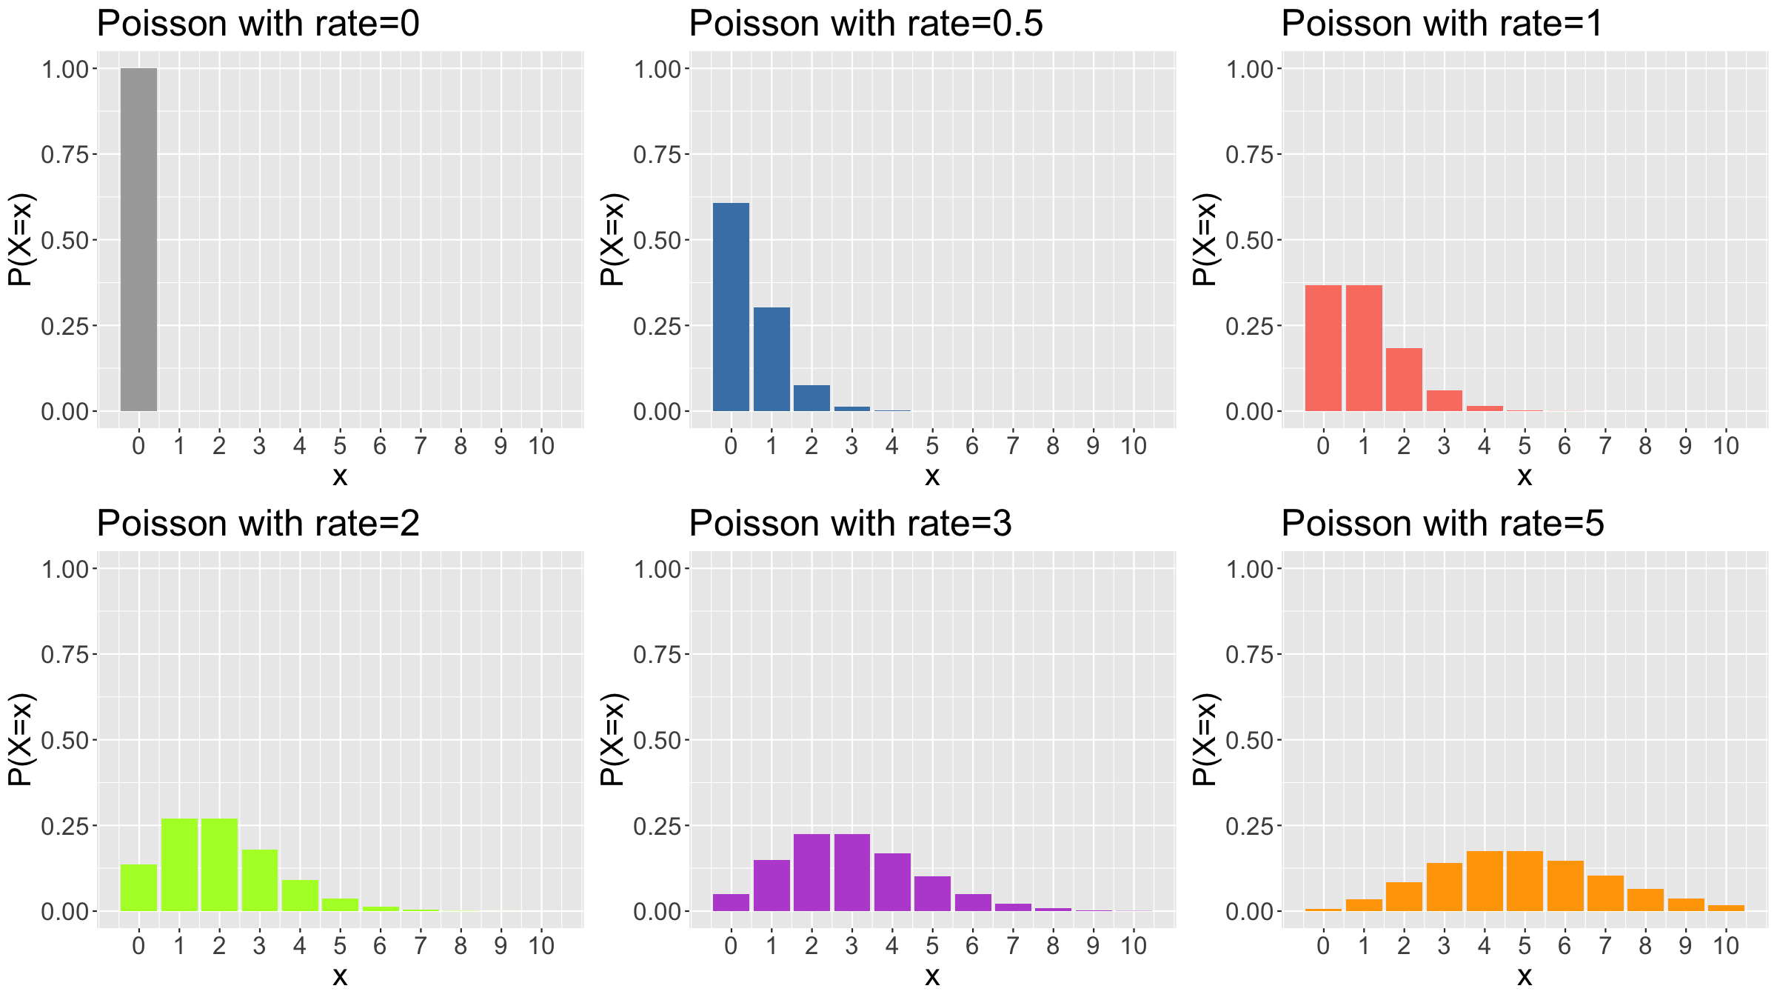
Probability theory: distributions

Slide 27
Probability theory: distributions
Normal / Gaussian distribution
This is the most important continuous distribution and is characterised by a symmetric bell-shaped curve around the mean.
$X∼N\left(μ,σ^{2}\right)$ if
$$p\left(x\right)=\frac{1}{\sqrt{2πσ^{2}}}e^{−\frac{{\left(x−μ\right)}^{2}}{2σ^{2}}}$$
$$E\left(X\right)=μ, Var\left(X\right)=σ^{2}$$
Because of the Central Limit Theorem, the normal distribution both arises in many real life situations and plays a major role in statistical inference.
Important special case: $N\left(0,1\right)$, the standard normal.
Example:
A random variable measuring the height of men.

Slide 28
Probability theory: distributions
l<-1000; x<-seq(-5,5,length=l) p1x<-dnorm(x,mean=0,sd=1); p2x<-dnorm(x,mean=0,sd=2) p3x<-dnorm(x,mean=0,sd=0.5); p4x<-dnorm(x,mean=2,sd=1) xFull<-rep(x,4); pFull<-c(p1x,p2x,p3x,p4x) pars<-factor(c(rep(1,l),rep(2,l),rep(3,l),rep(4,l))) df<-tibble(x=xFull,p=pFull,pars=pars) cols<-c("darkgrey", "steelblue", "salmon", "orange") labs<-c(expression(paste(sep="",mu,"=0, ",sigma,"=1")), expression(paste(sep="",mu,"=0, ",sigma,"=2")), expression(paste(sep="",mu,"=0, ",sigma,"=0.5")), expression(paste(sep="",mu,"=2, ",sigma,"=1"))) ggplot(data=df,mapping=aes(x=x,y=p,colour=pars,fill=pars)) + geom_line(lwd=1,alpha=0.75) + geom_area(alpha=0.25,position="dodge") + scale_color_manual(values=cols) + scale_fill_manual(values=cols,labels=labs) + labs(fill="parameters") + guides(colour=F) + ylab("density") + ggtitle("Normal distribution") + theme(text = element_text(size=20))

Slide 29
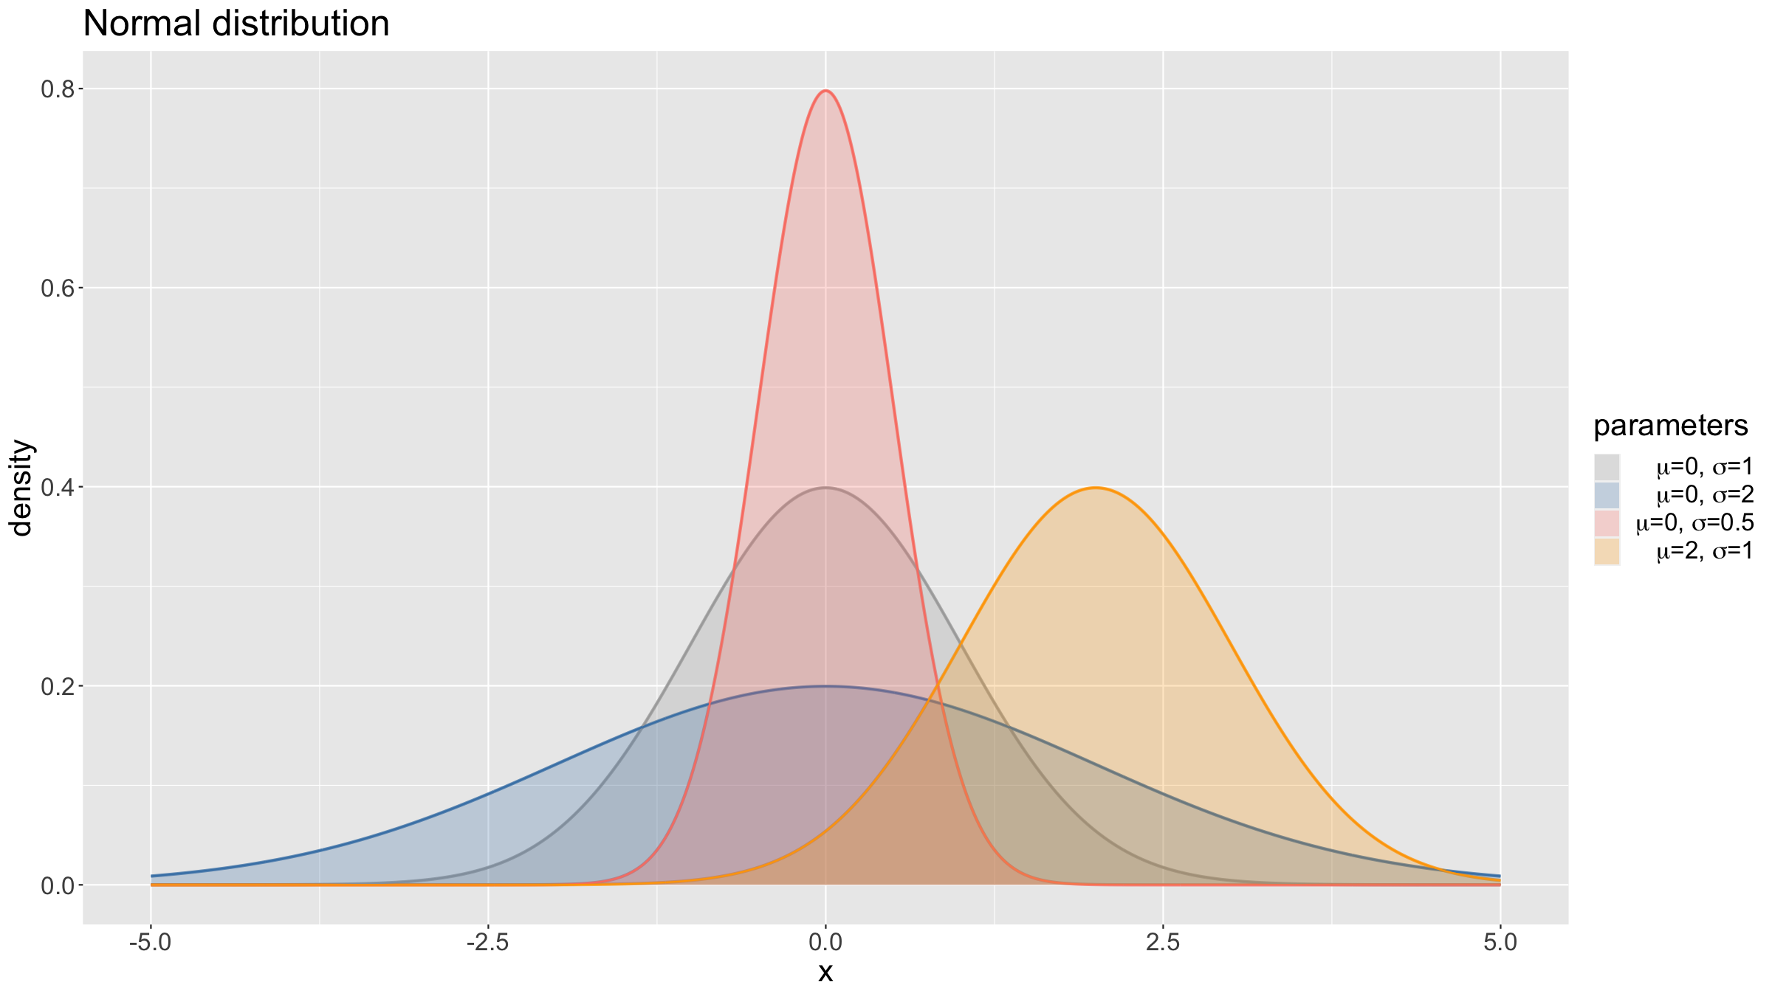
Probability theory: distributions

Slide 30
Probability theory: Central Limit Theorem
Central Limit Theorem (CLT)
The CLT is central / key in statistics because:
Any statistic that is a sum of enough random variables with similar distributions will be approximately normally distributed.
The normal distribution can be used to approximate the sampling distributions of many statistics, and the statistical theory for the normal distribution can be used to derive properties.
Examples
Normal approximation to the binomial.
t-test robust against deviations from normality.
Height distributions of humans.

Slide 31
Probability theory: Central Limit Theorem
cols<-c("darkgrey","steelblue","salmon","orange","greenyellow","mediumorchid","lightcyan","brown") generateMeans<-function(n=c(1,2,5,10,50,100,500,1000),col=cols,N=1e4,rDistFun,xlim=NULL,...){ sim<-matrix(nrow=N,ncol=length(n)) for(j in 1:length(n)){for(i in 1:N){ sim[i,j]<-mean(rDistFun(n[j],...)) }} par(mar=c(1.5,2.5,1.5,0.5),mfrow=c(length(n),1)) for(j in 1:length(n)){ if(length(xlim)<2){ hist(breaks=100,sim[,j],main=paste(sep="","n = ",n[j]),yaxt="n",col=col[j]) }else{ hist(breaks=100,sim[,j],main=paste(sep="","n = ",n[j]),xlim=xlim,yaxt="n",col=col[j]) } } }

Slide 32
Probability theory: Central Limit Theorem
To illustrate the CLT, you can use a simple shiny app I developed:
https://mlw-stats.shinyapps.io/DemonstrateTheCLT

Slide 33
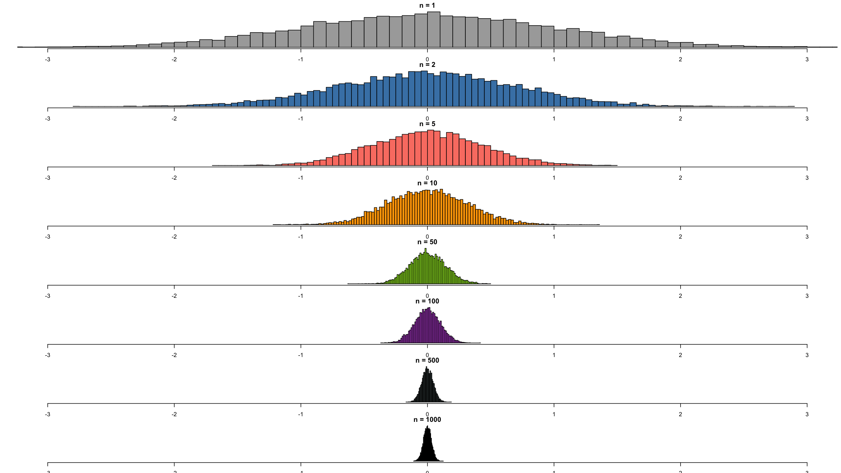
Probability theory: Central Limit Theorem
generateMeans(rDistFun=rnorm,xlim=c(-3,3))

Slide 34
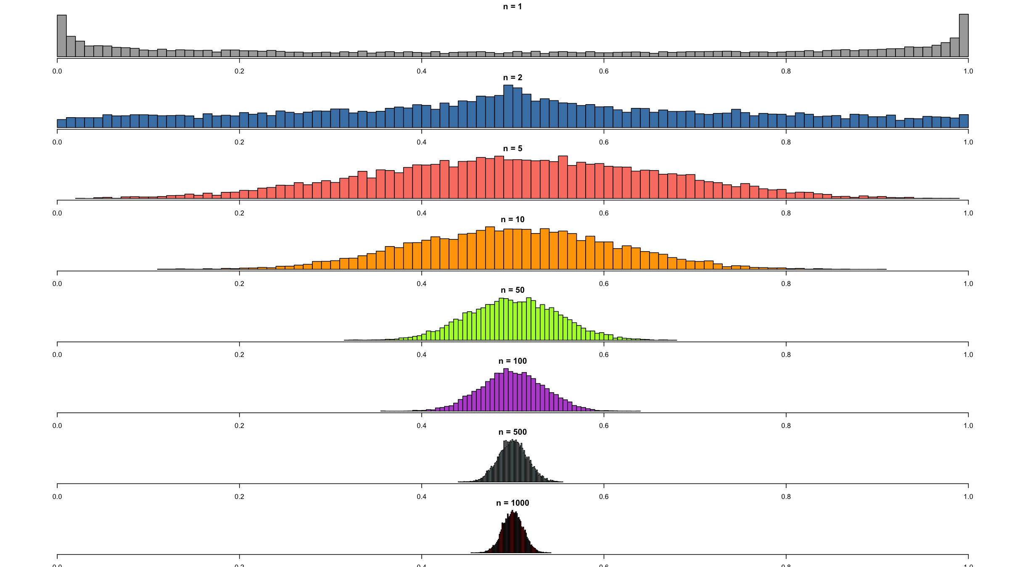
Probability theory: Central Limit Theorem
generateMeans(rDistFun=rbeta,shape1=0.5,shape2=0.5,xlim=c(0,1))

Slide 35
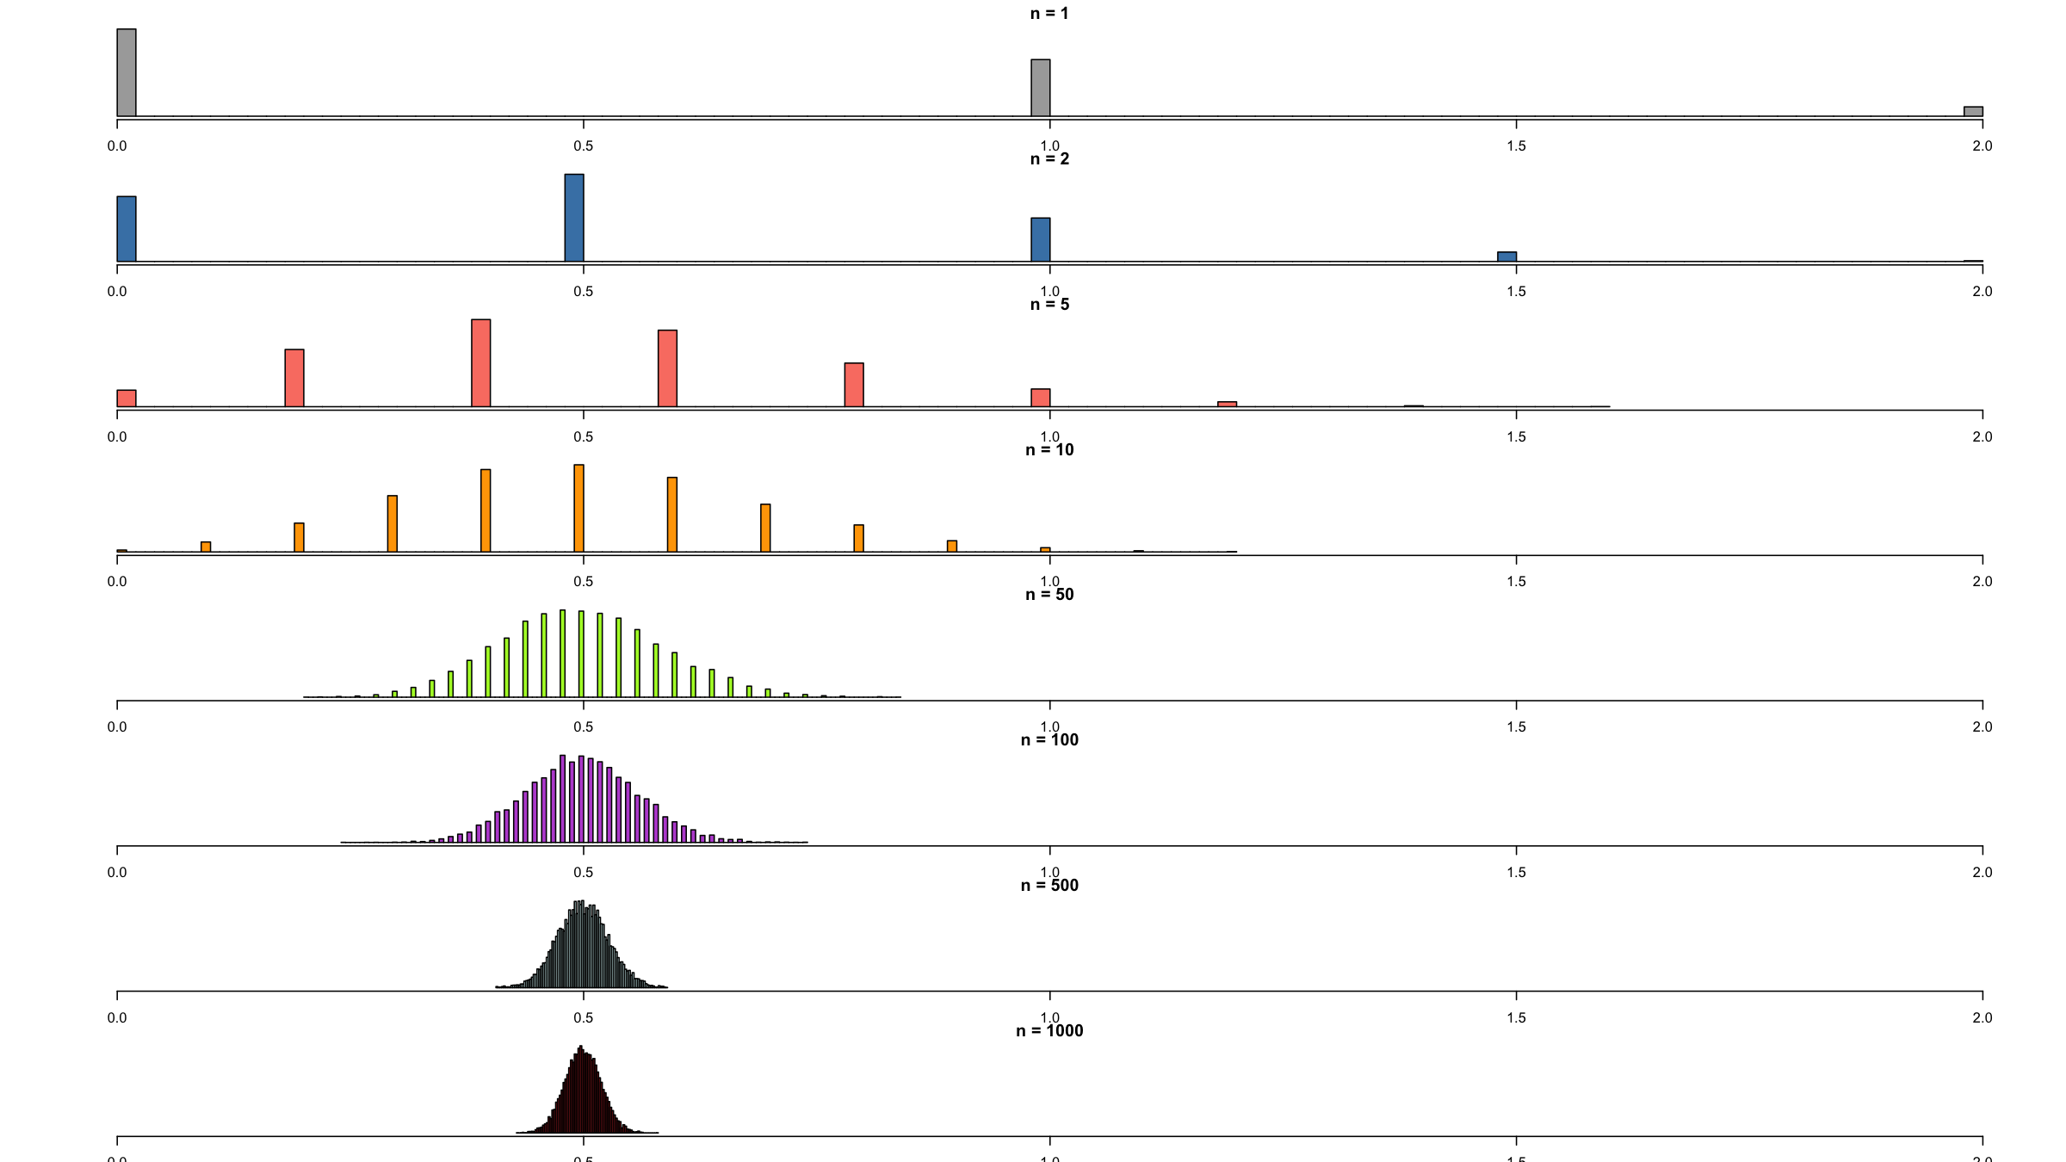
Probability theory: Central Limit Theorem
generateMeans(rDistFun=rbinom,size=2,prob=0.25,xlim=c(0,2))

Slide 36
Study designs

Slide 37
Study design
Research question
Any study starts with a hypothesis which in turn is used to define one or several study question(s).
The study question determines what design is needed or optimal to answer the question.
(Medical) research questions should follow the PICOT mnemonic:
Population - who do you need to study?
Intervention (if applicable) - what treatment are you investigating?
Comparison - which groups / exposures are you comparing, what is the control?
Outcome - what are you planning to measure?
Time - over what duration will you collect data?

Slide 38
Study design
Cross-sectional studies
The study is conducted once in a defined population at a specific point in time.
Get a snapshot of variables of interest (e.g. frequency of an exposure or prevalence of an outcome) for study population at that point in time.
Can be descriptive or analytical (e.g. if frequency of outcome is compared according to exposure status).

Slide 39
Study design
Cohort studies
Recruit from study population at a specific point in time, but then follow this group / cohort over time.
Usually individuals already with the outcome of interest are excluded from recruitment.
Observe outcome(s) of interest as they occur.
Can be prospective or retrospective.
Can be descriptive or analytical (e.g. if frequency of outcome is compared according to exposure status).

Slide 40
Study design
Case-control studies
Recruit individuals with a specific outcome of interest (cases).
Recruit from a representative group of individuals without the outcome (controls).
Compare cases and controls to assess differences in past exposures or personal characteristics to identify one or more risk factors.
Useful / efficient when cases are rare in the population.

Slide 41
Study design
Interventional and experimental studies
Rather than observing exposures and outcomes, researcher is in control of exposure:
Allocate (typically randomly) exposure (the intervention) to one group.
Another group allocated to no intervention (control or standard of care).
Follow the groups up over time.
Compare outcome(s) of interest in the intervention and control groups.
Can have more than one intervention arm.

Slide 42
Study design
Types of interventional studies
Randomised controlled trial (gold standard)
Randomised means allocation to the groups is random (note that random allocation is not the same as random sampling)
Controlled means one group receives the intervention while another does not
Trial means experiment or study
Randomisation can be at individual or group / cluster (e.g. households, schools, health centres, …) level (CRT)
CRTs require special sample size and analysis methods
Quasi-experimental design: no randomization
Before - after designs.
Stepped wedge designs.

Slide 43
Study design
Quick note on ethics in RCTs
Recall that an RCT is similar to a cohort (observational) study.
Differs because RCT allocates the exposure (intervention) rather than observing a naturally occurring exposure.
Investigator cannot allocate a harmful or withhold a beneficial intervention.
Equipoise means that there is no evidence that one of the interventions is superior to the other.

Slide 44
Study design
General design considerations
Research question / hypothesis
Power & sample size
Budget
Logistics

Slide 45
Common statistical tests

Slide 46
Common statistical tests
Studies are designed so as to allow answering one or more research questions which fall broadly into 2 categories:
Estimation of a parameter of interest.
Testing a specific hypothesis (e.g. to compare 2 or more group, to interrogate an association between 2 variables, …).
A hypothesis is defined as:
A supposition, arrived at from observation or reflection, that leads to refutable predictions.
Any claim cast in a form that will allow it to be tested and refuted if necessary.
Underlying Statistical Principles:
A hypothesis is either true or not in the real world.
We cannot study the whole world; therefore we must test a hypothesis in a sample.
Can never absolutely prove (or disprove) the hypothesis.
Therefore we use statistical tests to determine whether there is sufficient evidence to reject the null hypothesis.

Slide 47
Common statistical tests
For a formal, statistically principled analysis to test a specific hypothesis, we need several things:
A null hypothesis: a narrow hypothesis about the data which the researchers aim to refute with observed data. This informs the choice of the alternative hypothesis; this is a usually wide hypothesis about the parameter of interest and is mutually exclusive with the null.
A test statistic: a random variable dervied from the variables recorded in the data being interrogated.
A distribution of the test statistic under the null: Assuming the null hypothesis to be true, this is the distribution of the test statistic. The test statistic is chosen so that if the null is not true, it should have a very different distribution and that difference allows then rejecting the null.
Data: Finally data are needed to compute the observed value of the test statistic and to then compute the likelihood of observing that value if the null hypothesis is true.

Slide 48
Common statistical tests
There are many different statistical tests and we will cover several today. The general procedure / algorithm for all of these is the same:
Articulate a research question.
Formulate a testable (narrow) null hypothesis H₀ and a (wide) alternative hypothesis H₁ reflecting the research question.
Define the decision rule:
Define a test statistic.
Derive the distribution of the test statistics under H₀.
Define the decision rule (based on the p-value - see below).
Collect data.
Calculate the test statistic and calculate the probability, the so-called p-value, of observing a value of the test statistic that is as extreme or more extreme than the observed value, assuming the null distribution to hold.
Make a decision to reject H₀ in favour of H₁ or not.

Slide 49
Common statistical tests
One- and two-tailed hypotheses
One-tailed (one-sided) hypotheses specify a direction of effect (e.g. direction of an association between a predictor and outcome variable).
E.g. A new drug (Drug A) for malaria prophylaxis has better efficacy in preventing malaria in contrast to a currently approved drug (Drug B).
Two-tailed (two-sided) hypotheses specify only that there is an effect or that a certain parameter is equal to a specific value; they does not specify a direction.
E.g. The new drug (Drug A) for malaria prophylaxis has a different efficacy in preventing malaria in contrast to a currently approved drug (Drug B).
In other words, Drug A could be worse than Drug B OR Drug A could be better than Drug B.
Unless there are very clear reasons why a direction can only be in a certain direction, a two-tailed test should be preferred and is also, for the same level of significance, more conservative.

Slide 50
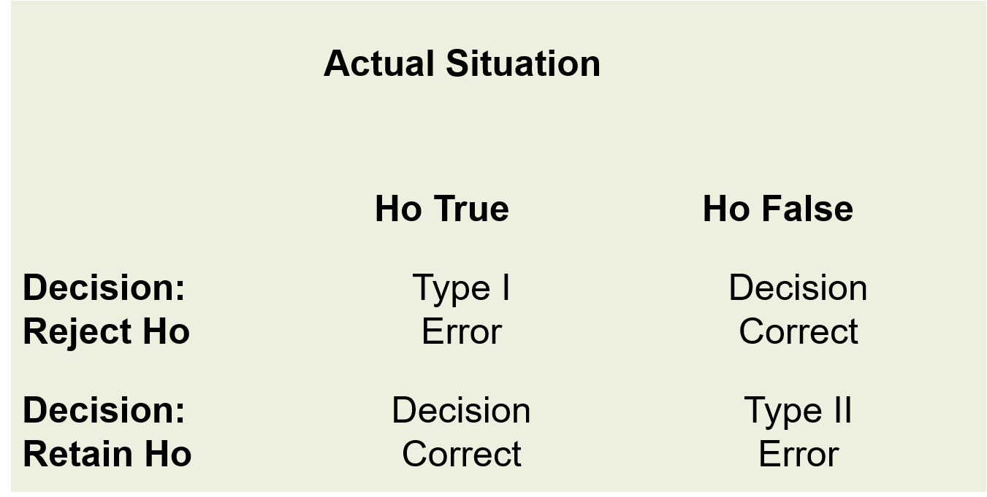
Common statistical tests
When doing a statistical test, we can end up making two different types of error:
FALSE POSITIVE: We falsely reject a null hypothesis that is true. This is called a Type I error.
FALSE NEGATIVE: We falsely fail to reject a null hypothesis that is not true. This is called a Type II error.
Types of errors in hypothesis testing

Slide 51
Common statistical tests
Confidence level and statistical power of a test:
Confidence level $α$: This is the probability of making a Type I error (rejecting the null hypothesis when it is true).
Statistical power: This is the probability of correctly rejecting the null hypothesis. In other words, it is equal to $1−β$ where $β$ is the probability of making a Type II error (failing to reject the null hypothesis when it is actually false).
Ideally $α$ and $β$ would be set to zero.
In practice they are made as small as possible (with an obvious trade-off between the two).
Reducing them both together requires an increase in sample size.
Most studies use $α=0.05$ and a $β=0.20$ or $β=0.10$.

Slide 52
Common statistical tests
Hypothesis testing can be done in different scenarios:
Is there a difference in means?
Is there a difference in proportions?
Difference in odds ratios or relative risks?
Is a slope of a regression line different from 0?
More about null and alternative hypotheses:
Null hypothesis
Narrow (in two-sided tests) - test statistic takes a single, specific value.
Usually the hypothesis of no effect / association / difference.
Alternative hypothesis
Wide - test statistic can take a large range of values.
Often the hypothesis held by the researcher.
Is the opposite of the null hypothesis.

Slide 53
Common statistical tests
Word of warning: to p or not to p
Null hypothesis significance testing can overly simplify complex research questions and nuance in analysis can be lost.
The common choices of $α$ and $β$ are completely arbitrary, set by a bunch of statisticians in the 1930s over a cup of tea (literally – https://en.wikipedia.org/wiki/Lady_tasting_tea).
Overall risk of a Type I error increases the more tests you do.
If you do several tests or fit several models but only report the one that was statistically significant, you are misleading your readers.
Publication bias and pressure to publish means very bad practices have become established (e.g. p-hacking), contributing to the reproducibility crisis.
Please read https://doi.org/10.1080/00031305.2019.1583913.

Slide 54
Common statistical tests
One-sample t-test
This test is used to check whether a sample mean is different from a known / hypothesized mean.
How different is the sample mean from the true population mean?
Continuous data.
Assumptions:
Random sample from the population.
The data must be continuous.
The sample mean must follow a normal distribution.

Slide 55
Common statistical tests
One-sample t-test
Let $X$ be the random variable for data that we wish to observe. Let $μ$ be the population mean, $\overset{‾}{x}$ the sample mean of the observed data, $s$ the sample standard deviation and $n$ the number of observations. Let $μ_{0}$ be the hypothsized null value of the population mean.
Hypotheses:
H₀: $μ=μ_{0}$
H₁: $μ≠μ_{0}$
Test statistic: difference between sample mean and null value $μ_{0}$ scaled by the standard error
$$T=\frac{\overset{‾}{x}−μ_{0}}{s/\sqrt{n}}∼t_{n−1} \text{ under }H_{0}$$

Slide 56
Common statistical tests
One-sample t-test - PRACTICAL
Suppose we want to test the hypothesis that the mean age is 24
$$H_{0}:μ=24$$
$$H_{1}:μ≠24$$
This is a two-sided test.

Slide 57
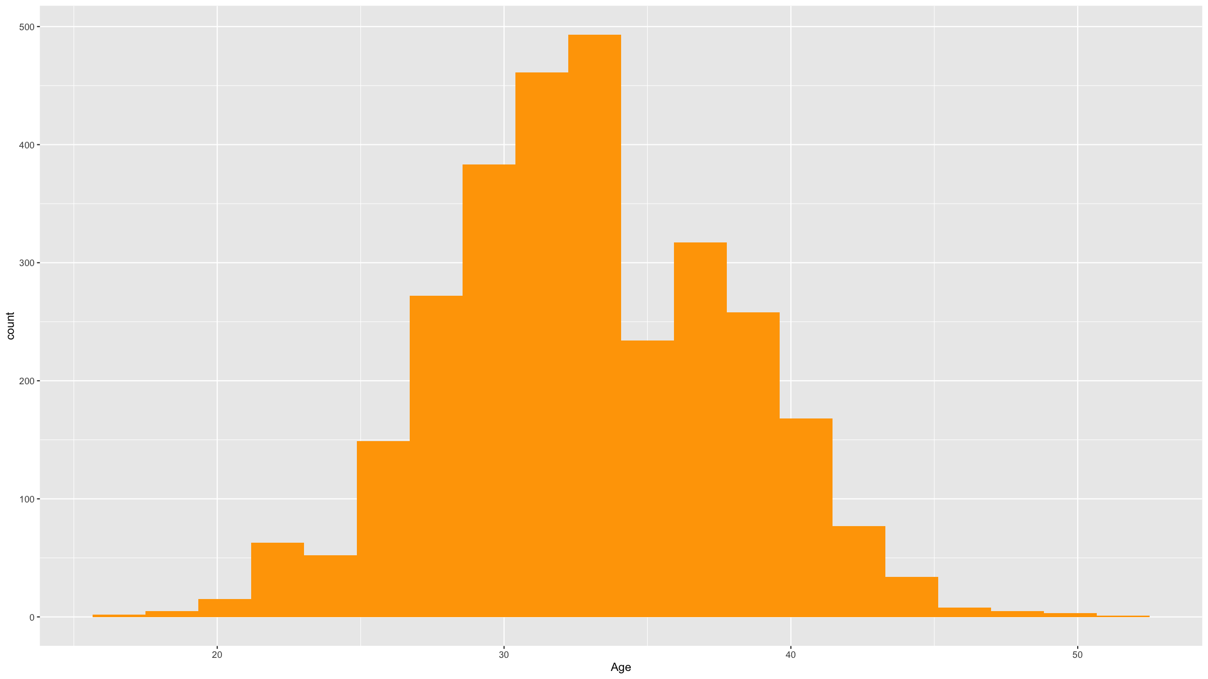
Common statistical tests
One-sample t-test - PRACTICAL
ASSUMPTIONS
Histogram to check normality. We only require the sample mean not the actual data to be normally distributed. However we only have a single observation of the sample mean. Thanks to the CLT, if the sample size is large enough and the distribution of the data is not too wildly non-normal (really severe skew, outliers and extreme values), then this will be met. So check the histogram for the data, but focus on evidence for severe non-normality.
dfTb %>% ggplot(mapping=aes(x=age)) + geom_histogram(bins=20,fill="#ffa500") + xlab("Age")

Slide 58
Common statistical tests
One-sample t-test - PRACTICAL
DO THE TEST
t.test(dfTb$age,mu=24) ## ## One Sample t-test ## ## data: dfTb$age ## t = 98.616, df = 2999, p-value < 2.2e-16 ## alternative hypothesis: true mean is not equal to 24 ## 95 percent confidence interval: ## 32.76225 33.11775 ## sample estimates: ## mean of x ## 32.94

Slide 59
Common statistical tests
One-sample t-test - PRACTICAL
DO THE TEST
We note that:
Sample mean = 32.94
p-value $<2.2⋅{10}^{−16}$ so much lower than the typical $α$ level of 0.05.
We reject the null hypothesis $H_{0}$ and conclude there is substantial evidence that the population mean is different from $μ_{0}=24$.

Slide 60
Common statistical tests
Two-sample t-test
We now have 2 samples (or 1 sample with 2 groups of observations) and we compare the sample means to make inference about the population means estimated by these sample means.
Let $X_{1},X_{2}$ be the random variables for data that we wish to observe. Let ${\overset{‾}{x}}_{1},{\overset{‾}{x}}_{2}$ be the sample means of the observed data, $s_{1},s_{2}$ the sample standard deviations and $n_{1},n_{2}$ the numbers of observations in each group.
Hypotheses:
H₀: $μ_{1}=μ_{2}$ (equal population means)
H₁: $μ_{1}≠μ_{2}$ (different population means)
Test statistic: difference between sample means scaled by the standard error
$$T=\frac{{\overset{‾}{x}}_{1}−{\overset{‾}{x}}_{2}}{\sqrt{s_{1}^{2}/n1+s2^{2}/n_{2}}}∼t_{k} \text{ under }H_{0}$$
The degrees of freedom $k$ needs to be computed using an approximation. The statistical software you will be using,m will do this for you. Note that there is a simpler expression for the standard error if you assume equal variances (t.test() has an argument var.equal that you could specify).

Slide 61
Common statistical tests
Two-sample t-test
Assumptions:
The data are continuous.
The sample means are normally distributed.
The two samples are independent.
Both samples are random samples of the respective underlying populations.

Slide 62
Common statistical tests
Two-sample t-test - PRACTICAL
In the TB dataset provided (read into R as dfTb), it is hypothesized that the mean age is the same for both men and women.
We can test this hypothesis
$$H_{0}:μ_{M}=μ_{F}$$
$$H_{1}:μ_{M}≠μ_{F}$$

Slide 63
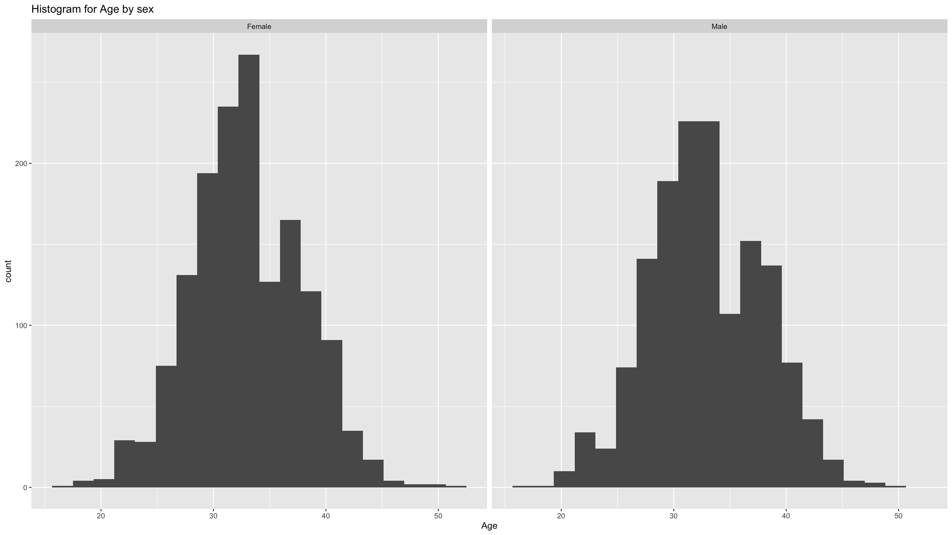
Common statistical tests
Two-sample t-test - PRACTICAL
ASSUMPTIONS
Check if the two populations are normally distributed. We really just need to check for severe non-normality as the normality assumption only applies to the sample means (and since these are sums of random variables, the CLT helps us).
dfTb %>% ggplot(mapping=aes(x=age)) + geom_histogram(bins=20) + labs(title="Histogram for Age by sex") + xlab("Age") + facet_wrap(~ifelse(sex==1,"Male","Female"))

Slide 64
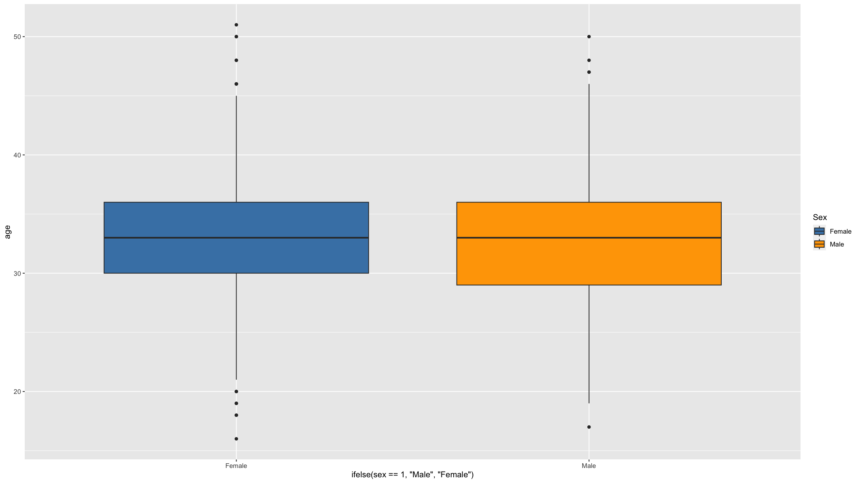
Common statistical tests
Two-sample t-test - PRACTICAL
ASSUMPTIONS
Check if the variances are the same (only needed if you specify var.equal=TRUE). By default var.equal is set to FALSE in the function t.test() and you do NOT need to check this assumption. However, this uses an approximation to the distribution used to compute the p-value and if you don’t want to make that approximation, you could set var.equal=TRUE but then you need to check this assumption of equal variances. A visual inspection is usually good enough for most situations.
dfTb %>% ggplot(mapping=aes(x=ifelse(sex==1,"Male","Female"),y=age,fill=ifelse(sex==1,"Male","Female"))) + scale_fill_manual(values=c("steelblue","orange"),name="Sex") + geom_boxplot()

Slide 65
Common statistical tests
Two-sample t-test - PRACTICAL
DO THE TEST
t.test(age~sex,data=dfTb) ## ## Welch Two Sample t-test ## ## data: age by sex ## t = -0.69127, df = 2982.6, p-value = 0.4895 ## alternative hypothesis: true difference in means between group 1 and group 2 is not equal to 0 ## 95 percent confidence interval: ## -0.4812899 0.2303877 ## sample estimates: ## mean in group 1 mean in group 2 ## 32.87585 33.00130

Slide 66
Common statistical tests
Two-sample t-test - PRACTICAL
DO THE TEST
We note that:
The observed difference in sample means is (32.87585 - 33.00130) = -0.12545.
p = 0.4895 which is larger than 0.05, the typical significance level.
From this we conclude that there is not enough evidence to reject the null hypothesis of no difference in mean age between men and women in this dataset.

Slide 67
Common statistical tests
Paired t-test
When observations are paired (e.g. repeat observations in the same individual; for example before and after a treatment or at 2 different time points), we cannot use the two-sample t-test (assumption of independent observations in both groups not met). However we can compute the pairwise difference and do a one-sample t-test to test the null hypothesis that the mean of these pairwise differences is 0.
For example we can test whether CD4 levels are the same T time points 1 and 2:
$$H_{0}:μ_{1}=μ_{2}$$
$$H_{1}:μ_{1}≠μ_{2}$$
t.test(dfTb$cd41,dfTb$cd42,paired = TRUE) ## ## Paired t-test ## ## data: dfTb$cd41 and dfTb$cd42 ## t = -98.346, df = 2999, p-value < 2.2e-16 ## alternative hypothesis: true mean difference is not equal to 0 ## 95 percent confidence interval: ## -203.1804 -195.2370 ## sample estimates: ## mean difference ## -199.2087

Slide 68
Common statistical tests
ANOVA - comparing more than two means
Sometimes we want to compare means of a variable in more than 2 groups.
For example, we might want to compare the mean CD4 among the 5 hospitals.
Use one way analysis of variance (ANOVA).
Compares the between groups variation to the within groups variation: if the former is larger than the latter, the group means cannot all be the same.
Assumptions:
Data in each group are approximately normally distributed (CLT applies again, but a bit more complicated than in the t-test case).
Equal variation within groups.
Independent and identically distributed variables.

Slide 69
Common statistical tests
ANOVA - comparing more than two means
A total of 3000 study participants were recruited in 5 hospitals providing ART. Each participant’s CD4 count upon entry into study was measured. We would like to investigate whether there is a difference in mean CD4 count at the entry into the study across the 5 participating facilities. State the hypothesis to be tested and your conclusion.
$$H_{0}:μ_{1}=μ_{2}=μ_{3}=μ_{4}=μ_{5}$$
$$H_{1}:μ_{i}≠μ_{j} \text{ for some }i,j$$
oneway.test(cd41 ~ hosp, data = dfTb) ## ## One-way analysis of means (not assuming equal variances) ## ## data: cd41 and hosp ## F = 0.22905, num df = 4, denom df = 1496, p-value = 0.9222

Slide 70
Common statistical tests
ANOVA - comparing more than two means
Same results:
res.hosp <- aov(cd41 ~ factor(hosp), data = dfTb) summary(res.hosp) ## Df Sum Sq Mean Sq F value Pr(>F) ## factor(hosp) 4 2204 551.1 0.229 0.922 ## Residuals 2995 7194212 2402.1

Slide 71
Common statistical tests
ANOVA - comparing more than two means
We note that:
$p=0.922$, which is larger than 0.05 and we do not reject the null hypothesis of all means being equal.
There is no evidence in our dataset to suggest that the measured CD4 value differ between the 5 hospitals.

Slide 72
Common statistical tests
A note on non-parametric tests:
The t-test and ANOVA are so-called parametric tests because they assume specific parameterised distributions for the data (in both cases the normal distribution) when deriving the distribution of the test statistic under the null hypothesis.
If those distributional assumptions are not met, the test results may be invalid.
There exist non-parametric alternatives, which should be used when
The data exhibit clear and severe non-normality.
The sample sizes are small (as the CLT will fail to apply).
We will not cover these here, but you need to be aware of them:
One-sample t-test $→$ Wilcoxon signed rank test
Two-sample t-test $→$ Wilcoxon rank sum or Mann-Whitney U test
ANOVA $→$ Kruskal-Wallis test

Slide 73
Common statistical tests
Tests for proportions - one sample test
When we estimate a proportion (e.g. a prevalence) in a study population, and then want to test the null hypothesis that this proportion is equal to a specific a prior known proportion, we can proceed in 2 ways:
Use a normal approximation test - prop.test() in R.
Use an exact binomial test - binom.test() in R.
The null and alternative hypotheses are the same for both tests. For example for a two-sided alternative:
$$H_{0}:p=p_{0}$$
$$H_{1}:p≠p_{0}$$
The normal approximation test uses the following test statistic:
$$T=\frac{p−p_{0}}{\sqrt{p_{0}\left(1−p_{0}\right)/n}}∼N\left(0,1\right) \text{ under }H_{0}$$

Slide 74
Common statistical tests
Tests for proportions - one sample test
When we estimate a proportion, we observe $X=k$ events / successes / outcomes in the $n$ units that we sampled, each success having a probbility $p_{0}$ to occur. This is a binomial distribution:
$X∼\text{Binom}\left(n,p_{0}\right)$.
The exact binomial test makes use of this and directly computes p-values from the binomial distribution.

Slide 75
Common statistical tests
Tests for proportions - one sample test
A recent survey found that approximately 23% of the population in a district are HIV positive. A researcher takes a random sample of 3000 people and finds that 560 tested positive for HIV. She wants to test whether this agrees with the recent survey data. State the hypotheses and your conclusion.

Slide 76
Common statistical tests
Tests for proportions - one sample test
A recent survey found that approximately 23% of the population in a district are HIV positive. A researcher takes a random sample of 3000 people and finds that 560 tested positive for HIV. She wants to test whether this agrees with the recent survey data. State the hypotheses and your conclusion.
$$H_{0}:p=0.23$$
$$H_{1}:p≠0.23$$

Slide 77
Common statistical tests
Tests for proportions - one sample test
Using a normal approximation:
prop.test(x=560,n=3000,p=0.23) ## ## 1-sample proportions test with continuity correction ## ## data: 560 out of 3000, null probability 0.23 ## X-squared = 31.565, df = 1, p-value = 1.929e-08 ## alternative hypothesis: true p is not equal to 0.23 ## 95 percent confidence interval: ## 0.1729659 0.2011784 ## sample estimates: ## p ## 0.1866667

Slide 78
Common statistical tests
Tests for proportions - one sample test
Using an exact binomial test:
binom.test(x=560,n=3000,p=0.23) ## ## Exact binomial test ## ## data: 560 and 3000 ## number of successes = 560, number of trials = 3000, p-value = 8.674e-09 ## alternative hypothesis: true probability of success is not equal to 0.23 ## 95 percent confidence interval: ## 0.1728678 0.2010794 ## sample estimates: ## probability of success ## 0.1866667

Slide 79
Common statistical tests
Comparing 2 proportions
When we collect data on 2 groups and want to compare proportions for an outcome of interest in these 2 groups, then we need to use a normal approximation test. Let $p_{1},p_{2}$ be the proportions in the 2 groups and $n_{1},n_{2}$ the sample sizes we collected from each group. Let $p=\left(n_{1}p_{1}+n_{2}p_{2}\right)/\left(n_{1}+n_{2}\right)$, the proportion in the 2 groups combined.
Hypotheses
$H_{0}:p_{1}=p_{2}$
$H_{0}:p_{1}≠p_{2}$
Test statistic
$$T=\frac{p_{1}−p_{2}}{\sqrt{p\left(1−p\right)\left(1/n_{1}+1/n_{2}\right)}}∼N\left(0,1\right) \text{ under }H_{0}$$
* In R: we still use prop.test().

Slide 80
Common statistical tests
Comparing 2 proportions
Example: We would like to investigate whether there is enough evidence that the proportion of HIV cases is different between men and women
$$H_{0}:p_{M}=p_{F}$$
$$H_{1}:p_{M}≠p_{F}$$
We need to calculate the proportions in each group before doing the test.
Proportion of men that tested positive; $p_{M}=n_{M}/N_{M}$
Proportion of women that tested positive; $p_{F}=n_{F}/N_{F}$

Slide 81
Test of proportion – Two sample tests
table(dfTb$sex,dfTb$hiv) ## ## 0 1 ## 1 1204 262 ## 2 1236 298 prop.test(x=c(262,298),n=c(262+1204,298+1236)) ## ## 2-sample test for equality of proportions with continuity correction ## ## data: c(262, 298) out of c(262 + 1204, 298 + 1236) ## X-squared = 1.093, df = 1, p-value = 0.2958 ## alternative hypothesis: two.sided ## 95 percent confidence interval: ## -0.04408002 0.01298849 ## sample estimates: ## prop 1 prop 2 ## 0.1787176 0.1942634

Slide 82
Common statistical tests
Chi-squared test
The chi-squared test is a more general test for comparing proportions between 2 or more groups. It specifically test whether 2 categorical variables are associated or not.
Given 2 categorical variables $V1$ (taking $c$ different values) and $V2$ (taking $r$ different values) we can compute an $r×c$ contingency table (i.e. we cross-tabulate the 2 variables) of the observed values.
$$\begin{matrix} & & & & V1 & \\ & & O_{11} & O_{12} & … & O_{1c} \\ & & O_{21} & O_{22} & … & O_{2c} \\ V2 & & … & & … & … \\ & & O_{r1} & O_{r2} & … & O_{rc}\end{matrix}$$

Slide 83
Common statistical tests
Chi-squared test
The principle to test whether the 2 variables are associated or not, is to compare the observed counts to the counts expected under the assumption of no association (the null hypothesis).
Define:
$n=$ the total number of observations (calculated as i​j​Oij)
$p_{i.}=$ the marginal proportion of row $i$ (calculated as 1nj​Oij)
$p_{.j}=$ the marginal proportion of column $j$ (calculated as 1ni​Oij)
$E_{ij}=$ the expected counts in each cell (calculated as $n⋅p_{i.}⋅p_{j.}$)
Note expected counts = expected under the assumption of no association.

Slide 84
Common statistical tests
Chi-squared test
We can then calculate the $χ^{2}$ statistic for this table:
χ2=i​j​Oij−Eij2Eij
($i$ sums over rows, $j$ sums over columns)
Under the null hypothesis H₀ of no association between the 2 variables, $χ^{2}$ follows a chi-squared distribution with $\left(r−1\right)\left(c−1\right)$ degrees of freedom. This can be used to compute p-values.

Slide 85
Common statistical tests
Chi-squared test
In R, you can do a chi-squared test using the chisq.test() function.
For example we can check if there is an association between stunting and mortality in the adolescent dataset:
chisq.test(table(dfAdo$stunt,dfAdo$died)) ## ## Pearson's Chi-squared test with Yates' continuity correction ## ## data: table(dfAdo$stunt, dfAdo$died) ## X-squared = 7.0641, df = 1, p-value = 0.007864
The p-value is 0.0078644 < 0.05, so we reject the null hypothesis of no association at the 5% significance level between stunting and mortality.

Slide 86
Common statistical tests
Chi-squared test
Or we can test the null hypothesis of no association between socio-economic status and hospital in the Blantyre TB dataset:
chisq.test(table(dfTb$ses,dfTb$hosp)) ## ## Pearson's Chi-squared test ## ## data: table(dfTb$ses, dfTb$hosp) ## X-squared = 7.864, df = 16, p-value = 0.9528
Note how the degrees of freedom has changed now. Here the p-value is 0.9528113 > 0.05, so we do not reject the null hypothesis of no association between socio-economic status and hospital.

Slide 87
Common statistical tests
Fisher’s exact test
The chi-square test relies on approximating the squared differences between observed and expected counts by chi-squared distributions. For this paramtric approximation, all expected cell counts need to be large enough (typically, the minimum expected cell count should be 5, 6 or larger).
Fisher’s test is non-parametric but computationally intensive: for a given null hypothesis, it derives all cross-tabulation tables that are as extreme or more extreme than the observed table.
For example, we can revisit the test we did when we checked if there is an association between stunting and mortality in the adolescent dataset:

Slide 88
Common statistical tests
Fisher’s exact test
fisher.test(table(dfAdo$stunt,dfAdo$died)) ## ## Fisher's Exact Test for Count Data ## ## data: table(dfAdo$stunt, dfAdo$died) ## p-value = 0.006215 ## alternative hypothesis: true odds ratio is not equal to 1 ## 95 percent confidence interval: ## 1.296104 7.696201 ## sample estimates: ## odds ratio ## 3.096198

Slide 89
Common statistical tests
Fisher’s exact test
However, when we revisit the test for the null hypothesis of no association between socio-economic status and hospital in the Blantyre TB dataset, we run out of memory for Fisher’s exact test – the table is too large with too many alternatives.
try( fisher.test(table(dfTb$ses,dfTb$hosp)) ) ## Error in fisher.test(table(dfTb$ses, dfTb$hosp)) : FEXACT error 5. ## The hash table key cannot be computed because the largest key ## is larger than the largest representable int. ## The algorithm cannot proceed. ## Reduce the workspace, consider using 'simulate.p.value=TRUE' or another algorithm.

Slide 90
Regression modelling

Slide 91
Regression modelling
Notation
$X,Y$ - random variables (here: X = predictor, Y = response)
$x,y$ - measured / observed values
$ϵ$ - random variable (here: error / residual)
$θ$ - a vector of parameters
$\overset{‾}{X}$, $\overset{‾}{Y}$ - sample mean estimators for X, Y
$\overset{‾}{x}$, $\overset{‾}{y}$ - sample mean estimates of X, Y
$\hat{T}$, $\hat{t}$ - given a statistic T, estimator and estimate of T
$P\left(A\right)$ - probability of an event A occuring
$f_{X}\left(.\right)$, $f_{Y}\left(.\right)$ - distribution mass / density functions of X, Y
$X∼F$ - X distributed according to distribution function F
$E\left[X\right]$, $E\left[Y\right]$, $E\left[T\right]$ - the expectation of X, Y, T respectively

Slide 92
Regression modelling
General concept of regression
Regression means describing some aspect of a dependent variable $Y$ as a function of some predictor or independent variables $X$ and parameters $θ$:
$$f_{1}\left(Y\right)=f_{2}\left(X;θ\right)$$
Here we focus on describing the mean of $Y$ as a function of a linear predictor of $X$.
3 main reasons for fitting regression models: inference, prediction, adjustment.

Slide 93
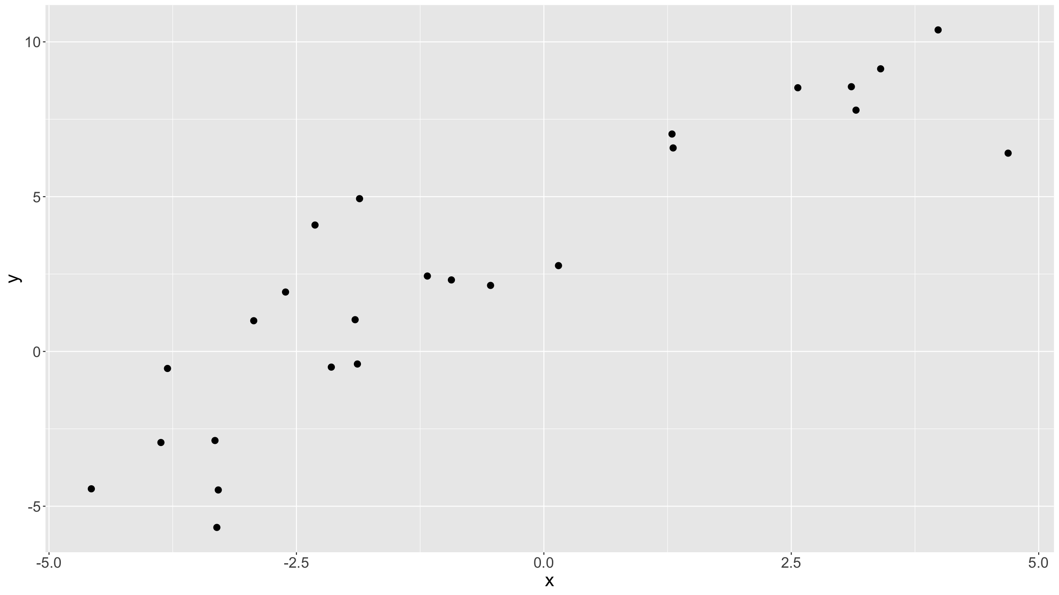
Regression modelling
Linear model
Let’s suppose we have some data:
df<-tibble( x=runif(25,min=-5,max=5), y=1.5*x+rnorm(25,sd=2)+3.5 ) ggplot(data=df,aes(x=x,y=y)) + geom_point(size=3) + theme(text = element_text(size=20))

Slide 94
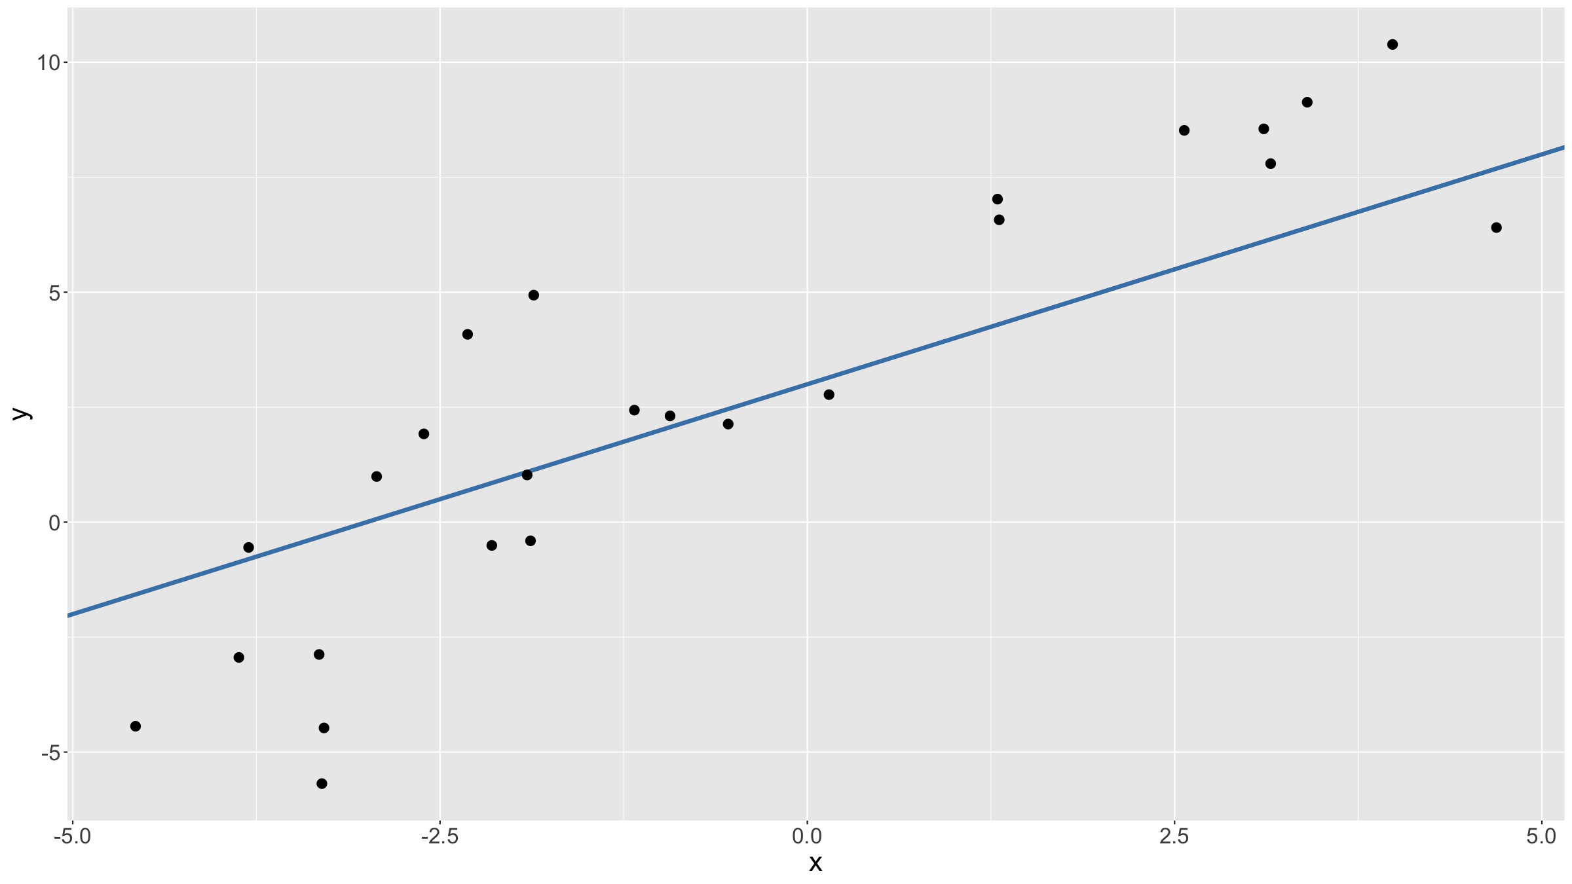
Regression modelling
Linear model
Looks like there is a linear relationship between the 2 variables:
as $x↗$, so $y↗$
We can try to guess what that relationship is.
E.g. we can guess $y≈x+3$:
ggplot(data=df,aes(x=x,y=y)) + geom_abline(intercept=3,slope=1,colour="steelblue",lwd=1.5) + geom_point(size=3) + theme(text = element_text(size=20))

Slide 95
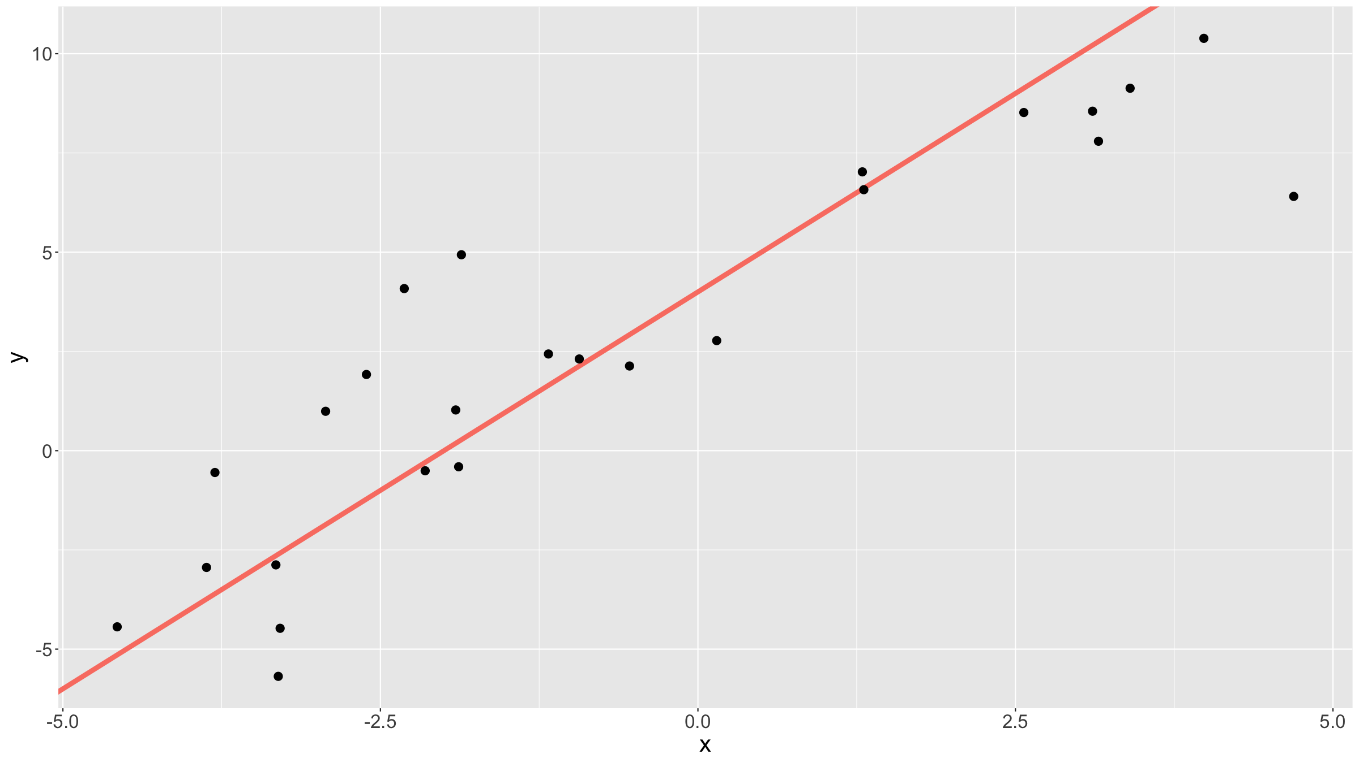
Regression modelling
Linear model
Looks good? Maybe the slope should be a bit steeper, the intercept larger?
$y≈2x+4$
ggplot(data=df,aes(x=x,y=y)) + geom_abline(intercept=4,slope=2,colour="salmon",lwd=2) + geom_point(size=3) + theme(text = element_text(size=20))

Slide 96
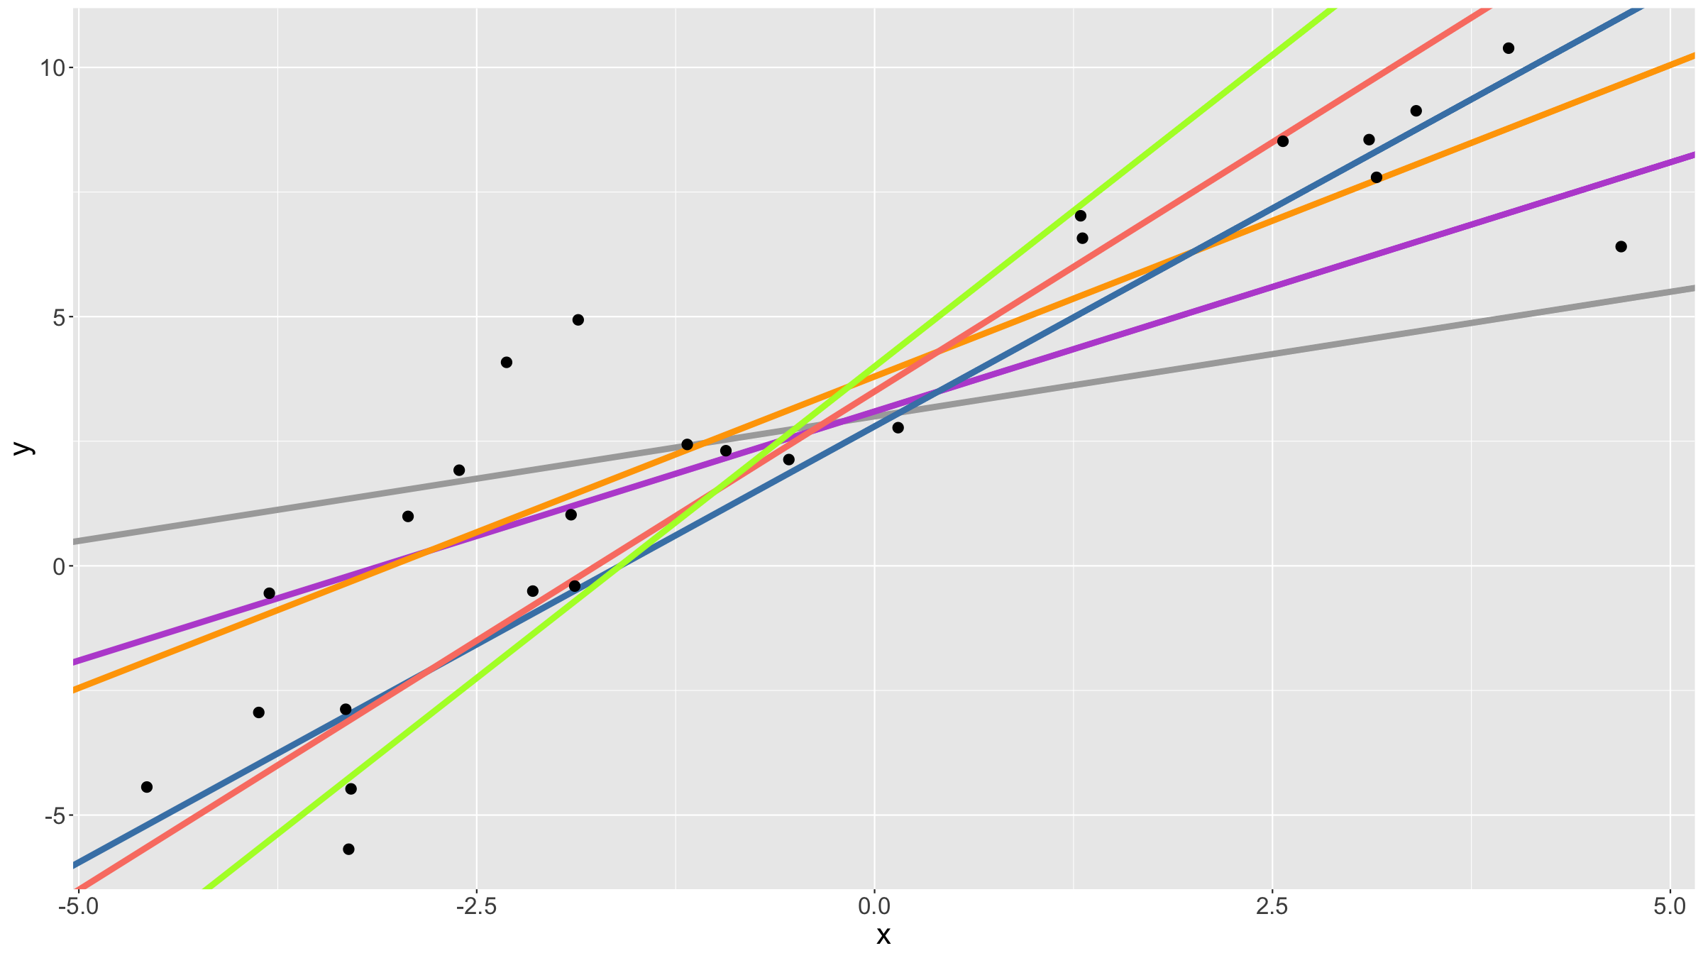
Regression modelling
Linear model
Which line to pick?
ggplot(data=df,aes(x=x,y=y)) + geom_abline(intercept=3,slope=0.5,colour="darkgrey",lwd=2) + geom_abline(intercept=3.1,slope=1,colour="mediumorchid",lwd=2) + geom_abline(intercept=3.8,slope=1.25,colour="orange",lwd=2) + geom_abline(intercept=2.8,slope=1.75,colour="steelblue",lwd=2) + geom_abline(intercept=3.5,slope=2,colour="salmon",lwd=2) + geom_abline(intercept=4,slope=2.5,colour="greenyellow",lwd=2) + geom_point(size=3) + theme(text = element_text(size=20))

Slide 97
Regression modelling
Linear model
We can try to minimize the errors, i.e. the deviations of the observed data from the line. Specifically, since these errors can be positive or negative, we can try to minimise the sum of the squares of the errors.
This is the principle of least squares (LS).
Let ${\hat{y}}_{i}=β_{0}+β_{1}x_{i}$.
We want to find values for $β_{0},β_{1}$ so that
SS=i​yi−yi2=i​yi−β0−β1xi2
is the smallest / minimum it can be.

Slide 98
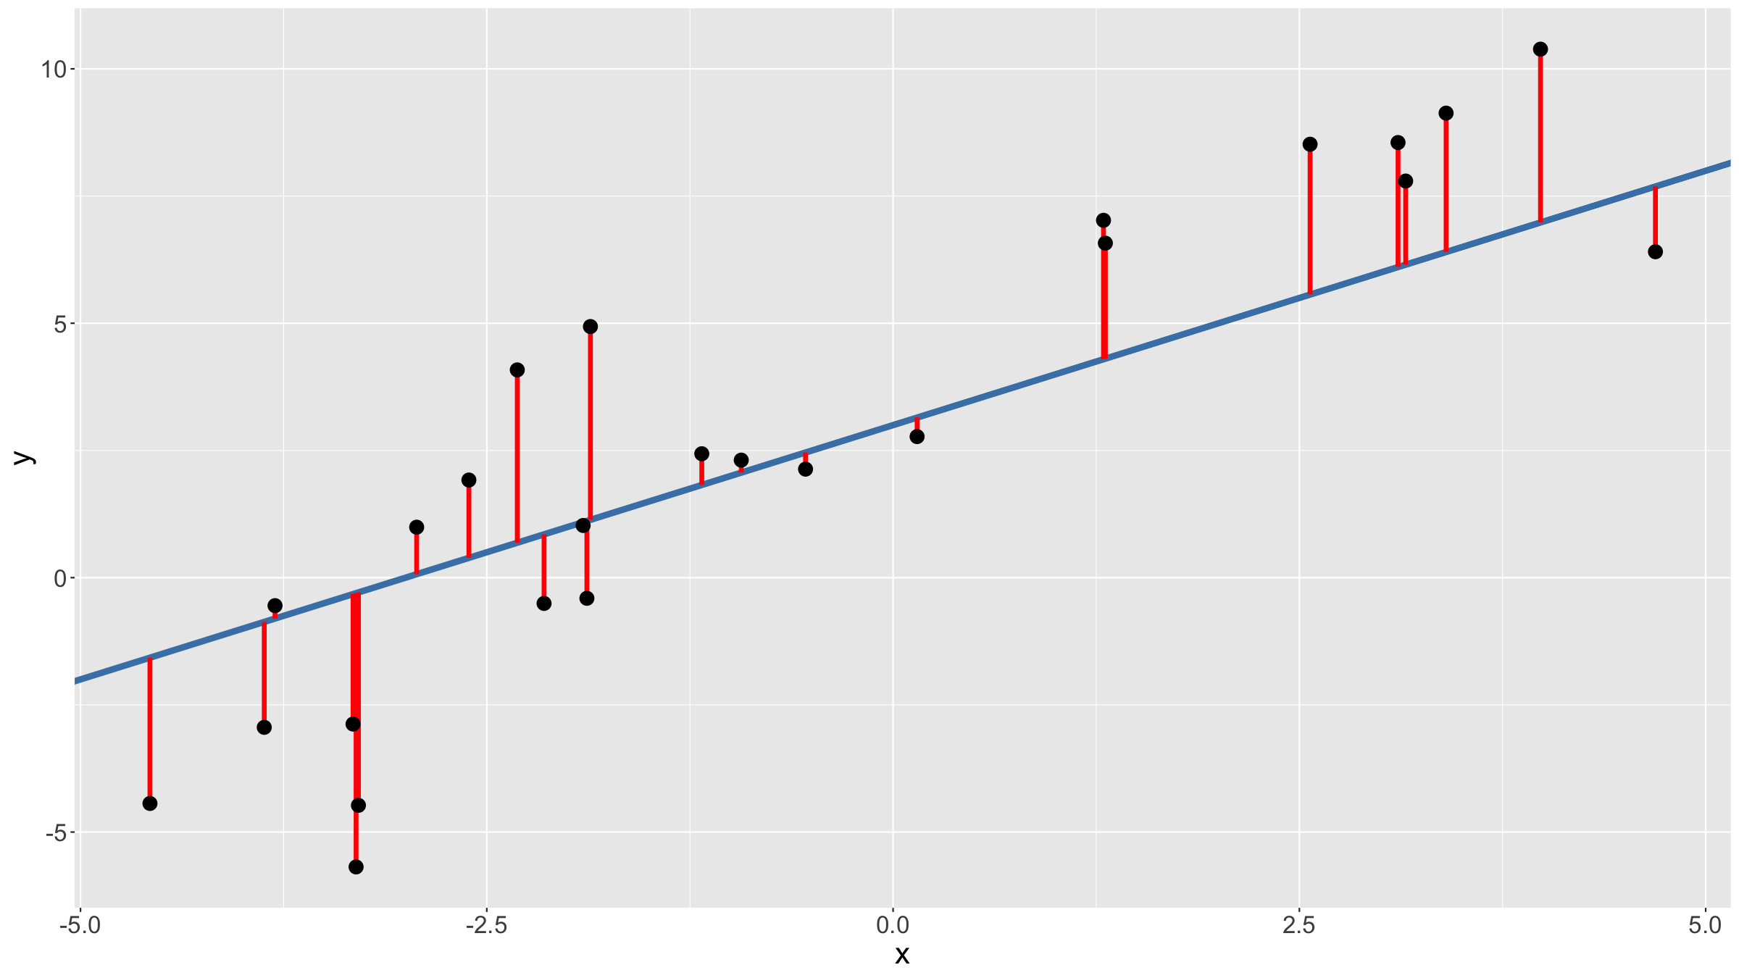
Regression modelling
Linear model
ggplot(data=df,aes(x=x,y=y)) + geom_abline(intercept=3,slope=1,colour="steelblue",lwd=2) + geom_segment(aes(x=x,xend=x,y=y,yend=x+3),colour="red",lwd=1.5) + geom_point(size=4) + theme(text = element_text(size=20))

Slide 99
Regression modelling
Linear model
We can fit this model in R by using the R function lm (or glm).
mod<-lm(y~x,data=df) print(mod) ## ## Call: ## lm(formula = y ~ x, data = df) ## ## Coefficients: ## (Intercept) x ## 3.603 1.485

Slide 100
Regression modelling
Linear model
We can get more information by typing summary(mod).
You get the same results by using glm rather than lm.

Slide 101
Regression modelling
Linear model
What we have done, is fit a linear model.
$$y_{i}=β_{0}+β_{1}x_{i}+ϵ_{i}$$
In other words, for a dependent variable $Y$ and an independent variable $X$ we hypothesise there is a model
$$Y=β_{0}+β_{1}X+ϵ$$
where $ϵ$ is a random variable.
Note that by using least squares we only fit a function to data as best as we can.
We don’t make any distributional assumptions about $Y$ or $ϵ$.

Slide 102
Regression modelling
Linear model
Parameter interpretation:
${\hat{β}}_{0}$ is the estimated intercept of the fitted regression line; it is the value predicted for $Y$ when $X=0$
${\hat{β}}_{1}$ is the estimated slope of the fitted regression line; it gives by how much $Y$ changes, on average, for every increase in $X$ by 1

Slide 103
Regression modelling
Linear model
The coefficient of determination $R^{2}$ gives the proportion of the variation that is explained by the regression model.
In the case of a single predictor $X$, $R^{2}$ is also the squared sample correlation coefficient $ρ\left(y,x\right)$ between the observed $y$ and $x$.

Slide 104
Regression modelling
Simple linear regression
So far we just fitted a line. Implicitly we made the following assumptions:
The data used to fit the model are representative of the underlying population.
The true relationship between $X$ and $Y$ is linear.
If we want to make statistical inference about any of the parameters in the model, we need to make additional assumptions:
The random error $ϵ∼N\left(0,σ^{2}\right)$ - specifically this implies that the residuals $ϵ_{i}$ are homoscedastic (have equal variance).
The observations $y_{i}$ are independent given the $x_{i}$ - in other words the residuals $ϵ_{i}$ are independent.

Slide 105
Regression modelling
Simple linear regression
Once we have made these assumptions, we can do statistical tests:
Test if $β_{1}=0$?
Test if the population correlation parameter $ρ=0$
The above 2 tests are in fact equal (in a model with a single predictor).
We can also test if the intercept $β_{0}=0$ (or some other value), but this test is usually not sensible as $β_{0}$, the average value of $Y$ if $X=0$, has, in most situations, little more meaning than providing a numerical scale for the observed values.

Slide 106
Regression modelling
Simple linear regression
By assuming $ϵ_{i}∼N\left(0,σ^{2}\right)$, we can also compute the model likelihood:
Lβ0,β1=i​ϕyi−β0−β1xi|0,σ2
where $ϕ\left(.|μ,σ^{2}\right)$ is the probability density function for a normal distribution with mean $μ$ and variance $σ^{2}$.
We can find values ${\hat{β}}_{0}′$ and ${\hat{β}}_{1}′$ that maximise $L\left(β_{0},β_{1}\right)$.
This is the principle of maximum likelihood estimation (MLE).

Slide 107
Regression modelling
Simple linear regression
One can show that the MLE estimators are equal to the OLS estimators, i.e. ${\hat{β}}_{0}′={\hat{β}}_{0}$ and ${\hat{β}}_{1}′={\hat{β}}_{1}$.
Notes:
This may be surprising, since we had to make additional assumptions to be able to write down the likelihood function.
In practice, fitting software minimise the negative log likelihood rather than maximising the likehihood.

Slide 108
Regression modelling
Simple linear regression
Once you fitted a model, you can predict new data, e.g. in the case of a linear model:
$${\hat{y}}_{new}={\hat{β}}_{0}+{\hat{β}}_{1}x_{new}$$
An important special case for diagnostic puposes is to predict the fitted value of your dataset:
$${\hat{y}}_{i}={\hat{β}}_{0}+{\hat{β}}_{1}x_{i}$$
This allows you to compute the residuals:
$$r_{i}=y_{i}−{\hat{y}}_{i}$$

Slide 109
Regression modelling
Simple linear regression
2 main reasons for computing residuals:
Adjustment: eliminate a nuisance parameter; e.g. blood pressure adjusted for age, weight adjusted for height, …
Model diagnostics: residuals are quite useful for checking model assumptions, identifying influential observations etc. (more later).
In practice, in R you use the predict() function to predict new data.

Slide 110
Regression modelling
Simple linear regression – PRACTICAL
Using the adolescent_small.csv data from earlier (object dfAdo):
Fit a linear model regressing weight (variable a104wt) on age (variable a12age).
Summarise the model fit.
Plot the model fit, including confidence bands.

Slide 111
Regression modelling
Simple linear regression – PRACTICAL
mod1<-glm(a104wt~a12age,data=dfAdo) summary(mod1) ## ## Call: ## glm(formula = a104wt ~ a12age, data = dfAdo) ## ## Deviance Residuals: ## Min 1Q Median 3Q Max ## -26.1077 -6.5219 -0.3766 6.1234 29.1485 ## ## Coefficients: ## Estimate Std. Error t value Pr(>|t|) ## (Intercept) -12.2481 3.0327 -4.039 7.05e-05 *** ## a12age 3.5562 0.2213 16.067 < 2e-16 *** ## --- ## Signif. codes: 0 '***' 0.001 '**' 0.01 '*' 0.05 '.' 0.1 ' ' 1 ## ## (Dispersion parameter for gaussian family taken to be 95.29828) ## ## Null deviance: 49760 on 265 degrees of freedom ## Residual deviance: 25159 on 264 degrees of freedom ## (35 observations deleted due to missingness) ## AIC: 1971 ## ## Number of Fisher Scoring iterations: 2

Slide 112
Regression modelling
Simple linear regression – PRACTICAL
dfNew<-data.frame( a12age=seq(9,19,by=0.01) ) dfNew<-dfNew %>% dplyr::mutate( a104wt=predict(object=mod1,newdata=dfNew,type="response"), a104wtSE=predict(object=mod1,newdata=dfNew,type="response",se.fit=TRUE)$se.fit ) %>% dplyr::mutate( a104wtLow=a104wt-1.96*a104wtSE, a104wtUpp=a104wt+1.96*a104wtSE )

Slide 113
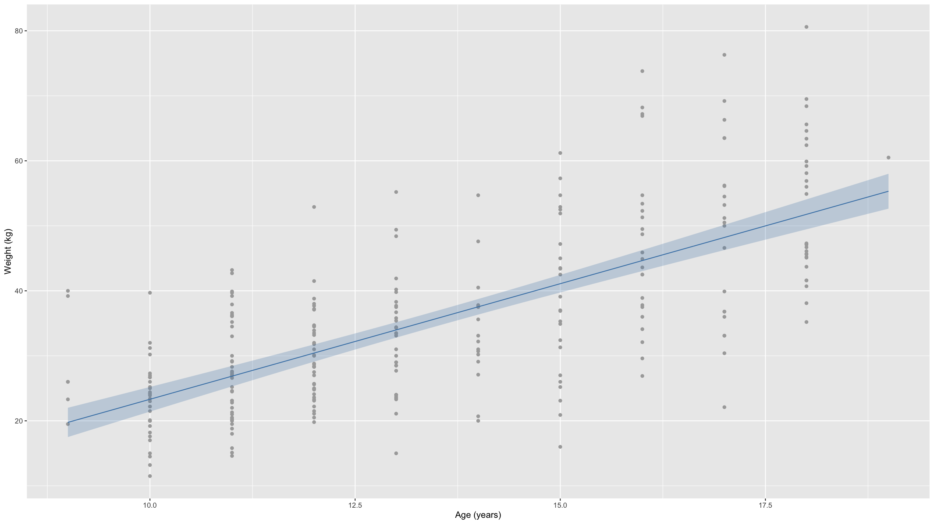
Regression modelling
Simple linear regression – PRACTICAL
ggplot(data=dfAdo,mapping=aes(x=a12age,y=a104wt)) + geom_point(col="darkgrey") + geom_line(col="steelblue",data=dfNew) + geom_ribbon(fill="steelblue",alpha=0.25,mapping=aes(min=a104wtLow,max=a104wtUpp),data=dfNew) + xlab("Age (years)") + ylab("Weight (kg)") ## Warning: Removed 35 rows containing missing values (`geom_point()`).

Slide 114
Regression modelling
Model diagnostics
Model diagnostics: why do it?
There is a very simple & good reason: if the data violate the model assumptions, then all the inferential results we derived (coverage of CIs, p-values, …) no longer hold – we cannot really say anything about the process that generated the data from our model and the model predictions are likely to be very wrong.
The point of model diagnostics is to check that the model assumptions appear to be met.
There are several checks that can be done. For each check, We will first discuss the case of the general linear model, then move on to generalised linear models.

Slide 115
Regression modelling
Model diagnostics
Let’s fit two linear models to the birth weight data:
modBW_Mppwt<-glm(Birthweight~mppwt,data=dfBw) modBW_GestMppwt<-glm(Birthweight~Gestation+mppwt,data=dfBw)

Slide 116
Regression modelling
Model diagnostics
You have fitted GLM models. How do we know either is any good?
Goodness of fit?
Visual check
$R^{2}$, $R_{adj}^{2}$
AIC, BIC
Residuals?
QQ plot
Residuals vs. predicted values
Hat values, Cook’s distance

Slide 117
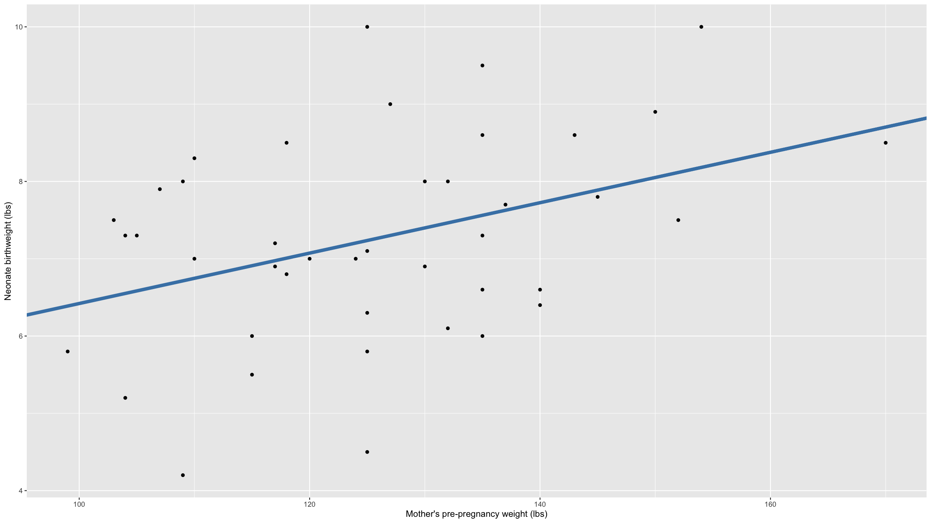
Regression modelling
Model diagnostics – Goodness of fit
Visual checks
These work well for simple models with only one or a limited number of predictors.
Conceptually simple: just plot response vs. prdictor and add a line for the model fit.
Same for general & generalised linear models.
ggplot(data=dfBw,mapping=aes(x=mppwt,y=Birthweight)) + geom_point() + geom_abline(intercept=coef(modBW_Mppwt)[1], slope=coef(modBW_Mppwt)[2], col="steelblue", lwd=2) + xlab("Mother's pre-pregnancy weight (lbs)") + ylab("Neonate birthweight (lbs)")

Slide 118
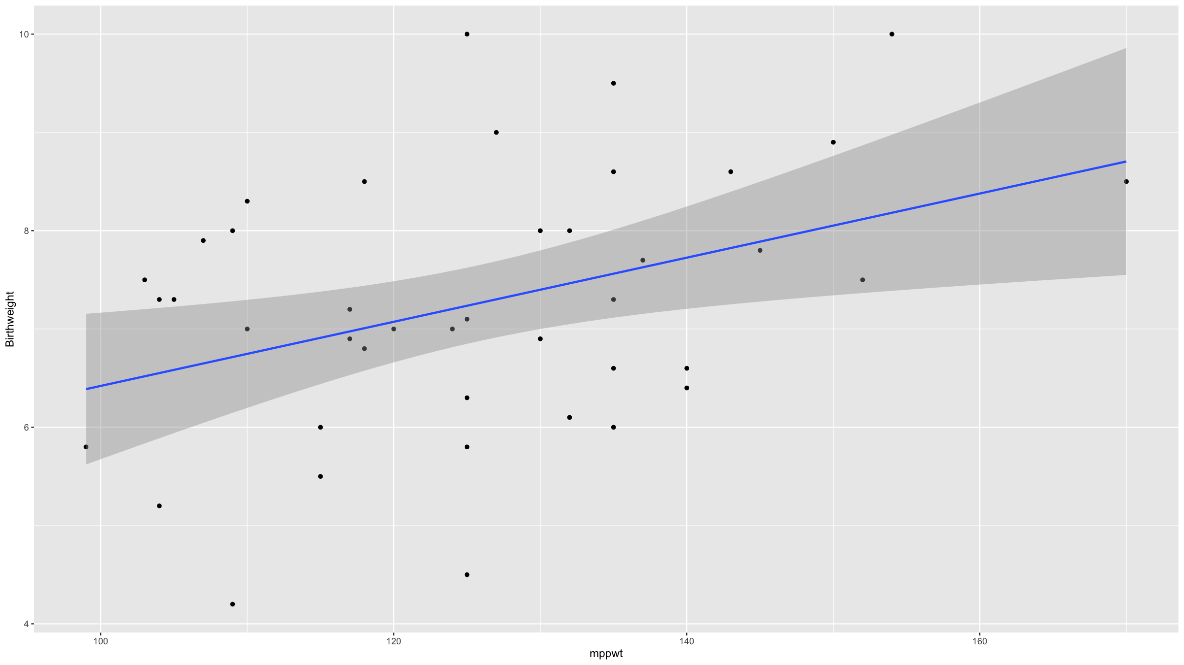
Regression modelling
Model diagnostics – Goodness of fit
Same thing…
ggplot(data=dfBw,mapping=aes(x=mppwt,y=Birthweight)) + geom_point()+ geom_smooth(method="lm") ## `geom_smooth()` using formula = 'y ~ x'

Slide 119
Regression modelling
Model diagnostics – Goodness of fit
We have already seen $R^{2}$, the coefficient of determination. It can be interpreted as the proportion of variance explained by the model.
It is not wise to maximise $R^{2}$: you will end up with overfitted models with many parameters.
The adjusted $R^{2}$,
$$R_{adj}^{2}=1−\left(1−R^{2}\right)\frac{n−1}{n−p−1}$$
is penalised for the number of parameters in the model.

Slide 120
Regression modelling
Model diagnostics – Goodness of fit
When maximum likelihood is used, you can also consider the likelihood itself as a measure of (relative) goodness of fit.
Again: better to penalise for the number of parameters in the model.
Akaike Information Criterion (AIC)
$$2⋅\left(p+1\right)−2⋅\text{ln}\left(\hat{L}\right)$$
Bayesian Information Criterion (BIC)
$$\text{ln(n)}⋅\left(p+1\right)−2⋅\text{ln}\left(\hat{L}\right)$$

Slide 121
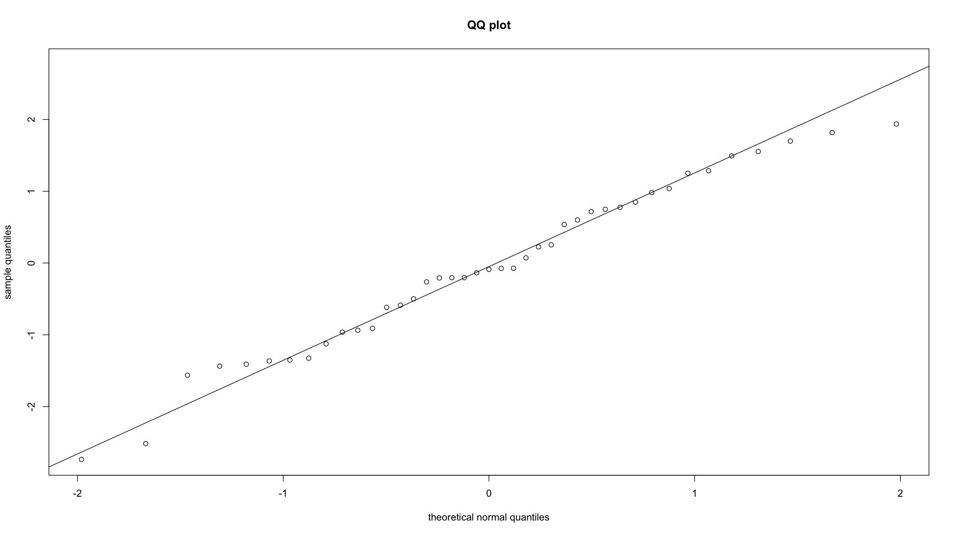
Regression modelling
Model diagnostics – QQ plot
Plots the empirical quantiles of the residuals against those from a normal distribution. If the residuals are normally distributed (model assumption), these should line on a straight line.
rmodBW<-residuals(modBW_Mppwt) theoQ<-qnorm(order(order(rmodBW))/length(rmodBW)) # calculates theorectical normal quantiles plot(theoQ,rmodBW, xlab="theoretical normal quantiles", ylab="sample quantiles", main="QQ plot") qqline(rmodBW) # just adds the line

Slide 122
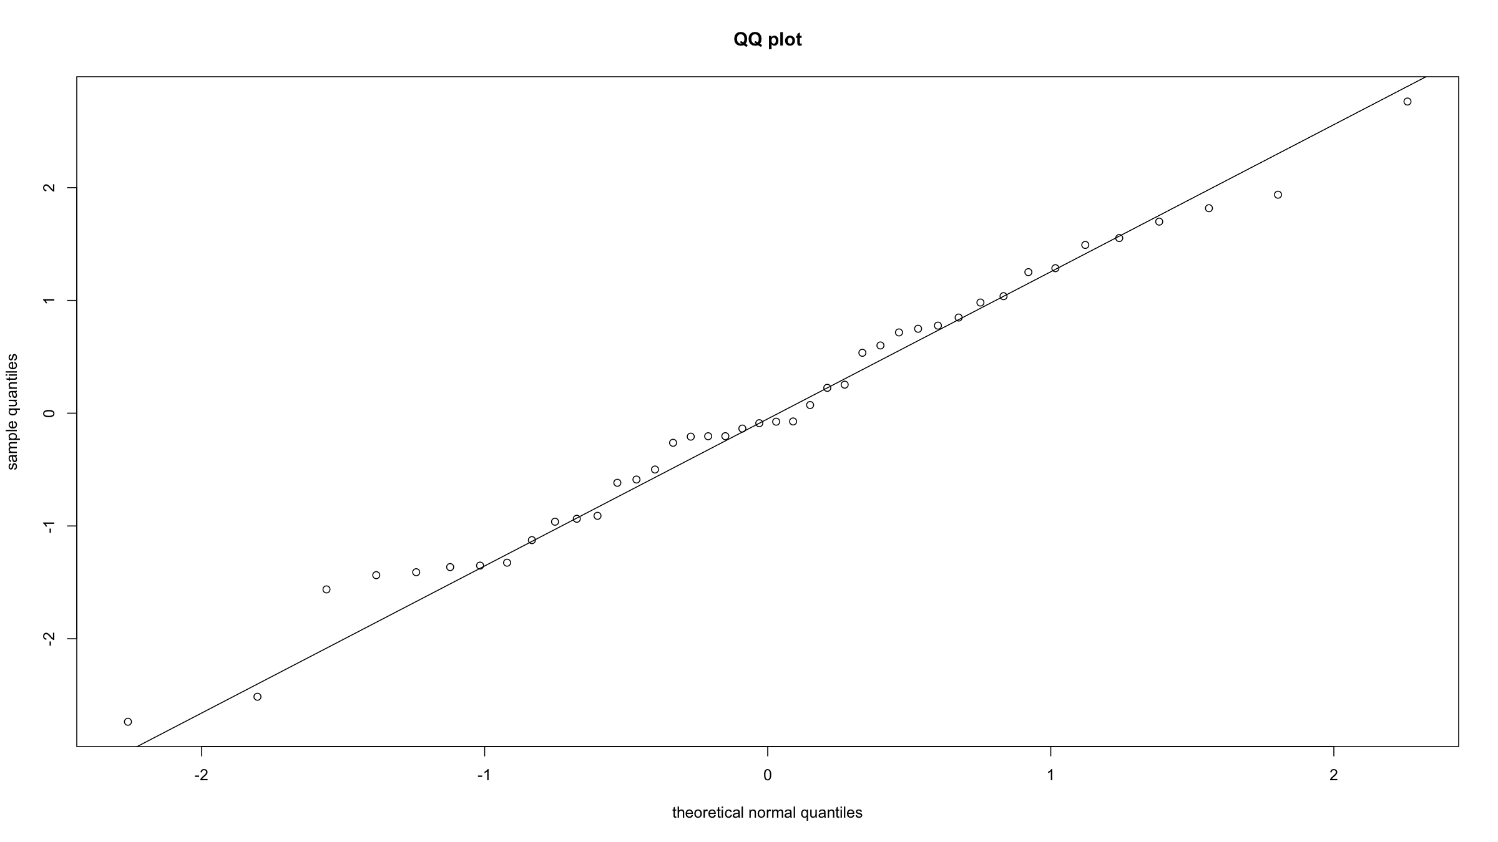
Regression modelling
Model diagnostics – QQ plot
This would also work:
qqnorm(rmodBW, xlab="theoretical normal quantiles", ylab="sample quantiles", main="QQ plot") qqline(rmodBW)

Slide 123
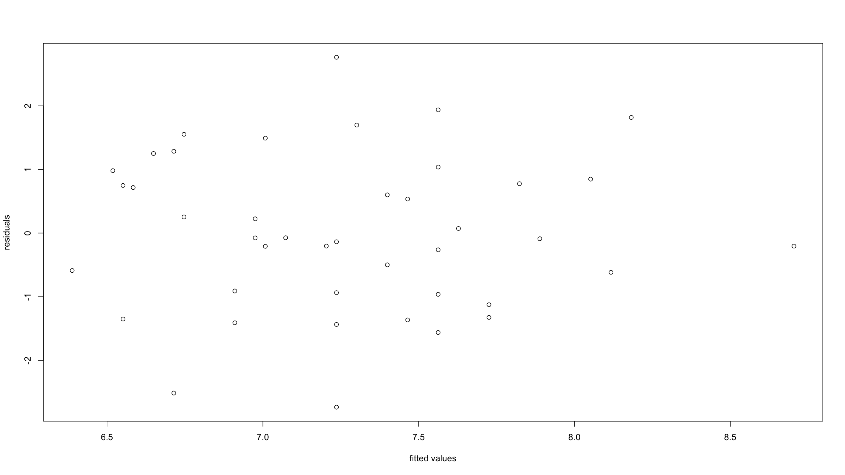
Regression modelling
Model diagnostics – Residuals vs. predicted values
You can easily (though subjectively) verify whether:
residuals centered symmetrically around 0
residuals have constant variance
there are any outliers
plot(predict(modBW_Mppwt,data=dfBw),residuals(modBW_Mppwt), xlab="fitted values", ylab="residuals")

Slide 124
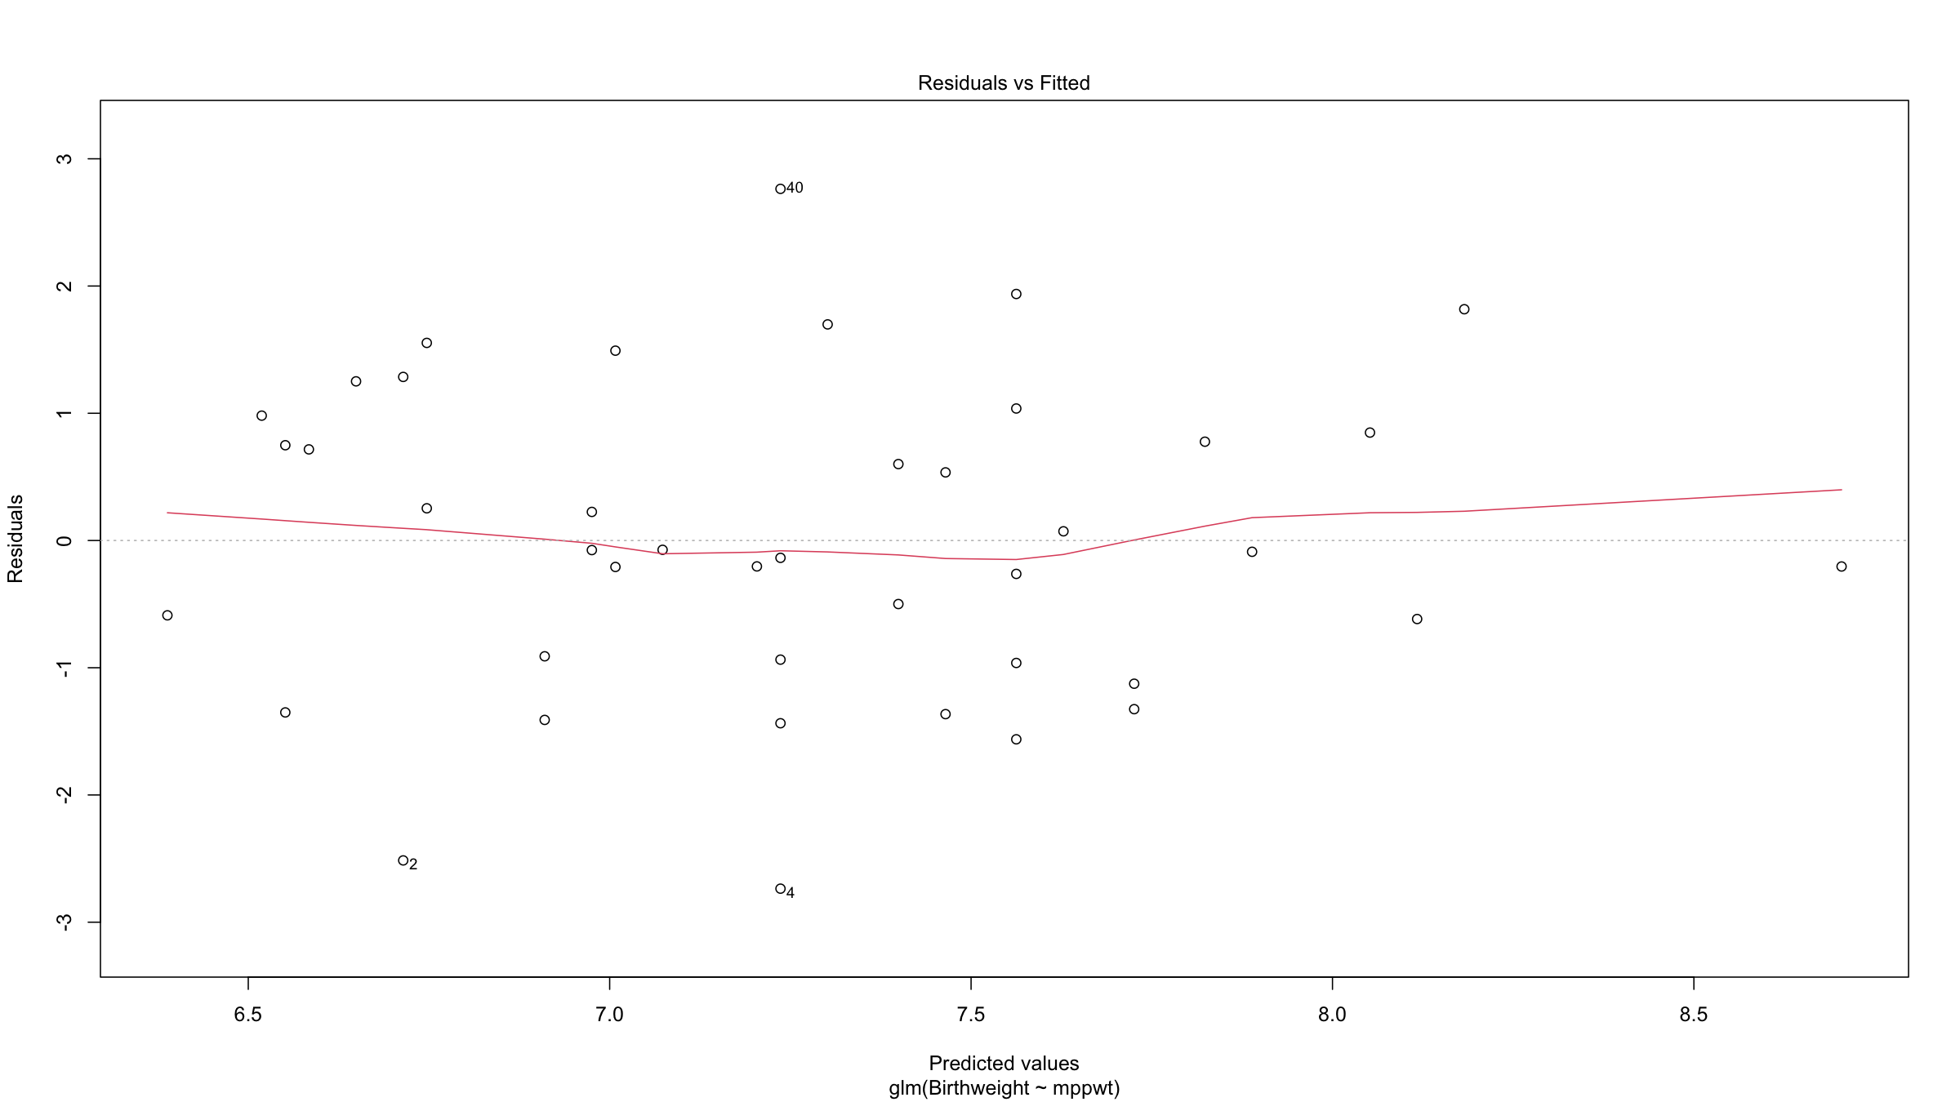
Regression modelling
Model diagnostics
Typing plot(modBW_Mppwt) will produce a set of diagnostic graphs (we have not the time to cover everything here) diagnostic graphs.
plot(modBW_Mppwt)

Slide 125
Regression modelling
Model diagnostics – Influential observations
An influential observation is an observation which, if dropped from the dataset when fitting the model, would noticeably affect the model parameter estimates.
We have already alluded to one type of such influential observations: observations with high leverage - large residuals near the extremes of the predictor variables’ ranges.
There are many methods, most based on re-fitting models while leaving out individual observations. We will focus on 2 metrics: hat values (measuring leverage of observations) and Cook’s distance (measuring influence).

Slide 126
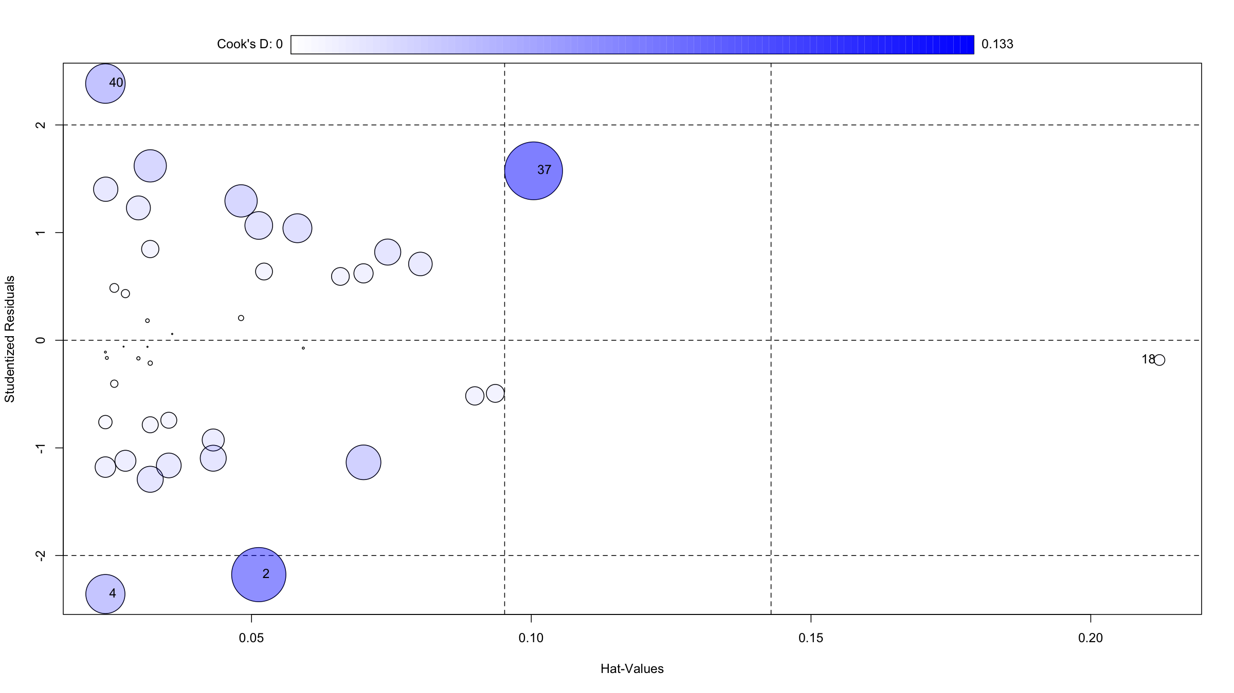
Regression modelling
Model diagnostics – Influential observations
The R package car has a helpful plotting function for plotting both the hat values and Cook’s D (and also studentised residuals). Cook’s D is given by the size of the circles.
library(car) influencePlot(modBW_Mppwt)

Slide 127
## StudRes Hat CookD ## 2 -2.1771480 0.05129374 0.11718176 ## 4 -2.3575737 0.02388058 0.06103449 ## 18 -0.1834157 0.21227697 0.00464508 ## 37 1.5738906 0.10041359 0.13332758 ## 40 2.3845565 0.02388058 0.06226080

Slide 128
Regression modelling
GLM
What we have seen so far is the linear model, also known as simple linear regression in the case where we make no assumptions about the distribution of the errors:
$$Y=β_{0}+β_{1}X+ϵ$$
where $ϵ∼N\left(0,σ^{2}\right)$
This can be generalised:
multiple predictors, both numerical and/or categorical: general linear model
non-normal error + link function: generalised linear model (GLM)
The general linear model includes both simple and multiple linear regression as well as AN(C)OVA (with fixed effects only) models.

Slide 129
Regression modelling
GLM
Note that
$$Y=β_{0}+β_{1}X_{1}+…+β_{p}X_{p}+ϵ$$
Can also be written as a conditional expectation:
$$E\left[Y|X\right]=β_{0}+β_{1}X_{1}+…+β_{p}X_{p}$$

Slide 130
Regression modelling
GLM
The GLM relates outcomes variables $Y$ to predictor variables $X$ via
$$E\left(Y|X\right)=g^{−1}\left(β_{0}+β_{1}X_{1}+…+β_{p}X_{p}\right)=g^{−1}\left(Xβ\right)$$
Specifically the GLM consists of 3 things:
$Y∼F$ where $F$ is an exponential family distribution mith mean $μ$
a linear predictor $η=Xβ$
a link function g(), linking $μ$, $η$: $g\left(μ\right)=η$
(Note the use of simplified, matrix notation here.)

Slide 131
Regression modelling
Logistic regression
Now suppose our response $Y$ is a binary variable, and suppose we have a single predictor variable $X$.
Obviously this will have a Bernoulli / binomial distribution: no problem for the GLM.
Our model:
$$E\left[Y|X\right]=P\left(Y|X\right)=g^{−1}\left(β_{0}+β_{1}X\right)$$
For the link function we will take $g\left(x\right)=log\left(x/\left(1−x\right)\right)$, the logit function.
This yields the logistic regression model:
$$\text{logit}\left(E\left[Y|X\right]\right)=β_{0}+β_{1}X$$
A one unit change in X will result in the log of a ratio of odds, i.e. $e^{β_{1}}$ will be the odds ratio associated with a one unit change in X.
Logistic regression is a direct probability model: no distributional assumptions beyond the fact that we assume individual events to be the result of a probability.

Slide 132
Regression modelling
Logistic regression
Example
Let’s fit a model to the birth weight data, using the variable lowbt (binary variable indicating low birth weight) as the response variable.
modLowBirthWeight<-glm(lowbwt~Gestation,data=dfBw,family=binomial) # family=binomial("logit") also works summary(modLowBirthWeight) ## ## Call: ## glm(formula = lowbwt ~ Gestation, family = binomial, data = dfBw) ## ## Deviance Residuals: ## Min 1Q Median 3Q Max ## -1.8376 -0.3269 -0.2125 -0.1009 2.4314 ## ## Coefficients: ## Estimate Std. Error z value Pr(>|z|) ## (Intercept) 31.3127 11.3145 2.767 0.00565 ** ## Gestation -0.8773 0.3046 -2.880 0.00398 ** ## --- ## Signif. codes: 0 '***' 0.001 '**' 0.01 '*' 0.05 '.' 0.1 ' ' 1 ## ## (Dispersion parameter for binomial family taken to be 1) ## ## Null deviance: 34.450 on 41 degrees of freedom ## Residual deviance: 18.025 on 40 degrees of freedom ## AIC: 22.025 ## ## Number of Fisher Scoring iterations: 6

Slide 133
Regression modelling
Logistic regression
Example
round(digits=2,cbind( exp(coef(modLowBirthWeight)), exp(confint(modLowBirthWeight)) )) ## Waiting for profiling to be done... ## 2.5 % 97.5 % ## (Intercept) 3.971124e+13 501487.34 1.146583e+26 ## Gestation 4.200000e-01 0.19 6.800000e-01

Slide 134
Regression modelling
Poisson regression
If $Y$ is a counting variable, then the Poisson distribution for $Y$ can be useful.
In Poisson regression, the log link is used:
$$log\left(E\left[Y|X\right]\right)=β_{0}+β_{1}X$$
or equivalently
$$E\left[Y|X\right]=e^{β_{0}+β_{1}X}$$
$β_{1}$ represents the increase in log event rate associated with a one unit change in $X$ (and $e^{β_{1}}$ is the rate ratio associated with a one unit change in $X$).
In Poisson regression, one often specifies an offset. This is a covariate the coefficient of which is fixed to be 1. This effectively serves as a denominator for the rate parameter: $β_{1}$ is the event rate per unit of the offset.

Slide 135
Regression modelling
Poisson regression
Example
library(pscl) # install.packages("pscl") ## Classes and Methods for R developed in the ## Political Science Computational Laboratory ## Department of Political Science ## Stanford University ## Simon Jackman ## hurdle and zeroinfl functions by Achim Zeileis data(prussian) # data on deaths from horse kicks in the Prussian army (famous example of a Poisson process) modPrus<-glm(y~year+as.factor(corp),data=prussian,family=poisson) # family=poisson(link="log") also works

Slide 136
Regression modelling
Poisson regression
Example
summary(modPrus) ## ## Call: ## glm(formula = y ~ year + as.factor(corp), family = poisson, data = prussian) ## ## Deviance Residuals: ## Min 1Q Median 3Q Max ## -1.6887 -1.1077 -0.8035 0.5348 2.0810 ## ## Coefficients: ## Estimate Std. Error z value Pr(>|z|) ## (Intercept) -1.815e+00 1.087e+00 -1.669 0.0951 . ## year 1.876e-02 1.243e-02 1.510 0.1312 ## as.factor(corp)I 3.850e-09 3.535e-01 0.000 1.0000 ## as.factor(corp)II -2.877e-01 3.819e-01 -0.753 0.4512 ## as.factor(corp)III -2.877e-01 3.819e-01 -0.753 0.4512 ## as.factor(corp)IV -6.931e-01 4.330e-01 -1.601 0.1094 ## as.factor(corp)IX -2.076e-01 3.734e-01 -0.556 0.5781 ## as.factor(corp)V -3.747e-01 3.917e-01 -0.957 0.3387 ## as.factor(corp)VI 6.062e-02 3.483e-01 0.174 0.8618 ## as.factor(corp)VII -2.877e-01 3.819e-01 -0.753 0.4512 ## as.factor(corp)VIII -8.267e-01 4.532e-01 -1.824 0.0681 . ## as.factor(corp)X -6.454e-02 3.594e-01 -0.180 0.8575 ## as.factor(corp)XI 4.463e-01 3.202e-01 1.394 0.1633 ## as.factor(corp)XIV 4.055e-01 3.227e-01 1.256 0.2090 ## as.factor(corp)XV -6.931e-01 4.330e-01 -1.601 0.1094 ## --- ## Signif. codes: 0 '***' 0.001 '**' 0.01 '*' 0.05 '.' 0.1 ' ' 1 ## ## (Dispersion parameter for poisson family taken to be 1) ## ## Null deviance: 323.23 on 279 degrees of freedom ## Residual deviance: 294.81 on 265 degrees of freedom ## AIC: 629.89 ## ## Number of Fisher Scoring iterations: 5

Slide 137
[end of Session 2]

