Slide 1
Statistics and R short course
James Chirombo & Marc Henrion

Slide 2
Session 6: Basic regression modelling II

Slide 3
Preliminaries
Certificates of attendance
You need to attend the first 7 sessions.
Sign in & check spelling of name on the sign-in sheet!
Only issued if paid-up and in exchange for completed feedback form.
Participant packs (copy of slides, R code etc.)
https://github.com/mlw-stats/R_And_Statistics_Training_2020
Housekeeping
Covid-19 measures
Refreshments
Fire exits
Bathrooms
RStudio Cloud
Have you paid up?

Slide 4
Notation
$X,Y$ - random variables (here: X = predictor, Y = response)
$x,y$ - measured / observed values
$ϵ$ - random variable (here: error / residual)
$θ$ - a vector of parameters
$\overset{‾}{X}$, $\overset{‾}{Y}$ - sample mean estimators for X, Y
$\overset{‾}{x}$, $\overset{‾}{y}$ - sample mean estimates of X, Y
$\hat{T}$, $\hat{t}$ - given a statistic T, estimator and estimate of T
$P(A)$ - probability of an event A occuring
$f_{X}(.)$, $f_{Y}(.)$ - distribution mass / density functions of X, Y
$X∼F$ - X distributed according to distribution function F
$E[X]$, $E[Y]$, $E[T]$ - the expectation of X, Y, T respectively

Slide 5
Packages
Install the following packages:
install.packages(c("nlme","lme4","gee","rms","car","Hmisc")
Then load them
library(nlme) library(lme4) library(gee) library(rms) library(Hmisc)
Also download the datasets cholDiet.csv, and adlescent_small.csv from GitHub.

Slide 6
GLM notes

Slide 7
GLM notes: Interaction terms
Consider the model
$$Y=β_{0}+β_{1}\text{ age}+β_{2}\text{ male}+β_{3}\text{ male}⋅\text{ age}+ϵ$$
If you are female, the effect on $Y$ for age is $β_{1}$.
If you are male, the effect on $Y$ for age is $β_{1}+β_{3}$.
This is an interaction effect: age and sex are not independent. There are different slopes for age, depending on your sex.
You can have interaction terms for 2 categorical variables, 1 categorical & 1 continuous, 2 continuous variables.
Interpretation becomes more difficult.
Always include both individual terms!

Slide 8
GLM notes: Interaction terms
Example
ado<-read.csv("adolescent_small.csv") modWeightInt<-glm(a104wt~a12age*hiv,data=ado) summary(modWeightInt)$coefficients ## Estimate Std. Error t value Pr(>|t|) ## (Intercept) -12.202112 3.3080393 -3.688624 2.741478e-04 ## a12age 3.895924 0.2359772 16.509745 1.844004e-42 ## hivpositive 9.074343 5.1781378 1.752434 8.086903e-02 ## a12age:hivpositive -1.453828 0.3808874 -3.816950 1.686588e-04

Slide 9
GLM notes: Collinearity
If two predictors $X_{1},X_{2}$ are correlated, then estimation of the GLM can become difficult and interpretation of coefficients also becomes tricky.
The numerical instability comes from the fact that MLE will involve matrix inversion and this will become singular the more $X_{1}$ and $X_{2}$ are correlated.
Centering correlated variables will often help.
Best to avoid including collinear predictors.
Variance inflation factors (VIF) can help to spot multicollinearity and to remove problematic explanatory variables.

Slide 10
GLM notes: Collinearity
Consider the model:
$$Y=β_{0}+β_{1}X_{1}+β_{2}X_{2}+…+β_{k}X_{k}+ϵ (*)$$
The VIF for the $j^{th}$ predictor variable is given by $VIF_{j}=1/(1−R_{j}^{2})$ where $R_{j}^{2}$ is the coefficient of determination of the model where $X_{j}$ is the response and all other explanatory variables in the model (*) are predictors.
If the $j^{t}h$ variable is independent of all other variables, then $R_{j}^{2}=0$ and $VIF_{j}=1$.
In practice (rule of thumb): $VIF>10$ = severe collinearity, $VIF>5$ = high collinearity.

Slide 11
GLM notes: Collinearity
In R: car::vif computes VIFs, but the function Hmisc::varclus can also be helpful.
ado$tmpVar<-ado$a103ht+rnorm(nrow(ado),sd=6) modWeightColl<-glm(a104wt~as.factor(a13sex)+a12age+a103ht+tmpVar,data=ado) car::vif(modWeightColl) ## Registered S3 methods overwritten by 'car': ## method from ## influence.merMod lme4 ## cooks.distance.influence.merMod lme4 ## dfbeta.influence.merMod lme4 ## dfbetas.influence.merMod lme4 ## as.factor(a13sex) a12age a103ht tmpVar ## 1.020445 2.207899 7.849973 7.273946

Slide 12
Notes: Variable selection
How to select variables for inclusion in a model?
This is not as trivial as it sounds. It is best to rely on expert knowledge and avoiding methods that are based on estimated effects / p-values such as
significant variables from single predictor regressions [the worst selection technique]
stepwise forwards selection
stepwise backwards selection [least bad as it involves at least a full model fot]
These methods are used (very) commonly, especially forwards selection, but violate many principles of statistical estimation and hypothesis testing.

Slide 13
Notes: Variable selection
The problems with these techniques (see Harrell, F., Regression Modelling Strategies, 2nd ed., 2015, Springer.):
Yield $R^{2}$ values that are biased high.
Ordinary F and $χ^{2}$ tests do not have the claimed distributions.
Standard errors of regression coefficients are biased low.
Resulting p-values are too small.
Regression coefficients are biased high.
Residual confounding is an issue.
Collinearity is not solved but exarcerbated by these techniques.

Slide 14
Notes: Variable selection
If you choose variables to keep in the model by their p-values, then use a high threshold, e.g. 0.5.
The best approach is to discuss a priori with experts in the field in which the data have been collected and ask them what should be included in the model. Then base your inference only on that single model you fitted. Keep variables even if they have non-significant coefficients. E.g. predictions can still benefit from non-significant variables in the model.
Regularisation techniques such as elastic net, ridge regression or the lasso have more desirable properties (but do not get around all problems). These methods put a penalty on the coefficients in the model and this either shrinks (ridge, L2 penalty) them or removes (lasso, L1 penalty) them from the model as the penalty is increased.

Slide 15
Notes: splines
Most relationships between variables are not linear.
Categorisation of a continuous predictor is often used to deal with such non-linearity. However, this is inefficient and leads to reduced power.
Transformations or polynomial terms ($X^{2}$, $X^{3}$ etc) can be used, but polynomials in particular have undesirable properties (peaks & valleys, points far away can have a large impact on the curve in another region, …).
Linear or cubic splines and Generalised Additive Models (GAMs) can provide very flexible ways to model data while still providing all the statistical inference machinery we have seen for GLMs.
geom_smooth() from ggplot2 uses GAMs for more than 1,000 observations (or when method="gam" is specified).

Slide 16
Notes: splines
A draftman’s spline is a flexible strip of wood or rubber to draw smooth curves (e.g. used by shipbuilders).
Mathematically, for a response $y$ and a predictor $x$, a linear spline with $k=3$ knots at locations $x=k_{1},k_{2},k_{3}$ can be written as:
$$y=β_{0}+β_{1}⋅x+β_{2}⋅(x−k_{1})_{+}+β_{3}⋅(x−k_{2})_{+}+β_{4}⋅(x−k_{3})_{+}+ϵ$$
where $(x)_{+}=x$ if $x≥0$ and $0$ otherwise.
This means that the fitted curve has different slopes in different intervals of values of $x$:

Slide 17
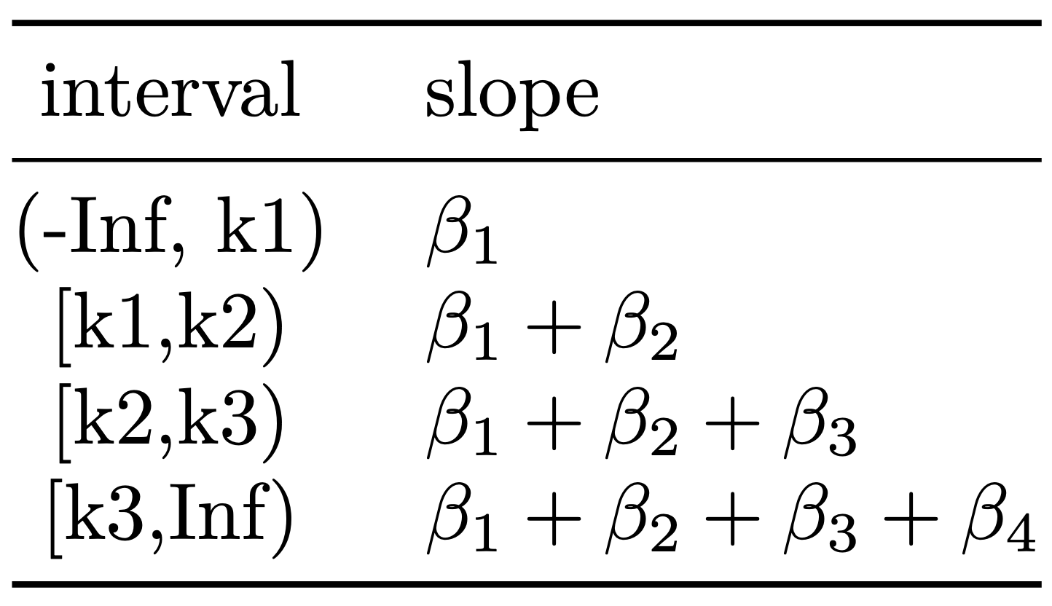

Slide 18
Notes: splines
x<-rnorm(100,mean=5,sd=2) y<-2+x-2*x^2+0.2*x^3+rnorm(100,sd=5) df<-data.frame(x,y) rm(x,y) modLsp<-glm(y~lsp(x,c(3,6)),data=df) # lsp() requires rms package newdf<-data.frame(x=df$x,predict.lm(modLsp,interval="confidence"))

Slide 19
Notes: splines
df %>% ggplot(mapping=aes(x=x,y=y)) + geom_point(size=3) + geom_line(data=newdf,mapping=aes(x=x,y=fit),col="orange",lwd=2) + geom_ribbon(data=newdf,mapping=aes(y=fit,ymin=lwr,ymax=upr),alpha=0.2) + geom_vline(xintercept=3,lty=2,col="darkgrey") + geom_vline(xintercept=6,lty=2,col="darkgrey")

Slide 20
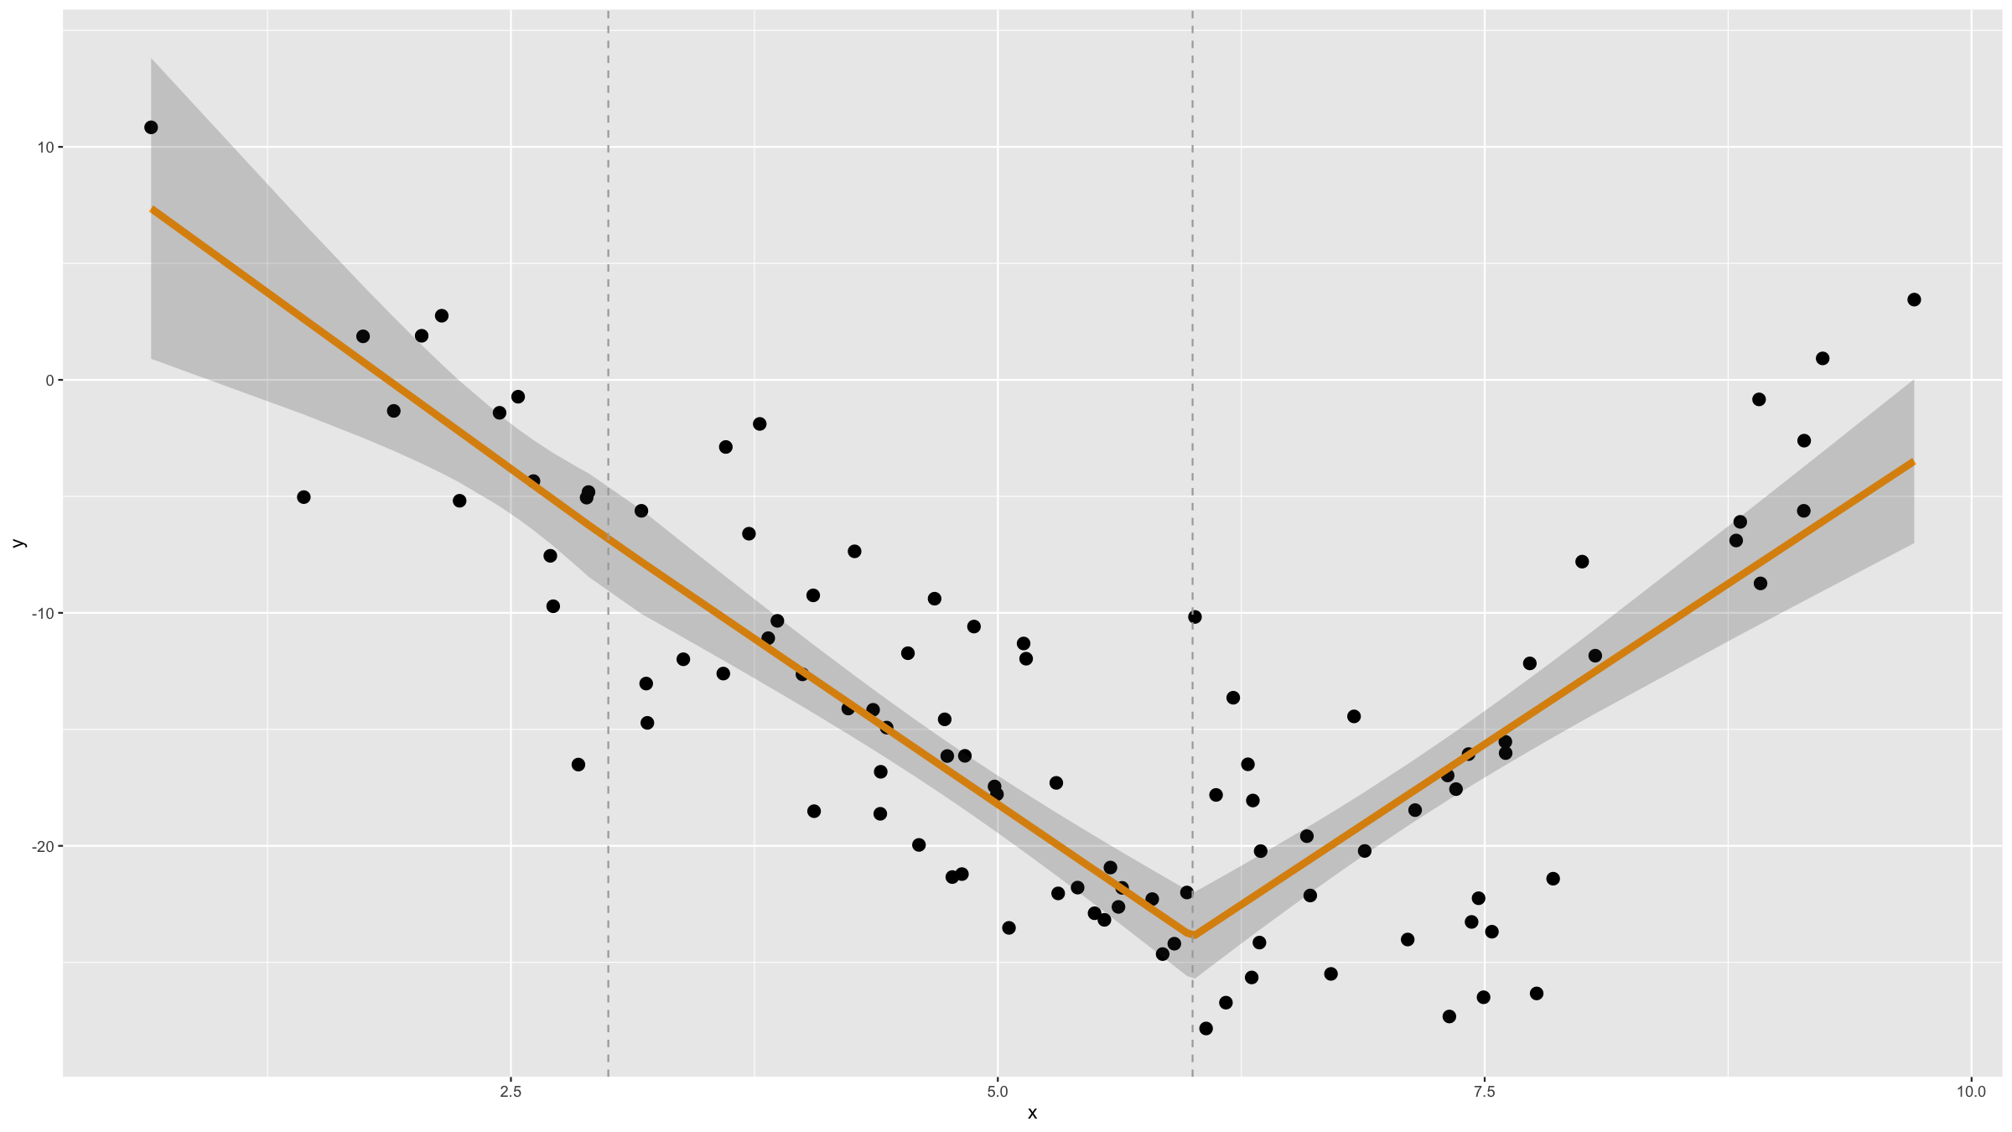

Slide 21
Notes: splines
Linear splines are not smooth and therefore cubic splines are often preferred.
Cubic splines can be poorly behaved in the tails (outside of the most extreme knots). To avoid this, they can be forced t be linear in the tails. Such splines are called restricted cubic splines.
modRcs<-glm(y~rcs(x,nk=3),data=df) # rcs requires rms package newdf<-data.frame(x=df$x,predict.lm(modRcs,interval="confidence"))
df %>% ggplot(mapping=aes(x=x,y=y)) + geom_point() + geom_line(col="orange",lwd=2,mapping=aes(x=x,y=predict(modRcs))) + geom_line(data=newdf,mapping=aes(x=x,y=fit),col="orange",lwd=2) + geom_ribbon(data=newdf,mapping=aes(y=fit,ymin=lwr,ymax=upr),alpha=0.2)

Slide 22
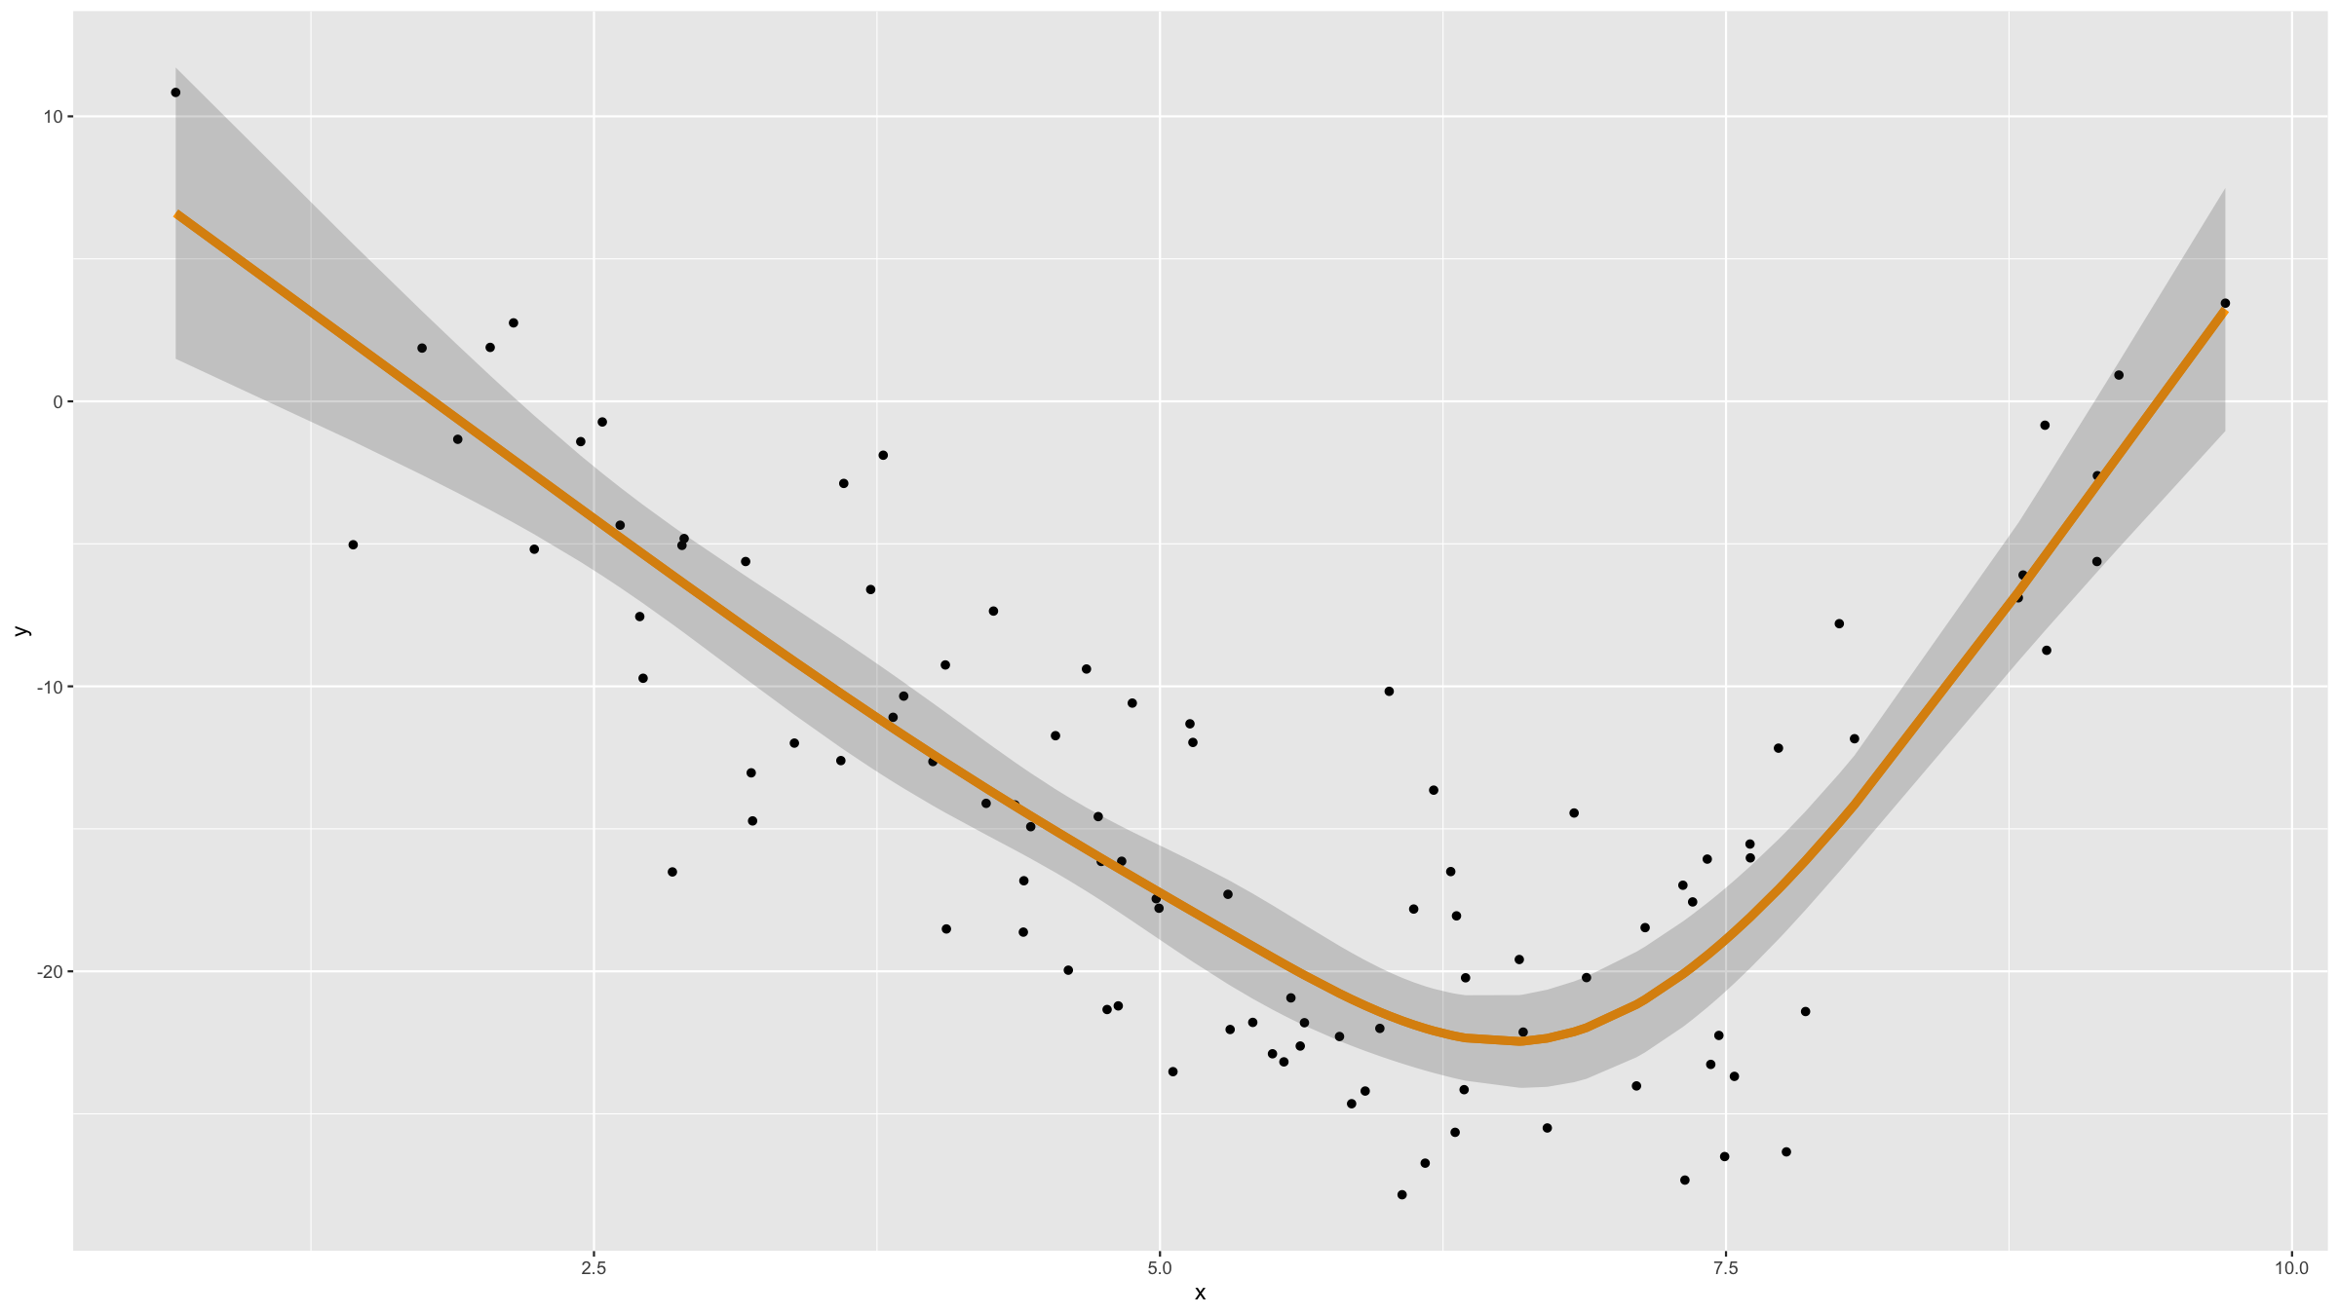

Slide 23
Notes: splines
Where the knots should be is not an easy problem. Adding them as model parameters to be estimated can lead to unstable parameter estimates and to standard estimation algorithms not being usable.
Luckily for cubic splines, the position of knots matters less than the number of knots. Knots are therefore often placed at regular intervals or quantiles of the continuous predictor.

Slide 24
Notes: rms package
The rms package provides a full set of tools for all kinds of regression problems.

Slide 25
Correlated data

Slide 26
Correlated data
In the statistical analyses and models we have seen so far, there has always been one specific assumption:
The data $x_{i},i=1,…,n$ are independent observations.
Why is this assumption needed?
Many estimation techniques require writing down the model likelihood of the data. This usually involves taking the product over all observations. This can only be done if the data are independent (two events A, B are independent if $P(A,B)=P(A)⋅P(B)$).
Many statistical tests require an estimate of the standard error of one or several statistics. If data are correlated, then the correlated observations exhibit less variance than if they were uncorrelated $⇒$ the standard error(s) are underestimated $⇒$ the null hypothesis may be wrongly rejected.

Slide 27
Correlated data
A number of common study designs result in data that are not independent observations:
A measurement of a biomarker before and after a treatment was administered.
Measurements are for the same individual and hence correlated due to the specific genetic factors, physiological characteristics, lifestyle etc of each individual.
Longitudinal cohort data.
Again measurements for the same individual will be correlated.
Matched cases and controls.
Observations are matched on a number of covariates. This makes them more similar to each other $⇒$ the data will be correlated.

Slide 28
Correlated data
Clustered data.
If sampling patients from several hospitals, then the outcomes from patients from the same hospital will be more similar to each other than patients from other hospitals as they share the same hospital infrastructure, the same nurses and doctors, the same availability of drugs and the catchment populations of different hospitals may differ in ethnicities etc.
Temporal or spatial data.
Observations close in time or space tend to be more similar than observations far apart in time and space. This is called autocorrelation. (We will not consider such data further in this session).

Slide 29
Correlated data
If we do not account for the correlated nature of the data in the analysis, we may bias the results and underestimate the variation in the data. Further some of the characteristics that induce the correlations in the data may also confound results if not accounted for.
In this lecture we will explore common techniques for dealing with various types of correlated data.

Slide 30
Matched or paired data

Slide 31
Matched or paired data
It is common to match participants in two groups (e.g. diseased/healthy, treated/control, …) in a study on a number of covariates in order to eliminate potential for confounding. However this matching of participants makes participants in the two groups more similar to each other. Hence this matching needs to be accounted for in the analysis or the effect size will be underestimated.
t & Wilcoxon tests: paired samples versions
Two proportion tests: McNemar or Liddell test
Regression models: include all covariates used for matching participants in the model

Slide 32
Matched or paired data
Similarly sometimes data on the same experimental unit is collected under different conditions (e.g. before & after a treatment, or using different growth media in the lab). Again, this needs to be accounted for in an analysis.
t & Wilcoxon tests: paired samples versions
Two proportion tests: McNemar or Liddell test
Regression models: include random effects in the model for participant / experimental unit ID

Slide 33
Matched or paired data
Example (continuous outcome):
Download the data file cholDiet.csv from GitHub and read the data into R.
This is a dataset from a cross-over trial where participants were randomly assigned to one of 2 diets (cornflakes or oat bran). After 2 weeks, cholesterol levels were measured in participants and they were then switched over to the other diet. After the 2 weeks on this diet, cholesterol levels were measured again.

Slide 34
Matched or paired data
Example (continuous outcome):
If we - WRONGLY - assume the data to be independent, then we would be concluding there is no difference in cholesterol levels between the diets:
chol<-read.csv("choldiet.csv") t.test(chol$CORNFLK_mmolPerL,chol$OATBRAN_mmolPerL,paired=F) ## ## Welch Two Sample t-test ## ## data: chol$CORNFLK_mmolPerL and chol$OATBRAN_mmolPerL ## t = 0.9469, df = 25.805, p-value = 0.3525 ## alternative hypothesis: true difference in means is not equal to 0 ## 95 percent confidence interval: ## -0.4251218 1.1508361 ## sample estimates: ## mean of x mean of y ## 4.443571 4.080714

Slide 35
Matched or paired data
Example (continuous outcome):
If we now - CORRECTLY - specify that these are paired data, we find that there is a difference in cholesterol levels between diets:
t.test(chol$CORNFLK_mmolPerL,chol$OATBRAN_mmolPerL,paired=T) ## ## Paired t-test ## ## data: chol$CORNFLK_mmolPerL and chol$OATBRAN_mmolPerL ## t = 3.3444, df = 13, p-value = 0.005278 ## alternative hypothesis: true difference in means is not equal to 0 ## 95 percent confidence interval: ## 0.1284606 0.5972537 ## sample estimates: ## mean of the differences ## 0.3628571

Slide 36
Matched or paired data
Example (continuous outcome):
An equivalent way of doing this test is to compute the difference in cholesterol between the diets for each participants, then testing the null hypothesis that this difference is 0:
t.test(chol$CORNFLK_mmolPerL-chol$OATBRAN_mmolPerL,mu=0) ## ## One Sample t-test ## ## data: chol$CORNFLK_mmolPerL - chol$OATBRAN_mmolPerL ## t = 3.3444, df = 13, p-value = 0.005278 ## alternative hypothesis: true mean is not equal to 0 ## 95 percent confidence interval: ## 0.1284606 0.5972537 ## sample estimates: ## mean of x ## 0.3628571

Slide 37
Matched or paired data
Example (continuous outcome):
Given how small this dataset is, assessing normality is difficult and a non parametric test may be safer. This will be a Wilcoxon test, and we again need to specify that the samples are paired.
wilcox.test(chol$CORNFLK_mmolPerL,chol$OATBRAN_mmolPerL,paired=T) ## ## Wilcoxon signed rank exact test ## ## data: chol$CORNFLK_mmolPerL and chol$OATBRAN_mmolPerL ## V = 93, p-value = 0.008545 ## alternative hypothesis: true location shift is not equal to 0
Or equivalently:
wilcox.test(chol$CORNFLK_mmolPerL-chol$OATBRAN_mmolPerL,mu=0) ## ## Wilcoxon signed rank exact test ## ## data: chol$CORNFLK_mmolPerL - chol$OATBRAN_mmolPerL ## V = 93, p-value = 0.008545 ## alternative hypothesis: true location is not equal to 0

Slide 38
Matched or paired data
Example (binary outcome):
The R help file for mcnemar.test() contains an example for approval ratings of the US President in two surveys, one month apart for a random sample of 1,600 voting-age Americans (Data from Agresti, A., Categorical Data Analysis, 1990, p.350).
apprPres<-matrix(c(794, 86, 150, 570), nrow = 2, dimnames = list("1st Survey" = c("Approve", "Disapprove"), "2nd Survey" = c("Approve", "Disapprove"))) apprPres ## 2nd Survey ## 1st Survey Approve Disapprove ## Approve 794 150 ## Disapprove 86 570

Slide 39
Matched or paired data
mcnemar.test(apprPres) ## ## McNemar's Chi-squared test with continuity correction ## ## data: apprPres ## McNemar's chi-squared = 16.818, df = 1, p-value = 4.115e-05
Note: if we had - incorrectly - used prop.test() here, we would have reached the same conclusion: significant drop in approval rating.

Slide 40
Clustered, repeated measures & longitudinal data

Slide 41
Clustered data
Clustered data arise when subjects within the same randomly selected group are observed:
patients within clinics
students within classrooms
There can be several levels of clustering and these levels may be either nested or crossed:
patients within wards within hospitals (nested)
individuals of different ethnic groups within different towns in a country (crossed)

Slide 42
Clustered data
Study designs resulting in clustered data:
Observational studies on units within clusters
cluster randomised trials
randomised block design experiments
Models fitted to clustered data are sometimes called multilevel models.

Slide 43
Repeated measurements & longitudinal data
When observations are made on the same individuals / units over time, we get longitudinal data.
When observations are made on the same individuals / units under different experimental or environmental conditions, we get repeated measures data. (The paired data we’ve seen earlier, are also an example of repeated measures data).
These two data types are very similar, the main difference being that with longitudinal there is a clear ordering of the observations for each individual and there is a degree of difference between observation times.

Slide 44
Repeated measurements & longitudinal data
The subject or unit can be considered to be a clustering variable for such data.
Repeated measures and longitudinal data allow us to study both within-individual/unit and between-individual/unit changes.

Slide 45
Clustered, rm & longitudinal data
Generalised least squares (GLS), allows to perform least squares minimisation, when there is a certain degree of correlation.
To do this, GLS uses the Mahalanobis distance between observations and predicted values.
$$\hat{β}=(y−Xβ)^{T}V^{−1}(y−Xβ)$$
where $V$ is a known covariance matrix.
GLS, while elegant, is not used that much these days. Generalised Estimating Equations often preferred (see later).
In R: gls().

Slide 46
Mixed models
A linear mixed model (LMM) is a parametric linear model for clustered, longitudinal or repeated measures data that quantifies the relationship between a continuous dependent variable and several predictor variables. An LMM may include both fixed effects associated with continuous or categorical covariates and random effects associated with random factors. LMMs are called mixed because of the presence of both fixed and random effects.
There are also generalised linear mixed models. The theory behind such models is complex, involving sophisticated approximations and several theoretical aspects (model diagnostics for example) have not been fully developed yet.
For this reason we only consider LMMs in this session.

Slide 47
Mixed models
Fixed factors
We consider a categorical variable to be a fixed factor if all the levels of this variable that are of interest to a study are included in it.
Examples:
sex
all regions in a country
treatment methods

Slide 48
Mixed models
Fixed effects
Fixed effects, also called regression coefficients, describe the relationship between the response and the predictor variables (i.e. either continuous variables or fixed factors).
Fixed effects are considered to be fixed quantitities in mixed models, only their estimators are considered to be random.

Slide 49
Mixed models
Random factors
A random factor is a categorical variable with levels that can be considered to have been sampled randomly from a larger, possibly infinite, set of levels. While not all levels are included in the study, the aim is make inference about the entire population of levels.
Examples:
individual / experimental unit
towns
schools
hospitals
fields

Slide 50
Mixed models
Random effects
Random effects are random values associated with the levels of a random factor and usually represent deviations from the relationships specified by the fixed effects.
Random effects are considered to be random variables in mixed models, usually with zero mean and some variance that will be estimated.
Examples:
random intercepts
random slopes

Slide 51
Mixed models
Denote $Y_{i}$ the vector of the response variable for the observations for subject i. Let $X_{i}^{(1)},…,X_{i}^{(p)}$ be the vectors of fixed factors or continuous covariates and let $Z_{i}^{(1)},…,Z_{i}^{(q)}$ be the vectors of random factors. Index experimental units / subjects by $i$ and let $t$ index the $n_{i}$ measurements for the $i^{th}$ subject.
Writing $β=(β_{1},…,β_{p})^{T}$ for the fixed effects and $u=(u_{1},…,u_{q})^{T}$ for the random effects, an LMM can be specified as:
$$\begin{matrix}Y_{ti} & = & β_{1}X_{ti}^{(1)}+β_{2}X_{ti}^{(2)}+…+β_{p}X_{ti}^{(p)} & \text{fixed} \\ & & +u_{1i}Z_{ti}^{(1)}+…+u_{qi}Z_{ti}^{(q)}+ϵ_{ti} & \text{random}\end{matrix}$$

Slide 52
Mixed models
In matrix notation we can write this as
$$Y_{i}=X_{i}β+Z_{i}u_{i}+ϵ_{i}$$
where
$$\left\{\begin{matrix}u_{i}∼N(0,D) \\ ϵ_{i}∼N(0,R_{i})\end{matrix}\right.$$
$D$ is the covariance matrix of the random effects
$R_{i}$ is the coariance matrix of the residuals for the i^{th} individual
The X covariates can be either time-varying (e.g. blood pressure at measurment time, or the time of measurement) or time-invariant (e.g. sex).

Slide 53
Mixed models: covariance structures
There are two commonly used covariance structures for the $D$ matrix:
unstructured
$$D=\left(\begin{matrix}σ_{u1}^{2} & σ_{u1,u2} & … & σ_{u1,up} \\ σ_{u1}^{2} & σ_{u2}^{2} & … & σ_{u2,up} \\ ⋮ & ⋮ & … & ⋮ \\ σ_{u1,up} & σ_{u2,up} & … & σ_{up}^{2}\end{matrix}\right)$$
variance components
$$D=\left(\begin{matrix}σ_{u1}^{2} & 0 & … & 0 \\ 0 & σ_{u2}^{2} & … & 0 \\ ⋮ & ⋮ & … & ⋮ \\ 0 & 0 & … & σ_{up}^{2}\end{matrix}\right)$$

Slide 54
Mixed models: covariance structures
There are several commonly used covariance structures for the $R_{i}$ matrix:
diagonal
$$R_{i}=\left(\begin{matrix}σ^{2} & 0 & … & 0 \\ 0 & σ^{2} & … & 0 \\ ⋮ & ⋮ & … & ⋮ \\ 0 & 0 & … & σ^{2}\end{matrix}\right)$$
compound symmetry
$$R_{i}=\left(\begin{matrix}σ^{2}+σ_{1} & σ_{1} & … & σ_{1} \\ σ_{1} & σ^{2}+σ_{1} & … & σ_{1} \\ ⋮ & ⋮ & … & ⋮ \\ 0 & σ_{1} & … & σ^{2}+σ_{1}\end{matrix}\right)$$

Slide 55
Mixed models: covariance structures
AR(1)
$$R_{i}=\left(\begin{matrix}σ^{2} & σ^{2}ρ & … & σ^{2}ρ^{n_{i}−1} \\ σ^{2}ρ & σ^{2} & … & σ^{2}ρ^{n_{i}−2} \\ ⋮ & ⋮ & … & ⋮ \\ σ^{2}ρ^{n_{i}−1} & σ^{2}ρ^{n_{i}−1} & … & σ^{2}\end{matrix}\right)$$
The $D$ and $R_{i}$ matrices can also be specified such as to allow heterogeneous variances for different groups of subjects (e.g. males / female):
same structures
different values

Slide 56
Mixed models: marginal models
For every LMM, one can specify a corresponding marginal model, i.e. the same model but without random effects.
The random effects in LMMs allow to study between-subject/cluster variation, but they are absent from marginal models. This means that LMMs allow for subject specific inference, whereas marginal models do not. For this reason LMMs are called subject-specific models and marginal models are referred to as population averaged models.

Slide 57
Mixed models: marginal models
For the matrix notation of LMMs we used before, the corresponding marginal model is specified as
$$Y_{i}=X_{i}β+ξ_{i}$$
where $ξ_{i}∼N(0,V_{i})$
The same structures we described for the $D$ and $R_{i}$ matrices can be used for the marginal variance-covariance matrix $V_{i}$.
The entire random part of the marginal model is described by $V_{i}$.
For the marginal model implied by a linear mixed model, $V_{i}$ is given by
$$V_{i}=Z_{i}DZ_{i}^{T}+R_{i}$$

Slide 58
Mixed models: marginal models
The marginal model does not contain random effects $u_{i}$ and hence is not a mixed model.
In linear mixed models, the fixed effects $β_{i}$ have both a subject-specific and a population averaged interpretation. This is not the case for generalised linear mixed models, where the link functions results in different fixed effects in the mixed and marginal models that correspond to each other.

Slide 59
Mixed models: estimation
We have seen maximum likelihood (ML) estimation in the context of (generalised) linear models: parameters are obtained by maximising the model likelihood function.
Writing $θ$ for the variance-covariance parameters given by the $D$ and $R_{i}$ matrices, the key difficulty in LMMs is to estimate both the fixed effects $β$ and the covariance parameters $θ$.

Slide 60
Mixed models: estimation
The details of the estimation procedures are beyond the scope of this course, but there are 2 different ways of estimating the covariance parameters $θ$:
maximum likelihood (ML) uses a profile likelihood function for $θ$
restricted or residual maximum likelihood (REML) uses a restricted likelihood function instead
REML is usually the default estimation method in software packages and it is often preferred as it results in unbiased estimates of the covariance parameters as it accounts for the loss of degrees of freedom due to estimating the fixed effects $β$.

Slide 61
Mixed models: estimation
The standard errors of the fixed effects are biased downwards in both ML and REML. The estimation process involves the $V_{i}$ matrix from the implied marginal model and this is replaced by an estimate ${\hat{V}}_{i}$ but the uncertainty in this estimate is not accounted for. Some softwares provide an adjustment to the standard errors.

Slide 62
Mixed models: inference
Tests for fixed effects:
likelihood ratio tests
based on ML estimatation; REML not appropriate
t-tests for single fixed effects
degrees of freedom need to be approximated
F tests for multiple fixed effects
degrees of freedom need to be approximated

Slide 63
Mixed models: inference
likelihood ratio tests
REML needs to be used because of biased estimated for covariance parameters with ML
When testing values on the boundary of the parameter space (e.g. testing if any covariance parameter is zero), the test statistics follows a mixture of $χ^{2}$ distributions; otherwise simply a $χ^{2}$ with d.f. equal to the difference in number of parameters between the nested models
Wald $z$-tests
requires a large number of levels in the random factor associated with the parameters that are tested

Slide 64
Mixed models: inference
Computation of p-values associated with fixed and random effects can be non-trivial in mixed models.
For this reason, some software packages, e.g. lme4, do not provide p-values.

Slide 65
Mixed models: diagnostics
Diagnostic checks proceed largely as for other models (e.g. GLMs), but obviously with the specific dsitributional assumptions made by the LMMs.
As LMMs are estimated using maximum likelihood techniques, goodness-of-fit measures involving the likelihood (e.g. AIC, BIC) are defined.

Slide 66
Mixed models: diagnostics
For residual-based diagnostic, there are several residuals that can be computed:
raw residuals
conditional residuals ${\hat{ϵ}}_{i}=y_{i}−X_{i}\hat{β}−Z_{i}{\hat{u}}_{i}$
marginal residuals ${\hat{ξ}}_{i}=y_{i}−X_{i}\hat{β}$
standardised and studentised residuals
standardised = residuals divided by their true standard deviation
studentised = residuals divided by their estimated standard deviation
Pearson residuals = residuals divided by the estimated standard deviation of the dependent variable

Slide 67
Mixed models: diagnostics
Diagnostics for random effects proceed by using empirical best linear unbiased predictors (EBLUPs) of the random effects: ${\hat{u}}_{i}$.
EBLUPs are useful for checking for outlying subjects / experimental units.
Checking EBLUPs for normality is of limited value as EBLUPs do not necessarily reflect the distribution of the random effects.

Slide 68
Mixed models: R
There are 2 main packages in R for fitting LMMs:
nlme
used to be the standard library for this
offers greater flexibility for specifying covariance structures
largely superseded by lme4
nested random factors
function for LMMs: lme()
lme4
newer, faster
GLMMs
nested & crossed random factors
function for LMMs: lmer()

Slide 69
Mixed models: R
Type ?Orthodont to get information about a dataset in the nlme package on orthodontic measurements.
We can fit random intercept models (not the different way of specifying random factors in the 2 packages):
nlme
orthModLme<-lme(distance~age+Sex, random=~1|Subject, data=Orthodont) summary(orthModLme)
lme4
orthModLmer<-lmer(distance~age+Sex+(1|Subject), data=Orthodont) summary(orthModLmer)

Slide 70
Mixed models: R
Output using nlme:
## Linear mixed-effects model fit by REML ## Data: Orthodont ## AIC BIC logLik ## 447.5125 460.7823 -218.7563 ## ## Random effects: ## Formula: ~1 | Subject ## (Intercept) Residual ## StdDev: 1.807425 1.431592 ## ## Fixed effects: distance ~ age + Sex ## Value Std.Error DF t-value p-value ## (Intercept) 17.706713 0.8339225 80 21.233044 0.0000 ## age 0.660185 0.0616059 80 10.716263 0.0000 ## SexFemale -2.321023 0.7614168 25 -3.048294 0.0054 ## Correlation: ## (Intr) age ## age -0.813 ## SexFemale -0.372 0.000 ## ## Standardized Within-Group Residuals: ## Min Q1 Med Q3 Max ## -3.74889609 -0.55034466 -0.02516628 0.45341781 3.65746539 ## ## Number of Observations: 108 ## Number of Groups: 27

Slide 71
Mixed models: R
Output using lme4:
## Linear mixed model fit by REML ['lmerMod'] ## Formula: distance ~ age + Sex + (1 | Subject) ## Data: Orthodont ## ## REML criterion at convergence: 437.5 ## ## Scaled residuals: ## Min 1Q Median 3Q Max ## -3.7489 -0.5503 -0.0252 0.4534 3.6575 ## ## Random effects: ## Groups Name Variance Std.Dev. ## Subject (Intercept) 3.267 1.807 ## Residual 2.049 1.432 ## Number of obs: 108, groups: Subject, 27 ## ## Fixed effects: ## Estimate Std. Error t value ## (Intercept) 17.70671 0.83392 21.233 ## age 0.66019 0.06161 10.716 ## SexFemale -2.32102 0.76142 -3.048 ## ## Correlation of Fixed Effects: ## (Intr) age ## age -0.813 ## SexFemale -0.372 0.000

Slide 72
Mixed models: R
Type ?sleepstudy to get information on a dataset from the lme4 on the reaction time for subjects in a sleep deprivation study.
We can also fit random slope models:
nlme
sleepModLme<-lme(Reaction~Days, random=~Days|Subject, data=sleepstudy) summary(sleepModLme)
lme4
sleepModLmer<-lmer(Reaction~Days+(Days|Subject), data=sleepstudy) summary(sleepModLmer)

Slide 73
Mixed models: R
Output using nlme:
## Linear mixed-effects model fit by REML ## Data: sleepstudy ## AIC BIC logLik ## 1755.628 1774.719 -871.8141 ## ## Random effects: ## Formula: ~Days | Subject ## Structure: General positive-definite, Log-Cholesky parametrization ## StdDev Corr ## (Intercept) 24.740241 (Intr) ## Days 5.922103 0.066 ## Residual 25.591843 ## ## Fixed effects: Reaction ~ Days ## Value Std.Error DF t-value p-value ## (Intercept) 251.40510 6.824516 161 36.83853 0 ## Days 10.46729 1.545783 161 6.77151 0 ## Correlation: ## (Intr) ## Days -0.138 ## ## Standardized Within-Group Residuals: ## Min Q1 Med Q3 Max ## -3.95355735 -0.46339976 0.02311783 0.46339621 5.17925089 ## ## Number of Observations: 180 ## Number of Groups: 18

Slide 74
Mixed models: R
Output using lme4:
## Linear mixed model fit by REML ['lmerMod'] ## Formula: Reaction ~ Days + (Days | Subject) ## Data: sleepstudy ## ## REML criterion at convergence: 1743.6 ## ## Scaled residuals: ## Min 1Q Median 3Q Max ## -3.9536 -0.4634 0.0231 0.4634 5.1793 ## ## Random effects: ## Groups Name Variance Std.Dev. Corr ## Subject (Intercept) 612.10 24.741 ## Days 35.07 5.922 0.07 ## Residual 654.94 25.592 ## Number of obs: 180, groups: Subject, 18 ## ## Fixed effects: ## Estimate Std. Error t value ## (Intercept) 251.405 6.825 36.838 ## Days 10.467 1.546 6.771 ## ## Correlation of Fixed Effects: ## (Intr) ## Days -0.138

Slide 75
GEE
Generalised Estimating Equations (GEE) fit generalised linear models accounting for correlations due to categorical variables that are present in the data.
GEEs do not include random effects and as such can be used only for population averaged inference. GEE models are marginal models.
GEEs use estimating equations (obtained from the score equations in ML) to derive parameter estimates and they use only the first 2 moments of the data variables without directly maximising or even evaluating the model likelihood. this means likelihood based inferential and diagnostic tools such as likelihood ratio tests and AIC/BIC are not defined.
Methods like GEE are sometimes called quasi-likelihood methods.

Slide 76
GEE
The variance structure for the error term can be specified using the same structures we have seen for the $V_{i}$ matrices in LMMs.
GEEs will yield unbiased parameter estimates for $β$, even if the correlation structure is misspecified. However the associated standard errors will be affected.
GEE is not a model, but an estimating technique.

Slide 77
GEE
In R: gee / GEE
We can use GEE to fit a GLM to the orthodontic dataset:
orthModGee<-gee(distance~age+Sex, id=Subject, data=Orthodont) ## Beginning Cgee S-function, @(#) geeformula.q 4.13 98/01/27 ## running glm to get initial regression estimate ## (Intercept) age SexFemale ## 17.7067130 0.6601852 -2.3210227 summary(orthModGee) ## ## GEE: GENERALIZED LINEAR MODELS FOR DEPENDENT DATA ## gee S-function, version 4.13 modified 98/01/27 (1998) ## ## Model: ## Link: Identity ## Variance to Mean Relation: Gaussian ## Correlation Structure: Independent ## ## Call: ## gee(formula = distance ~ age + Sex, id = Subject, data = Orthodont) ## ## Summary of Residuals: ## Min 1Q Median 3Q Max ## -5.98819444 -1.48819444 -0.05856481 1.19159827 5.37106481 ## ## ## Coefficients: ## Estimate Naive S.E. Naive z Robust S.E. Robust z ## (Intercept) 17.7067130 1.11220946 15.920304 0.88945628 19.907345 ## age 0.6601852 0.09775895 6.753194 0.06992132 9.441830 ## SexFemale -2.3210227 0.44488623 -5.217115 0.74977059 -3.095644 ## ## Estimated Scale Parameter: 5.160679 ## Number of Iterations: 1 ## ## Working Correlation ## [,1] [,2] [,3] [,4] ## [1,] 1 0 0 0 ## [2,] 0 1 0 0 ## [3,] 0 0 1 0 ## [4,] 0 0 0 1

Slide 78
Note
Other methods exist, e.g. Bayesian hierarchical models, but outside the scope of this course.
The same is true for other types of correlated data such as time series and spatially correlated data.

Slide 79
[end of Session 6]

