Slide 1
Statistics and R short course
Session 5: Basic regression modelling Marc Henrion, James Chirombo

Slide 2
Introduction

Slide 3
Preliminaries
Certificates of attendance
You need to attend all 6 sessions.
Sign in & check spelling of name on the sign-in sheet!
Only issued if paid-up and in exchange for completed feedback form.
Course website / GitHub: https://github.com/mlw-stats/R_And_Statistics_Training_2021
Office hours
James - Tuesdays 2-3pm
Marc - Fridays 8.30am-9.30am
Housekeeping
Covid-19 measures
Refreshments & lunch
Fire exits & bathrooms

Slide 4
Learning outcomes
KNOW R: Explain know what R is & what it can do.
KNOW R RESOURCES: List useful R resources and access them.
DO R: Perform basic operations relevant for your research in R:
Read data into R & write data or results to the harddrive.
Manipulate & use different object types.
Write & use functions in R
Perform basic analyses on a dataset: mean, standard deviation, linear regression.
Produce various standard graphs and tables
UNDERSTAND BASICS OF STATISTICS: Explain basic statistical theory: common distributions, standard statistical techniques, common study designs, assumptions behind common statistical tests and regression models.
UNDERSTAND STUDY DESIGNS: Recommend appropriate designs & analyses.
COMPREHEND OPEN SCIENCE: Summarise principles of open, reproducible research.
DO OPEN SCIENCE WITH R: Use R scripts, R markdown, packages & GitHub.

Slide 5
Notation
$X,Y$ - random variables (here: X = predictor, Y = response)
$x,y$ - measured / observed values
$ϵ$ - random variable (here: error / residual)
$θ$ - a vector of parameters
$\overset{‾}{X}$, $\overset{‾}{Y}$ - sample mean estimators for X, Y
$\overset{‾}{x}$, $\overset{‾}{y}$ - sample mean estimates of X, Y
$\hat{T}$, $\hat{t}$ - given a statistic T, estimator and estimate of T
$P\left(A\right)$ - probability of an event A occuring
$f_{X}\left(.\right)$, $f_{Y}\left(.\right)$ - distribution mass / density functions of X, Y
$X∼F$ - X distributed according to distribution function F
$E\left[X\right]$, $E\left[Y\right]$, $E\left[T\right]$ - the expectation of X, Y, T respectively

Slide 6
Libraries & data
Install the pscl and rms libraries: install.packages(c("pscl","rms"))
Let’s load some datasets for this session. Please download the datasets titanic.csv from the GitHub site and a dataset on birth weight from the University of Sheffield:
https://www.sheffield.ac.uk/polopoly_fs/1.886038!/file/Birthweight_reduced_R.csv
Tbreg<-read.csv("dataAndSupportDocs/btTBreg.csv") Tbreg<-Tbreg %>% mutate(cd4change=cd42-cd41) # TB dataset used previously bw<-read.csv("dataAndSupportDocs/Birthweight_reduced_R.csv") # Data contributed by Ellen Marshall, University of Sheffield titanic<-read.csv("dataAndSupportDocs/titanic.csv") titanic<-titanic[,-1] # data on survivors and casualties of the Titanic disaster

Slide 7
Linear model & correlation

Slide 8
Linear model
General concept of regression
Regression means describing some aspect of a dependent variable $Y$ as a function of some predictor or independent variables $X$ and parameters $θ$:
$$f_{1}\left(Y\right)=f_{2}\left(X;θ\right)$$
Here we focus on describing the mean of $Y$ as a function of a linear predictor of $X$.
3 main reasons for fitting regression models: inference, prediction, adjustment.

Slide 9
Linear model
Let’s suppose we have some data:
df<-tibble( x=runif(25,min=-5,max=5), y=1.5*x+rnorm(25,sd=2)+3.5 ) ggplot(data=df,aes(x=x,y=y)) + geom_point(size=3) + theme(text = element_text(size=20))

Slide 10
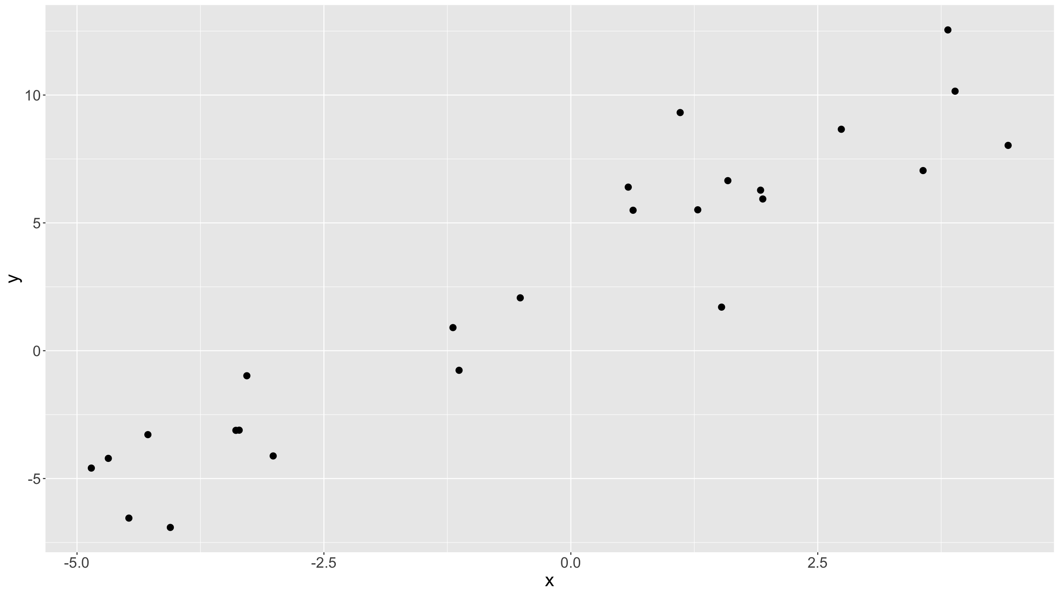

Slide 11
Linear model
Looks like there is a linear relationship between the 2 variables:
as $x↗$, so $y↗$
We can try to guess what that relationship is.
E.g. we can guess $y≈x+3$:
ggplot(data=df,aes(x=x,y=y)) + geom_abline(intercept=3,slope=1,colour="steelblue",lwd=1.5) + geom_point(size=3) + theme(text = element_text(size=20))

Slide 12
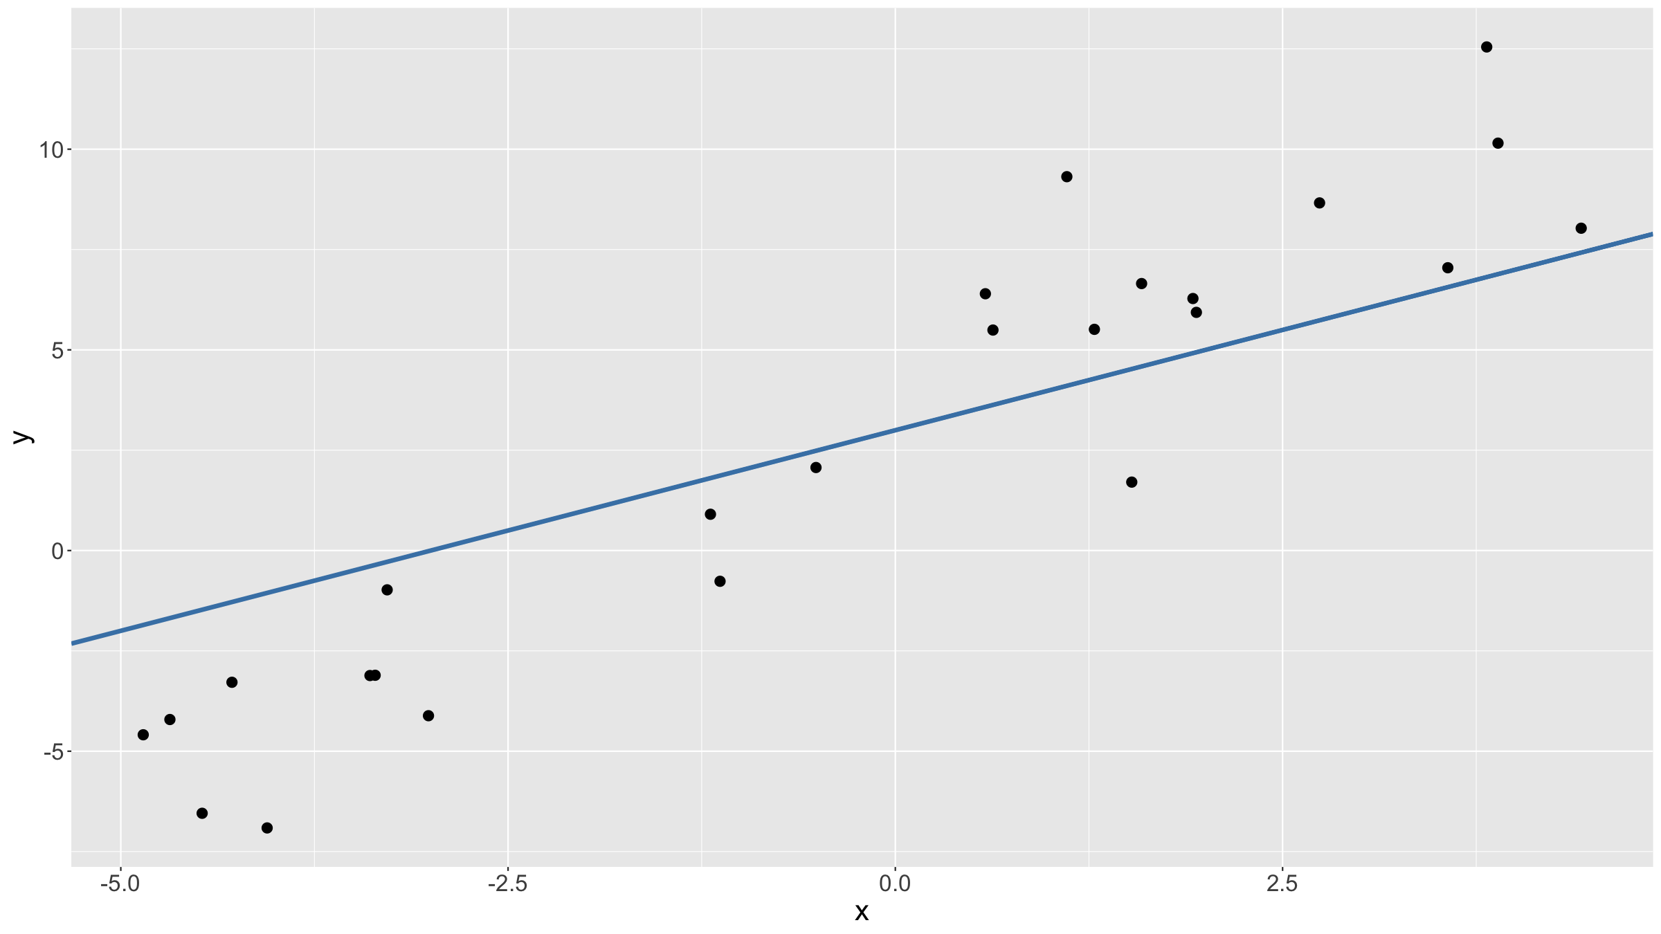

Slide 13
Linear model
Looks good? Maybe the slope should be a bit steeper, the intercept larger?
$y≈2x+4$
ggplot(data=df,aes(x=x,y=y)) + geom_abline(intercept=4,slope=2,colour="salmon",lwd=2) + geom_point(size=3) + theme(text = element_text(size=20))

Slide 14
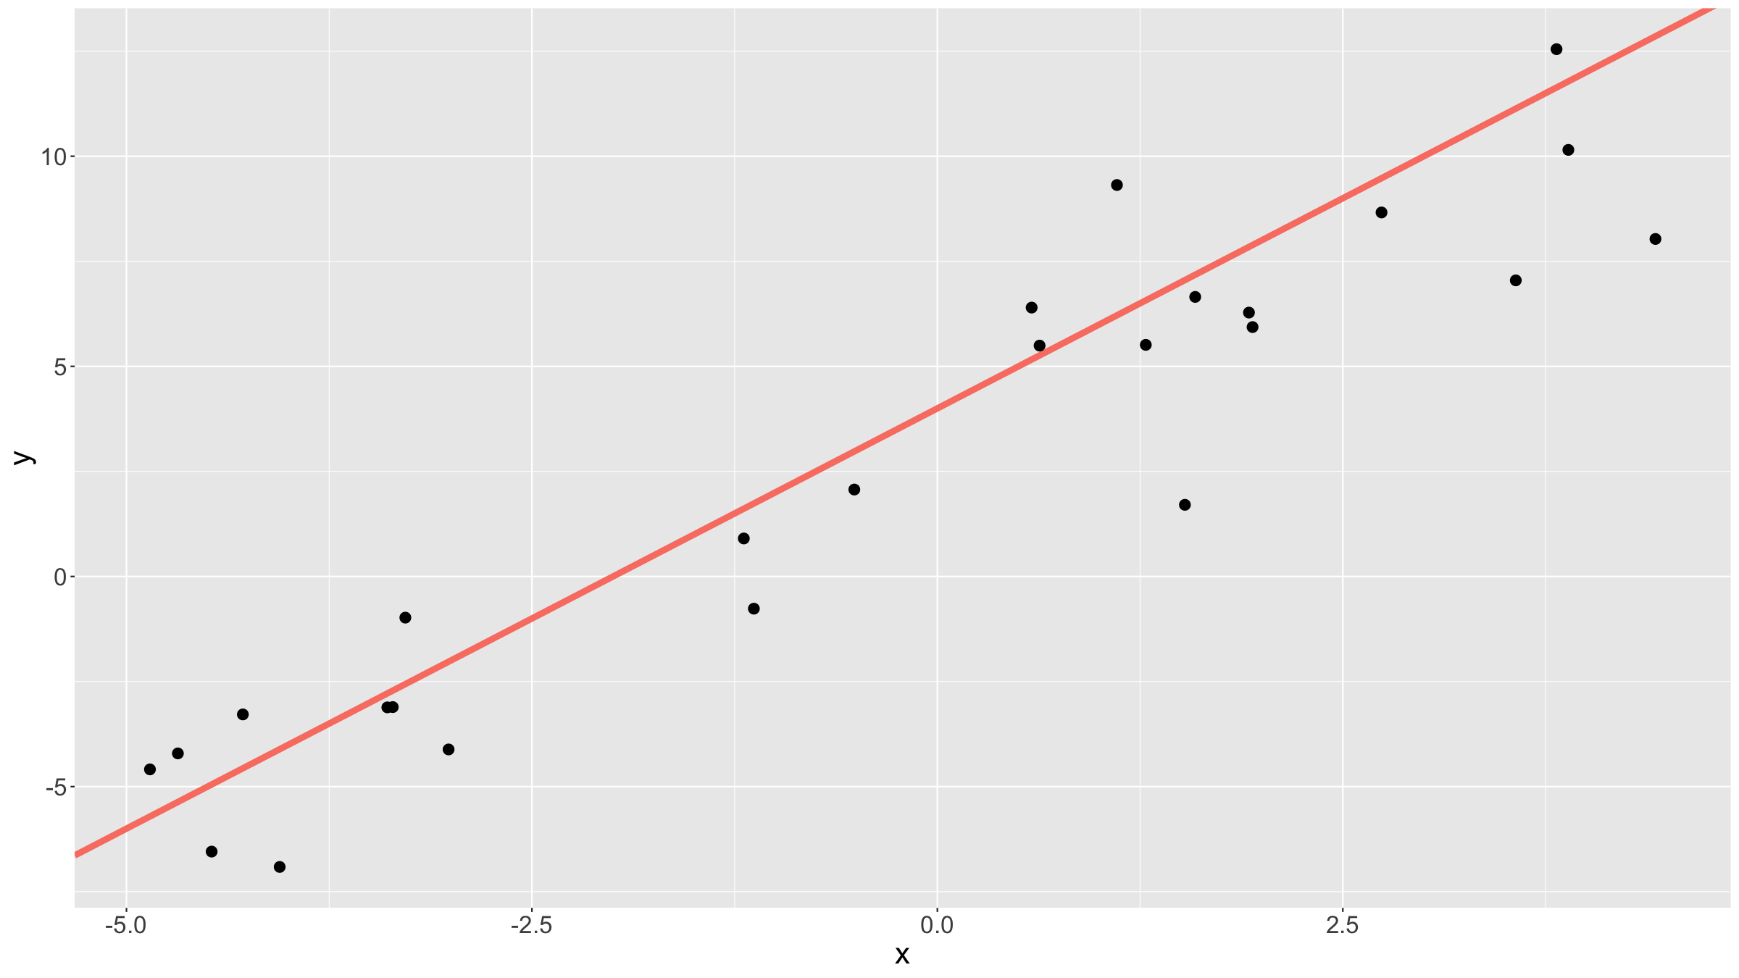

Slide 15
Linear model
Which line to pick?
ggplot(data=df,aes(x=x,y=y)) + geom_abline(intercept=3,slope=0.5,colour="darkgrey",lwd=2) + geom_abline(intercept=3.1,slope=1,colour="mediumorchid",lwd=2) + geom_abline(intercept=3.8,slope=1.25,colour="orange",lwd=2) + geom_abline(intercept=2.8,slope=1.75,colour="steelblue",lwd=2) + geom_abline(intercept=3.5,slope=2,colour="salmon",lwd=2) + geom_abline(intercept=4,slope=2.5,colour="greenyellow",lwd=2) + geom_point(size=3) + theme(text = element_text(size=20))

Slide 16
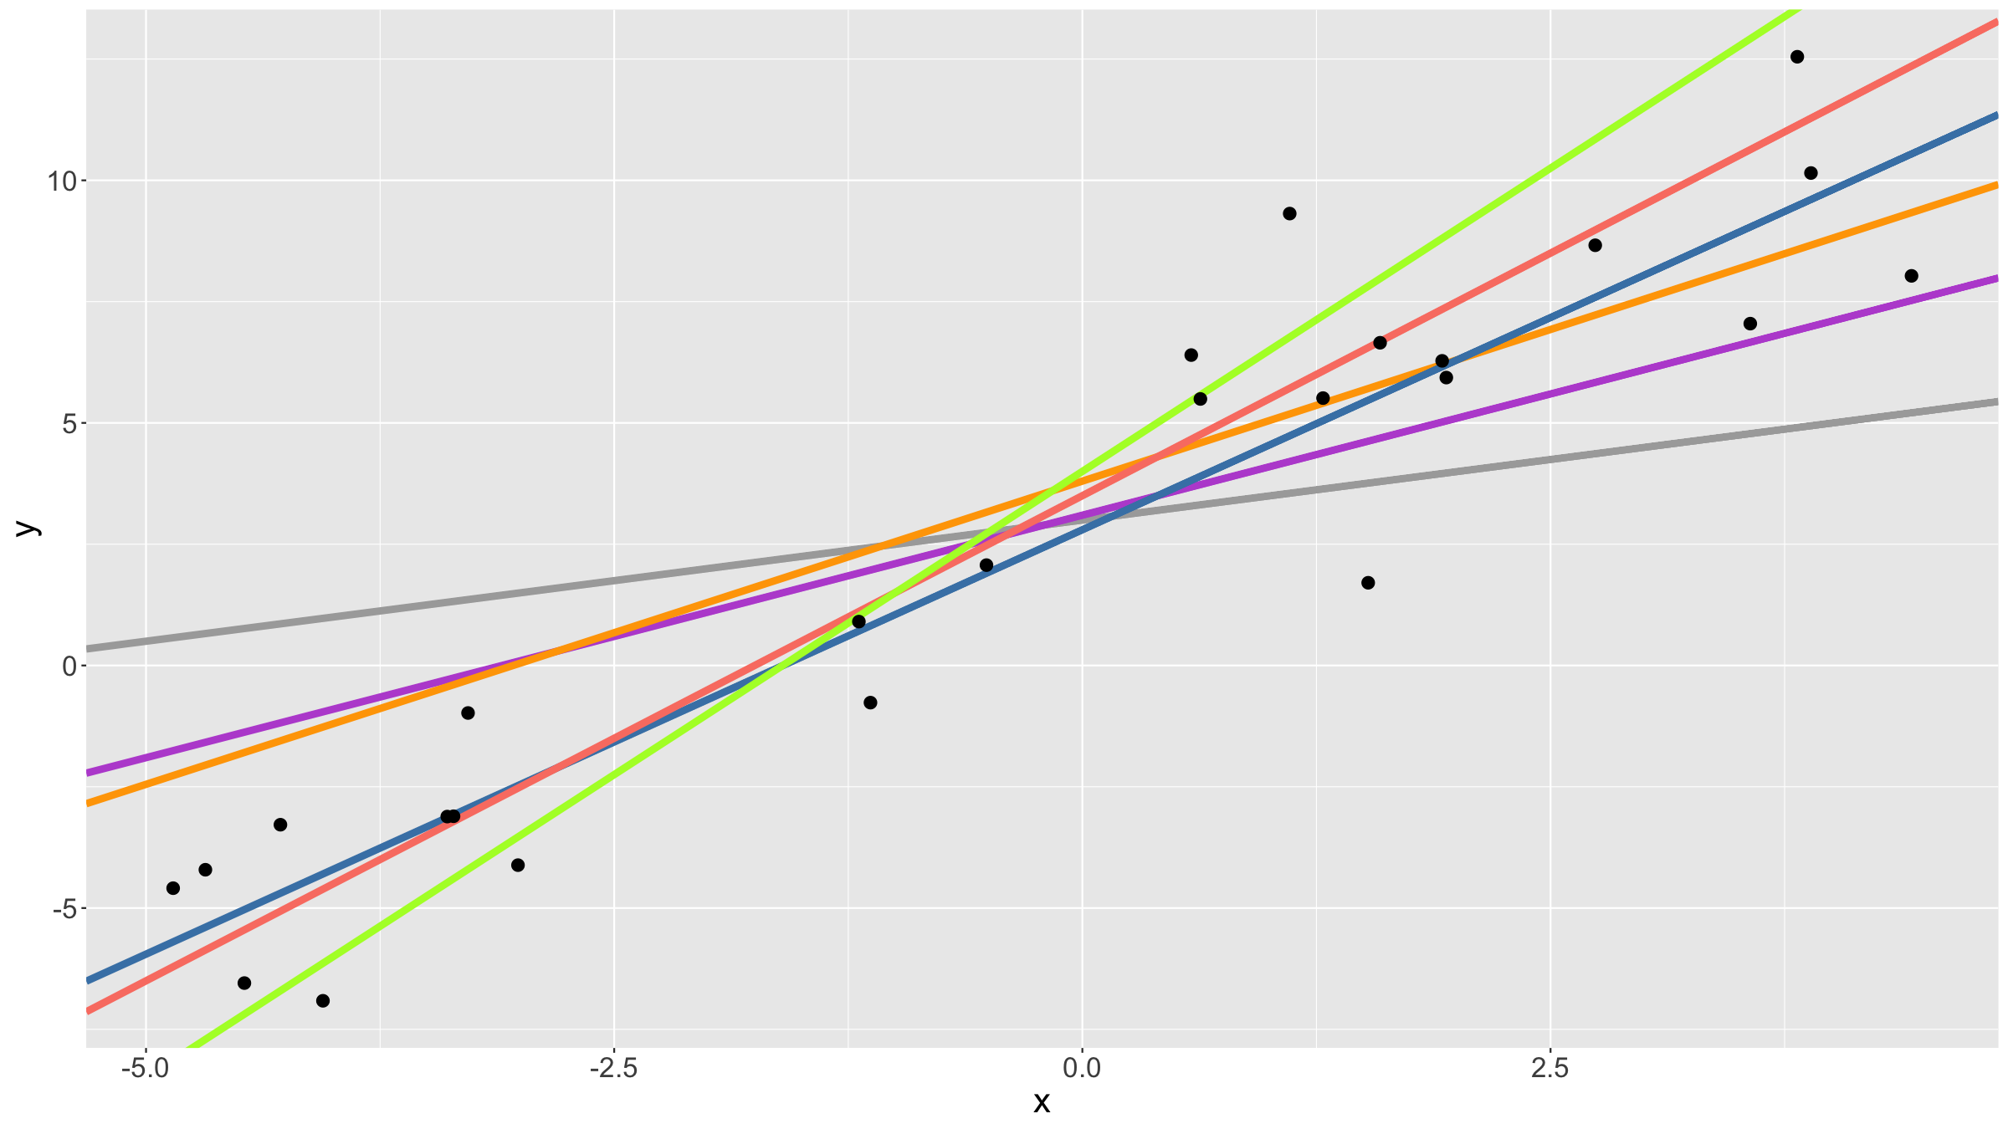

Slide 17
Linear model
We can try to minimize the errors, i.e. the deviations of the observed data from the line. Specifically, since these errors can be positive or negative, we can try to minimise the sum of the squares of the errors.
This is the principle of least squares (LS).
Let ${\hat{y}}_{i}=β_{0}+β_{1}x_{i}$.
We want to find values for $β_{0},β_{1}$ so that
SS=i​yi−yi2=i​yi−β0−β1xi2
is the smallest / minimum it can be.

Slide 18
Linear model
ggplot(data=df,aes(x=x,y=y)) + geom_abline(intercept=3,slope=1,colour="steelblue",lwd=2) + geom_segment(aes(x=x,xend=x,y=y,yend=x+3),colour="red",lwd=1.5) + geom_point(size=4) + theme(text = element_text(size=20))

Slide 19
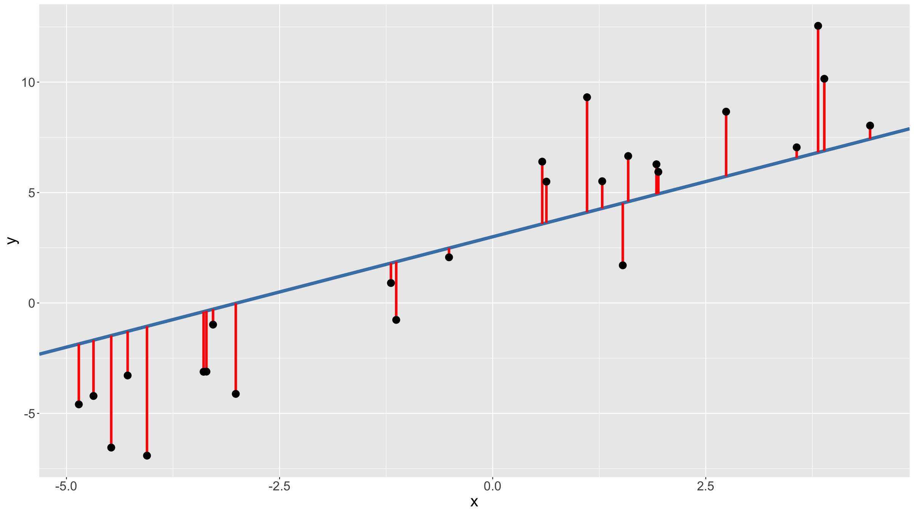

Slide 20
Linear model
We can write the sum of squares as a function in R:
sumSquares<-function(beta,dat=df){ return( sum( (dat$y - (beta[1]+beta[2]*dat$x))^2 ) ) }
We can then try this for several values, hoping to find the minimum:
sumSquares(c(0,0)) ## [1] 942.8436 sumSquares(c(0,1)) ## [1] 410.4472 sumSquares(c(2,1)) ## [1] 237.33 sumSquares(c(3,1.5)) ## [1] 105.4892

Slide 21
Linear model
There are minimisation algorithms that can do this for us.
betaHat<-optim(fn=sumSquares,par=c(0,0)) print(betaHat$par) ## [1] 3.014646 1.770476 print(betaHat$value) ## [1] 88.63483
betaHat is a list object.
Check what else it reports by typing print(betaHat).
For more details about optim, type ?optim.

Slide 22
Linear model
What we have done, is fit a linear model.
$$y_{i}=β_{0}+β_{1}x_{i}+ϵ_{i}$$
In other words, for a dependent variable $Y$ and an independent variable $X$ we hypothesise there is a model
$$Y=β_{0}+β_{1}X+ϵ$$
where $ϵ$ is a random variable.
Note that by using least squares we only fit a function to data as best as we can. We don’t make any distributional assumptions about $Y$ or $ϵ$.

Slide 23
Linear model
We can fit this directly (without writing down the sum of squares function) by using the R function lm or glm.
mod<-lm(y~x,data=df) print(mod) ## ## Call: ## lm(formula = y ~ x, data = df) ## ## Coefficients: ## (Intercept) x ## 3.015 1.770

Slide 24
Linear model
We can get more information by typing summary(mod).
You get the same results by using glm rather than lm.

Slide 25
Linear model
If we write where $\overset{‾}{x}$, $\overset{‾}{y}$ for the sample means and define:
SSy=i​yi−y2
SSx=i​xi−x2
Sxy=i​xi−xyi−y
The LS estimates for the parameters $β_{0},β_{1}$ are:
$${\hat{β}}_{1}=S_{xy}/SS_{x}$$
$${\hat{β}}_{0}=\overset{‾}{y}−{\hat{β}}_{1}\overset{‾}{x}$$

Slide 26
Linear model
Parameter interpretation:
${\hat{β}}_{0}$ is the estimated intercept of the fitted regression line; it is the value predicted for $Y$ when $X=0$
${\hat{β}}_{1}$ is the estimated slope of the fitted regression line; it gives by how much $Y$ changes, on average, for every increase in $X$ by 1

Slide 27
Linear model
The total variation (total sum of squares = TSS) in the data is $SS_{y}$ and you can show that this can be split into 2 components:
the regression sum of squares $RSS=S_{xy}^{2}/SS_{x}$
the error sum of squares $ESS=TSS−RSS=SS_{y}−\left(S_{xy}^{2}/SS_{x}\right)$
The coefficient of determination $R^{2}$ gives the proportion of the variation that is explained by the regression model.
$$R^{2}=\frac{RSS}{TSS}=\frac{S_{xy}^{2}}{SS_{x}SS_{y}}$$
In the case of a single predictor $X$, $R^{2}$ is also the squared sample correlation coefficient $ρ\left(y,x\right)$ between the observed $y$ and $x$.

Slide 28
Linear model
So far we just fitted a line. Implicitly we made the following assumptions:
The data used to fit the model are representative of the underlying population.
The true relationship between $X$ and $Y$ is linear.
If we want to make statistical inference about any of the parameters in the model, we need to make additional assumptions:
the random error $ϵ∼N\left(0,σ^{2}\right)$ - specifically this implies that the residuals $ϵ_{i}$ are homoscedastic (have equal variance)
the observations $y_{i}$ are independent given the $x_{i}$ - in other words the residuals $ϵ_{i}$ are independent

Slide 29
Linear model
Once we have made these assumptions, we can do statistical tests:
test if $β_{1}=0$?
test if the population correlation parameter $ρ=0$
The above 2 tests are in fact equal (in a model with a single predictor).
We can also test if the intercept $β_{0}=0$ (or some other value), but this test is usually not sensible as $β_{0}$, the average value of $Y$ if $X=0$, has, in most situations, little more meaning than providing a numerical scale for the observed values.

Slide 30
Linear model
By assuming $ϵ_{i}∼N\left(0,σ^{2}\right)$, we can also compute the model likelihood:
Lβ0,β1=i​ϕyi−β0−β1xi|0,σ2
where $ϕ\left(.|μ,σ^{2}\right)$ is the probability density function for a normal distribution with mean $μ$ and variance $σ^{2}$.
We can find values ${\hat{β}}_{0}′$ and ${\hat{β}}_{1}′$ that maximise $L\left(β_{0},β_{1}\right)$. This is the principle of maximum likelihood estimation (MLE).

Slide 31
Linear model
One can show that the MLE estimators are equal to the OLS estimators, i.e. ${\hat{β}}_{0}′={\hat{β}}_{0}$ and ${\hat{β}}_{1}′={\hat{β}}_{1}$.
Notes:
This may be surprising, since we had to make additional assumptions to be able to write down the likelihood function.
In practice, fitting software minimise the negative log likelihood rather than maximising the likehihood.

Slide 32
Linear model
Once you fitted a model, you can predict new data, e.g. in the case of a linear model:
$${\hat{y}}_{new}={\hat{β}}_{0}+{\hat{β}}_{1}x_{new}$$
An important special case for diagnostic puposes is to predict the fitted value of your dataset:
$${\hat{y}}_{i}={\hat{β}}_{0}+{\hat{β}}_{1}x_{i}$$
This allows you to compute the residuals:
$$r_{i}=y_{i}−{\hat{y}}_{i}$$
The error sum of squares (ESS), also known as the residual sum of squares ESS=i​ri2=i​yi−yi2 is the variation not explained by the model: $TSS=RSS+ESS$.

Slide 33
Linear model
2 main reasons for computing residuals:
adjustment: eliminate a nuisance parameter; e.g. blood pressure adjusted for age, weight adjusted for height, …
model diagnostics: residuals are quite useful for checking model assumptions, identifying influential observations etc. (more later)

Slide 34
Generalised linear model

Slide 35
Generalised linear model
What we have seen so far is the linear model, also known as simple linear regression in the case where we make no assumptions about the distribution of the errors:
$$Y=β_{0}+β_{1}X+ϵ$$
where $ϵ∼N\left(0,σ^{2}\right)$
This can be generalised:
multiple predictors, both numerical and/or categorical: general linear model
non-normal error + link function: generalised linear model (GLM)
The general linear model includes both simple and multiple linear regression as well as AN(C)OVA (with fixed effects only) models.

Slide 36
Generalised linear model
Note that
$$Y=β_{0}+β_{1}X+ϵ$$
Can also be written as a conditional expectation:
$$E\left[Y|X\right]=β_{0}+β_{1}X$$

Slide 37
Generalised linear model
The GLM relates outcomes variables $Y$ to predictor variables $X$ via
$$E\left(Y|X\right)=g^{−1}\left(Xβ\right)$$
Specifically the GLM consists of 3 things:
$Y∼F$ where $F$ is an exponential family distribution mith mean $μ$
a linear predictor $η=Xβ$
a link function g(), linking $μ$, $η$: $g\left(μ\right)=η$
Note that the above uses matrix notation: $Y$, $X$, $β$ are all matrices.

Slide 38

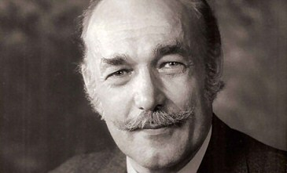
Generalised linear model
John Ashworth Nelder (public domain / Wikipedia)
Robert Wedderburn (public domain / Wikipedia)

Slide 39
Generalised linear model
An important special case is multiple linear regression:
$g\left(x\right)=x$
$Y∼N\left(η,σ^{2}\right)$
This can be written as:
$$Y=β_{0}+β_{1}X_{1}+…+β_{p}X_{p}+ϵ$$
with $ϵ∼N\left(0,σ^{2}\right)$
A special case of this model: 1 or 2 categorical predictor(s) only (one- or two-way ANOVA; see practical).

Slide 40
Generalised linear model
Same model we fitted before with lm():
modAlt<-glm(y~x,data=df,family=gaussian("identity")) summary(modAlt) ## ## Call: ## glm(formula = y ~ x, family = gaussian("identity"), data = df) ## ## Deviance Residuals: ## Min 1Q Median 3Q Max ## -4.0121 -1.6389 0.0023 1.0658 4.3398 ## ## Coefficients: ## Estimate Std. Error t value Pr(>|t|) ## (Intercept) 3.0149 0.3955 7.622 9.73e-08 *** ## x 1.7704 0.1300 13.618 1.70e-12 *** ## --- ## Signif. codes: 0 '***' 0.001 '**' 0.01 '*' 0.05 '.' 0.1 ' ' 1 ## ## (Dispersion parameter for gaussian family taken to be 3.853688) ## ## Null deviance: 803.257 on 24 degrees of freedom ## Residual deviance: 88.635 on 23 degrees of freedom ## AIC: 108.59 ## ## Number of Fisher Scoring iterations: 2

Slide 41
Generalised linear model
The linear predictor is linear in the coefficients $β_{i}$.
These are linear models:
$$E\left[Y|X\right]=β_{0}+β_{1}X+β_{2}X^{2}$$
$$E\left[Y|X\right]=β_{0}+β_{1}log\left(X\right)$$
$$E\left[Y|X\right]=β_{0}e^{−β_{1}X}$$
These are non-linear models:
$$E\left[Y|X\right]=β_{0}+β_{1}X^{−β_{2}}$$
$$E\left[Y|X\right]=\frac{β_{0}}{1+{\left(X/β_{1}\right)}^{2}}$$
$$E\left[Y|X\right]=\left\{\begin{matrix}β_{0}+β_{1}X & \text{ if }x<x_{0} \\ β_{2}+β_{3}X & \text{ otherwise}\end{matrix}\right.$$

Slide 42
Generalised linear model
Suppose we now observe data $D=\{y,x\}$ consisting of $n$ observations for 1 response and $p$ predictors. We can compute the probability density of observing these data:
$$L\left(D|θ\right)=\prod_{i=1}^{n}{f}\left(y_{i};μ_{i}=β_{0}+β_{1}x_{i1}+…+β_{p}x_{ip},σ_{i}\right)$$
where $θ=\left(β_{0},…,β_{k},σ\right)$, and $f\left(;μ,σ\right)$ is the pdf of the normal distribution with mean $μ$ and variance $σ^{2}$.
The parameters $β_{0},β_{1},…,β_{p},σ$ that maximise the likelihood $L\left(D|θ\right)$ are known as the maximum likelihood estimates.

Slide 43
Generalised linear model
Easier to use matrix notation.
Let:
$$Y={\left(Y_{1},…,Y_{n}\right)}^{T}$$
$$X=\left(\begin{matrix}1 & X_{11} & … & X_{p1} \\ ⋮ & ⋮ & ⋮ & ⋮ \\ 1 & X_{1n} & … & X_{pn}\end{matrix}\right)$$
$$β={\left(β_{0},…,β_{p}\right)}^{T}$$
$$ϵ={\left(ϵ_{1}…ϵ_{n}\right)}^{T}$$

Slide 44
Generalised linear model
We can then write the general linear model as
$$Y=Xβ+ϵ$$
where $ϵ∼N\left(0,σ^{2}I\right)$.
This can also be written as:
$$\left\{\begin{matrix}E\left(Y|X\right)=Xβ \\ Var\left(Y−Xβ\right)=σ^{2}\end{matrix}\right.$$
$X$ is called the design matrix.
Dimensions: $Y$ is $n×1$, $X$ is $n×\left(p+1\right)$, $β$ is $\left(p+1\right)×1$, $ϵ$ is $n×1$.

Slide 45
Generalised linear model
We noted already previously that for the multiple linear regression case, the ML estimates are equal to the LS estimates.
For observed data $y$ and $x$, the ML / LS estimates are given by
$$\hat{β}={\left(x^{T}x\right)}^{−1}x^{T}y$$
$${\hat{σ}}^{2}=\frac{1}{n}{\left|y−x\hat{β}\right|}^{2}$$

Slide 46
Generalised linear model
The above expressions are for the general linear model.
In practice, for the generalised linear model with no identity link function and/or non-Gaussian errors, parameter estimates are found by using iteratively reweighted least-squares and involve iteratively updating working weights weights $W$ and working responses (link scale) $Z$.

Slide 47
Generalised linear model
The GLM parameter estimates can be found using an iteratively weighted least squares (IWLS) algorithm:
Start with initial estimates $μ_{i}^{\left(r\right)}$.
Calculate working responses $z_{i}^{\left(r\right)}$ and working weights $w_{i}^{\left(r\right)}$.
Calculate $β^{\left(r\right)}$ by weighted least squares.
Repeat 2. and 3. until convergence.
For models with so-called canonical link functions (the default links in R), this is the Newton-Raphson method. For Gaussian errors with identity link, the Taylor series expansion is exact and the algorithm finishes in 1 iteration.
The IWLS algorithm for GLMs is so powerful because it works for the entire family of exponential distributions.

Slide 48
Generalised linear model
Recap:
Independent observations, true relation between response and predictor(s) is linear: linear regression.
Normal distribution of errors / residuals, continuous & categorical predictors, linear predictor is linear in parameters (not necessarily in the predictors): general linear model.
Link function, exponential-family distribution for errors / residuals: generalised linear model (GLM).

Slide 49
Statistical inference for GLMs

Slide 50
Generalised linear model
Quite often, we want to do statistical inference: we can use statistical theory and the estimated regression coefficients to make statements about the data and hence the processes that gave rise to them.
For instance we may want to check whether any of the predictor variables does indeed predict the response variable. That is, we want to test whether all or a subset of coefficients are zero.
There are 3 types of test we can perform:
Likelihood ratio tests
Wald tests
Score tests

Slide 51
Generalised linear model
We can arrange our vector of parameters $β$ so that it is the bottom $q$ of the $p+1$ coefficients that we want to test.
$$β=\left({β_{1} \atop β_{2}}\right)$$
where $β$ is $\left(p+1\right)×1$, $β_{1}$ is $\left(p−q+1\right)×1$ and $β_{2}$ is $q×1$.
We can then test $H_{0}:β_{2}=β_{2}^{0}$ against $H_{1}:β_{2}≠β_{2}^{0}$ where $β_{2}^{0}$ are some set of fixed values (usually $β_{2}^{0}=0$).

Slide 52
Generalised linear model
The likelihood ratio test is given by
$$2\left[L\left(\hat{β}\right)−L\left({\hat{β}}_{1},β_{2}^{0}\right)\right]∼χ_{q}^{2}$$

Slide 53
Generalised linear model
The Wald test is given by
$${\left({\hat{β}}_{2}−β_{2}^{0}\right)}^{T}{\left(Cov\left({\hat{β}}_{2}\right)\right)}^{−1}\left({\hat{β}}_{2}−β_{2}^{0}\right)∼χ_{q}^{2}$$
Wald tests are typically what is reported by statistical software, and for the case where $q=1$, this simplifies to a z-test (i.e. based on the normal distribution; recall: the square of a normal is a $χ_{1}^{2}$).
For $q=1$, we test $H_{0}:β_{j}=b$ vs. $H_{1}:β_{j}≠b$ and the test statistic (using the normal distribution of the MLE estimates) is given by:
$$Z_{j}=\frac{{\hat{β}}_{j}−b}{\sqrt{a\left(ϕ\right)}{\left(X^{T}\hat{W}X\right)}_{jj}^{−1}}∼N\left(0,1\right)$$
Note that this distributional result only holds asymptotically.

Slide 54
Generalised linear model
The score test is given by
$$s{\left(β_{2}^{0}\right)}^{T}(Cov{\left(s\left(β_{2}^{0})\right)\right)}^{−1}s\left(β_{2}^{0}\right)∼χ_{q}^{2}$$
where $s\left(β\right)$ is the vector of scores / partial derivatives of the log-likelihood: $s\left(β_{j}\right)=\frac{δl}{δβ_{j}}$.

Slide 55
Generalised linear model
All 3 tests are exact only asymptotically and for any finite dataset, they will be only approximate.
For Gaussian distributions, specifically the general linear model, we can derive exact tests that take into account that we also need to estimate the dispersion parameter (in this case $σ^{2}$).

Slide 56
Generalised linear model
The F-test
$H_{0}:β_{1}=β_{2}=…β_{p}=0$
$H_{1}:\text{ at least one }β_{j}≠0,j=1,…,p$
Test statistic:
$$F=RSS/ESS∼F_{p,n−p−1}$$
In general we can test a null hypothesis for $q$ of the coefficients to be all zero against one where not all of the $q$ coefficients are zero: $F∼F_{q,n−p−1}$.

Slide 57
Generalised linear model
The t-test
The F test has a special case: when we test only $q=1$ parameter. This is a $F_{1,n−p−1}$ distribution, which turns out to be the square of a $t_{n−p−1}$ distribution (see Session 2 - diagram of relations between distributions).
But you can also derive it directly as a test for the estimated coefficient:
$$H_{0}:β_{j}=b$$
$$H_{1}:β_{j}≠b$$
Test statistic:
$$T=\frac{\hat{β_{j}}−b}{se\left({\hat{β}}_{j}\right)}∼T_{n−p−1}$$

Slide 58
Generalised linear model: confidence bands
Once we have fitted a GLM, we can predict new values.
Predicting response values for predictor values well outside the ones used to fit the model should be avoided!
Prediction uses estimates. Can we derive prediction confidence intervals? What we predict in a GLM is the mean response. We can actually consider 2 types of prediction confidence intervals:
for the mean response
for a new observation
The first one takes only the uncertainty of the model fit into account, the second one also takes the variability of the response values into account.

Slide 59
Generalised linear model: confidence bands
We have seen that the estimators $\hat{β}$ are asympotically normally distributed. This implies that, on the link function scale (i.e. for the linear predictor $η$), we can construct confidence intervals using the asympotic normal distribution, then back transform to the scale of the response variable.
For a 95% confidence interval for the mean response:
$$\hat{η}±1.96×SE\left(\hat{η}\right)$$
And then, backtransforming
$${\hat{y}}_{low}=g^{−1}\left({\hat{η}}_{low}\right)$$
$${\hat{y}}_{high}=g^{−1}\left({\hat{η}}_{high}\right)$$

Slide 60
Generalised linear model: confidence bands
Example:
modPois<-glm(dist~speed,data=cars,family=poisson) newX<-data.frame(speed=seq(1,30,length=500)) pred<-predict(modPois,type="link",newdata=newX, se.fit=T) predFit<-exp(pred$fit) predLow<-exp(pred$fit-qnorm(0.975)*pred$se.fit) predHigh<-exp(pred$fit+qnorm(0.975)*pred$se.fit) plot(dist~speed,data=cars,cex=2,xlim=c(1,30),ylim=c(0,170)) lines(newX$speed,predFit,lwd=2,col="steelblue") polygon(x=c(newX$speed,newX$speed[nrow(newX):1]),y=c(predLow,predHigh[nrow(newX):1]),col=rgb(70,130,180,alpha=100,maxColorValue=255),border=NA)

Slide 61
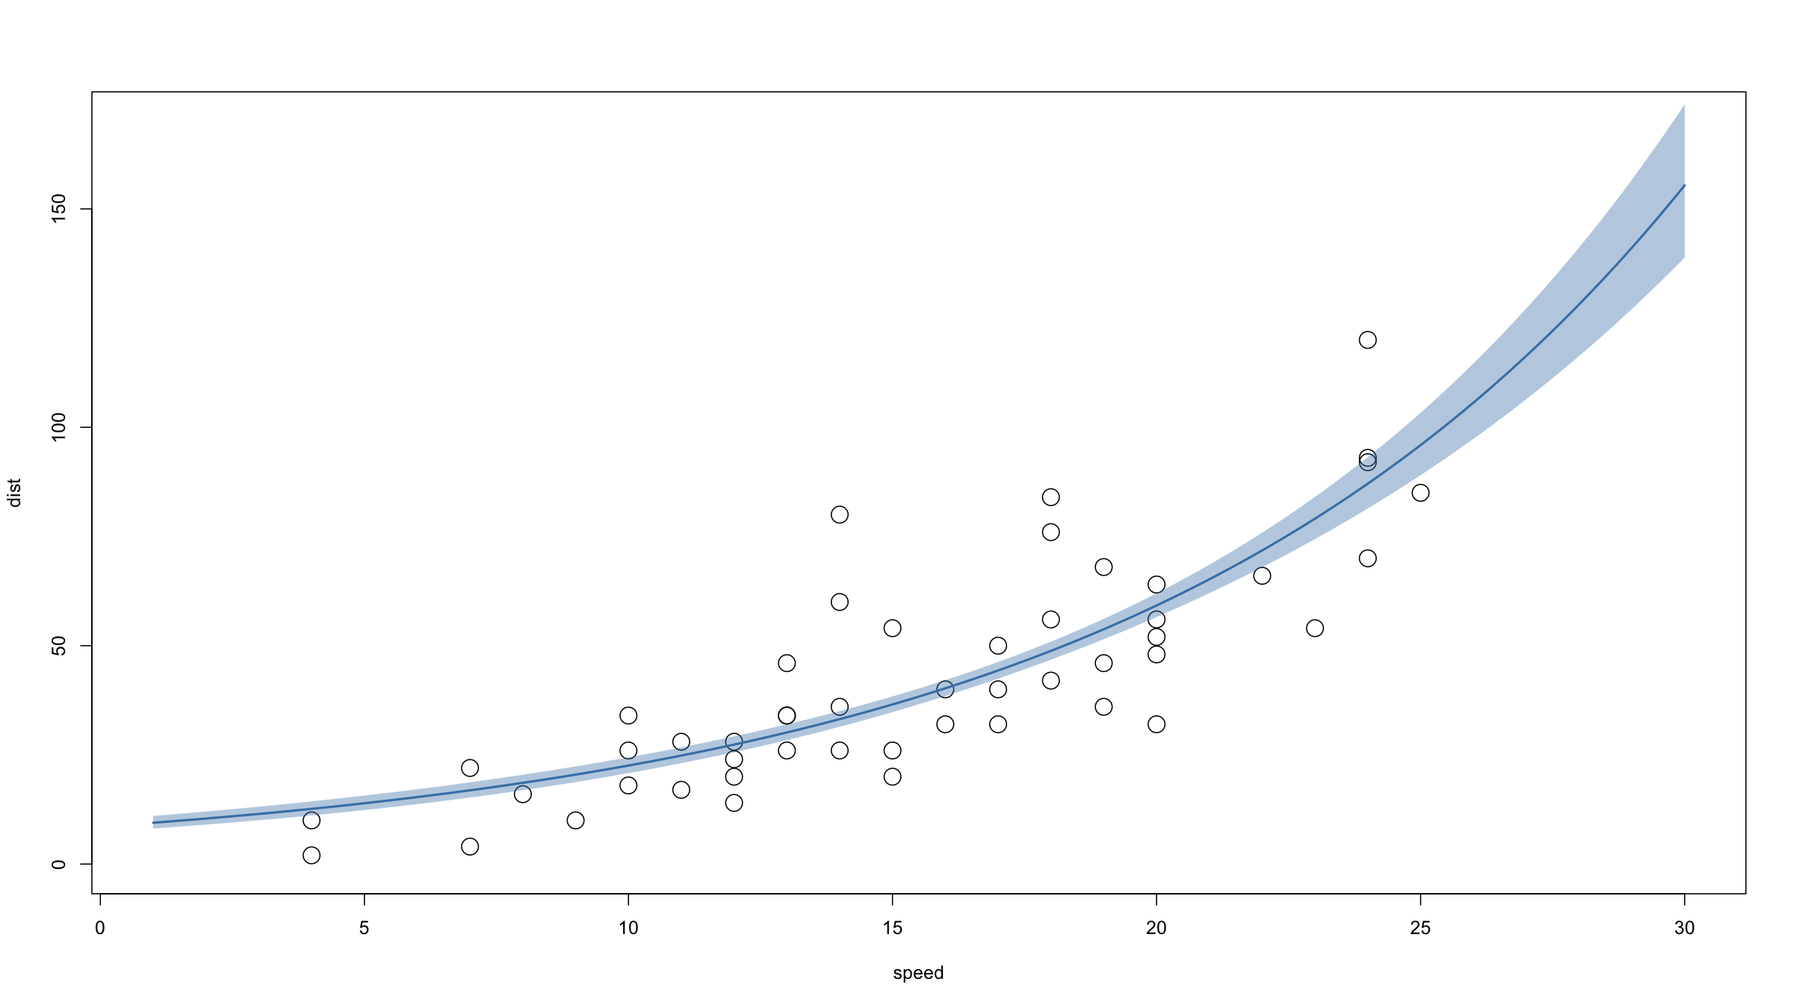

Slide 62
Generalised linear model: confidence bands
Confidence intervals for new observations are more tricky as we would need an estimate of the variability of the response variable on the link scale.
For some models, we cannot derive analytical solutions (e.g. Poisson) and for others (e.g. binomial), it would make little sense.
We can do this for general linear models however.

Slide 63
Generalised linear model: confidence bands
For Gaussian distribution with identity link GLMs, we can even derive exact prediction confidence intervals - for both the mean response and new observations.
Mean response confidence interval for a model with $p$ predictors:
$$\hat{y}±t_{α/2,n−p−1}SE\left(\hat{y}\right)$$
where $SE\left(\hat{y}\right)=\sqrt{MSE×x_{new}{\left(X^{T}X\right)}^{−1}x_{new}}$ and $x_{new}$ is the vector of predictors corresponding to $\hat{y}$.
Confidence intervals for a new observation for a model with $p$ predictors:
$$\hat{y}±t_{α/2,n−p−1}\sqrt{MSE+SE{\left(\hat{y}\right)}^{2}}$$

Slide 64
Generalised linear model: confidence bands
Example:
set.seed(20190718) x<-rnorm(50) y<-1.5*x+rnorm(50) df<-data.frame(x=x,y=y) mod<-lm(y~x,data=df) xx<-seq(-3,3,length=500) predMean<-as.data.frame(predict(mod,newdata=data.frame(x=xx),interval="confidence")) predNew<-as.data.frame(predict(mod,newdata=data.frame(x=xx),interval="prediction"))

Slide 65
Generalised linear model: confidence bands
Example:
plot(y~x,data=df,cex=2) lines(c(-3,3),coef(mod)[1]+coef(mod)[2]*c(-3,3),lwd=2,col="steelblue") polygon(c(xx,xx[length(xx):1]),c(predNew$lwr,predNew$upr[length(xx):1]),border=NA,col=rgb(200,0,0,alpha=80,maxColorValue=255)) polygon(c(xx,xx[length(xx):1]),c(predMean$lwr,predMean$upr[length(xx):1]),border=NA,col=rgb(120,200,0,alpha=130,maxColorValue=255)) lines(c(-3,3),coef(mod)[1]+coef(mod)[2]*c(-3,3),lwd=2,col="steelblue")

Slide 66
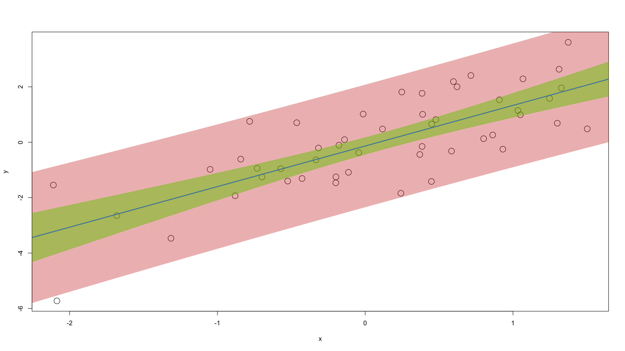

Slide 67
Non-identity link functions & non-normal distributions

Slide 68
Generalised linear model
Now suppose our response $Y$ is a binary variable.
Obiously this will have a Bernoulli / binomial distribution: no problem for the GLM.
Our model:
$$E\left[Y|X\right]=P\left(Y|X\right)=g^{−1}\left(β_{0}+β_{1}X\right)$$

Slide 69
Generalised linear model
If $g\left(x\right)=x$, then $β_{1}$ will the average change in risk, $P\left(Y|X\right)$, for a one unit change in X.
I.e. an estimate for $β_{1}$ will estimate the risk difference associated with a one unit change in X.
But: given estimates $\hat{β_{0}},\hat{β_{1}}$, we can easily predict values for p outside of $\left[0,1\right]$. So an identity-link model for a binary outcome, almost always is nonsense.
glm(y~x,family=binomial("identity"))

Slide 70
Generalised linear model
Let’s consider
$$\text{log}\left(E\left[Y|X\right]\right)=β_{0}+β_{1}X$$
Now a one unit change in $X$ will results in a difference in logs, i.e. a log of a ratio.
$e^{β_{1}}$ will be the risk ratio or relative risk associated with a one unit change in X.
However, since $E\left[Y|X\right]$ is a probability, $log\left(E\left[Y|X\right]\right)≤0$.
So we can still sometimes predict impossible values.
Still: this is a useful model sometimes. It’s the log-binomial model.
glm(y~x,family=binomial("log"))

Slide 71
Generalised linear model
Now let’s take $g\left(x\right)=log\left(x/\left(1−x\right)\right)$, the logit function.
This yields the logistic regression model:
$$\text{logit}\left(E\left[Y|X\right]\right)=β_{0}+β_{1}X$$
Now a one unit change in X will result in the log of a ratio of odds, i.e. $e^{β_{1}}$ will be the odds ratio associated with a one unit change in X.
Logistic regression is a direct probability model: no distributional assumptions.

Slide 72
Generalised linear model
Binomial data can be presented in 2 forms:
ungrouped; every $Y_{i}∈\{0,1\}$ and $m_{i}=1$
grouped; our data has been grouped (e.g. by class, by household, by village) and we only observe the number of events among $m_{i}$ trials in each group: $Y_{i}∈\{0,1,…,m_{i}\}$ and $m_{i}≥1$

Slide 73
Generalised linear model
Example
# ungrouped modLowBirthWeight<-glm(as.factor(lowbwt)~Gestation,data=bw,family=binomial) # family=binomial("logit") also works #summary(mod4) round(digits=2,cbind( exp(coef(modLowBirthWeight)), exp(confint(modLowBirthWeight)) )) ## Waiting for profiling to be done... ## 2.5 % 97.5 % ## (Intercept) 3.971124e+13 501487.34 1.146583e+26 ## Gestation 4.200000e-01 0.19 6.800000e-01

Slide 74
Generalised linear model
Example
# grouped modTitanic<-glm(cbind(survivors, dead) ~ class + age + sex + class*sex, data = titanic, family = binomial("logit")) round(digits=2,cbind( exp(coef(modTitanic)), exp(confint(modTitanic)) )) ## Waiting for profiling to be done... ## 2.5 % 97.5 % ## (Intercept) 35.09 14.82 114.15 ## class2nd 0.19 0.05 0.55 ## class3rd 0.02 0.01 0.05 ## classCrew 0.19 0.04 1.02 ## ageChild 2.87 1.82 4.51 ## sexMale 0.01 0.00 0.04 ## class2nd:sexMale 1.57 0.47 6.24 ## class3rd:sexMale 17.51 6.44 61.76 ## classCrew:sexMale 2.96 0.53 14.95

Slide 75
Generalised linear model
Note that given parameters estimates $\hat{β}$, we can compute estimated soutcome probabilities:
$$P\left(\text{outcome}|x\right)=\frac{e^{{\hat{β}}^{T}x}}{1+e^{{\hat{β}}^{T}x}}$$
And we can compare these to the empirical outcome probabilities. In the case of the titanic.csv dataset, our outcome is survival.
# empirical survival probabilities titanic$empSurvP<-round(digits=4,titanic$survivors/(titanic$survivors+titanic$dead)) # model survival probabilities linearPredictor<-predict(modTitanic,type="link") titanic$modSurvP<-round(digits=2,exp(linearPredictor)/(1+exp(linearPredictor)))

Slide 76
Generalised linear model
print(titanic) ## class age sex survivors dead empSurvP modSurvP ## 1 1st Adult Male 57 118 0.3257 0.34 ## 2 2nd Adult Male 14 154 0.0833 0.13 ## 3 3rd Adult Male 75 387 0.1623 0.15 ## 4 Crew Adult Male 192 670 0.2227 0.22 ## 5 1st Child Male 5 0 1.0000 0.59 ## 6 2nd Child Male 11 0 1.0000 0.30 ## 7 3rd Child Male 13 35 0.2708 0.34 ## 8 1st Adult Female 140 4 0.9722 0.97 ## 9 2nd Adult Female 80 13 0.8602 0.87 ## 10 3rd Adult Female 76 89 0.4606 0.42 ## 11 Crew Adult Female 20 3 0.8696 0.87 ## 12 1st Child Female 1 0 1.0000 0.99 ## 13 2nd Child Female 13 0 1.0000 0.95 ## 14 3rd Child Female 14 17 0.4516 0.67

Slide 77
Generalised linear model
If $Y$ is a counting variable, then the Poisson distribution for $Y$ can be useful.
In Poisson regression, the log link is used:
$$log\left(E\left[Y|X\right]\right)=β_{0}+β_{1}X$$
or equivalently
$$E\left[Y|X\right]=e^{β_{0}+β_{1}X}$$
$β_{1}$ represents the increase in event rate associated with a one unit change in $X$.
In Poisson regression, one often specifies an offset. This is a covariate the coefficient of which is fixed to be 1. This effectively serves as a denominator for the rate parameter: $β_{1}$ is the event rate per unit of the offset.

Slide 78
Generalised linear model
Example
library(pscl) # install.packages("pscl") ## Classes and Methods for R developed in the ## Political Science Computational Laboratory ## Department of Political Science ## Stanford University ## Simon Jackman ## hurdle and zeroinfl functions by Achim Zeileis data(prussian) # data on deaths from horse kicks in the Prussian army (famous example of a Poisson process) modPrus<-glm(y~year+as.factor(corp),data=prussian,family=poisson) # family=poisson(link="log") also works

Slide 79
Model diagnostics

Slide 80
Diagnostics
For GLMs, we can generalise the residual sum of squares (also known as the error sum of squares). We introduce the deviance:
$$D\left(y,\hat{μ}\right)=2ϕ\left(l\left({\hat{θ}}_{s}\right)−l\left(\hat{θ}\right)\right)$$
where ${\hat{θ}}_{s}$ and $\hat{θ}$ refer to the MLE parameters of the saturated and the proposed model respectively and 𝑙() is the log-likelihood function ($ϕ$ is a scale parameter).
The saturated model is a model with 1 parameter for every observation. It is the model that fits the data exactly.

Slide 81
Diagnostics
The deviance is a scaled likelihood ratio statistic (recall: differences of logs = log of ratio).
As we saw, the deviance generalises the residual / error sum of squares to GLMs. This means the deviance can be used as a measure of goodness of fit.
Under the null hypothesis of no difference between the saturated and the proposed model:
$$D\left(y,\hat{μ}\right)∼χ_{n−p−1}^{2}$$

Slide 82
Diagnostics
We can also compute the deviance for the worst model: the one where we include only an intercept.
This is called the null deviance and in the general linear model it is equal to the total sum of squares $TSS=SS_{y}$.
$$D_{0}\left(y\right)=D\left(y,\overset{‾}{y}\right)=2ϕ\left(l\left({\hat{θ}}_{s}\right)−l\left({\hat{θ}}_{0}\right)\right)$$

Slide 83
Diagnostics
Residuals
We can calculate several different types of residulals in a GLM:
response $r_{i}=y_{i}−{\hat{y}}_{i}$
working $r_{i}^{W}$ obtained from the last iteration of the IWLS algorithm
Pearson response residuals standardised by the variance function $r_{i}^{P}=\frac{y_{i}−{\hat{y}}_{i}}{\sqrt{V\left({\hat{μ}}_{i}\right)}}$
deviance $r_{i}^{D}$ so that i​riD2=Dy,μ

Slide 84
Diagnostics
Residuals
Note: for normal models these are all equal.
R will by default return deviance residuals (e.g.by typing resid(mod)). You can use the same R function to compute the other residuals: resid(mod,type="pearson") will compute the Pearson residuals.

Slide 85
Diagnostics
Model diagnostics: why do it?
There is a very simple & good reason: if the data violate the model assumptions, then all the inferential results we derived (coverage of CIs, p-values, …) no longer hold – we cannot really say anything about the process that generated the data from our model and the model predictions are likely to be very wrong.
The point of model diagnostics is to check that the model assumptions appear to be met.
There are several checks that can be done. For each check, We will first discuss the case of the general linear model, then move on to generalised linear models.

Slide 86
Diagnostics
Let’s fit a linear model to the TB data from Sessions 1 and 4:
modBW_Mppwt<-glm(Birthweight~mppwt,data=bw) modBW_GestMppwt<-glm(Birthweight~Gestation+mppwt,data=bw)

Slide 87
Diagnostics
You have fitted a GLM model. How do you know it’s any good?
Goodness of fit?
Visual check
$R^{2}$, $R_{adj}^{2}$
AIC, BIC
Residuals?
QQ plot
Residuals vs. predicted values
Hat values, Cook’s distance

Slide 88
Diagnostics
Goodness of fit
Visual checks
These work well for simple models with only one or a limited number of predictors.
Conceptually simple: just plot response vs. prdictor and add a line for the model fit.
Same for general & generalised linear models.
ggplot(data=bw,mapping=aes(x=mppwt,y=Birthweight)) + geom_point() + geom_abline(intercept=coef(modBW_Mppwt)[1], slope=coef(modBW_Mppwt)[2], col="steelblue", lwd=2) + xlab("mother's pre-pregnancy weight (lbs)") + ylab("neonate birthweight (lbs)")

Slide 89
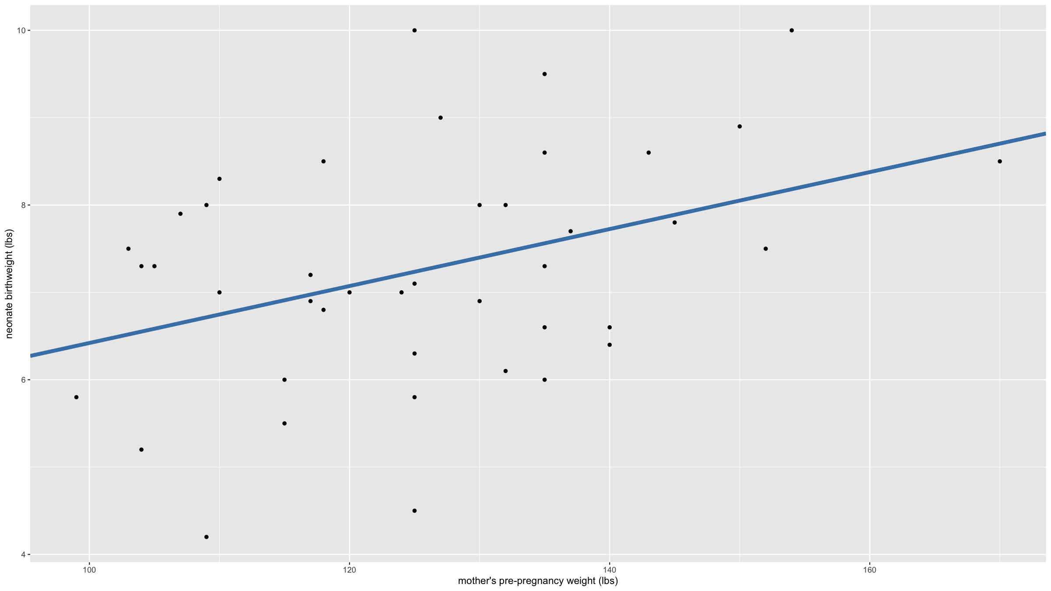

Slide 90
Diagnostics
Goodness of fit
Same thing…
ggplot(data=bw,mapping=aes(x=mppwt,y=Birthweight)) + geom_point()+ geom_smooth(method="lm") ## `geom_smooth()` using formula 'y ~ x'

Slide 91
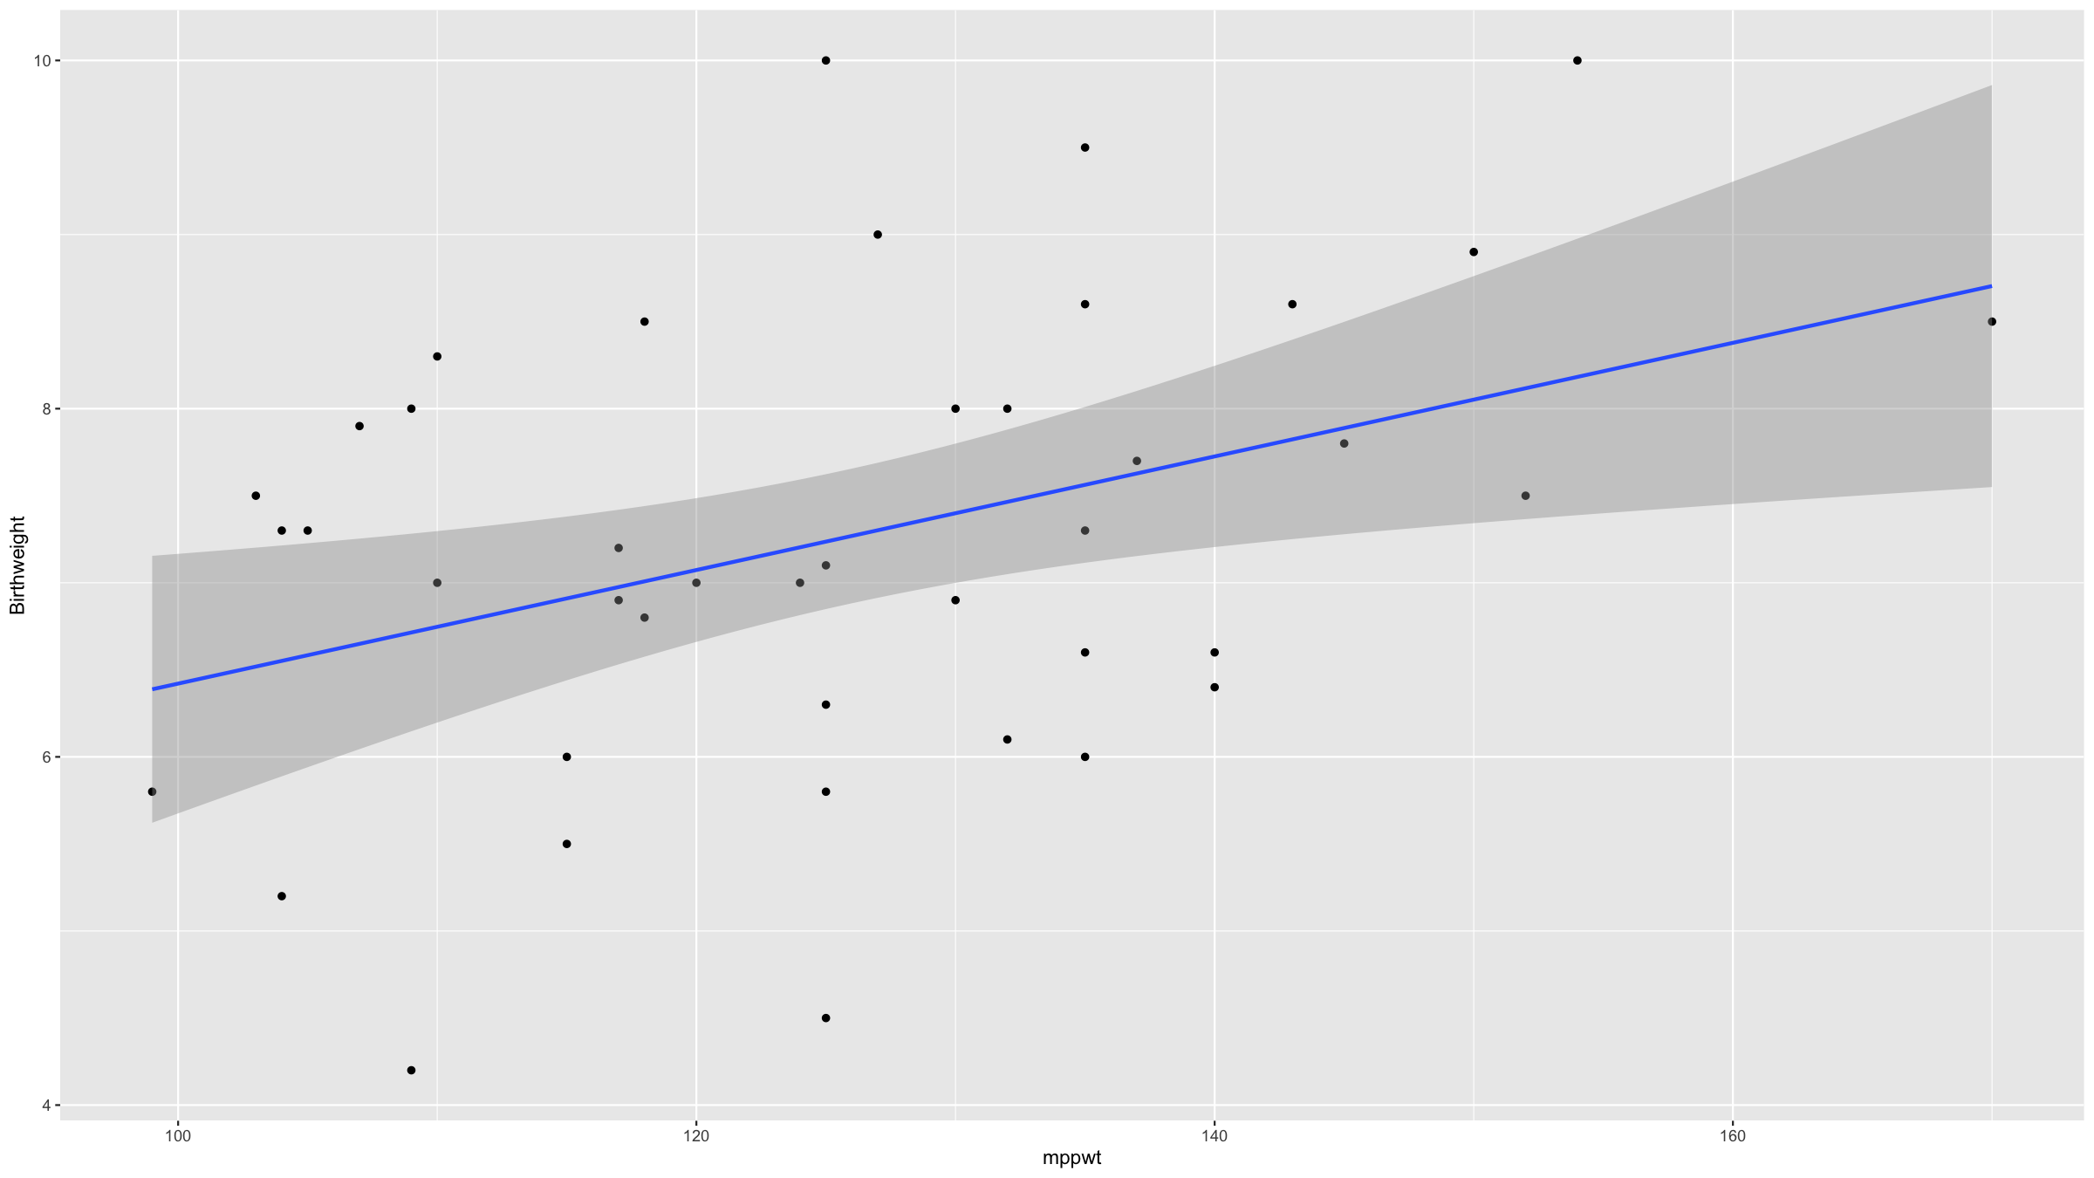

Slide 92
Diagnostics
Goodness of fit
We have already seen $R^{2}$, the coefficient of determination. It can be interpreted as the proportion of variance explained by the model.
It is not wise to maximise $R^{2}$: you will end up with overfitted models with many parameters.
The adjusted $R^{2}$,
$$R_{adj}^{2}=1−\left(1−R^{2}\right)\frac{n−1}{n−p−1}$$
is penalised for the number of parameters in the model.

Slide 93
Diagnostics
Goodness of fit
For GLMs we need to generalise $R^{2}$ however. We can compute the proportion of deviance explained, the pseudo $R^{2}$:
$$R_{d}^{2}=1−\frac{D\left(y,\hat{μ}\right)}{D_{0}\left(y\right)}$$
Intuitively, you are checking how much of the null deviance is explained by your model.
As for the standard $R^{2}$, if you select your model based on $R_{d}^{2}$, you will overfit, so use the adjusted $R_{d,adj}^{2}$.

Slide 94
Diagnostics
Goodness of fit
When maximum likelihood is used, you can also consider the likelihood itself as a measure of (relative) goodness of fit.
Again: better to penalise for the number of parameters in the model.
Akaike Information Criterion (AIC)
$$2⋅\left(p+1\right)−2⋅\text{ln}\left(\hat{L}\right)$$
Bayesian Information Criterion (BIC)
$$\text{ln(n)}⋅\left(p+1\right)−2⋅\text{ln}\left(\hat{L}\right)$$
This works also for GLMs.

Slide 95
Diagnostics
QQ plot
Plots the empirical quantiles of the residuals against those from a normal distribution. If the residuals are normally distributed, these should line on a straight line.
rmodBW<-residuals(modBW_Mppwt) theoQ<-qnorm(order(order(rmodBW))/length(rmodBW)) # calculates theorectical normal quantiles plot(theoQ,rmodBW, xlab="theoretical normal quantiles", ylab="sample quantiles", main="QQ plot") qqline(rmodBW) # just adds the line

Slide 96
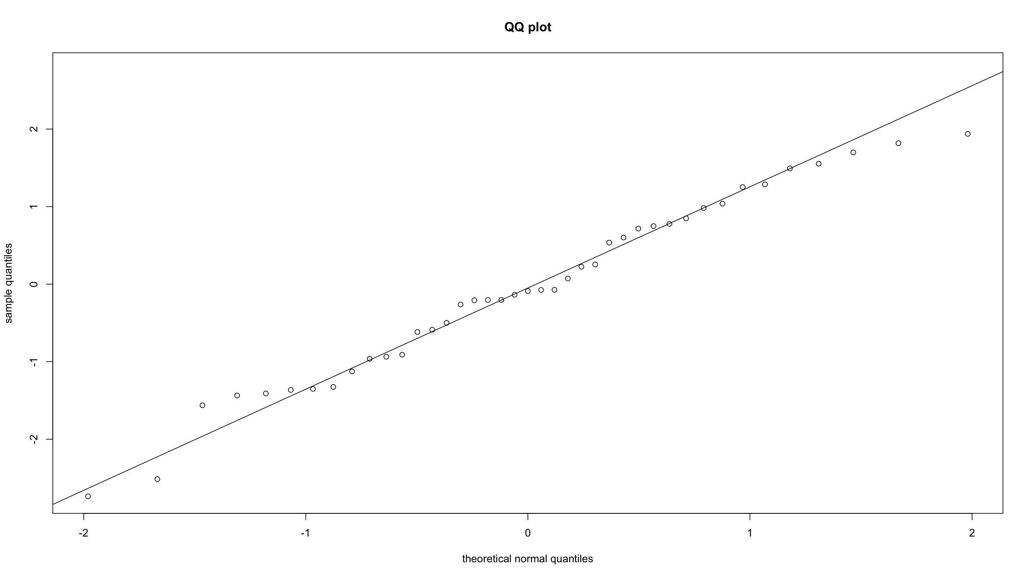

Slide 97
Diagnostics
QQ plot
This would also work:
qqnorm(rmodBW, xlab="theoretical normal quantiles", ylab="sample quantiles", main="QQ plot") qqline(rmodBW)

Slide 98
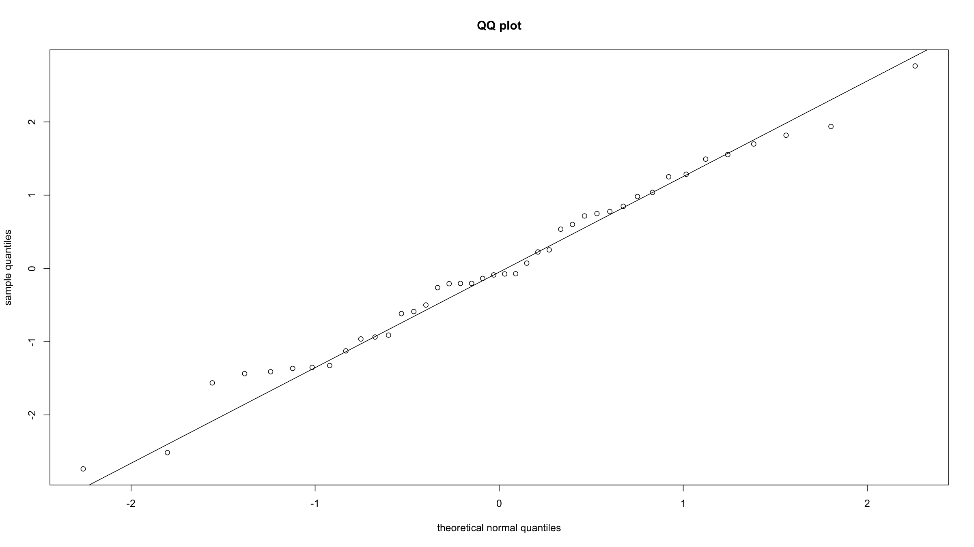

Slide 99
Diagnostics
QQ plot
QQ plots show the empirical quantiles of the residuals against those from the theoretical distribution of the errors.
For Gaussian response models, the theoretical distribution is just the normal distribution. For other response distributions, this can be a bit trickier and simulations may be needed needed to derive approximate theoretical quantiles.
We know that the linear predictor estimates are approximately normally distributed, so we could compute residuals on that scale and then do a normal distribution QQ plot. However even this has its limitations

Slide 100
Diagnostics
QQ plot
Further, models like logistic regression are direct probability models and hence there are no distributional assumptions for the errors.
For these reasons, in GLMs, as opposed to normal distribution linear models, QQ plots are not often used.

Slide 101
Diagnostics
Residuals vs. predicted values
You can easily (though subjectively) verify whether:
residuals centered symmetrically around 0
residuals have constant variance
there are any outliers
plot(predict(modBW_Mppwt,data=bw),residuals(modBW_Mppwt), xlab="fitted values", ylab="residuals")

Slide 102
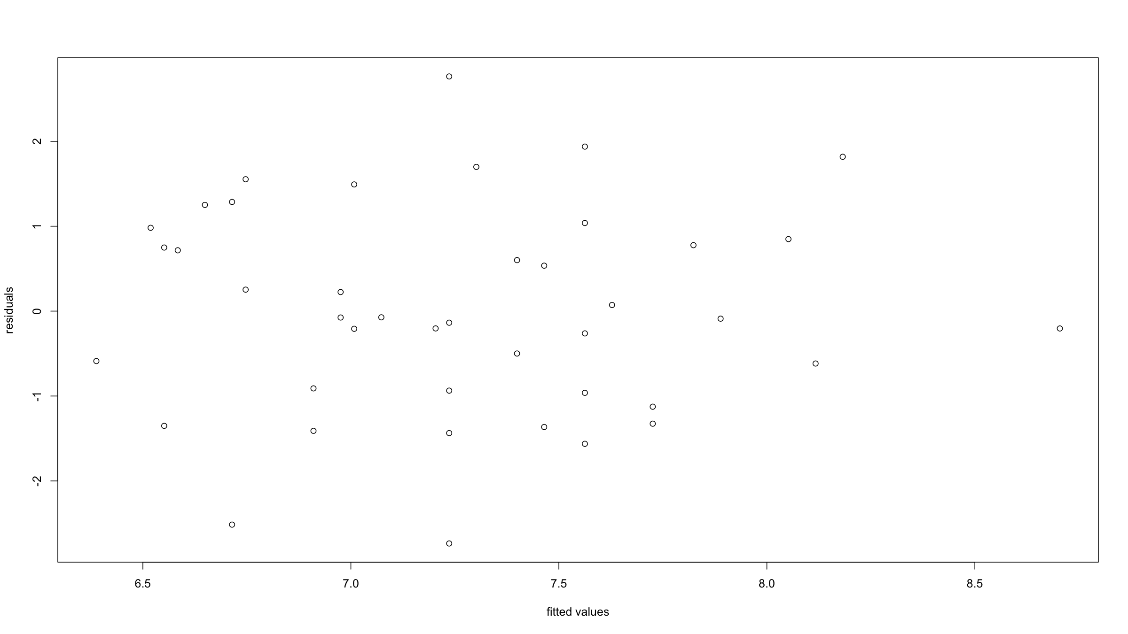

Slide 103
Diagnostics
Residuals vs. predicted values
For non-normal distribution GLMs, the variance function of the model can imply a trend of the variance with the mean.
for this reason, Pearson residuals are very useful in GLMs: these residuals are standardised by the estimated variance function. In other words, if the Pearson residuals exhibit non-constant variance, then this suggest we have misspecified the data distribution.

Slide 104
Diagnostics
Typing plot(modBW_Mppwt) will produce these and a few more (we have not the time to cover everything here) diagnostic graphs.
plot(modBW_Mppwt)

Slide 105
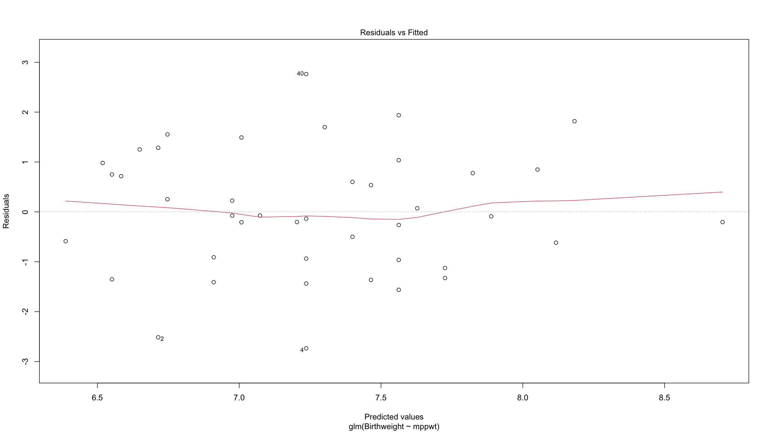

Slide 106
Diagnostics
Influential observations
An influential observation is an observation which, if dropped from the dataset when fitting the model, would noticeably affect the model parameter estimates.
We have already alluded to one type of such influential observations: observations with high leverage - large residuals near the extremes of the predictor variables’ ranges.
There are many methods, most based on re-fitting models while leaving out individual observations. We will focus on 2 metrics: hat values (measuring leverage of observations) and Cook’s distance (measuring influence).

Slide 107
Diagnostics
Influential observations
The hat matrix $H$ is the matrix that projects $y$ onto the subspace spanned by the columns of the design matrix $X$: $\hat{y}=Hy$. In the normal distribution linear model:
$$H=X{\left(X^{T}X\right)}^{−1}X^{T}$$
and in GLMs:
$$H=W^{1/2}X{\left(X^{T}WX\right)}^{−1}X^{T}W^{1/2}$$
The hat values $h_{ii}$ are the diagonal elements of this matrix and they indicate the leverage of observations.

Slide 108
Diagnostics
Influential observations
The $h_{ii}$ are bounded between 0 and 1 (in models with an intercept, they are bounded between 1/n and 1), and their sum, i​hii, is always equal to $p+1$, the number of coefficients in the model, including the intercept. Problems in which there are a few very large $h_{ii}$ can be troublesome: in particular, large-sample normality of some linear combinations of the regressors is likely to fail, and high-leverage observations may exert undue influence on the results.
The R function hatvalues() will compute hat values for both lm and glm objects.
plot(hatvalues(modBW_Mppwt),cex=2)

Slide 109
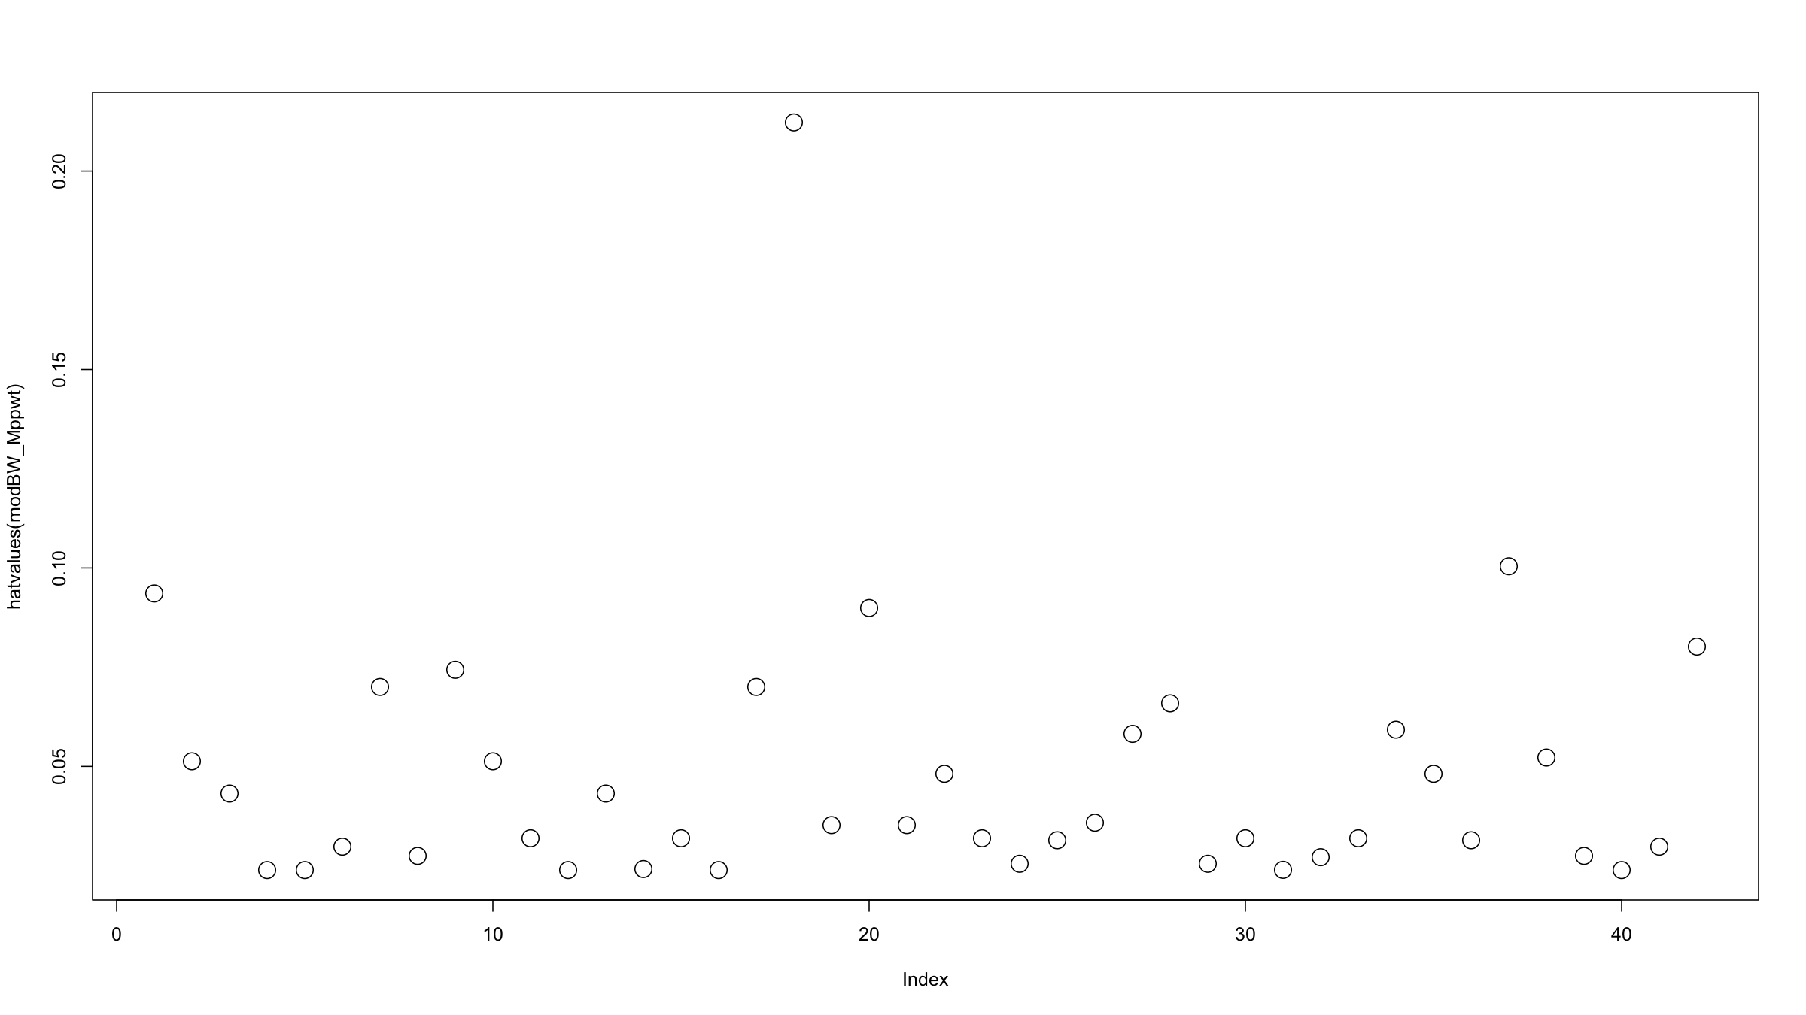

Slide 110
Diagnostics
Influential observations
The most common influence measure is Cook’s distance. It is one of many leave-one-out / deletion methods for measuring influence of observations.
If $\hat{β}$ is the estimated coefficient vector from the full dataset, then let ${\hat{β}}_{\left(i\right)}$ be the vector of coefficient estimates obtained from fitting the model to the dataset with the $i^{th}$ observation removed.
The difference $\hat{β}−{\hat{β}}_{\left(i\right)}$ directly measures the influence of the $i^{th}$ observation: small / large difference = small / large influence.

Slide 111
Diagnostics
Influential observations
This difference is a vector however, and it is more convenient to summarise the influence by a single number.
Cook’s distance is the weighted sum of squares of the differences between the individual vector elements. In matrix notation:
$$D_{i}=\frac{{\left(β−{\hat{β}}_{\left(i\right)}\right)}^{T}{\left(X^{T}WX\right)}^{−1}\left(β−{\hat{β}}_{\left(i\right)}\right)}{\left(p+1\right)s^{2}}$$

Slide 112
Diagnostics
Influential observations
The R function cooks.distance() computes Cook’s distance for both lm and glm objects.
plot(cooks.distance(modBW_Mppwt),cex=2)

Slide 113
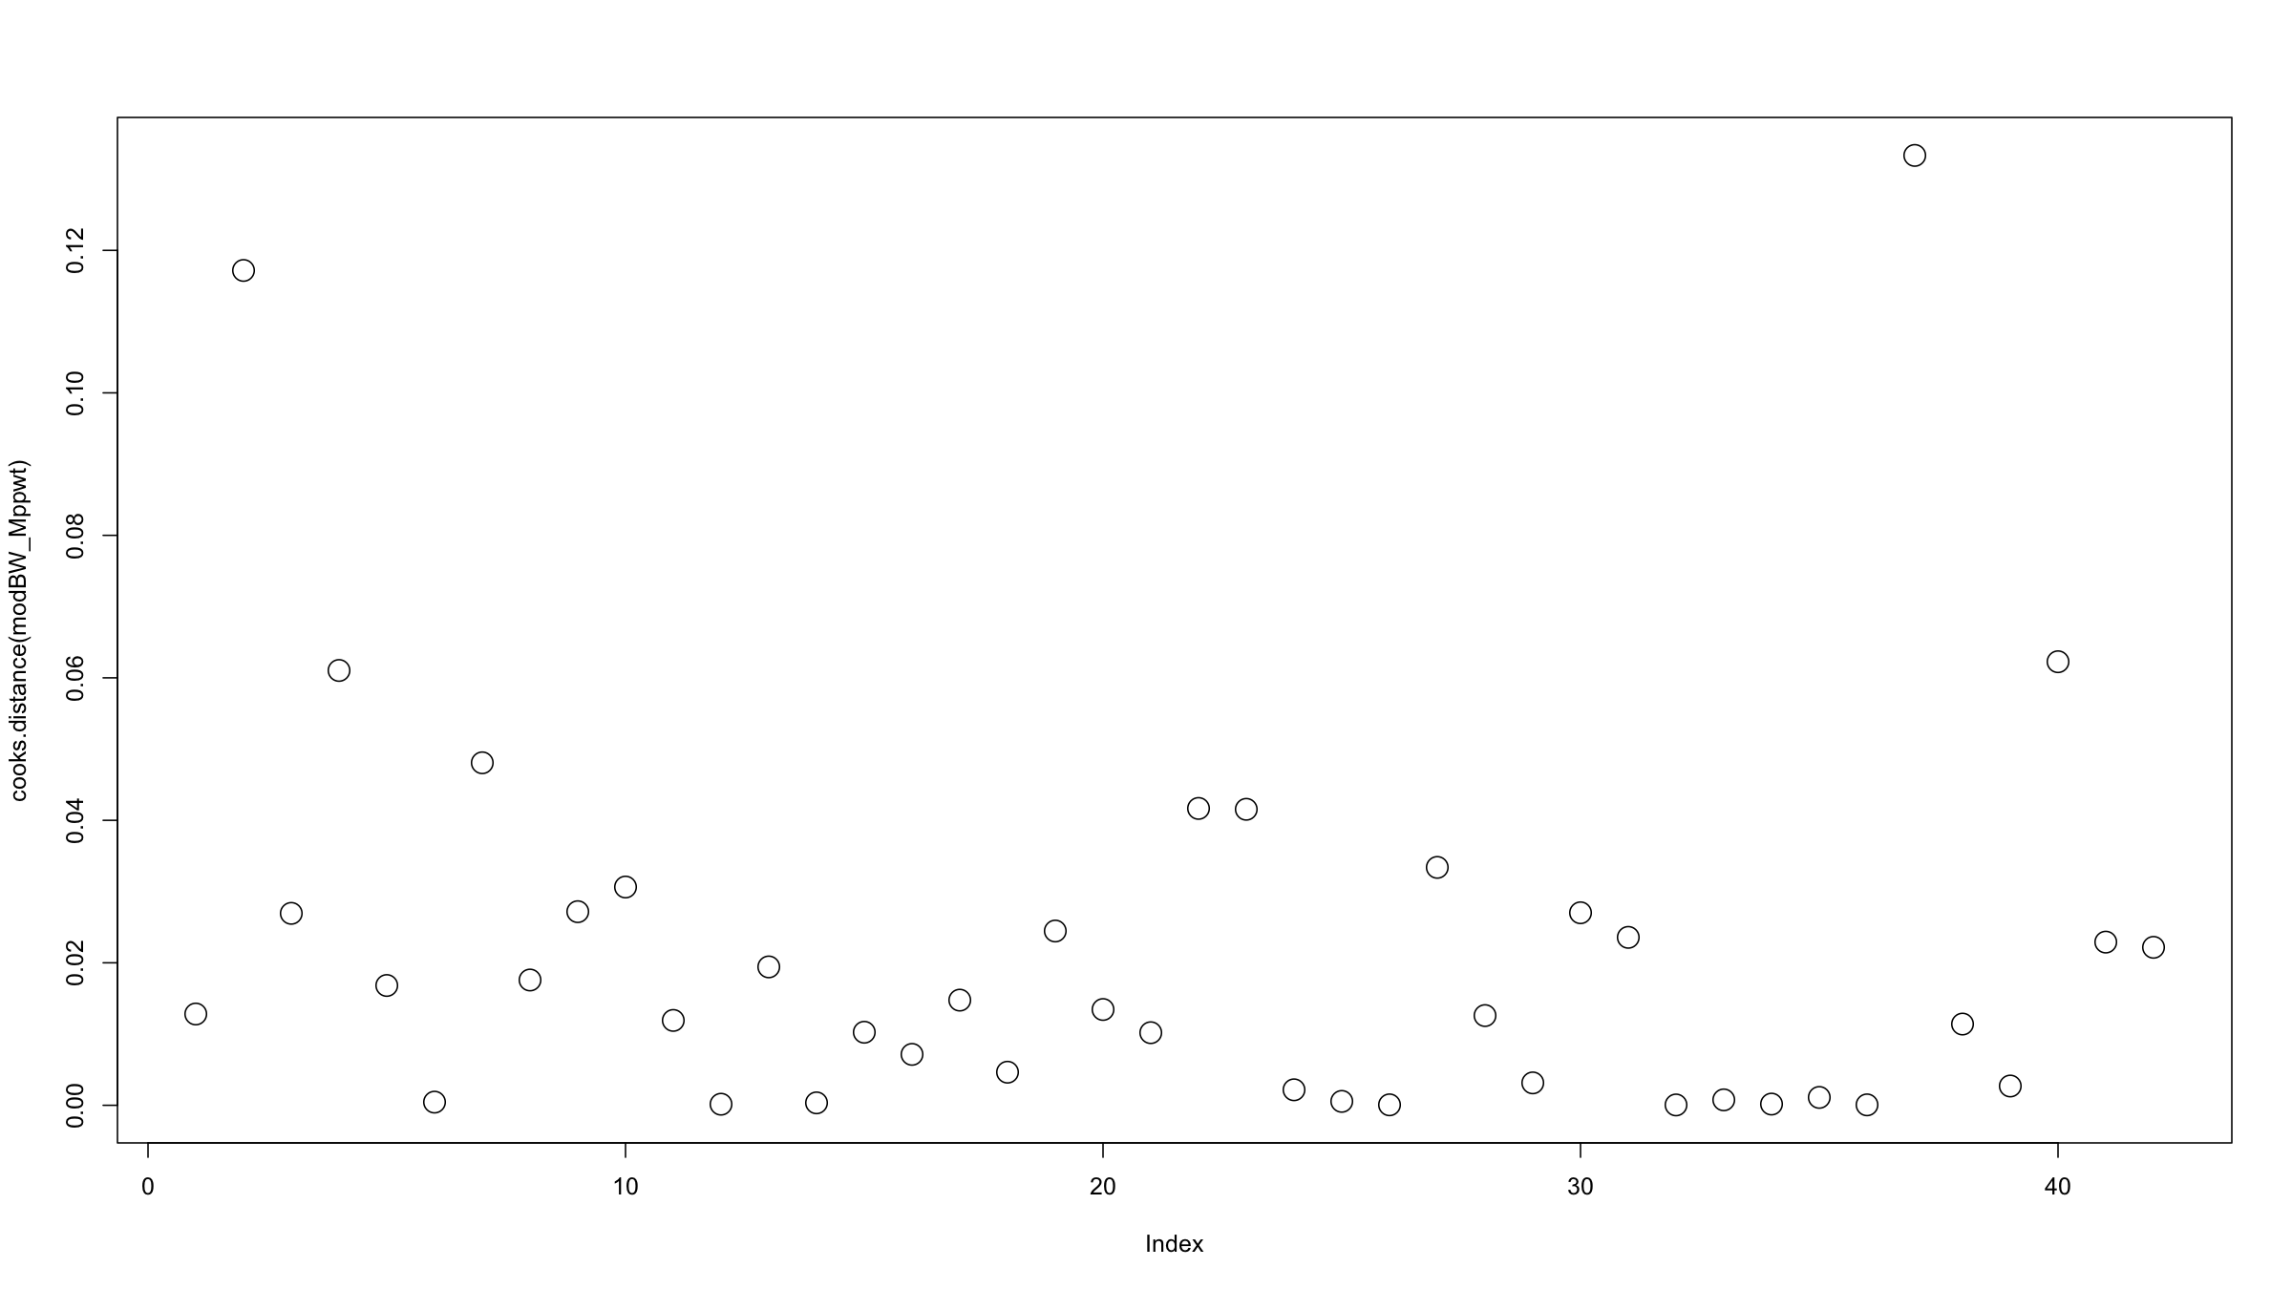

Slide 114
Diagnostics
Influential observations
The R package car has a helpful plotting function for plotting both the hat values and Cook’s D (and also studentised residuals). Cook’s D is given by the size of the circles.
library(car) influencePlot(modBW_Mppwt)

Slide 115
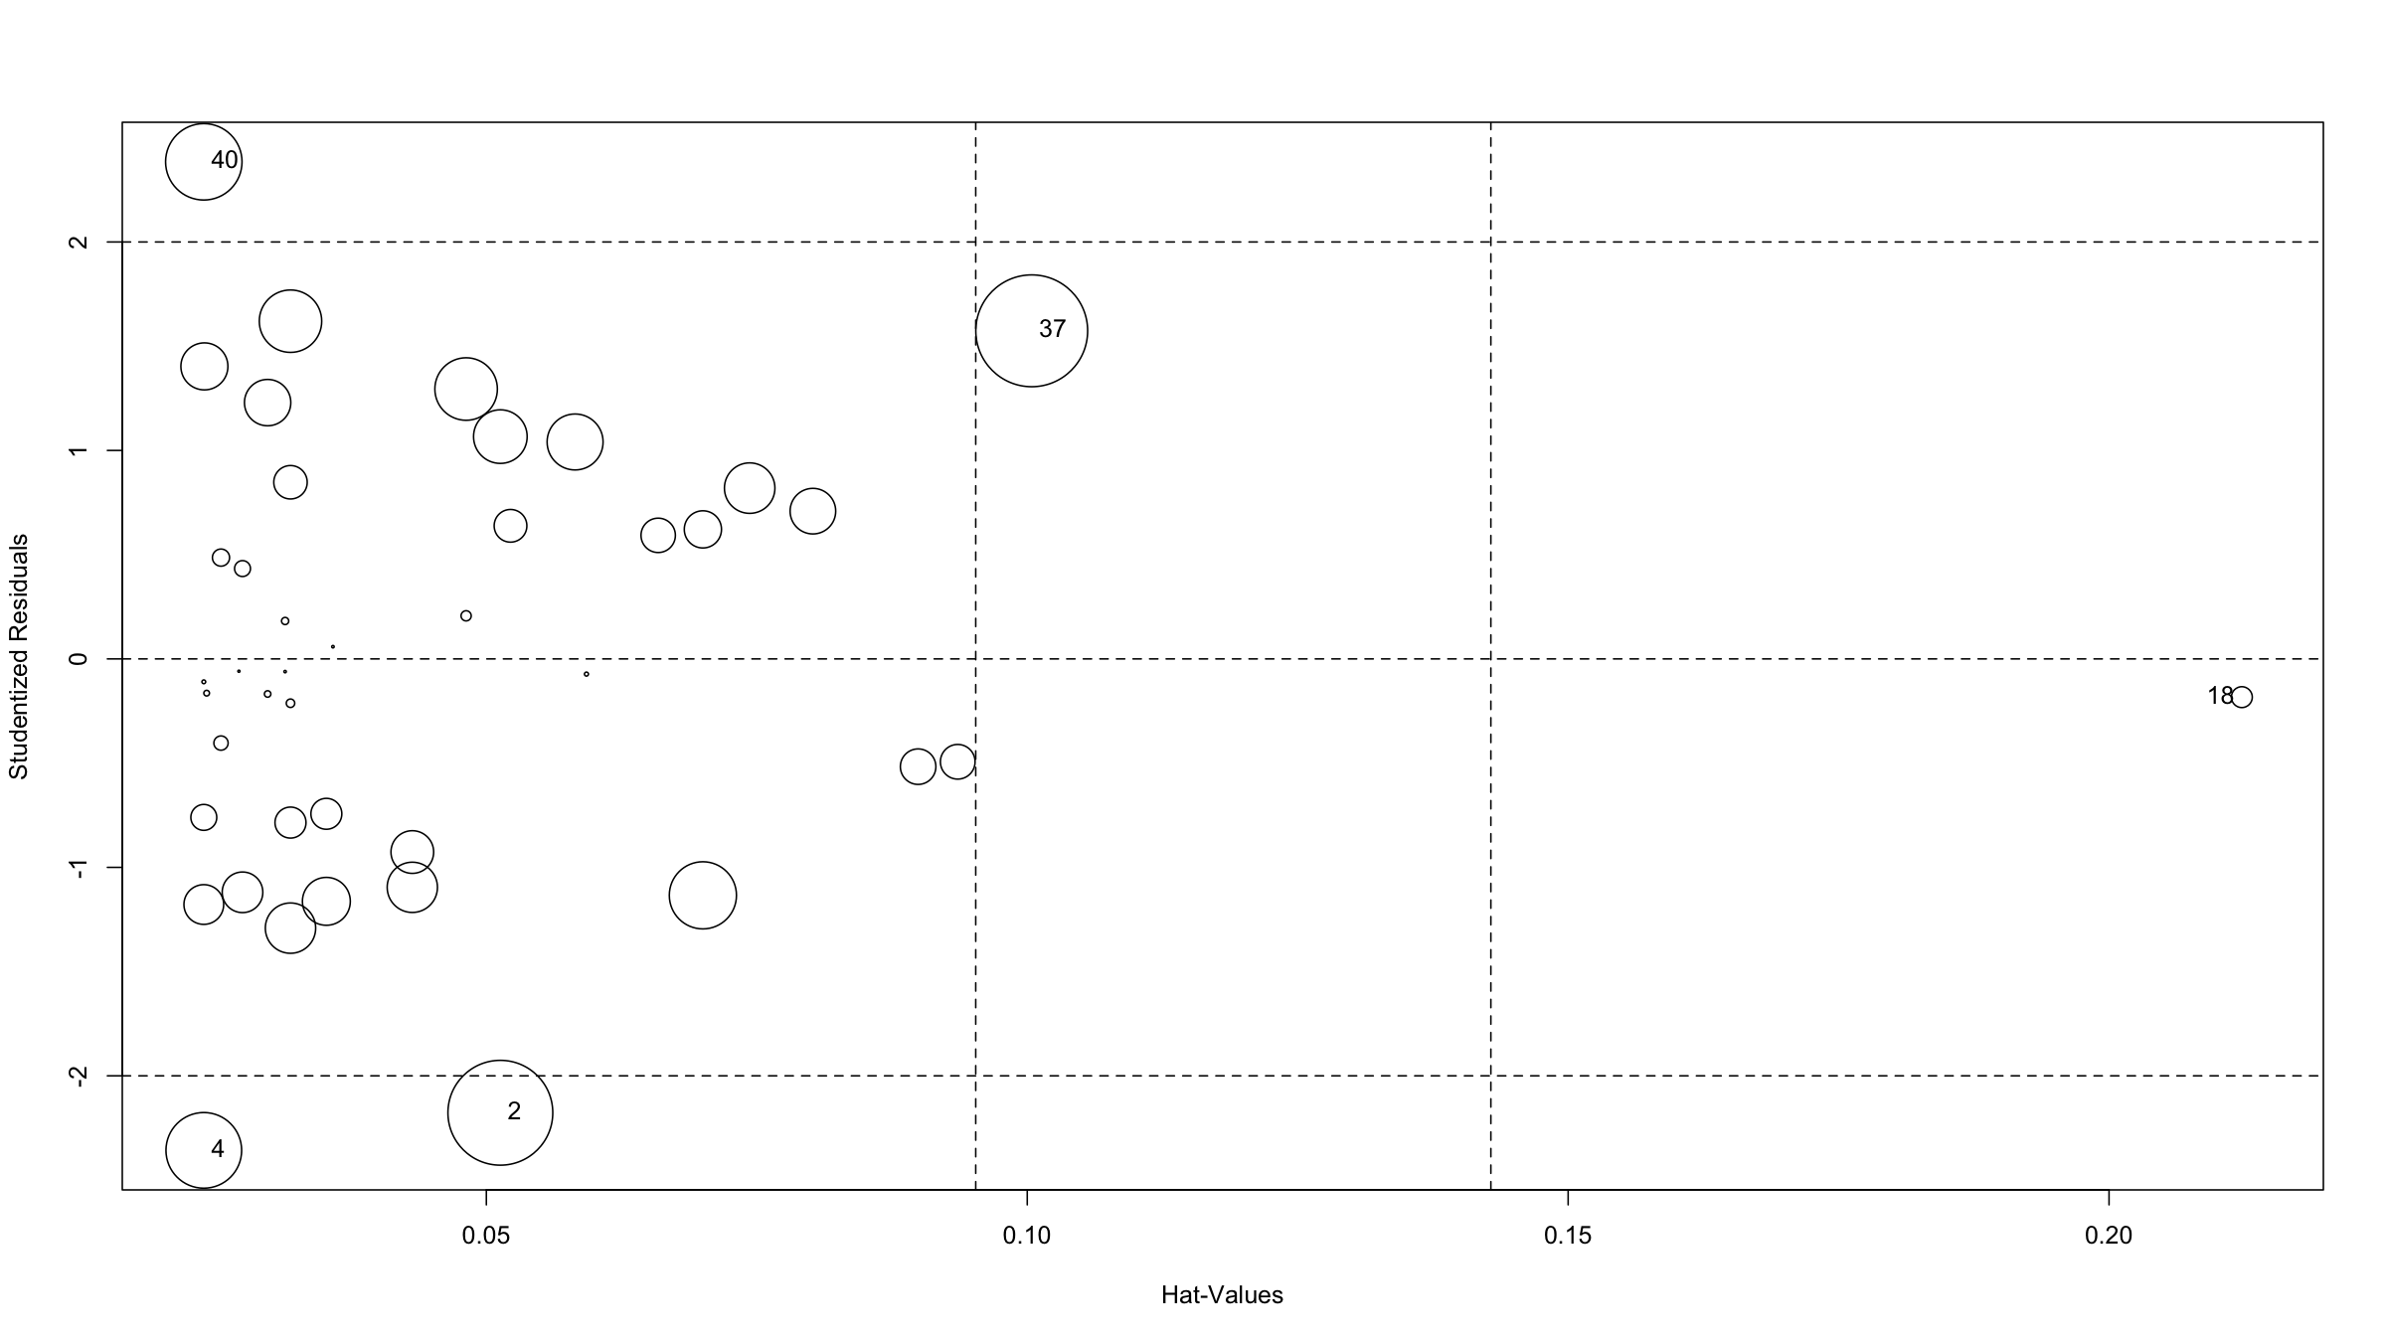

Slide 116
## StudRes Hat CookD ## 2 -2.1771480 0.05129374 0.11718176 ## 4 -2.3575737 0.02388058 0.06103449 ## 18 -0.1834157 0.21227697 0.00464508 ## 37 1.5738906 0.10041359 0.13332758 ## 40 2.3845565 0.02388058 0.06226080

Slide 117
GLM notes

Slide 118
GLM notes: Interaction terms
Consider the model
$$Y=β_{0}+β_{1}\text{ age}+β_{2}\text{ male}+β_{3}\text{ male}⋅\text{ age}+ϵ$$
If you are female, the effect on $Y$ for age is $β_{1}$.
If you are male, the effect on $Y$ for age is $β_{1}+β_{3}$.
This is an interaction effect: age and sex are not independent. There are different slopes for age, depending on your sex.
You can have interaction terms for 2 categorical variables, 1 categorical & 1 continuous, 2 continuous variables.
Interpretation becomes more difficult.
Always include both individual terms!

Slide 119
GLM notes: Interaction terms
Example
ado<-read.csv("dataAndSupportDocs/adolescent_small.csv") modWeightInt<-glm(a104wt~a12age*hiv,data=ado) summary(modWeightInt)$coefficients ## Estimate Std. Error t value Pr(>|t|) ## (Intercept) -12.202112 3.3080393 -3.688624 2.741478e-04 ## a12age 3.895924 0.2359772 16.509745 1.844004e-42 ## hivpositive 9.074343 5.1781378 1.752434 8.086903e-02 ## a12age:hivpositive -1.453828 0.3808874 -3.816950 1.686588e-04

Slide 120
GLM notes: Collinearity
If two predictors $X_{1},X_{2}$ are correlated, then estimation of the GLM can become difficult and interpretation of coefficients also becomes tricky.
The numerical instability comes from the fact that MLE will involve matrix inversion and this will become singular the more $X_{1}$ and $X_{2}$ are correlated.
Centering correlated variables will often help.
Best to avoid including collinear predictors.
Variance inflation factors (VIF) can help to spot multicollinearity and to remove problematic explanatory variables.

Slide 121
GLM notes: Collinearity
Consider the model:
$$Y=β_{0}+β_{1}X_{1}+β_{2}X_{2}+…+β_{k}X_{k}+ϵ \left(*\right)$$
The VIF for the $j^{th}$ predictor variable is given by $VIF_{j}=1/\left(1−R_{j}^{2}\right)$ where $R_{j}^{2}$ is the coefficient of determination of the model where $X_{j}$ is the response and all other explanatory variables in the model (*) are predictors.
If the $j^{t}h$ variable is independent of all other variables, then $R_{j}^{2}=0$ and $VIF_{j}=1$.
In practice (rule of thumb): $VIF>10$ = severe collinearity, $VIF>5$ = high collinearity.

Slide 122
GLM notes: Collinearity
In R: car::vif computes VIFs, but the function Hmisc::varclus can also be helpful.
ado$tmpVar<-ado$a103ht+rnorm(nrow(ado),sd=6) modWeightColl<-glm(a104wt~as.factor(a13sex)+a12age+a103ht+tmpVar,data=ado) car::vif(modWeightColl) ## as.factor(a13sex) a12age a103ht tmpVar ## 1.019997 2.187040 8.808446 7.422361

Slide 123
Notes: Variable selection
How to select variables for inclusion in a model?
This is not as trivial as it sounds. It is best to rely on expert knowledge and avoiding methods that are based on estimated effects / p-values such as
significant variables from single predictor regressions [the worst selection technique]
stepwise forwards selection
stepwise backwards selection [least bad as it involves at least a full model fot]
These methods are used (very) commonly, especially forwards selection, but violate many principles of statistical estimation and hypothesis testing.

Slide 124
Notes: Variable selection
The problems with these techniques (see Harrell, F., Regression Modelling Strategies, 2nd ed., 2015, Springer.):
Yield $R^{2}$ values that are biased high.
Ordinary F and $χ^{2}$ tests do not have the claimed distributions.
Standard errors of regression coefficients are biased low.
Resulting p-values are too small.
Regression coefficients are biased high.
Residual confounding is an issue.
Collinearity is not solved but exarcerbated by these techniques.

Slide 125
Notes: Variable selection
If you choose variables to keep in the model by their p-values, then use a high threshold, e.g. 0.5.
The best approach is to discuss a priori with experts in the field in which the data have been collected and ask them what should be included in the model. Then base your inference only on that single model you fitted. Keep variables even if they have non-significant coefficients. E.g. predictions can still benefit from non-significant variables in the model.
Regularisation techniques such as elastic net, ridge regression or the lasso have more desirable properties (but do not get around all problems). These methods put a penalty on the coefficients in the model and this either shrinks (ridge, L2 penalty) them or removes (lasso, L1 penalty) them from the model as the penalty is increased.

Slide 126
Notes: splines
Most relationships between variables are not linear.
Categorisation of a continuous predictor is often used to deal with such non-linearity. However, this is inefficient and leads to reduced power.
Transformations or polynomial terms ($X^{2}$, $X^{3}$ etc) can be used, but polynomials in particular have undesirable properties (peaks & valleys, points far away can have a large impact on the curve in another region, …).
Linear or cubic splines and Generalised Additive Models (GAMs) can provide very flexible ways to model data while still providing all the statistical inference machinery we have seen for GLMs.
geom_smooth() from ggplot2 uses GAMs for more than 1,000 observations (or when method="gam" is specified).

Slide 127
Notes: splines
A draftman’s spline is a flexible strip of wood or rubber to draw smooth curves (e.g. used by shipbuilders).
Mathematically, for a response $y$ and a predictor $x$, a linear spline with $k=3$ knots at locations $x=k_{1},k_{2},k_{3}$ can be written as:
$$y=β_{0}+β_{1}⋅x+β_{2}⋅{\left(x−k_{1}\right)}_{+}+β_{3}⋅{\left(x−k_{2}\right)}_{+}+β_{4}⋅{\left(x−k_{3}\right)}_{+}+ϵ$$
where ${\left(x\right)}_{+}=x$ if $x≥0$ and $0$ otherwise.
This means that the fitted curve has different slopes in different intervals of values of $x$:

Slide 128
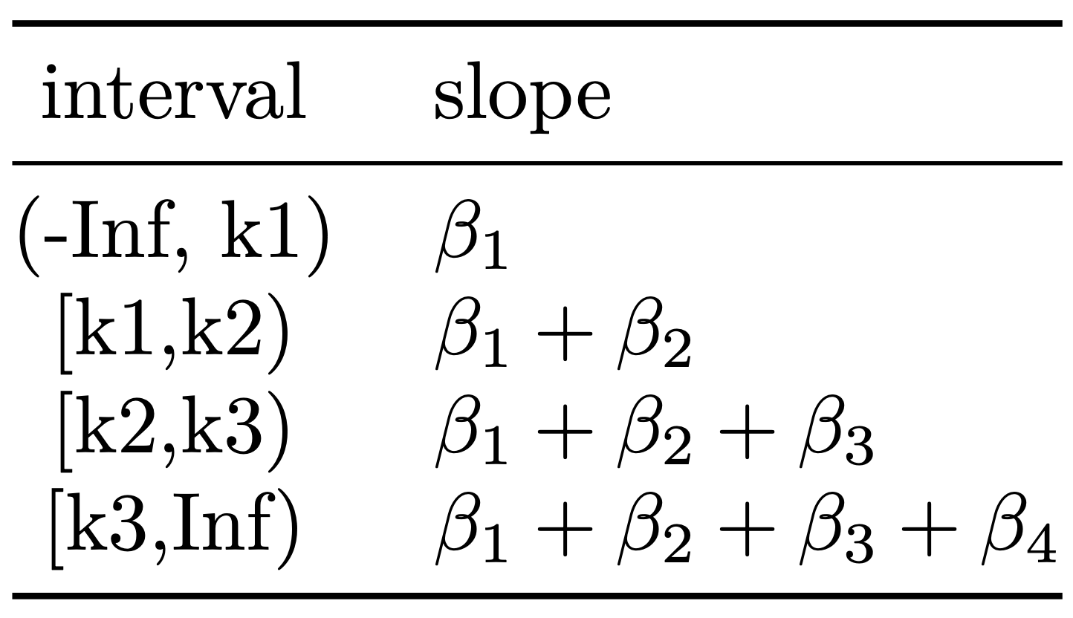

Slide 129
Notes: splines
x<-rnorm(100,mean=5,sd=2) y<-2+x-2*x^2+0.2*x^3+rnorm(100,sd=5) df<-data.frame(x,y) rm(x,y) modLsp<-glm(y~lsp(x,c(3,6)),data=df) # lsp() requires rms package newdf<-data.frame(x=df$x,predict.lm(modLsp,interval="confidence"))

Slide 130
Notes: splines
df %>% ggplot(mapping=aes(x=x,y=y)) + geom_point(size=3) + geom_line(data=newdf,mapping=aes(x=x,y=fit),col="orange",lwd=2) + geom_ribbon(data=newdf,mapping=aes(y=fit,ymin=lwr,ymax=upr),alpha=0.2) + geom_vline(xintercept=3,lty=2,col="darkgrey") + geom_vline(xintercept=6,lty=2,col="darkgrey")

Slide 131
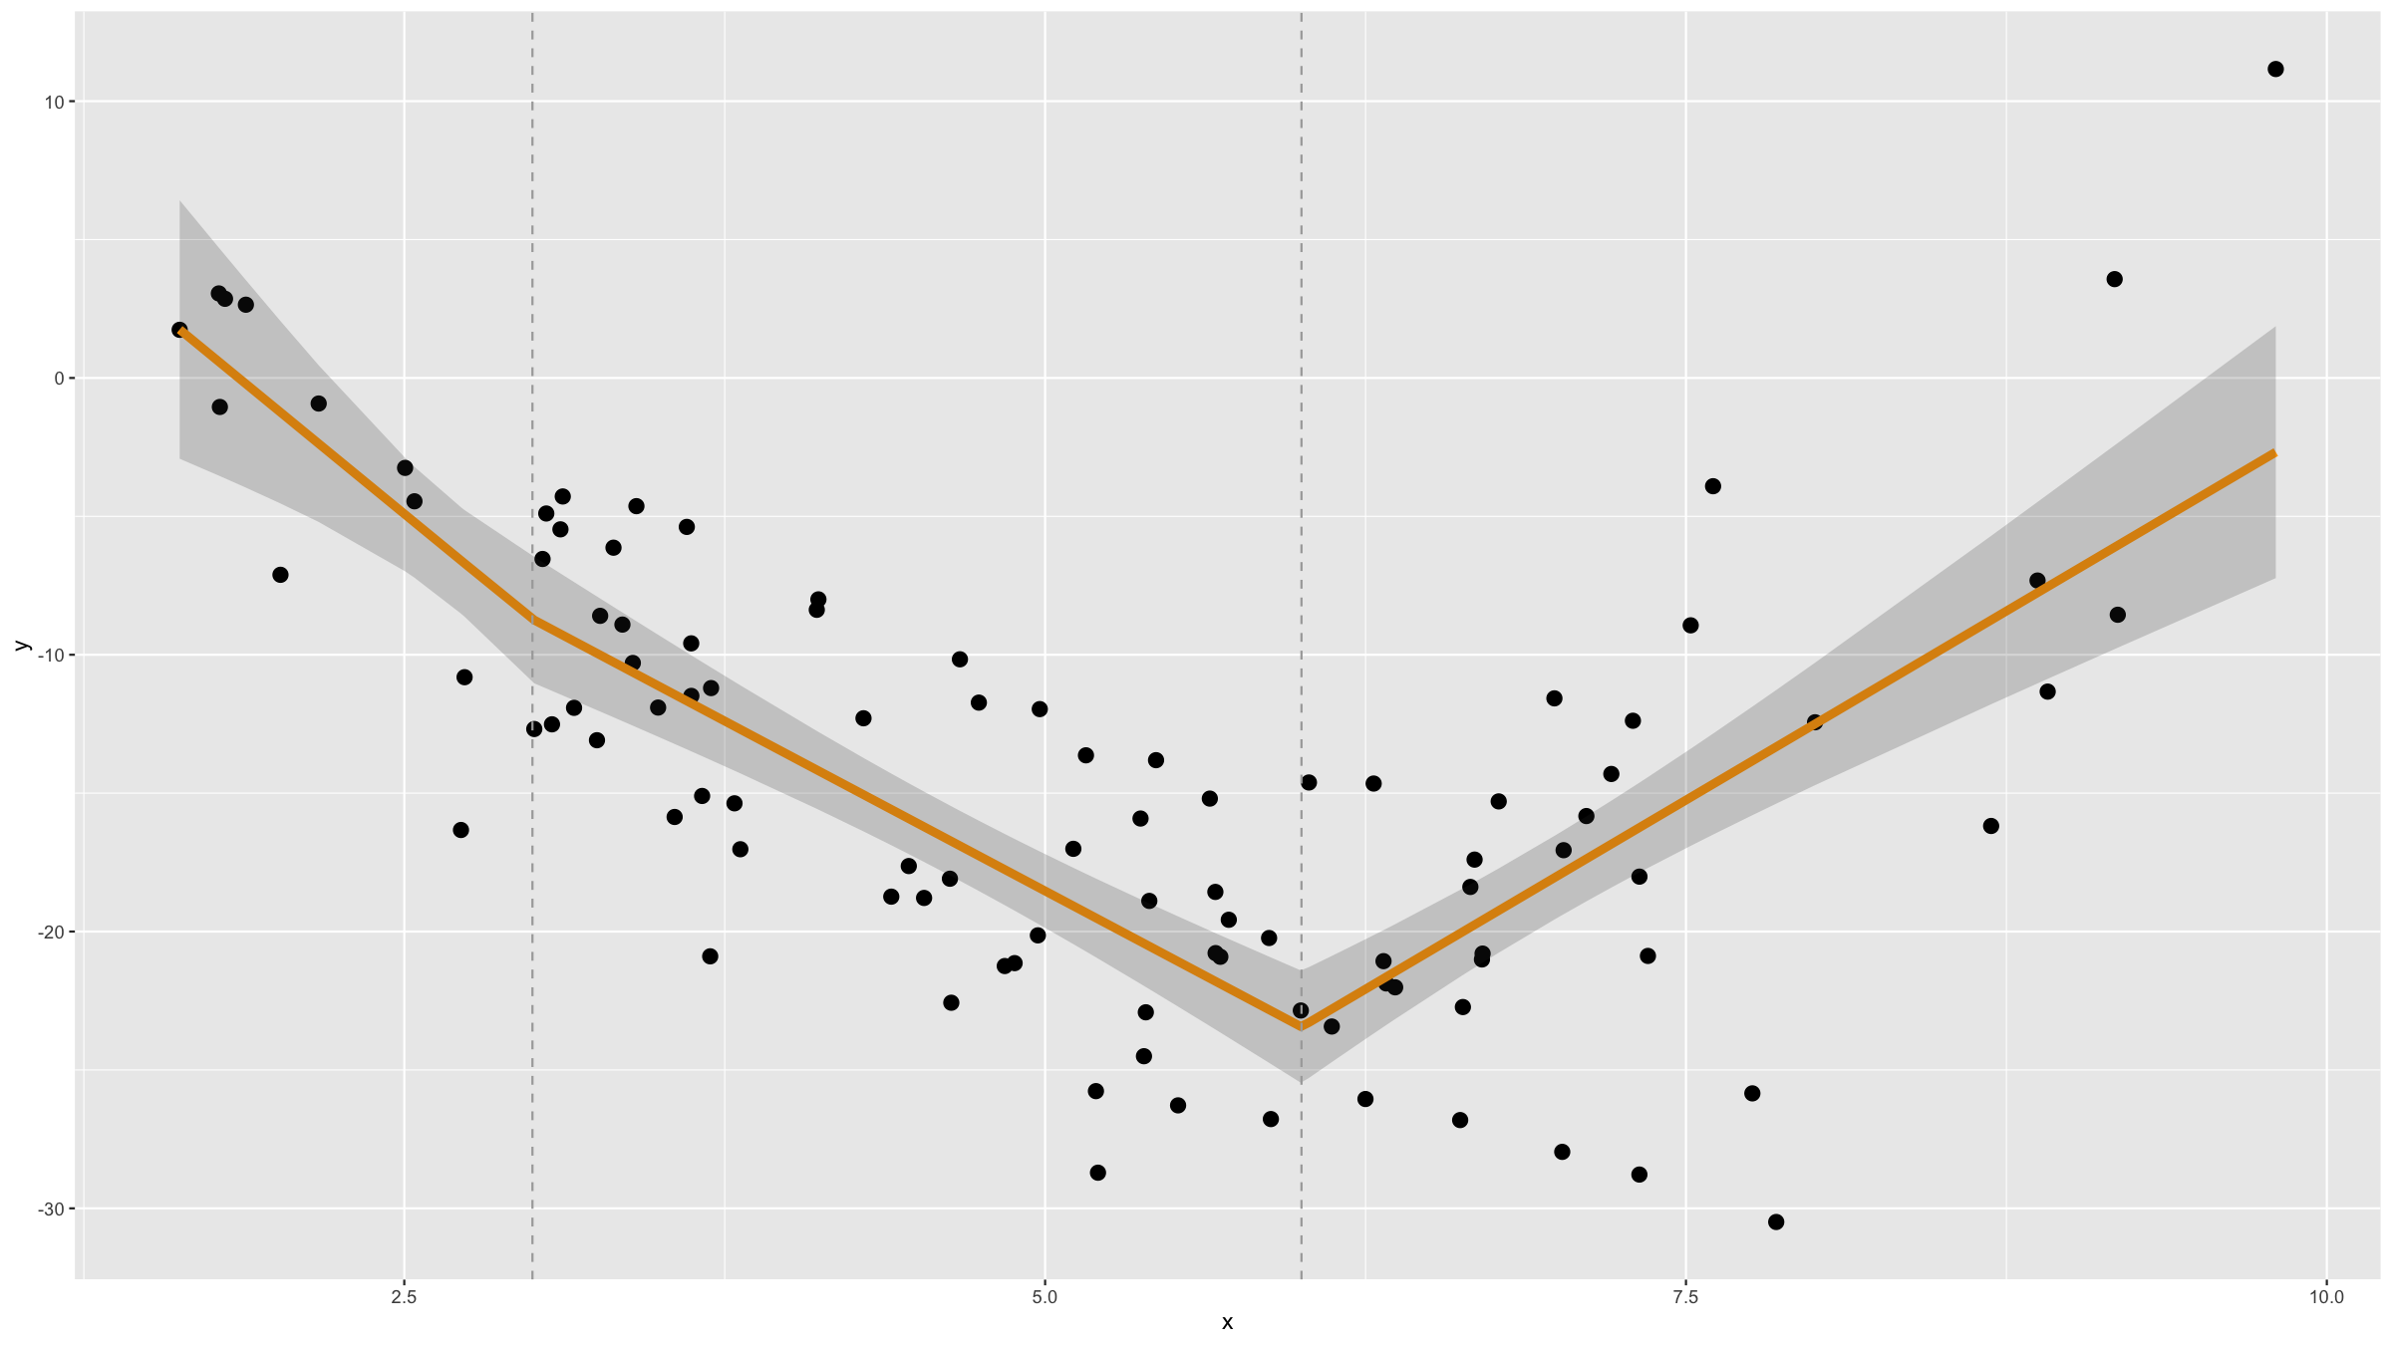

Slide 132
Notes: splines
Linear splines are not smooth and therefore cubic splines are often preferred.
Cubic splines can be poorly behaved in the tails (outside of the most extreme knots). To avoid this, they can be forced t be linear in the tails. Such splines are called restricted cubic splines.
modRcs<-glm(y~rcs(x,nk=3),data=df) # rcs requires rms package newdf<-data.frame(x=df$x,predict.lm(modRcs,interval="confidence"))
df %>% ggplot(mapping=aes(x=x,y=y)) + geom_point() + geom_line(col="orange",lwd=2,mapping=aes(x=x,y=predict(modRcs))) + geom_line(data=newdf,mapping=aes(x=x,y=fit),col="orange",lwd=2) + geom_ribbon(data=newdf,mapping=aes(y=fit,ymin=lwr,ymax=upr),alpha=0.2)

Slide 133
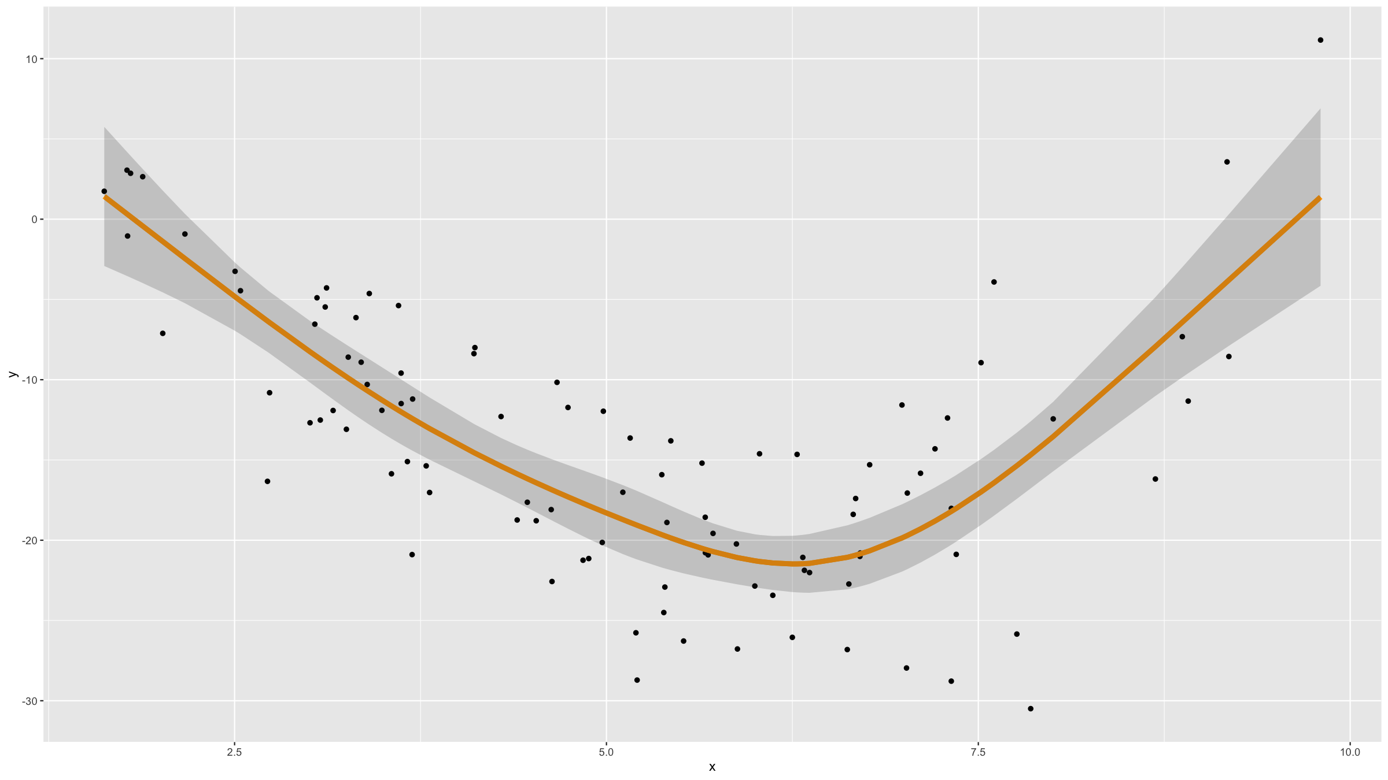

Slide 134
Notes: splines
Where the knots should be is not an easy problem. Adding them as model parameters to be estimated can lead to unstable parameter estimates and to standard estimation algorithms not being usable.
Luckily for cubic splines, the position of knots matters less than the number of knots. Knots are therefore often placed at regular intervals or quantiles of the continuous predictor.

Slide 135
Notes: Correlated data
If your observations $y_{i}$ are not independent because of correlations, e.g. clustering of children within teachers within schools, or longitudinal data with multiple observations for the same individual, we cannot use the GLM.
Marginal models: General Estimating Equations (GEE)
library(gee)
Mixed models: [Generalised] Linear Mixed Models ([G]LMM)
library(nlme) library(lme4)

Slide 136
Notes: rms package
The rms package provides a full set of tools for all kinds of regression problems.

Slide 137
[end of Session 5]

