Slide 1
Statistics and R short course
Session 6: Open Science
Marc Henrion

Slide 2
Introduction

Slide 3
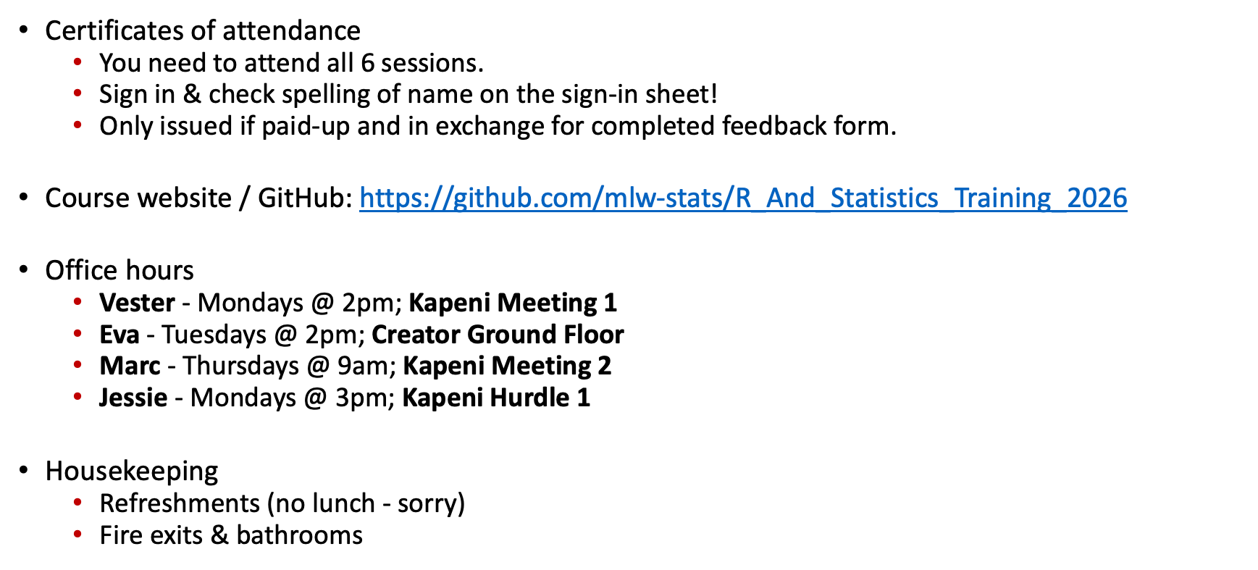
Preliminaries
Certificates of attendance
  You need to attend all 6 sessions.
  Sign in & check spelling of name on the sign-in sheet!
  Only issued if paid-up and in exchange for completed feedback form.
Course website / GitHub: https://github.com/mlw-stats/R_And_Statistics_Training_2026
Office hours
  Vester - Mondays @ 2pm; Kapeni Meeting 1
  Eva - Tuesdays @ 2pm; Creator Ground Floor
  Marc - Thursdays @ 9am; Kapeni Meeting 2
  Jessie - Mondays @ 3pm; Kapeni Hurdle 1
Housekeeping
  Refreshments (no lunch - sorry)
  Fire exits & bathrooms

Slide 4

Preliminaries
https://github.com/mlw-stats/R_And_Statistics_Training_2026

Slide 5
Learning outcomes
KNOW R: Explain know what R is & what it can do.
KNOW R RESOURCES: List useful R resources and access them.
DO R: Perform basic operations relevant for your research in R:
  Read data into R & write data or results to the harddrive.
  Manipulate & use different object types.
  Write & use functions in R
  Perform basic analyses on a dataset: mean, standard deviation, linear regression.
  Produce various standard graphs and tables
UNDERSTAND BASICS OF STATISTICS: Explain basic statistical theory: common distributions, standard statistical techniques, assumptions behind common statistical tests and regression models.
COMPREHEND OPEN SCIENCE: Summarise principles of open, reproducible research.
DO OPEN SCIENCE WITH R: Use R scripts, R markdown, packages & GitHub.

Slide 6
Resources

Slide 7
Resources
Quarto & R markdown
https://quarto.org/docs/computations/r.html
https://rmarkdown.rstudio.com/articles.html
GitHub & git
https://youtube.com/playlist?list=PL0lo9MOBetEFcp4SCWinBdpml9B2U25-f&si=Y4PsXrAVdRqTSCDz
https://guides.github.com/activities/hello-world
https://guides.github.com/introduction/git-handbook
Open Science Framework
https://osf.io

Slide 8
Open Science

Slide 9
Open Science
Discuss:
What do you understand by Open Science?
Why is Open Science important?
Is not all science open?

Slide 10
Open Science
“If I have seen further it is by standing on the shoulders of Giants.”
Isaac Newton, 1675

Slide 11
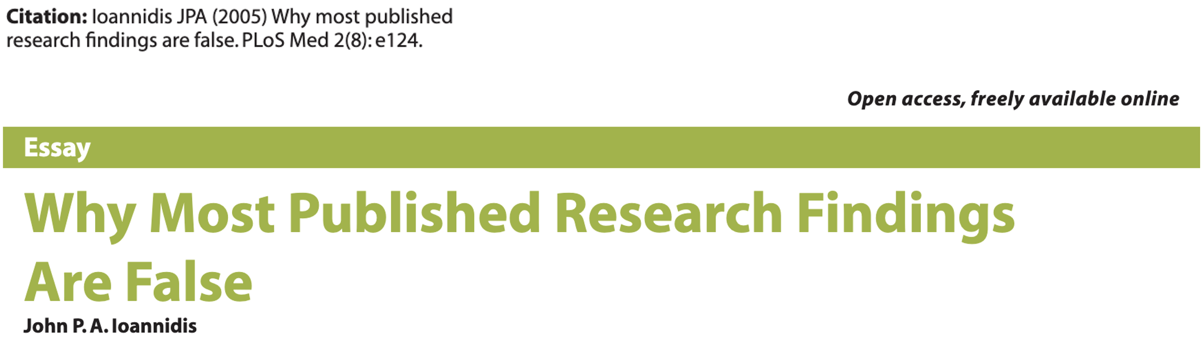
Open Science

Slide 12
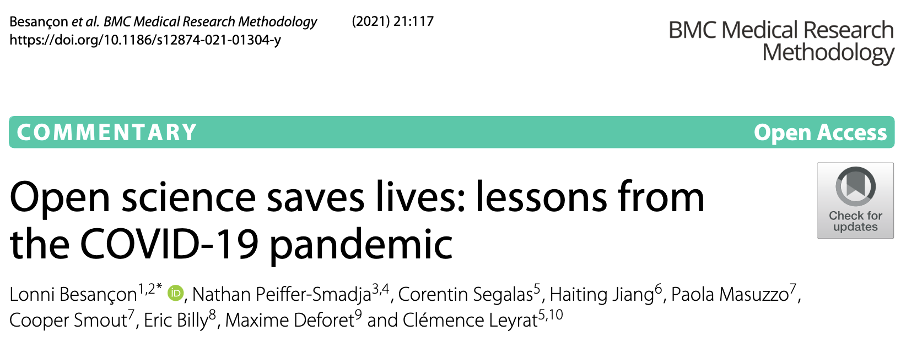
Open Science

Slide 13
Open Science
Scientific outputs are freely available to anybody - policymakers, professional and amateur researchers, lay public.
  Research findings.
  Datasets.
  Methods.
  Other resources.
Science is transparent & reproducible.
Part of a wider movement for open data, content, knowledge http://opendefinition.org. Started in the 17th century with the advent of the academic journal¹.

Slide 14
Open Science
6 principles:
Open methodology - document the entire research process.
Open source - use open source technology only.
Open data - make generated data publicly available.
Open access - make results and data accessible by anybody.
Open peer review - transparent, published quality assurance.
Open educational resources - use / generate free, open training resources.
http://openscienceasap.org/open-science

Slide 15
Open Science
Limits (?)
Confidential, sensitive, identifiable data $→$ GDPR, HIPAA etc. Some data may need to access controlled (e.g. human genomic data $→$ dbGaP).
Dangerous technology liable to misuse (e.g. H5N1 transmission studies in ferrets²) - a false argument?
After fake news, fake science?

Slide 16
Open Science: how to do open science?
Publish research protocols.
  $→$ Peer-reviewed protocol paper.
  $→$ Pre-print server.
  $→$ Zenodo / figshare / …
Publish lab protocols / analysis plans.
  See later session in this course.
  $→$ Publish as peer-reviewed lab protocol / analysis plan.
  $→$ Pre-print server.
  $→$ Zenodo / figshare / …
Publish findings (open access, open peer review).
  CC BY license, use pre-print if possible.
Publish data.
  If ethical and legal to do so.
  $→$ Zenodo / figshare / specialised repositories (e.g. GEO, dbGaP, …)
Publish analysis code.
  Use Quarto (for example).
  $→$ GitHub
  $→$ R data + code compendium package
  $→$ Zenodo / figshare / …
Use Open Science Framework.

Slide 17
Quarto / R markdown

Slide 18
Quarto / R markdown
As a researcher it is important that you can effectively communicate your results.
Quarto and R markdown are open-source science and technical publishing systems, both relying on Pandoc (a universal document converter). Both are markdown languages.
Quarto and R markdown allow creating reports that combine R code with the analysis output. R markdown, and quarto, is a “unified authoring framework for data science, combining your code, its results and your prose commentary”³.

Slide 19
Quarto / R markdown
Quarto allows you to tell a story and share a report that transparently lists the code the generated your results. Markdown documents are fully reproducible (up to a point!) and support a number of output format: html, pdf, docx, pptx…
Quarto is meant to achieve 3 things:
Communicate with stakeholders.
Collaborate with other researchers.
A framework within which to do data science (like a modern-day lab notebook).

Slide 20
Quarto / R mardown
Main differences between quarto and R markdown:
Quarto is newer and will probably supersede R markdown - so best to just learn quarto (but both are almost identical to use).
Quarto is independent of R and works with many other programming languages (python, Julia, …)
Slight differences in YAML header specification.
Slightly different layout & style of final document.

Slide 21
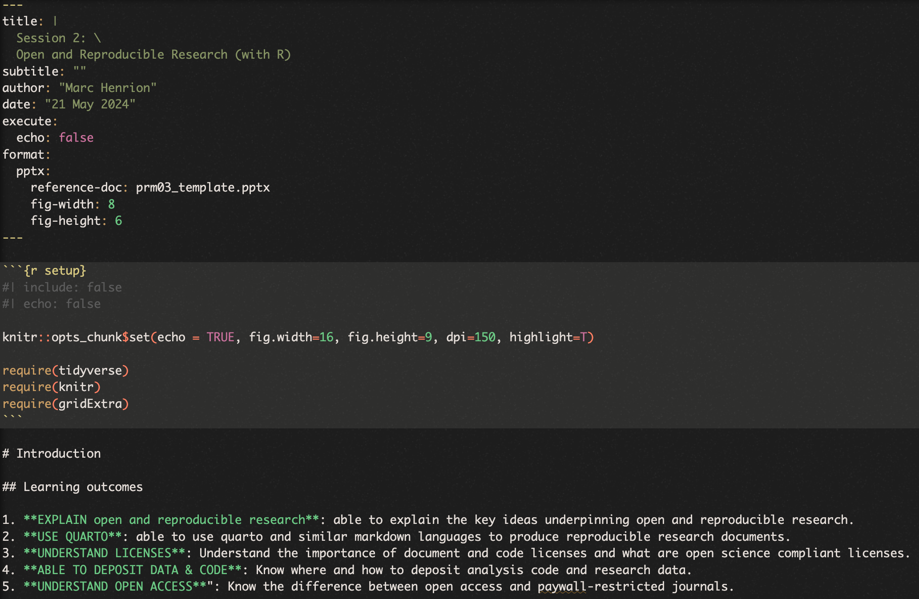
Quarto / R markdown
There are 3 building blocks to a markdown document:
A YAML header.
Chunks of R code (if you want to strip out all chunks of R code within a markdown document to write a pure R script, you can use the purl() function from the knitr package).
Narrative, formatted text.

Slide 22
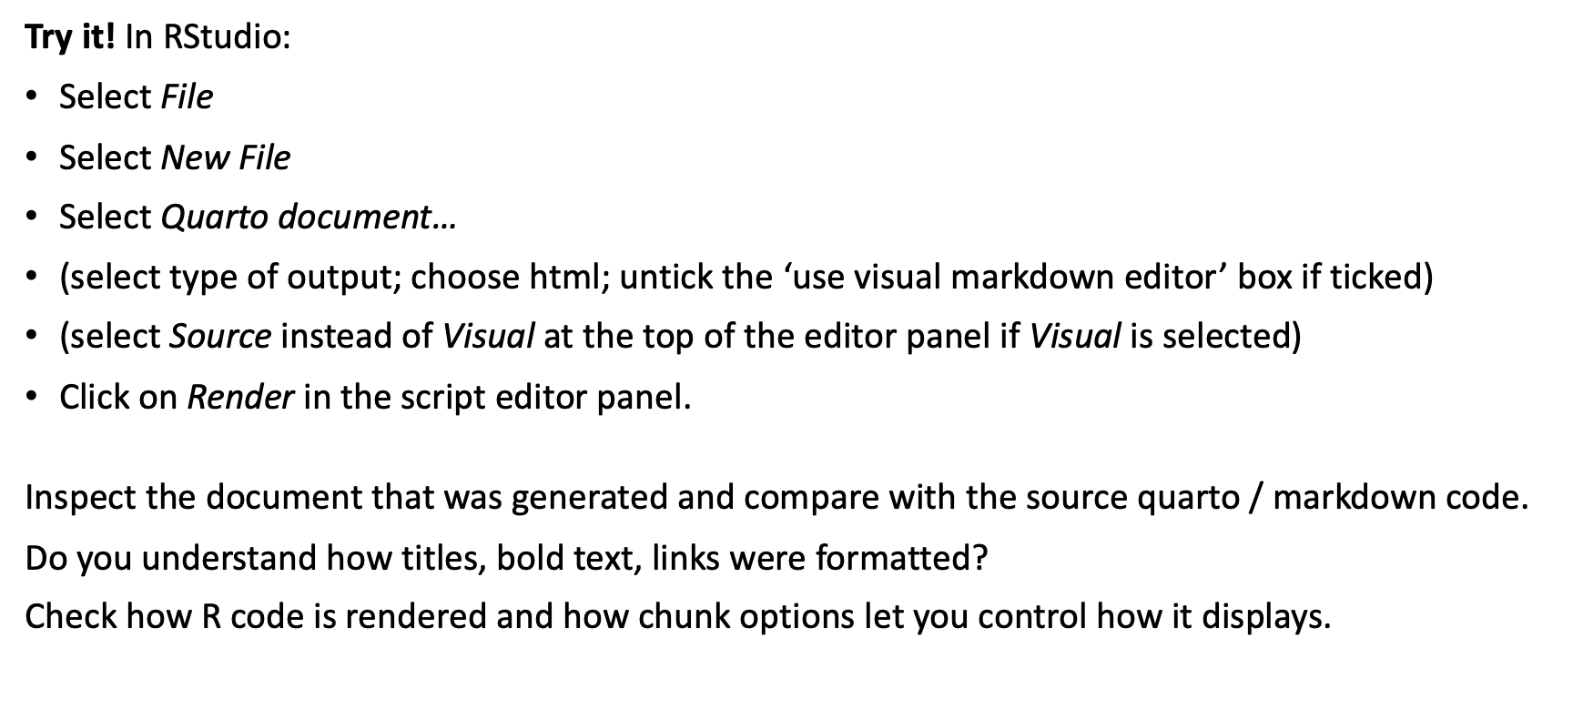
Quarto / R markdown
Try it! In RStudio:
Select File
Select New File
Select Quarto document…
(select type of output; choose html; untick the ‘use visual markdown editor’ box if ticked)
(select Source instead of Visual at the top of the editor panel if Visual is selected)
Click on Render in the script editor panel.
Inspect the document that was generated and compare with the source quarto / markdown code.
Do you understand how titles, bold text, links were formatted?
Check how R code is rendered and how chunk options let you control how it displays.

Slide 23
Publishing data & code

Slide 24
GitHub
While you can use markdown document and R packages as part of your own workflow, if you want to use them as part of an Open Science paradigm, then you really need to publish them.
The easiest way to do this is using GitHub.
GitHub is a hosting service for software development and fully integrates with git a powerful, open source version control software (you are highly encouraged to use git, but we will not cover that here).

Slide 25
GitHub
To use GitHub:
Create a GitHub account if you have not done so already.
Create a repository on GitHub and upload your package files (either using git or through the GitHub direct website upload feature).
Make sure your branch is called main (previously the main branch was called master).
Upload files using either the upload function or using git directly on your computer.

Slide 26
GitHub
GitHub project releases:
GitHub is primarily meant for colaboratively developing code. It uses version control allows branching projects into different directions, adding and removing files, … In other words, any given repository on GitHub can change over time.
For users, you may wish to create a release to bundle and deliver iterations of a project to users.
See https://docs.github.com/en/repositories/releasing-projects-on-github/managing-releases-in-a-repository how to create and manage GitHub releases.

Slide 27
R packages
Packages in R are bundles of shareable code, data and documentation.
Packages allow users to contribute functionality to R and avoid having to re-invent the wheel. They are what make R so powerful a tool.
Anybody can write an R package: this includes you (in fact you will write one before the session is up)!
To publish an R package formally (CRAN, Bioconductor) will take a bit more effort and provides minimal quality control.
Packages are not formally peer reviewed, the R community will provide feedback to package authors and maintainers but very new and/or little used packages could do incorrect analyses (buyer beware!). This is where commercial software with stringent QA and validation processes have a role to play.
Crucially, you can also use R packages to organise your own work flow and to publish your work as a reproducible research compendium^{4,5}.

Slide 28
R packages
An R package can be in one of 5 states:
Source (i.e. a directory)
Bundled (i.e. a tarball, typically a *.tar.gz file)
Binary (pre-compiled, single file, platform specific, typically a *.tgz file for Mac OS and *.zip for Windows)
Installed (i.e. after you called install.packages())
In memory (i.e. after you called library())

Slide 29
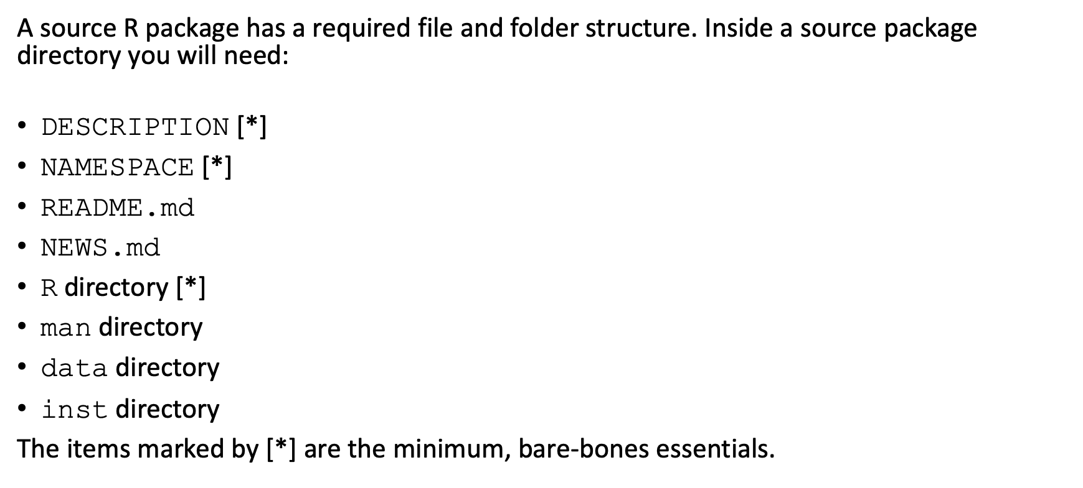
R packages
A source R package has a required file and folder structure. Inside a source package directory you will need:
DESCRIPTION [*]
NAMESPACE [*]
README.md
NEWS.md
R directory [*]
man directory
data directory
inst directory
The items marked by [*] are the minimum, bare-bones essentials.

Slide 30
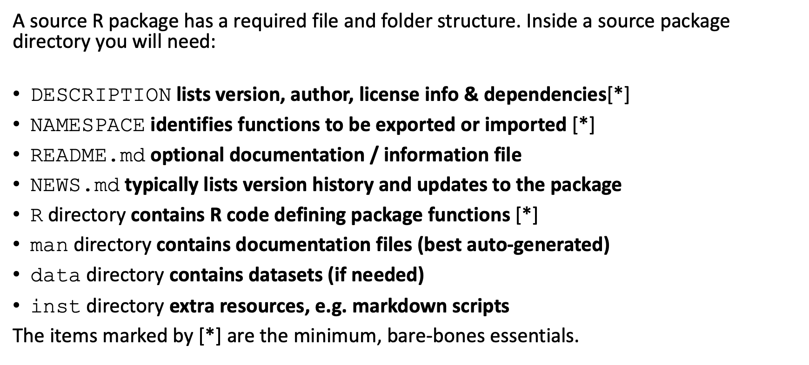
R packages
A source R package has a required file and folder structure. Inside a source package directory you will need:
DESCRIPTION lists version, author, license info & dependencies[*]
NAMESPACE identifies functions to be exported or imported [*]
README.md optional documentation / information file
NEWS.md typically lists version history and updates to the package
R directory contains R code defining package functions [*]
man directory contains documentation files (best auto-generated)
data directory contains datasets (if needed)
inst directory extra resources, e.g. markdown scripts
The items marked by [*] are the minimum, bare-bones essentials.

Slide 31
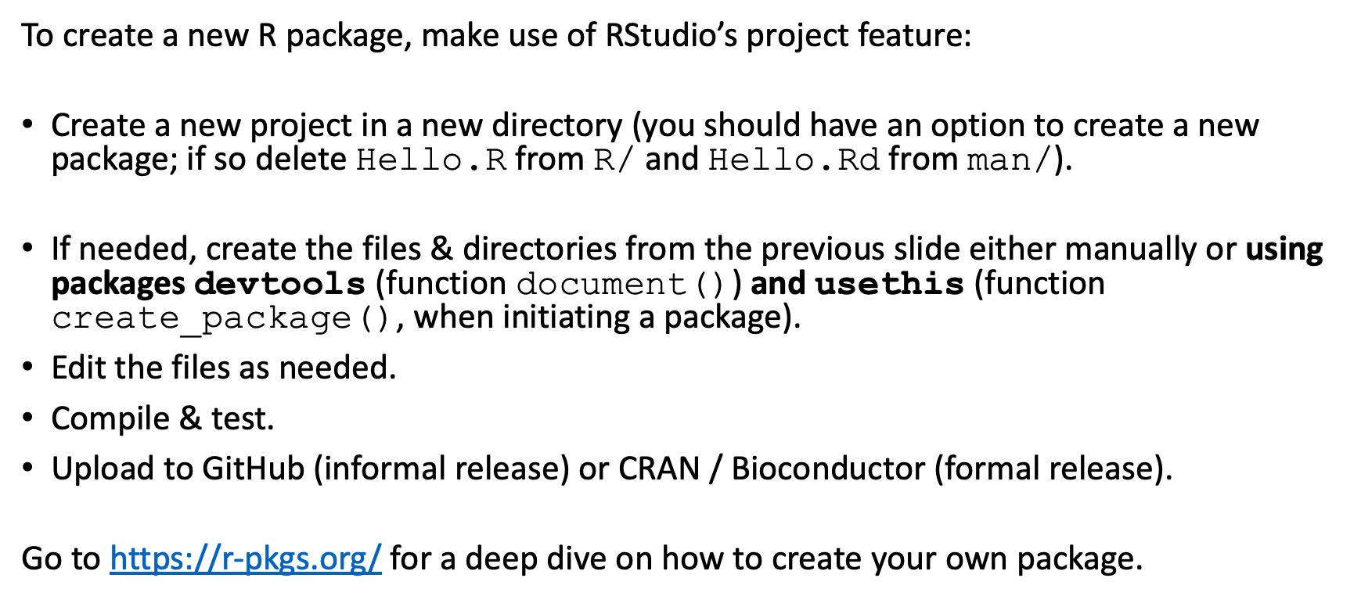
R packages
To create a new R package, make use of RStudio’s project feature:
Create a new project in a new directory (you should have an option to create a new package; if so delete Hello.R from R/ and Hello.Rd from man/).
If needed, create the files & directories from the previous slide either manually or using packages devtools (function document()) and usethis (function create_package(), when initiating a package).
Edit the files as needed.
Compile & test.
Upload to GitHub (informal release) or CRAN / Bioconductor (formal release).
Go to https://r-pkgs.org/ for a deep dive on how to create your own package.

Slide 32
Figshare / Zenodo
You can also publish markdown documents, script files and data using repositories such as
figshare https://figshare.com
Zenodo https://zenodo.org
These can be either private or public. Once public, they can only be updated, not modified. The main advantage of these repositories is that you can get a Digital Object Identifier (DOI) number for your data/code publication which can be directly cited by other researchers.

Slide 33
Licenses

Slide 34
Licenses
Discuss:
What is a license (in the context of documents, software, …)?
Why should you use a license to publish content or software?

Slide 35
Licenses
Why use licenses?
A license is a legal document that will provide you and your institution some protection regarding how your content or software can be used and what attribution / credit needs to be given to your and your co-authors.
While a license or a copyright license can obviously be used to restrict usage, you should still use one for open source documents to clarify wheher your work can be used for commercial purposes, how you should be given credit for your work, etc.
For software, it is generally recommended to have a no-warranty / AS-IS statement in the license to protect you and your organisation from lawsuits from users of your software.
Software vs content
You can use the same license for content and software but it is generally recommended to use content-specific licenses for content and software-specific licenses for computer code.

Slide 36
Licenses
Common open source software licenses:
MIT
GPL-3.0
See https://opensource.org/licenses/alphabetical for OSI approved licenses.
You can select one of several standard licenses on GitHub or upload your own.
Content licenses
The most common here is the Creative Commons Attribution International license, CC BY 4.0. Wellcome funded research needs to be published using this license.
The Unlicense
This is a public-domain equivalent license, without an attribution clause but with a no-warranty statement. See http://unlicense.org.

Slide 37
Licenses
Patents are similar to licenses - in a way.
They provide a legal protection (for commercial purposes) of a technology. As a price for that protection, you need to share the principles of the technology.
Mostly relevant for novel software, assays and other products rather than directly research output.

Slide 38
Practical

Slide 39
Quarto / R markdown
Practical
Simulate a dataset and save it as a binary R data file (*.rda or *.RData).
Write a new quarto document which:
Loads the simulated data.
Performs a basic analysis and produces a table with results.
Displays a graph.
Make sure to use quarto’s capability of providing a commentary along with your analysis.
Create an account on Zenodo, figshare or GitHub and upload your files there.

Slide 40
Quarto / R markdown
Practical
Simulated data (as an example):

Slide 41
Quarto / R markdown
Practical
Analysis (as an example):
t-test comparing variable z between types A & B.
Linear regression of z against x.
Graph (as an example):
Scatterplot of z against x, stratified by type.
Boxplot of z values by type.
Barplot of type.

Slide 42
[end of Session 6]

Slide 43
Notes
1. Machado, J., “Open data and open science”. In Albagli, Maciel & Abdo, “Open Science, Open Questions” 2015.
2. [https://doi.org/10.1126/science.336.6088.1521)
3. https://r4ds.had.co.nz
4. Gentleman, R. & Temple Lang, D. (2007). Statistical Analyses and Reproducible Research. Journal of Computational and Graphical Statistics, 16:1, 1-23, DOI:10.1198/106186007X178663
5. Marwick, B., Boettiger, C. & Mullen, L. (2018). Packaging Data Analytical Work Reproducibly Using R (and Friends). The American Statistician, 72:1, 80-88, DOI:10.1080/00031305.2017.1375986

