Slide 1
Statistics and R short course
Session 4: Parameter estimation and Statistical hypothesis testing
Vester Gunsaru

Slide 2
Introduction

Slide 3
Preliminaries
Course website / GitHub:
https://github.com/mlw-stats/R_And_Statistics_Training_2026
Office hours
  Vester - Mondays @ 2pm; Kapeni Meeting 1
  Eva - Tuesdays @ 2pm; Creator Ground Floor
  Marc - Thursdays @ 9am; Kapeni Meeting 2
  Jessie - Mondays @ 3pm; Kapeni Hurdle 1
Housekeeping
  Refreshments (no lunch - sorry)
  Fire exits & bathrooms

Slide 4

Preliminaries
https://github.com/mlw-stats/R_And_Statistics_Training_2026

Slide 5
Learning outcomes
KNOW R: Explain know what R is & what it can do.
KNOW R RESOURCES: List useful R resources and access them.
DO R: Perform basic operations relevant for your research in R:
  Read data into R & write data or results to the harddrive.
  Manipulate & use different object types.
  Write & use functions in R
  Perform basic analyses on a dataset: mean, standard deviation, linear regression.
  Produce various standard graphs and tables
UNDERSTAND BASICS OF STATISTICS: Explain basic statistical theory: common distributions, standard statistical techniques, assumptions behind common statistical tests and regression models.
COMPREHEND OPEN SCIENCE: Summarise principles of open, reproducible research.
DO OPEN SCIENCE WITH R: Use R scripts, R markdown, packages & GitHub.

Slide 6
Outline
Estimation
Null hypothesis significance testing
Sample size calculations

Slide 7
Estimation

Slide 8
Exercise
Think about a population parameter that you might be interested in knowing.
How could you imagine that you would go about estimating this parameter?

Slide 9
General principles
We are typically interested in studying populations, for example:
Children born to mothers living with HIV in Blantyre, Malawi
Patients admitted with febrile illness in Chikhwawa District Hospital
Households with at least 2 children under the age of 5 in Ndirande Township
And, typically, we are interested in particular characteristics of those populations:
Proportion of HIV-exposed but uninfected children.
Prevalence of non-malaria illness.
Household income.

Slide 10
General principles
If we could assess the entire population, then we can directly measure these characteristics.
But usually we cannot and so we need to sample these populations and then estimate the quantities of interest.
If we take a random sample (or more generally a probability sample), we can then do formal statistical inference on these estimates.
In this lecture, we will cover 2 basic concepts of statistical inference:
Parameter estimation.
Testing a hypothesis.
Further, we will look at one aspect of planning a study to either estimate a parameter or test a hypothesis: we will see how to calculate how large a sample we need to take to be able to do meaningful inference.

Slide 11
Estimating a proportion
In the entire population, of size $N$, there will be $K$ individuals who have a condition of interest. The exact proportion of people with the condition is $π=K/N$. There is no need for a measure of uncertainty / confidence interval here, as this is for the entire population.
If we only sample a subset, of size $n$, of the total population, then we need to estimate the proportion.
We can define a random variable $X$ to record whether or not a study participant experienced an outcome of interest. The $i^{th}$ participant either experiences the event ($X_{i}=1$) or not ($X_{i}=0$). We know that $X∼\text{Bernoulli}\left(π\right)$.
The estimator for the sample estimate of the proportion $π$, which we denote by $\hat{π}$, is then:
$$\hat{π}=\frac{\sum_{i=1}^{n}{X_{i}}}{n}$$

Slide 12
Estimating a proportion
If $n$ is large enough, then as a result of the Central Limit Theorem, $\hat{π}$ will have an approximate normal distribution with variance $σ^{2}=\hat{π}⋅\left(1−\hat{π}\right)/n$.
A 95% confidence interval is given by:
$$\hat{π}±z_{1−α/2}⋅σ=\hat{π}±z_{1−α/2}⋅\sqrt{\frac{\hat{π}⋅\left(1−\hat{π}\right)}{n}}$$
where $z_{1−α/2}$ is a quantile from the standard normal distribution. For a 95% confidence interval, $α=0.05$ and $z_{1−α/2}≃1.96$.
This confidence interval is only approximate (as it uses a normal approximation to the binomial distribution) and is called the Wald interval.
A better, exact approach is to compute exact binomial intervals (for which the equations are much more complicated). In R we would use the function binom.test() to compute these exact intervals.

Slide 13
Estimating a proportion
Exercise
You recruited $n=422$ participants to a study investigating the prevalence of HIV among young adults aged 18-30 in Blantyre, Malawi. $k=38$ of your recruited participants had a positive rapid diagnostic test.
Compute an estimate of the prevalence of HIV in this population and give a 95% confidence interval.

Slide 14
Estimating a proportion
Solution
# Proportion
k<-38
n<-422
p<-k/n
print(p)
## [1] 0.09004739
# Wald interval
sigma<-sqrt(p*(1-p)/n)
pLow<-p-qnorm(1-0.05/2)*sigma
pUpp<-p+qnorm(1-0.05/2)*sigma
CI<-c(pLow,pUpp)
print(CI)
## [1] 0.06273644 0.11735834
# Exact binomial CI
binom.test(x=k,n=n)$conf.int
## [1] 0.06451124 0.12150117
## attr(,"conf.level")
## [1] 0.95

Slide 15
Estimating a sample mean
Let us now suppose you want to estimate the population mean $μ$ of a certain quantity of interest. You recruit $n$ individuals from your population of interest and measure the quantity for each of them. Let us denote this again by a random variable $X_{i}$ for the $i^{t}h$ individual.
The $X_{i}$ random variables will be distributed according to some continuous distribution with mean $μ$ and variance $σ^{2}$: $X_{i}∼F$, $E\left(X_{i}\right)=μ$, Var$\left(X\right)=σ^{2}$.
An estimator for $μ$ will be the sample mean $\overset{‾}{X}$:
$$\hat{μ}=\frac{\sum_{i=1}^{n}{X_{i}}}{n}$$

Slide 16
Estimating a sample mean
Similar to the case of the sample proportion, $\overset{‾}{X}$ will be approximately normally distributed thanks to the CLT: $\overset{‾}{X}∼𝒩\left(μ,σ^{2}/n\right)$.
As we usually do not know $μ,σ^{2}$, we estimate these quantities: $μ$ through $\overset{‾}{X}$ and $σ^{2}$ by the sample variance: $s^{2}=\frac{1}{n−1}\sum_{i=1}^{n}{{\left(X_{i}−\overset{‾}{X}\right)}^{2}}$.
In this case, since $s^{2}$ is random itself, the distribution will not be normal but a Student’s t distribution with $n−1$ degrees of freedom.
We can get a 95% confidence interval for $\overset{‾}{X}$ by computing:
$$\overset{‾}{X}±t_{1−α/2,n−1}⋅\sqrt{\frac{s^{2}}{n}}$$
where $t_{1−α/2,n−1}$ is the ${95}^{th}$ percentile of a t distribution with $n−1$ degrees of freedom.

Slide 17
Estimating a mean
Exercise
You have conducted a study to estimate the average height of 12 year old boys in Blantyre, recruiting $n=12$ boys into your study. These are the recorded heights (in cm):
156 147 155 145 148 144 150 148 152 149 145 143
Compute the sample mean and a 95% confidence interval.

Slide 18
Estimating a mean
Solution
x<-c(156,147,155,145,148,144,150,148,152,149,145,143)
# sample mean
xbar<-mean(x)
print(xbar)
## [1] 148.5
# 95% CI
n<-length(x)
s2<-var(x)
xLow<-xbar-qt(0.975,df=n-1)*sqrt(s2/n)
xUpp<-xbar+qt(0.975,df=n-1)*sqrt(s2/n)
CI<-c(xLow,xUpp)
print(CI)
## [1] 145.8524 151.1476
# same as
t.test(x,conf.level=0.95)$conf.int
## [1] 145.8524 151.1476
## attr(,"conf.level")
## [1] 0.95

Slide 19
Estimating a regression coefficient
We will cover this in Session 5 on Generalised Linear Models.

Slide 20
Null hypothesis significance testing

Slide 21
Hypothesis
Definition:
A supposition, arrived at from observation or reflection, that leads to refutable predictions.
Any statement/claim/conjecture cast in a form that will allow it to be tested and refuted if necessary.
Example:
Suppose we believe that everybody who lives up to age 90 or more is a non-smoker.
We could investigate this in two ways:-
Prove the hypothesis by finding every single person aged 90 or more and checking that they are all non-smokers.
Disprove the hypothesis by finding just one person aged 90 or more who smokes.

Slide 22
Null Hypothesis
For formal statistical testing, we usually need to frame a narrow, refutable hypothesis that we can then formally evaluate using probability theory tools. Often we are interested to investigate whether 2 groups are different, whether a certain drug has an effect, whether a relationship exists between variables, …
These are wide hypotheses in the sense that there are many ways in which 2 groups can differ, a drug can have positive or negative, a large or small effect, a relationship between variables can take many shapes, may be strong or weak, …
The complementary hypotheses, i.e. the absence of something or whether something is equal to a specific value are narrow and can easily be formally tested. These are example of a special type of hypothesis, the null hypothesis, often denoted $H_{0}$.

Slide 23
Null Hypothesis
Examples:
There is NO association between the risk factor and outcome in a population.
A factor of interest is NOT associated with or different from another factor or a pre-specified value.
There is NO difference in the efficacy of a new drug (drug A) for malaria prophylaxis in contrast to a currently approved drug (drug B).

Slide 24
Null hypothesis
Null hypotheses
Are the formal basis for testing statistical significance.
Start with proposition that there is no difference / association / …
Statistical tests can estimate the probability an observed association could be due to chance.
The null hypothesis is always narrow.

Slide 25
Alternative hypothesis
The opposite of a null hypothesis is called the alternative hypothesis, usually denoted $H_{1}$. These are the wide hypotheses we mentioned earlier.
Examples:
There IS an association between the risk factor and outcome in the population.
The distribution of outcomes is different for different levels of the risk factor under consideration.
The new drug (drug A) for malaria prophylaxis has better efficacy in preventing malaria in contrast to a currently approved drug (drug B).
A key point is that due to their broadness, alternative hypotheses cannot usually be tested directly.
But we can reject the null hypothesis if the data suggests observing the data that were collected are extremely unlikely under the null hypothesis.

Slide 26
Statistical hypothesis
Underlying statistical principles:
A hypothesis is either true or not in the real world.
We cannot study the whole world; therefore we must test a hypothesis in a sample.
Can never absolutely prove (or disprove) a hypothesis.
Therefore we use statistical tests to determine whether there is sufficient evidence to reject a narrow null hypothesis.
A test means formulating a statistic that can be evaluated from observed data and for which we can derive its distribution under the null hypothesis.
If the probability of observing the value for the test statistic that we computed from the observed data is unlikely (under that null hypothesis distribution), then we can reject the null in favour of the alternative hypothesis.

Slide 27
One and Two tailed Hypotheses
One-tailed Hypotheses: (one-sided) specifies a direction of association between a predictor and outcome variable.
  E.g. The new drug (drug A) for malaria prophylaxis has better efficacy in preventing malaria in contrast to a currently approved drug (drug B).
Two-tailed Hypotheses: (two-sided) specifies only that an association exists; it does not specify a direction.
  E.g. The new drug (drug A) for malaria prophylaxis has a different efficacy in preventing malaria in contrast to a currently approved drug (drug B).
  In other words, drug A could be worse than drug B OR drug A could be better than drug B.
Unless there are very clear reasons why a direction can only be in a certain direction, a two-tailed test should be preferred and is also, for the same level of significance, more conservative.

Slide 28
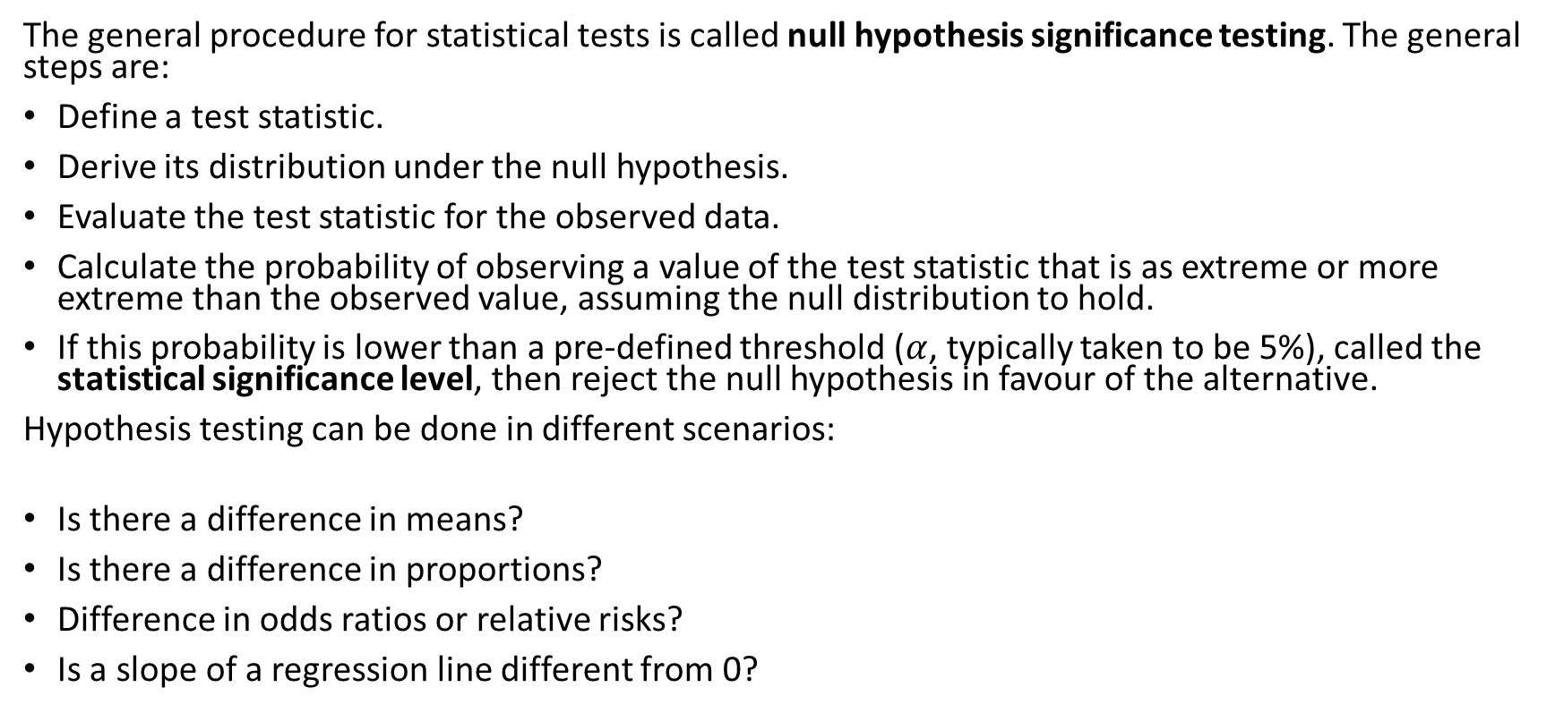
Statistical null hypothesis testing
The general procedure for statistical tests is called null hypothesis significance testing. The general steps are:
Define a test statistic.
Derive its distribution under the null hypothesis.
Evaluate the test statistic for the observed data.
Calculate the probability of observing a value of the test statistic that is as extreme or more extreme than the observed value, assuming the null distribution to hold.
If this probability is lower than a pre-defined threshold ($α$, typically taken to be 5%), called the statistical significance level, then reject the null hypothesis in favour of the alternative.
Hypothesis testing can be done in different scenarios:
Is there a difference in means?
Is there a difference in proportions?
Difference in odds ratios or relative risks?
Is a slope of a regression line different from 0?

Slide 29
A note on hypothesis testing
There are two approaches to testing: computing critical regions and p-values
In the critical region approach, we determine whether the observed test statistic is more extreme that a defined critical value
If the test statistic is more extreme than the critical value (i.e. outside of the critical region), we reject H₀.
If the test statistic is not more extreme than the critical value (i.e. within the critical region), we fail to reject the H₀.
In this session, we will focus on the p-value approach - this involves computing a probability of observing a value for the test statistic that is as extreme or more extreme than the observed value; if this probability is less than the specified significance level, we reject H₀.
Note: we never accept the alternative hypothesis, we only reject the null.

Slide 30
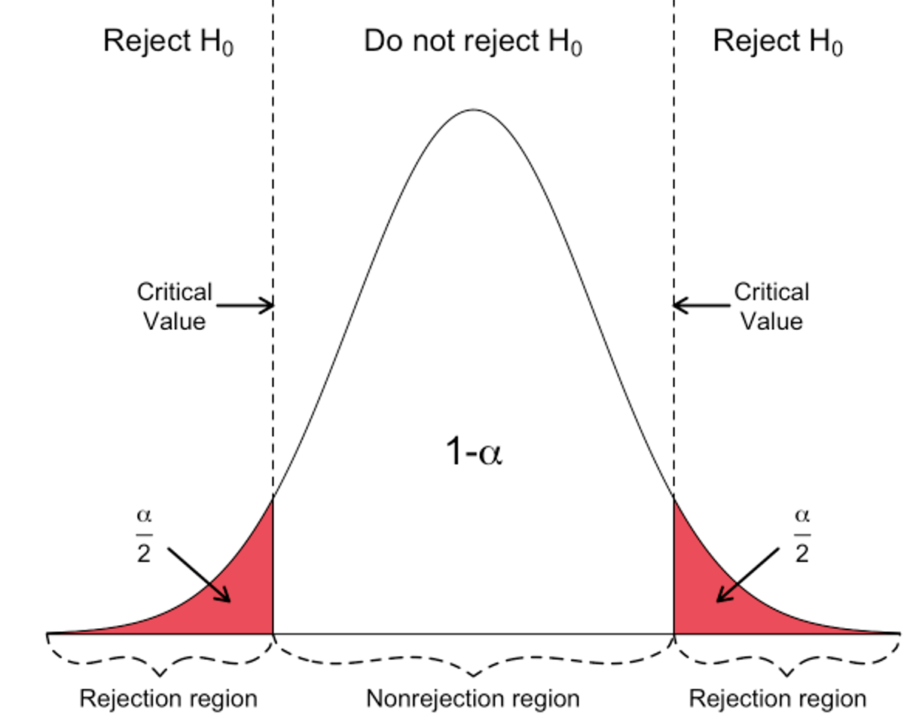
A note on hypothesis testing
Hartmann, K., Krois, J., Waske, B. (2018): E-Learning Project SOGA: Statistics and Geospatial Data Analysis. Department of Earth Sciences, Freie Universität Berlin

Slide 31
Type I and Type II errors
Type I error: (False positive) reject a null hypothesis that is actually true in the population.
  In other words, saying that the new drug (drug A) for malaria prophylaxis has better efficacy in preventing malaria in contrast to a currently approved drug (drug B), when it does not.
Type II error: (False negative) fail to reject a null hypothesis that is actually false in the population.
  In other words, saying that there is no difference in the efficacy of a new drug (drug A) for malaria prophylaxis in contrast to a currently approved drug (drug B), when drug A is better than drug B

Slide 32
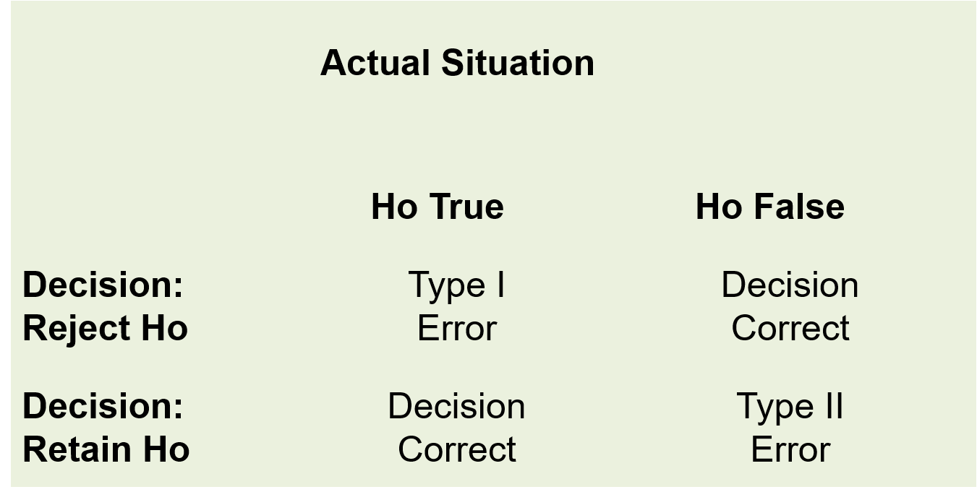
Type I and Type II errors
Types of errors in hypothesis testing

Slide 33
Alpha and Beta
Alpha $\left(α\right)$: The probability of making a Type I error (rejecting the null hypothesis when it is true); this is the statistical significance level.
Beta $\left(β\right)$: The probability of making a Type II error (failing to reject the null hypothesis when it is actually false).
  Statistical power is defined as 1-$β$; the probability of correctly identifying a significant result if is true.
Ideally $α$ and $β$ would be set to zero.
In practice they are made as small as possible.
Reducing them requires an increase in sample size
Most studies use $α=0.05$ and $β=0.10$ or $β=0.20$.

Slide 34
Data
Please download and read into R the 2 datasets from GitHub:
btTBreg.csv
adolescent_small.csv
df1 <- read.csv("dataAndSupportDocs/btTBreg.csv",header = TRUE)
df2 <- read.csv("dataAndSupportDocs/adolescent_small.csv",header = TRUE)

Slide 35
Overview for the rest of this section
General procedure
Parametric tests
  One- and two-sample t-test
  Paired t-test
  One-way analysis of variance (ANOVA)
  One- and two-sample tests for proportions
  Chi-squared test
Non-parametric tests
  Wilcoxon one-sample signed rank and two-sample rank-sum test
  Paired Wilcoxon signed rank test
  Kruskal-Wallis test
  Fisher’s exact test
Permutation tests
Use of p-values in statistics

Slide 36
General procedure
There are many different statistical tests and we will cover several today. The general procedure / algorithm for all of these is the same:
Formulate a (narrow) null hypothesis H₀ and a (wide) alternative hypothesis H₁.
Define the decision rule:
  Define a test statistic.
  Derive the distribution of the test statistics under H₀.
  Derive the decision rule (either based on a rejection region or a p-value) for a chosen significance level.
Collect data.
Calculate the test statistic, rejection region and/or p-value.
Make a decision to reject H₀ in favour of H₁ or not.

Slide 37
When can hypothesis testing be used

Slide 38
Parametric tests

Slide 39
One-sample t test
This test is used to check whether a sample mean is different from a known / hypothesized mean.
  How different is the sample mean from the true population mean
This test is for continuous data.
Assumptions:
Random sample from the population.
The data must be continuous.
The sample mean must follow a normal distribution.

Slide 40
One-sample t test
Let $X$ be the random variable for data that we wish to observe. Let $μ=E\left[X\right]$. Let $\overset{‾}{x}$ be the sample mean of the observed data, $s$ the sample standard deviation and $n$ the number of observations.
Hypotheses:
$$\begin{matrix}H_{0}: & μ=μ_{0} \\ H_{1}: & μ≠μ_{0}\end{matrix}$$
Test statistic: difference between sample mean and null value $μ_{0}$ scaled by the standard error
$$T=\frac{\overset{‾}{x}−μ_{0}}{s/\sqrt{n}}∼t_{n−1} \text{under} H_{0}$$

Slide 41
One-sample t test
Suppose we want to test the hypothesis that the mean age in a population is 24.
$$\begin{matrix}H_{0}: & μ=24 \\ H_{1}: & μ≠24\end{matrix}$$
This is a two-sided test.

Slide 42
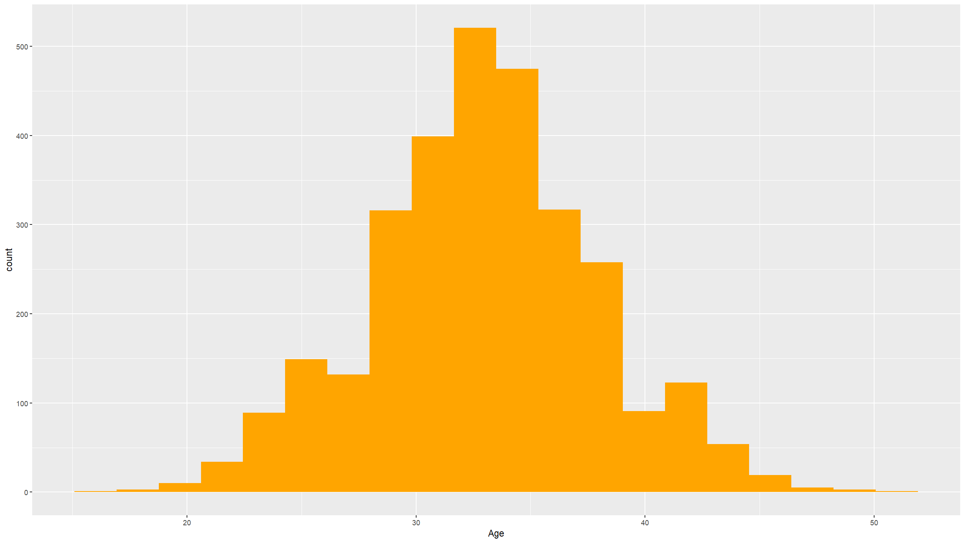
Check the assumptions
Histogram to check normality. We only require the sample mean not the actual data to be normally distributed. However, we only have a single observation of the sample mean. Thanks to the CLT, if the sample size is large enough and the distribution of the data is not too wildly non-normal (really severe skew, outliers and extreme values), then this will be met. So check the histogram for the data, but focus on evidence for severe non-normality.
df1 %>%
ggplot(mapping=aes(x=age)) +
geom_histogram(bins=20,fill="#ffa500") +
xlab("Age")

Slide 43
One sample t-test
t.test(df1$age,mu=24)
##
## One Sample t-test
##
## data: df1$age
## t = 98.616, df = 2999, p-value < 2.2e-16
## alternative hypothesis: true mean is not equal to 24
## 95 percent confidence interval:
## 32.76225 33.11775
## sample estimates:
## mean of x
## 32.94

Slide 44
One sample t-test - one sided
Need to specify the direction - less or greater?
t.test(df1$age,mu=24,alternative="less")
##
## One Sample t-test
##
## data: df1$age
## t = 98.616, df = 2999, p-value = 1
## alternative hypothesis: true mean is less than 24
## 95 percent confidence interval:
## -Inf 33.08916
## sample estimates:
## mean of x
## 32.94

Slide 45
One sample t-test - one sided
Need to specify the direction - less or greater?
t.test(df1$age,mu=24,alternative="greater")
##
## One Sample t-test
##
## data: df1$age
## t = 98.616, df = 2999, p-value < 2.2e-16
## alternative hypothesis: true mean is greater than 24
## 95 percent confidence interval:
## 32.79084 Inf
## sample estimates:
## mean of x
## 32.94

Slide 46
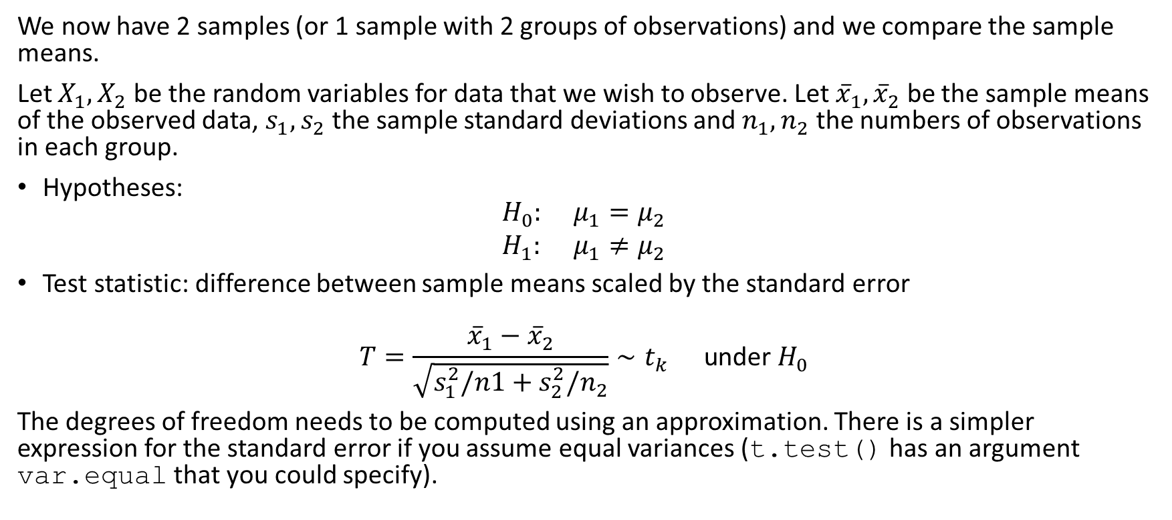
Two sample t-test
We now have 2 samples (or 1 sample with 2 groups of observations) and we compare the sample means.
Let $X_{1},X_{2}$ be the random variables for data that we wish to observe. Let ${\overset{‾}{x}}_{1},{\overset{‾}{x}}_{2}$ be the sample means of the observed data, $s_{1},s_{2}$ the sample standard deviations and $n_{1},n_{2}$ the numbers of observations in each group.
Hypotheses:
$$\begin{matrix}H_{0}: & μ_{1}=μ_{2} \\ H_{1}: & μ_{1}≠μ_{2}\end{matrix}$$
Test statistic: difference between sample means scaled by the standard error
$$T=\frac{{\overset{‾}{x}}_{1}−{\overset{‾}{x}}_{2}}{\sqrt{s_{1}^{2}/n1+s_{2}^{2}/n_{2}}}∼t_{k} \text{under} H_{0}$$
The degrees of freedom needs to be computed using an approximation. There is a simpler expression for the standard error if you assume equal variances (t.test() has an argument var.equal that you could specify).

Slide 47
Two sample t-test
Assumptions:
The data are continuous.
The sample means must follow normal distributions.
The two samples are independent.
Both samples are random samples of the respective underlying populations.

Slide 48
Two sample t-test
In the dataset provided, it is hypothesized that the mean age is the same for both men and women.
We can test this hypothesis
$$H_{0}:μ_{1}=μ_{2}$$
$$H_{1}:μ_{1}≠μ_{2}$$

Slide 49
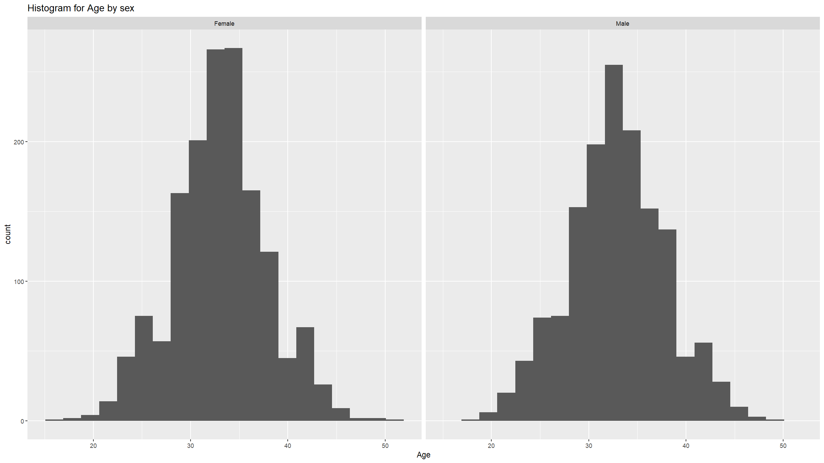
Assumptions
Check if the two populations are normally distributed. Again, we really just need to check for severe non-normality.
df1 %>%
ggplot(mapping=aes(x=age)) +
geom_histogram(bins=20) +
labs(title="Histogram for Age by sex") +
xlab("Age") +
facet_wrap(~ifelse(sex==1,"Male","Female"))

Slide 50
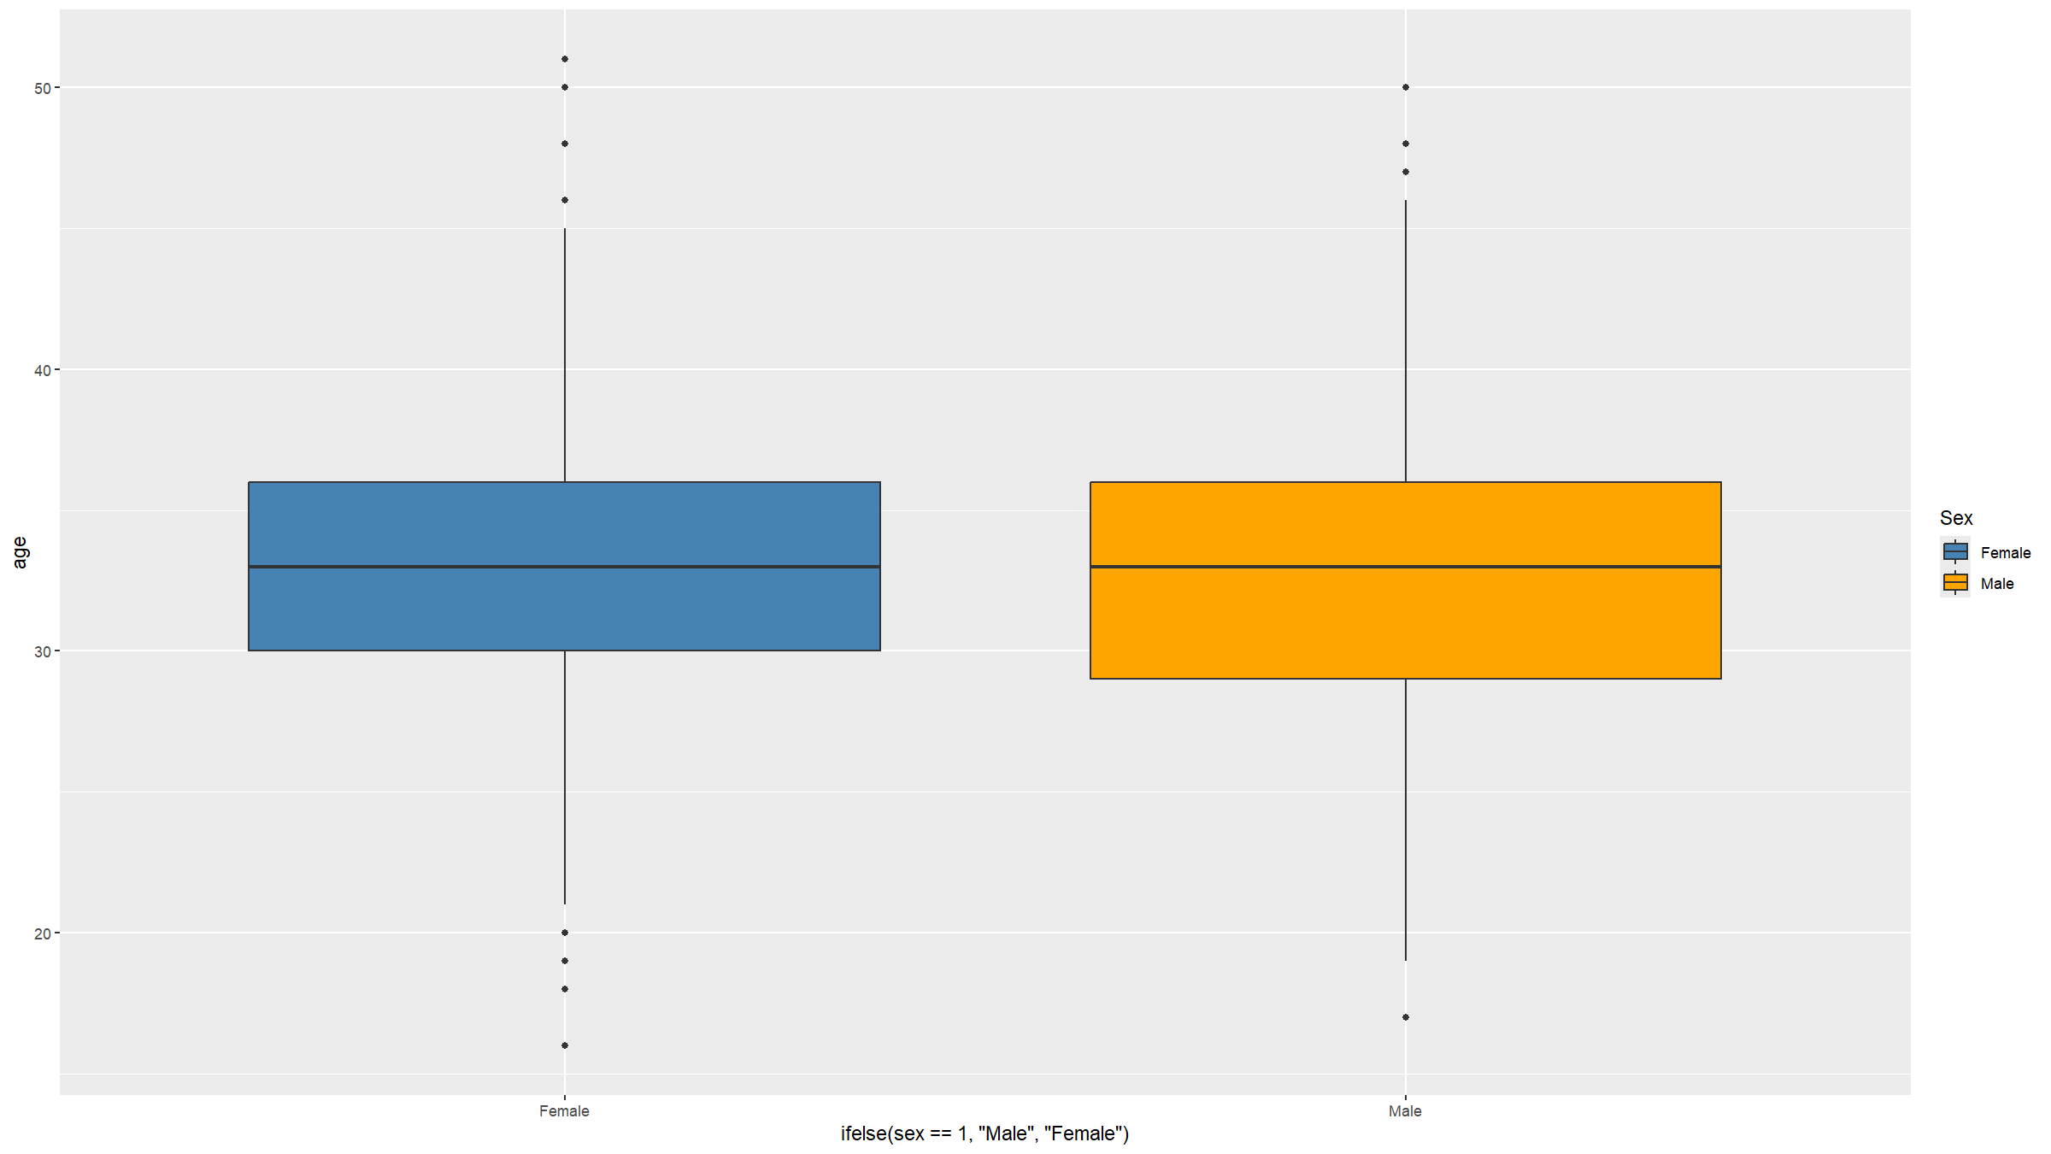
Assumptions
Check if the variances are the same (only needed if you specify var.equal=TRUE). By default var.equal is set to FALSE in the function t.test() and you do NOT need to check this assumption. However, this uses an approximation to the distribution used to compute the p-value and if you don’t want to make that approximation, you could set var.equal=TRUE but then you need to check this assumption of equal variances. A visual inspection is usually good enough for most situations.
df1 %>%
ggplot(mapping=aes(x=ifelse(sex==1,"Male","Female"),y=age,fill=ifelse(sex==1,"Male","Female"))) +
scale_fill_manual(values=c("steelblue","orange"),name="Sex") +
geom_boxplot()

Slide 51
Two sample t-test
t.test(age~sex,data=df1)
##
## Welch Two Sample t-test
##
## data: age by sex
## t = -0.69127, df = 2982.6, p-value = 0.4895
## alternative hypothesis: true difference in means between group 1 and group 2 is not equal to 0
## 95 percent confidence interval:
## -0.4812899 0.2303877
## sample estimates:
## mean in group 1 mean in group 2
## 32.87585 33.00130

Slide 52
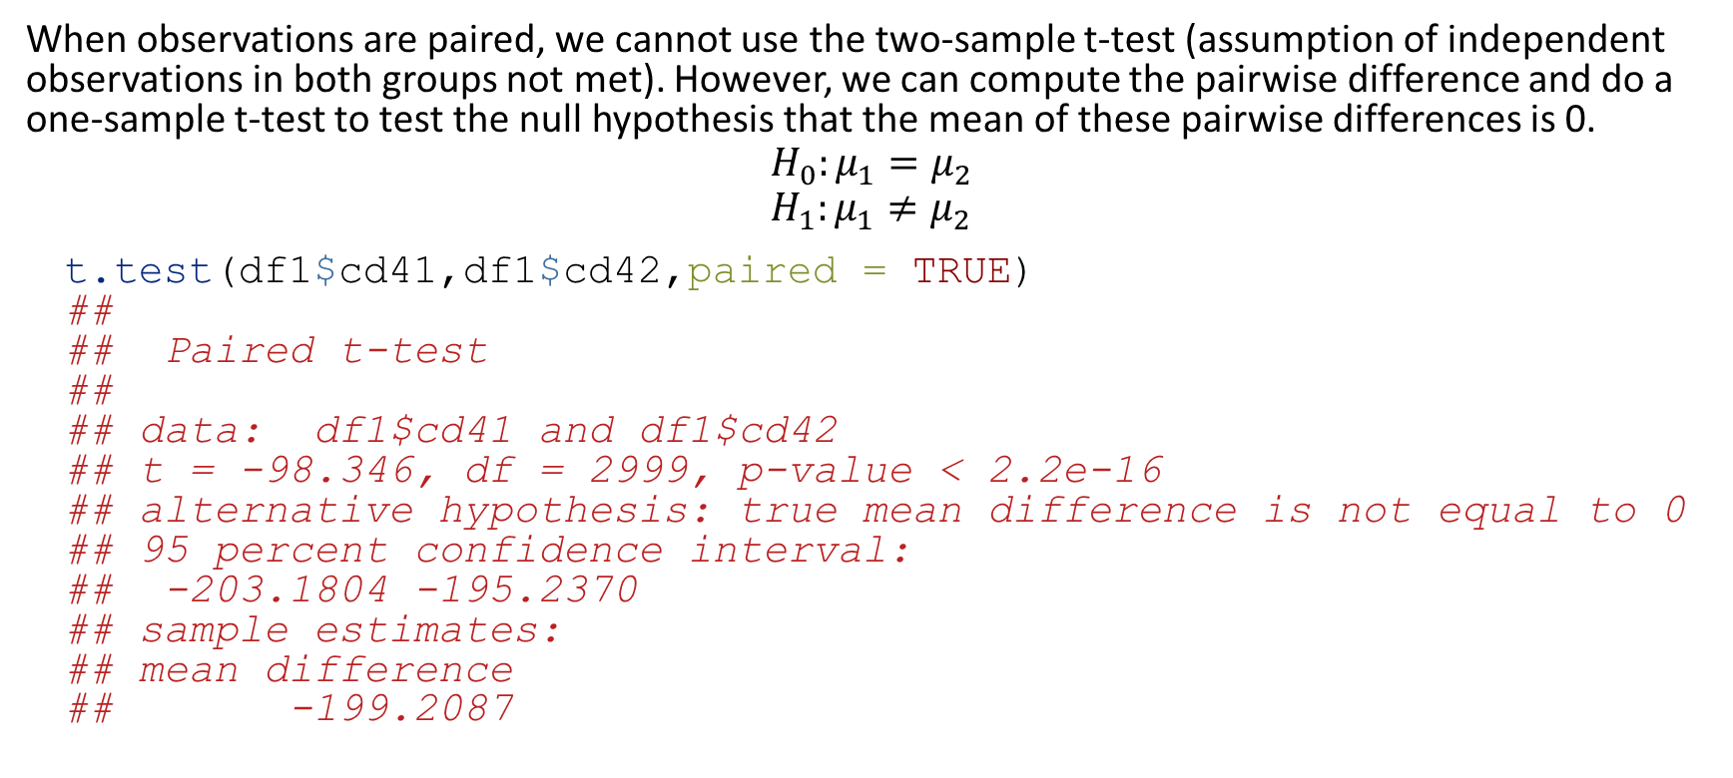
Paired t-test
When observations are paired, we cannot use the two-sample t-test (assumption of independent observations in both groups not met). However, we can compute the pairwise difference and do a one-sample t-test to test the null hypothesis that the mean of these pairwise differences is 0.
$$H_{0}:μ_{1}=μ_{2}$$
$$H_{1}:μ_{1}≠μ_{2}$$
t.test(df1$cd41,df1$cd42,paired = TRUE)
##
## Paired t-test
##
## data: df1$cd41 and df1$cd42
## t = -98.346, df = 2999, p-value < 2.2e-16
## alternative hypothesis: true mean difference is not equal to 0
## 95 percent confidence interval:
## -203.1804 -195.2370
## sample estimates:
## mean difference
## -199.2087

Slide 53
Comparing means - >2 groups
Sometimes we want to compare means of a variable across more than 2 groups.
For example, we might want to compare the mean CD4 among 5 hospitals.
Use one way analysis of variance (ANOVA).
Compares the between groups variation to the within groups variation: if the former is larger than the latter, the group means cannot all be the same.
Based on assumptions:
  Data in each group are approximately normally distributed (CLT applies again, but a bit more complicated than in the t-test case).
  Equal variation within groups.
  Independent and identically distributed variables.

Slide 54
One-way ANOVA
A total of 3000 study participants were recruited in 5 hospitals providing ART. Each participant’s CD4 count upon entry into study was measured. We would like to investigate whether there is a difference in mean CD4 count at the entry into the study across the 5 participating facilities. State the hypothesis to be tested.

Slide 55
One-way ANOVA
$$\begin{matrix}H_{0}: & μ_{1}=μ_{2}=μ_{3}=μ_{4}=μ_{5} & \\ H_{1}: & μ_{i}≠μ_{j} & \text{for} \text{some} i,j\end{matrix}$$
oneway.test(cd41 ~ hosp, data = df1)
##
## One-way analysis of means (not assuming equal variances)
##
## data: cd41 and hosp
## F = 0.22905, num df = 4, denom df = 1496, p-value = 0.9222

Slide 56
One-way ANOVA
res.hosp <- aov(cd41 ~ factor(hosp), data = df1)
summary(res.hosp)
## Df Sum Sq Mean Sq F value Pr(>F)
## factor(hosp) 4 2204 551.1 0.229 0.922
## Residuals 2995 7194212 2402.1

Slide 57
Comparing proportions: one sample
When we estimate a proportion (e.g. a prevalence) in a study population, and then want to test the null hypothesis that this proportion is equal to a specific a prior known proportion, we can proceed in 2 ways:
Use a normal approximation test - prop.test() in R.
Use an exact binomial test - binom.test() in R.
The null and alternative hypotheses are the same for both tests. For example for a two-sided alternative:
$$\begin{matrix}H_{0}: & p=p_{0} \\ H_{1}: & p≠p_{0}\end{matrix}$$

Slide 58
Comparing proportions: one sample
The normal approximation test uses the following test statistic:
$$T=\frac{p−p_{0}}{\sqrt{p_{0}\left(1−p_{0}\right)/n}}∼N\left(0,1\right) \text{under} H_{0}$$

Slide 59
Comparing proportions: one sample
When we estimate a proportion, we observe $X=k$ events / successes / outcomes in the $n$ units that we sampled, each success having a probability $p_{0}$ to occur. This is a binomial distribution:
$X∼\text{Binom}\left(n,p_{0}\right)$.
The exact binomial test makes use of this and directly computes p-values from the binomial distribution:
Two-sided case: p-value = $\sum_{i∈I}^{​}{P}\left(X=i|n,p_{0}\right)$ where $I=\{i:P\left(X=i|n,p_{0}\right)≤P\left(X=k|n,p_{0}\right)\}$.
One-sided case: p-value = $\sum_{i=0}^{k}{P}\left(X=i|n,p_{0}\right)$ or $\sum_{i=k}^{n}{P}\left(X=i|n,p_{0}\right)$ depending on the direction.

Slide 60
Comparing proportions: one sample
A recent survey found that approximately 23% of the population in a district are HIV positive. A researcher thinks that the current proportion of the adult population that is HIV+ is greater than 23%. The researcher takes a random sample of 3000 and finds that 560 tested positive. State the hypotheses and your conclusion.

Slide 61
Comparing proportions: one sample
A recent survey found that approximately 23% of the population in a district are HIV positive. A researcher thinks that the current proportion of the adult population that is HIV+ is greater than 23%. The researcher takes a random sample of 3000 and finds that 560 tested positive. State the hypotheses and your conclusion.
This is a one-sided test, with the researcher’s hypothesis being the alternative hypothesis.
$$\begin{matrix}H_{0}: & p≤0.23 \\ H_{1}: & p>0.23\end{matrix}$$

Slide 62
Comparing proportions: one sample
Using a normal approximation:
prop.test(x=560,n=3000,p=0.23,alternative="greater")
##
## 1-sample proportions test with continuity correction
##
## data: 560 out of 3000, null probability 0.23
## X-squared = 31.565, df = 1, p-value = 1
## alternative hypothesis: true p is greater than 0.23
## 95 percent confidence interval:
## 0.1750871 1.0000000
## sample estimates:
## p
## 0.1866667
Using an exact binomial test:
binom.test(x=560,n=3000,p=0.23,alternative="greater")
##
## Exact binomial test
##
## data: 560 and 3000
## number of successes = 560, number of trials = 3000, p-value = 1
## alternative hypothesis: true probability of success is greater than 0.23
## 95 percent confidence interval:
## 0.1750282 1.0000000
## sample estimates:
## probability of success
## 0.1866667
pbinom(560,size=3000,prob=0.23) # manual computation of the p-value
## [1] 4.453593e-09

Slide 63
Comparing proportions: two samples
When we collect data on 2 groups and want to compare proportions for an outcome of interest in these 2 groups, then we need to use a normal approximation test. Let $p_{1},p_{2}$ be the proportions in the 2 groups and $n_{1},n_{2}$ the sample sizes we collected from each group. Let $p=\left(n_{1}p_{1}+n_{2}p_{2}\right)/\left(n_{1}+n_{2}\right)$, the proportion in the 2 groups combined.
Hypotheses
$$\begin{matrix}H_{0}: & p_{1}=p_{2} \\ H_{1}: & p_{1}≠p_{2}\end{matrix}$$
Test statistic (normal approximation)
$$T=\frac{p_{1}−p_{2}}{\sqrt{p\left(1−p\right)\left(1/n_{1}+1/n_{2}\right)}}∼N\left(0,1\right) \text{under} H_{0}$$
* In R: we still use prop.test().

Slide 64
Comparing proportions: two samples
Example: We would like to investigate whether there is enough evidence that the proportion of HIV cases is different between men and women
$$\begin{matrix}H_{0}: & p_{1}=p_{2} \\ H_{1}: & p_{1}≠p_{2}\end{matrix}$$
We need to calculate the proportions in each group before doing the test.
Proportion of men that tested positive; $p_{1}=n_{1}/N_{1}$
Proportion of women that tested positive; $p_{2}=n_{2}/N_{2}$

Slide 65
Comparing proportions: two samples
table(df1$sex,df1$hiv)
##
## 0 1
## 1 1204 262
## 2 1236 298
prop.test(x=c(262,298),n=c(1466,1534))
##
## 2-sample test for equality of proportions with continuity correction
##
## data: c(262, 298) out of c(1466, 1534)
## X-squared = 1.093, df = 1, p-value = 0.2958
## alternative hypothesis: two.sided
## 95 percent confidence interval:
## -0.04408002 0.01298849
## sample estimates:
## prop 1 prop 2
## 0.1787176 0.1942634

Slide 66
Comparing proportions: two samples
There are 2 alternative ways to do the same test - one of which does not involve making the normal approximation:
chisq.test(table(df1$sex,df1$hiv)) # normal approximation
##
## Pearson's Chi-squared test with Yates' continuity correction
##
## data: table(df1$sex, df1$hiv)
## X-squared = 1.093, df = 1, p-value = 0.2958
fisher.test(table(df1$sex,df1$hiv)) # exact Fisher test (see later: non-parametric tests)
##
## Fisher's Exact Test for Count Data
##
## data: table(df1$sex, df1$hiv)
## p-value = 0.2813
## alternative hypothesis: true odds ratio is not equal to 1
## 95 percent confidence interval:
## 0.9178971 1.3377516
## sample estimates:
## odds ratio
## 1.107919

Slide 67
Comparing proportions: chi-squared
Chi-squared tests can be used to test whether 2 categorical variables are independent or not.
Given 2 categorical variables $V1$ (taking $c$ different values) and $V2$ (taking $r$ different values) we can compute an $r×c$ contingency table (i.e. we cross-tabulate the 2 variables) of the observed values.
$$\begin{matrix} & & & & V1 & \\ & & O_{11} & O_{12} & … & O_{1c} \\ & & O_{21} & O_{22} & … & O_{2c} \\ V2 & & … & & … & … \\ & & O_{r1} & O_{r2} & … & O_{rc} \\ & & & & & \end{matrix}$$

Slide 68
Comparing proportions: chi-squared
The principle to test whether the 2 variables are associated or not, is to compare the observed counts to the counts expected under the assumption of no association (the null hypothesis).
Define:
$n=$ the total number of observations (calculated as $\sum_{i}^{​}{\sum_{j}^{​}{O_{ij}}}$)
$p_{i.}=$ the marginal proportion of row $i$ (calculated as $\frac{1}{n}\sum_{j}^{​}{O_{ij}}$)
$p_{.j}=$ the marginal proportion of column $j$ (calculated as $\frac{1}{n}\sum_{i}^{​}{O_{ij}}$)
$E_{ij}=$ the expected counts in each cell (calculated as $n⋅p_{i.}⋅p_{j.}$)
Note expected counts = expected under the assumption of no association.

Slide 69
Comparing proportions: chi-squared
We can then calculate the $χ^{2}$ statistic for this table:
$$χ^{2}=\sum_{i}^{​}{\sum_{j}^{​}{\frac{{\left(O_{ij}−E_{ij}\right)}^{2}}{E_{ij}}}}$$
($i$ sums over rows, $j$ sums over columns)
Under the null hypothesis H₀ of no association between the 2 variables, $χ^{2}$ follows a chi-squared distribution with $\left(r−1\right)\left(c−1\right)$ degrees of freedom. This can be used to compute p-values.

Slide 70
Comparing proportions: chi-squared
In R, you can do a chi-squared test using the chisq.test() function.
For example we can check if there is an association between stunting and mortality in the adolescent dataset:
ctest<-chisq.test(table(df2$stunt,df2$died))
ctest
##
## Pearson's Chi-squared test with Yates' continuity correction
##
## data: table(df2$stunt, df2$died)
## X-squared = 7.0641, df = 1, p-value = 0.007864
The p-value is 0.0078644 < 0.05, so we reject the null hypothesis of no association at the 5% significance level.

Slide 71
Comparing proportions: chi-squared
Or we can test the null hypothesis of no association between socio-economic status and hospital in the Blantyre TB dataset:
ctest<-chisq.test(table(df1$ses,df1$hosp))
ctest
##
## Pearson's Chi-squared test
##
## data: table(df1$ses, df1$hosp)
## X-squared = 7.864, df = 16, p-value = 0.9528
Note how the degrees of freedom has changed now. Here the p-value is 0.9528113 > 0.05, so we do not reject H₀.

Slide 72
Non-parametric tests

Slide 73
Non-parametric tests
When we cannot make distributional assumptions about the test statistic (i.e. typically when the assumption of normality is not met).
Have non-parametric equivalent for most parametric tests.
These tests still assume randomly sampled, independent and identically distributed observations. It is only the distributional assumption that is no longer made.

Slide 74
Wilcoxon one-sample signed rank test
When assumption of normality of sample mean in the one-sample t-test is violated.
This test compares the median (not the mean) against a fixed value.
Hypotheses (two-sided case):
$$\begin{matrix}H_{0}: & \text{median}=m \\ H_{1}: & \text{median}≠m\end{matrix}$$
In R: wilcox.test().

Slide 75
Wilcoxon one-sample signed rank test
To compute the test statistic, we first need to rank the data $X_{1},…,X_{n}$ from smallest to largest and assign the corresponding ranks $R_{1},…,R_{n}$.
The test statistic is then:
$$T=\sum_{i}^{​}{\text{sgn}}\left(X_{i}−m\right)R_{i}∼F \text{under} H_{0}$$
The distribution $F$ of the test statistic has no closed form solution and p-values need to be computed using a computer. The main feature is that under $H_{0}$, observations $x_{i}$ smaller than $m$ should have ranks that are on average similar to those from observations $x_{i}$ larger than $m$.

Slide 76
Wilcoxon one-sample signed rank test
For example, for the adolescent dataset, we can test the null hypothesis that the median weight in the study population is 38kg.
wilcox.test(df2$a104wt,mu=38)
##
## Wilcoxon signed rank test with continuity correction
##
## data: df2$a104wt
## V = 12805, p-value = 0.0001147
## alternative hypothesis: true location is not equal to 38

Slide 77
Wilcoxon two-sample rank-sum test
When we want to compare 2 groups, we can use Wilcoxon’s rank-sum test as an alternative to the parametric two-sample t-test. This test is also known as the Mann-Whitney U test.
It is important that this test compares the entire distribution of values in each of the groups. It is most sensitive to changes in the median, so is often interpreted as a test for the medians, but this is not fully correct.

Slide 78
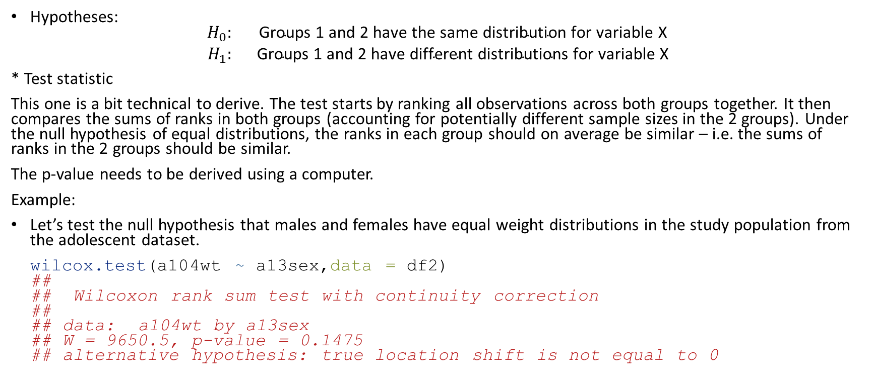
Wilcoxon two-sample rank-sum test
Hypotheses:
$$\begin{matrix}H_{0}: & \text{Groups}\text{ 1 }\text{and}\text{ 2 }\text{have} \text{the} \text{same} \text{distribution} \text{for} \text{variable} \text{X} \\ H_{1}: & \text{Groups}\text{ 1 }\text{and}\text{ 2 }\text{have} \text{different} \text{distributions} \text{for} \text{variable} \text{X}\end{matrix}$$
* Test statistic
This one is a bit technical to derive. The test starts by ranking all observations across both groups together. It then compares the sums of ranks in both groups (accounting for potentially different sample sizes in the 2 groups). Under the null hypothesis of equal distributions, the ranks in each group should on average be similar – i.e. the sums of ranks in the 2 groups should be similar.
The p-value needs to be derived using a computer.
Example:
Let’s test the null hypothesis that males and females have equal weight distributions in the study population from the adolescent dataset.
wilcox.test(a104wt ~ a13sex,data = df2)
##
## Wilcoxon rank sum test with continuity correction
##
## data: a104wt by a13sex
## W = 9650.5, p-value = 0.1475
## alternative hypothesis: true location shift is not equal to 0

Slide 79
Wilcoxon paired signed rank test
For paired data, we reduce the problem to a one-sample test by computing the pairwise differences and testing the null hypothesis that the median differences is 0.
Example:
Test the hypothesis that the CD4 counts are the same at the two time points
wilcox.test(df1$cd41.sk,df1$cd42.sk,paired=TRUE)
##
## Wilcoxon signed rank test with continuity correction
##
## data: df1$cd41.sk and df1$cd42.sk
## V = 782047, p-value < 2.2e-16
## alternative hypothesis: true location shift is not equal to 0
wilcox.test(df1$cd41.sk-df1$cd42.sk) # equivalent
##
## Wilcoxon signed rank test with continuity correction
##
## data: df1$cd41.sk - df1$cd42.sk
## V = 782047, p-value < 2.2e-16
## alternative hypothesis: true location is not equal to 0

Slide 80
Kruskal-Wallis test – more than 2 groups
Analogous to one way ANOVA.
Like the Wilcoxon signed rank and rank-sum test, this test first ranks all observations across all groups. It then compares the between groups rank differences to the within group rank differences.
In R: kruskal.test()

Slide 81
Kruskal-Wallis test – more than 2 groups
Example:
It is claimed that differences exist in the mean weight between the different conditions (excellent, fair, good and poor)
kruskal.test(a104wt ~ a63well,data = df2)
##
## Kruskal-Wallis rank sum test
##
## data: a104wt by a63well
## Kruskal-Wallis chi-squared = 70.206, df = 3, p-value = 3.855e-15

Slide 82
Fisher’s exact test
When we compare categorical variables, we saw that we can use the chi-square test which relies on approximating the squared differences between observed and expected counts by chi-squared distributions. For this approximation, all expected cell counts need to be large enough (typically, the minimum expected cell count should be 5, 6 or larger).
Fisher’s test is computationally intensive: for a given null hypothesis, it derives all cross-tabulation tables that are as extreme or more extreme than the observed table.
For example we can revisit the test we did when we checked if there is an association between stunting and mortality in the adolescent dataset:

Slide 83
Fisher’s exact test
fisher.test(table(df2$stunt,df2$died))
##
## Fisher's Exact Test for Count Data
##
## data: table(df2$stunt, df2$died)
## p-value = 0.006215
## alternative hypothesis: true odds ratio is not equal to 1
## 95 percent confidence interval:
## 1.296104 7.696201
## sample estimates:
## odds ratio
## 3.096198

Slide 84
Fisher’s exact test
However, when we revisit the test for the null hypothesis of no association between socio-economic status and hospital in the Blantyre TB dataset, we run out of memory for Fisher’s exact test – the table is too large with too many alternatives.
try(
fisher.test(table(df1$ses,df1$hosp))
)
## Error in fisher.test(table(df1$ses, df1$hosp)) : FEXACT error 5.
## The hash table key cannot be computed because the largest key
## is larger than the largest representable int.
## The algorithm cannot proceed.
## Reduce the workspace, consider using 'simulate.p.value=TRUE' or another algorithm.

Slide 85
Permutation tests

Slide 86
Permutation tests
Permutation tests do not make use of parametric or non-parametric distributions. Instead, permutation tests compute empirical distributions of the test statistic by randomly shuffling the group allocations (thereby guaranteeing random groups). The algorithm is simple:
Calculate the test statistics.
Repeat many times:
  Randomly allocate individuals to one of the groups being compared - this will by definition mean that the outcome is independent of the grouping variable.
  Compute the test statistic for the resampled data and store this.
The stored test statistics for the data with random group allocation form an empirical distribution of the test statistic. Count what proportion of draws from this empirical distribution are as extreme or more extreme than the observed data. This will yield the p-value.
We illustrate permutation tests here as an alternative to the t-test, but they can be used in many other situations.

Slide 87
Permutation tests
For example, in the case of testing whether the sample means for age differ between males and females:
t<-t.test(age~sex,data=df1)$statistic
B<-5000
tVect<-rep(NA,B)
for(b in 1:B){
dfTmp<-df1
dfTmp$sex<-sample(df1$sex,replace=FALSE,size=nrow(df1))
tVect[b]<-t.test(age~sex,data=dfTmp)$statistic
}
sum(abs(tVect)>=abs(t))/B # compare this to p=0.4895
## [1] 0.488

Slide 88
Word of warning: to p or not to p
Null hypothesis significance testing can overly simplify complex research questions and nuance in analysis can be lost.
The common choices of $α$ and $β$ are completely arbitrary, set by a bunch of statisticians in the 1930s over a cup of tea (literally – https://en.wikipedia.org/wiki/Lady_tasting_tea).
Overall risk of a Type I error increases the more tests you do.
If you do several tests or fit several model but only report the one that was statistically significant, you are misleading your readers.
Publication bias and pressure to publish means very bad practices have become established (e.g. p-hacking), contributing to the reproducibility crisis.
Please read https://doi.org/10.1080/00031305.2019.1583913.

Slide 89
Sample size calculations

Slide 90
Sample size considerations
Sample size is the number of units in each group in a study that you need to recruit to have a reasonable chance to establish an association between 2 variables if that association exists or to estimate a given parameter with a minimum desired precision.
Sample size calculations may be based on the precision (descriptive studies) or the power (analytical studies) of a study.
  Precision refers to the desired width of the confidence interval for a sample estimate.
  Recall: power = 1-$β$ (The probability of finding a significant result if one exists)

Slide 91
Basic elements
The objective of the study:
  Descriptive studies: what parameter is being estimated?
  Analytical studies: what comparison is being made, what are the null and alternative hypotheses?
What is a reasonable minimum effect size (analytical studies)?
What is the desired confidence / significance level?
What is the desired power or precision / margin of error?

Slide 92
Basic elements
Study objectives may include some of the following:
Estimating a single value: e.g.
  To examine what proportion of the population of Malawi currently smokes.
  To estimate the prevalence of anaemia in under-fives in a malaria endemic area.
Comparison of outcomes:
  To examine the association between hormone replacement therapy and cardiovascular disease.
  To examine how much the risk of malaria will be reduced with the use of impregnated bed-nets.
  To examine the effect of a new intervention on the incidence of stomach cancer.

Slide 93
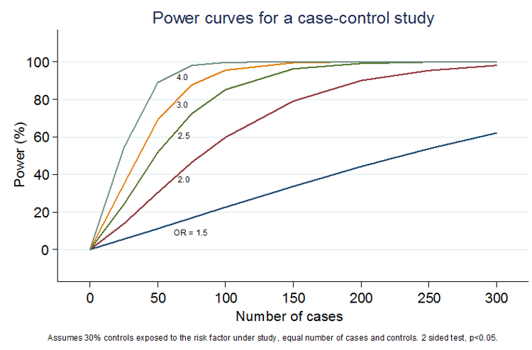
Sample size and power
Relationship between power and sample size

Slide 94
Notes on sample size
Sample size is important:
If the sample size is too low: cannot answer the research question.
If the sample size is too large: wasting research funds and can be unethical in the case of experimental studies.
Too low a sample size is generally worse than too large a sample size.
In any sample size estimation:
  Round up to nearest integer.
  Use realistic but conservative estimates to guide your calculations.
  Do the calculations for a range of values if uncertain what would be good parameter estimates.
Calculations for complex problems may need to be done via simulation.

Slide 95
pwr library
For common designs, the pwr library is very useful.
library(pwr)
pwr has several functions for calculating sample sizes
pwr.p.test - one sample proportion test
pwr.2p.test - two sample proportions test (equal n)
pwr.2p2n.test - two proportions (unequal n)
pwr.anova.test - balanced one way ANOVA
pwr.chisq.test - chi-square test
pwr.f2.test - general linear model
pwr.p.test - proportion (one sample)
pwr.r.test - correlation
pwr.t.test - t-tests (one sample, 2 sample, paired)
pwr.t2n.test - t-test (two samples with unequal n)

Slide 96
Sample size for estimating a proportion
Example:
Suppose you want to estimate the proportion of all children aged 12 to 24 months in Blantyre district who received measles vaccine in the year 2011.
There are 3 steps to calculate sample size for a proportion:
First, provide an estimate of the proportion of children immunised – usually obtained from previous studies e.g. 80%. If you have no idea, choose 50% as the most conservative estimate (highest uncertainty at 50%).
Decide confidence level. e.g. 95%.
Decide margin of error (half the width of the confidence interval) e.g. 5% (be clear whether this is absolute or relative).

Slide 97
Sample size for estimating a proportion
The sample size for estimating a single proportion is given by:
$$n=\frac{p\left(1−p\right)}{{\left(E/1.96\right)}^{2}}$$
where
  $n$ = minimum sample size;
  $p$ = expected prevalence;
  $E$ = margin of error (expressed as a proportion);
  1.96 is the z-value corresponding to a 95% confidence level

Slide 98
Sample size for estimating a proportion
sampSizeOneProp<-function(p,E,alpha=0.05){
n<-p*(1-p)/((E/qnorm(1-alpha/2))^2)
return(ceiling(n))
}
sampSizeOneProp(p=0.8,E=0.05)
## [1] 246

Slide 99
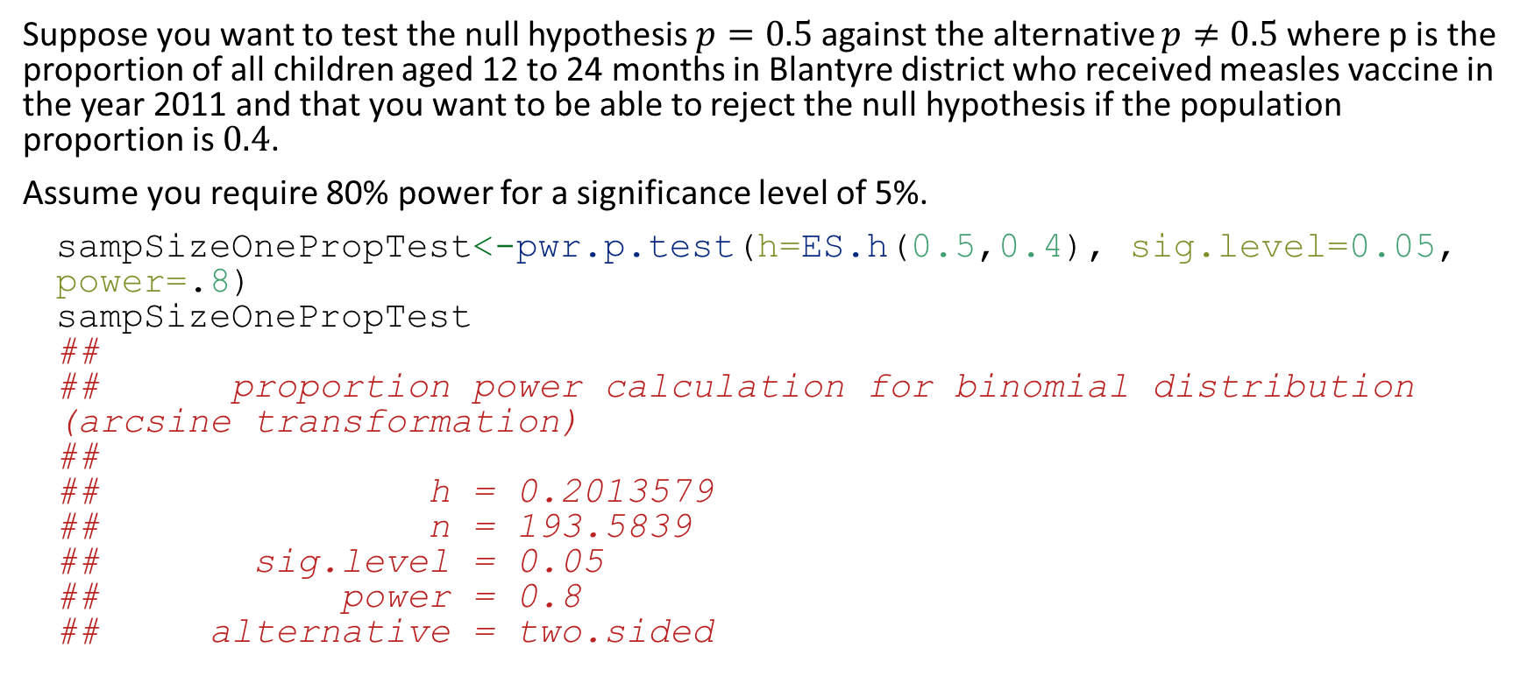
Sample size for testing one proportion
Suppose you want to test the null hypothesis $p=0.5$ against the alternative $p≠0.5$ where p is the proportion of all children aged 12 to 24 months in Blantyre district who received measles vaccine in the year 2011 and that you want to be able to reject the null hypothesis if the population proportion is $0.4$.
Assume you require 80% power for a significance level of 5%.
sampSizeOnePropTest<-pwr.p.test(h=ES.h(0.5,0.4), sig.level=0.05, power=.8)
sampSizeOnePropTest
##
## proportion power calculation for binomial distribution (arcsine transformation)
##
## h = 0.2013579
## n = 193.5839
## sig.level = 0.05
## power = 0.8
## alternative = two.sided

Slide 100
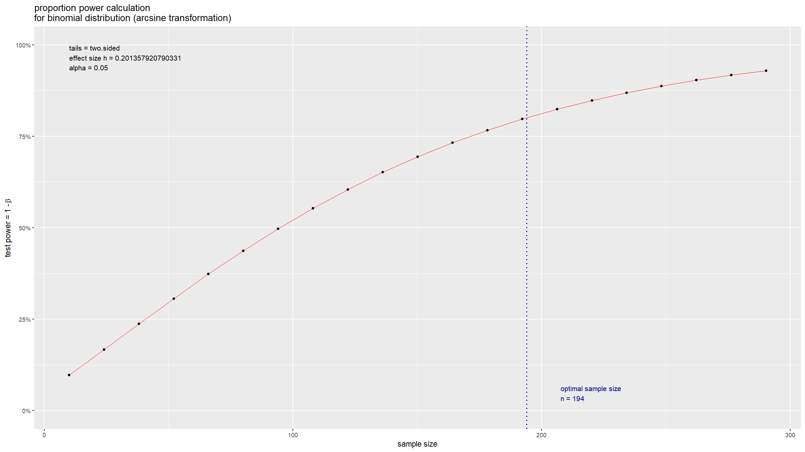
Sample size for testing one proportion
R makes it easy to plot a sample size curve:
plot(sampSizeOnePropTest)
## Warning: Using `size` aesthetic for lines was deprecated in ggplot2 3.4.0.
## ℹ Please use `linewidth` instead.
## ℹ The deprecated feature was likely used in the pwr package.
## Please report the issue to the authors.
## This warning is displayed once every 8 hours.
## Call `lifecycle::last_lifecycle_warnings()` to see where this warning was
## generated.

Slide 101
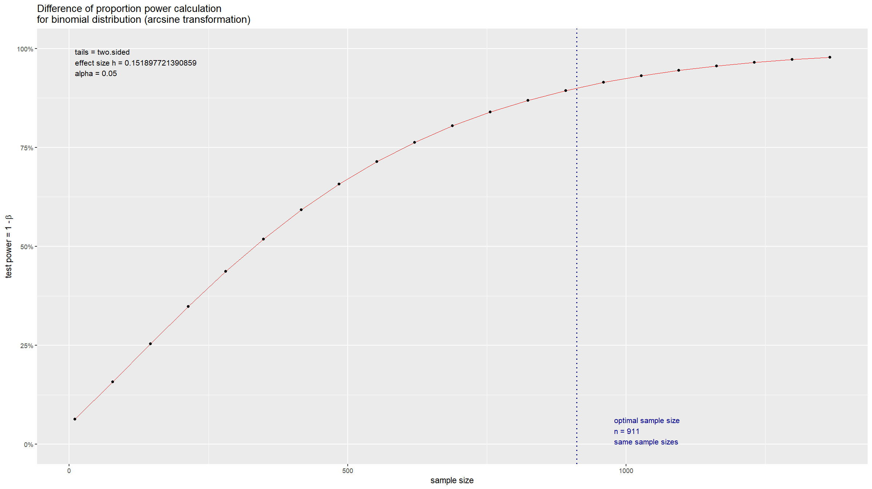
Sample size for comparing two proportions
Suppose you want to study and compare the prevalence of HIV in 2 populations (e.g. Ndirande vs Chilomoni). To calculate the required sample size, you need:
Estimate of prevalence of HIV in each area, e.g 10% and 15%.
Significance level for the comparison, e.g. 0.05.
The power to detect the difference, e.g. 0.9 (90% power).
sampSizeTwoPropTest <- pwr.2p.test(h = ES.h(p1=0.10, p2=0.15), sig.level=0.05, power=0.9)
sampSizeTwoPropTest
##
## Difference of proportion power calculation for binomial distribution (arcsine transformation)
##
## h = 0.1518977
## n = 910.8011
## sig.level = 0.05
## power = 0.9
## alternative = two.sided
##
## NOTE: same sample sizes
plot(sampSizeTwoPropTest)

Slide 102
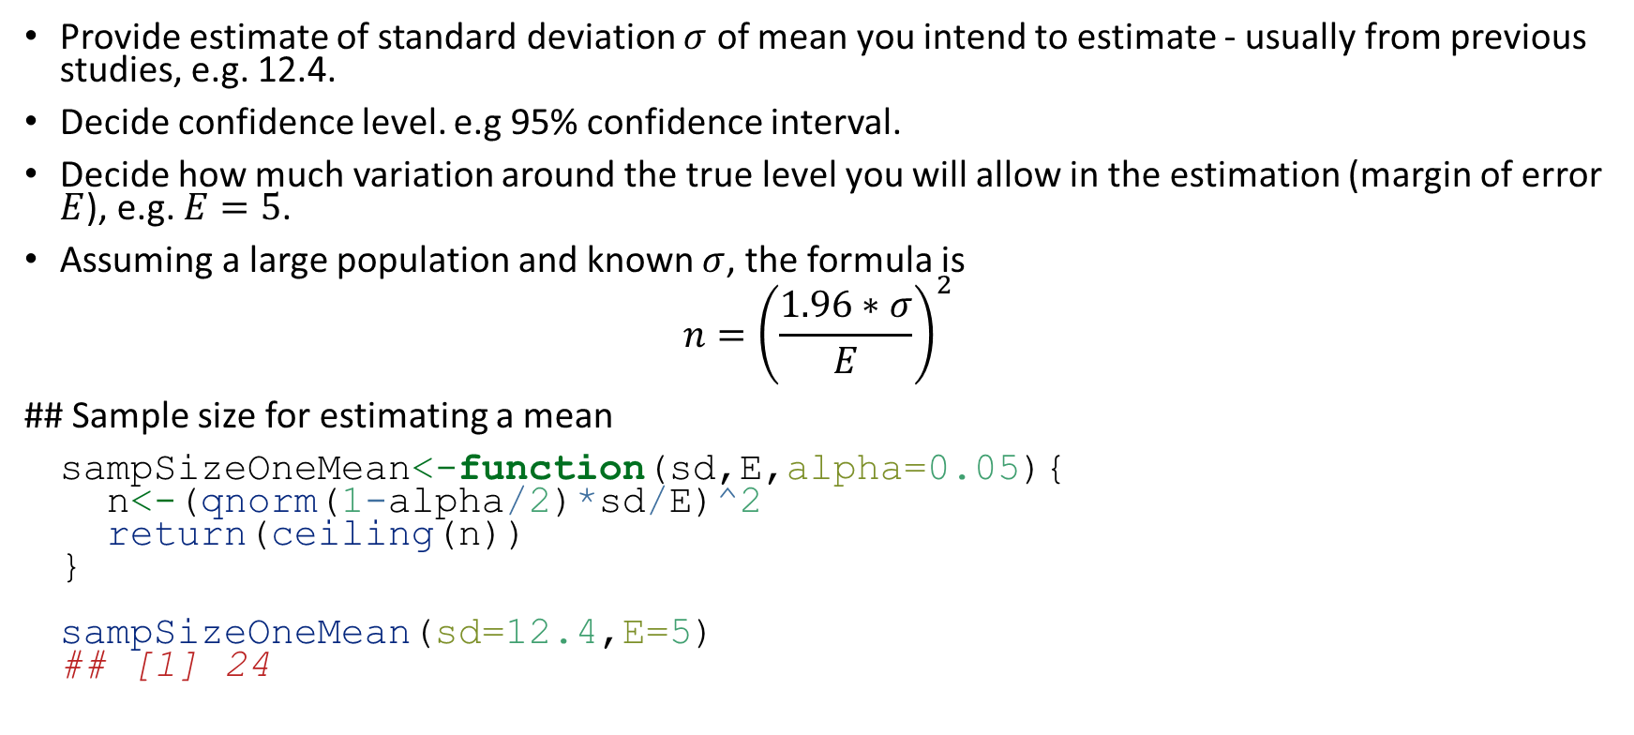
Sample size for estimating a mean
Provide estimate of standard deviation $σ$ of mean you intend to estimate - usually from previous studies, e.g. 12.4.
Decide confidence level. e.g 95% confidence interval.
Decide how much variation around the true level you will allow in the estimation (margin of error $E$), e.g. $E=5$.
Assuming a large population and known $σ$, the formula is
$$n={\left(\frac{1.96∗σ}{E}\right)}^{2}$$
## Sample size for estimating a mean
sampSizeOneMean<-function(sd,E,alpha=0.05){
n<-(qnorm(1-alpha/2)*sd/E)^2
return(ceiling(n))
}
sampSizeOneMean(sd=12.4,E=5)
## [1] 24

Slide 103
Sample size for comparing two means
First, provide an estimate of the standard deviation $σ$ of two means you intend to compare - this is usually obtained from previous studies.
Decide what your confidence level will be. E.g 95% confidence interval / significance level of 0.05.
Decide power of your study: 0.8 or 0.9 (80% or 90%).
Decide what the minimum difference (effect size) between groups, $δ={\overset{‾}{x}}_{2}−{\overset{‾}{x}}_{1}$, that you would still want to be powered to detect should be.
pwr expresses the effect size using Cohen’s d statistic, which is defined as
$$d=\frac{δ}{σ}$$

Slide 104
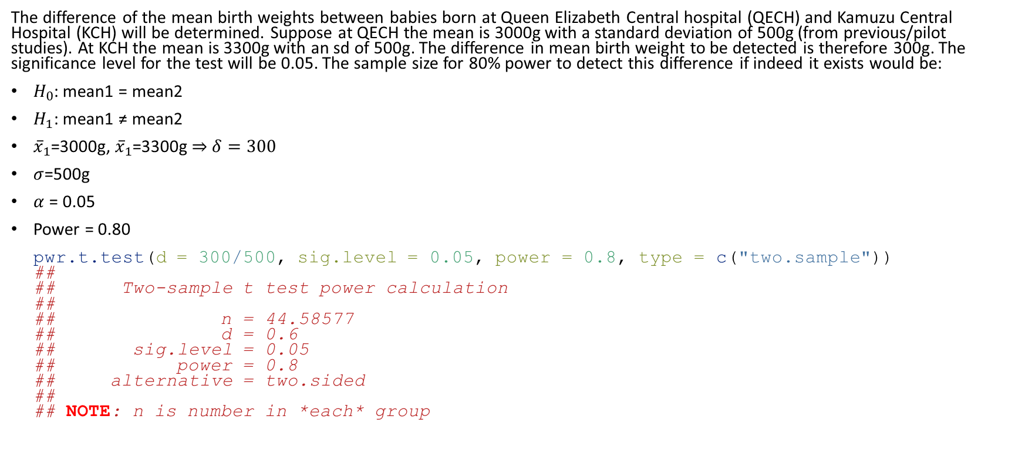
Sample size for comparing two means
The difference of the mean birth weights between babies born at Queen Elizabeth Central hospital (QECH) and Kamuzu Central Hospital (KCH) will be determined. Suppose at QECH the mean is 3000g with a standard deviation of 500g (from previous/pilot studies). At KCH the mean is 3300g with an sd of 500g. The difference in mean birth weight to be detected is therefore 300g. The significance level for the test will be 0.05. The sample size for 80% power to detect this difference if indeed it exists would be:
$H_{0}$: mean1 = mean2
$H_{1}$: mean1 ≠ mean2
${\overset{‾}{x}}_{1}$=3000g, ${\overset{‾}{x}}_{1}$=3300g $⇒$ $δ=300$
$σ$=500g
$α$ = 0.05
Power = 0.80
pwr.t.test(d = 300/500, sig.level = 0.05, power = 0.8, type = c("two.sample"))
##
## Two-sample t test power calculation
##
## n = 44.58577
## d = 0.6
## sig.level = 0.05
## power = 0.8
## alternative = two.sided
##
## NOTE: n is number in *each* group

Slide 105
Sample size for cluster sampling
In RCT and similar studies, we need to account for the additional sampling error
  Simple random sampling violated
  Within and between cluster variation
Intra cluster correlation coefficient (ICC), $ρ$.
Average cluster size, $m$.
Design effect (D_{eff}) - just multiply the sample size for an individually randomised / sample study by this.
$$D_{eff}=1+\left(m−1\right)ρ$$
Analysis will also need to account for clustering

Slide 106
Useful reading and practice
Package pwr
Theory behind sample size
  Normal distribution
  Simulations may be better
  Statistician may be needed

Slide 107
Power curves / sample size graphs
We have seen a few slides earlier an example of a sample size curve.
Vary ranges of expected effect sizes
Compute sample sizes for different scenarios
Plot sample size against some value e.g. effect size
Useful if you are not sure what an appropriate effect size would be (and want to see how sensitive your sample size requirement is to changes in effect size).
Instead of varying effect size, you can also vary power or sample size (and keep other parameters fixed).

Slide 108
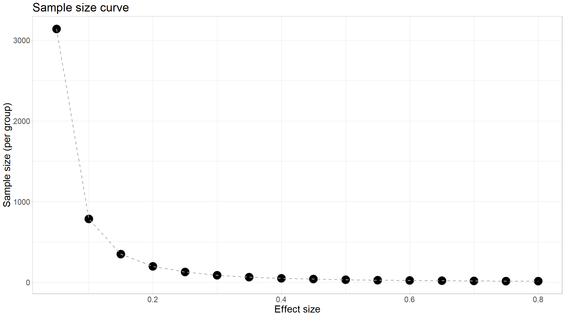
Simple R code for producing sample size graph
h <- seq(.05,.8, by=.05)
n <- rep(NA,length(h))
for(i in 1:length(h)){
n[i] <- pwr.p.test(h = h[i] , sig.level =0.05, power = .8)[2]
}
df<-data.frame(effectSize=h,sampleSize=unlist(n))
df %>%
ggplot(mapping=aes(x=effectSize,y=sampleSize)) +
geom_point(size=8) +
geom_line(lty=2,lwd=0.75,col="darkgrey") +
theme_light() +
ggtitle("Sample size curve") +
xlab("Effect size") +
ylab("Sample size (per group)") +
theme(text=element_text(size=20))

Slide 109
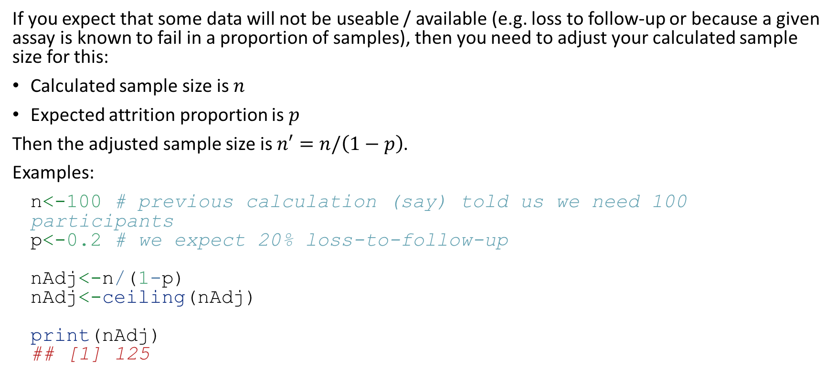
Adjusting for attrition
If you expect that some data will not be useable / available (e.g. loss to follow-up or because a given assay is known to fail in a proportion of samples), then you need to adjust your calculated sample size for this:
Calculated sample size is $n$
Expected attrition proportion is $p$
Then the adjusted sample size is $n′=n/\left(1−p\right)$.
Examples:
n<-100 # previous calculation (say) told us we need 100 participants
p<-0.2 # we expect 20% loss-to-follow-up
nAdj<-n/(1-p)
nAdj<-ceiling(nAdj)
print(nAdj)
## [1] 125

Slide 110
[end of Session 4]

