Slide 1
Statistics and R short course
Session 2: Data visualisation
Vester Gunsaru

Slide 2
Introduction

Slide 3

Preliminaries
Certificates of attendance
  You need to attend all 6 sessions.
  Sign in & check spelling of name on the sign-in sheet!
  Only issued if paid-up and in exchange for completed feedback form.
Course website / GitHub: https://github.com/mlw-stats/R_And_Statistics_Training_2026
Office hours
  Vester - Mondays @ 2pm; Kapeni Meeting 1
  Eva - Tuesdays @ 2pm; Creator Ground Floor
  Marc - Thursdays @ 9am; Kapeni Meeting 2
  Jessie - Mondays @ 3pm; Kapeni Hurdle 1
Housekeeping
  Refreshments (no lunch - sorry)
  Fire exits & bathrooms

Slide 4
Learning outcomes
KNOW R: Explain know what R is & what it can do.
KNOW R RESOURCES: List useful R resources and access them.
DO R: Perform basic operations relevant for your research in R:
  Read data into R & write data or results to the harddrive.
  Manipulate & use different object types.
  Write & use functions in R
  Perform basic analyses on a dataset: mean, standard deviation, linear regression.
  Produce various standard graphs and tables
UNDERSTAND BASICS OF STATISTICS: Explain basic statistical theory: common distributions, standard statistical techniques, common study designs, assumptions behind common statistical tests and regression models.
UNDERSTAND STUDY DESIGNS: Recommend appropriate designs & analyses.
COMPREHEND OPEN SCIENCE: Summarise principles of open, reproducible research.
DO OPEN SCIENCE WITH R: Use R scripts, R markdown, packages & GitHub.

Slide 5

Preliminaries
https://github.com/mlw-stats/R_And_Statistics_Training_2026

Slide 6
A little exercise

Slide 7
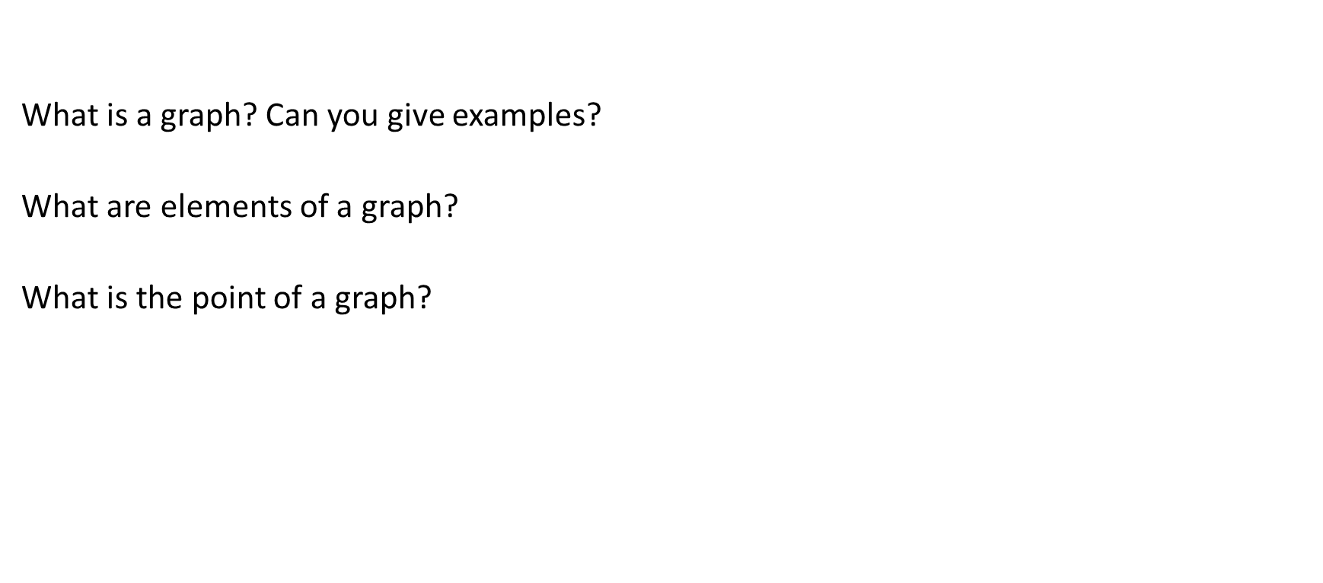
A little exercise
What is a graph? Can you give examples?
What are elements of a graph?
What is the point of a graph?

Slide 8
Grammar of graphics

Slide 9
Basic figures & graphs
R has powerful data visualisation capabilities, especially when you start using packages.
The standard R visualisation library is graphics, which is installed when you install R and loaded automatically at start-up. The main function here is plot().
However, the graphics package is quite basic and has inconsistent syntax and function names for different types of graphs.
The tidyverse comes with the R package ggplot2 which provides a more consistent way of producing graphs (it is based on a grammar of graphics).
For example, let’s do a scatter plot.

Slide 10
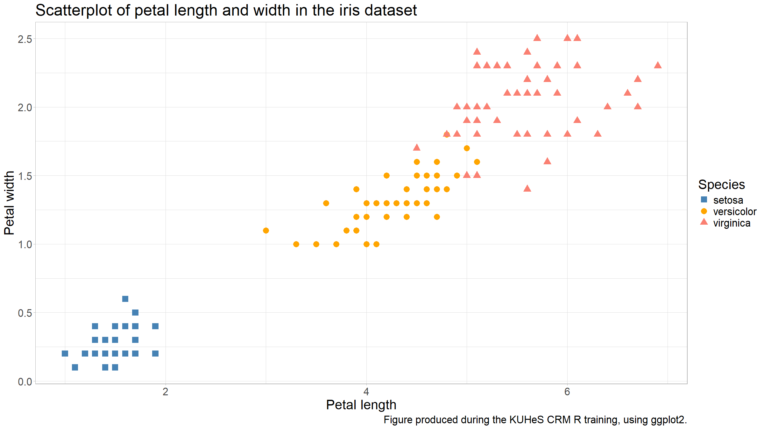
Basic figures & graphs
iris %>%
ggplot(mapping=aes(x=Petal.Length,y=Petal.Width,col=Species,pch=Species)) +
geom_point() +
scale_colour_manual(values=c("steelblue","orange","salmon"),name="Species") +
scale_shape_manual(values=15:17,name="Species") +
xlab("Petal length") +
ylab("Petal width") +
labs(title="Scatterplot of petal length and width in the iris dataset",caption="Figure produced during the KUHeS CRM R training, using ggplot2.") +
theme_light()

Slide 11
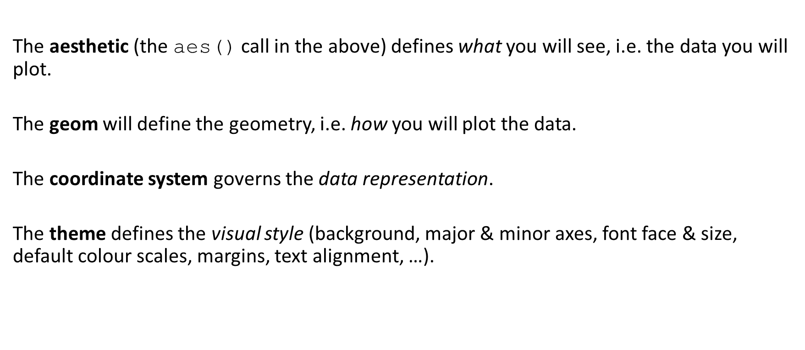
Basic figures & graphs
The aesthetic (the aes() call in the above) defines what you will see, i.e. the data you will plot.
The geom will define the geometry, i.e. how you will plot the data.
The coordinate system governs the data representation.
The theme defines the visual style (background, major & minor axes, font face & size, default colour scales, margins, text alignment, …).

Slide 12
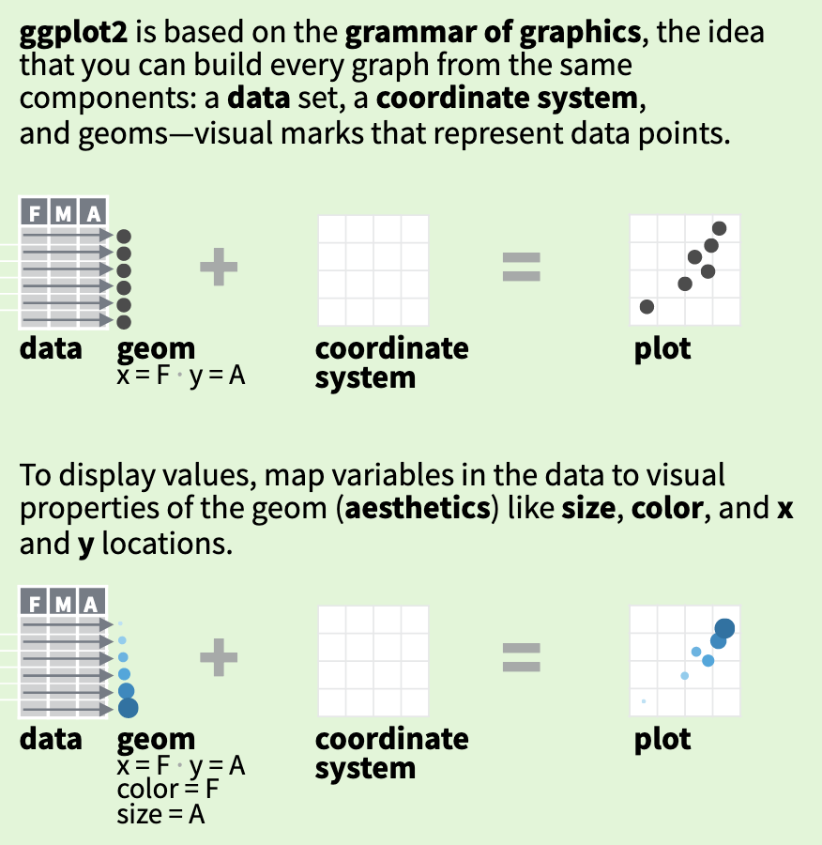
Basic figures & graphs
The basics behind ggplot2 (https://github.com/rstudio/cheatsheets/raw/master/data-visualization.pdf).

Slide 13
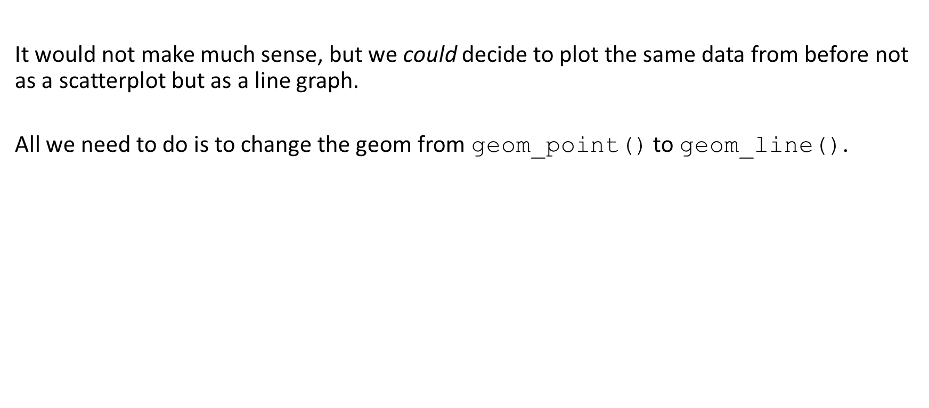
Basic figures & graphs
It would not make much sense, but we could decide to plot the same data from before not as a scatterplot but as a line graph.
All we need to do is to change the geom from geom_point() to geom_line().

Slide 14
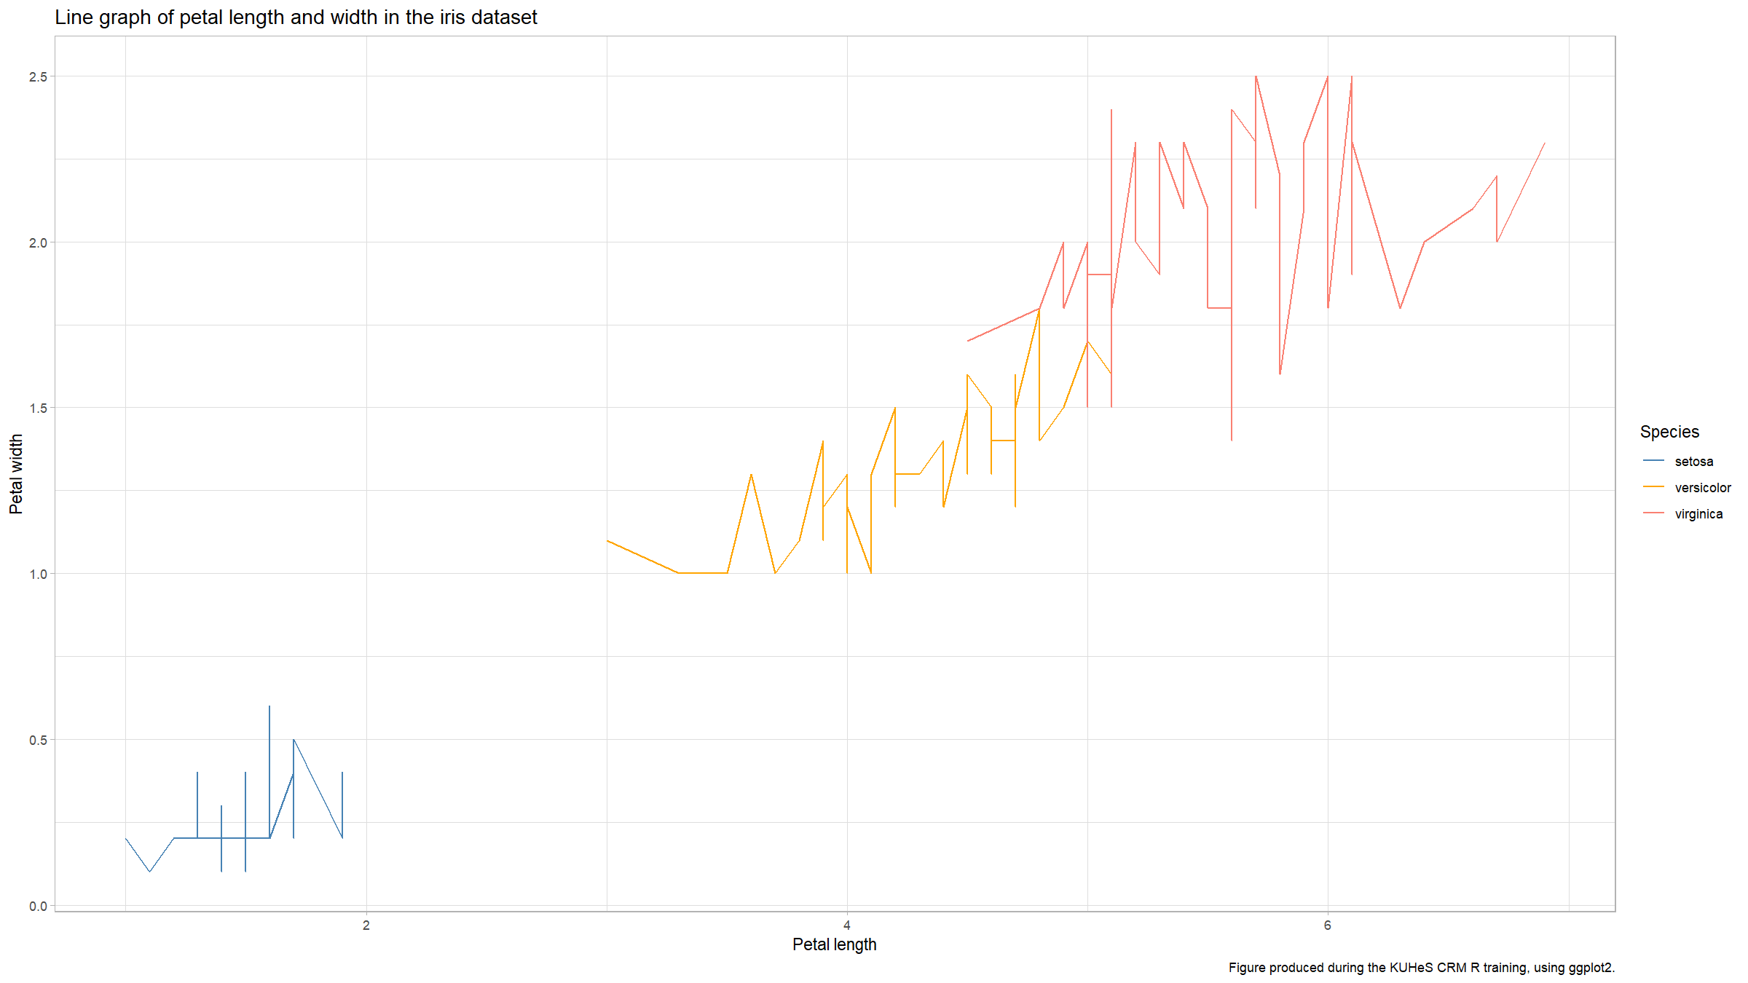
Basic figures & graphs
iris %>%
ggplot(mapping=aes(x=Petal.Length,y=Petal.Width,col=Species,pch=Species)) +
geom_line() +
scale_colour_manual(values=c("steelblue","orange","salmon"),name="Species") +
scale_shape_manual(values=15:17,name="Species") +
xlab("Petal length") +
ylab("Petal width") +
labs(title="Line graph of petal length and width in the iris dataset",caption="Figure produced during the KUHeS CRM R training, using ggplot2.") +
theme_light()

Slide 15
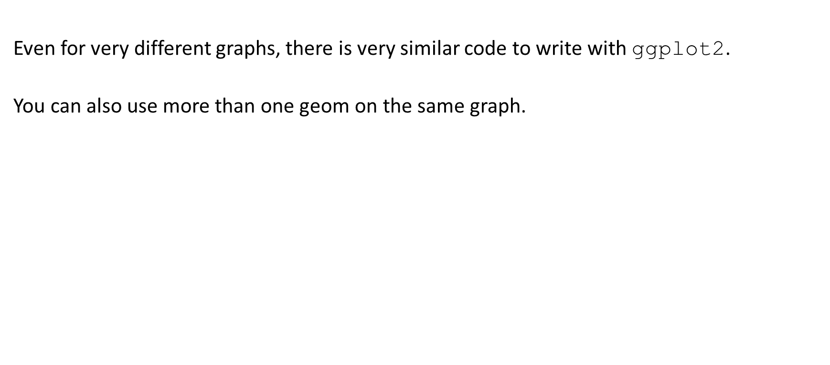
Basic figures & graphs
Even for very different graphs, there is very similar code to write with ggplot2.
You can also use more than one geom on the same graph.

Slide 16
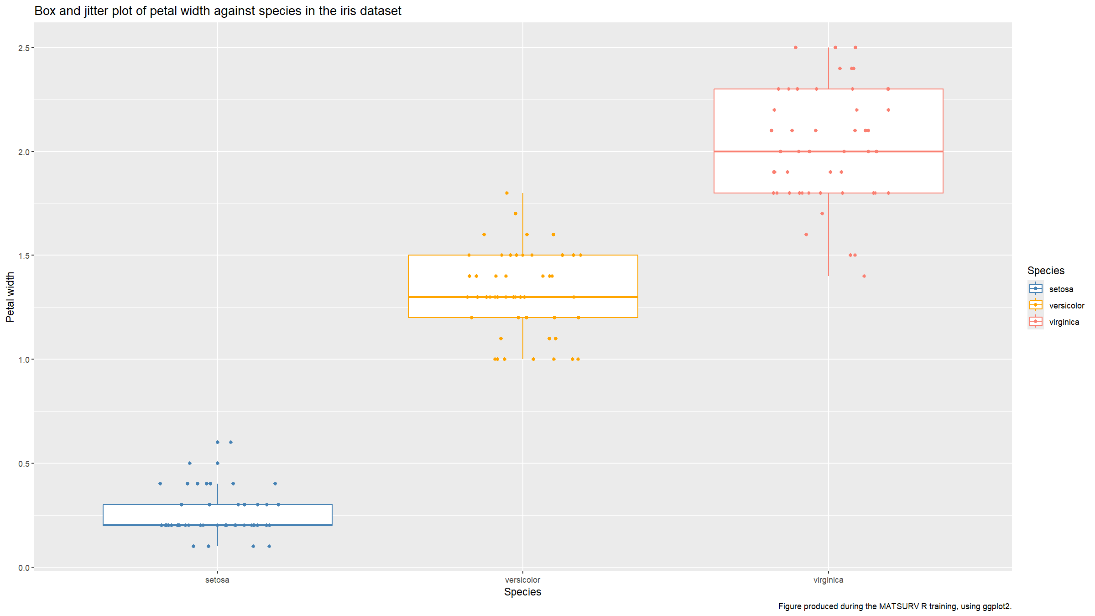
Basic figures & graphs
iris %>%
ggplot(mapping=aes(x=Species,y=Petal.Width,col=Species)) +
geom_boxplot() +
geom_jitter(height=0,width=0.2) +
scale_colour_manual(values=c("steelblue","orange","salmon")) +
scale_fill_manual(values=c("steelblue","orange","salmon")) +
xlab("Species") +
ylab("Petal width") +
labs(title="Box and jitter plot of petal width against species in the iris dataset",caption="Figure produced during the MATSURV R training, using ggplot2.")

Slide 17
Resources

Slide 18
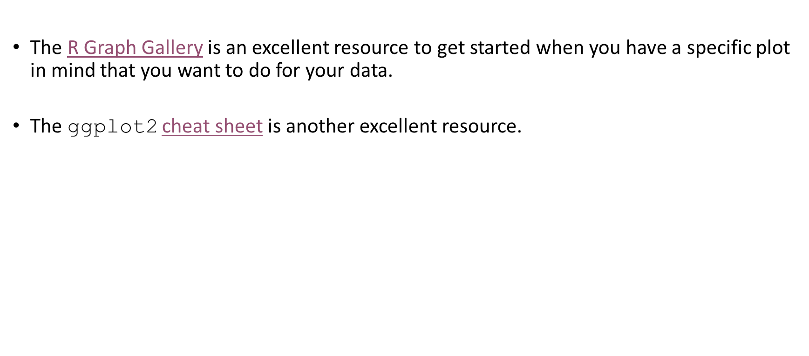
Resources
The R Graph Gallery is an excellent resource to get started when you have a specific plot in mind that you want to do for your data.
The ggplot2 cheat sheet is another excellent resource.

Slide 19
Distribution figures

Slide 20
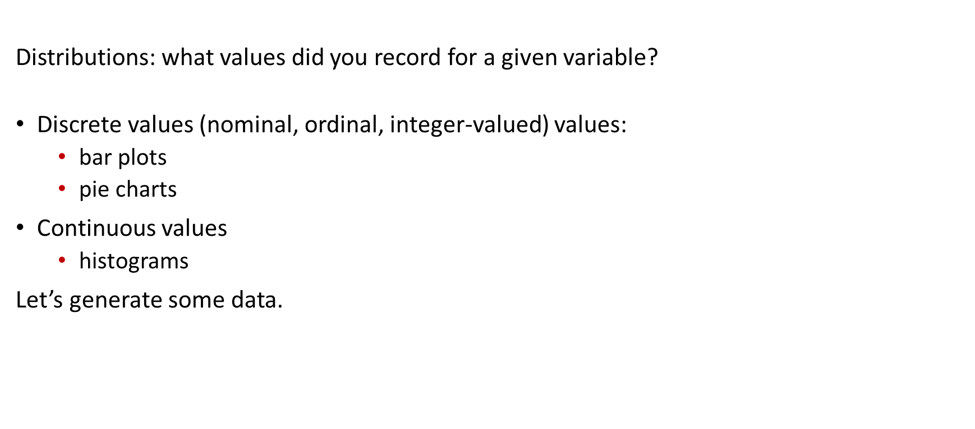
Distribution figures
Distributions: what values did you record for a given variable?
Discrete values (nominal, ordinal, integer-valued) values:
  bar plots
  pie charts
Continuous values
  histograms
Let’s generate some data.

Slide 21
Distribution figures
typesTmp<- paste(sep="","type",1:3)
type<-factor(sample(typesTmp,
size=1000,
replace=T,
prob=c(0.45,0.3,0.25)))
x1<-rbinom(1000,size=1,prob=0.25)
x2<-rpois(1000,lambda=ifelse(type=="type3",6,4))

Slide 22
Distribution figures
dat<-data.frame(type,x1,x2) %>%
mutate(x3=ifelse(type=="type1",
rnorm(sum(type=="type1"),mean=-2),
ifelse(type=="type2",
rnorm(sum(type=="type2"),mean=2),
runif(sum(type=="type3"))
)
)
) %>%
mutate(x4=rnorm(n(),mean=x3))

Slide 23
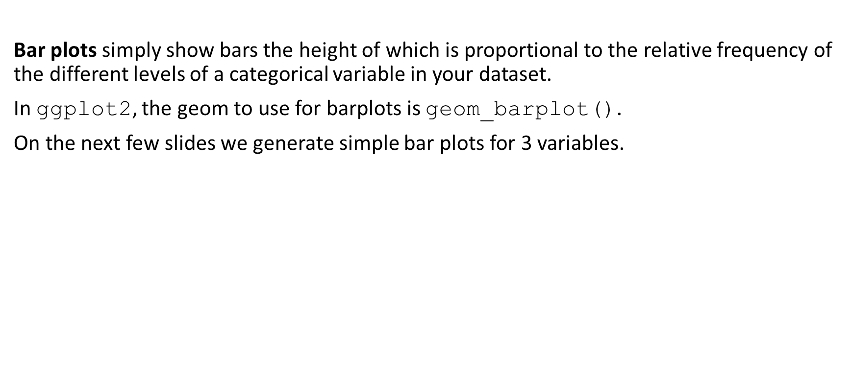
Distribution figures
Bar plots simply show bars the height of which is proportional to the relative frequency of the different levels of a categorical variable in your dataset.
In ggplot2, the geom to use for barplots is geom_barplot().
On the next few slides we generate simple bar plots for 3 variables.

Slide 24
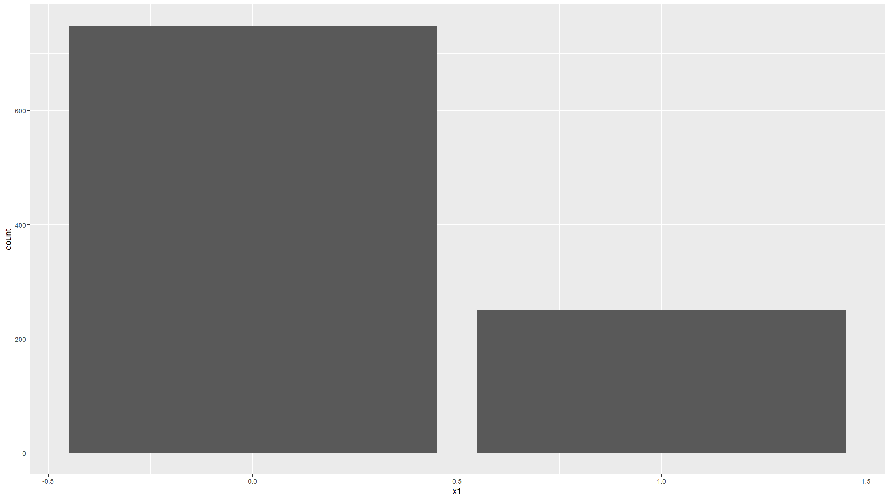
Distribution figures
ggplot(data=dat,mapping=aes(x=x1)) +
geom_bar()

Slide 25
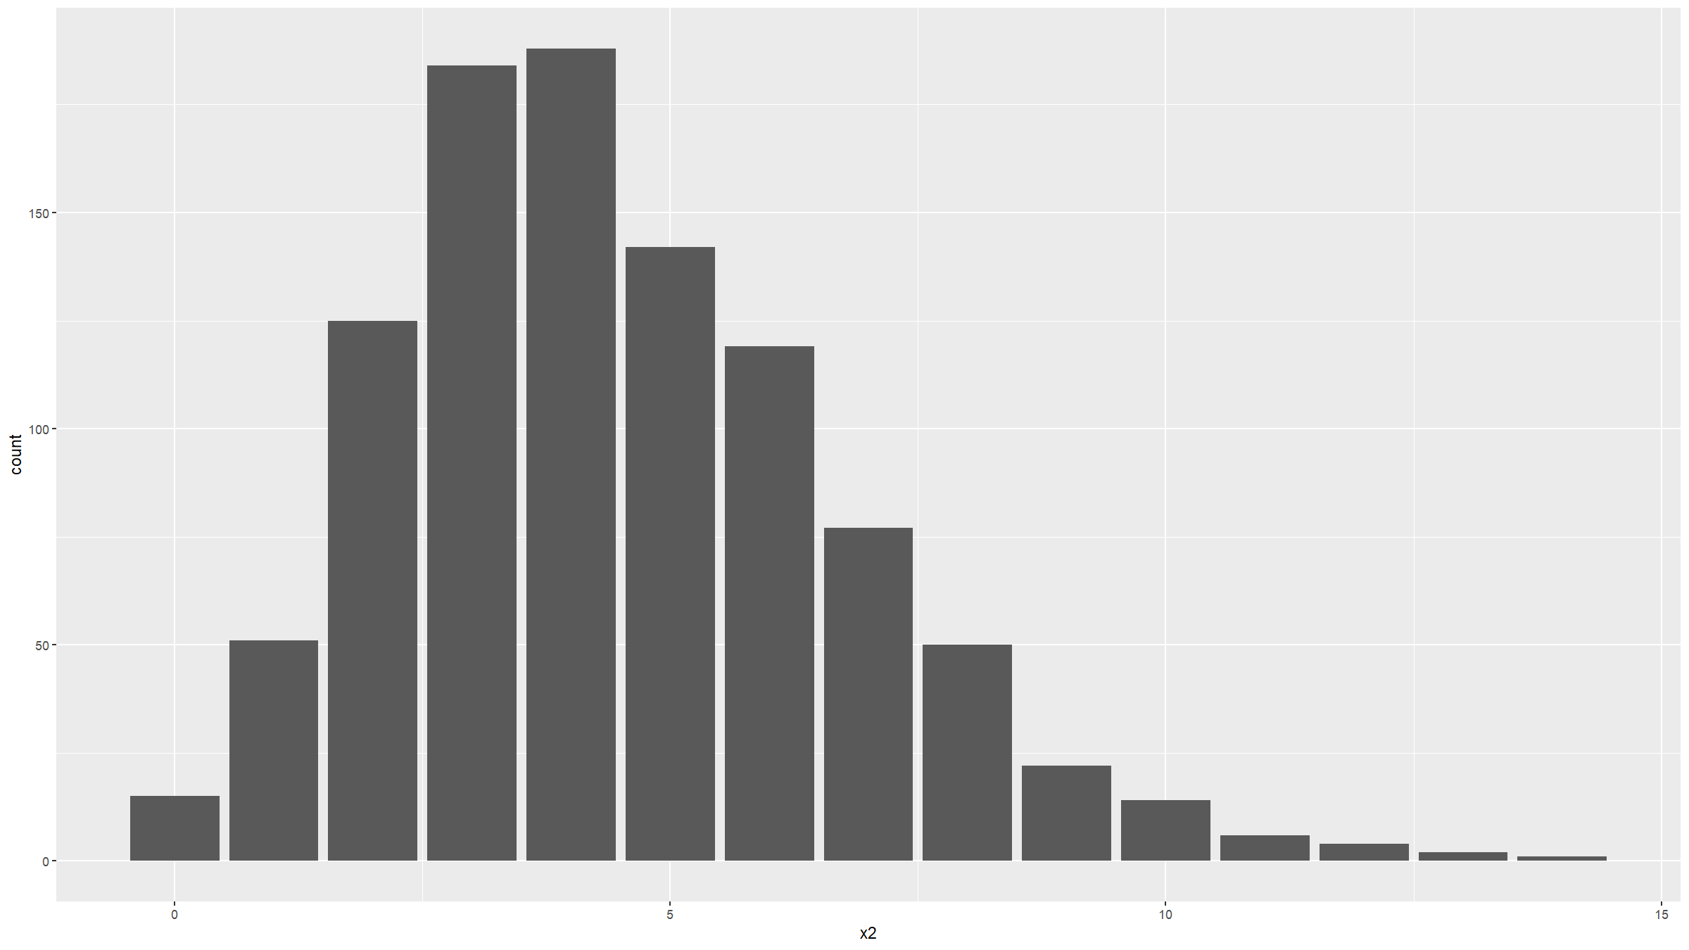
Distribution figures
ggplot(data=dat,mapping=aes(x=x2)) +
geom_bar()

Slide 26
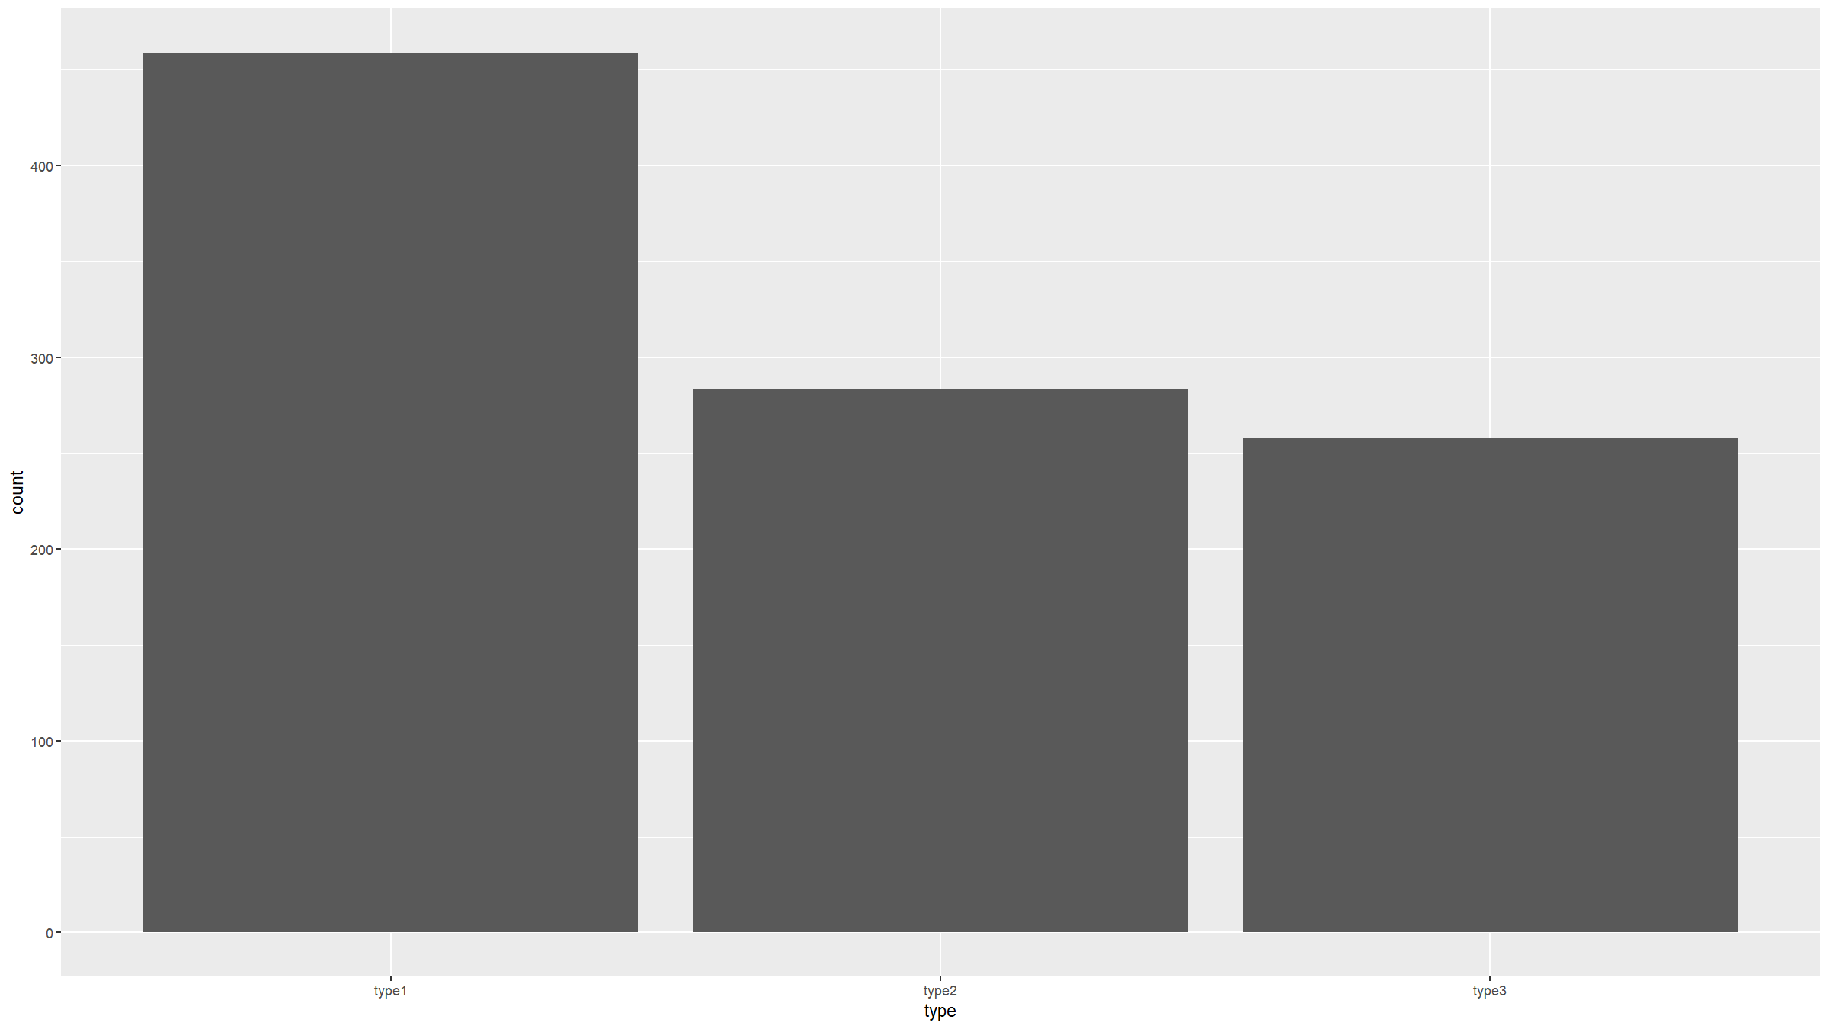
Distribution figures
ggplot(data=dat,mapping=aes(x=type)) +
geom_bar()

Slide 27
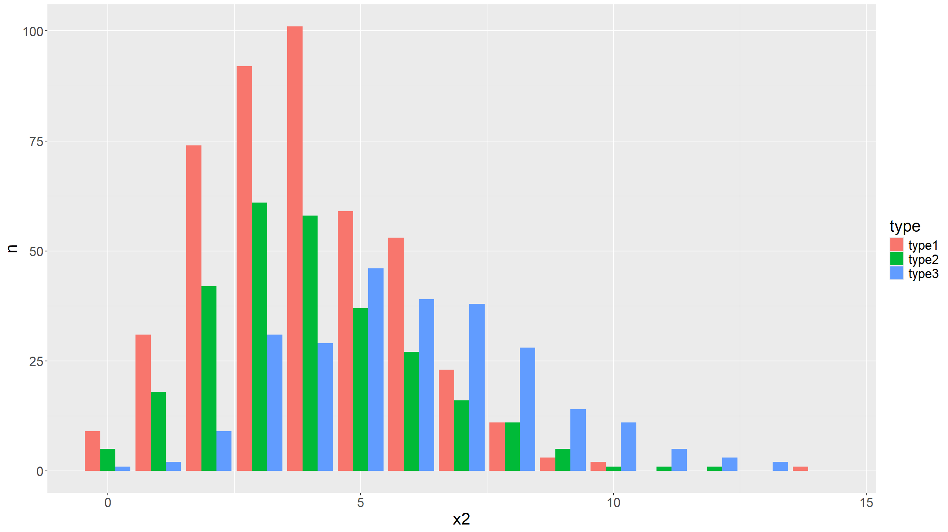
Distribution figures
We can stratify a bar plot by a grouping variable (in this case the variable type).
dat %>%
count(type,x2) %>%
complete(type,x2,fill=list(n=0)) %>%
ggplot(mapping=aes(fill=type,y=n,x=x2)) +
geom_bar(position="dodge",stat="identity") +
theme(text = element_text(size=20))

Slide 28
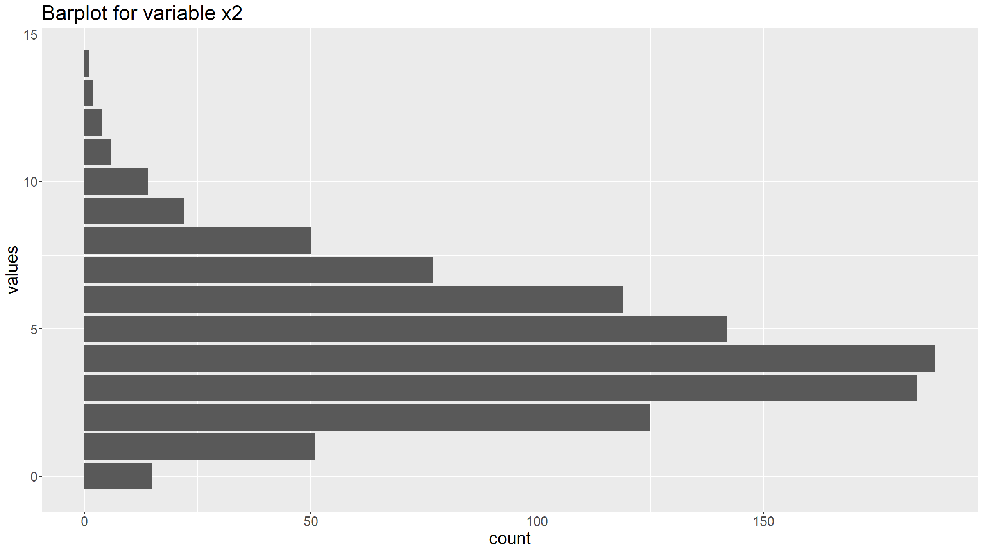
Distribution figures
You can customise graphs by adding other options for the coordinate system, the annotations, the theme etc.
ggplot(data=dat,mapping=aes(x=x2)) +
geom_bar() +
coord_flip() +
ggtitle("Barplot for variable x2") +
xlab("values") +
ylab("count") +
theme(text = element_text(size=20))

Slide 29
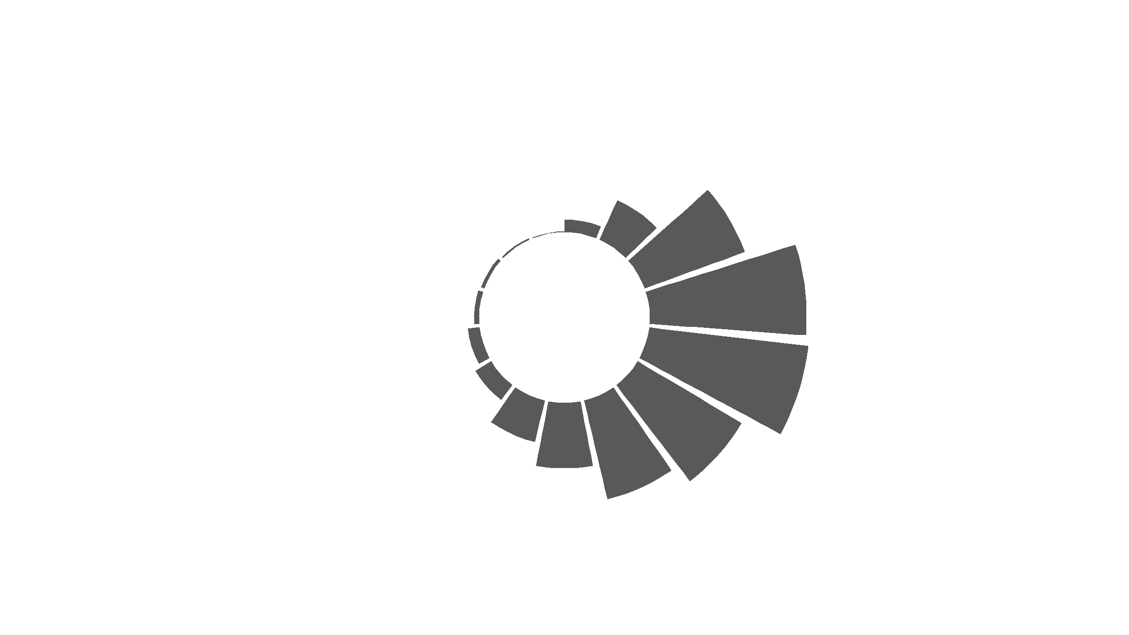
Distribution figures
You can change the coordinate system to get a circular plot (note, use these carefully - most often they are NOT a good idea).
For this you can use coord_polar().
To get annotations for each bar, requires a bit more work (but see the R Graph Gallery for examples).
ggplot(data=dat,mapping=aes(x=x2)) +
geom_bar() + coord_polar(start=0) + theme_minimal() +
theme(
axis.text = element_blank(),
axis.title = element_blank(),
panel.grid = element_blank(),
plot.margin = unit(rep(-2,4), "cm") # removing unnecessary margins
) +
ylim(-100,250) # dtermines size of the inner radius

Slide 30
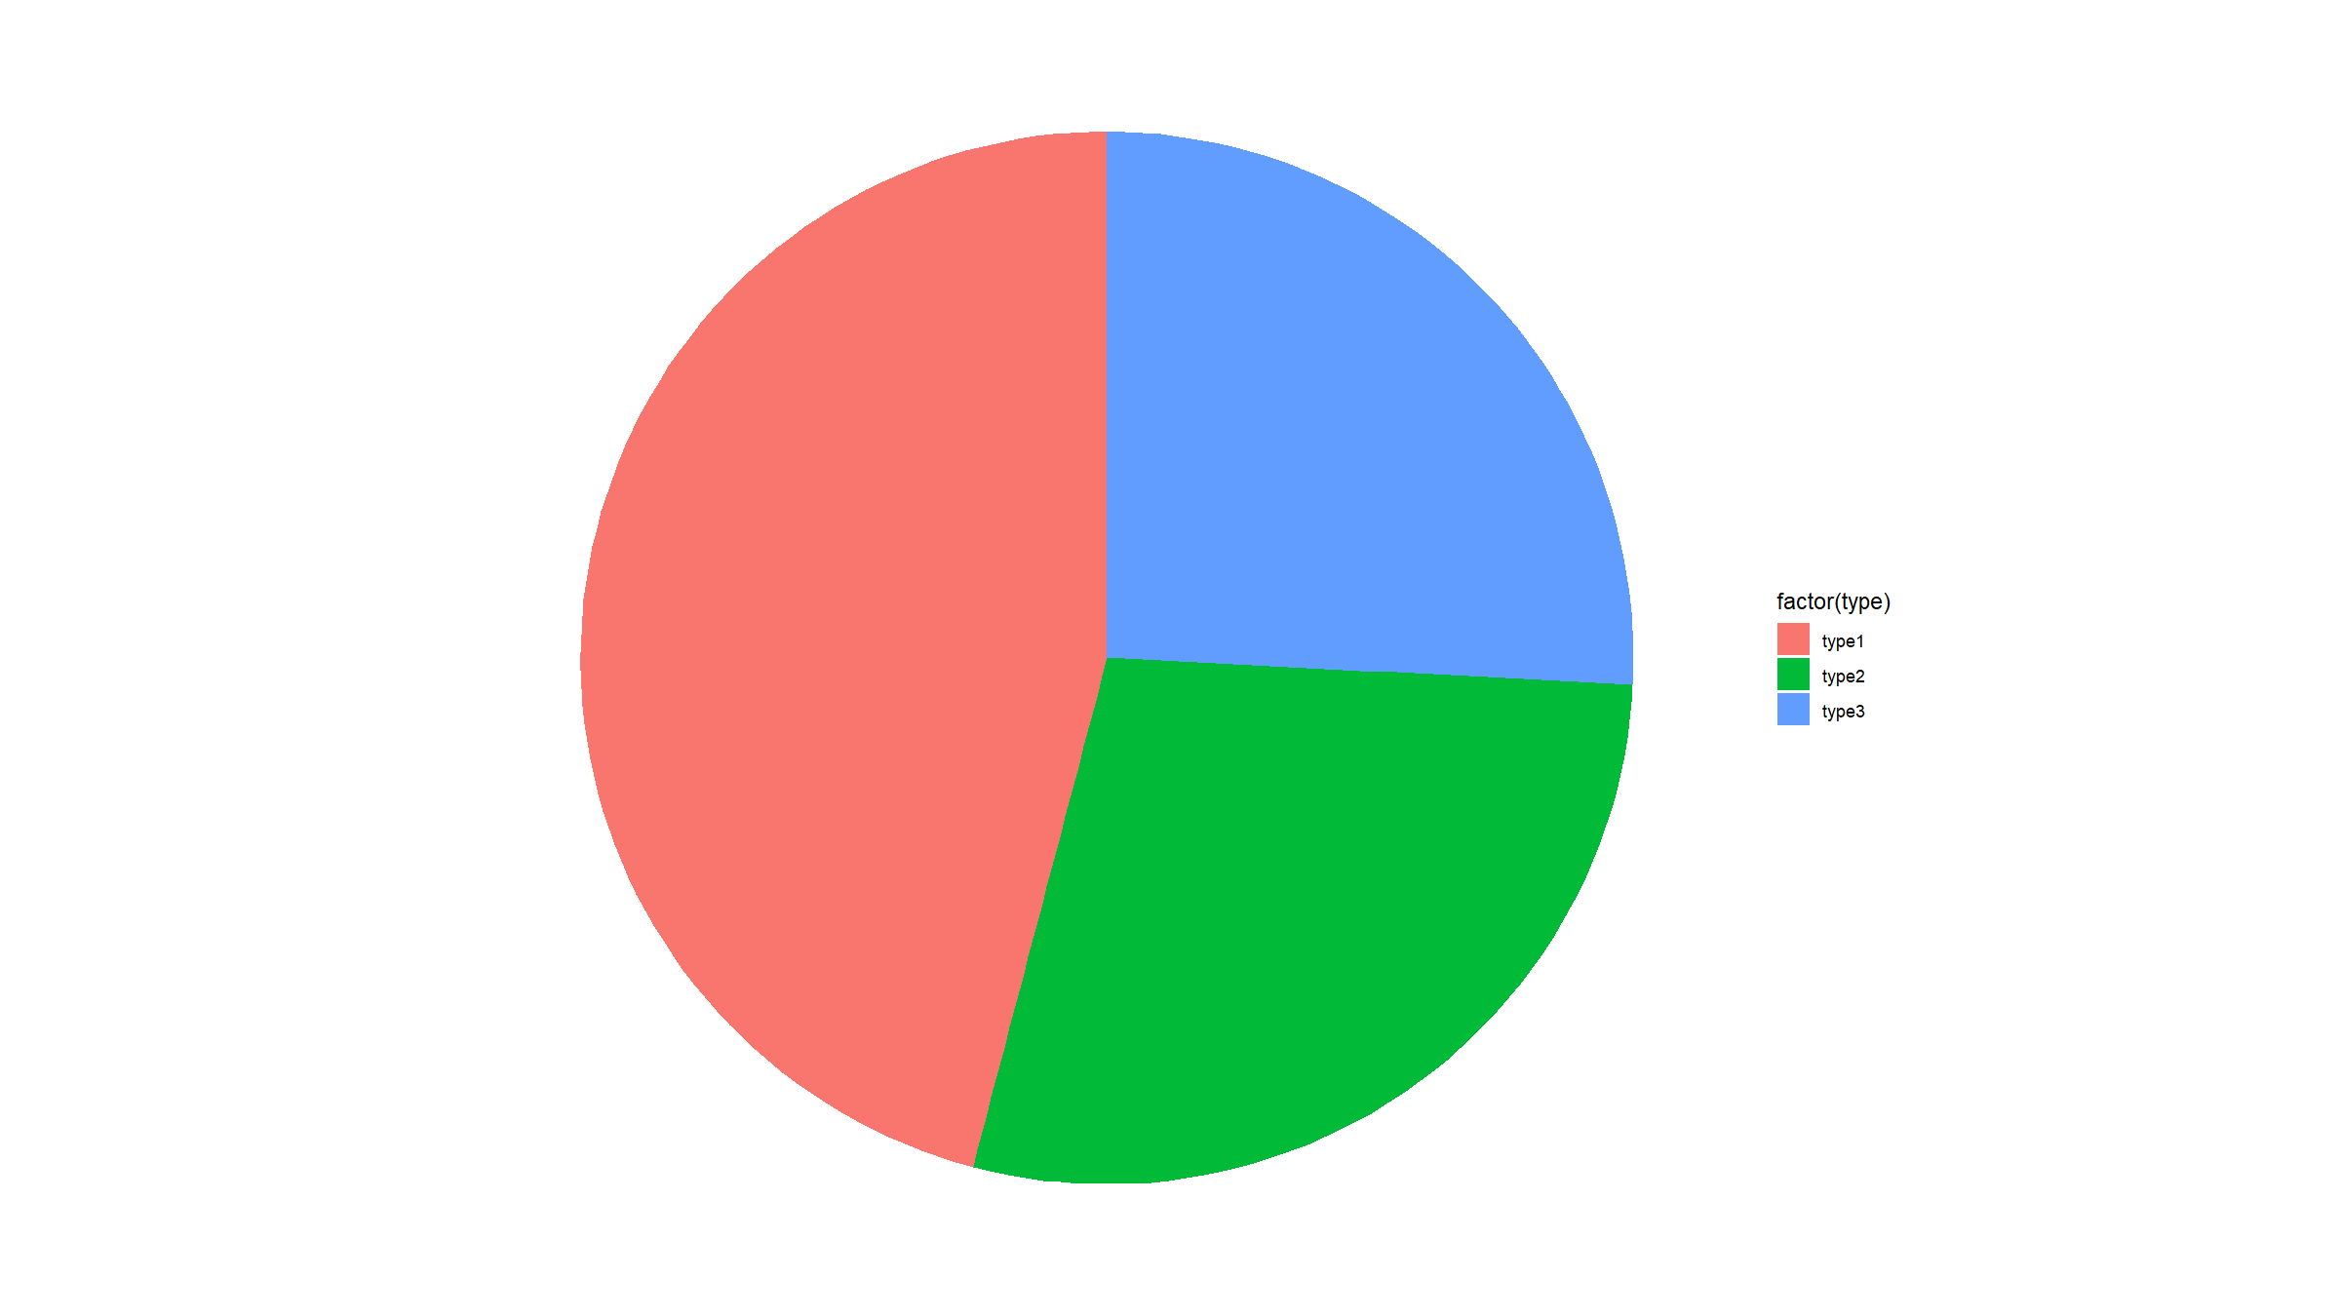
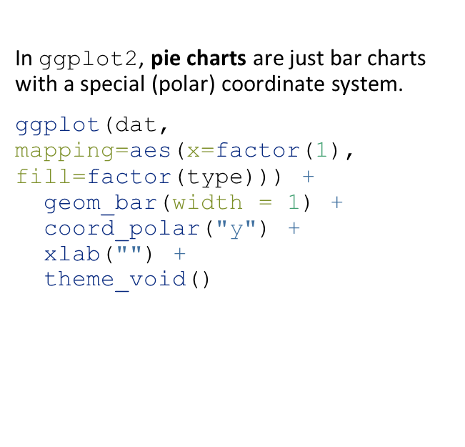
Distribution figures
In ggplot2, pie charts are just bar charts with a special (polar) coordinate system.
ggplot(dat, mapping=aes(x=factor(1), fill=factor(type))) +
geom_bar(width = 1) +
coord_polar("y") +
xlab("") +
theme_void()

Slide 31
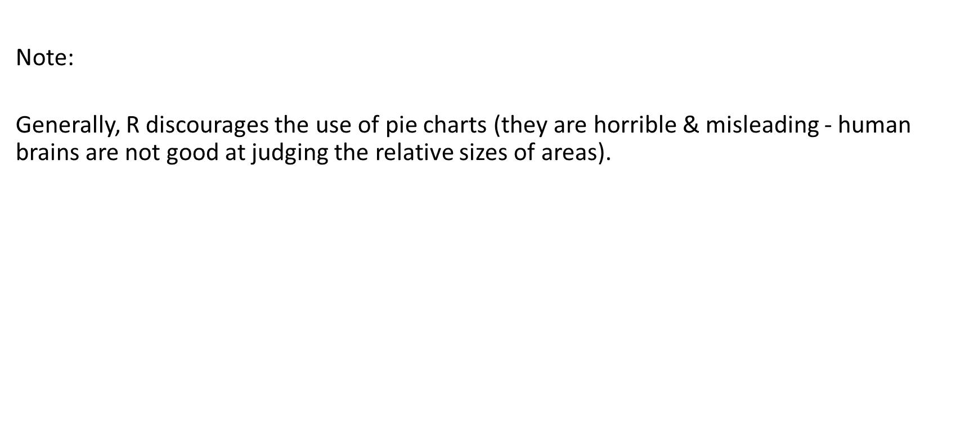
Distribution figures
Note:
Generally, R discourages the use of pie charts (they are horrible & misleading - human brains are not good at judging the relative sizes of areas).

Slide 32
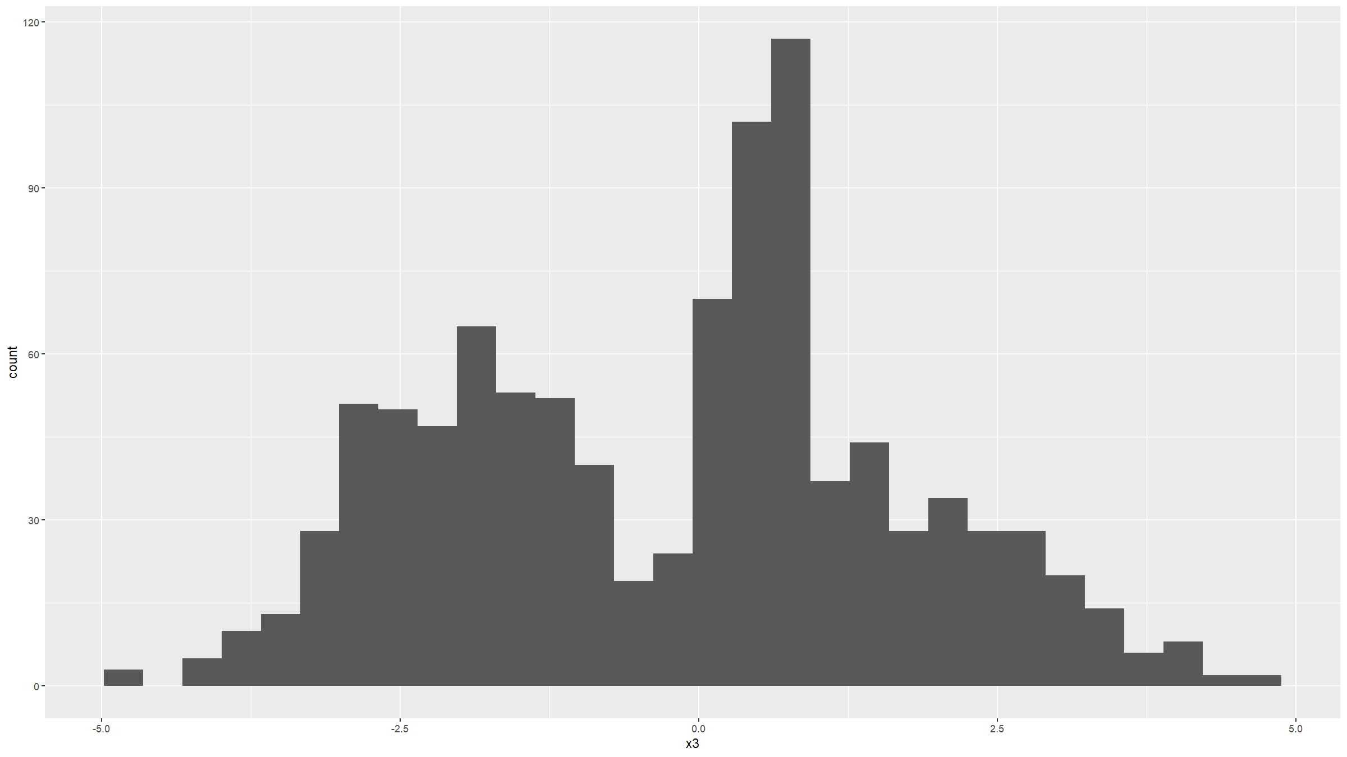
Distribution figures
Histograms are useful graphs. They:
Summarise the distribution of continuous variables, by binning data into discrete intervals.
Can be used for binary and discrete variables as well, but barplots better suited for such variables.
In ggplot2, the geom_histogram() is used to generate histograms.
ggplot(data=dat,mapping=aes(x=x3)) +
geom_histogram()
## `stat_bin()` using `bins = 30`. Pick better value `binwidth`.

Slide 33
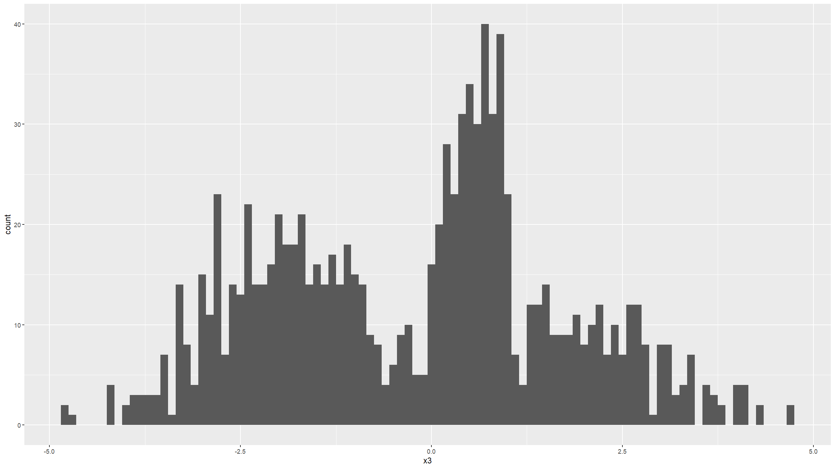
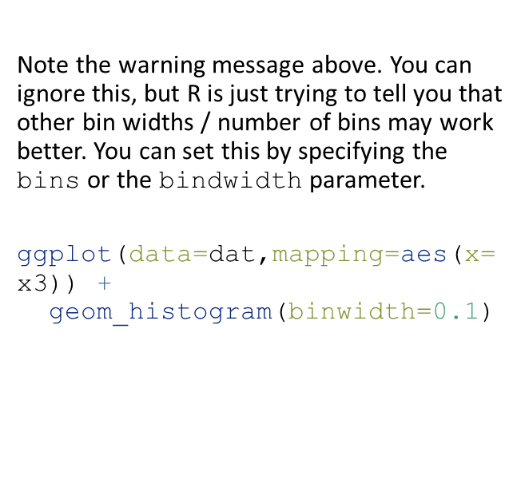
Distribution figures
Note the warning message above. You can ignore this, but R is just trying to tell you that other bin widths / number of bins may work better. You can set this by specifying the bins or the bindwidth parameter.
ggplot(data=dat,mapping=aes(x=x3)) +
geom_histogram(binwidth=0.1)

Slide 34
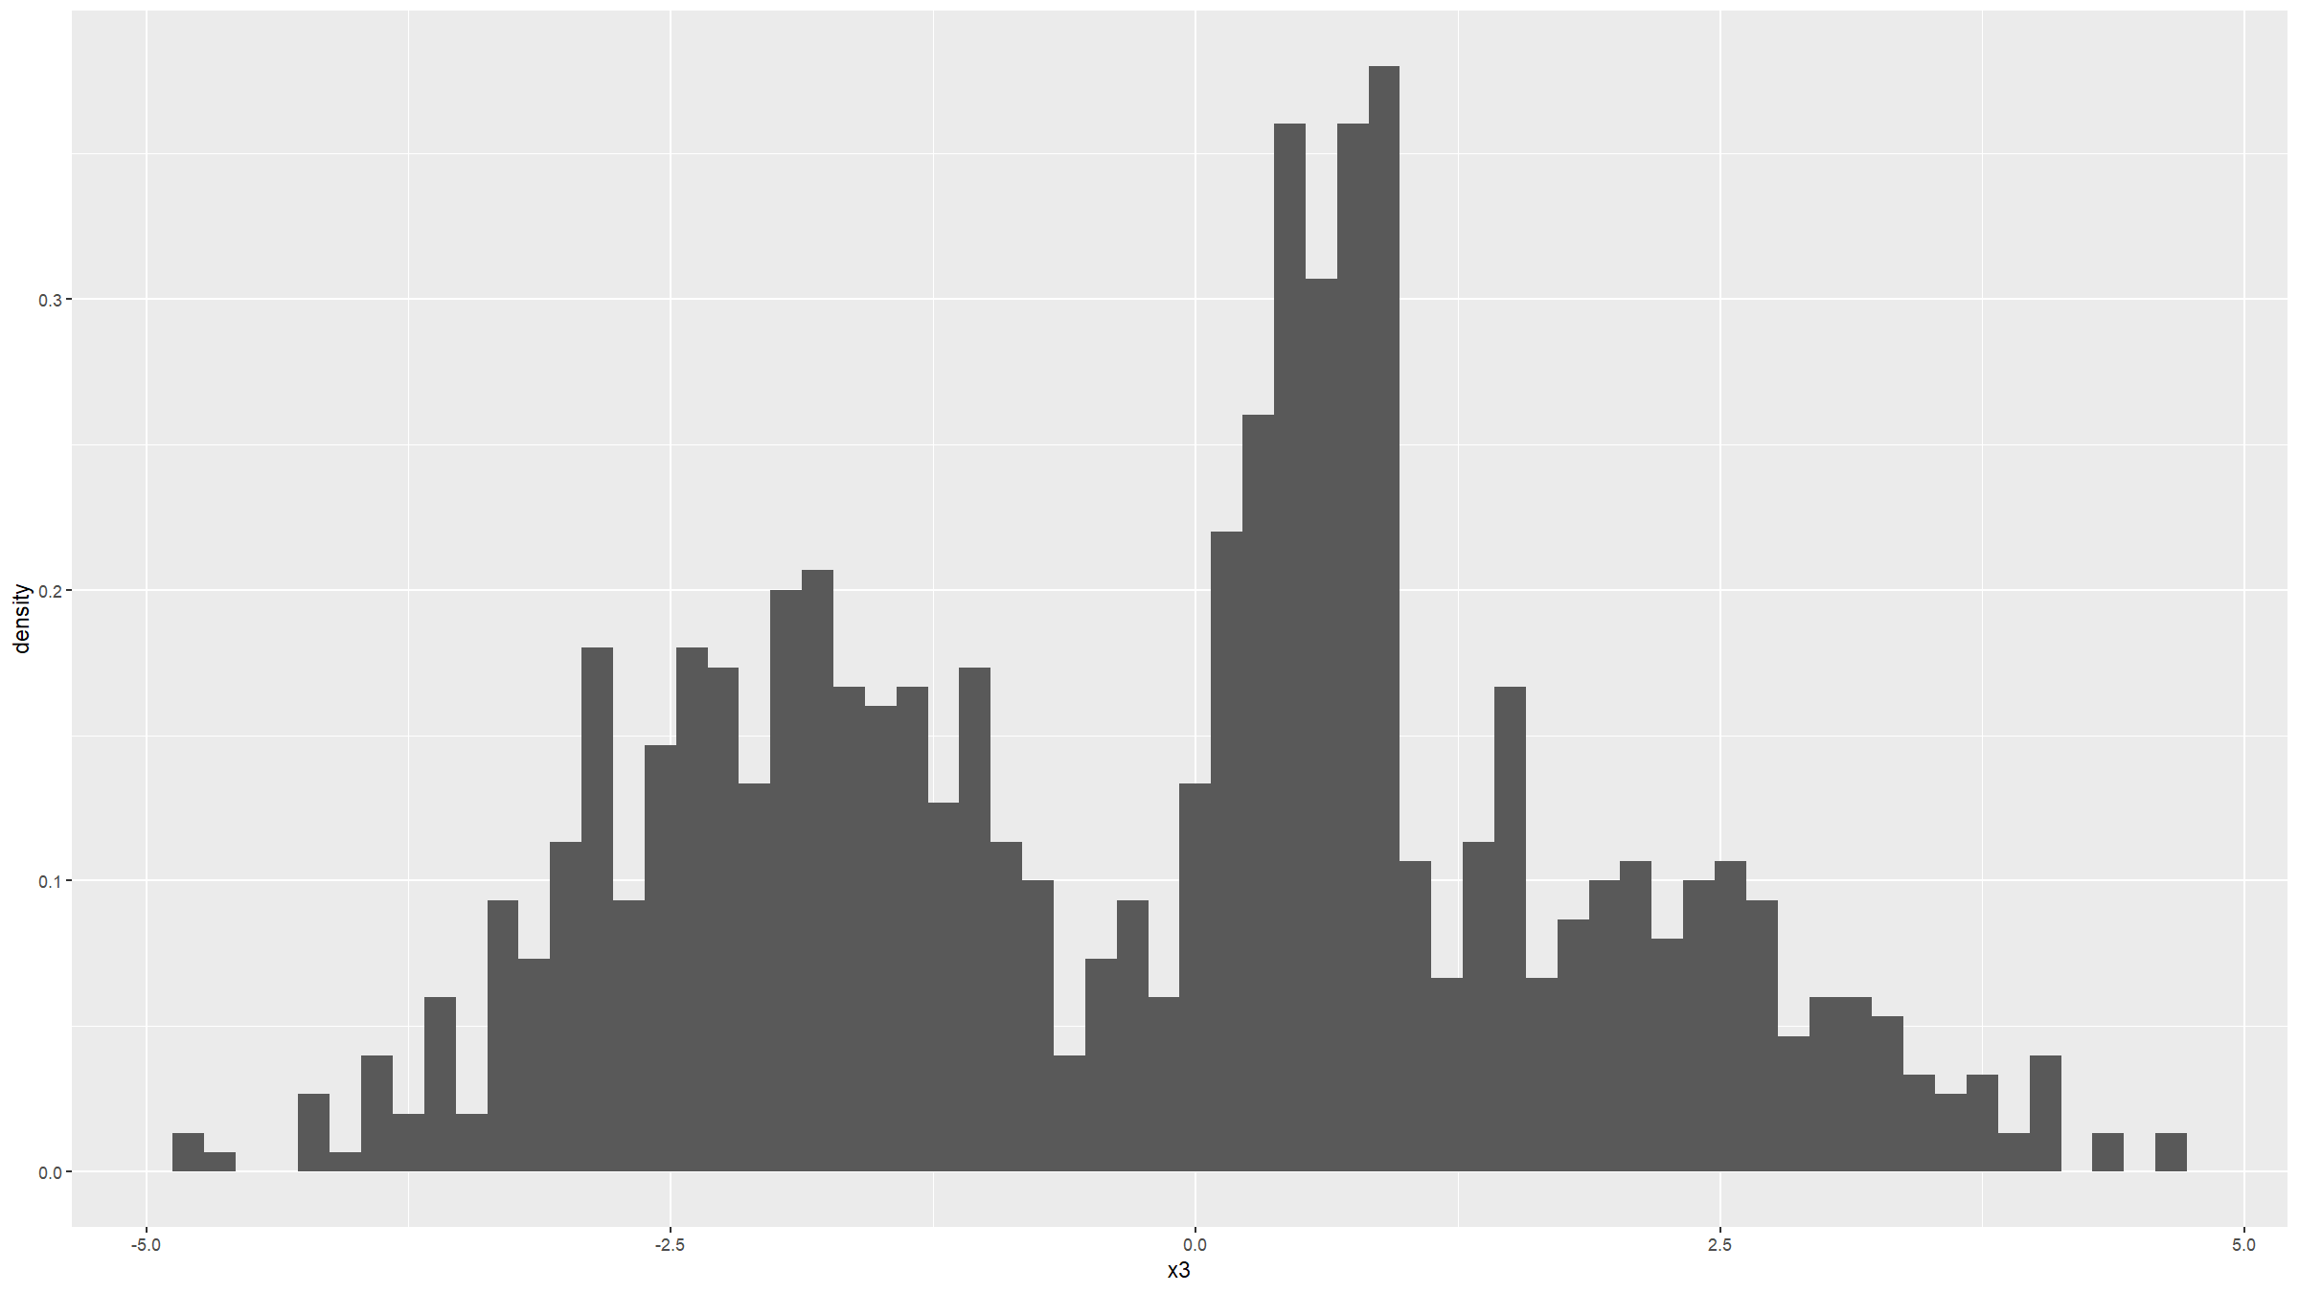
ggplot(data=dat,mapping=aes(x=x3,stat(density))) +
geom_histogram(binwidth=0.15)
## Warning: `stat(density)` was deprecated in ggplot2 3.4.0.
## ℹ Please use `after_stat(density)` instead.
## This warning is displayed once every 8 hours.
## Call `lifecycle::last_lifecycle_warnings()` to see where this warning was
## generated.

Slide 35
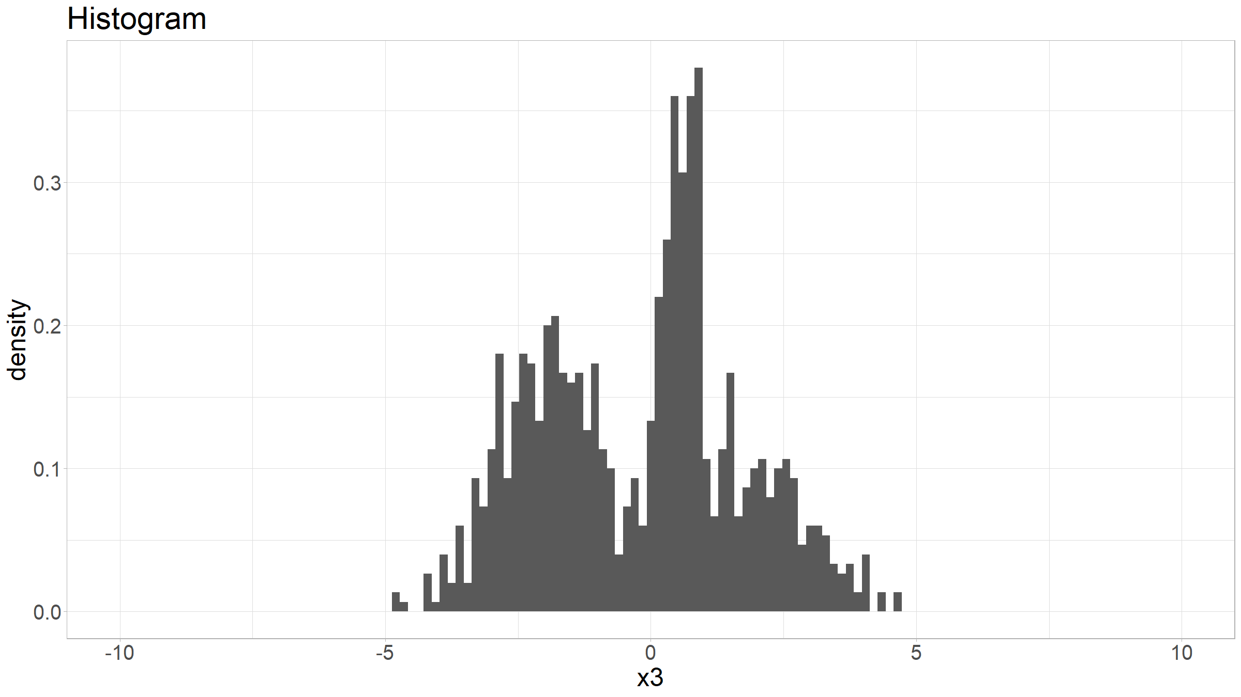
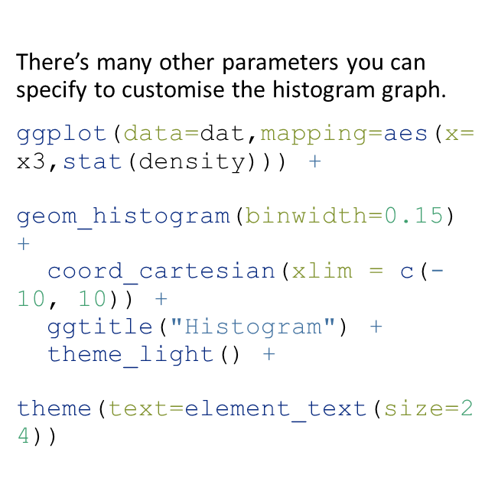
Distribution figures
There’s many other parameters you can specify to customise the histogram graph.
ggplot(data=dat,mapping=aes(x=x3,stat(density))) +
geom_histogram(binwidth=0.15) +
coord_cartesian(xlim = c(-10, 10)) +
ggtitle("Histogram") +
theme_light() +
theme(text=element_text(size=24))

Slide 36
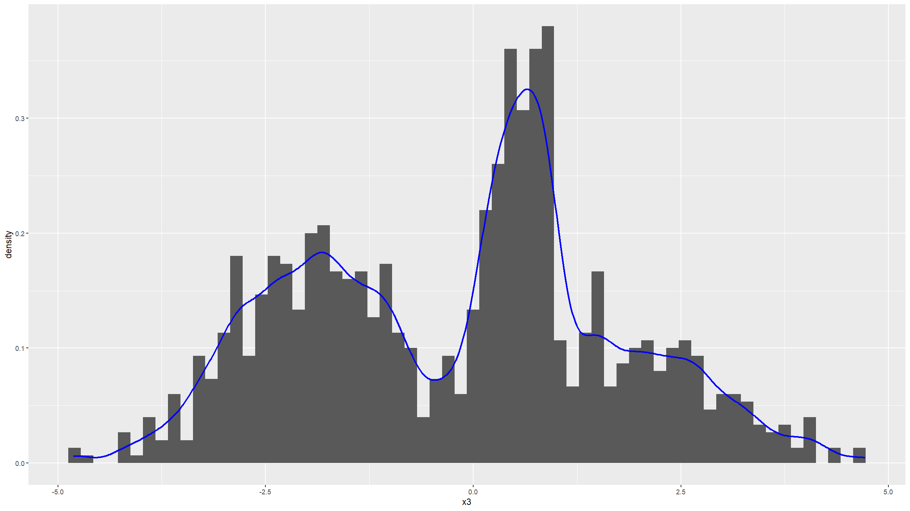
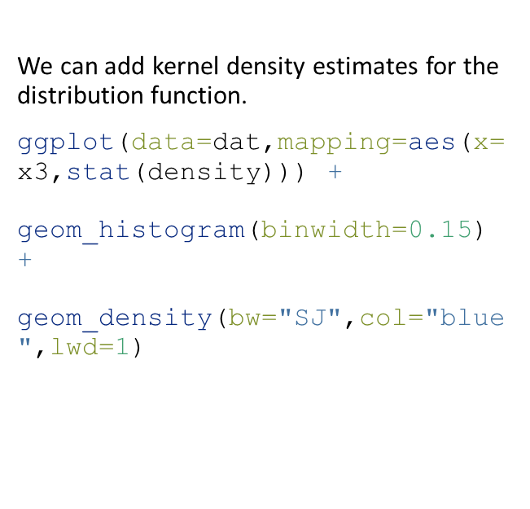
Distribution figures
We can add kernel density estimates for the distribution function.
ggplot(data=dat,mapping=aes(x=x3,stat(density))) +
geom_histogram(binwidth=0.15) +
geom_density(bw="SJ",col="blue",lwd=1)

Slide 37
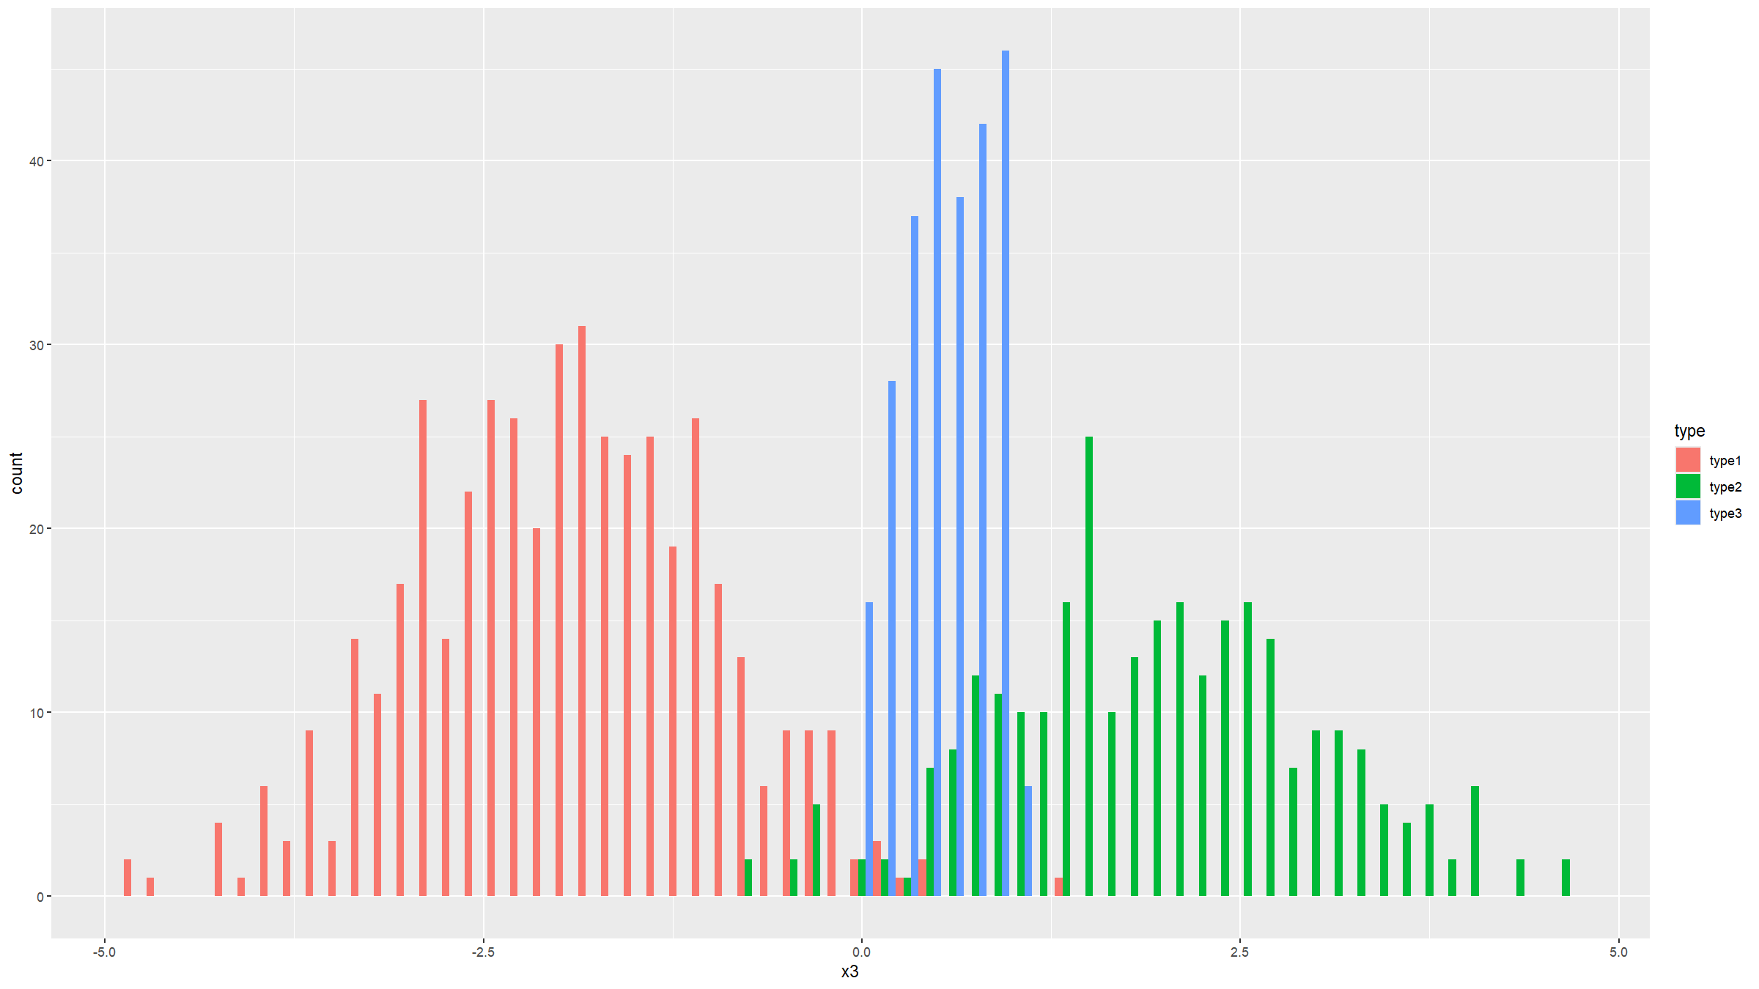
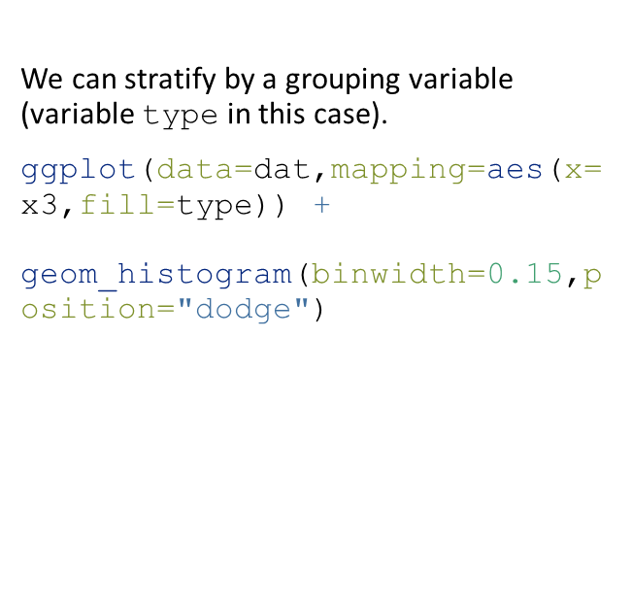
Distribution figures
We can stratify by a grouping variable (variable type in this case).
ggplot(data=dat,mapping=aes(x=x3,fill=type)) +
geom_histogram(binwidth=0.15,position="dodge")

Slide 38
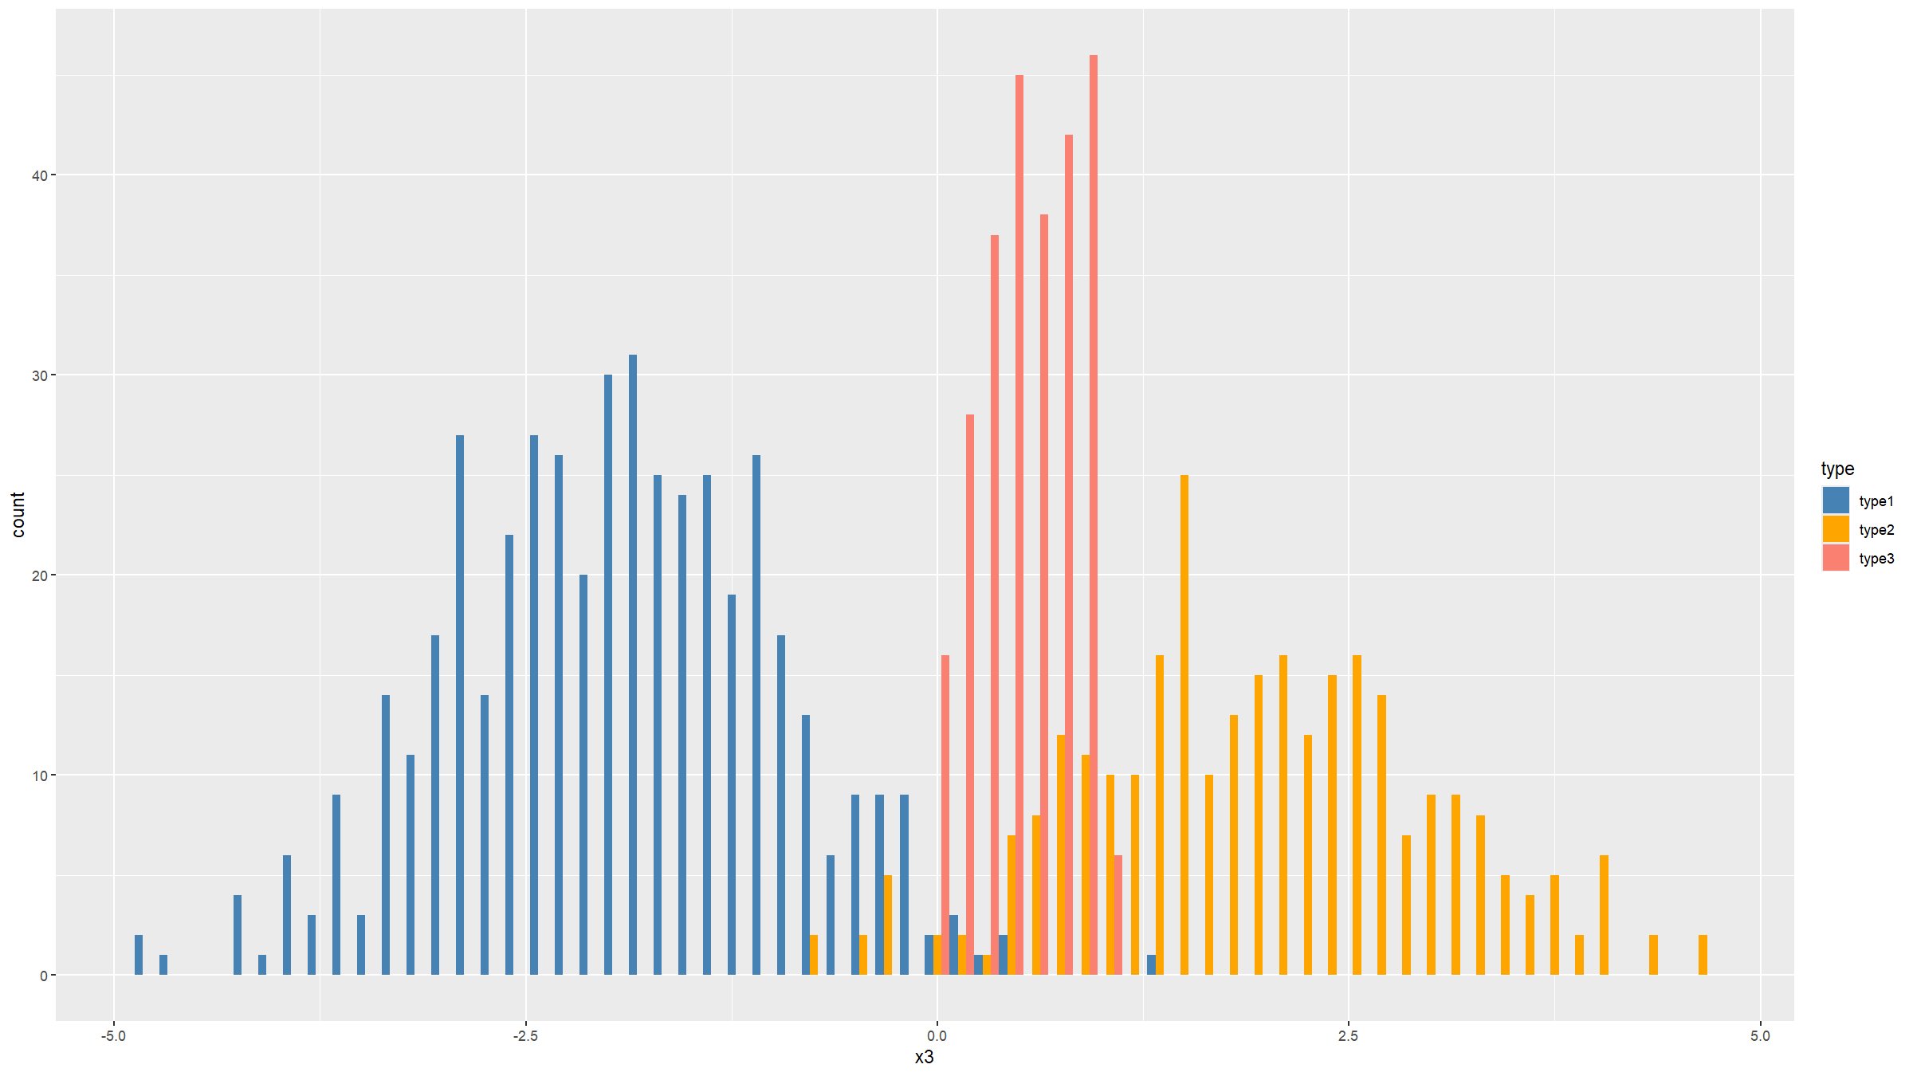
Distribution figures
You can change the default colours that are being used for the type variable.
The aesthetic element governing the colour of the bars is the variable specified by fill=type.
So to change the colours, we need to use the function scale_fill_manual().
ggplot(data=dat,mapping=aes(x=x3,fill=type)) +
geom_histogram(binwidth=0.15,position="dodge") +
scale_fill_manual(values=c("steelblue","orange","salmon"))

Slide 39
Covariation figures

Slide 40
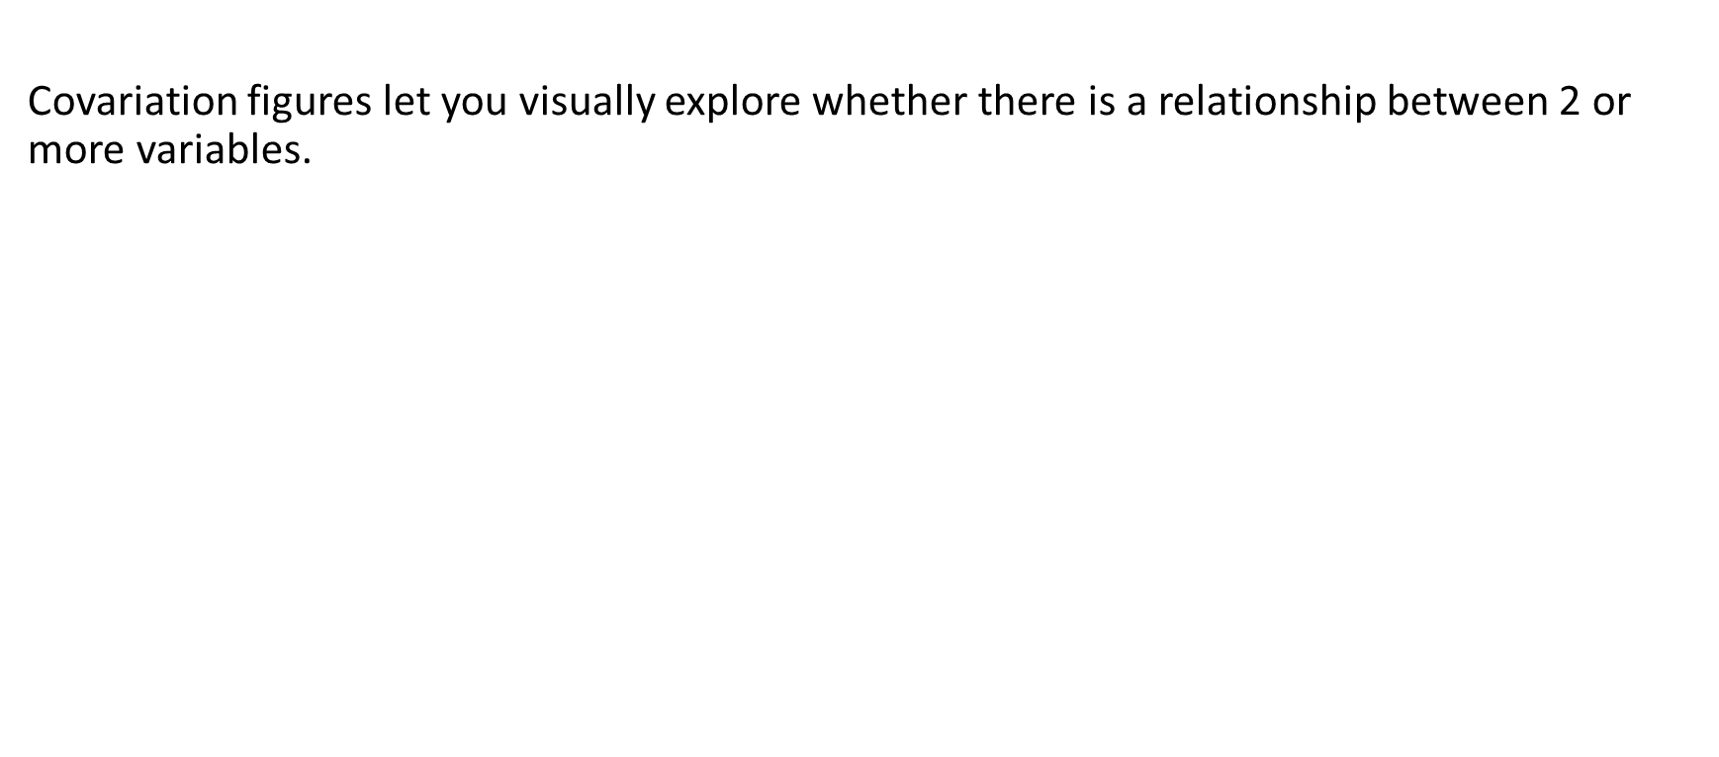
Covariation figures
Covariation figures let you visually explore whether there is a relationship between 2 or more variables.

Slide 41
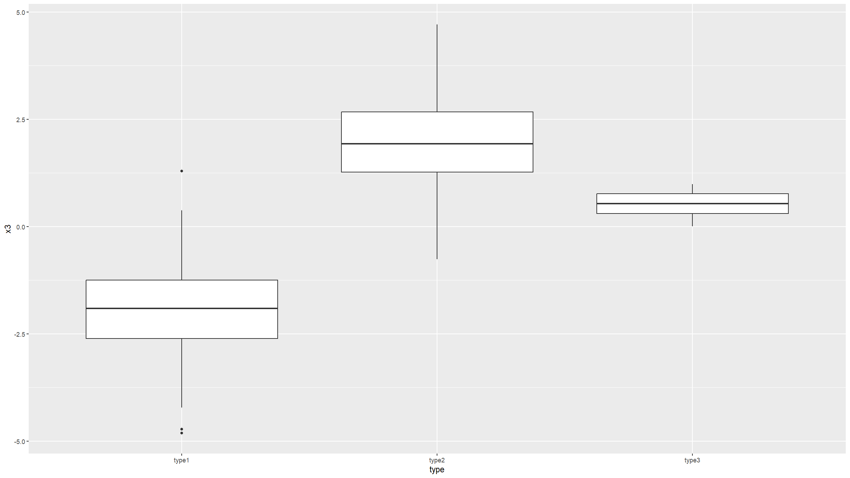
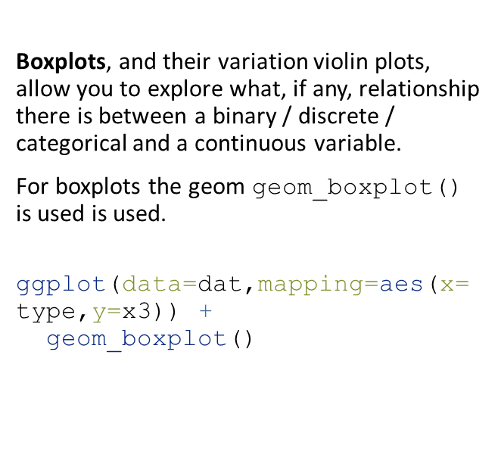
Covariation figures
Boxplots, and their variation violin plots, allow you to explore what, if any, relationship there is between a binary / discrete / categorical and a continuous variable.
For boxplots the geom geom_boxplot() is used is used.
ggplot(data=dat,mapping=aes(x=type,y=x3)) +
geom_boxplot()

Slide 42
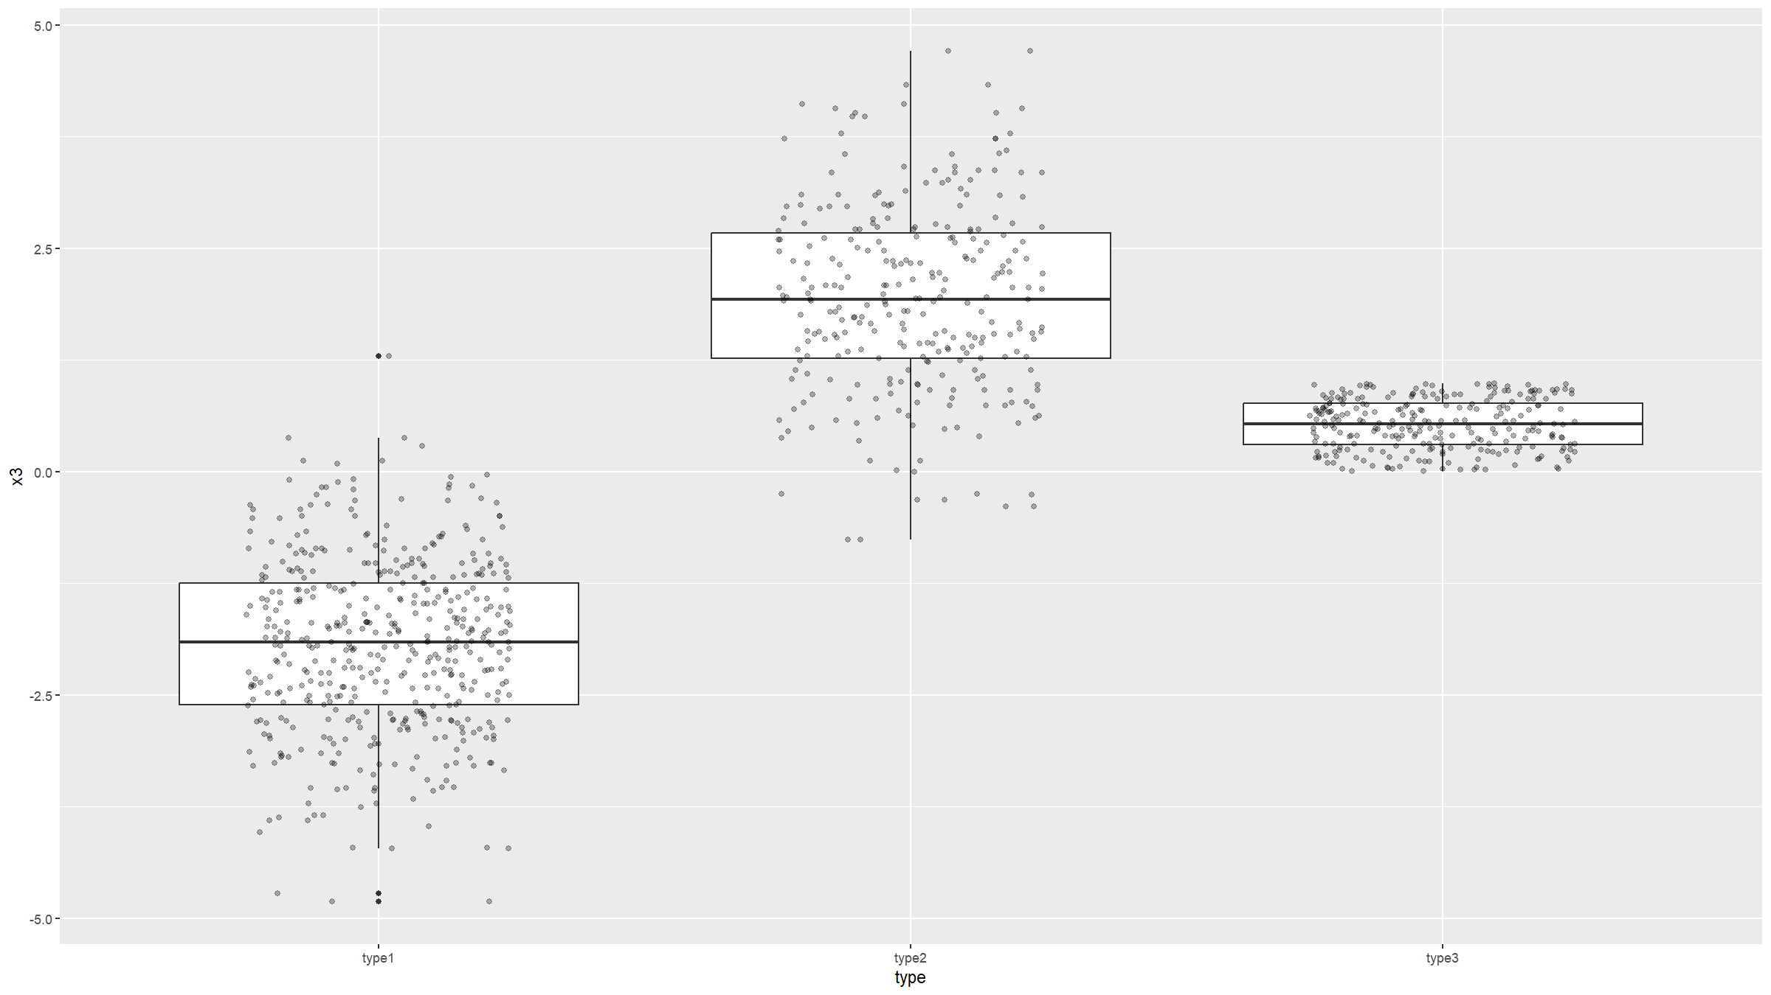
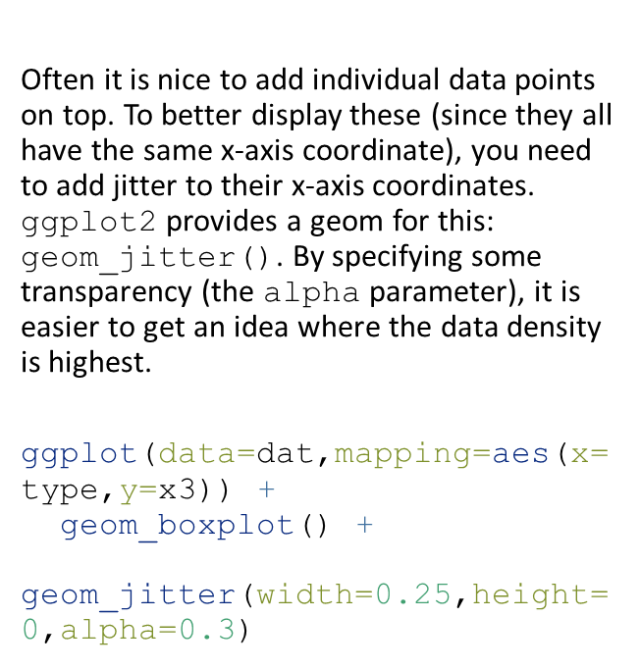
Covariation figures
Often it is nice to add individual data points on top. To better display these (since they all have the same x-axis coordinate), you need to add jitter to their x-axis coordinates. ggplot2 provides a geom for this: geom_jitter(). By specifying some transparency (the alpha parameter), it is easier to get an idea where the data density is highest.
ggplot(data=dat,mapping=aes(x=type,y=x3)) +
geom_boxplot() +
geom_jitter(width=0.25,height=0,alpha=0.3)

Slide 43
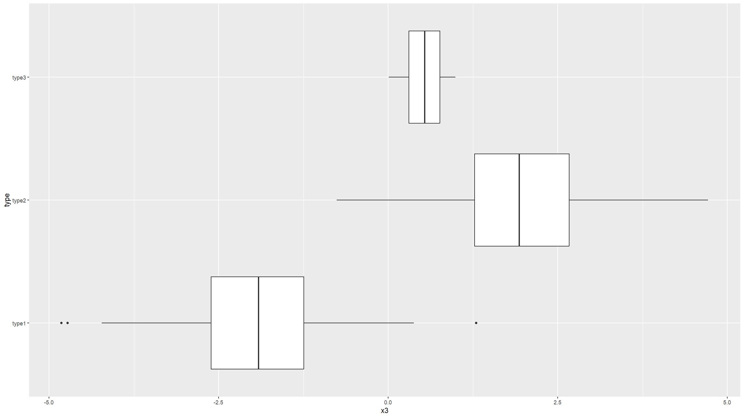
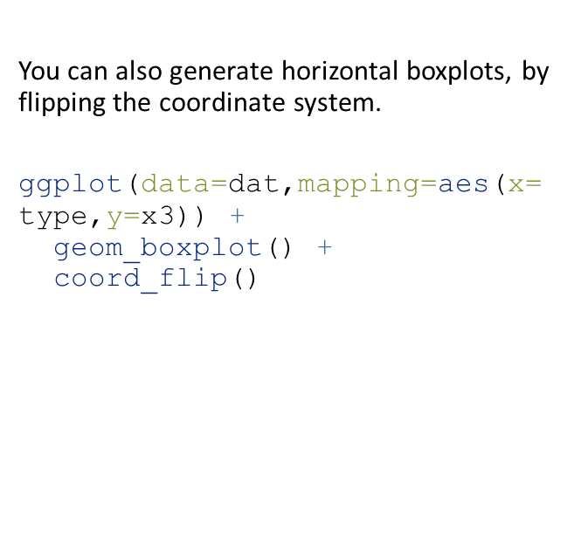
Covariation figures
You can also generate horizontal boxplots, by flipping the coordinate system.
ggplot(data=dat,mapping=aes(x=type,y=x3)) +
geom_boxplot() +
coord_flip()

Slide 44
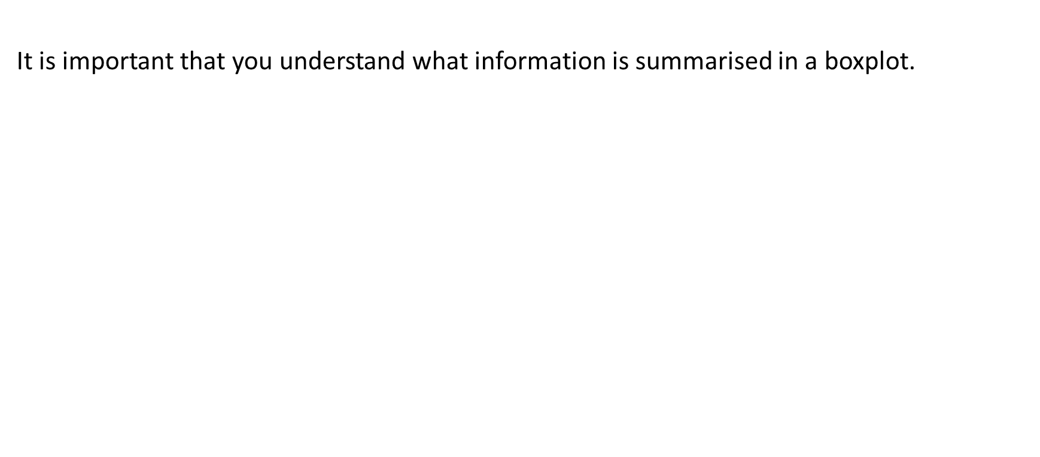
Covariation figures
It is important that you understand what information is summarised in a boxplot.

Slide 45
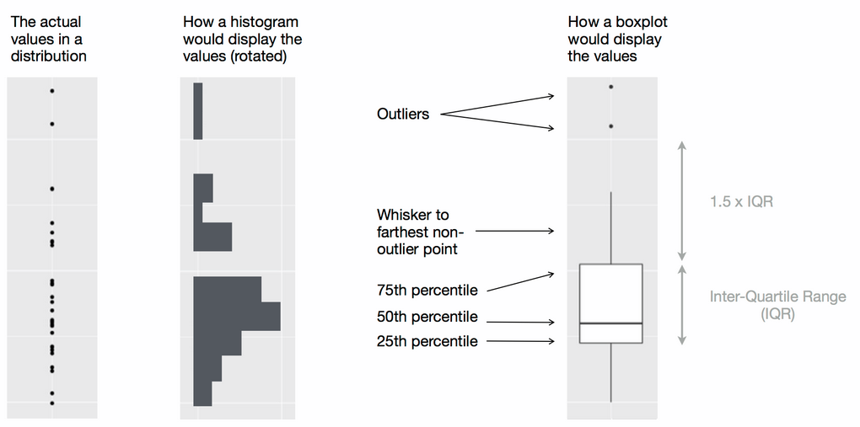
Covariation figures
Wickham, H. & Grolemund G., R for Data Science, O’Reilly, 2016

Slide 46
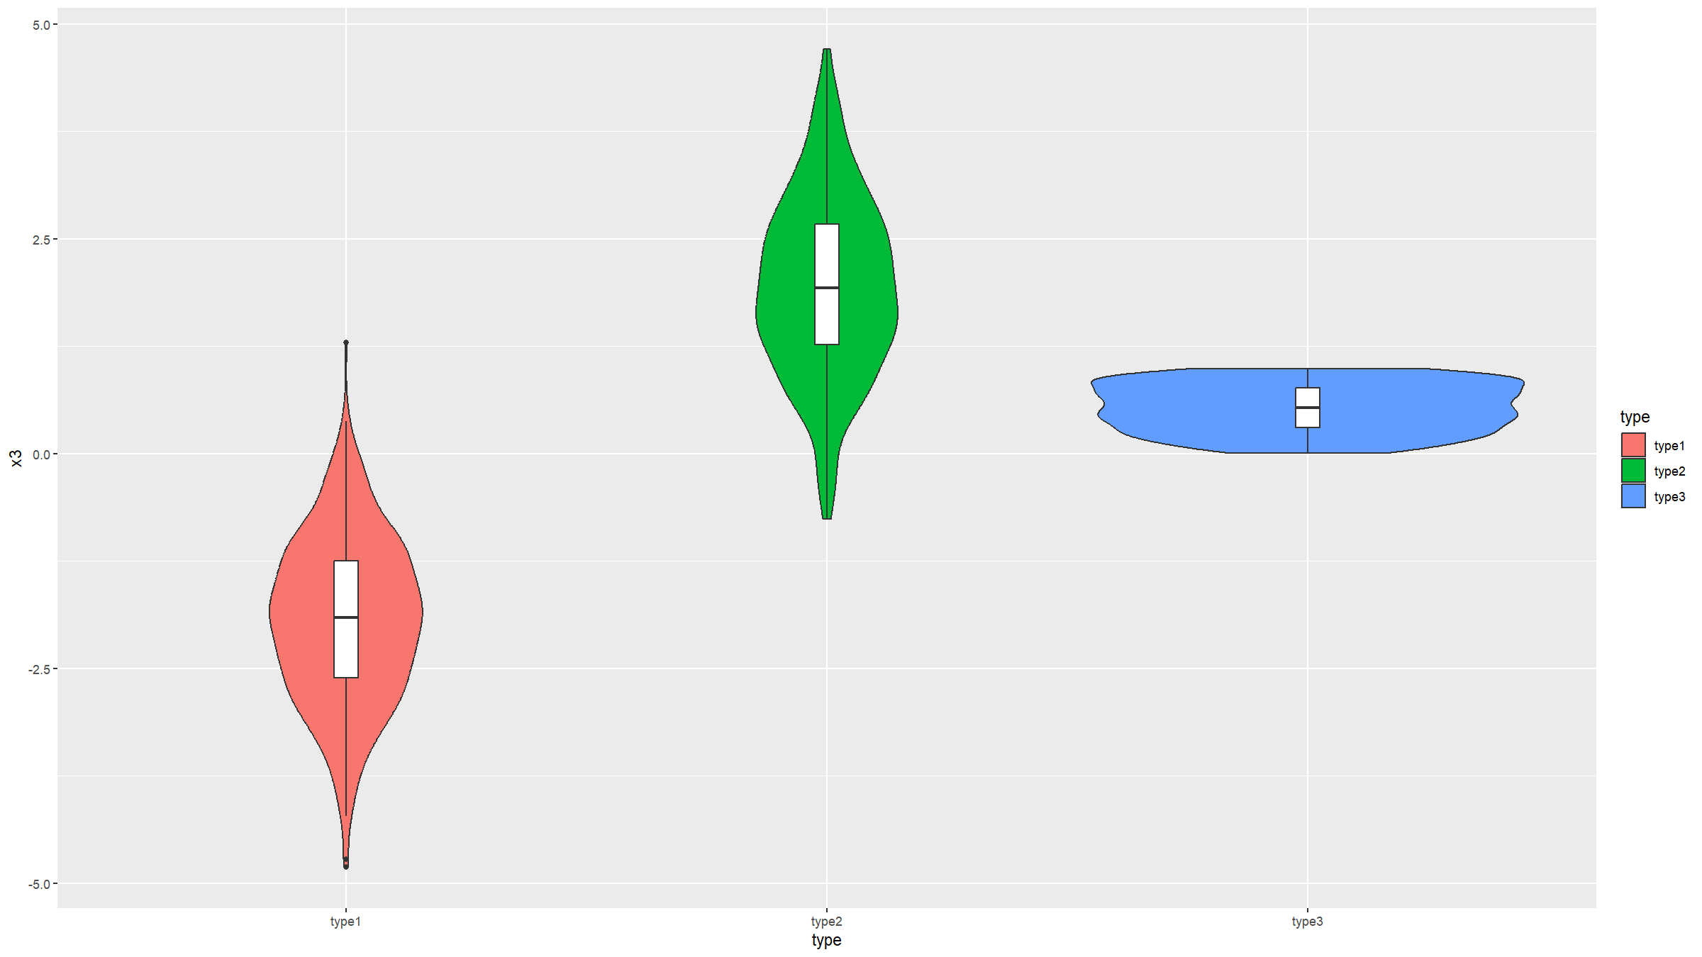
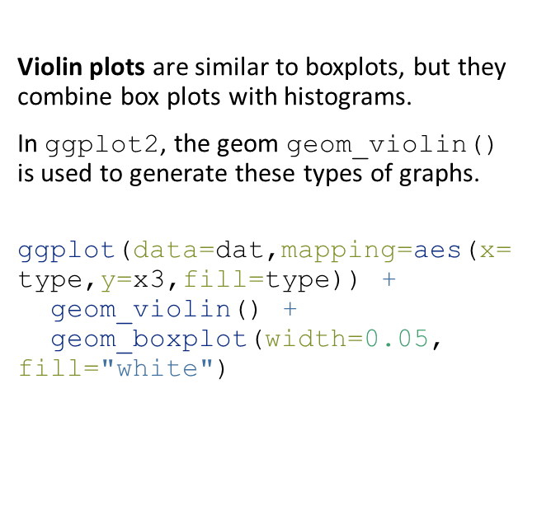
Covariation figures
Violin plots are similar to boxplots, but they combine box plots with histograms.
In ggplot2, the geom geom_violin() is used to generate these types of graphs.
ggplot(data=dat,mapping=aes(x=type,y=x3,fill=type)) +
geom_violin() +
geom_boxplot(width=0.05, fill="white")

Slide 47
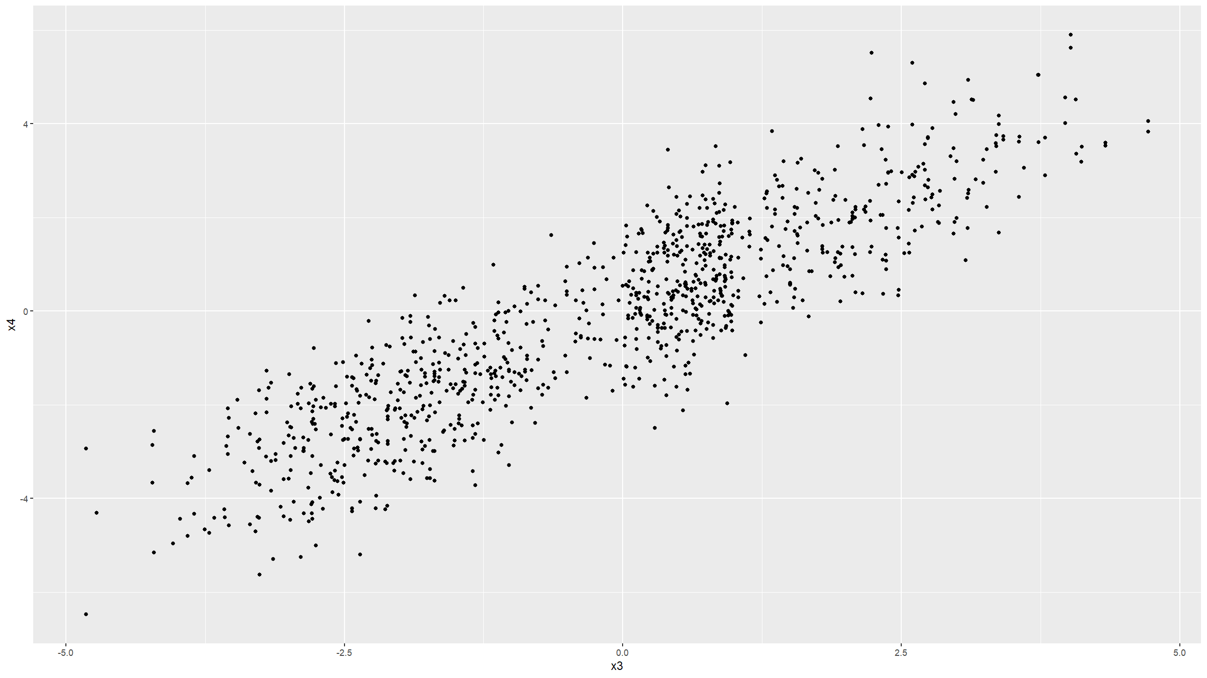
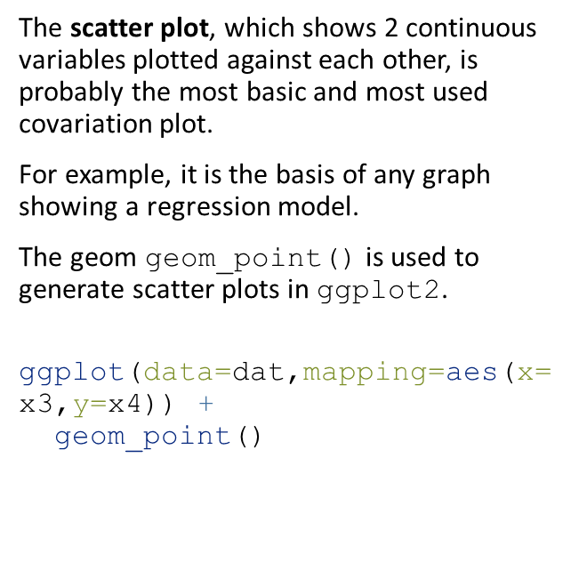
Covariation figures
The scatter plot, which shows 2 continuous variables plotted against each other, is probably the most basic and most used covariation plot.
For example, it is the basis of any graph showing a regression model.
The geom geom_point() is used to generate scatter plots in ggplot2.
ggplot(data=dat,mapping=aes(x=x3,y=x4)) +
geom_point()

Slide 48
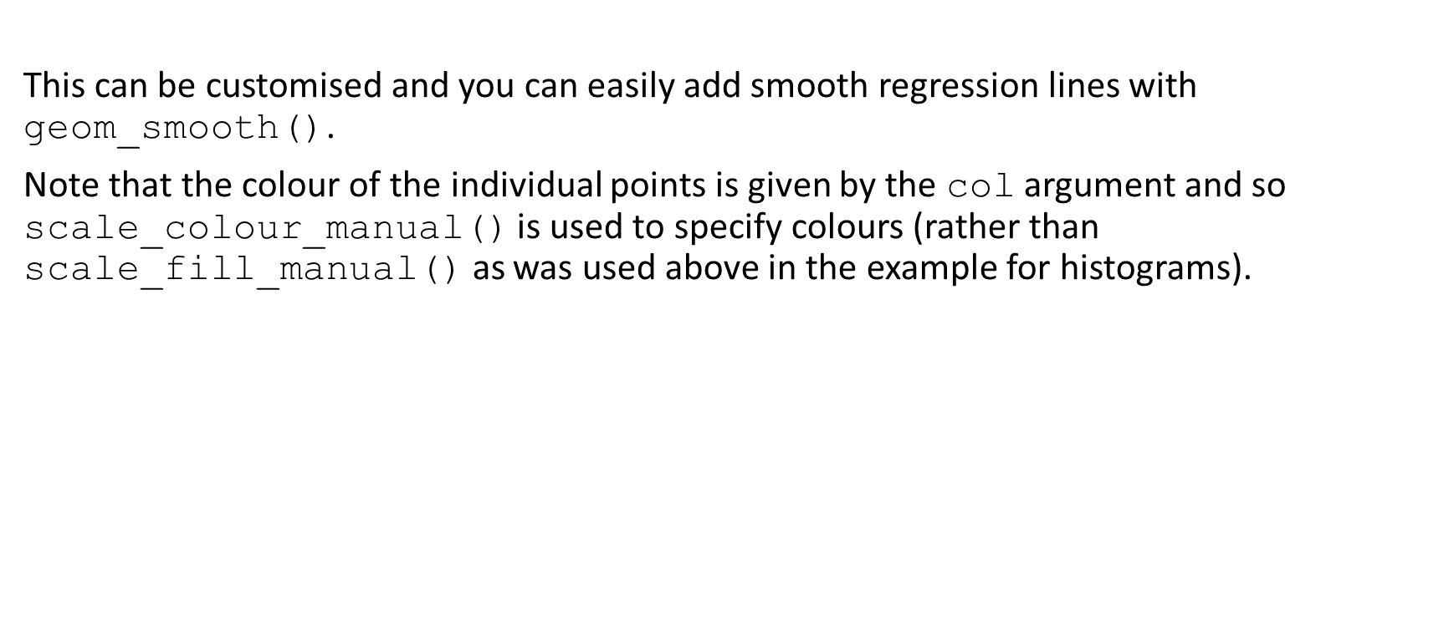
Covariation figures
This can be customised and you can easily add smooth regression lines with geom_smooth().
Note that the colour of the individual points is given by the col argument and so scale_colour_manual() is used to specify colours (rather than scale_fill_manual() as was used above in the example for histograms).

Slide 49
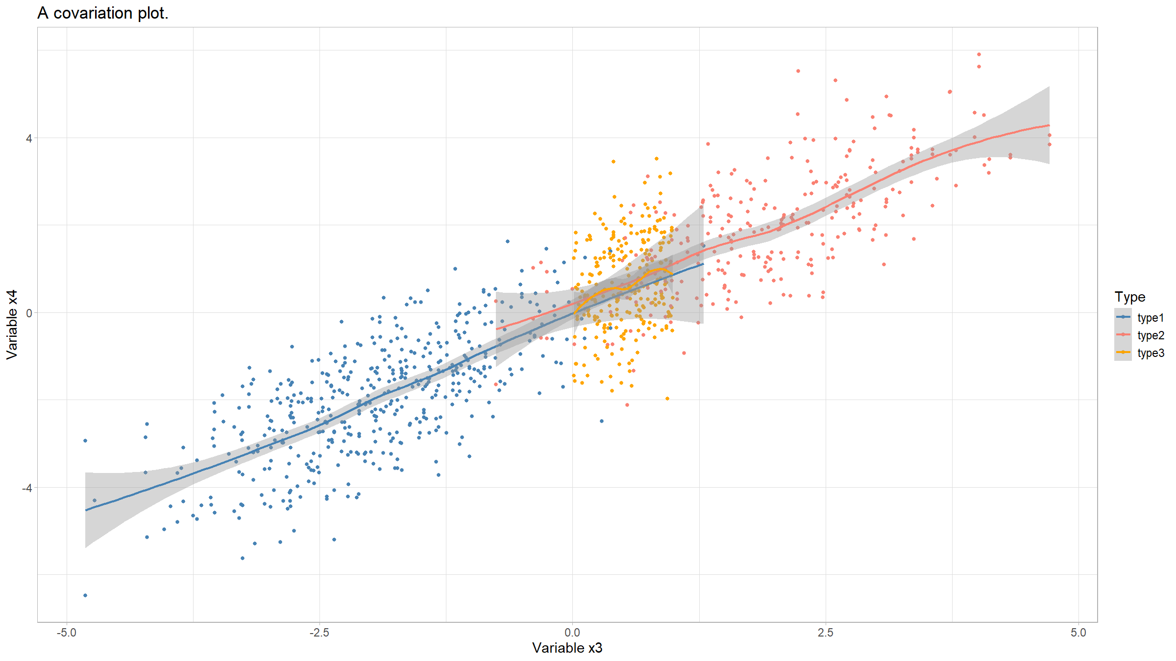
Covariation figures
ggplot(data=dat,mapping=aes(x=x3,y=x4,col=type)) +
geom_point() +
geom_smooth() +
scale_colour_manual(values=c("steelblue","salmon","orange"),
name="Type") +
xlab("Variable x3") +
ylab("Variable x4") +
ggtitle("A covariation plot.") +
theme_light() +
theme(text=element_text(size=14))
## `geom_smooth()` using method = 'loess' and formula = 'y ~ x'

Slide 50
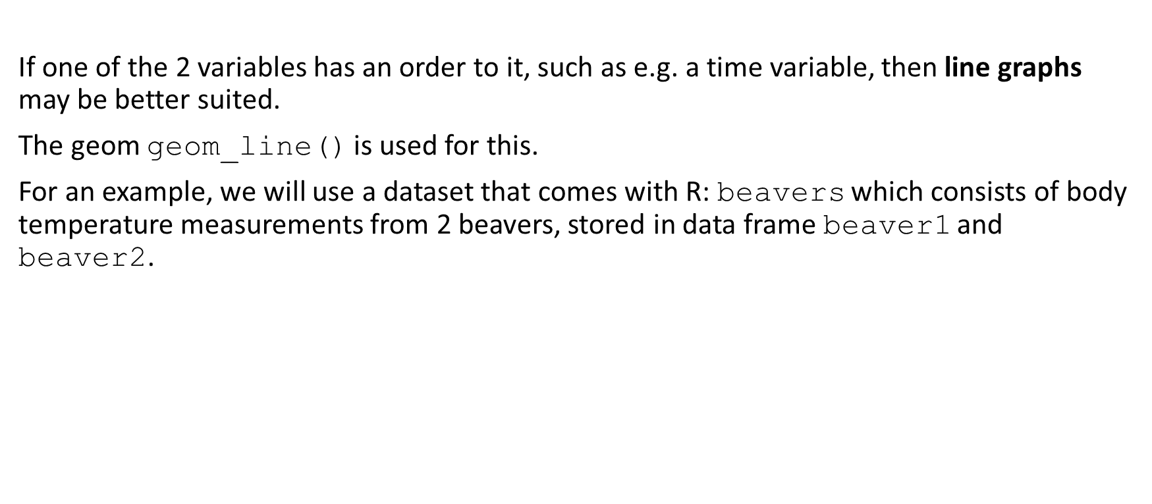
Covariation figures
If one of the 2 variables has an order to it, such as e.g. a time variable, then line graphs may be better suited.
The geom geom_line() is used for this.
For an example, we will use a dataset that comes with R: beavers which consists of body temperature measurements from 2 beavers, stored in data frame beaver1 and beaver2.

Slide 51

Covariation figures
beaver<-rbind(beaver1[beaver1$day==346,],beaver2[beaver2$day==307,])
beaver<-data.frame(
name=c(rep("beaver1",sum(beaver1$day==346)),
rep("beaver2",sum(beaver2$day==307))),beaver)

Slide 52
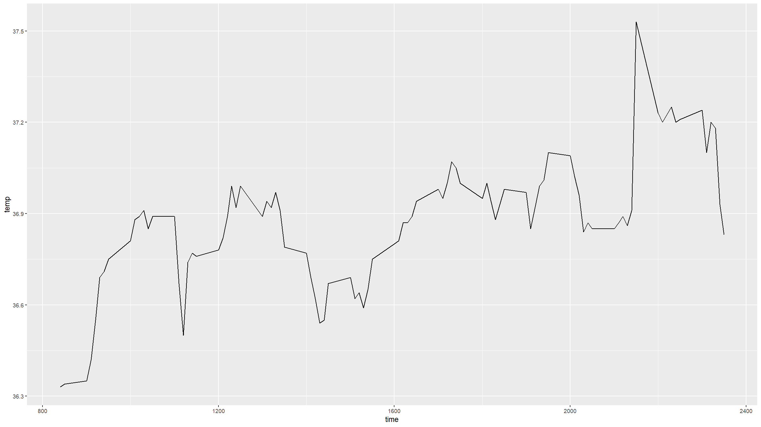
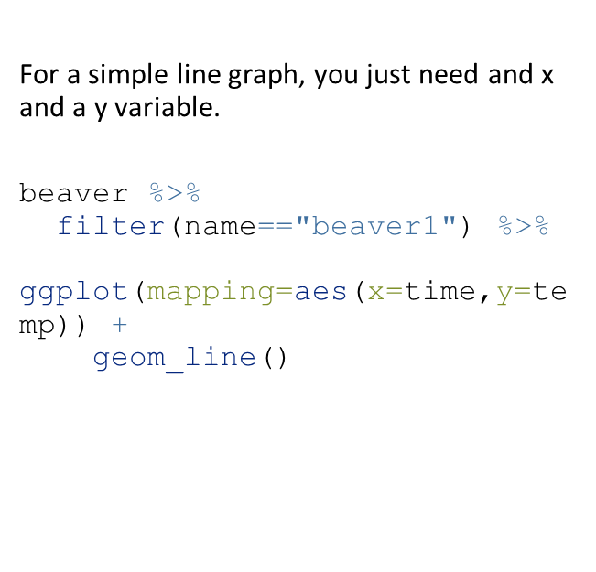
Covariation figures
For a simple line graph, you just need and x and a y variable.
beaver %>%
filter(name=="beaver1") %>%
ggplot(mapping=aes(x=time,y=temp)) +
geom_line()

Slide 53


Covariation figures
You can easily stratify a line graph by a grouping variable (in this case the variable name) in ggplot2.
ggplot(data=beaver,mapping=aes(x=time,y=temp,colour=name)) +
geom_line(lwd=1.5) # the lwd parameter sets the line width

Slide 54

Covariation figures
Heatmaps are useful to show covariation among 3 variables.
The x- and y-axis show 2 of the variables and the third variable determines the colour of cells.
The variables can be either categorical or continuous.
In ggplot2, one geom that you can use for heatmaps is geom_tile().
First, we need some data.

Slide 55
Covariation figures
dens<-function(x,y){
return(
0.35*dnorm(x)*dnorm(y,sd=1.5) +
0.65*dnorm(x,mean=2,sd=2)*dnorm(y,mean=3)
)
}
x<-seq(-2.5,6.5,by=0.05)
y<-seq(-3,5.5,by=0.05)
densSurf<-expand.grid(x=x,y=y) %>%
mutate(dens=dens(x,y))

Slide 56


Covariation figures
Then we can do a basic heat map, using default colours.
densSurf %>%
ggplot(mapping=aes(x=x,y=y,fill=dens)) +
geom_tile(width=0.05,height=0.05)

Slide 57

Covariation figures
But we can also provide custom colour scales.
clrs<-colorRampPalette(c("blue","red","orange","yellow","white"))
densSurf %>%
ggplot(mapping=aes(x=x,y=y,fill=dens)) +
geom_tile(width=0.05,height=0.05) +
scale_fill_gradientn(colours = clrs(200),name="probability density") +
theme_minimal()

Slide 58


Covariation figures
Contour plots are similar but use contour lines rather than colour scales to show variation in the third variable.
ggplot(data=densSurf,mapping=aes(x=x,y=y,z=dens)) +
geom_contour()

Slide 59

Covariation figures
You can combine heampaps and contour plots.
densSurf %>%
ggplot(mapping=aes(x=x,y=y,fill=dens,z=dens)) +
geom_tile(width=0.05,height=0.05) +
geom_contour(col="darkgrey",lwd=0.35,alpha=0.75) +
scale_fill_gradientn(colours = clrs(200),name="probability density") +
theme_minimal()
## Warning: The following aesthetics were dropped during statistical transformation: fill.
## ℹ This can happen when ggplot fails to infer the correct grouping structure in
## the data.
## ℹ Did you forget to specify a `group` aesthetic or to convert a numerical
## variable into a factor?

Slide 60
Multi-panel figures

Slide 61
Multi-panel figures
There’s multiple ways to generate multi-panel figures. Here we just cover 2 examples.
For a basic, but general way of combining multipe graphs onto the same figure, the function grid.arrange() from the R package gridExtra can be used.
The procedure is very simple:
Load the package (if not loaded already): library(gridExtra)
Assign each ggplot() call to an object (e.g. p1<-ggplot(...) + ...)
Produce a multipanel figure with grid.arrange(p1,p2,...,nrow=2)
The nrow parameter specifies over how many rows you want to arrange the plots.

Slide 62
Multi-panel figures
g1<-ggplot(data=dat,mapping=aes(x=type,y=x3)) +
geom_boxplot() +
geom_jitter(width=0.25,height=0,alpha=0.3) +
xlab("") +
ylab("Variable x3") +
ggtitle("A box & jitter plot.") +
theme_minimal()

Slide 63
Multi-panel figures
g2<-ggplot(data=dat,mapping=aes(x=x3,y=x4,col=type)) +
geom_point() +
geom_smooth() +
scale_colour_manual(values=c("steelblue","salmon","orange"),
name="Type") +
xlab("Variable x3") +
ylab("Variable x4") +
ggtitle("A covariation plot.") +
theme_light() +
theme(text=element_text(size=14))

Slide 64

Multi-panel figures
grid.arrange(g1,g2,nrow=1)
## `geom_smooth()` using method = 'loess' and formula = 'y ~ x'

Slide 65

Multi-panel figures
The other approach we will cover, is if you want to repeat the same graph for different groups of observations within your dataset.
This is called faceting and in ggplot2 the function facet_wrap() allows to do this very easily.
iris %>%
ggplot(mapping=aes(x=Petal.Length,y=Petal.Width)) +
geom_point() +
facet_wrap(~Species)

Slide 66
Saving graphs to files

Slide 67

Saving figures
In ggplot2, the simplest way to save graphs is to use the function ggsave().
ggsave(g1,filename="myplot.png",width=16,height=9,units="cm",dpi=450)

Slide 68

Saving figures
Another way is to enclose your plotting code inside a statement that specifies a graphics device. “Graphics device” means a pdf, png, jpg or other file.
Example:
pdf(width=16,height=9,file="myfile.pdf") # opens the device; pdf will produce vector graphics
# plotting code here
dev.off() # closes the device

Slide 69

Saving figures
Or:
png(width=16,height=9,units="in",res=450) # raster graphics
# plotting code here
dev.off()

Slide 70

[end of Session 2]

