Slide 1
R and statistics course
James Chirombo and Evaristar Kudowa

Slide 2
Session 4: Hypothesis testing

Slide 3
Preliminaries
Certificates of attendance
You need to attend all 6 sessions.
Sign in & check spelling of name on the sign-in sheet!
Only issued if paid-up and in exchange for completed feedback form.
Course website / GitHub: https://github.com/mlw-stats/R_And_Statistics_Training_Autumn2023
Office hours
Marc - Tuesdays 9-10 am
James - Wednesday 2-3 pm
Evaristar – Wednesday 3-4 pm
Housekeeping
Refreshments
Fire exits & bathrooms

Slide 4
Data for the session
Read in the data that was previously shared:
btTBreg.csv
adolescent_small.csv
The data are in CSV format
df1 <- read.csv("datasets/btTBreg.csv",header = TRUE) df2 <- read.csv("datasets/adolescent_small.csv",header = TRUE)

Slide 5
Outline
Key principles
Parametric tests
One- and two-sample t-test
Paired t-test
One-way analysis of variance (ANOVA)
Chi-squared test
One- and two-sample tests for proportions
Non-parametric tests
Wilcoxon one-sample signed rank and two-sample rank-sum test
Paired Wilcoxon signed rank test
Kruskal-Wallis test
Fisher’s exact test
Permutation tests
Use of p-values in statistics

Slide 6
Key principles

Slide 7
Uncertainity
Any data we collect is noisy: inherent uncertainty, measurement error, unobserved latent factors, …
If we want to do statistical inference, we need to quantify the uncertainty so that we can assess whether any effects we see are likely to be real or simply due to random error / chance.
For example: collect data on a certain continuous variable in 2 different groups of individuals. The sample means of the 2 groups will always be at least slightly different. We need a way to quantify whether that difference is a real difference or just in line with what to expect given the stochastic nature of data observation.
This is where we use the tools of probability theory.

Slide 8
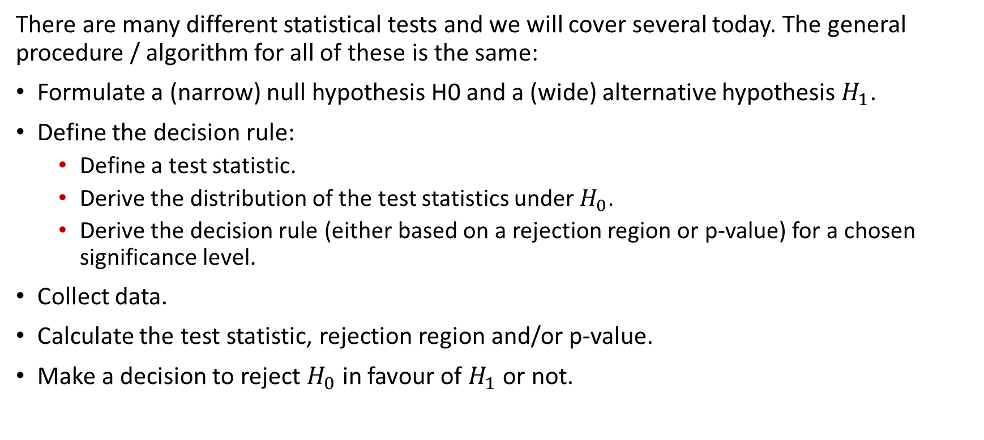
General procedure
There are many different statistical tests and we will cover several today. The general procedure / algorithm for all of these is the same:
Formulate a (narrow) null hypothesis H0 and a (wide) alternative hypothesis $H_{1}$.
Define the decision rule:
Define a test statistic.
Derive the distribution of the test statistics under $H_{0}$.
Derive the decision rule (either based on a rejection region or p-value) for a chosen significance level.
Collect data.
Calculate the test statistic, rejection region and/or p-value.
Make a decision to reject $H_{0}$ in favour of $H_{1}$ or not.

Slide 9
When can hypothesis testing be used
Hypothesis testing can be done in different scenarios:
Is there a difference in means?
Is there a difference in proportions?
Difference in odds ratios or relative risks?
Is a slope of a regression line different from 0?

Slide 10
Null and alternative hypotheses
Null hypothesis
Narrow (in two-sided tests) - test statistic takes a single, specific value.
Usually the hypothesis of no effect / association / difference.
Alternative hypothesis
Wide - test statistic can take a large range of values.
Often the hypothesis held by the researcher.
Is the opposite of the null hypothesis.

Slide 11
Statistical hypothesis
Definition:
Definition: A supposition, arrived at from observation or reflection, that leads to refutable predictions
Any claim cast in a form that will allow it to be tested and refuted
A statement that we make about a population parameter that can be tested after drawing a sample.
For example, one can hypothesize that the average age at first marriage among girls in Blantyre rural is 20.
A new mosquito trap is more effective than the standard trap.
This hypothesis has to be tested and conclusion made.

Slide 12
Steps in hypothesis testing
Come up with the hypothesis
Formulate the hypothesis – both null and alternative
Set the decision rule
Collect data
Calculate the test statistics.
Construct rejection regions.
Obtain p-value based on a known distribution and make decision.
Interpret p-value and make conclusion.

Slide 13
Statistical hypothesis testing
Is there a statistically significant “difference”?
OR “effect”, or “association” or “relationship”.
Is the observed difference due to chance?

Slide 14
When can hypothesis testing be used
Hypothesis testing can be done in different scenarios
Is there a difference in means
Is there a difference in proportions
Difference in odds ratios or relative risks

Slide 15
Null and alternative hypotheses
Null hypothesis
Narrow (in two-sided tests) - test statistic takes a single, specific value.
Usually the hypothesis of no effect / association / difference.
Alternative hypothesis
Wide - test statistic can take a large range of values.
Often the hypothesis held by the researcher.
Is the opposite of the null hypothesis.

Slide 16
Parametric tests

Slide 17
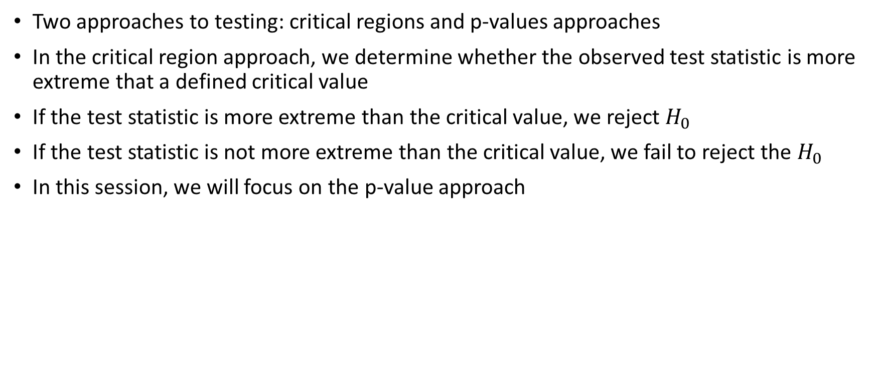
A note on hypothesis testing
Two approaches to testing: critical regions and p-values approaches
In the critical region approach, we determine whether the observed test statistic is more extreme that a defined critical value
If the test statistic is more extreme than the critical value, we reject $H_{0}$
If the test statistic is not more extreme than the critical value, we fail to reject the $H_{0}$
In this session, we will focus on the p-value approach

Slide 18
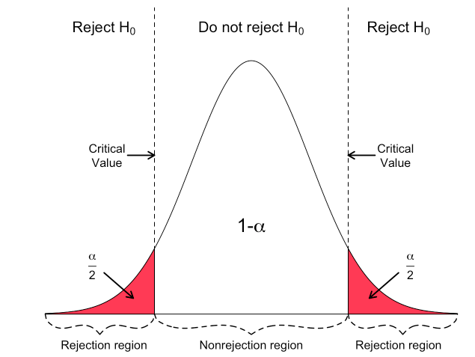
A note on hypothesis testing
Hartmann, K., Krois, J., Waske, B. (2018): E-Learning Project SOGA: Statistics and Geospatial Data Analysis. Department of Earth Sciences, Freie Universitaet Berlin.

Slide 19
One-sample t test
This test is used to check whether a sample mean is different from a known/hypothesized mean
How different is the sample mean from the true population mean
Continuous data
Assumptions:
Random sample from the population
The data must be continuous
Data must follow the normal distribution

Slide 20
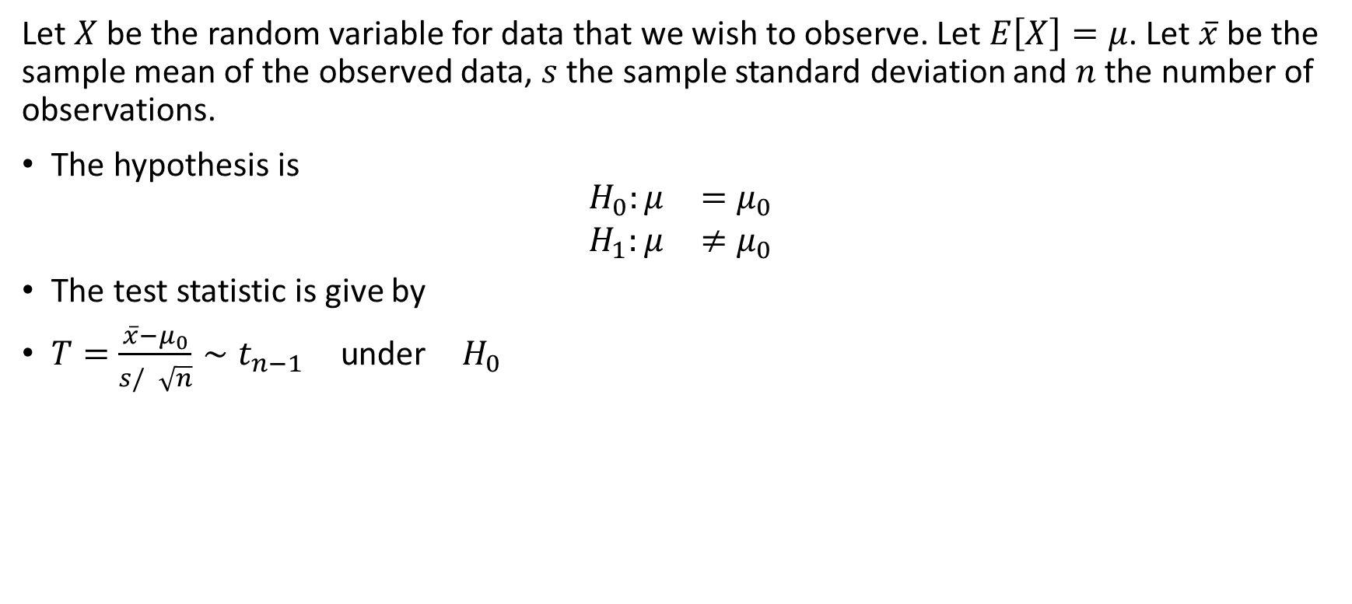
One-sample t test
Let $X$ be the random variable for data that we wish to observe. Let $E\left[X\right]=μ$. Let $\overset{‾}{x}$ be the sample mean of the observed data, $s$ the sample standard deviation and $n$ the number of observations.
The hypothesis is
$$\begin{matrix}H_{0}:μ & =μ_{0} \\ H_{1}:μ & ≠μ_{0}\end{matrix}$$
The test statistic is give by
$T=\frac{\overset{‾}{x}−μ_{0}}{s/\sqrt{n}}∼t_{n−1} \text{under} H_{0}$

Slide 21

One-sample t test
Suppose we want to test the hypothesis that the mean age is 24
$$H_{0}:μ=24$$
$$H_{1}:μ≠24$$
This is a two-sided test.

Slide 22
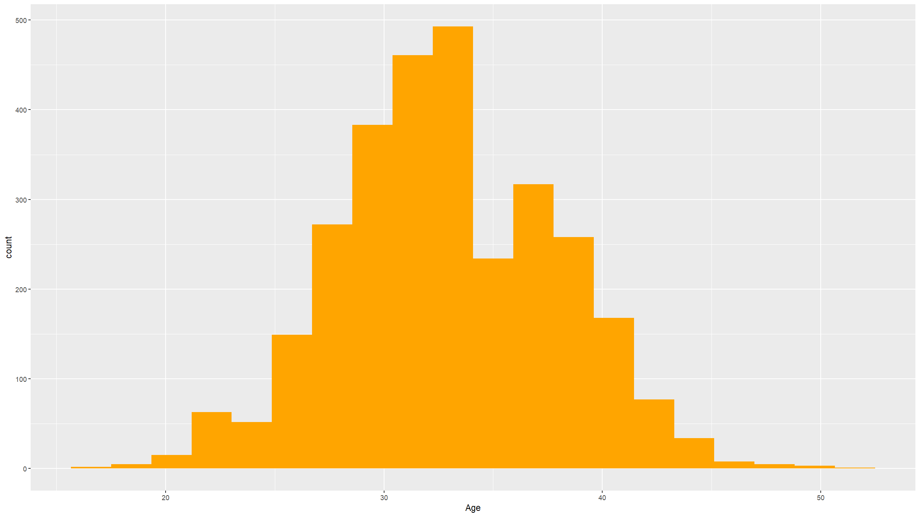
Check the assumptions
Histogram to check normality.
df1 %>% ggplot(mapping=aes(x=age)) + geom_histogram(bins=20,fill="#ffa500") + xlab("Age")

Slide 23
One sample t-test
t.test(df1$age,mu=24)
## ## One Sample t-test ## ## data: df1$age ## t = 98.616, df = 2999, p-value < 2.2e-16 ## alternative hypothesis: true mean is not equal to 24 ## 95 percent confidence interval: ## 32.76225 33.11775 ## sample estimates: ## mean of x ## 32.94

Slide 24
One sample t-test - one sided
Specift “greater” or “less”
t.test(df1$age,mu=24,alternative="less")
## ## One Sample t-test ## ## data: df1$age ## t = 98.616, df = 2999, p-value = 1 ## alternative hypothesis: true mean is less than 24 ## 95 percent confidence interval: ## -Inf 33.08916 ## sample estimates: ## mean of x ## 32.94

Slide 25
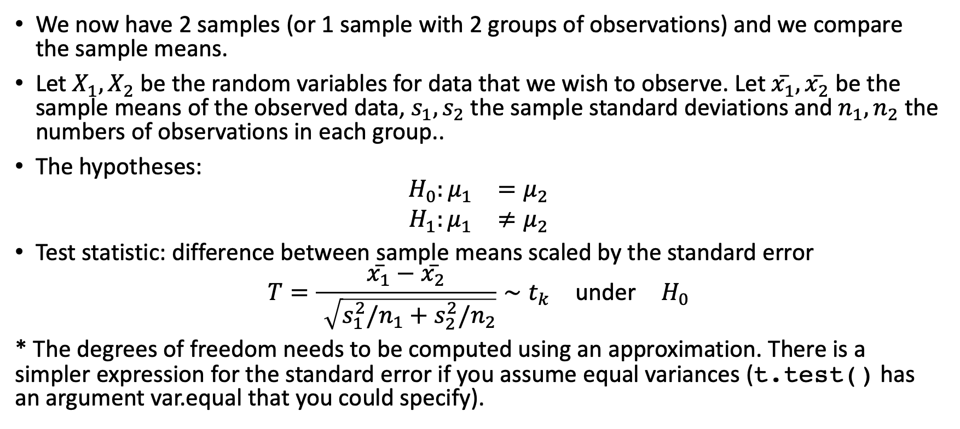
Two sample t-test
We now have 2 samples (or 1 sample with 2 groups of observations) and we compare the sample means.
Let $X_{1},X_{2}$ be the random variables for data that we wish to observe. Let $\overset{‾}{x_{1}},\overset{‾}{x_{2}}$ be the sample means of the observed data, $s_{1},s_{2}$ the sample standard deviations and $n_{1},n_{2}$ the numbers of observations in each group..
The hypotheses:
$$\begin{matrix}H_{0}:μ_{1} & =μ_{2} \\ H_{1}:μ_{1} & ≠μ_{2}\end{matrix}$$
Test statistic: difference between sample means scaled by the standard error
$$T=\frac{\overset{‾}{x_{1}}−\overset{‾}{x_{2}}}{\sqrt{s_{1}^{2}/n_{1}+s_{2}^{2}/n_{2}}}∼t_{k} \text{under} H_{0}$$
* The degrees of freedom needs to be computed using an approximation. There is a simpler expression for the standard error if you assume equal variances (t.test() has an argument var.equal that you could specify).

Slide 26
Two sample t-test
Assumptions
The data are continuous
The sample means must follow a normal distribution
The two samples are independent
Both samples are random samples of the respective underlying population
The variances within the two groups are equal (homoscedasticity)

Slide 27

Two sample t-test
In the dataset provided, it is hypothesized that the mean age is the same for both men and women.
We can test this hypothesis
$$H_{0}:μ_{1}=μ_{2}$$
$$H_{1}:μ_{1}≠μ_{2}$$

Slide 28
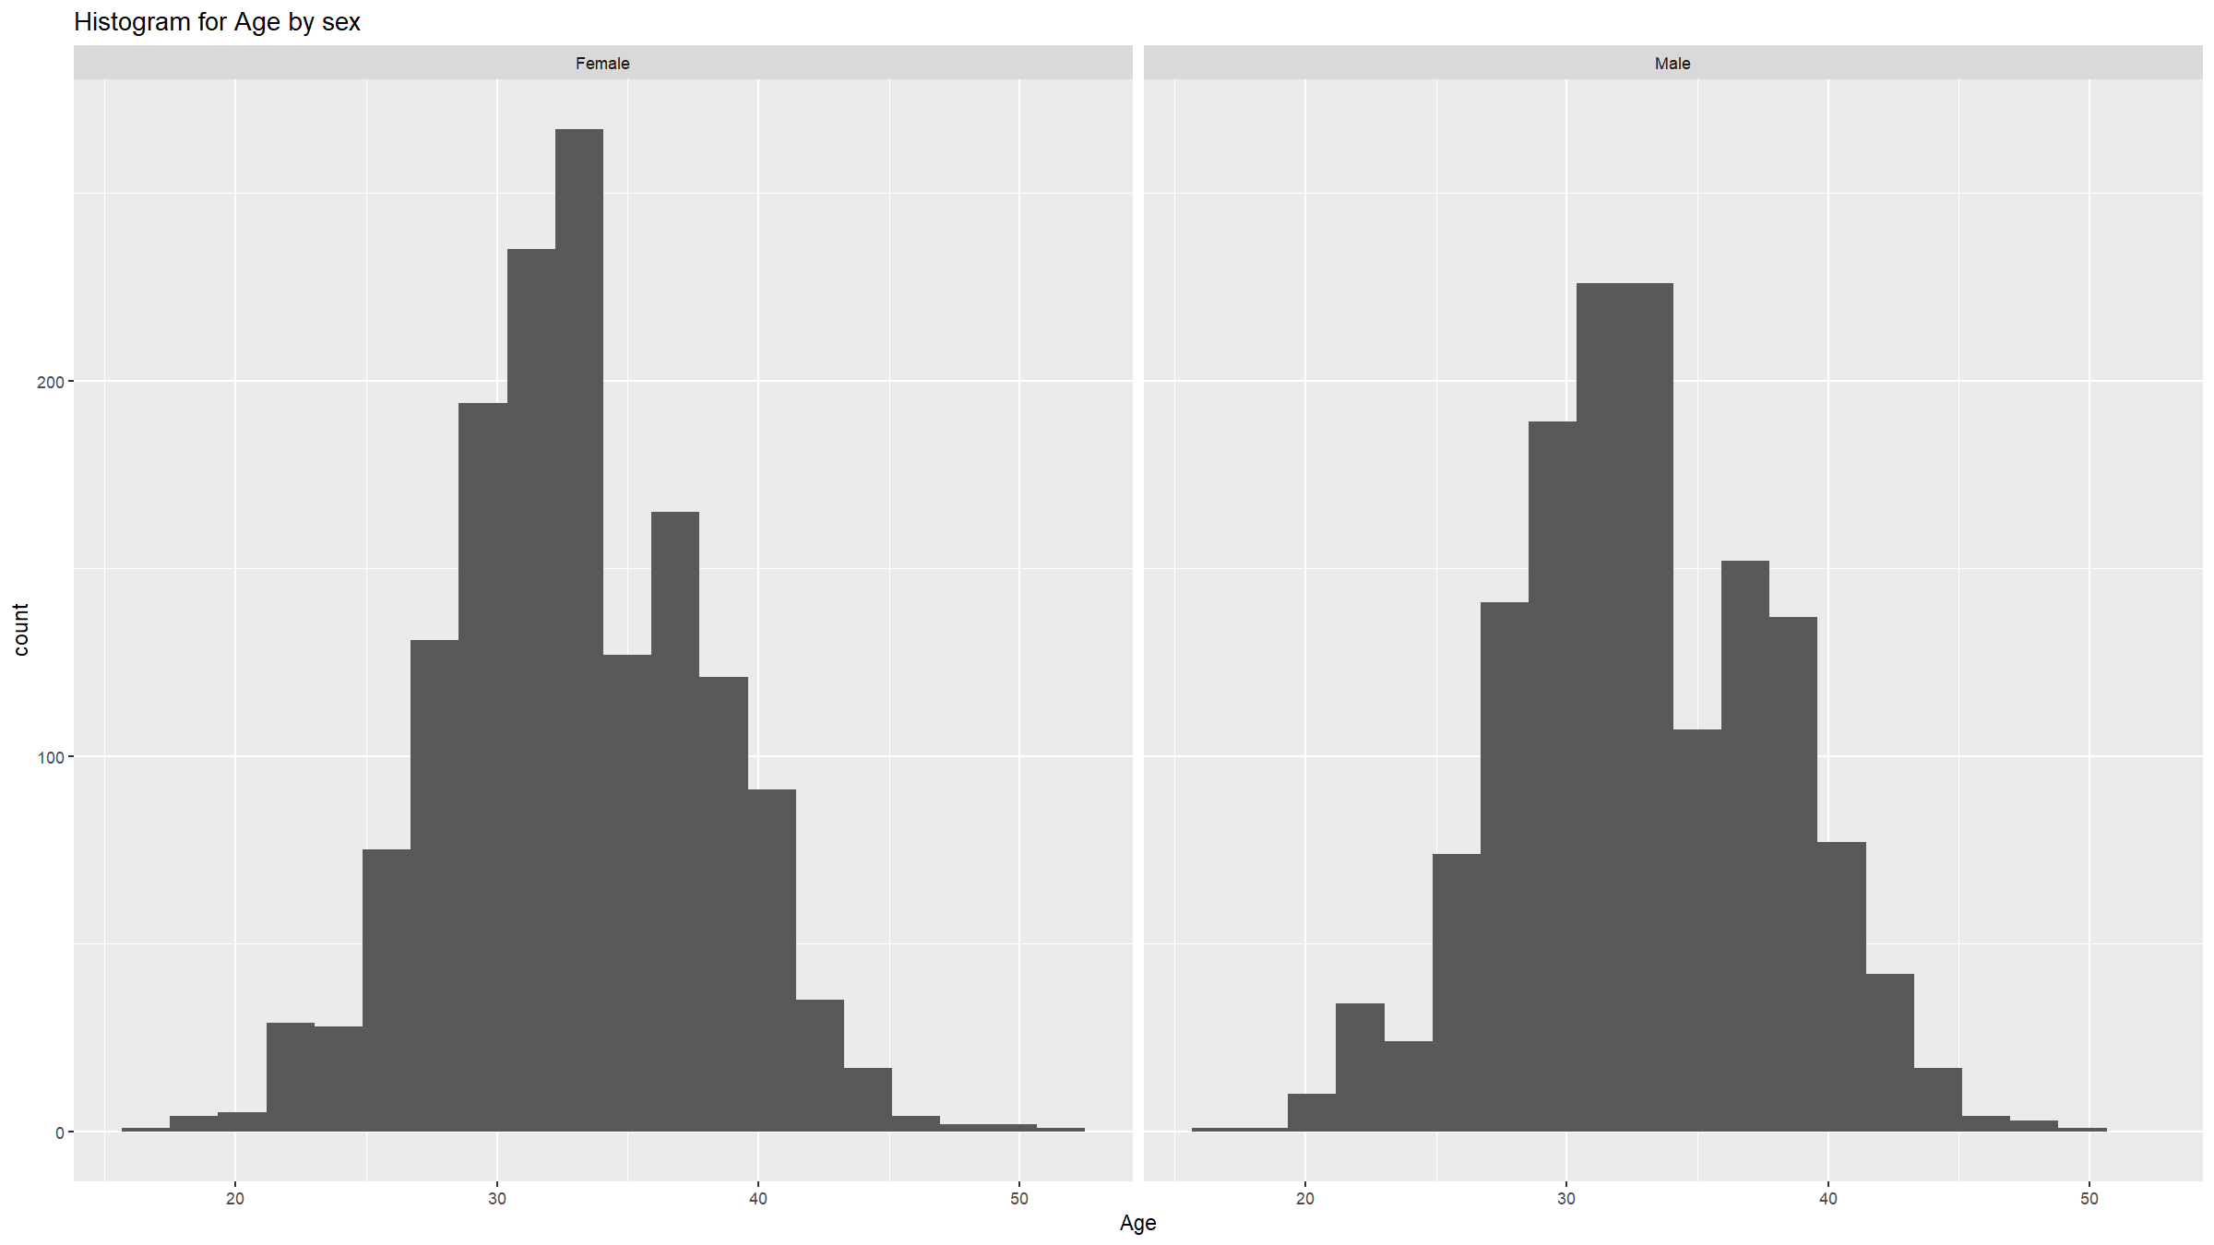
Assumptions
Check if the two populations are normally distributed.
df1 %>% ggplot(mapping=aes(x=age)) + geom_histogram(bins=20) + labs(title="Histogram for Age by sex") + xlab("Age") + facet_wrap(~ifelse(sex==1,"Male","Female"))

Slide 29
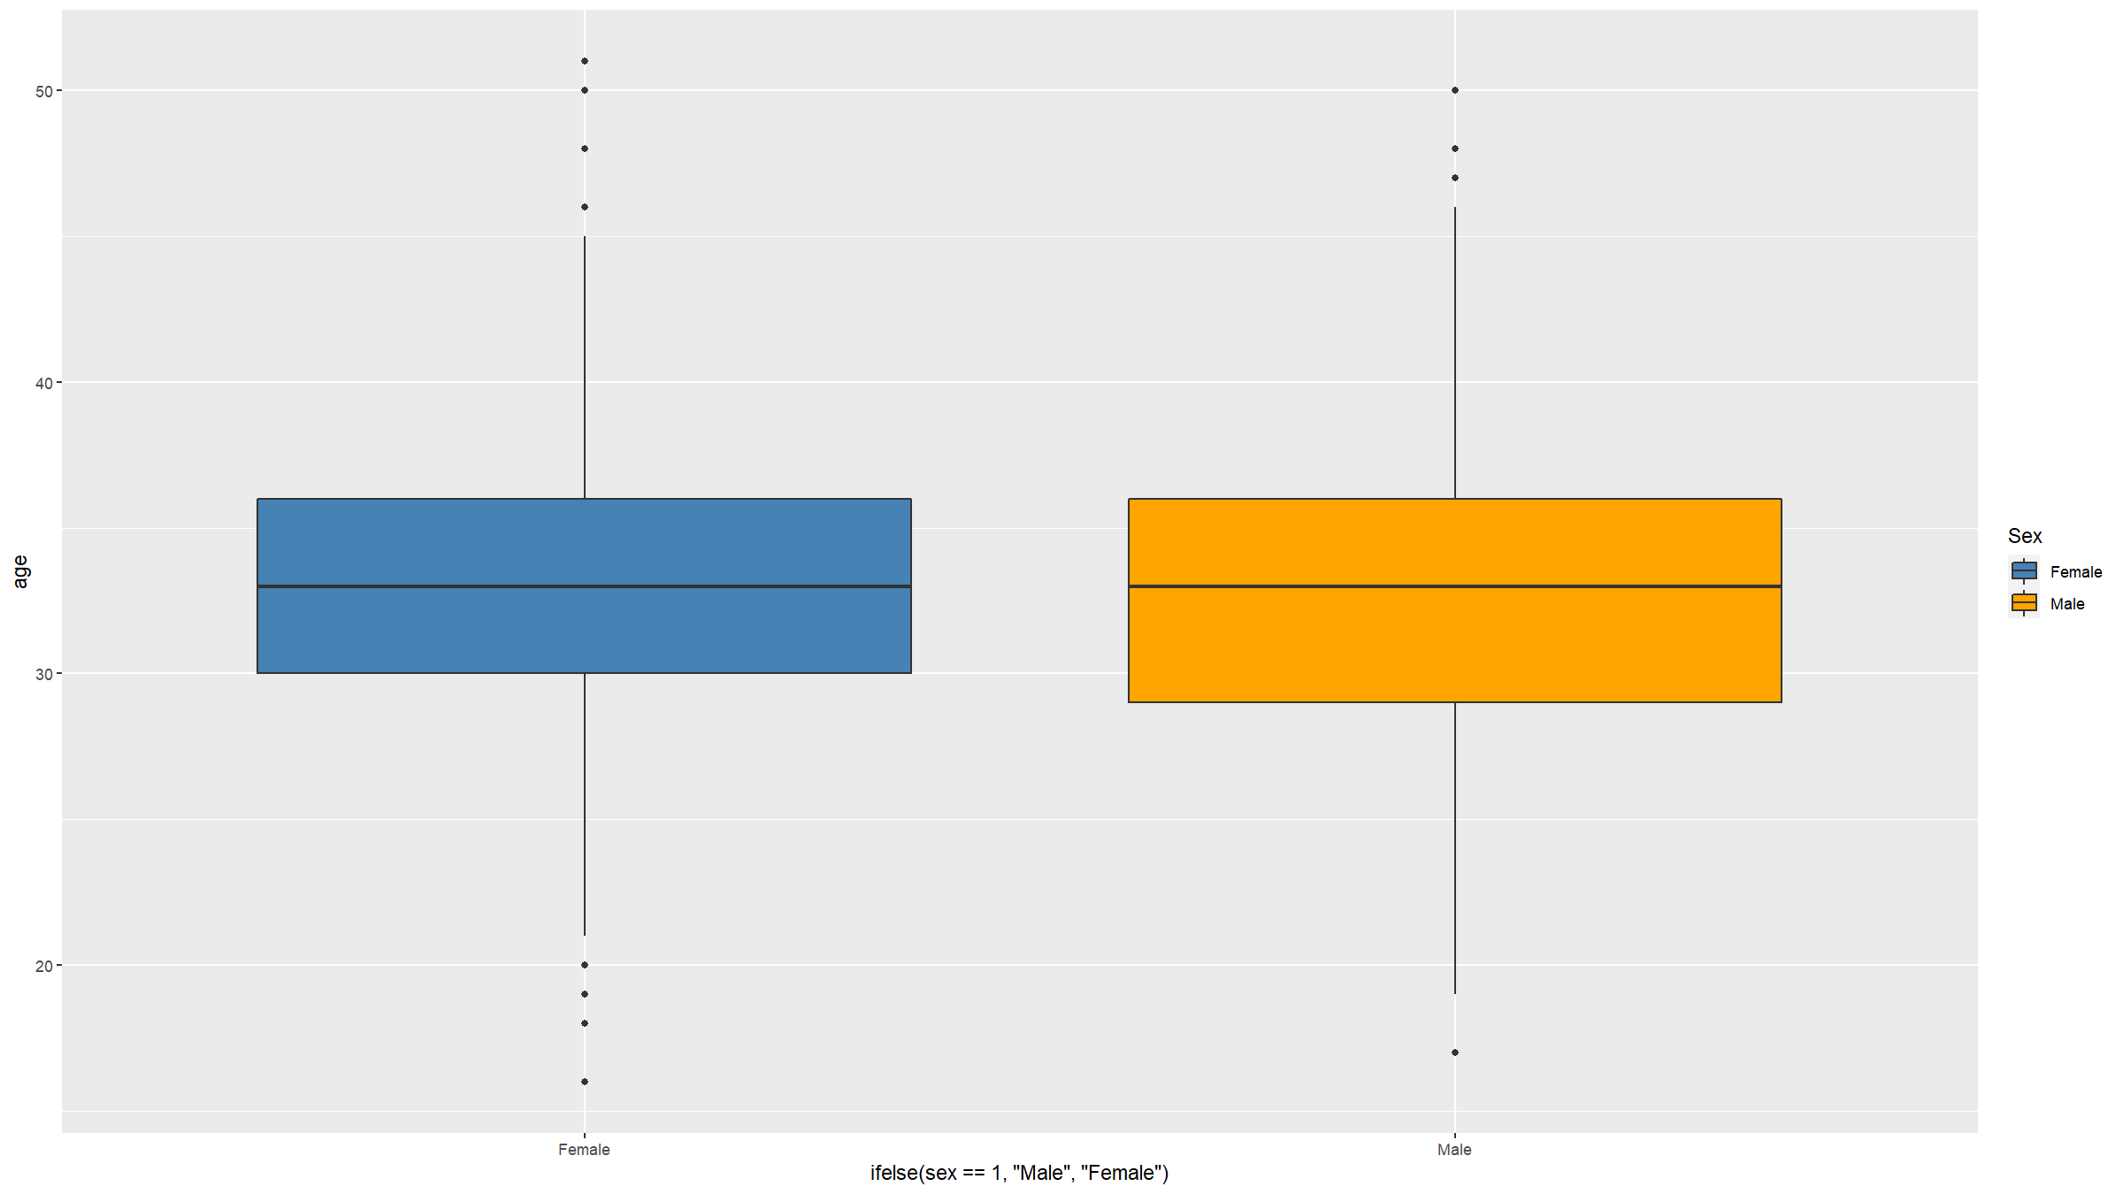
Assumptions
Check if the variances are the same
df1 %>% ggplot(mapping=aes(x=ifelse(sex==1,"Male","Female"),y=age,fill=ifelse(sex==1,"Male","Female"))) + scale_fill_manual(values=c("steelblue","orange"),name="Sex") + geom_boxplot()

Slide 30
Two sample t-test
t.test(age~sex,data=df1)
## ## Welch Two Sample t-test ## ## data: age by sex ## t = -0.69127, df = 2982.6, p-value = 0.4895 ## alternative hypothesis: true difference in means between group 1 and group 2 is not equal to 0 ## 95 percent confidence interval: ## -0.4812899 0.2303877 ## sample estimates: ## mean in group 1 mean in group 2 ## 32.87585 33.00130

Slide 31
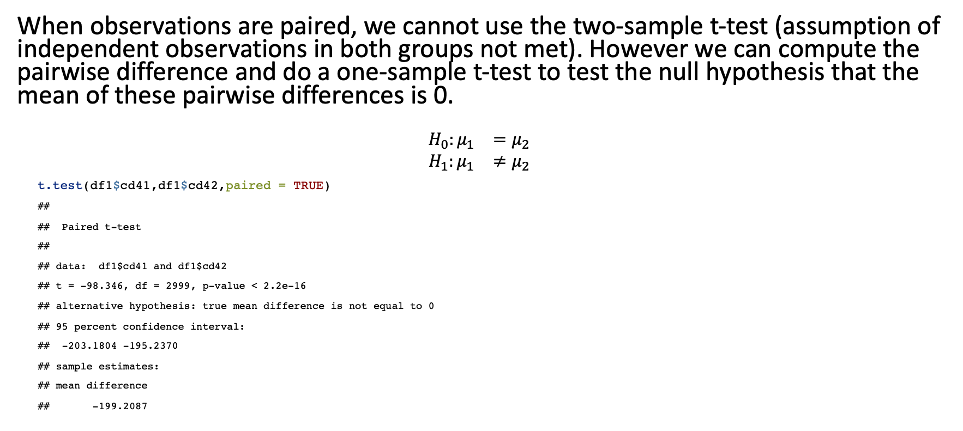
Paired t test
When observations are paired, we cannot use the two-sample t-test (assumption of independent observations in both groups not met). However we can compute the pairwise difference and do a one-sample t-test to test the null hypothesis that the mean of these pairwise differences is 0.
$$\begin{matrix}H_{0}:μ_{1} & =μ_{2} \\ H_{1}:μ_{1} & ≠μ_{2}\end{matrix}$$
t.test(df1$cd41,df1$cd42,paired = TRUE)
## ## Paired t-test ## ## data: df1$cd41 and df1$cd42 ## t = -98.346, df = 2999, p-value < 2.2e-16 ## alternative hypothesis: true mean difference is not equal to 0 ## 95 percent confidence interval: ## -203.1804 -195.2370 ## sample estimates: ## mean difference ## -199.2087

Slide 32
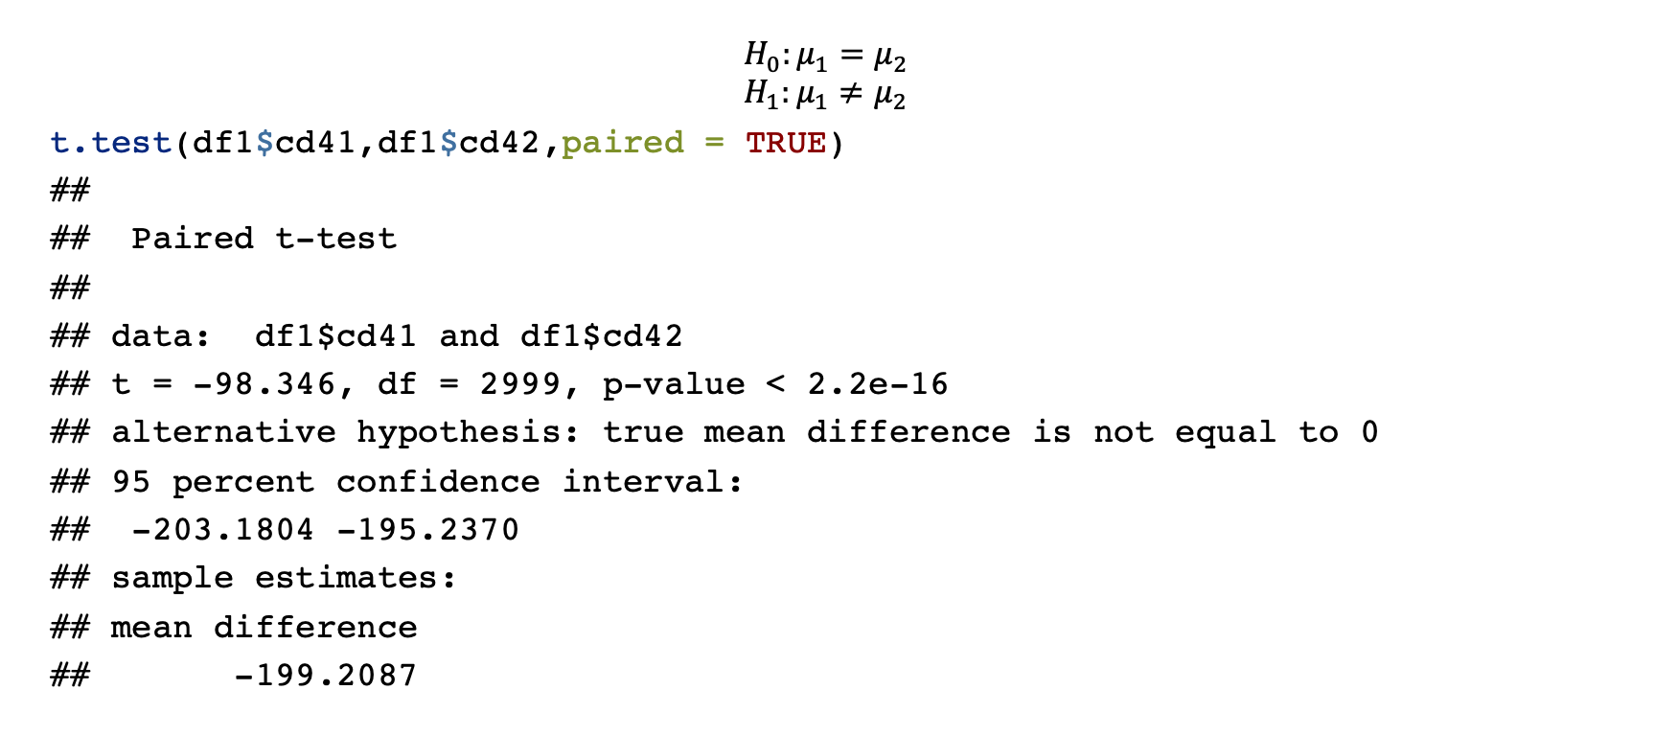
Paired t-test
$$H_{0}:μ_{1}=μ_{2}$$
$$H_{1}:μ_{1}≠μ_{2}$$
t.test(df1$cd41,df1$cd42,paired = TRUE)
## ## Paired t-test ## ## data: df1$cd41 and df1$cd42 ## t = -98.346, df = 2999, p-value < 2.2e-16 ## alternative hypothesis: true mean difference is not equal to 0 ## 95 percent confidence interval: ## -203.1804 -195.2370 ## sample estimates: ## mean difference ## -199.2087

Slide 33
Comparing means - more than two groups
Sometimes we want to compare means of a variable in more than 2 groups
For example, we might want to compare the mean CD4 among the 5 hospitals.
Use one way analysis of variance (anova)
Based on assumptions:
Sample means for the different groups follow a normal distribution
Equal variation within groups
Independent and identically distributed variables

Slide 34
One-way anova
A total of 3000 study participants were recruited in 5 hospitals providing ART. Each participant’s CD4 count upon entry into study was measured. We would like to investigate whether there is a difference in mean CD4 count at the entry into the study across the 5 participating facilities. State the hypothesis to be tested and your conclusion.

Slide 35

One-way anova
$$\begin{matrix}H_{0}:μ_{1} & =μ_{2}=μ_{3}=μ_{4}=μ_{5} \\ H_{1}:μ_{i} & ≠μ_{j} \text{for} \text{some} i,j\end{matrix}$$
oneway.test(cd41 ~ hosp, data = df1)
## ## One-way analysis of means (not assuming equal variances) ## ## data: cd41 and hosp ## F = 0.22905, num df = 4, denom df = 1496, p-value = 0.9222

Slide 36
One-way anova
res.hosp <- aov(cd41 ~ factor(hosp), data = df1) summary(res.hosp)
## Df Sum Sq Mean Sq F value Pr(>F) ## factor(hosp) 4 2204 551.1 0.229 0.922 ## Residuals 2995 7194212 2402.1

Slide 37
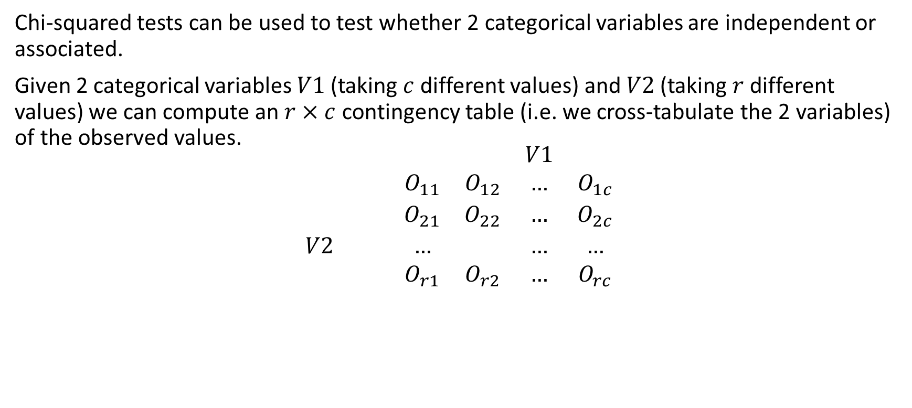
Chi-squared test
Chi-squared tests can be used to test whether 2 categorical variables are independent or associated.
Given 2 categorical variables $V1$ (taking $c$ different values) and $V2$ (taking $r$ different values) we can compute an $r×c$ contingency table (i.e. we cross-tabulate the 2 variables) of the observed values.
$$\begin{matrix} & & & & V1 & \\ & & O_{11} & O_{12} & … & O_{1c} \\ & & O_{21} & O_{22} & … & O_{2c} \\ V2 & & … & & … & … \\ & & O_{r1} & O_{r2} & … & O_{rc}\end{matrix}$$

Slide 38
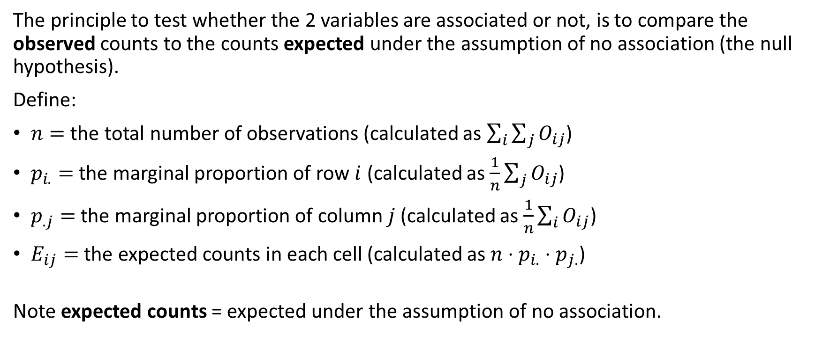
Chi-squared test
The principle to test whether the 2 variables are associated or not, is to compare the observed counts to the counts expected under the assumption of no association (the null hypothesis).
Define:
$n=$ the total number of observations (calculated as $\sum_{i}^{​}{\sum_{j}^{​}{O_{ij}}}$)
$p_{i.}=$ the marginal proportion of row $i$ (calculated as $\frac{1}{n}\sum_{j}^{​}{O_{ij}}$)
$p_{.j}=$ the marginal proportion of column $j$ (calculated as $\frac{1}{n}\sum_{i}^{​}{O_{ij}}$)
$E_{ij}=$ the expected counts in each cell (calculated as $n⋅p_{i.}⋅p_{j.}$)
Note expected counts = expected under the assumption of no association.

Slide 39
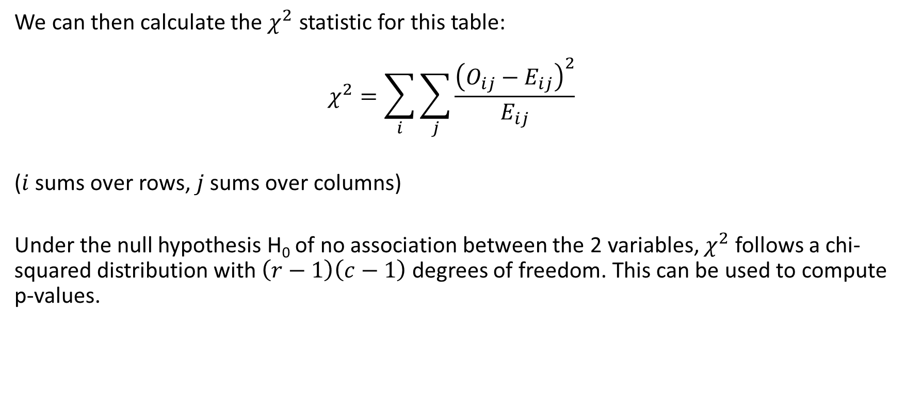
Chi-squared test
We can then calculate the $χ^{2}$ statistic for this table:
$$χ^{2}=\sum_{i}^{​}{\sum_{j}^{​}{\frac{{\left(O_{ij}−E_{ij}\right)}^{2}}{E_{ij}}}}$$
($i$ sums over rows, $j$ sums over columns)
Under the null hypothesis H₀ of no association between the 2 variables, $χ^{2}$ follows a chi-squared distribution with $\left(r−1\right)\left(c−1\right)$ degrees of freedom. This can be used to compute p-values.

Slide 40
Chi-squared test
In R, you can do a chi-squared test using the chisq.test() function.
For example we can check if there is an association between stunting and mortality in the adolescent dataset:
ctest<-chisq.test(table(df2$stunt,df2$died)) ctest
## ## Pearson's Chi-squared test with Yates' continuity correction ## ## data: table(df2$stunt, df2$died) ## X-squared = 7.0641, df = 1, p-value = 0.007864
The p-value is 0.0078644 < 0.05, so we reject the null hypothesis of no association at the 5% significance level.

Slide 41
Chi-squared test
Or we can test the null hypothesis of no association between socio-economic status and hospital in the Blantyre TB dataset:
ctest<-chisq.test(table(df1$ses,df1$hosp)) ctest
## ## Pearson's Chi-squared test ## ## data: table(df1$ses, df1$hosp) ## X-squared = 7.864, df = 16, p-value = 0.9528
Note how the degrees of freedom has changed now. Here the p-value is 0.9528113 > 0.05, so we do not reject H₀.

Slide 42
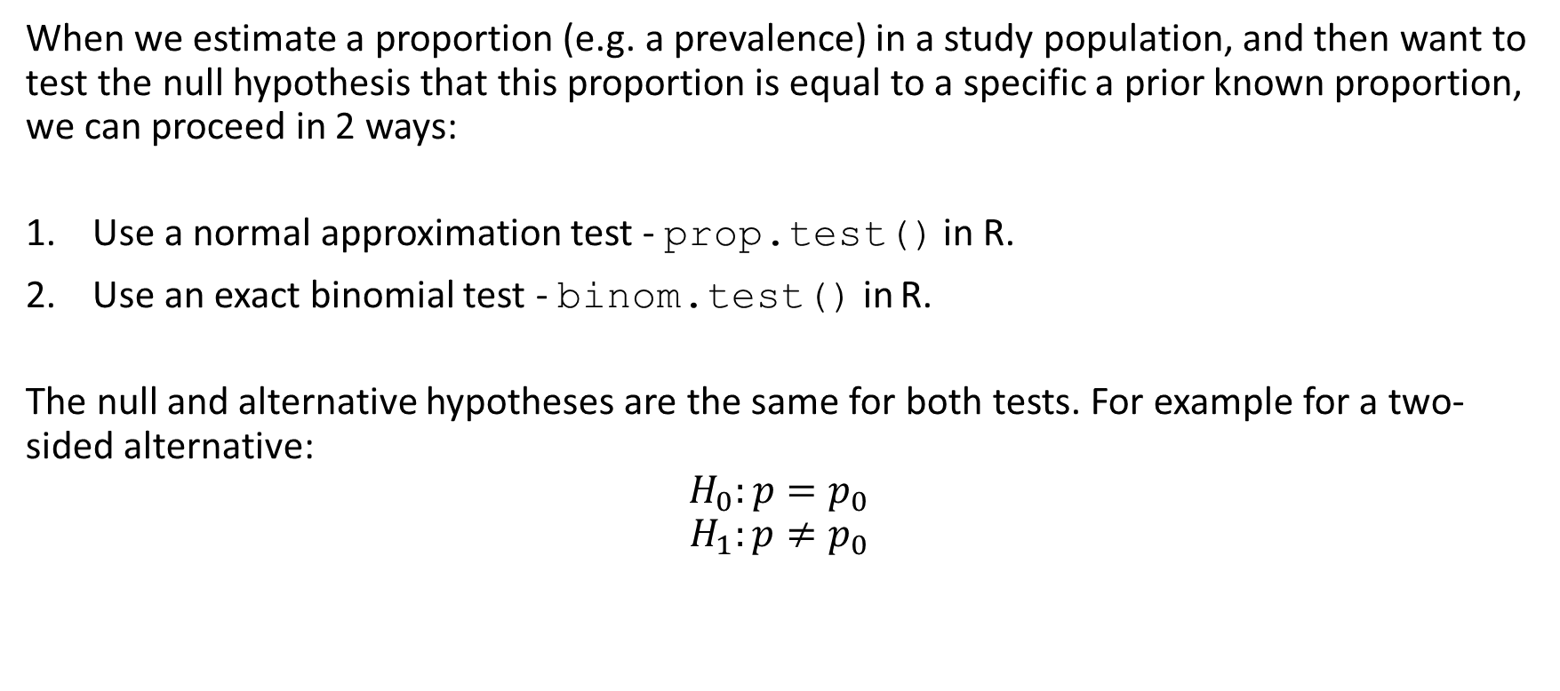
Tests for proportions - one sample test
When we estimate a proportion (e.g. a prevalence) in a study population, and then want to test the null hypothesis that this proportion is equal to a specific a prior known proportion, we can proceed in 2 ways:
Use a normal approximation test - prop.test() in R.
Use an exact binomial test - binom.test() in R.
The null and alternative hypotheses are the same for both tests. For example for a two-sided alternative:
$$H_{0}:p=p_{0}$$
$$H_{1}:p≠p_{0}$$

Slide 43

Tests for proportions - one sample test
The normal approximation test uses the following test statistic:
$$T=\frac{p−p_{0}}{\sqrt{p_{0}\left(1−p_{0}\right)/n}}∼N\left(0,1\right) \text{under} H_{0}$$

Slide 44
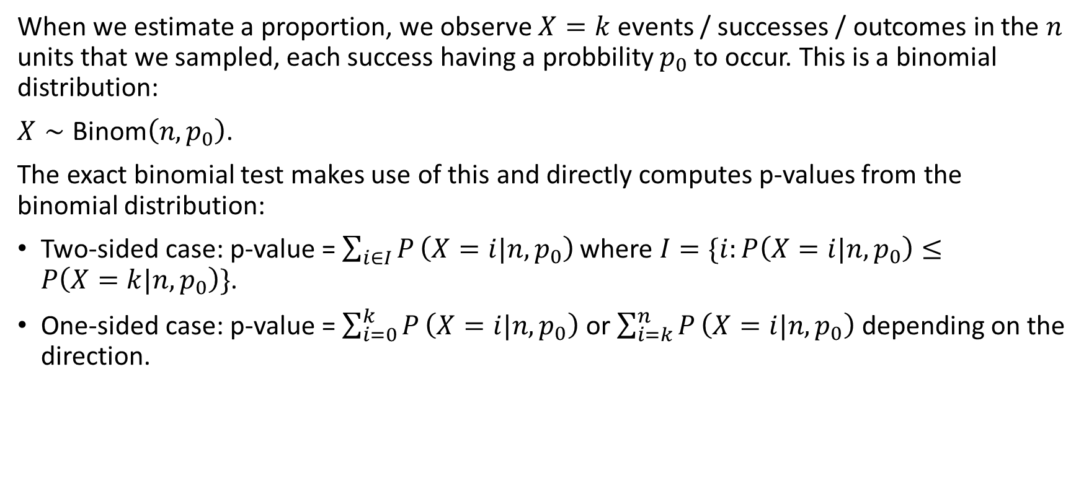
Tests for proportions - one sample test
When we estimate a proportion, we observe $X=k$ events / successes / outcomes in the $n$ units that we sampled, each success having a probbility $p_{0}$ to occur. This is a binomial distribution:
$X∼\text{Binom}\left(n,p_{0}\right)$.
The exact binomial test makes use of this and directly computes p-values from the binomial distribution:
Two-sided case: p-value = $\sum_{i∈I}^{​}{P}\left(X=i|n,p_{0}\right)$ where $I=\{i:P\left(X=i|n,p_{0}\right)≤P\left(X=k|n,p_{0}\right)\}$.
One-sided case: p-value = $\sum_{i=0}^{k}{P}\left(X=i|n,p_{0}\right)$ or $\sum_{i=k}^{n}{P}\left(X=i|n,p_{0}\right)$ depending on the direction.

Slide 45
Tests for proportions – one sample test
A recent survey found that approximately 23% of the population in a district are HIV positive. A researcher thinks that the current proportion of the adult population that is HIV+ is greater than 23%. The researcher takes a random sample of 3000 and finds that 560 tested positive. State the hypotheses and your conclusion

Slide 46

Tests for proportions – one sample test
A recent survey found that approximately 23% of the population in a district are HIV positive. A researcher thinks that the current proportion of the adult population that is HIV+ is greater than 23%. The researcher takes a random sample of 3000 and finds that 560 tested positive. State the hypotheses and your conclusion
$$H_{0}:p≤0.23$$
$$H_{1}:p>0.23$$

Slide 47
Tests for proportions – one sample test
prop.test(560,3000,0.23,alternative = "greater")
## ## 1-sample proportions test with continuity correction ## ## data: 560 out of 3000, null probability 0.23 ## X-squared = 31.565, df = 1, p-value = 1 ## alternative hypothesis: true p is greater than 0.23 ## 95 percent confidence interval: ## 0.1750871 1.0000000 ## sample estimates: ## p ## 0.1866667

Slide 48
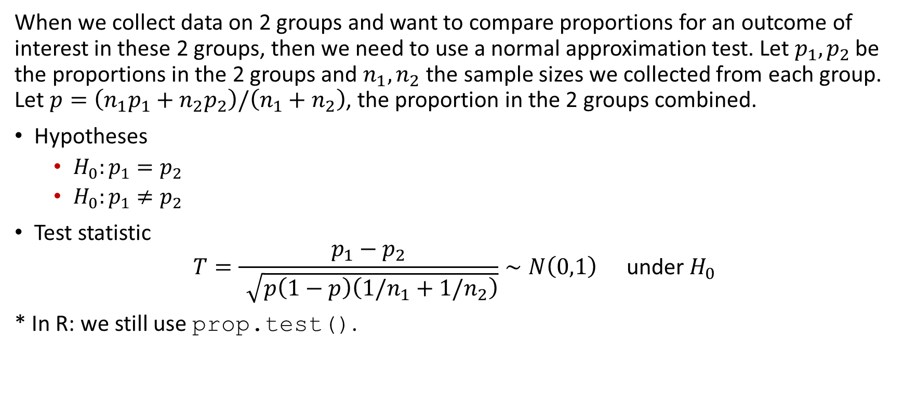
Test of proportion – Two sample tests
When we collect data on 2 groups and want to compare proportions for an outcome of interest in these 2 groups, then we need to use a normal approximation test. Let $p_{1},p_{2}$ be the proportions in the 2 groups and $n_{1},n_{2}$ the sample sizes we collected from each group. Let $p=\left(n_{1}p_{1}+n_{2}p_{2}\right)/\left(n_{1}+n_{2}\right)$, the proportion in the 2 groups combined.
Hypotheses
$H_{0}:p_{1}=p_{2}$
$H_{0}:p_{1}≠p_{2}$
Test statistic
$$T=\frac{p_{1}−p_{2}}{\sqrt{p\left(1−p\right)\left(1/n_{1}+1/n_{2}\right)}}∼N\left(0,1\right) \text{under} H_{0}$$
* In R: we still use prop.test().

Slide 49
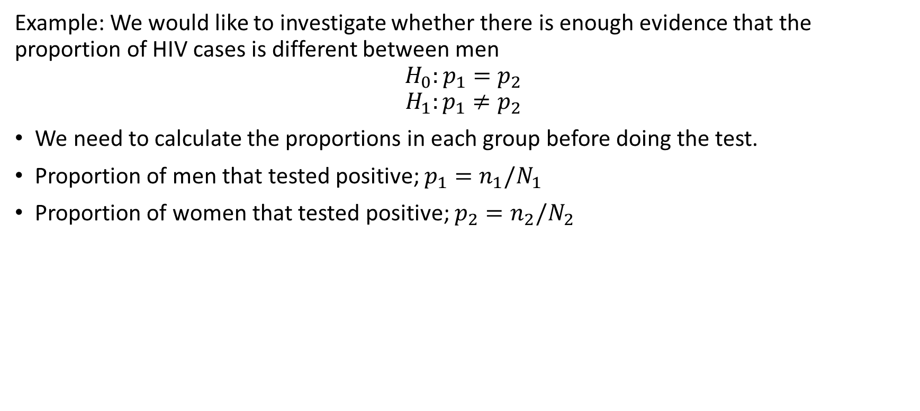
Test of proportion – Two sample tests
Example: We would like to investigate whether there is enough evidence that the proportion of HIV cases is different between men
$$H_{0}:p_{1}=p_{2}$$
$$H_{1}:p_{1}≠p_{2}$$
We need to calculate the proportions in each group before doing the test.
Proportion of men that tested positive; $p_{1}=n_{1}/N_{1}$
Proportion of women that tested positive; $p_{2}=n_{2}/N_{2}$

Slide 50
Test of proportion – Two sample tests
table(df1$sex,df1$hiv)
## ## 0 1 ## 1 1204 262 ## 2 1236 298
prop.test(x=c(262,298),n=c(1466,1534))
## ## 2-sample test for equality of proportions with continuity correction ## ## data: c(262, 298) out of c(1466, 1534) ## X-squared = 1.093, df = 1, p-value = 0.2958 ## alternative hypothesis: two.sided ## 95 percent confidence interval: ## -0.04408002 0.01298849 ## sample estimates: ## prop 1 prop 2 ## 0.1787176 0.1942634

Slide 51
Non-parametric tests

Slide 52
Non-parametric tests
When we cannot make distributional assumptions about the test statistic (i.e. typically when the assumption of normality is not met).
Have non-parametric equivalent for most parametric tests.
These tests still assume randomly sampled, independent and identically distributed observations. It is only the distributional assumption that is no longer made.

Slide 53

Wilcoxon one-sample signed rank test
When assumption of normality of sample mean in the one-sample t-test is violated.
This test compares the median (not the mean) against a fixed value.
Hypotheses (two-sided case):
$H_{0}: \text{median}=m$
$H_{0}: \text{median}≠m$
In R: wilcox.test().

Slide 54
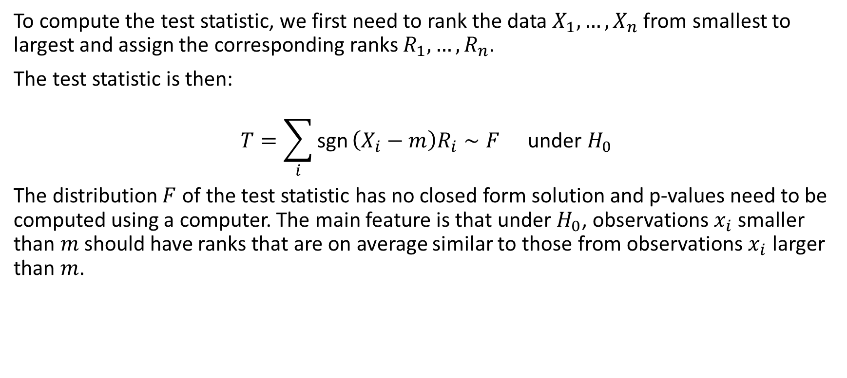
Wilcoxon one-sample signed rank test
To compute the test statistic, we first need to rank the data $X_{1},…,X_{n}$ from smallest to largest and assign the corresponding ranks $R_{1},…,R_{n}$.
The test statistic is then:
$$T=\sum_{i}^{​}{\text{sgn}}\left(X_{i}−m\right)R_{i}∼F \text{under} H_{0}$$
The distribution $F$ of the test statistic has no closed form solution and p-values need to be computed using a computer. The main feature is that under $H_{0}$, observations $x_{i}$ smaller than $m$ should have ranks that are on average similar to those from observations $x_{i}$ larger than $m$.

Slide 55
Wilcoxon one-sample signed rank test
For example, for the adolescent dataset, we can test the null hypothesis that the median weight in the study population is 38kg.
wilcox.test(df2$a104wt,mu=38)
## ## Wilcoxon signed rank test with continuity correction ## ## data: df2$a104wt ## V = 12805, p-value = 0.0001147 ## alternative hypothesis: true location is not equal to 38

Slide 56
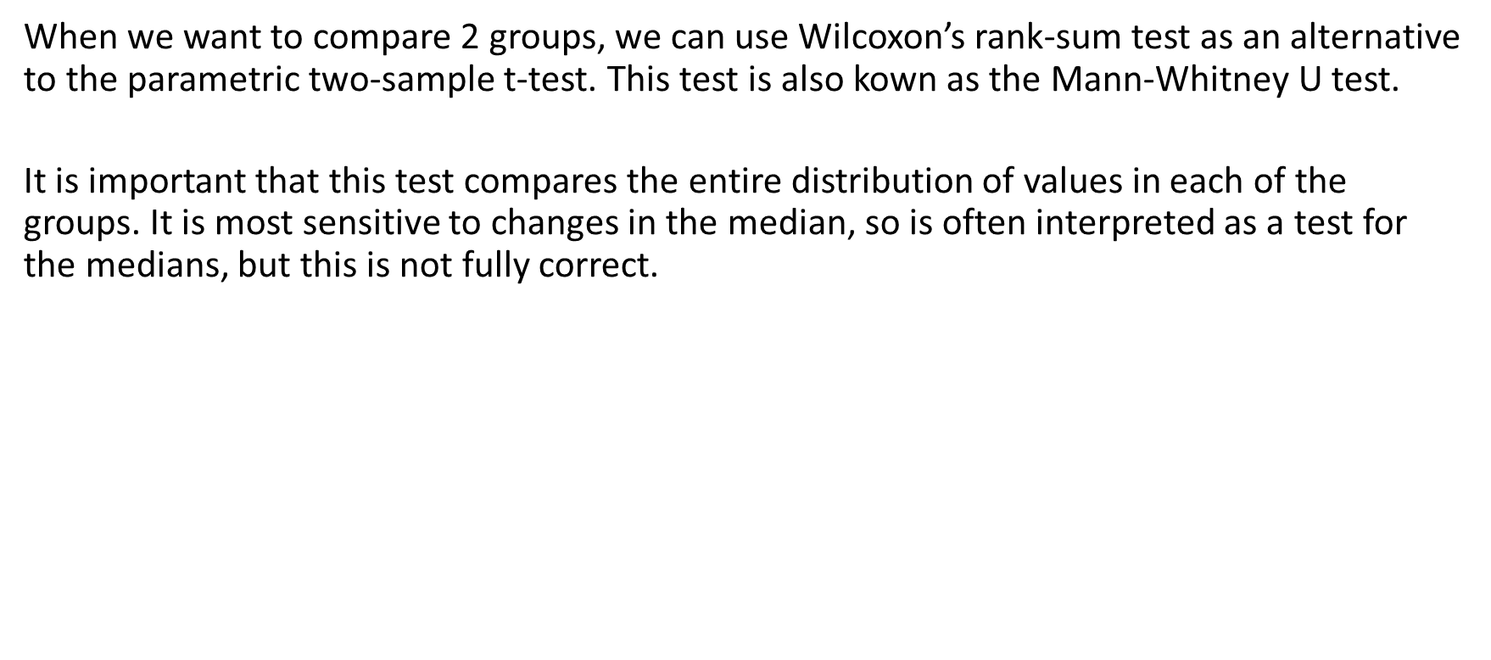
Wilcoxon two-sample rank-sum test
When we want to compare 2 groups, we can use Wilcoxon’s rank-sum test as an alternative to the parametric two-sample t-test. This test is also kown as the Mann-Whitney U test.
It is important that this test compares the entire distribution of values in each of the groups. It is most sensitive to changes in the median, so is often interpreted as a test for the medians, but this is not fully correct.

Slide 57
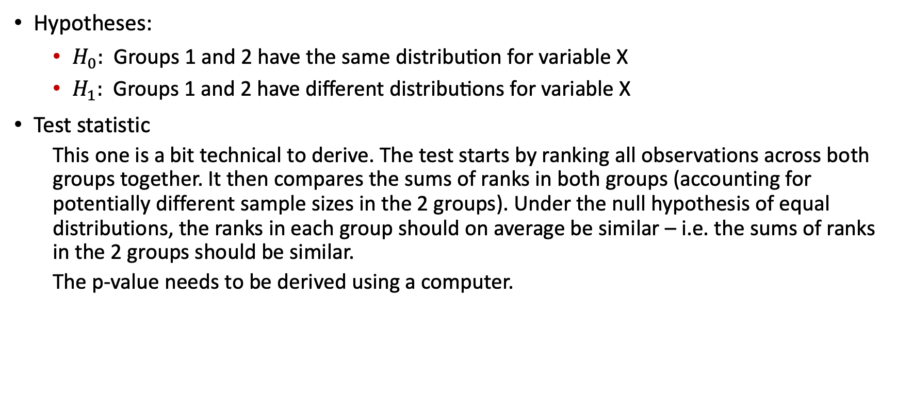
Wilcoxon two-sample rank-sum test
Hypotheses:
$H_{0}: \text{Groups}\text{ 1 }\text{and}\text{ 2 }\text{have} \text{the} \text{same} \text{distribution} \text{for} \text{variable} \text{X}$
$H_{1}: \text{Groups}\text{ 1 }\text{and}\text{ 2 }\text{have} \text{different} \text{distributions} \text{for} \text{variable} \text{X}$
Test statistic
This one is a bit technical to derive. The test starts by ranking all observations across both groups together. It then compares the sums of ranks in both groups (accounting for potentially different sample sizes in the 2 groups). Under the null hypothesis of equal distributions, the ranks in each group should on average be similar – i.e. the sums of ranks in the 2 groups should be similar.
The p-value needs to be derived using a computer.

Slide 58
Wilcoxon two-sample rank-sum test
Example:
Let’s test the null hypothesis that males and females have equal weight distributions in the study population from the adolescent dataset.
wilcox.test(a104wt ~ a13sex,data = df2)
## ## Wilcoxon rank sum test with continuity correction ## ## data: a104wt by a13sex ## W = 9650.5, p-value = 0.1475 ## alternative hypothesis: true location shift is not equal to 0

Slide 59
Wilcoxon paired signed rank test
For paired data, we reduce the problem to a one-sample test by computing the pairwise differences and testing the null hypothesis that the median differences is 0.
Example:
Test the hypothesis that the CD4 counts are the same at the two time points
wilcox.test(df1$cd41.sk,df1$cd42.sk,paired=TRUE)
## ## Wilcoxon signed rank test with continuity correction ## ## data: df1$cd41.sk and df1$cd42.sk ## V = 782047, p-value < 2.2e-16 ## alternative hypothesis: true location shift is not equal to 0
wilcox.test(df1$cd41.sk-df1$cd42.sk) # equivalent
## ## Wilcoxon signed rank test with continuity correction ## ## data: df1$cd41.sk - df1$cd42.sk ## V = 782047, p-value < 2.2e-16 ## alternative hypothesis: true location is not equal to 0

Slide 60
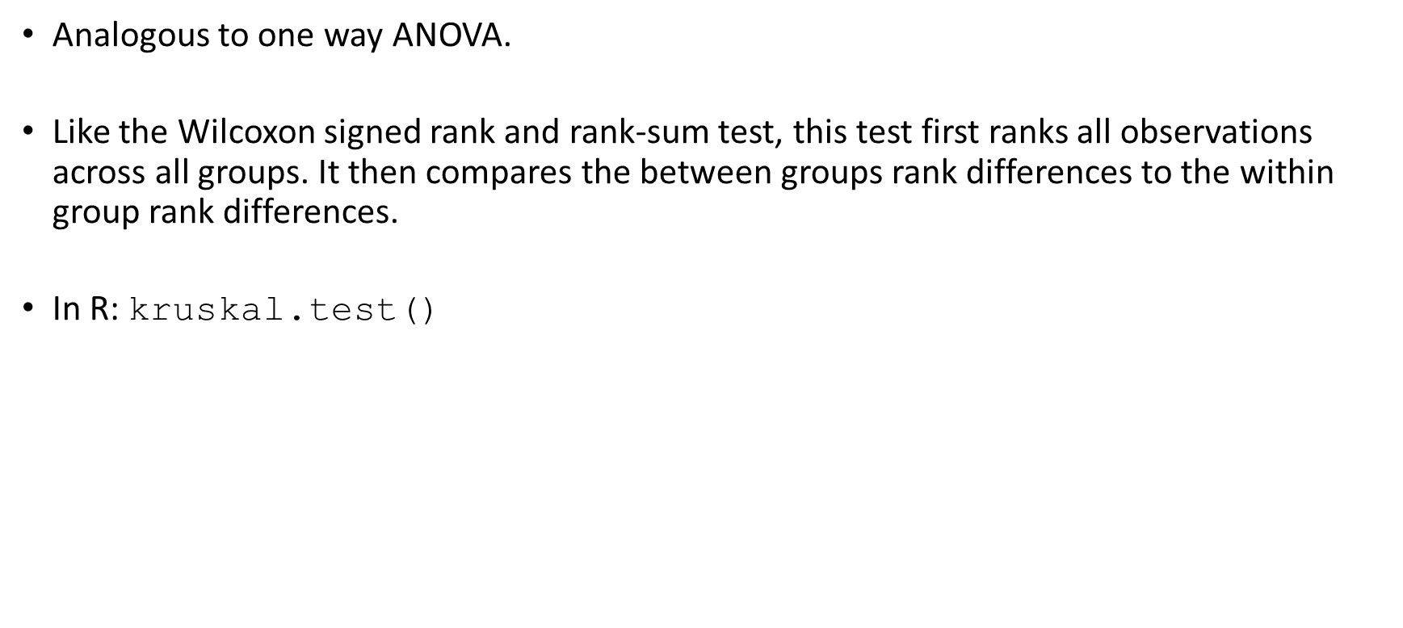
Kruskal-Wallis test – more than 2 groups
Analogous to one way ANOVA.
Like the Wilcoxon signed rank and rank-sum test, this test first ranks all observations across all groups. It then compares the between groups rank differences to the within group rank differences.
In R: kruskal.test()

Slide 61
Kruskal-Wallis test – more than 2 groups
Example:
It is claimed that differences exist in the mean weight between the different conditions (excellent, fair, good and poor)
kruskal.test(a104wt ~ a63well,data = df2)
## ## Kruskal-Wallis rank sum test ## ## data: a104wt by a63well ## Kruskal-Wallis chi-squared = 70.206, df = 3, p-value = 3.855e-15

Slide 62
Fisher’s exact test
When we compare categorical variables, we saw that we can use the chi-square test which relies on approximating the squared differences between observed and expected counts by chi-squared distributions. For this approximation, all expected cell counts need to be large enough (typically, the minimum expected cell count should be 5, 6 or larger).
Fisher’s test is computationally intensive: for a given null hypothesis, it derives all cross-tabulation tables that are as extreme or more extreme than the observed table.
For example we can revisit the test we did when we checked if there is an association between stunting and mortality in the adolescent dataset:

Slide 63
Fisher’s exact test
fisher.test(table(df2$stunt,df2$died))
## ## Fisher's Exact Test for Count Data ## ## data: table(df2$stunt, df2$died) ## p-value = 0.006215 ## alternative hypothesis: true odds ratio is not equal to 1 ## 95 percent confidence interval: ## 1.296104 7.696201 ## sample estimates: ## odds ratio ## 3.096198

Slide 64
Fisher’s exact test
However, when we revisit the test for the null hypothesis of no association between socio-economic status and hospital in the Blantyre TB dataset, we run out of memory for Fisher’s exact test – the table is too large with too many alternatives.
try( fisher.test(table(df1$ses,df1$hosp)) )
## Error in fisher.test(table(df1$ses, df1$hosp)) : FEXACT error 5. ## The hash table key cannot be computed because the largest key ## is larger than the largest representable int. ## The algorithm cannot proceed. ## Reduce the workspace, consider using 'simulate.p.value=TRUE' or another algorithm.

Slide 65
Permutation tests

Slide 66
Permutation tests
Permutation tests do not make use of parametric or non-parametric distributions. Instead, permutation tests compute empirical distributions of the test statistic by randomly shuffling the group allocations (thereby guaranteeing random groups). The algorithm is simple:
Calculate the test statistics.
Repeat many times:
Randomly allocate individuals to one of the groups being compared - this will by definition mean that the outcome is independent of the grouping variable.
Compute the test statistic for the resampled data and store this.
The stored test statistics for the data with random group allocation form an empirical distribution of the test statistic. Count what proportion of draws from this empirical distribution are as extreme or more extreme than the observed data. This will yield the p-value.
We illustrate permutation tests here as an alternative to the t-test, but they can be used in many other situations.

Slide 67
Permutation tests
For example, in the case of testing whether the sample means for age differ between males and females:
t<-t.test(age~sex,data=df1)$statistic B<-5000 tVect<-rep(NA,B) for(b in 1:B){ dfTmp<-df1 dfTmp$sex<-sample(df1$sex,replace=FALSE,size=nrow(df1)) tVect[b]<-t.test(age~sex,data=dfTmp)$statistic } sum(abs(tVect)>=abs(t))/B # compare this to p=0.4895
## [1] 0.4936

Slide 68
Use of p-values in statistics

Slide 69
ASA statement on statistical signigicance and p-values
P-values indicate degree to which data are incompatible with a given statistical model.
P-values do not measure the probability of H₀ being true.
Decision-making should not be based solely on whether a p-value is below a certain threshold.
Proper inference requires full reporting and transparency.
A p-value does not measure the size of an effect / importance of a result.
Context matters: a p-value by itself does not provide a good measure of evidence regarding a model or hypothesis.

Slide 70
Note on p-values
Stop the use of P-values in the conventional, dichotomous way.
P-values alone should not be used to refute or support a scientific hypothesis.
Rebrand confidence intervals to “compatibility intervals”.
Discuss all values that fall within the confidence interval / are compatible with the data.
Do acknowledge that the point estimates and values close to it are more compatible than values at the extremes of the interval.
Emphasize / embrace uncertainty.
Please read https://doi.org/10.1080/00031305.2019.1583913.

Slide 71

[end of Session 4]

