Slide 1
Statistics and R short course
Session 6: Reproducible research with R Marc Henrion, James Chirombo, Eva Kudowa

Slide 2
Introduction

Slide 3
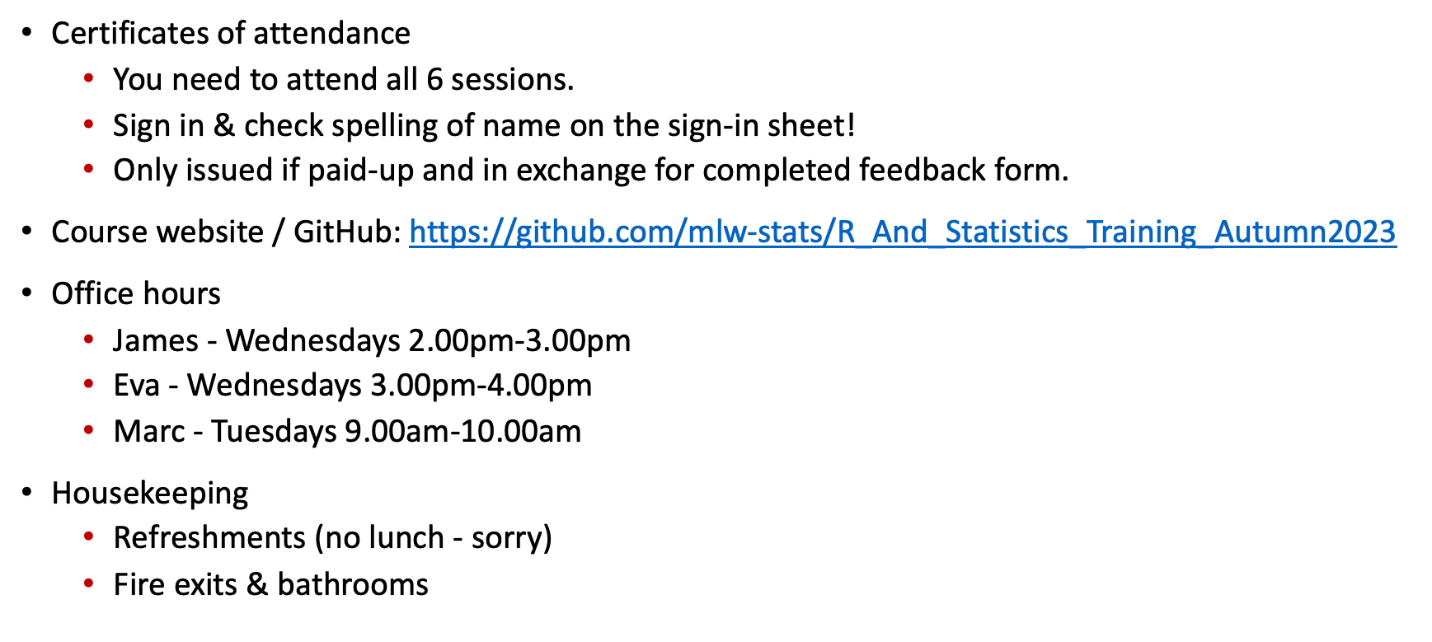
Preliminaries
Certificates of attendance
You need to attend all 6 sessions.
Sign in & check spelling of name on the sign-in sheet!
Only issued if paid-up and in exchange for completed feedback form.
Course website / GitHub: https://github.com/mlw-stats/R_And_Statistics_Training_Autumn2023
Office hours
James - Wednesdays 2.00pm-3.00pm
Eva - Wednesdays 3.00pm-4.00pm
Marc - Tuesdays 9.00am-10.00am
Housekeeping
Refreshments (no lunch - sorry)
Fire exits & bathrooms

Slide 4
Learning outcomes
KNOW R: Explain know what R is & what it can do.
KNOW R RESOURCES: List useful R resources and access them.
DO R: Perform basic operations relevant for your research in R:
Read data into R & write data or results to the harddrive.
Manipulate & use different object types.
Write & use functions in R
Perform basic analyses on a dataset: mean, standard deviation, linear regression.
Produce various standard graphs and tables
UNDERSTAND BASICS OF STATISTICS: Explain basic statistical theory: common distributions, standard statistical techniques, common study designs, assumptions behind common statistical tests and regression models.
UNDERSTAND STUDY DESIGNS: Recommend appropriate designs & analyses.
COMPREHEND OPEN SCIENCE: Summarise principles of open, reproducible research.
DO OPEN SCIENCE WITH R: Use R scripts, R markdown, packages & GitHub.

Slide 5
Resources

Slide 6
Resources
Quarto & R markdown
https://quarto.org/docs/computations/r.html
https://rmarkdown.rstudio.com/articles.html
GitHub & git
https://www.youtube.com/githubguides
https://guides.github.com/activities/hello-world
https://guides.github.com/introduction/git-handbook

Slide 7
Open Science

Slide 8
Open Science
Discuss:
What do you understand by Open Science?
Why is Open Science important?

Slide 9
Open Science
Scientific outputs are freely available to anybody - policymakers, professional and amateur researchers, lay public.
Research findings.
Datasets.
Methods.
Other resources.
Science is transparent & reproducible.
Part of a wider movement for open data, content, knowledge http://opendefinition.org. Started in the 17th century with the advent of the academic journal¹.

Slide 10
Open Science
6 principles:
Open methodology - document the entire research process.
Open source - use open source technology only.
Open data - make generated data publicly available.
Open access - make results and data accessible by anybody.
Open peer review - transparent, published quality assurance.
Open educational resources - use / generate free, open training resources.
http://openscienceasap.org/open-science

Slide 11
Open Science
Limits (?)
Confidential, sensitive, identifiable data –> GDPR, HIPAA etc. Some data may need to access controlled (e.g. human genomic data –> dbGaP).
Dangerous technology liable to misuse (e.g. H5N1 transmission studies in ferrets²) - a false argument?
After fake news, fake science?

Slide 12
Quarto / R markdown

Slide 13
Quarto / R markdown
As a researcher it is important that you can effectively communicate your results.
Quarto and R markdown are open-source science and technical publishing systems, both relying on Pandoc (a universal document converter). Both are markdown languages.
Quarto and R markdown allow creating reports that combine R code with the analysis output. R markdown, and quarto, is a “unified authoring framework for data science, combining your code, its results and your prose commentary”³.

Slide 14
Quarto / R markdown
Quarto allows you to tell a story and share a report that transparently lists the code the generated your results. Markdown documents are fully reproducible (up to a point!) and support a number of output format: html, pdf, docx, pptx…
Quarto is meant to achieve 3 things:
Communicate with stakeholders.
Collaborate with other researchers.
A framework within which to do data science (like a modern-day lab notebook).

Slide 15
Quarto / R mardown
Main differences between quarto and R markdown:
Quarto is newer and will probably supersede R markdown - so best to just learn quarto (but both are almost identical to use).
Quarto is independent of R and works with many other programming languages (python, Julia, …)
Slight differences in YAML header specification.
Slightly different layout & style of final document.

Slide 16
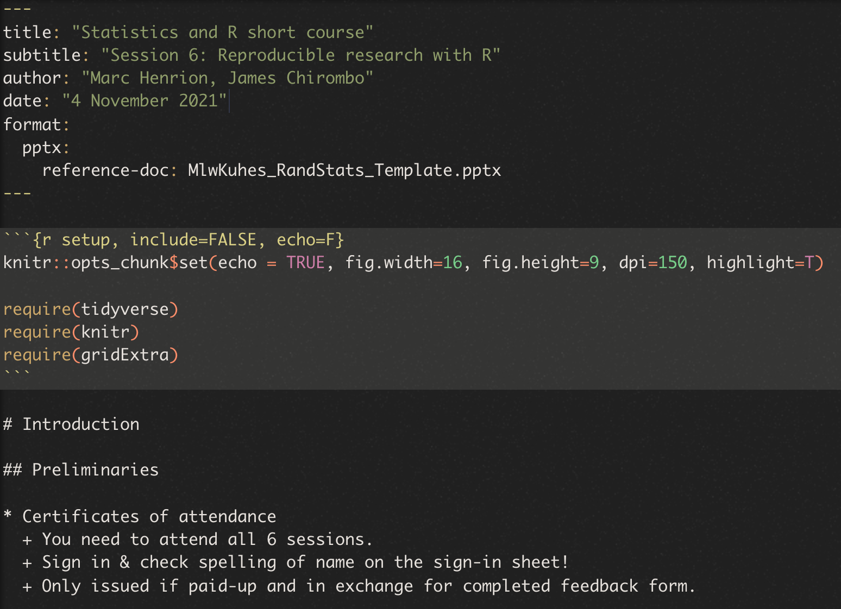
Quarto / R markdown
There are 3 building blocks to a markdown document:
A YAML header.
Chunks of R code (if you want to strip out all chunks of R code within a markdown document to write a pure R script, you can use the purl() function from the knitr package).
Narrative, formatted text.

Slide 17
Quarto / R markdown
Exercise
Simulate a dataset and save it as a binary R data file (*.rda or *.RData).
(In RStudio): File –> New File –> Quarto document… –> (select type of output; choose html; untick the ‘use visual markdown editor’ box), then click on ‘Render’ in the script editor panel.
Write a new quarto document which:
Loads the simulated data.
Performs a basic analysis and produces a table with results.
Displays a graph.
Make sure to use quarto’s capability of providing a commentary along with your analysis.

Slide 18
Quarto / R markdown
Simulated data (as an example):
dat<-data.frame( type=sample(c("A","B"),size=100,prob=c(0.6,0.4),replace=T), x=rnorm(100,sd=5), y=rexp(100) ) %>% dplyr::mutate( z=ifelse(type=="A", 2*x-y+5, 1.25*x-0.5*y+1) + rnorm(100,sd=1.25) )

Slide 19
Quarto / R markdown
Analysis (as an example):
t-test comparing variable z between types A & B.
Linear regression of z against x.
Graph (as an example):
Scatterplot of z against x, stratified by type.
Boxplot of z values by type.
Barplot of type.

Slide 20
GitHub

Slide 21
GitHub
While you can use markdown document and R packages as part of your own workflow, if you want to use them as part of an Open Science paradigm, then you really need to publish them.
The easiest way to do this is using GitHub.
GitHub is a hosting service for software development and fully integrates with git a powerful, open source version control software (you are highly encouraged to use git, but we will not cover that here).

Slide 22
GitHub
To use GitHub:
Create a GitHub account if you have not done so already.
Create a repository on GitHub and upload your package files (either using git or through the GitHub direct website upload feature).
Make sure your branch is called main (previously the main branch was called master).
Upload files using either the upload function or using git directly on your computer.

Slide 23
GitHub
Alternatives:
You can also publish markdown documents, script files and data using repositories such as
figshare
Zenodo

Slide 24
Licenses

Slide 25
Licenses
Discuss:
Why should you use a license to publish content or software?

Slide 26
Licenses
Why use licenses?
A license is a legal document that will provide you and your institution some protection regarding how your content or software can be used and what attribution / credit needs to be given to your and your co-authors.
While a license or a copyright license can obviously be used to restrict usage, you should still use one for open source documents to clarify wheher your work can be used for commercial purposes, how you should be given credit for your work, etc.
For software, it is generally recommended to have a no-warranty / AS-IS statement in the license to protect you and your organisation from lawsuits from users of your software.
Software vs content
You can use the same license for content and software but it is generally recommended to use content-specific licenses for content and software-specific licenses for computer code.

Slide 27
Licenses
Common open source software licenses:
MIT
GPL-3.0
See https://opensource.org/licenses/alphabetical for OSI approved licenses.
You can select one of several standard licenses on GitHub or upload your own.
Content licenses
The most common here is the Creative Commons Attribution International license, CC BY 4.0. Wellcome funded research needs to be published using this license.
The Unlicense
This is a public-domain equivalent license, without an attribution clause but with a no-warranty statement. See http://unlicense.org.

Slide 28
[end of Session 6]

Slide 29
Notes
1. Machado, J., “Open data and open science”. In Albagli, Maciel & Abdo, “Open Science, Open Questions” 2015.
2. https://www.sciencemag.org/site/special/h5n1
3. https://r4ds.had.co.nz

