Slide 1
R and statistics course
James Chirombo and Evaristar Kudowa

Slide 2

Preliminaries
Certificates of attendance
You need to attend all 6 sessions.
Sign in & check spelling of name on the sign-in sheet!
Only issued if paid-up and in exchange for completed feedback form.
Course website / GitHub: https://github.com/mlw-stats/R_And_Statistics_Training_Autumn2024
Office hours
Vester - Thursdays 10 & 17 October @ 2pm; Monday 21 October @2pm; DMSU meeting room
Eva - Tuesdays @ 2pm, Friday 18 October @2pm; Mango area
Marc - Friday 11 October @ 2pm; Monday 21 October @ 9am; Ruo room
Housekeeping
Refreshments (no lunch - sorry)
Fire exits & bathrooms

Slide 3
Session 4: Statistical inference

Slide 4
Hypothesis testing

Slide 5
Hypothesis
Definition:
A supposition, arrived at from observation or reflection, that leads to refutable predictions.
Any claim cast in a form that will allow it to be tested and refuted if necessary.
Example:
Suppose we believe that everybody who lives up to age 90 or more is a non-smoker. We could investigate this in two ways:-
Prove the hypothesis by finding every single person aged 90 or more and checking that they are all non-smokers.
Disprove the hypothesis by finding just one person aged 90 or more who smokes.

Slide 6
Null Hypothesis
Definition 1: There is NO association between the risk factor and outcome in a population.
Definition 2: The hypothesis that the factor of interest is not associated with or not different from another factor or a pre-specified value.
Example:
There is no difference in the efficacy of a new drug (Drug A) for malaria prophylaxis in contrast to a currently approved drug (Drug B).
Formal basis for testing statistical significance.
Start with proposition that there is no difference.
Statistical tests can estimate the probability an observed association could be due to chance.
The null hypothesis is always narrow.

Slide 7
Alternative hypothesis
Definition 1: There IS an association between the risk factor and outcome in the population.
Definition 2: The hypothesis that the distribution of outcomes is different for different levels of the risk factor under consideration.
Example:
The new drug (Drug A) for malaria prophylaxis has better efficacy in preventing malaria in contrast to a currently approved drug (Drug B).
Cannot be tested directly.
But we can reject the null hypothesis if the data suggests observing the data that was collected is extremely unlikely under the null hypothesis.

Slide 8
Statistical hypothesis
Underlying Statistical Principles:
A hypothesis is either true or not in the real world.
We cannot study the whole world; therefore we must test a hypothesis in a sample.
Can never absolutely prove (or disprove) the hypothesis.
Therefore we use statistical tests to determine whether there is sufficient evidence to reject the null hypothesis.

Slide 9
One and Two tailed Hypotheses
One-tailed Hypotheses: (one-sided) specifies a direction of association between a predictor and outcome variable.
E.g. The new drug (Drug A) for malaria prophylaxis has better efficacy in preventing malaria in contrast to a currently approved drug (Drug B).
Two-tailed Hypotheses: (two-sided) specifies only that an association exists; it does not specify a direction.
E.g. The new drug (Drug A) for malaria prophylaxis has a different efficacy in preventing malaria in contrast to a currently approved drug (Drug B).
In other words, Drug A could be worse than Drug B OR Drug A could be better than Drug B.
Unless there are very clear reasons why a direction can only be in a certain direction, a two-tailed test should be preferred and is also, for the same level of significance, more conservative.

Slide 10

Statistical null hypothesis testing
Defining a statistic, the distribution of which under the null hypothesis can be derived.
Calculate the statistic for the observed data.
Calculate the probability of observing a value of the test statistic that is as extreme or more extreme than the observed value, assuming the null distribution to hold.
If this probability is lower than a pre-defined threshold ($α$, the statistical significance level), then reject the null hypothesis in favour of the alternative.

Slide 11
Type I and Type II Errors
Type I error: (False positive) reject a null hypothesis that is actually true in a population.
In other words saying that the new drug (Drug A) for malaria prophylaxis has better efficacy in preventing malaria in contrast to a currently approved drug (Drug B), when it does not.
Type II error: (False negative) fail to reject a null hypothesis that is actually false in the population.
In other words saying that there is no difference in the efficacy of a new drug (Drug A) for malaria prophylaxis in contrast to a currently approved drug (Drug B), when Drug A is better than Drug B

Slide 12
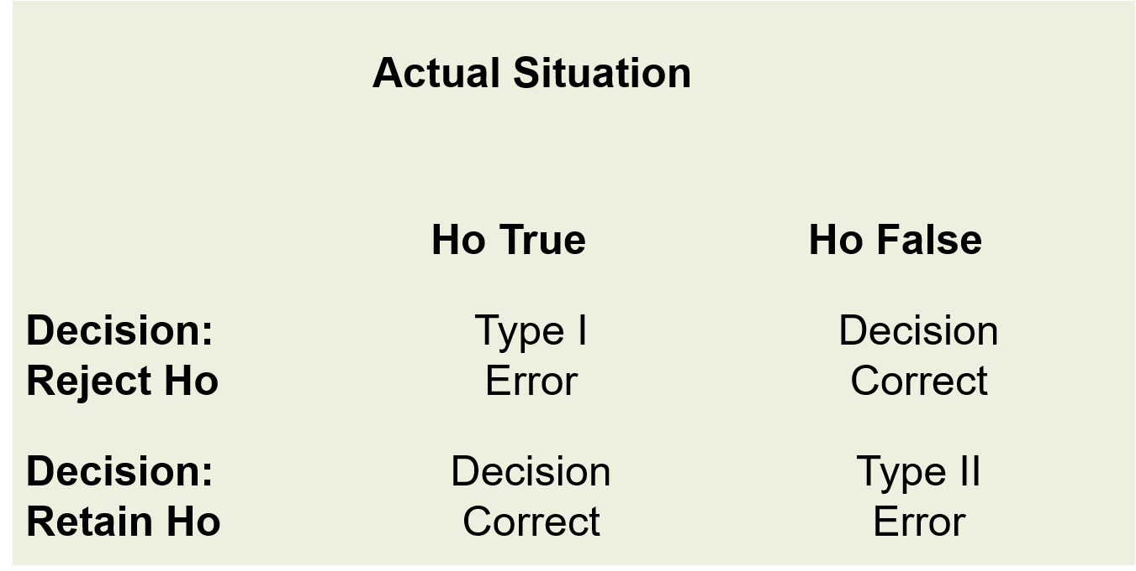
Errors in hypothesis testing
Types of errors in hypothesis testing

Slide 13
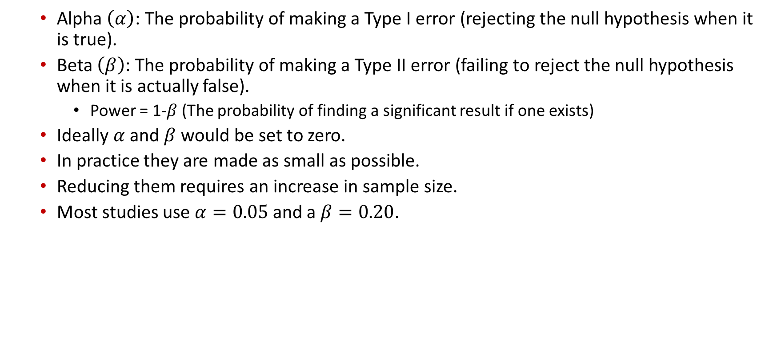
Alpha and Beta
Alpha $\left(α\right)$: The probability of making a Type I error (rejecting the null hypothesis when it is true).
Beta $\left(β\right)$: The probability of making a Type II error (failing to reject the null hypothesis when it is actually false).
Power = 1-$β$ (The probability of finding a significant result if one exists)
Ideally $α$ and $β$ would be set to zero.
In practice they are made as small as possible.
Reducing them requires an increase in sample size.
Most studies use $α=0.05$ and a $β=0.20$.

Slide 14
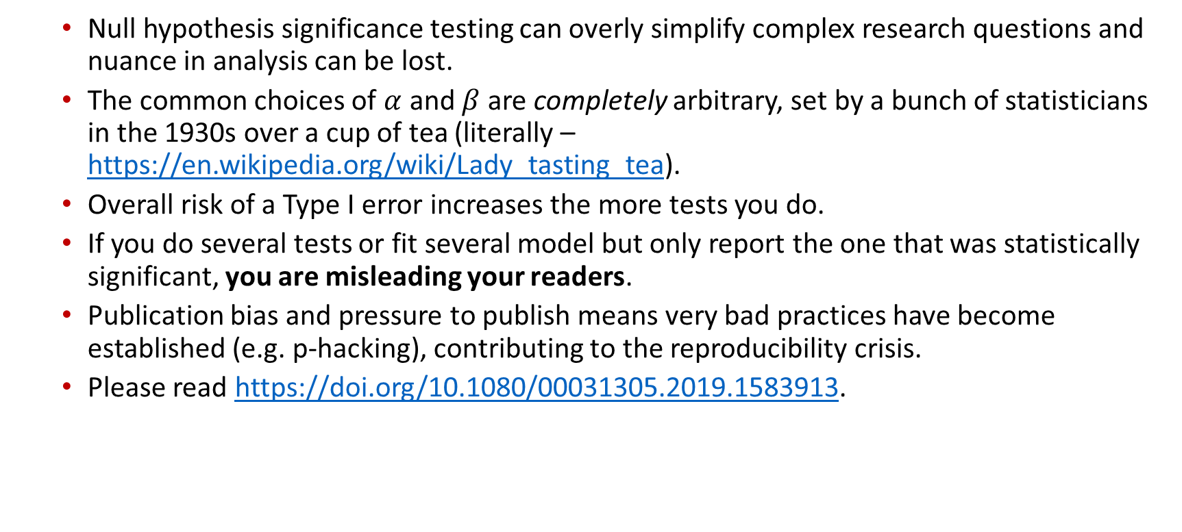
Word of warning: to p or not to p
Null hypothesis significance testing can overly simplify complex research questions and nuance in analysis can be lost.
The common choices of $α$ and $β$ are completely arbitrary, set by a bunch of statisticians in the 1930s over a cup of tea (literally – https://en.wikipedia.org/wiki/Lady_tasting_tea).
Overall risk of a Type I error increases the more tests you do.
If you do several tests or fit several model but only report the one that was statistically significant, you are misleading your readers.
Publication bias and pressure to publish means very bad practices have become established (e.g. p-hacking), contributing to the reproducibility crisis.
Please read https://doi.org/10.1080/00031305.2019.1583913.

Slide 15

Sample size considerations
Sample size calculations may be based on the precision (descriptive studies) or the power (analytical studies) of a study.
Sample size is the number of units in each group in a study that you need to recruit to have a reasonable chance to establish an association between 2 variables if that association exists or to estimate a given parameter with a minimum desired precision.
Precision refers to the desired width of the confidence interval for a sample estimate.
Power = 1-$β$ (The probability of finding a significant result if one exists)

Slide 16
Data for the session
Read in the data that was previously shared:
btTBreg.csv
adolescent_small.csv
The data are in CSV format
df1 <- read.csv("datasets/btTBreg.csv",header = TRUE) df2 <- read.csv("datasets/adolescent_small.csv",header = TRUE)

Slide 17
Outline
Key principles
Parametric tests
One- and two-sample t-test
Paired t-test
One-way analysis of variance (ANOVA)
Chi-squared test
One- and two-sample tests for proportions
Non-parametric tests
Wilcoxon one-sample signed rank and two-sample rank-sum test
Paired Wilcoxon signed rank test
Kruskal-Wallis test
Fisher’s exact test
Permutation tests
Use of p-values in statistics

Slide 18
Key principles

Slide 19
Uncertainity
Any data we collect is noisy: inherent uncertainty, measurement error, unobserved latent factors, …
If we want to do statistical inference, we need to quantify the uncertainty so that we can assess whether any effects we see are likely to be real or simply due to random error / chance.
For example: collect data on a certain continuous variable in 2 different groups of individuals. The sample means of the 2 groups will always be at least slightly different. We need a way to quantify whether that difference is a real difference or just in line with what to expect given the stochastic nature of data observation.
This is where we use the tools of probability theory.

Slide 20
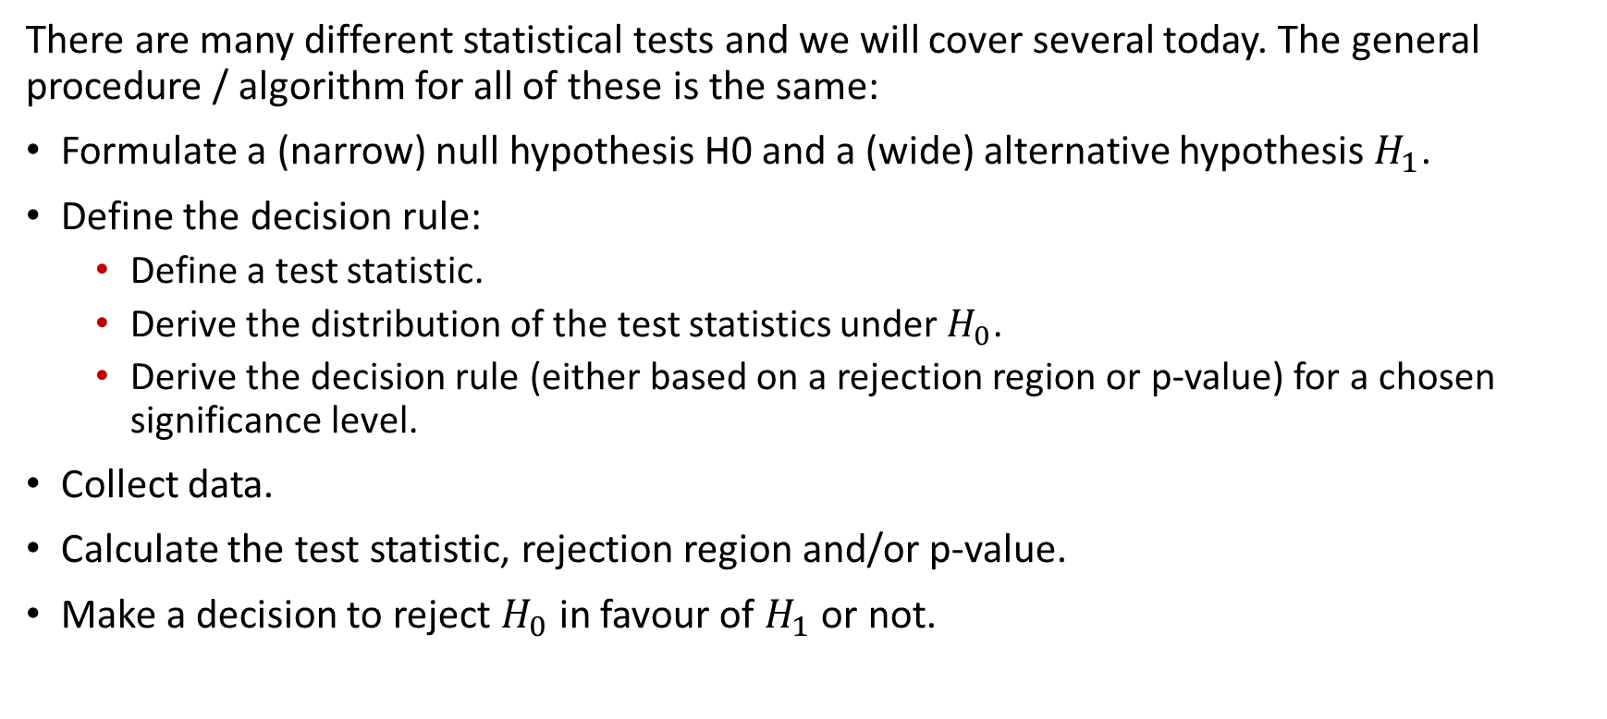
General procedure
There are many different statistical tests and we will cover several today. The general procedure / algorithm for all of these is the same:
Formulate a (narrow) null hypothesis H0 and a (wide) alternative hypothesis $H_{1}$.
Define the decision rule:
Define a test statistic.
Derive the distribution of the test statistics under $H_{0}$.
Derive the decision rule (either based on a rejection region or p-value) for a chosen significance level.
Collect data.
Calculate the test statistic, rejection region and/or p-value.
Make a decision to reject $H_{0}$ in favour of $H_{1}$ or not.

Slide 21
When can hypothesis testing be used
Hypothesis testing can be done in different scenarios:
Is there a difference in means?
Is there a difference in proportions?
Difference in odds ratios or relative risks?
Is a slope of a regression line different from 0?

Slide 22
Null and alternative hypotheses
Null hypothesis
Narrow (in two-sided tests) - test statistic takes a single, specific value.
Usually the hypothesis of no effect / association / difference.
Alternative hypothesis
Wide - test statistic can take a large range of values.
Often the hypothesis held by the researcher.
Is the opposite of the null hypothesis.

Slide 23
Statistical hypothesis
Definition:
Definition: A supposition, arrived at from observation or reflection, that leads to refutable predictions
Any claim cast in a form that will allow it to be tested and refuted
A statement that we make about a population parameter that can be tested after drawing a sample.
For example, one can hypothesize that the average age at first marriage among girls in Blantyre rural is 20.
A new mosquito trap is more effective than the standard trap.
This hypothesis has to be tested and conclusion made.

Slide 24
Steps in hypothesis testing
Come up with the hypothesis
Formulate the hypothesis – both null and alternative
Set the decision rule
Collect data
Calculate the test statistics.
Construct rejection regions.
Obtain p-value based on a known distribution and make decision.
Interpret p-value and make conclusion.

Slide 25
Statistical hypothesis testing
Is there a statistically significant “difference”?
OR “effect”, or “association” or “relationship”.
Is the observed difference due to chance?

Slide 26
When can hypothesis testing be used
Hypothesis testing can be done in different scenarios
Is there a difference in means
Is there a difference in proportions
Difference in odds ratios or relative risks

Slide 27
Null and alternative hypotheses
Null hypothesis
Narrow (in two-sided tests) - test statistic takes a single, specific value.
Usually the hypothesis of no effect / association / difference.
Alternative hypothesis
Wide - test statistic can take a large range of values.
Often the hypothesis held by the researcher.
Is the opposite of the null hypothesis.

Slide 28
Parametric tests

Slide 29
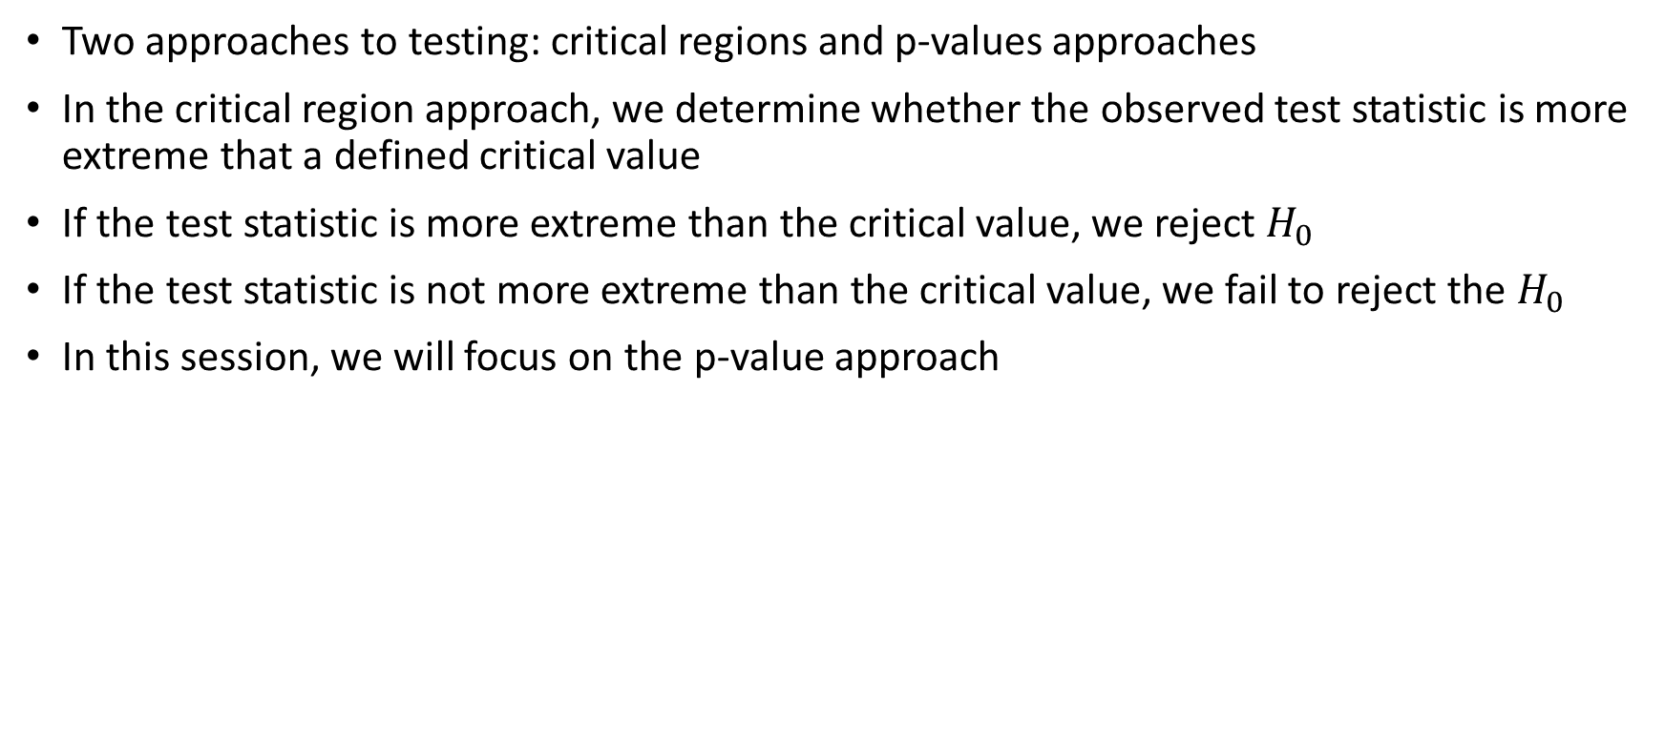
A note on hypothesis testing
Two approaches to testing: critical regions and p-values approaches
In the critical region approach, we determine whether the observed test statistic is more extreme that a defined critical value
If the test statistic is more extreme than the critical value, we reject $H_{0}$
If the test statistic is not more extreme than the critical value, we fail to reject the $H_{0}$
In this session, we will focus on the p-value approach

Slide 30
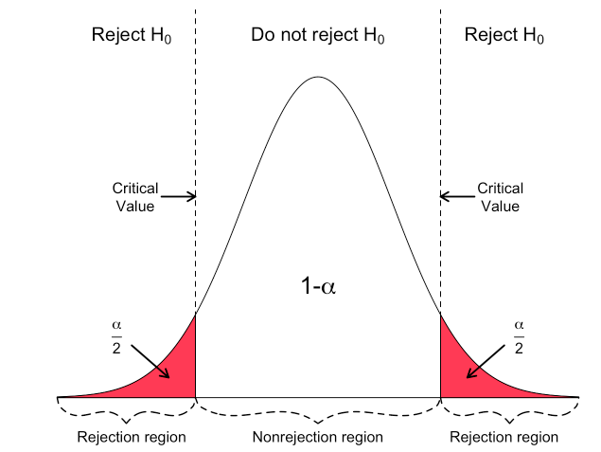
A note on hypothesis testing
Hartmann, K., Krois, J., Waske, B. (2018): E-Learning Project SOGA: Statistics and Geospatial Data Analysis. Department of Earth Sciences, Freie Universitaet Berlin.

Slide 31
One-sample t test
This test is used to check whether a sample mean is different from a known/hypothesized mean
How different is the sample mean from the true population mean
Continuous data
Assumptions:
Random sample from the population
The data must be continuous
Data must follow the normal distribution

Slide 32
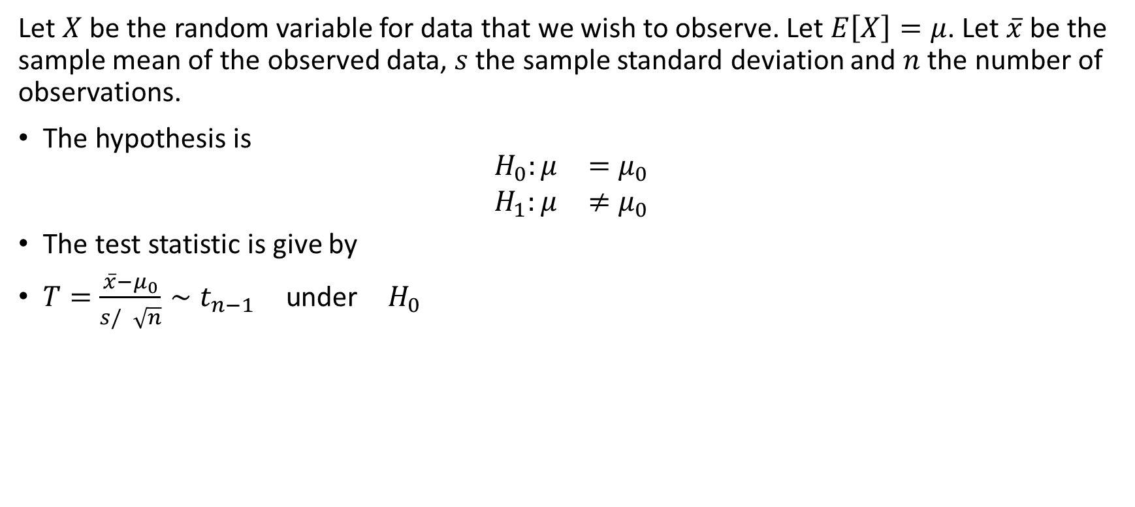
One-sample t test
Let $X$ be the random variable for data that we wish to observe. Let $E\left[X\right]=μ$. Let $\overset{‾}{x}$ be the sample mean of the observed data, $s$ the sample standard deviation and $n$ the number of observations.
The hypothesis is
$$\begin{matrix}H_{0}:μ & =μ_{0} \\ H_{1}:μ & ≠μ_{0}\end{matrix}$$
The test statistic is give by
$T=\frac{\overset{‾}{x}−μ_{0}}{s/\sqrt{n}}∼t_{n−1} \text{under} H_{0}$

Slide 33

One-sample t test
Suppose we want to test the hypothesis that the mean age is 24
$$H_{0}:μ=24$$
$$H_{1}:μ≠24$$
This is a two-sided test.

Slide 34
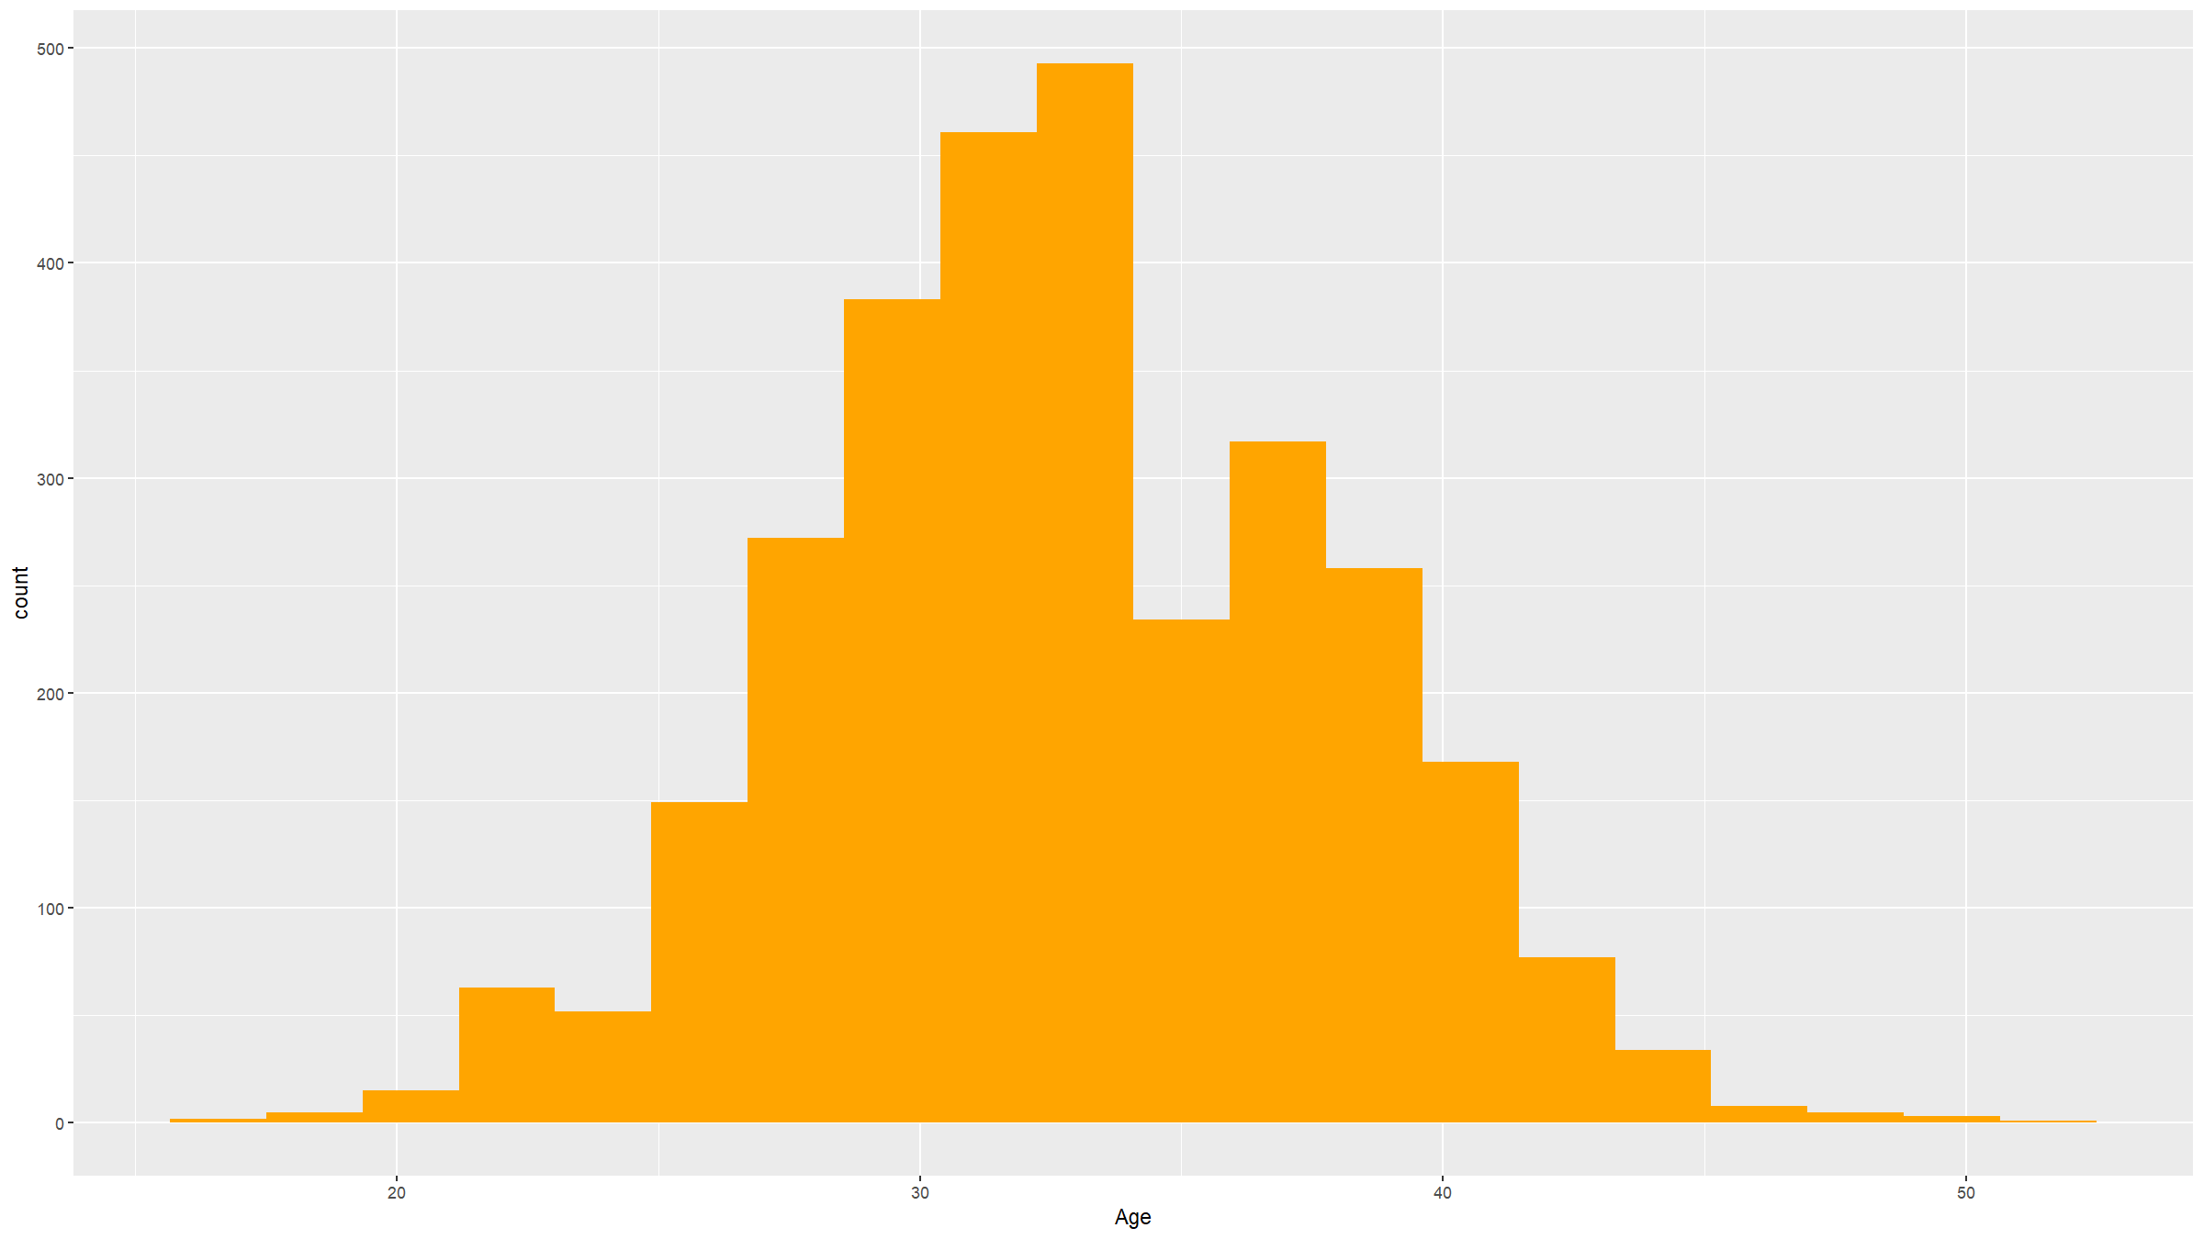
Check the assumptions
Histogram to check normality.
df1 %>% ggplot(mapping=aes(x=age)) + geom_histogram(bins=20,fill="#ffa500") + xlab("Age")

Slide 35
One sample t-test
t.test(df1$age,mu=24)
## ## One Sample t-test ## ## data: df1$age ## t = 98.616, df = 2999, p-value < 2.2e-16 ## alternative hypothesis: true mean is not equal to 24 ## 95 percent confidence interval: ## 32.76225 33.11775 ## sample estimates: ## mean of x ## 32.94

Slide 36
One sample t-test - one sided
Specift “greater” or “less”
t.test(df1$age,mu=24,alternative="less")
## ## One Sample t-test ## ## data: df1$age ## t = 98.616, df = 2999, p-value = 1 ## alternative hypothesis: true mean is less than 24 ## 95 percent confidence interval: ## -Inf 33.08916 ## sample estimates: ## mean of x ## 32.94

Slide 37
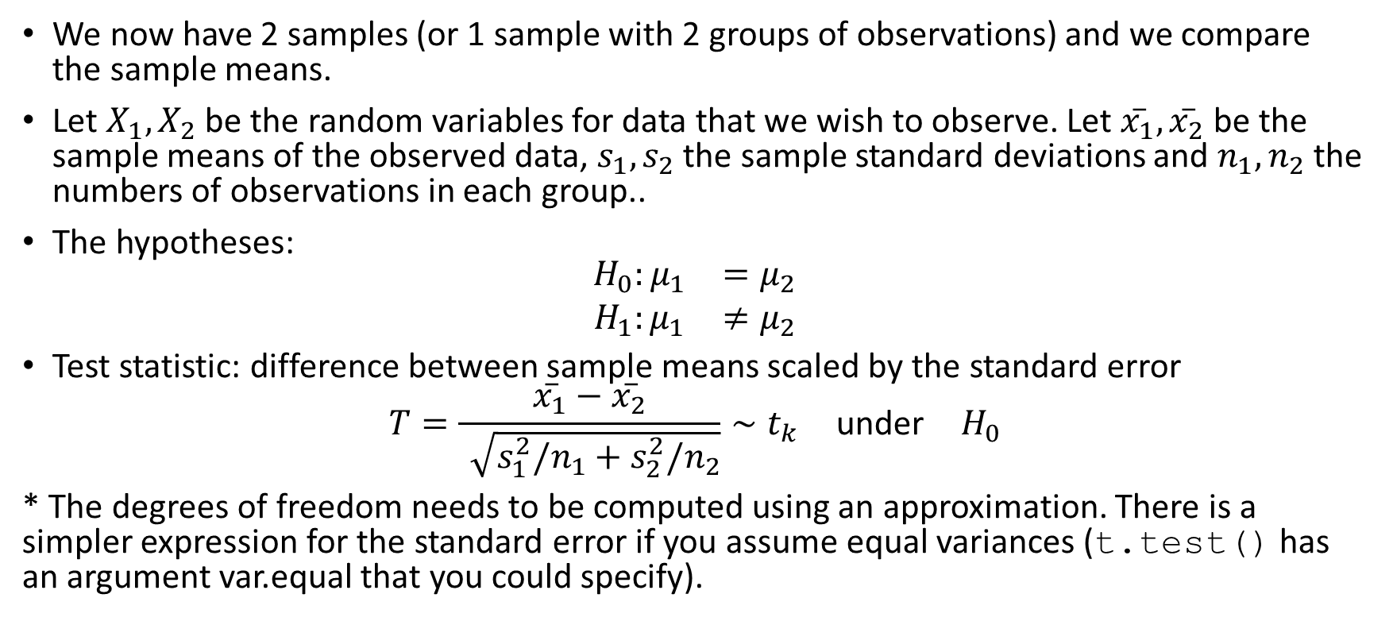
Two sample t-test
We now have 2 samples (or 1 sample with 2 groups of observations) and we compare the sample means.
Let $X_{1},X_{2}$ be the random variables for data that we wish to observe. Let $\overset{‾}{x_{1}},\overset{‾}{x_{2}}$ be the sample means of the observed data, $s_{1},s_{2}$ the sample standard deviations and $n_{1},n_{2}$ the numbers of observations in each group..
The hypotheses:
$$\begin{matrix}H_{0}:μ_{1} & =μ_{2} \\ H_{1}:μ_{1} & ≠μ_{2}\end{matrix}$$
Test statistic: difference between sample means scaled by the standard error
$$T=\frac{\overset{‾}{x_{1}}−\overset{‾}{x_{2}}}{\sqrt{s_{1}^{2}/n_{1}+s_{2}^{2}/n_{2}}}∼t_{k} \text{under} H_{0}$$
* The degrees of freedom needs to be computed using an approximation. There is a simpler expression for the standard error if you assume equal variances (t.test() has an argument var.equal that you could specify).

Slide 38
Two sample t-test
Assumptions
The data are continuous
The data must follow a normal distribution
The two samples are independent
Both samples are random samples of the respective underlying population
The variances within the two groups are equal (homoscedasticity)

Slide 39

Two sample t-test
In the dataset provided, it is hypothesized that the mean age is the same for both men and women.
We can test this hypothesis
$$H_{0}:μ_{1}=μ_{2}$$
$$H_{1}:μ_{1}≠μ_{2}$$

Slide 40
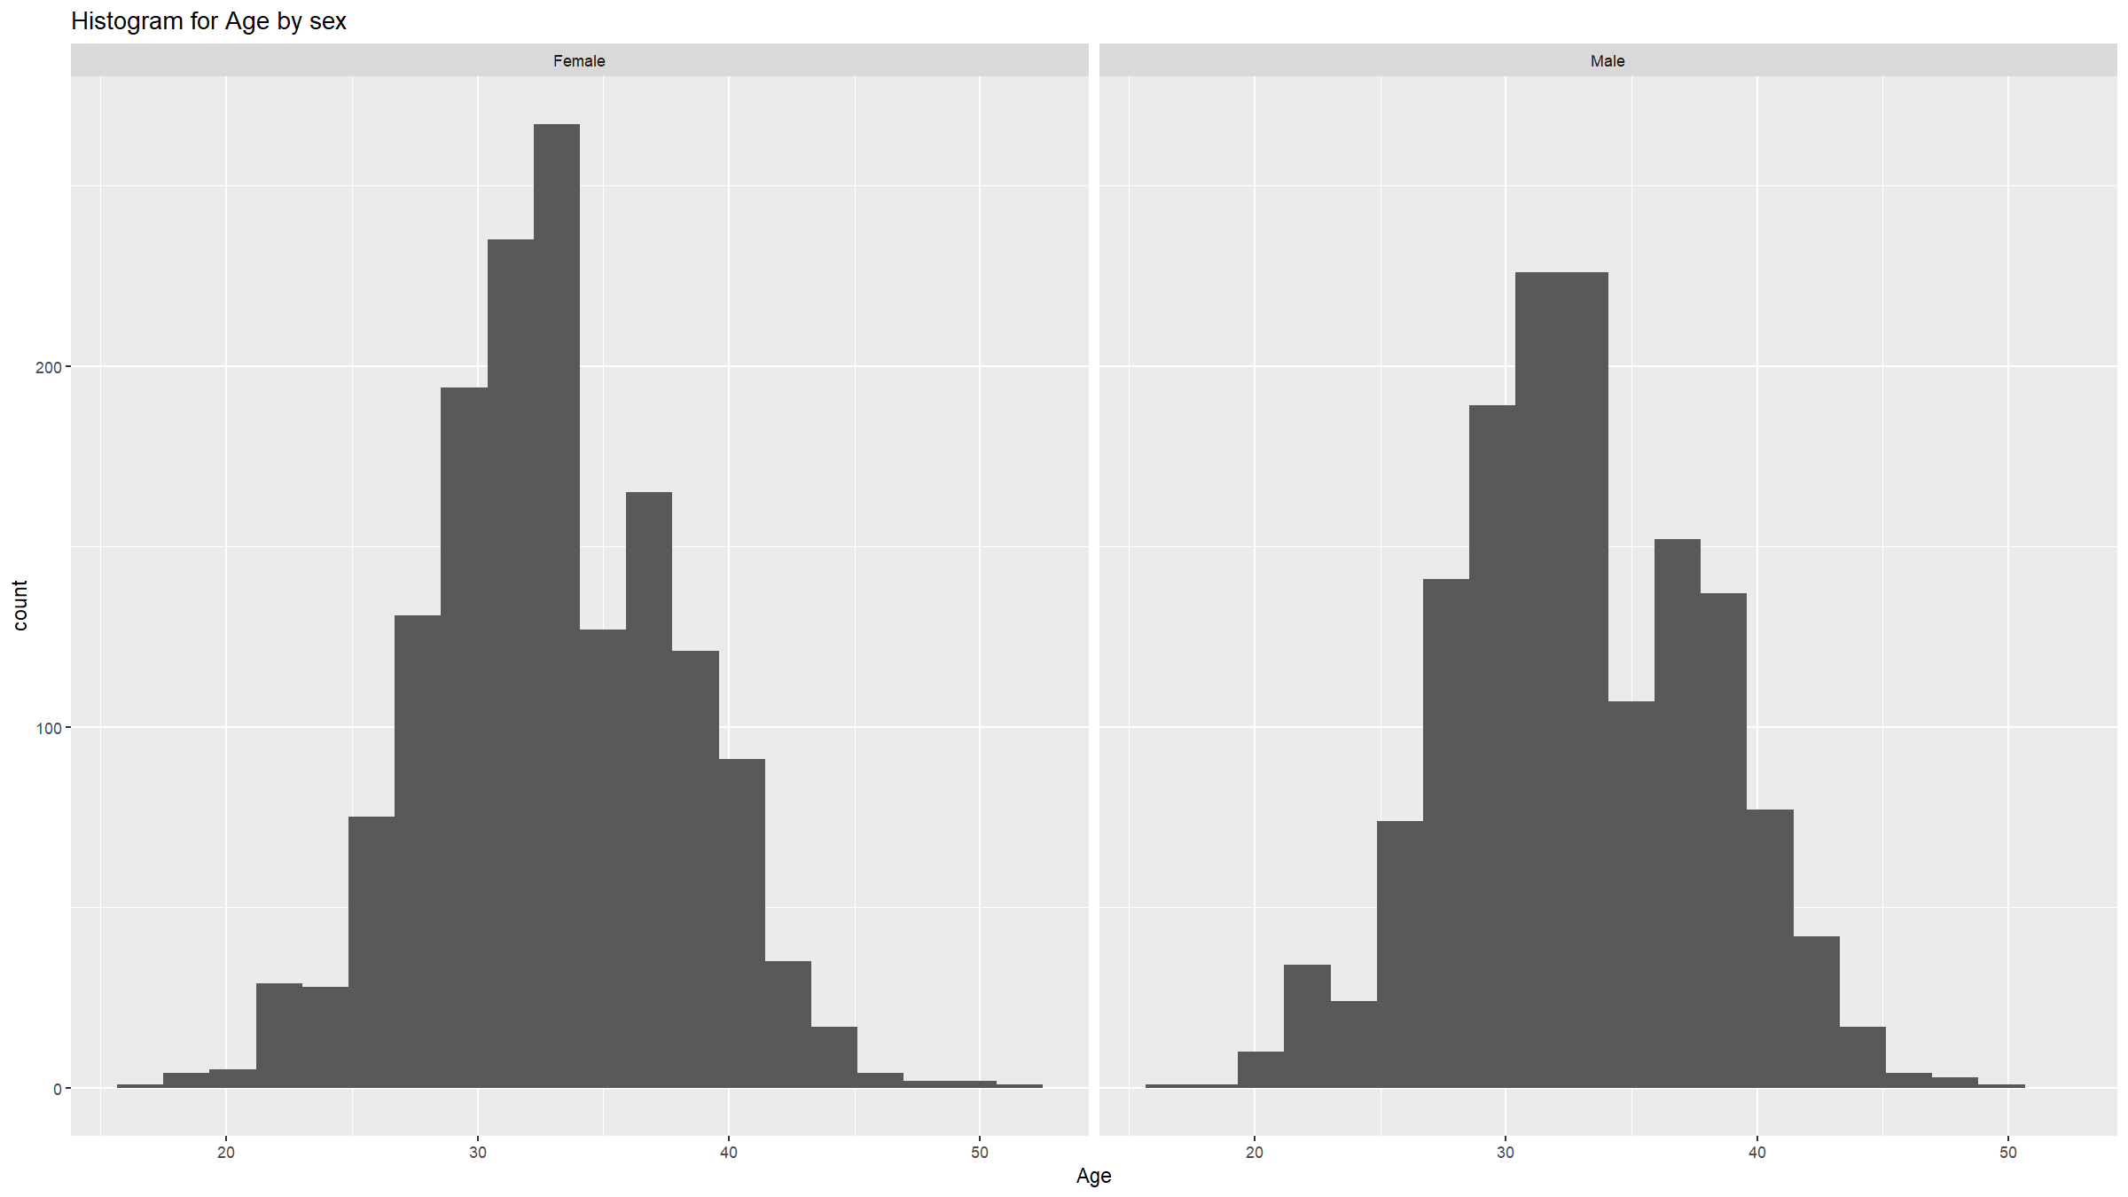
Assumptions
Check if the two populations are normally distributed.
df1 %>% ggplot(mapping=aes(x=age)) + geom_histogram(bins=20) + labs(title="Histogram for Age by sex") + xlab("Age") + facet_wrap(~ifelse(sex==1,"Male","Female"))

Slide 41
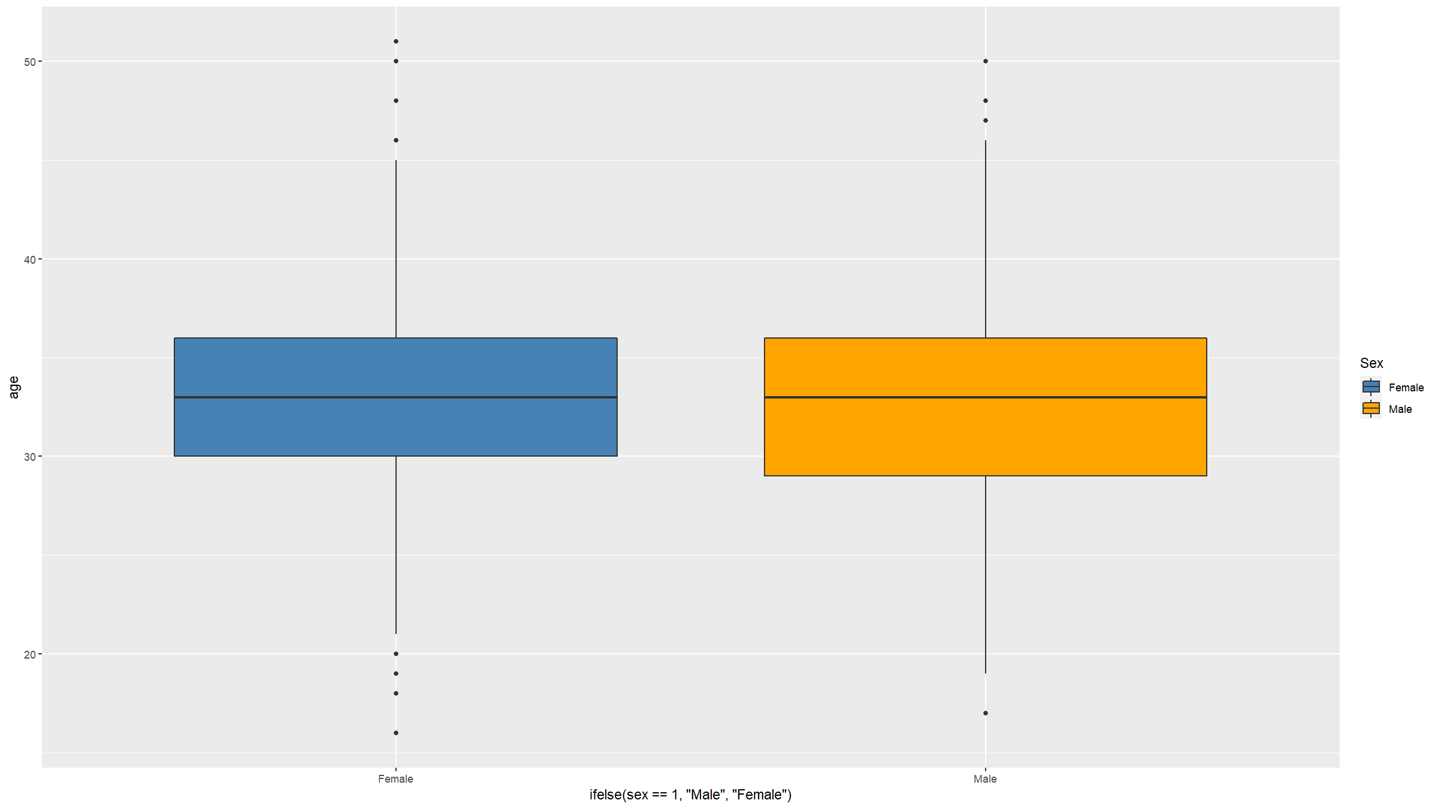
Assumptions
Check if the variances are the same
df1 %>% ggplot(mapping=aes(x=ifelse(sex==1,"Male","Female"),y=age,fill=ifelse(sex==1,"Male","Female"))) + scale_fill_manual(values=c("steelblue","orange"),name="Sex") + geom_boxplot()

Slide 42
Two sample t-test
t.test(age~sex,data=df1)
## ## Welch Two Sample t-test ## ## data: age by sex ## t = -0.69127, df = 2982.6, p-value = 0.4895 ## alternative hypothesis: true difference in means between group 1 and group 2 is not equal to 0 ## 95 percent confidence interval: ## -0.4812899 0.2303877 ## sample estimates: ## mean in group 1 mean in group 2 ## 32.87585 33.00130

Slide 43
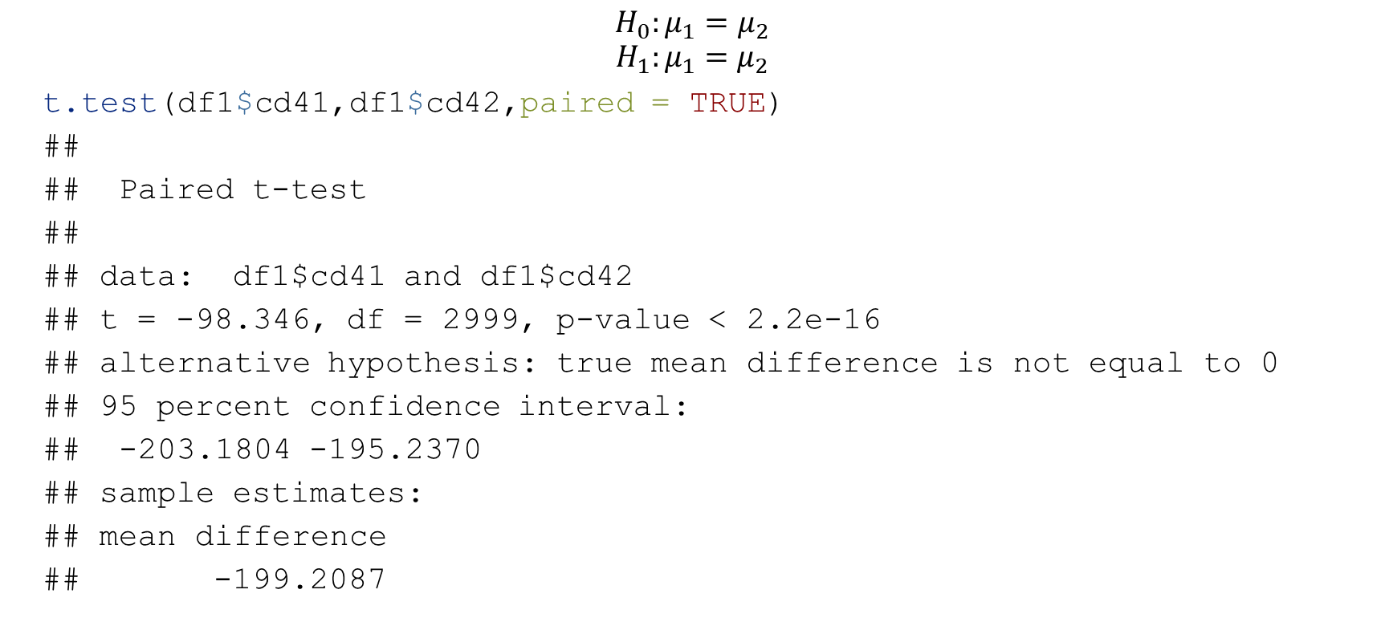
Paired t-test
$$H_{0}:μ_{1}=μ_{2}$$
$$H_{1}:μ_{1}=μ_{2}$$
t.test(df1$cd41,df1$cd42,paired = TRUE)
## ## Paired t-test ## ## data: df1$cd41 and df1$cd42 ## t = -98.346, df = 2999, p-value < 2.2e-16 ## alternative hypothesis: true mean difference is not equal to 0 ## 95 percent confidence interval: ## -203.1804 -195.2370 ## sample estimates: ## mean difference ## -199.2087

Slide 44
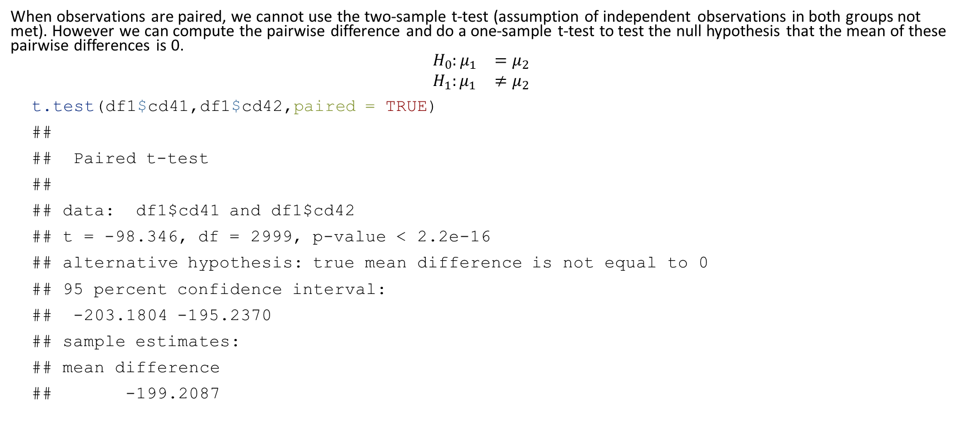
Paired t test
When observations are paired, we cannot use the two-sample t-test (assumption of independent observations in both groups not met). However we can compute the pairwise difference and do a one-sample t-test to test the null hypothesis that the mean of these pairwise differences is 0.
$$\begin{matrix}H_{0}:μ_{1} & =μ_{2} \\ H_{1}:μ_{1} & ≠μ_{2}\end{matrix}$$
t.test(df1$cd41,df1$cd42,paired = TRUE)
## ## Paired t-test ## ## data: df1$cd41 and df1$cd42 ## t = -98.346, df = 2999, p-value < 2.2e-16 ## alternative hypothesis: true mean difference is not equal to 0 ## 95 percent confidence interval: ## -203.1804 -195.2370 ## sample estimates: ## mean difference ## -199.2087

Slide 45
Comparing means - more than one group
Sometimes we want to compare means of a variable in more than 2 groups
For example, we might want to compare the mean CD4 among the 5 hospitals.
Use one way analysis of variance (anova)
Based on assumptions:
Data within the groups follows a normal distribution
Equal variation within groups
Independent and identically distributed variables

Slide 46
One-way anova
A total of 3000 study participants were recruited in 5 hospitals providing ART. Each participant’s CD4 count upon entry into study was measured. We would like to investigate whether there is a difference in mean CD4 count at the entry into the study across the 5 participating facilities. State the hypothesis to be tested and your conclusion.

Slide 47

One-way anova
$$\begin{matrix}H_{0}:μ_{1} & =μ_{2}=μ_{3}=μ_{4}=μ_{5} \\ H_{1}:μ_{i} & ≠μ_{j} \text{for} \text{some} i,j\end{matrix}$$
oneway.test(cd41 ~ hosp, data = df1)
## ## One-way analysis of means (not assuming equal variances) ## ## data: cd41 and hosp ## F = 0.22905, num df = 4, denom df = 1496, p-value = 0.9222

Slide 48
One-way anova
res.hosp <- aov(cd41 ~ factor(hosp), data = df1) summary(res.hosp)
## Df Sum Sq Mean Sq F value Pr(>F) ## factor(hosp) 4 2204 551.1 0.229 0.922 ## Residuals 2995 7194212 2402.1

Slide 49
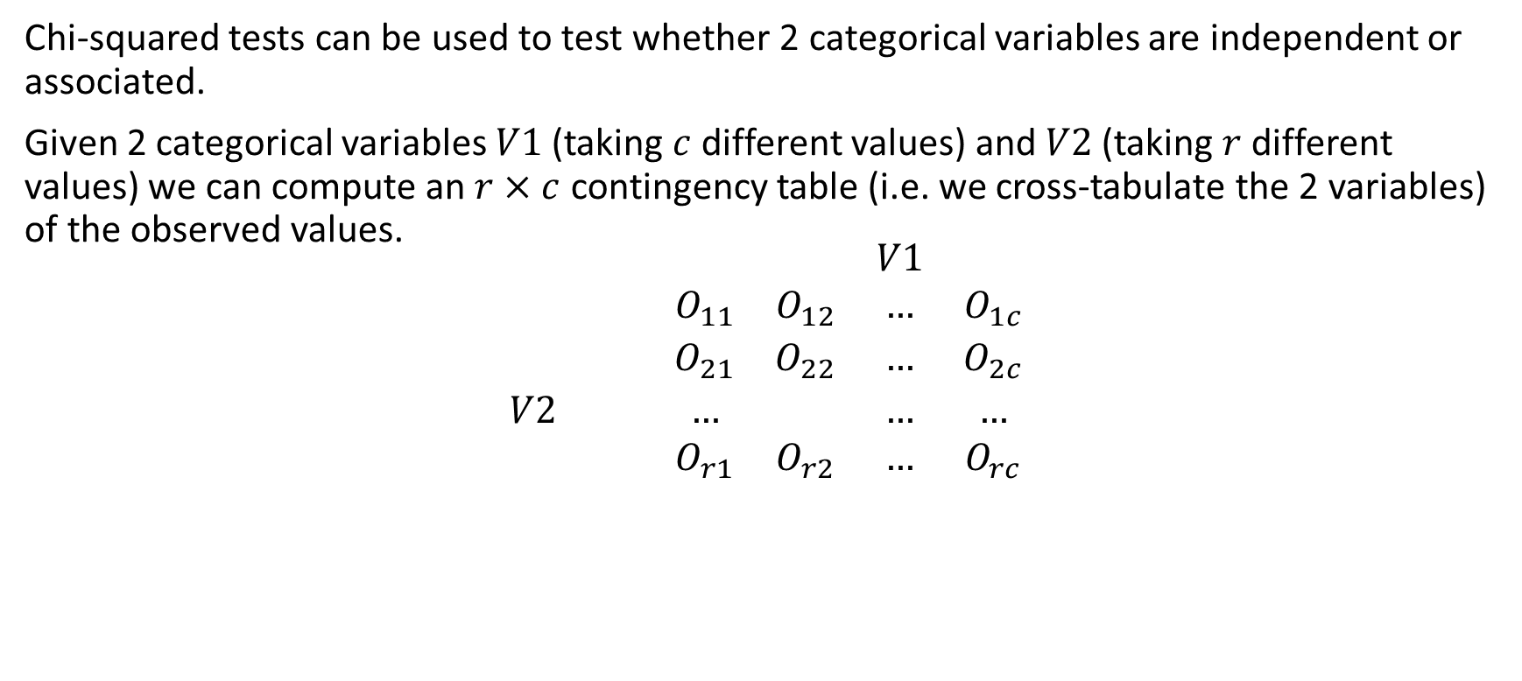
Chi-squared test
Chi-squared tests can be used to test whether 2 categorical variables are independent or associated.
Given 2 categorical variables $V1$ (taking $c$ different values) and $V2$ (taking $r$ different values) we can compute an $r×c$ contingency table (i.e. we cross-tabulate the 2 variables) of the observed values.
$$\begin{matrix} & & & & V1 & \\ & & O_{11} & O_{12} & … & O_{1c} \\ & & O_{21} & O_{22} & … & O_{2c} \\ V2 & & … & & … & … \\ & & O_{r1} & O_{r2} & … & O_{rc}\end{matrix}$$

Slide 50
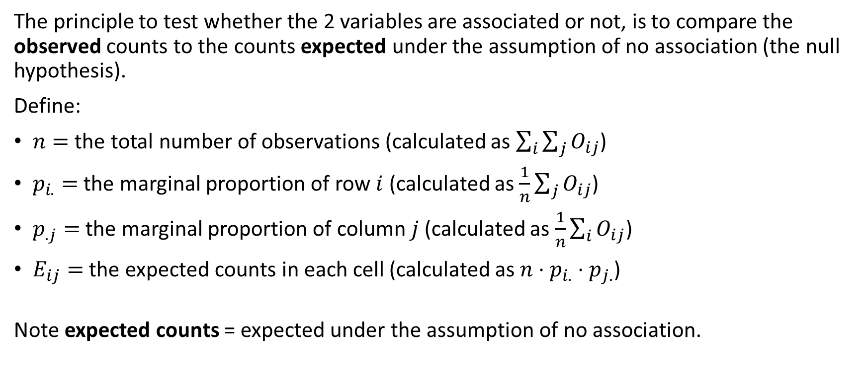
Chi-squared test
The principle to test whether the 2 variables are associated or not, is to compare the observed counts to the counts expected under the assumption of no association (the null hypothesis).
Define:
$n=$ the total number of observations (calculated as $\sum_{i}^{​}{\sum_{j}^{​}{O_{ij}}}$)
$p_{i.}=$ the marginal proportion of row $i$ (calculated as $\frac{1}{n}\sum_{j}^{​}{O_{ij}}$)
$p_{.j}=$ the marginal proportion of column $j$ (calculated as $\frac{1}{n}\sum_{i}^{​}{O_{ij}}$)
$E_{ij}=$ the expected counts in each cell (calculated as $n⋅p_{i.}⋅p_{j.}$)
Note expected counts = expected under the assumption of no association.

Slide 51
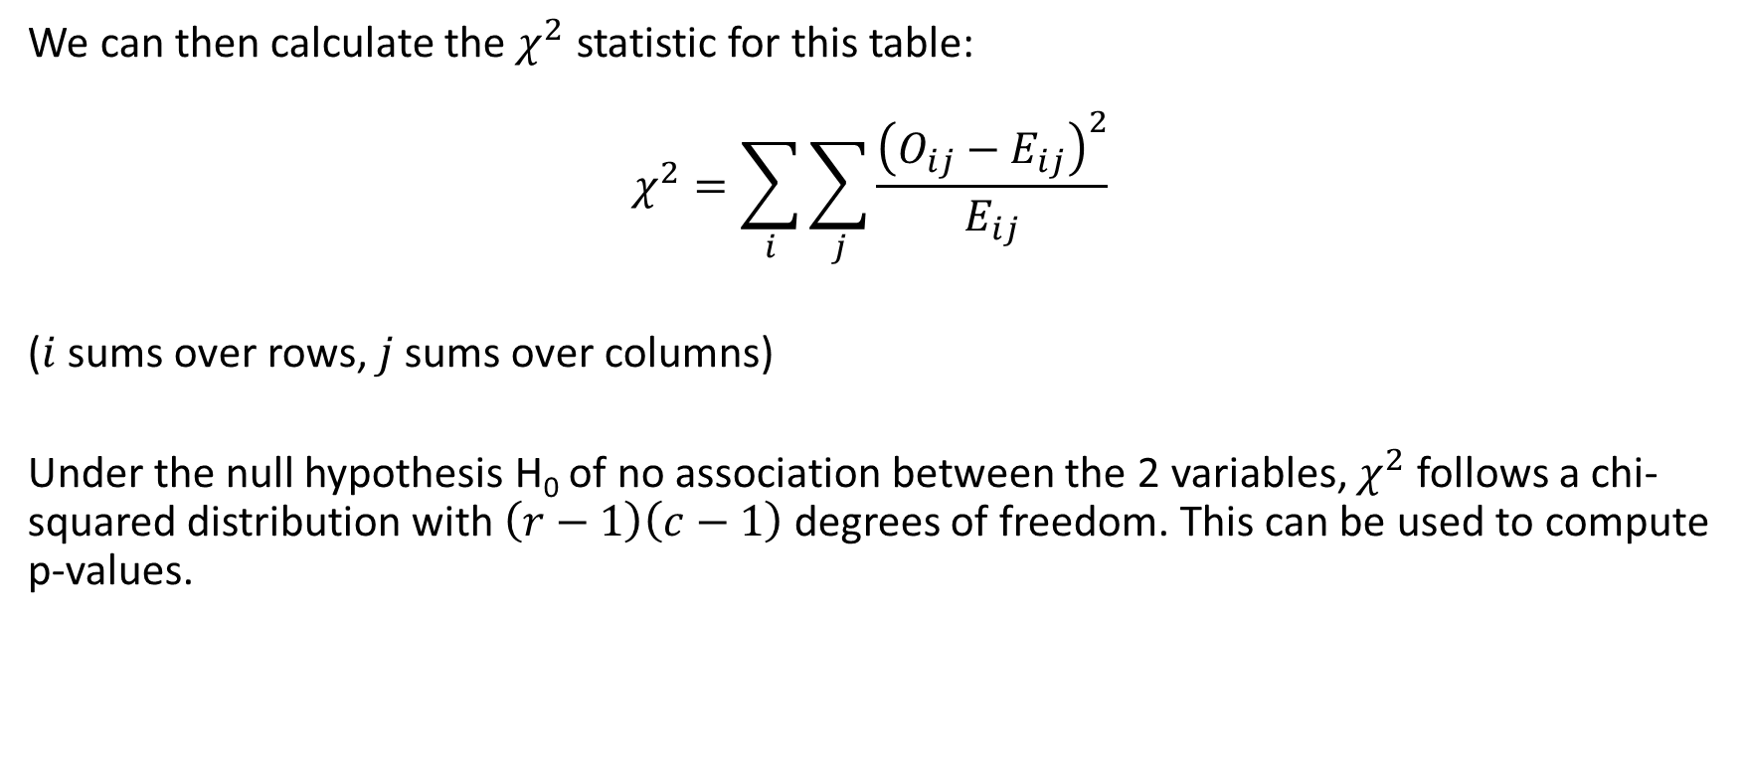
Chi-squared test
We can then calculate the $χ^{2}$ statistic for this table:
$$χ^{2}=\sum_{i}^{​}{\sum_{j}^{​}{\frac{{\left(O_{ij}−E_{ij}\right)}^{2}}{E_{ij}}}}$$
($i$ sums over rows, $j$ sums over columns)
Under the null hypothesis H₀ of no association between the 2 variables, $χ^{2}$ follows a chi-squared distribution with $\left(r−1\right)\left(c−1\right)$ degrees of freedom. This can be used to compute p-values.

Slide 52
Chi-squared test
In R, you can do a chi-squared test using the chisq.test() function.
For example we can check if there is an association between stunting and mortality in the adolescent dataset:
ctest<-chisq.test(table(df2$stunt,df2$died)) ctest
## ## Pearson's Chi-squared test with Yates' continuity correction ## ## data: table(df2$stunt, df2$died) ## X-squared = 7.0641, df = 1, p-value = 0.007864
The p-value is 0.0078644 < 0.05, so we reject the null hypothesis of no association at the 5% significance level.

Slide 53
Chi-squared test
Or we can test the null hypothesis of no association between socio-economic status and hospital in the Blantyre TB dataset:
ctest<-chisq.test(table(df1$ses,df1$hosp)) ctest
## ## Pearson's Chi-squared test ## ## data: table(df1$ses, df1$hosp) ## X-squared = 7.864, df = 16, p-value = 0.9528
Note how the degrees of freedom has changed now. Here the p-value is 0.9528113 > 0.05, so we do not reject H₀.

Slide 54
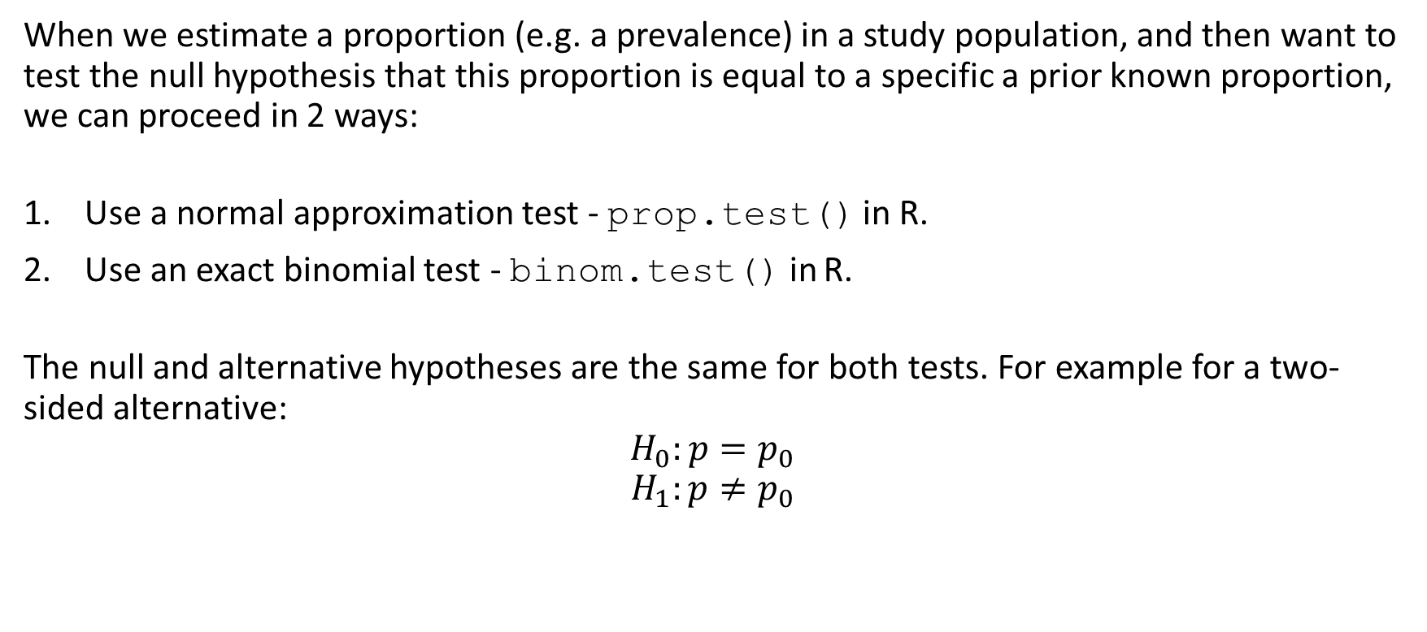
Tests for proportions - one sample test
When we estimate a proportion (e.g. a prevalence) in a study population, and then want to test the null hypothesis that this proportion is equal to a specific a prior known proportion, we can proceed in 2 ways:
Use a normal approximation test - prop.test() in R.
Use an exact binomial test - binom.test() in R.
The null and alternative hypotheses are the same for both tests. For example for a two-sided alternative:
$$H_{0}:p=p_{0}$$
$$H_{1}:p≠p_{0}$$

Slide 55

Tests for proportions - one sample test
The normal approximation test uses the following test statistic:
$$T=\frac{p−p_{0}}{\sqrt{p_{0}\left(1−p_{0}\right)/n}}∼N\left(0,1\right) \text{under} H_{0}$$

Slide 56
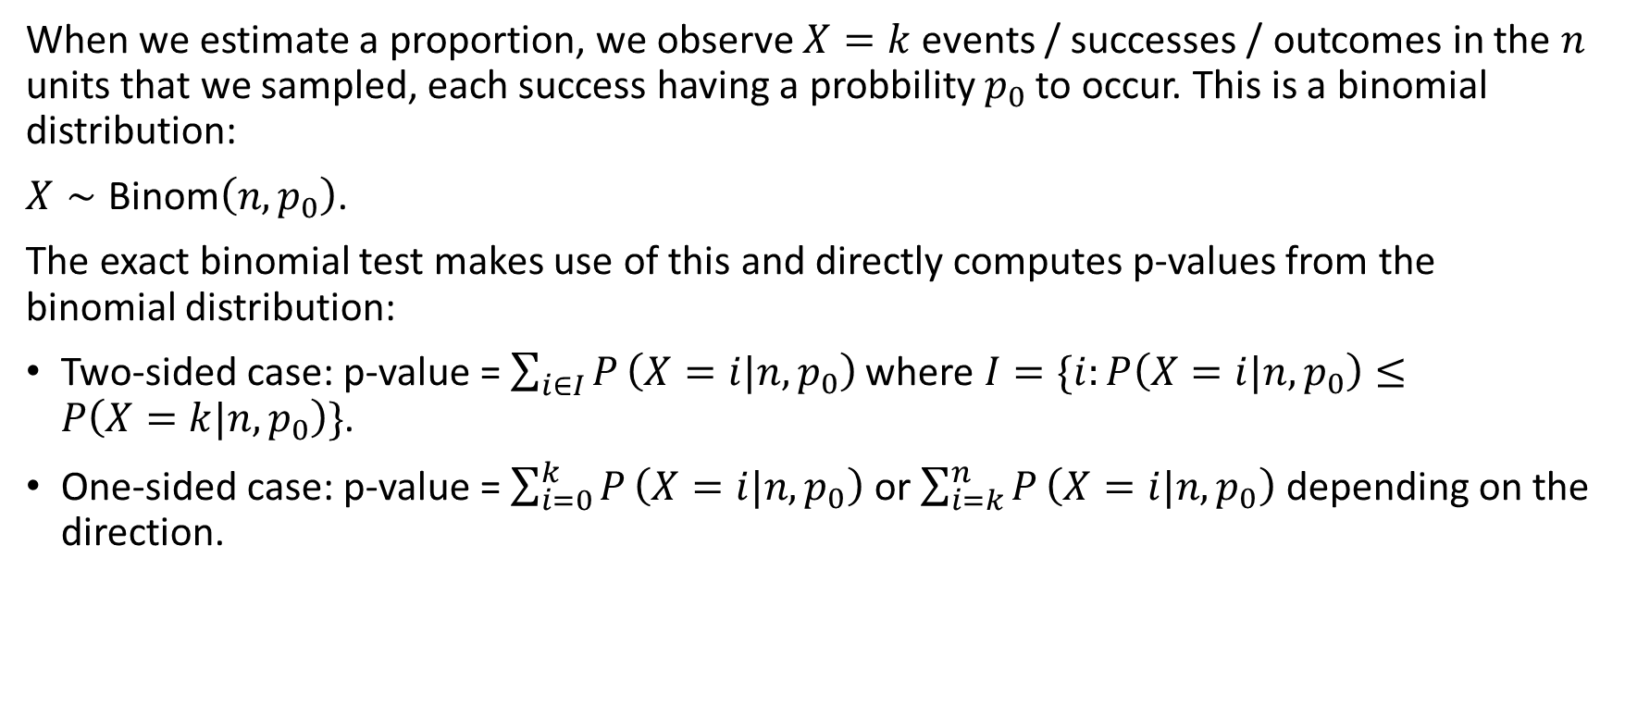
Tests for proportions - one sample test
When we estimate a proportion, we observe $X=k$ events / successes / outcomes in the $n$ units that we sampled, each success having a probbility $p_{0}$ to occur. This is a binomial distribution:
$X∼\text{Binom}\left(n,p_{0}\right)$.
The exact binomial test makes use of this and directly computes p-values from the binomial distribution:
Two-sided case: p-value = $\sum_{i∈I}^{​}{P}\left(X=i|n,p_{0}\right)$ where $I=\{i:P\left(X=i|n,p_{0}\right)≤P\left(X=k|n,p_{0}\right)\}$.
One-sided case: p-value = $\sum_{i=0}^{k}{P}\left(X=i|n,p_{0}\right)$ or $\sum_{i=k}^{n}{P}\left(X=i|n,p_{0}\right)$ depending on the direction.

Slide 57
Tests for proportions – one sample test
A recent survey found that approximately 23% of the population in a district are HIV positive. A researcher thinks that the current proportion of the adult population that is HIV+ is greater than 23%. The researcher takes a random sample of 3000 and finds that 560 tested positive. State the hypotheses and your conclusion

Slide 58

Tests for proportions – one sample test
A recent survey found that approximately 23% of the population in a district are HIV positive. A researcher thinks that the current proportion of the adult population that is HIV+ is greater than 23%. The researcher takes a random sample of 3000 and finds that 560 tested positive. State the hypotheses and your conclusion
$$H_{0}:p≤0.23$$
$$H_{1}:p>0.23$$

Slide 59
Tests for proportions – one sample test
prop.test(560,3000,0.23,alternative = "greater")
## ## 1-sample proportions test with continuity correction ## ## data: 560 out of 3000, null probability 0.23 ## X-squared = 31.565, df = 1, p-value = 1 ## alternative hypothesis: true p is greater than 0.23 ## 95 percent confidence interval: ## 0.1750871 1.0000000 ## sample estimates: ## p ## 0.1866667

Slide 60
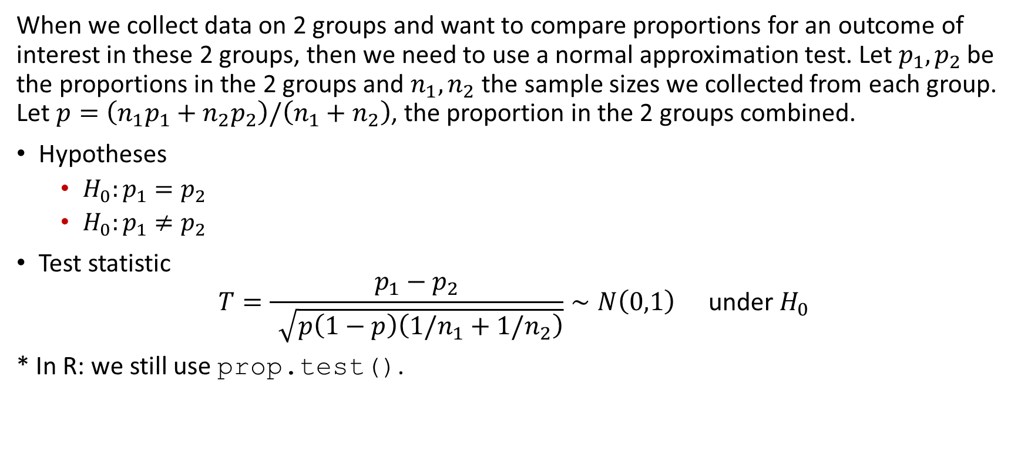
Test of proportion – Two sample tests
When we collect data on 2 groups and want to compare proportions for an outcome of interest in these 2 groups, then we need to use a normal approximation test. Let $p_{1},p_{2}$ be the proportions in the 2 groups and $n_{1},n_{2}$ the sample sizes we collected from each group. Let $p=\left(n_{1}p_{1}+n_{2}p_{2}\right)/\left(n_{1}+n_{2}\right)$, the proportion in the 2 groups combined.
Hypotheses
$H_{0}:p_{1}=p_{2}$
$H_{0}:p_{1}≠p_{2}$
Test statistic
$$T=\frac{p_{1}−p_{2}}{\sqrt{p\left(1−p\right)\left(1/n_{1}+1/n_{2}\right)}}∼N\left(0,1\right) \text{under} H_{0}$$
* In R: we still use prop.test().

Slide 61
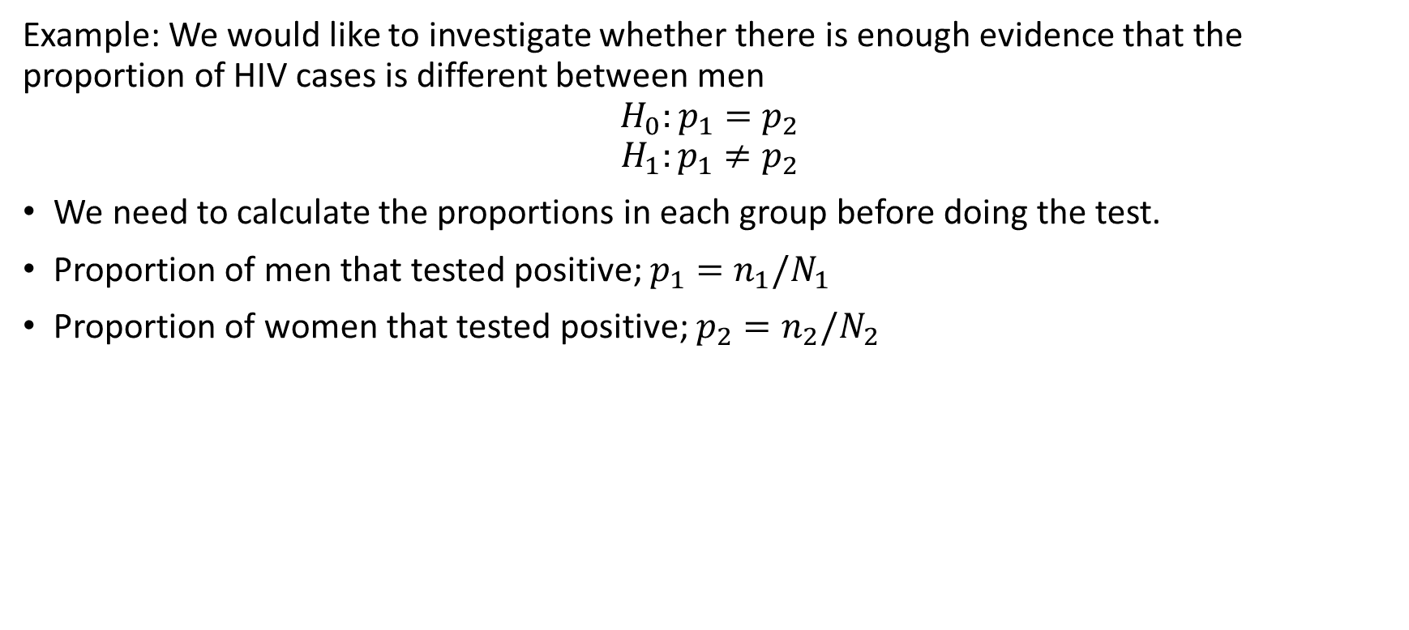
Test of proportion – Two sample tests
Example: We would like to investigate whether there is enough evidence that the proportion of HIV cases is different between men
$$H_{0}:p_{1}=p_{2}$$
$$H_{1}:p_{1}≠p_{2}$$
We need to calculate the proportions in each group before doing the test.
Proportion of men that tested positive; $p_{1}=n_{1}/N_{1}$
Proportion of women that tested positive; $p_{2}=n_{2}/N_{2}$

Slide 62
Test of proportion – Two sample tests
table(df1$sex,df1$hiv)
## ## 0 1 ## 1 1204 262 ## 2 1236 298
prop.test(x=c(262,298),n=c(1466,1534))
## ## 2-sample test for equality of proportions with continuity correction ## ## data: c(262, 298) out of c(1466, 1534) ## X-squared = 1.093, df = 1, p-value = 0.2958 ## alternative hypothesis: two.sided ## 95 percent confidence interval: ## -0.04408002 0.01298849 ## sample estimates: ## prop 1 prop 2 ## 0.1787176 0.1942634

Slide 63
Non-parametric tests

Slide 64
Non-parametric tests
When we cannot make distributional assumptions about the test statistic (i.e. typically when the assumption of normality is not met).
Have non-parametric equivalent for most parametric tests.
These tests still assume randomly sampled, independent and identically distributed observations. It is only the distributional assumption that is no longer made.

Slide 65

Wilcoxon one-sample signed rank test
When assumption of normality of sample mean in the one-sample t-test is violated.
This test compares the median (not the mean) against a fixed value.
Hypotheses (two-sided case):
$H_{0}: \text{median}=m$
$H_{0}: \text{median}≠m$
In R: wilcox.test().

Slide 66
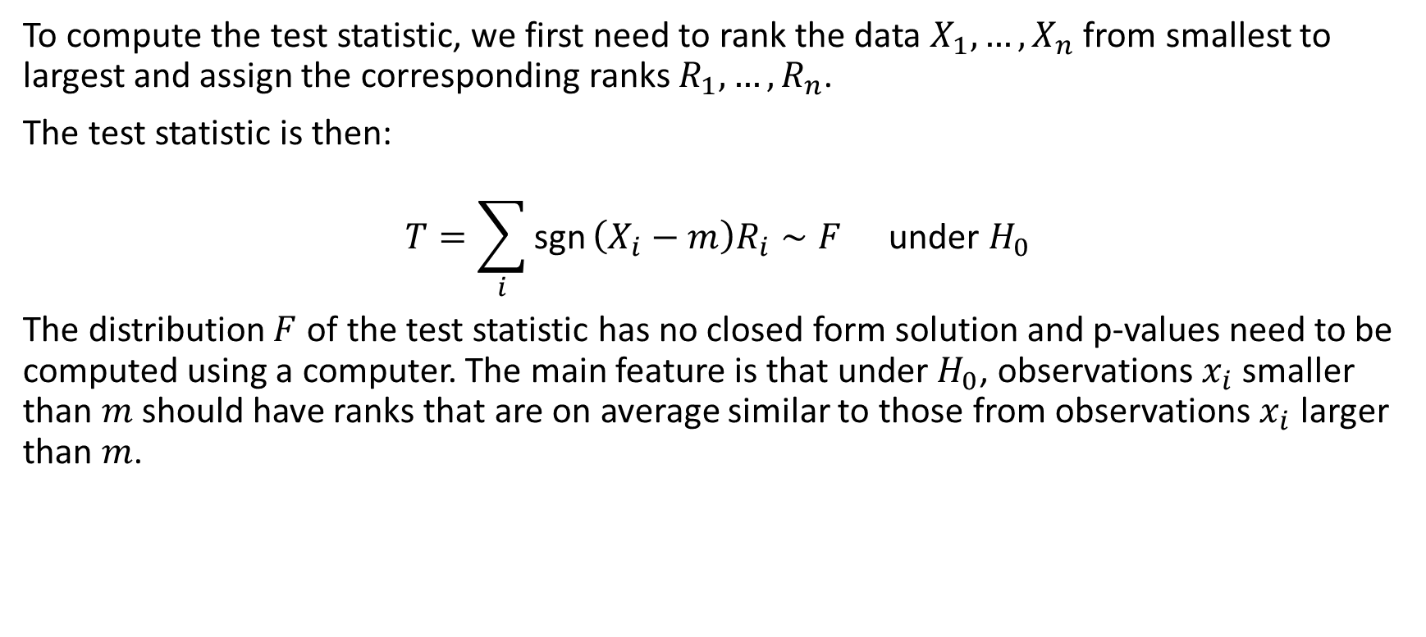
Wilcoxon one-sample signed rank test
To compute the test statistic, we first need to rank the data $X_{1},…,X_{n}$ from smallest to largest and assign the corresponding ranks $R_{1},…,R_{n}$.
The test statistic is then:
$$T=\sum_{i}^{​}{\text{sgn}}\left(X_{i}−m\right)R_{i}∼F \text{under} H_{0}$$
The distribution $F$ of the test statistic has no closed form solution and p-values need to be computed using a computer. The main feature is that under $H_{0}$, observations $x_{i}$ smaller than $m$ should have ranks that are on average similar to those from observations $x_{i}$ larger than $m$.

Slide 67
Wilcoxon one-sample signed rank test
For example, for the adolescent dataset, we can test the null hypothesis that the median weight in the study population is 38kg.
wilcox.test(df2$a104wt,mu=38)
## ## Wilcoxon signed rank test with continuity correction ## ## data: df2$a104wt ## V = 12805, p-value = 0.0001147 ## alternative hypothesis: true location is not equal to 38

Slide 68
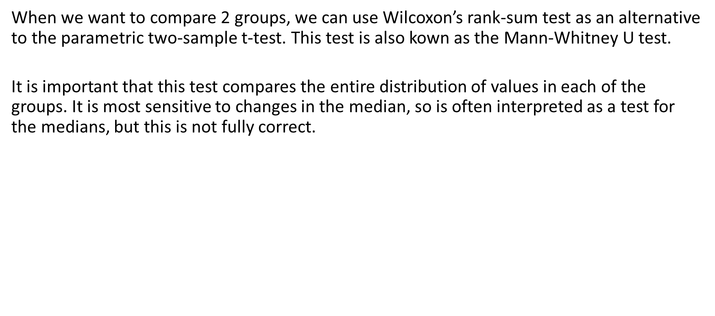
Wilcoxon two-sample rank-sum test
When we want to compare 2 groups, we can use Wilcoxon’s rank-sum test as an alternative to the parametric two-sample t-test. This test is also kown as the Mann-Whitney U test.
It is important that this test compares the entire distribution of values in each of the groups. It is most sensitive to changes in the median, so is often interpreted as a test for the medians, but this is not fully correct.

Slide 69
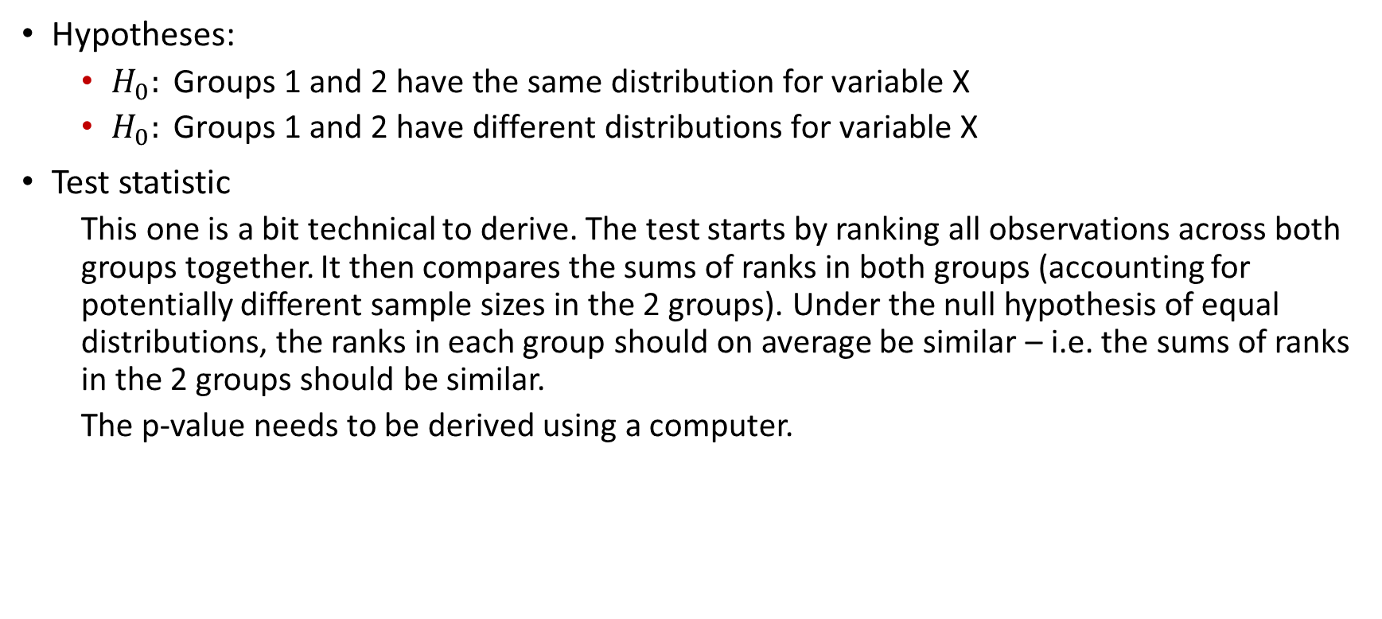
Wilcoxon two-sample rank-sum test
Hypotheses:
$H_{0}: \text{Groups}\text{ 1 }\text{and}\text{ 2 }\text{have} \text{the} \text{same} \text{distribution} \text{for} \text{variable} \text{X}$
$H_{0}: \text{Groups}\text{ 1 }\text{and}\text{ 2 }\text{have} \text{different} \text{distributions} \text{for} \text{variable} \text{X}$
Test statistic
This one is a bit technical to derive. The test starts by ranking all observations across both groups together. It then compares the sums of ranks in both groups (accounting for potentially different sample sizes in the 2 groups). Under the null hypothesis of equal distributions, the ranks in each group should on average be similar – i.e. the sums of ranks in the 2 groups should be similar.
The p-value needs to be derived using a computer.

Slide 70
Wilcoxon two-sample rank-sum test
Example:
Let’s test the null hypothesis that males and females have equal weight distributions in the study population from the adolescent dataset.
wilcox.test(a104wt ~ a13sex,data = df2)
## ## Wilcoxon rank sum test with continuity correction ## ## data: a104wt by a13sex ## W = 9650.5, p-value = 0.1475 ## alternative hypothesis: true location shift is not equal to 0

Slide 71
Wilcoxon paired signed rank test
For paired data, we reduce the problem to a one-sample test by computing the pairwise differences and testing the null hypothesis that the median differences is 0.
Example:
Test the hypothesis that the CD4 counts are the same at the two time points
wilcox.test(df1$cd41.sk,df1$cd42.sk,paired=TRUE)
## ## Wilcoxon signed rank test with continuity correction ## ## data: df1$cd41.sk and df1$cd42.sk ## V = 782047, p-value < 2.2e-16 ## alternative hypothesis: true location shift is not equal to 0
wilcox.test(df1$cd41.sk-df1$cd42.sk) # equivalent
## ## Wilcoxon signed rank test with continuity correction ## ## data: df1$cd41.sk - df1$cd42.sk ## V = 782047, p-value < 2.2e-16 ## alternative hypothesis: true location is not equal to 0

Slide 72
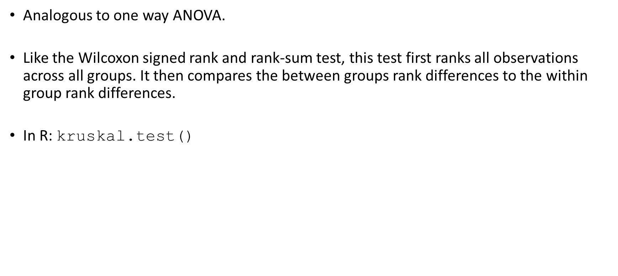
Kruskal-Wallis test – more than 2 groups
Analogous to one way ANOVA.
Like the Wilcoxon signed rank and rank-sum test, this test first ranks all observations across all groups. It then compares the between groups rank differences to the within group rank differences.
In R: kruskal.test()

Slide 73
Kruskal-Wallis test – more than 2 groups
Example:
It is claimed that differences exist in the mean weight between the different conditions (excellent, fair, good and poor)
kruskal.test(a104wt ~ a63well,data = df2)
## ## Kruskal-Wallis rank sum test ## ## data: a104wt by a63well ## Kruskal-Wallis
-squared = 70.206, df = 3, p-value = 3.855e-15

Slide 74
Fisher’s exact test
When we compare categorical variables, we saw that we can use the chi-square test which relies on approximating the squared differences between observed and expected counts by chi-squared distributions. For this approximation, all expected cell counts need to be large enough (typically, the minimum expected cell count should be 5, 6 or larger).
Fisher’s test is computationally intensive: for a given null hypothesis, it derives all cross-tabulation tables that are as extreme or more extreme than the observed table.
For example we can revisit the test we did when we checked if there is an association between stunting and mortality in the adolescent dataset:

Slide 75
Fisher’s exact test
fisher.test(table(df2$stunt,df2$died))
## ## Fisher's Exact Test for Count Data ## ## data: table(df2$stunt, df2$died) ## p-value = 0.006215 ## alternative hypothesis: true odds ratio is not equal to 1 ## 95 percent confidence interval: ## 1.296104 7.696201 ## sample estimates: ## odds ratio ## 3.096198

Slide 76
Fisher’s exact test
However, when we revisit the test for the null hypothesis of no association between socio-economic status and hospital in the Blantyre TB dataset, we run out of memory for Fisher’s exact test – the table is too large with too many alternatives.
try( fisher.test(table(df1$ses,df1$hosp)) )
## Error in fisher.test(table(df1$ses, df1$hosp)) : FEXACT error 5. ## The hash table key cannot be computed because the largest key ## is larger than the largest representable int. ## The algorithm cannot proceed. ## Reduce the workspace, consider using 'simulate.p.value=TRUE' or another algorithm.

Slide 77
Use of p-values in statistics

Slide 78
A statement on statistical significance and p-values
P-values indicate degree to which data are incompatible with a given statistical model.
P-values do not measure the probability of H₀ being true.
Decision-making should not be based solely on whether a p-value is below a certain threshold.
Proper inference requires full reporting and transparency.
A p-value does not measure the size of an effect / importance of a result.
Context matters: a p-value by itself does not provide a good measure of evidence regarding a model or hypothesis.

Slide 79
Note on p-values
Stop the use of P-values in the conventional, dichotomous way.
P-values alone should not be used to refute or support a scientific hypothesis.
Rebrand confidence intervals to “compatibility intervals”.
Discuss all values that fall within the confidence interval / are compatible with the data.
Do acknowledge that the point estimates and values close to it are more compatible than values at the extremes of the interval.
Emphasize / embrace uncertainty.
Please read https://doi.org/10.1080/00031305.2019.1583913.

Slide 80

[end of Session 4]

