Slide 1
Machine Learning and Wi-Fi:
Confluences, Ongoing Activities, and Ways Forward
Francesc Wilhelmi, Szymon Szott, Katarzyna Kosek-Szott, Boris Bellalta
October, 2023
Mobicom
Notes:
Boris: part 1 and one example in part 2
Szymon: example in part 1 and rest of part 2 and part 3
Target time: 90 minutes total
Boris
Welcome. It’s a pleasure to give this tutorial in this meeting. Thanks for inviting us.
In this talk, we aim to provide a brief and concise overview of standard ML techniques, as well as how they have been applied to Wi-Fi by the research community in the last years. We hope you will find it interesting.

Slide 2
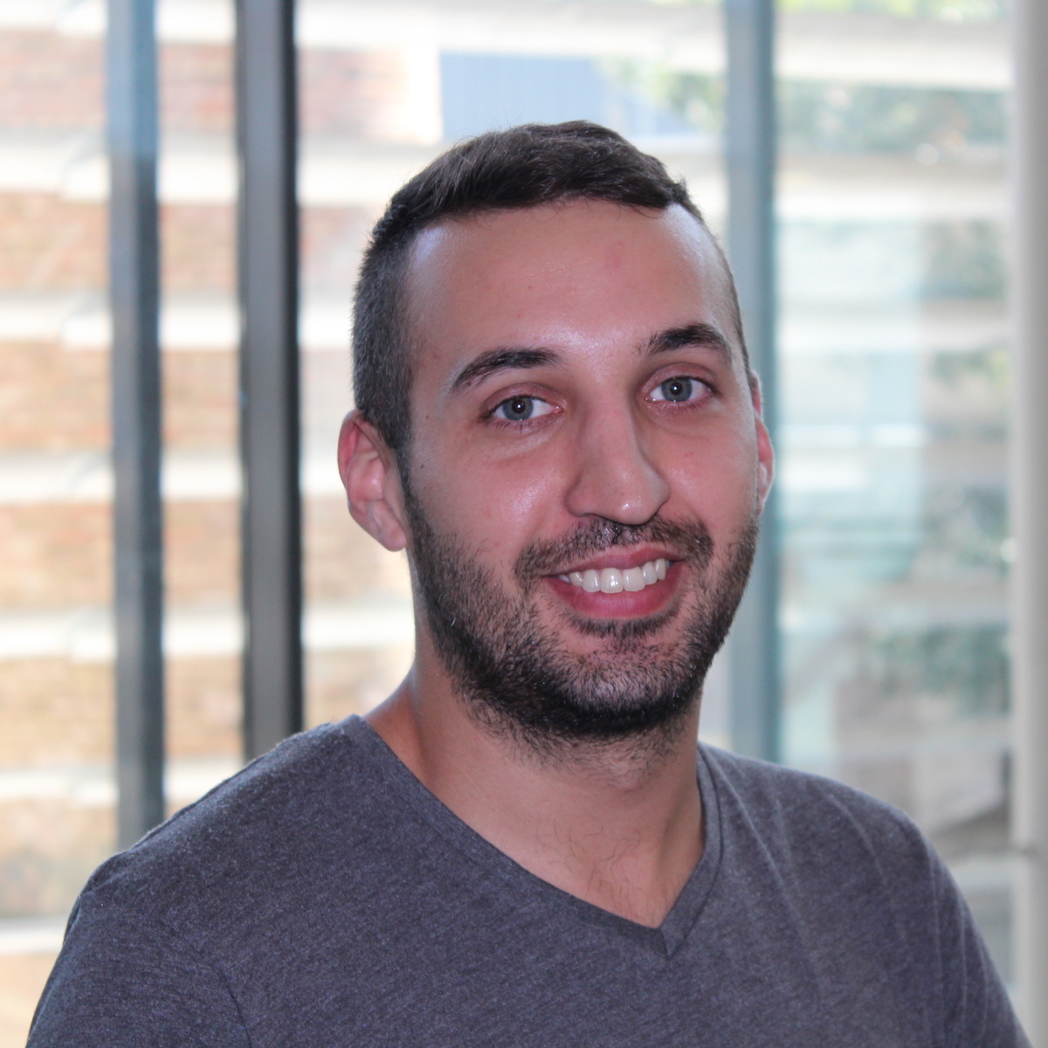

Francesc Wilhelmi
Research Engineer at Radio Systems Research (RSR), Nokia Bell-Labs Germany
PhD from Universitat Pompeu Fabra (UPF)
Interests:
Wi-Fi networks & unlicensed wireless technologies
AIML for communications
DLT & blockchain
Contact: francisco.wilhelmi@nokia.com
Notes:
Boris
I’m a full professor at UPF, where I head the wireless networking group. Our work focuses on wireless networks operating in unlicensed bands, and so in Wi-Fi as the most successful Internet access technology working there.
I became interested in ML techniques to see if using them we could improve Wi-Fi performance. My personal interests are mainly on low complexity Reinforcement Learning agents to deal with coexistence problems in dense Wi-Fi networks.

Slide 3
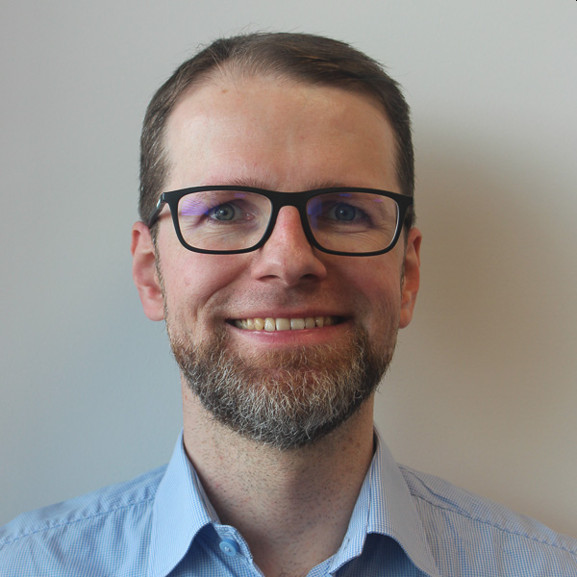
Szymon Szott
Associate professor at AGH University of Kraków, Poland
Research interests
Wireless local area networks
Channel access
Quality of service
Security
Inter-technology coexistence
ML interest: clever ways to improve performance
Contact:
szott@agh.edu.pl
https://szymonszott.github.io/
Notes:
Szymon
I’m an associate professor at AGH University in Kraków, Poland
I’m mostly interested in channel access methods for improving Wi-Fi performance and I believe ML methods can provide clever means in certain cases.

Slide 4
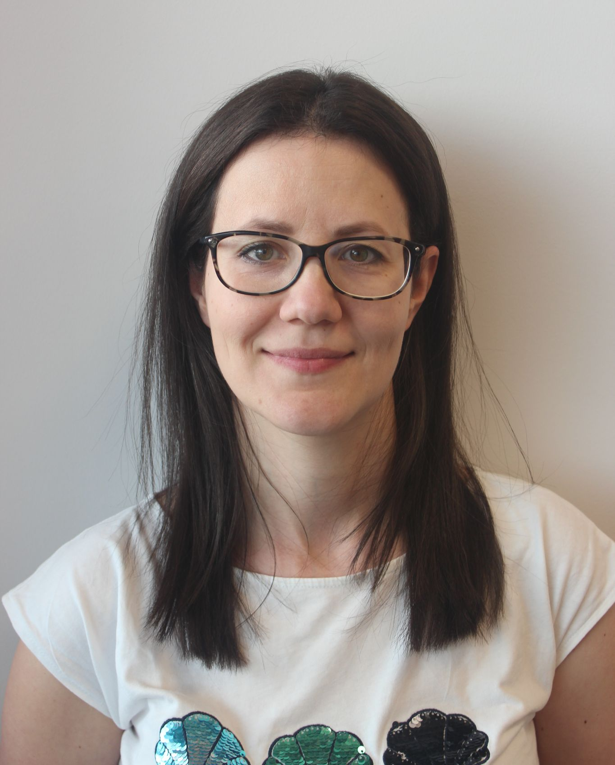
Katarzyna Kosek-Szott
Associate Professor at AGH University of Krakow
Major interests
Novel IEEE 802.11 amendments
Coexistence of radio technologies in unlicensed bands
Application of ML in IEEE 802.11 networks
Contact: kks@agh.edu.pl
Notes:
Katarzyna
I’m an associate professor at AGH University in Kraków, Poland
My major interests are…

Slide 5
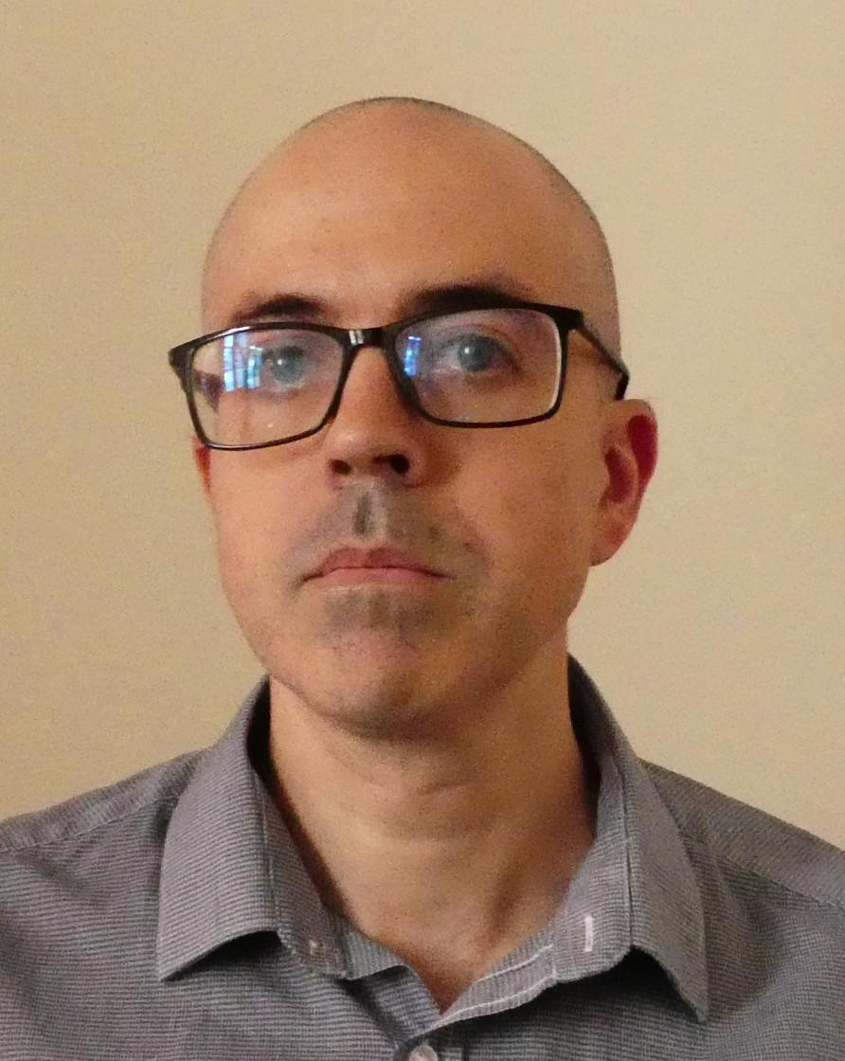

Boris Bellalta
Full-professor at UPF
Head of the Wireless Networking group
Unlicensed bands, Wi-Fi
XR Immersive Communications (over Wi-Fi)
ML interest: ‘intelligent’ adaptive systems; low-complexity but responsive RL agents; interplay between ML agents;
Contact: boris.bellalta@upf.edu
Notes:
Boris
I’m a full professor at UPF, where I head the wireless networking group. Our work focuses on wireless networks operating in unlicensed bands, and so in Wi-Fi as the most successful Internet access technology working there.
I became interested in ML techniques to see if using them we could improve Wi-Fi performance. My personal interests are mainly on low complexity Reinforcement Learning agents to deal with coexistence problems in dense Wi-Fi networks.

Slide 6
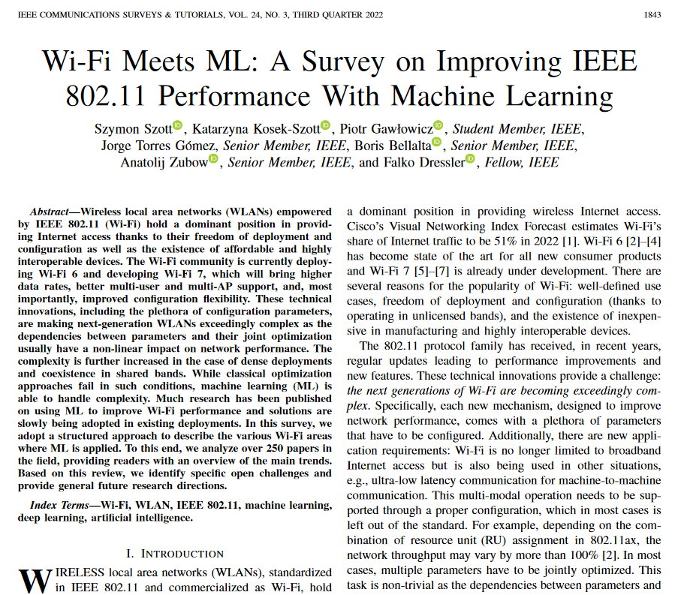

Acknowledgements
Piotr Gawłowicz, Jorge Torres Gómez, Anatolij Zubow, Falko Dressler, co-authors of the survey paper “Wi-Fi Meets ML: A Survey on Improving IEEE 802.11 Performance with Machine Learning” in IEEE Communications Surveys & Tutorials, vol. 24, no. 3, pp. 1843-1893, third quarter 2022, doi: 10.1109/COMST.2022.3179242. [1]
From projects:
National Science Centre, Poland, under Grant DEC-2020/39/I/ST7/01457
WI-XR PID2021-123995NB-I00 & WINDMAL PGC2018-099959-BI00 (MCIU/AEI/FEDER,UE)
Notes:
Szymon
This tutorial originates from a survey we published in IEEE COMST together with our colleagues who we would like to acknowledge.
We looked through over 250 papers on improving Wi-Fi performance alone. This has given us some insights we would like to share with you today.

