Slide 1


React/Redux Development
Where Do I Put the Business Logic?

Slide 2
Speaker Details
Matt Wigdahl
VP of Software Technology at ScriptPro LLC
LinkedIn: https://linkedin.com/in/mlwigdahl
Twitter: @mlwigdahl
Email: mlwigdahl@gmail.com
Code demos and PowerPoint on Github: https://github.com/mlwigdahl/react-redux-presentation
Thanks to our sponsors! Visit them!
Notes:
Thank everyone for coming out on an early Friday!
Ask how many people have used React in production. Redux in production?

Slide 3
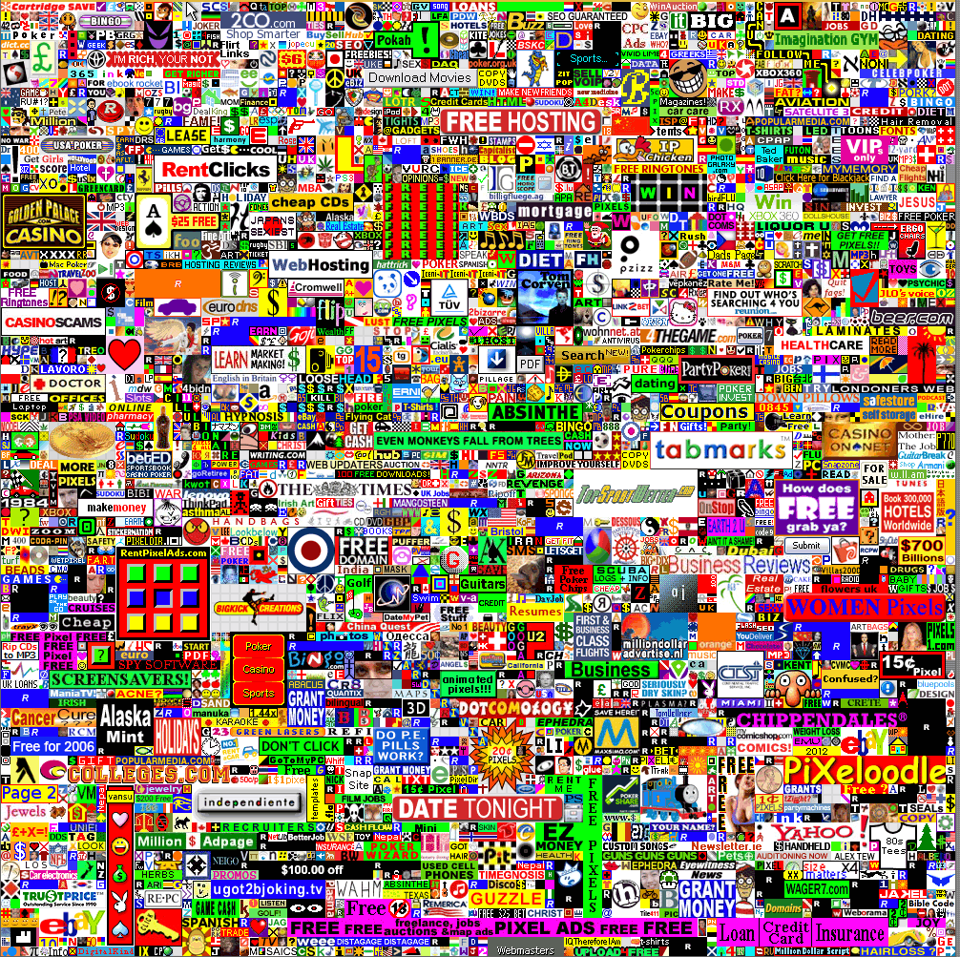
Notes:
Thank everyone for coming out on an early Friday!
Ask how many people have used React in production. Redux in production?

Slide 4






































Notes:
Thank everyone for coming out on an early Friday!
Ask how many people have used React in production. Redux in production?

Slide 5

I Feel Your Pain
You have a clear idea of how you want to implement your UI…
…React
You have a backend API to provide you with your state, and you’ve picked a state management framework…
…Redux

Slide 6

I Feel Your Pain
You need to make your clean React UI interact with your clean Redux store…
That’s business logic, it’s dirty, and you have lots of options to choose from!
…???
Notes:
I’ll take JavaScript libraries that start with ‘RE’ for $1000, Alex!

Slide 7
Roadmap
React/Redux in 5 Minutes Or Your Money Back
Overview of React
Overview of Flux architecture
Overview of Redux
Demos
Sample React UI
React/Redux/redux-thunk
React/Redux/redux-saga
React/Redux/redux-observable
React/Redux/redux-logic
Throwdown!
Bonus Features
React setState() only
React/Redux no middleware
Notes:
Offer does not apply to conference admission fees, hotel, meals, parking, or paid time off

Slide 8
React in 2 Minutes
React is…
A JavaScript UI library
From Facebook
Represents UI as components (HTML in JS)
Based on one-way data flow
UI is a function of props (top-down) and state (internal)
JSX extends JS and provides HTML-like syntax (optional)
Virtual DOM allows optimized rendering, targets other than DOM
Not a framework! Roll your own state management, routing, etc.

Slide 9
One-Way Data Flow?
Facebook had problems with scaling MVC architecture
The more complex the app, the worse the problems with two-way connections and unexpected state changes
Too much “Spooky action at a distance”
Their answer was Flux
Notes:
If you’ve only used the MVC paradigm, this may seem strange or even heretical

Slide 10
Flux Diagram
External Action
Internal Action
Dispatcher
Store
View
Notes:
View receives data from outside and renders solely as a function of that data.
UI controls or other application entities can emit events (called “actions”) and “dispatch” them to one more more “stores”
The stores update their contained data based on the type and content of the actions and notify subscribed components that the data has changed.
The notified UI controls then rerender their UI
Disadvantage is additional ceremony around state updates
Advantage is that given a set of input data you know what the UI should look like

Slide 11
Redux in 2 Minutes
Redux is…
An implementation of the Flux architecture…
…ish
Imposes additional constraints / tradeoffs:
Single store, not multiple stores
Single reducer – pure function, runs synchronously
State is immutable – to change, return a new object

Slide 12
Benefits of Redux
Predictable state in a single source of truth
Enables cool features that devs are starting to take for granted:
Time travel debugging
Hot reloading
“Simpler” server-side rendering
Clean scaling using reducer “slice” composition
Notes:
Time travel debugging – revert your state to what it was at some point, then replay actions
Hot reloading – swap in new versions of components or other code into a running application

Slide 13
Redux Diagram
External Action
Internal Action
Dispatch
Reducer
Store
Subscribed Component

Slide 14
React/Redux Vocabulary
Component – a JS entity that renders a block of UI based on input props (and internal state)
Props – input data provided to a React component
Action – a JS object with a “type” property that describes a request for a state update
Action Creator – a function that generates a Redux action
Dispatching – injecting an action into Redux for processing
Reducer – a pure function that updates the Redux store’s state based on an action
State – data managed by a React component or the Redux store
Store – the single repository of immutable Redux state

Slide 15
What Do We Mean By Business Logic?
Sync operation – single state
Picking an item from a list
Liking a post
Sync operation – multiple state entities
Reporting
Calculating a price
Formatting a receipt
Adding a comment
Create a new record
Async operation – could fail
Access a web API
Long DB query
Complex operation
Logon/logoff
Notes:
Some of this stuff manipulates global state -- state that should be persisted to a data store.
Some is arguably local state -- state that affects how a component is currently displayed but which is not needed to persist and isn’t needed outside the scope of the component.

Slide 16
The Crux of the Problem
We want to keep our business logic out of UI
Single Responsibility Principle
Better testability
Actions? No!
Reducers? Maybe…
Reducers should be pure functions
Reducers are run synchronously
Hard to access multiple slices of state at once
Notes:
SRP – modularity and reuse
Hard to access state – but you can, will show in basic Redux example

Slide 17
The Crux of the Problem
Action Creators? Better…
They’re extracted functions so minimal coupling
Allowed to be impure – async OK
No access to Redux store – caller must provide state
Higher-Order Components? Container Components?
Lots of different possibilities
Lots of different tradeoffs
Notes:
Caller providing state couples components to state shape

Slide 18
Middleware To the Rescue!
Redux provides hooks to allow custom processing
Runs as chain of functions injected between dispatch and reducer
Has access to store state, can dispatch new actions
Within those limits, anything goes (except mutating store state)
The problem is which to choose (or to roll your own)
Notes:
Like Express middleware

Slide 19
Demo Application
Lightweight message board app
Only the interesting parts
Three types of business logic
Like a post – simple increment of single state value
Gather metrics over posts – scan multiple items and aggregate
Load new posts – complex action: async fetch, error handling, plus metrics refresh
Notes:
Metrics puts aggregate value into new state area.

Slide 20
Demo #1 – Just React
Basic UI layout using React
One HTML file
<script> tags from CDN
No state or logic – all components are functional
Tip: This is a great way to
prototype quickly!

Slide 21
Demo #2 – redux-thunk
First real middleware
Simple, written by Dan Abramov, author of Redux
Allows dispatch() to accept functions as well as action objects
“Thunks” called with dispatch()and getState() injected
Tip: Functional components
can be connected to Redux!
Notes:
Awful lot of value for approx. 10 lines of code:
Access to state from action creator
Easy access to dispatch multiple items
State access is async so getting latest in a promise chain is easy
Using for two different things:
Complex logic (cross-state, async, compound) [loadPosts]
Getting access to store data from action creator [postMetrics]
Note! “Subscribe” means that when the relevant state slices change, component’s props are updated and you rerender
Note! Functional components render every time their props are updated, regardless whether they are different or not.
Note! Functional components aren’t inherently faster, but could use recompose pure() HOC to make them equivalent to PureComponent
Note! Actions can be processed by multiple reducers!
Note! React-redux Provider component passes store down via context so all descendants can connect()

Slide 22

Demo #3 – redux-saga
By far the most popular middleware package
Takes a “saga” – a generator function that keys off of dispatched actions and processes them
“Watchers” and “workers”
Requires generator support, learning curve
Makes complex async code readable
Very testable due to effect objects
Rich API, access to state, etc.
Action creators stay pure
Notes:
***Jump to demo after “requires generator support”
Documentation is very good!
We can get our business logic out of action creators – that’s what saga workers are for

Slide 23
Demo #4 – redux-observable
Based on Reactive Extensions (RxJS), which must also be included
Much like redux-thunk, a thin layer – over Observables
Converts your actions into Observables, then you use RxJS to manipulate them
Powerful API – if you know it
Testability requires extensive mocking, DI
Manipulations are real, hard to intercept
Notes:
Presentation on RxJS in this room later on today!
Redux-thunk is a thin layer over functions, redux-observable is a thin layer over observables

Slide 24
Demo #5 – redux-logic
Powerful declarative model covers a lot of bases easily
Based on RxJS but doesn’t require you to use or know it
Unlike redux-saga or redux-observable, can intercept / transform actions before reducers
More obscure, less community uptake / support
process() is very like redux-thunk
Also supports validate() and transform()

Slide 25
Everyone Gets a Trophy…
Except “no middleware” (Boo!)
setState()is great for simple, lightweight apps with minimal state requirements
redux-thunk is very lightweight and gives surprising power for little code
redux-saga makes async flows very clear and has good testability
redux-observable exposes the brevity and power of RxJS
redux-logic covers a surprising number of complex cases declaratively without sacrificing power

Slide 26
…Then Fights to the Death!
But if only one middleware can survive…
…
I pick redux-saga!
Strong community support
Great documentation
Power
Clarity
Testability
Notes:
Only one can survive to throw Mankind off Hell in a Cell 16 feet through an announcer’s table

Slide 27
Questions / Comments
Matt Wigdahl
VP of Software Technology at ScriptPro LLC
LinkedIn: https://linkedin.com/in/mlwigdahl
Twitter: @mlwigdahl
Email: mlwigdahl@gmail.com
Code demos and PowerPoint on Github: https://github.com/mlwigdahl/react-redux-presentation
Thanks again to our sponsors! Visit them!

Slide 28
Bonus Demo #1 – setState()Only
Redux provides value, but also boilerplate and ceremony
For small apps, it might not be worth it
Try React’s setState()and callbacks until it’s too painful
Presentational / Container component pattern
Presentational – functional, no state, no lifecycle. Render UI based on props
Container – manage state, orchestrate other components
Fine to mix at all levels
State will get “pushed up”
When to switch? When managing callback chains through multiple levels gets too painful
Notes:
Tip! Functional setState() – avoids unintended merging of state
Tip! Object rest/spread syntax is very valuable for returning changed state in both React and Redux – no mutation!
Note! We get refresh for free when using setState(), but when modifying global data like the status, we have to manually refresh (!)
Note! Must bind when using class function syntax, but we can use experimental class member syntax and not have to bind
Note! Using functions in handlers ensures that the child components’ props _change_ every time, could be performance problem if you’re trying to run pure (also overhead of creating new functions)

Slide 29
Bonus Demo #2 – Raw React / Redux
Without middleware, much uglier
Cross-slice data access requires modifying the root reducer
Async or compound logic requires passing in dispatch
Either coupled or logic is spread around
Not a lot more lines of code, but lots more to keep straight

