Slide 1

Exam Boards, Roles and Responsibilities, and Compassionate Communications
Governance structure
Examiner appointments
Board of Examiners
Assessment Officer responsibilities
Recommended practice
Compassionate communications
Guidance, details and information all can be found in the Code of Assessment, 2024-25

Slide 2

Governance Structure and Examiner Appointments
Head of School Responsibilities
Internal Examiners
External Examiners
All academic staff teaching on the programme
At least one External Examiner shall be appointed by Court based on recommendations from the Head of School.
The Head of School bears ultimate responsibility for managing the assessment scheme of all degrees in their school. This encompasses oversight of examiner appointments, assessment procedures, and quality assurance mechanisms.
They must ensure appropriate training is provided to all Internal Examiners, including those who are not permanent academic staff of the University.
Additional academic staff appointed by the Head of School
Honorary Lecturers, Research Fellows Category A, and Graduate Teaching Assistants (subject to approval)
Staff from Associated Institutions (subject to approval by Education Policy & Strategy Committee)
External Examiners provide crucial independent oversight of the assessment process, maintaining standards and ensuring fairness.

Slide 3








Board of Examiners Composition and Function
Board Membership
Convenership
Internal and External Examiners plus Assessment Officers
(EE’s functions can be discharged by email but should be present for at least one board per year)
Head of School (or Nominee) acts as convenor for all proceedings
Quality Assurance
Primary Function
Authentication of results before submission to Registry
Determination of assessment results through collective review
The Board of Examiners serves as the authoritative body for determining assessment outcomes. It provides a forum where both internal academic perspective and external independent oversight converge to ensure academic standards are maintained. The Head of School's convenership ensures appropriate institutional authority is exercised in the assessment process.
External Examiners must be provided with all necessary assessment materials and, where practicable, opportunities to attend oral examinations and presentations to facilitate their crucial role in the quality assurance process.

Slide 4
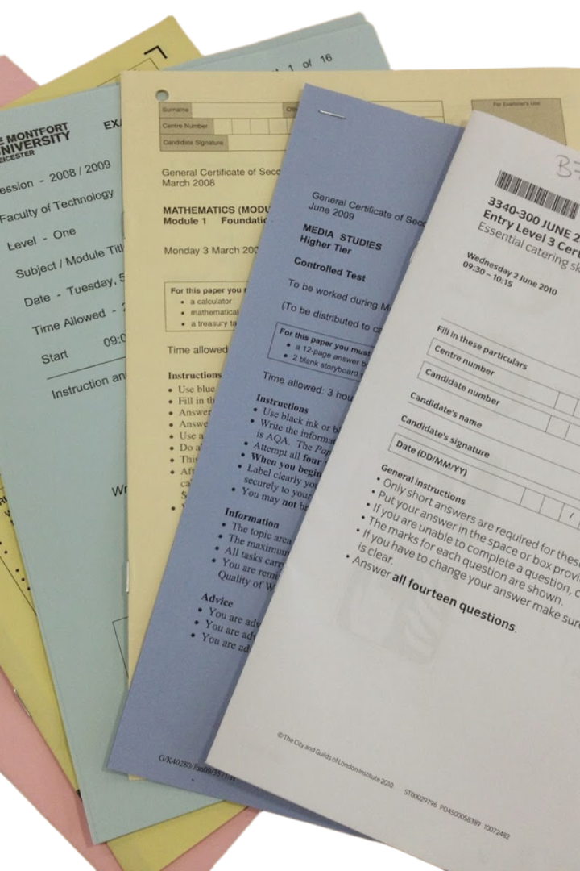




Assessment Officer Responsibilities
Documentation Management
Ensure course documentation accurately describes assessment schemes and procedures
Security Protocols
Maintain security of examination papers, assessed work, and records throughout the assessment period
Administrative Coordination
Supervise candidate lists, submission recording, and special needs arrangements
Results Processing
Collate provisional results, report to Board of Examiners, and convey authenticated results to Registry
For each course, the Head of School appoints an academic or senior administrative staff member as Assessment Officer. This role serves as the operational linchpin of the assessment process, ensuring procedural integrity and administrative rigour. A single Assessment Officer may oversee multiple courses, or responsibilities may be distributed across multiple officers at School level.

Slide 5






Appeals and Procedural Oversight
Academic Standards Committee
Determines questions of principle or procedure
Clerk of Senate
Authority on individual cases of incomplete assessment
Head of College
Ensures appeals are considered per prevailing Appeals Code
The Head of College bears responsibility for ensuring that appeals against assessment outcomes are handled in accordance with the established Appeals Code. This provides a clear hierarchical structure for addressing student concerns about assessment decisions.
For issues relating to incomplete assessments or considerations of Good Cause, the Academic Standards Committee determines matters of principle or procedure.
For individual cases, the Clerk of Senate serves as the final authority. This multi-layered approach to governance ensures that assessment procedures remain fair, transparent and consistent with University regulations.

Slide 6
Assurance of Standards
‘The business of the Board of Examiners shall be minuted and particular records kept of the External Examiner's adjudications, comments and recommendations, as well as particular decisions made by the Board in respect of incomplete assessment, good cause and disciplinary matters.
Returns of results shall be completed, checked by two persons and confirmed at the meeting of the Board of Examiners.’
Code of Assessment, 2024-25

Slide 7
“Administrative Grades”
Course outcomes not on Schedules A or B (ie not on the A1/A0-H scale) are often called “administrative grades”, though this term is not in the Code of Assessment. Common administrative grades include:
MV – “Approved compassionate or certified medical absence”, can be a temporary or permanent grade and is used to indicate the presence of approved Good Cause. Can be remedied with reassessment.
CW – “Credit Withheld”, a temporary grade generally indicating some missing assessment. Must not be present on a graduating transcript. CWs are “repairable” at Pre-Honours and PGT levels with reassessment, and are changed for graduating Honours students (with ≥75% of Honours assessment submitted) by grading missing elements at H/0.
CR – “Credit Refused”, a permanent grade awarded for a failure to comply, in the absence of Good Cause, with the published requirements of the course/programme or as a penalty for a serious breach of regulations. At Pre-Honours and PGT levels CR is awarded for not submitting ≥75% of course assessment at both the first and resit diets with no Good Cause for either, and at Honours level CR is awarded for courses where at the end of the programme the candidate has not submitted ≥75% of that course’s assessment and has not submitted ≥75% of the totality of Honours assessment. Occasionally CR can also be issued as a conduct penalty.
7 – “Deferred Result”, a temporary grade for conduct cases or other deferred outcomes. Must not be present on a graduating transcript.

Slide 8



Honours Incomplete Degree Scenarios
Less than 30% completed
Not presented for Honours assessment
30% to <75% completed with Good Cause
Where Good Cause accounts for completion being below 75%, an unclassified degree may
be awarded
≥75% completed
Classified degree possible
75% of work submitted is the minimum threshold at Honours for award of a classified degree.
Where a student has completed between 30% and 75% of assessment and has good cause approved for the remainder below 75%, and the student is going to be unable to complete 75% assessment within the session, an unclassified degree may be awarded. (In this scenario, the dissertation can be an element which has not been submitted.) All unclassified degree awards must be vetted by Academic Policy & Governance.
Students with less than 30% completion should be considered for a repeat year.
Students with less than 75% of Honours work submitted in the absence of Good Cause should be entered into consideration for an exit award as defined in the degree regulations and programme PIP.

Slide 9








Honours Exam Boards: Handling MV and CW Grades
MV with ≥75% Course Completion
Previous CW Grades
Where a student has ≥75% programme completion and ≥75% course completion with Good Cause, calculate grade on completed components only
Where a student has ≥75% programme completion and a degree is being awarded, revise CW grades counting missing assessment as 0
MV with <75% Course Completion
Missing Work Without Good Cause
Where a student has completed ≥75% of programme assessment, any individual courses with Good Cause and <75% completion should remain as MV
For Senior Honours semester 2 courses with missing work and no Good Cause, then if the student is graduating with an Honours degree (≥75% of Honours assessment submitted), calculate grade with missing portion as 0
For any grade changes to Junior Honours or semester 1 of Senior Honours courses, a 'Change of Grade' form must be submitted to Registry. This ensures proper documentation of all grade adjustments.

Slide 10

Best Practice Guidelines for Examination Boards
March 2025
This best practice is designed to enhance the rigour, transparency, and efficiency of examination board processes. The following recommendations establish a structured approach to pre-scrutiny, board proceedings, and documentation.

Slide 11




Pre-Scrutiny Framework
Appoint Scrutineers
Schedule Pre-Scrutiny
A minimum of three designated colleagues are formally appointed to conduct pre-scrutiny checks of results before the exam board. Usually includes assessment officer.
Scrutiny activities occur in the days before exam boards (sometimes 24 hours before, sometimes a few days). Marking timescales must be adhered to in order to permit this. Late marking may result in delayed graduation.
Certify Findings
Allocate Time
Scrutineers state in writing (email/Teams) that they are satisfied with the accuracy of reported outcomes or identify specific concerns requiring board attention.
Scrutineers are asked to prioritise this time-sensitive task, scheduling dedicated hours for thorough review before the exam board, and marking therefore must be completed on time.

Slide 12




Suggested Pre-Scrutiny Procedures
Assessment Weightings
Confirm all assessment components are correctly weighted and present in the spreadsheet calculations. This ensures the final grade accurately reflects the assessment structure. (Course conveners can be asked to do this.)
Random Sampling 1
Conduct spot checks for several randomly selected students, comparing grades in Moodle or MyGrades against those recorded in board spreadsheets. (Course conveners can be asked to do this.)
Random Sampling 2
Conduct spot checks for randomly selected students to check that the spreadsheet outcome matches what should be the outcome. Scan the spreadsheet for anomalous patterns in grades or unusual outliers.
Complex Case Review
Examine cases with special markers (MV, NS) and students with unusual or complex course outcomes (CW, CR, fails) to ensure proper recording of these exceptional circumstances. Sorting the spreadsheet by final grade helps with this.

Slide 13




Scrutineer Activity
Review Board Spreadsheets
Scrutineers examine assessment data for accuracy, completeness and internal consistency
Flag Anomalies
Identify and document any discrepancies or concerns requiring discussion by scrutineers or by the exam board
Propose Solutions
Discuss preliminary recommendations with other scrutineers (including Assessment Officer) for discrepancies or identified issues, or check with Advising or other colleagues for input
Document Findings
Send (email/Teams) a confirmation of pre-scrutiny and any suggested items to be presented to the board

Slide 14
Board Attendance
All attendees of a board should have also completed their own scrutiny in advance – they do not have to certify in advance by email or Teams, but will be listed in the board minutes as having scrutinised the material and assenting to its accuracy.
Board attendees are sent the materials either when the scrutineers get it or once scrutiny is complete, should timescales allow.
They put time to scrutinize material in their diaries the day before.
There is an argument that there should be no place at a board for colleagues who have not read the board's material in advance; there will be nothing for them to contribute, their input could be unhelpful or incorrect, and they should not want to be minuted as having assented to outcomes they have not checked.
Conversely, some colleagues or areas may believe that there is value in having some attendees who can help make decisions on the difficult cases. It should be minuted who was at the board but not able to assent to outcomes.
Some exam boards have a space for External Examiners to discuss the programme. There is an argument for separating out the exam board process from the External Examiner discussion and review, and some areas have a separate “programme wash-up” with the EEs for this purpose, especially given the boards are online.

Slide 15
Board Discussions
Complex Situations with Good Cause
Missing Assessment Components
Practice Standardisation
Discuss a few random samples as well as unusual or precedent-setting cases to ensure consistency in assessment practices and help train colleagues.
The board should review all cases where good cause has been accepted but which present unusual circumstances or require special consideration for progression or award purposes.
Any student record with incomplete assessment profiles should be examined to check appropriate academic outcomes.
Procedural clarifications
Non-submission without good cause which could cause issues for progression or award
Policy interpretation cases
External examiner feedback
Multiple assessment deferrals
Borderline good cause decisions
Progression implications
While individual uncomplicated cases will not require detailed discussion, there should at the board be both spot checking (eg going through one or two uncomplicated cases to explain the calculations to all present) and then oversight of complex situations.

Slide 16






Scrutineer Appointment
Assessment Officers or Heads of Subject/Programme nominate a schedule of three qualified academic staff per board for scrutiny roles.
Training Session
The university will start to develop training throughout 2025, and meanwhile we are happy to discuss training for colleagues
Marking Completed
Heads of School and Subject ensure marking is completed with enough time for spreadsheets to be completed and circulated.
Spreadsheet Distribution
Administrative team to circulate final assessment spreadsheets no later than 24 hours before scheduled board meetings.
Pre-Board Scrutiny
Designated scrutineers to complete verification checks and submit findings to the Assessment Officer the night before the boards.
Board Meeting
Streamlined examination board.

Slide 17
Scrutineer Reporting/Comments
Overleaf are some anonymized comments from different scrutineers in different situations. They can give you a flavour of the sorts of activity which can happen in the pre-scrutiny phase.
Thanks to those anonymous colleagues who agreed to provide screenshots!

Slide 22





Core Principles of Compassionate Communication
Culture of Kindness
Incorporating kindness into student-facing policies, processes, and communications.
Mindful Communications
Ensuring clarity, empathy, action-focus, and supportive tone.
Timely Delivery
Careful consideration of timing, enabling access to support when needed.
Inclusivity & Reflection
Addressing barriers to engagement and committing to continuous improvement.

Slide 23





Practical Implementation Strategies
Understanding Students Better
Create supportive environments by knowing student needs and concerns.
Paying Attention to Emotional States
Notice changes in attitude to identify when additional support is needed.
Encouraging Open Communication
Promote transparency that allows for feedback and constructive criticism.
Eliminating Barriers
Reduce boundaries between administration and students for better collaboration.
We have a duty of care to all our students.

Slide 24
Communication Considerations
Acknowledge Tone Limitations
Explicitly recognise that tone can be difficult to discern in emails and text communications.
The default communications from MyCampus can be confusing and do not offer support.
Example:
Re: MODULE EC2501 RESULT: FAIL
Your mark of CR is a fail. This course must be passed to progress to year 3. You must register for the August resit examination by 30 June. Failure to pass the resit will result in termination of your studies.
Re: MODULE EC2501 RESULT AND NEXT STEPS
I'm writing regarding your mark of CR for EC2501. While this does mean a resit will be necessary, I want to offer specific guidance to help you succeed in August.
Looking at your exam paper, I can see you demonstrated good understanding in sections 1 and 3. The areas needing development are the mathematical models in section 2 and application of theory in section 4.
Additionally, our Student Learning Development team can help with exam techniques and managing exam anxiety if that would be helpful. Our Wellbeing and Inclusion team can likewise help with managing preparation for your exams.
Please register for the August resit by 30 June using the student portal. If you wish to speak further, we can be contacted at XXX. Keep in mind we are here to help you.

Slide 25
Practical Next Steps
Audit Existing Communications
Review with diverse stakeholder groups to identify areas for improvement. Create an open, inclusive and friendly tone to communications.
Identify Pressure Points
Locate where communication frequently breaks down or causes stress. Provide students with detailed, specific next action points.
Develop Context-Specific Principles
Create exemplars tailored to your team’s unique needs. Catalogue and have access to up-to-date student support information.
Provide Targeted Training
Address discipline-specific communications and challenges. Ensure staff know of where to direct students for specific queries.
Regularly Evaluate Impact
Use both quantitative and qualitative measures to assess effectiveness. Monitoring of communications is key.

Slide 26
Good Cause: Some Reminders
Good Cause decisions should be made and communicated to students within ten working days of their submission of a Good Cause claim (Guide to the Code, Chapter 5, p.8). See also p.13 of Requests for additional consideration from the Office of the Independent Adjudicator.
The exceptions are claims of manifest prejudice where marking should be complete (or, in some cases, other grades gathered as evidence) before a decision can be made.
Good practice advice is available in chapter 5 of the Guide to the Code.

