Slide 1


“up yours at the end of life” Opposition, Emotion, and Overlap in a Corpus of Scottish Debates on Assisted Dying
Marc Alexander and James Balfour
University of Glasgow
CILC16, Salamanca
May 2025

Slide 2
Content Advisory
Death (throughout)
Suicide (throughout)
Suffering at end of life (throughout)
Abortion (brief mention in texts)

Slide 3
Assisted Dying
In texts of citizens writing their opinions, for a government audience, on something as controversial as Assisted Dying, what can corpus linguistics bring to the table?
Three questions:
What is linguistically polarized in this debate?
How do these polarized ideas lead to contested meanings?
What are some societal implications?

Slide 4
Outline
Background
Our Corpora
Polarization and Entrenchment
Argumentation and Authority
Implications and Democracy
Conclusion

Slide 5
1. Background

Slide 6
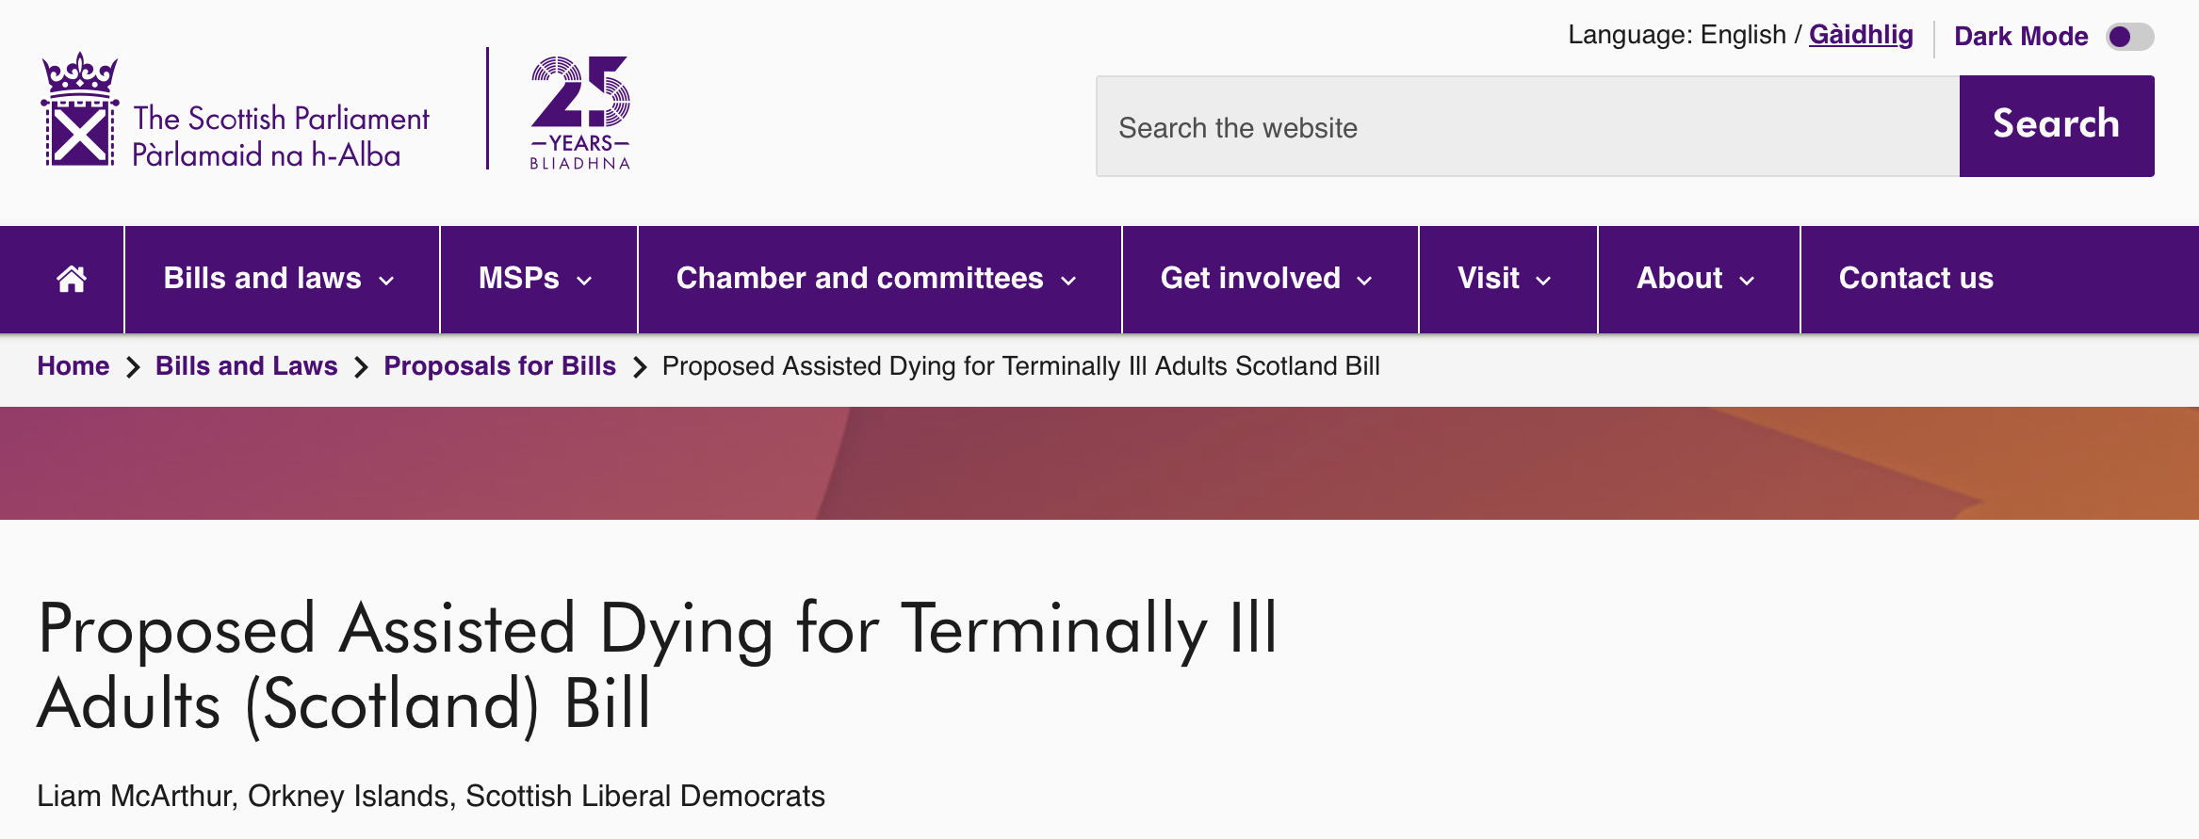
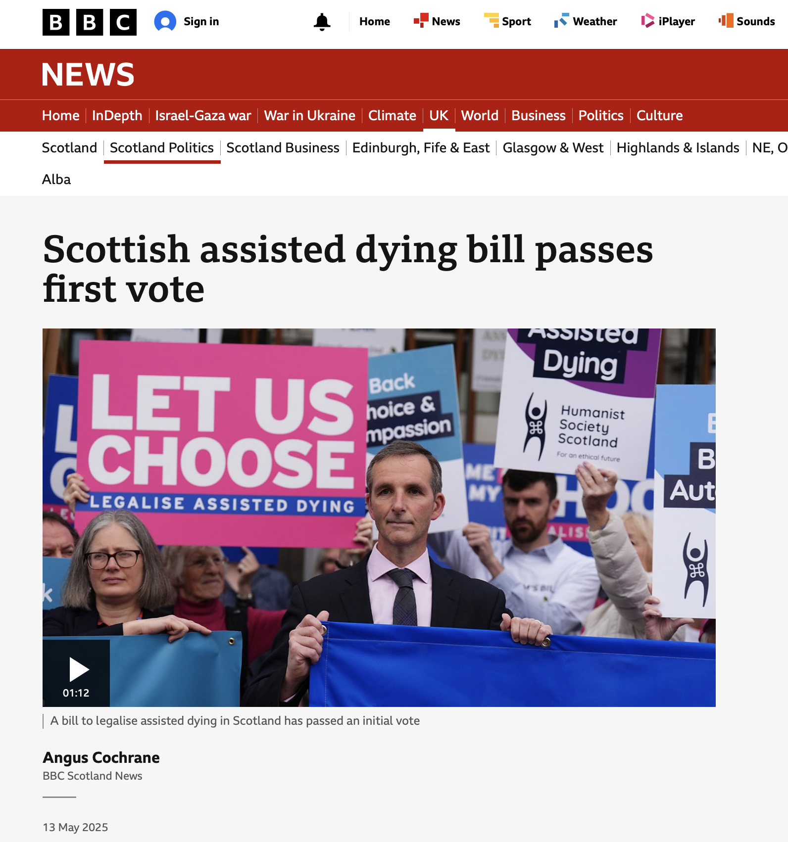
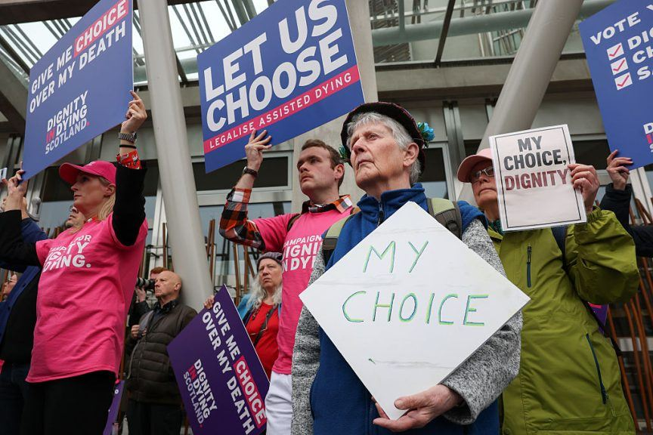
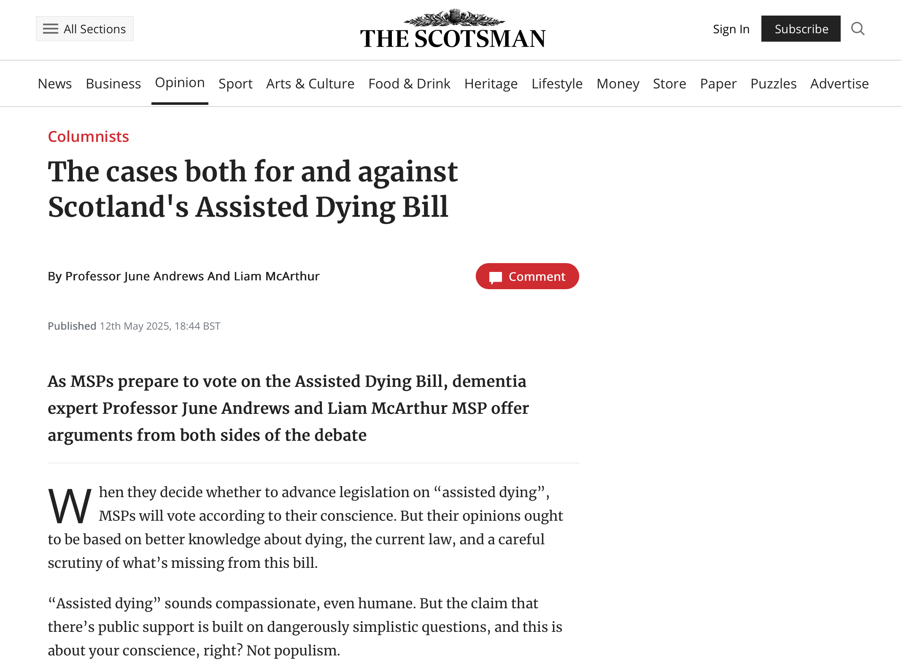
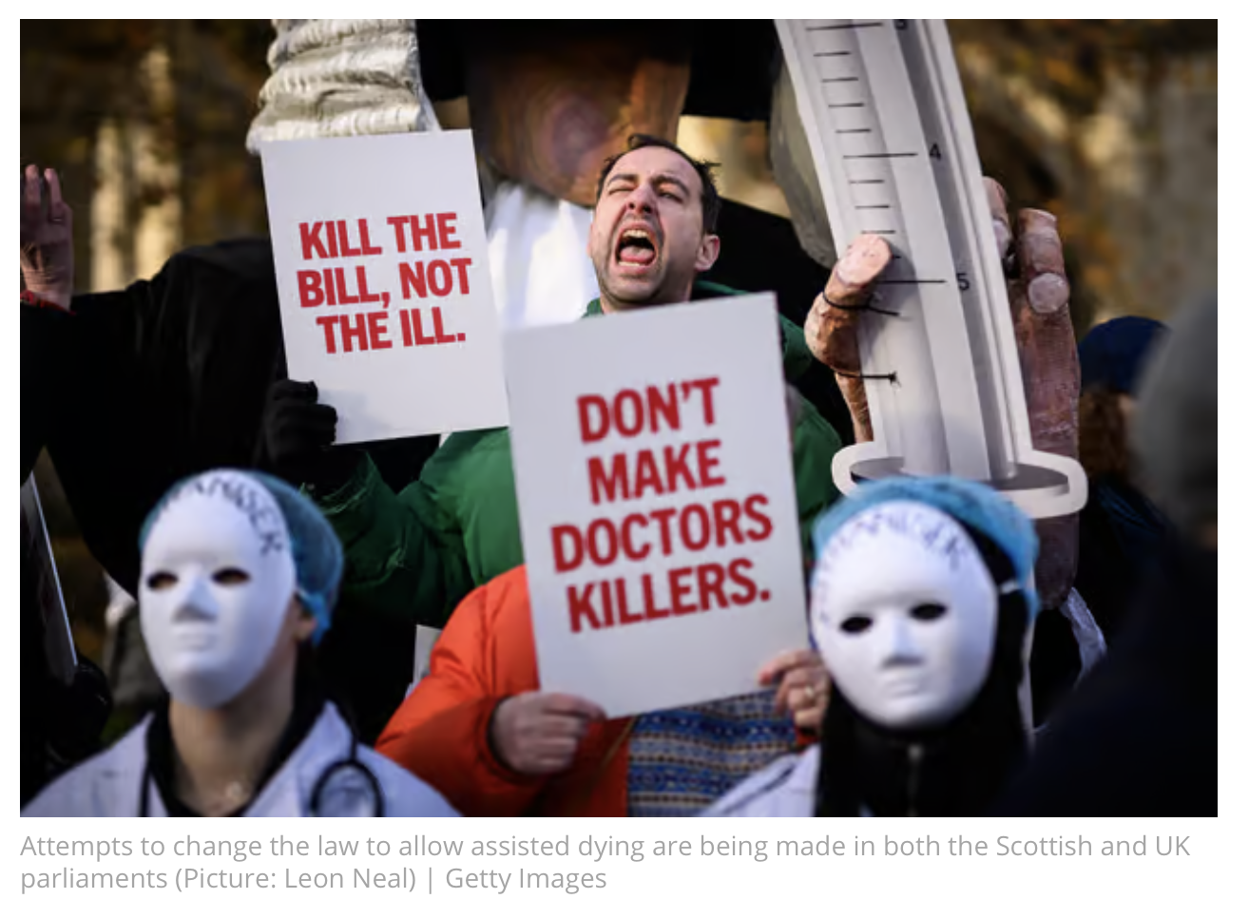
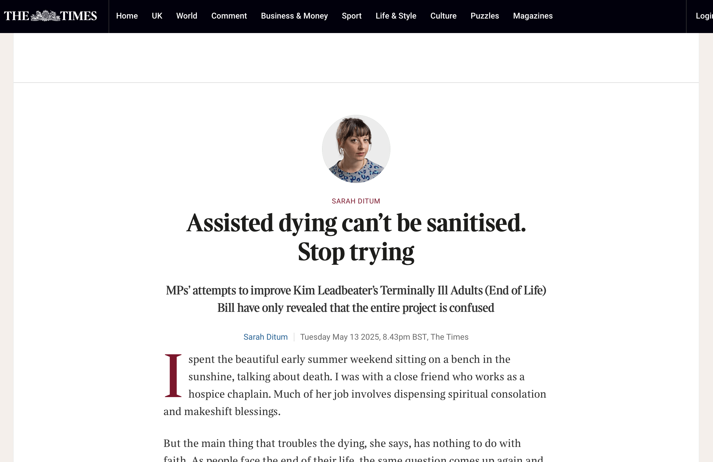
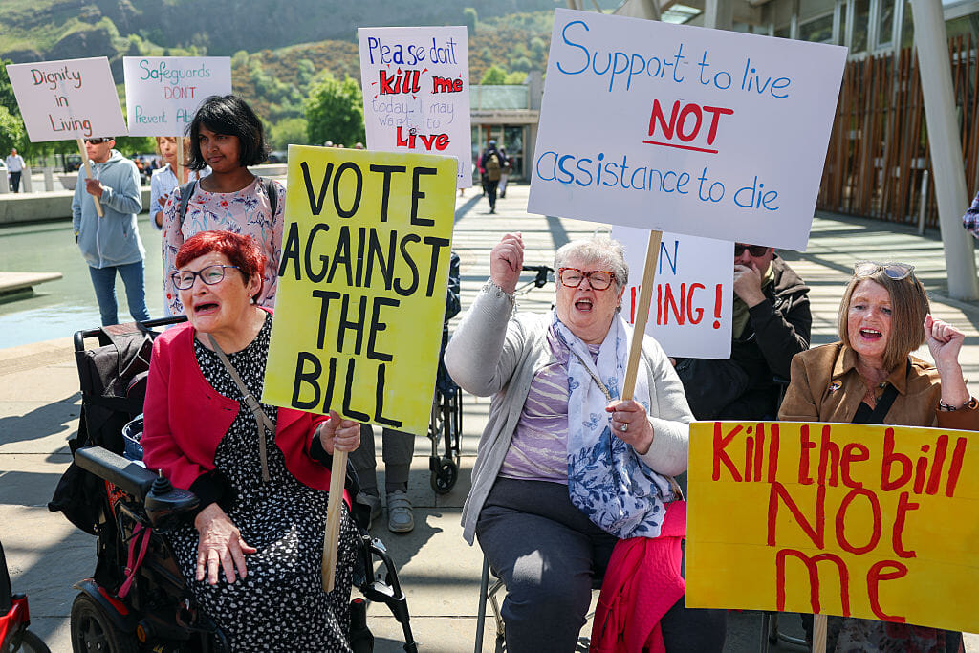
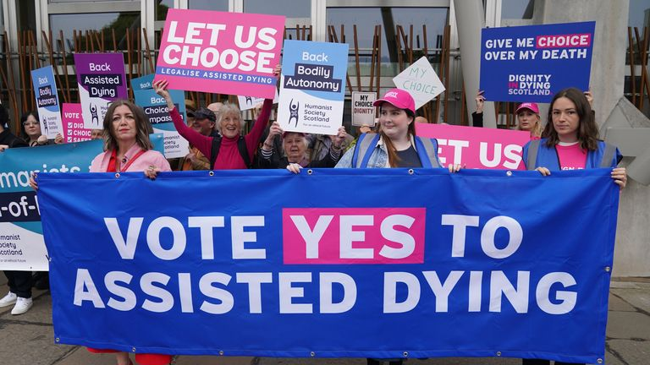
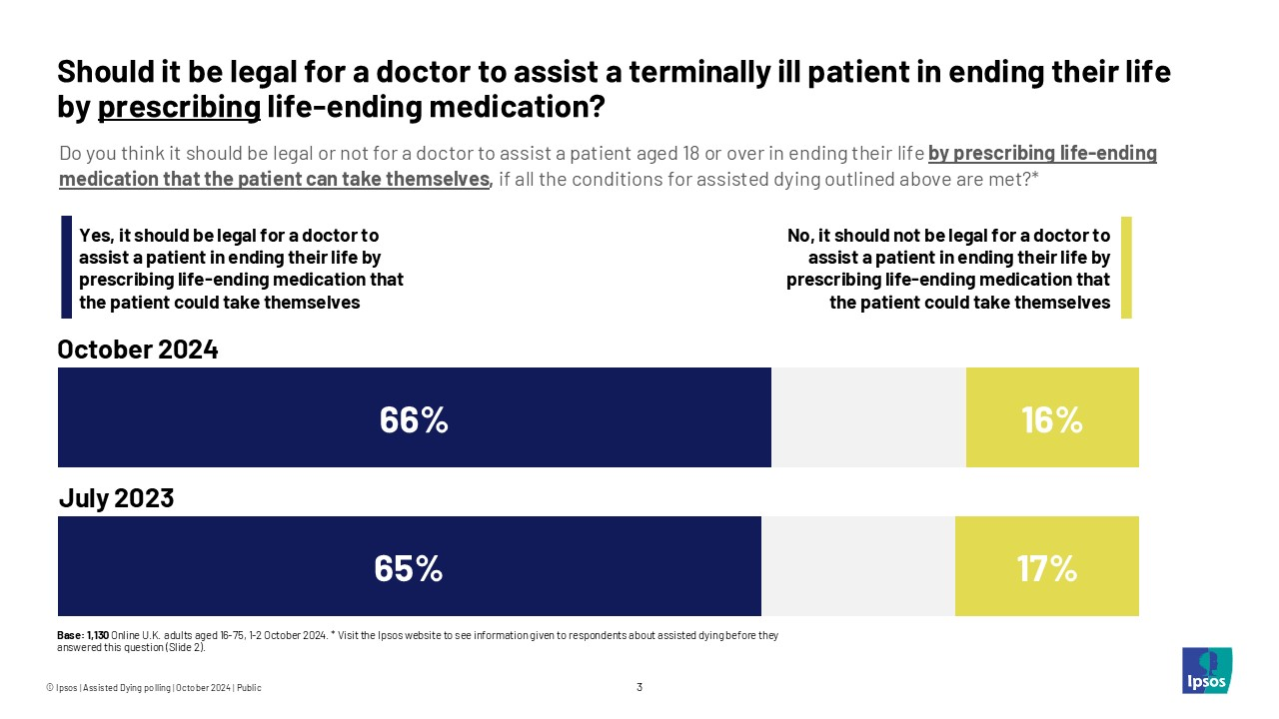
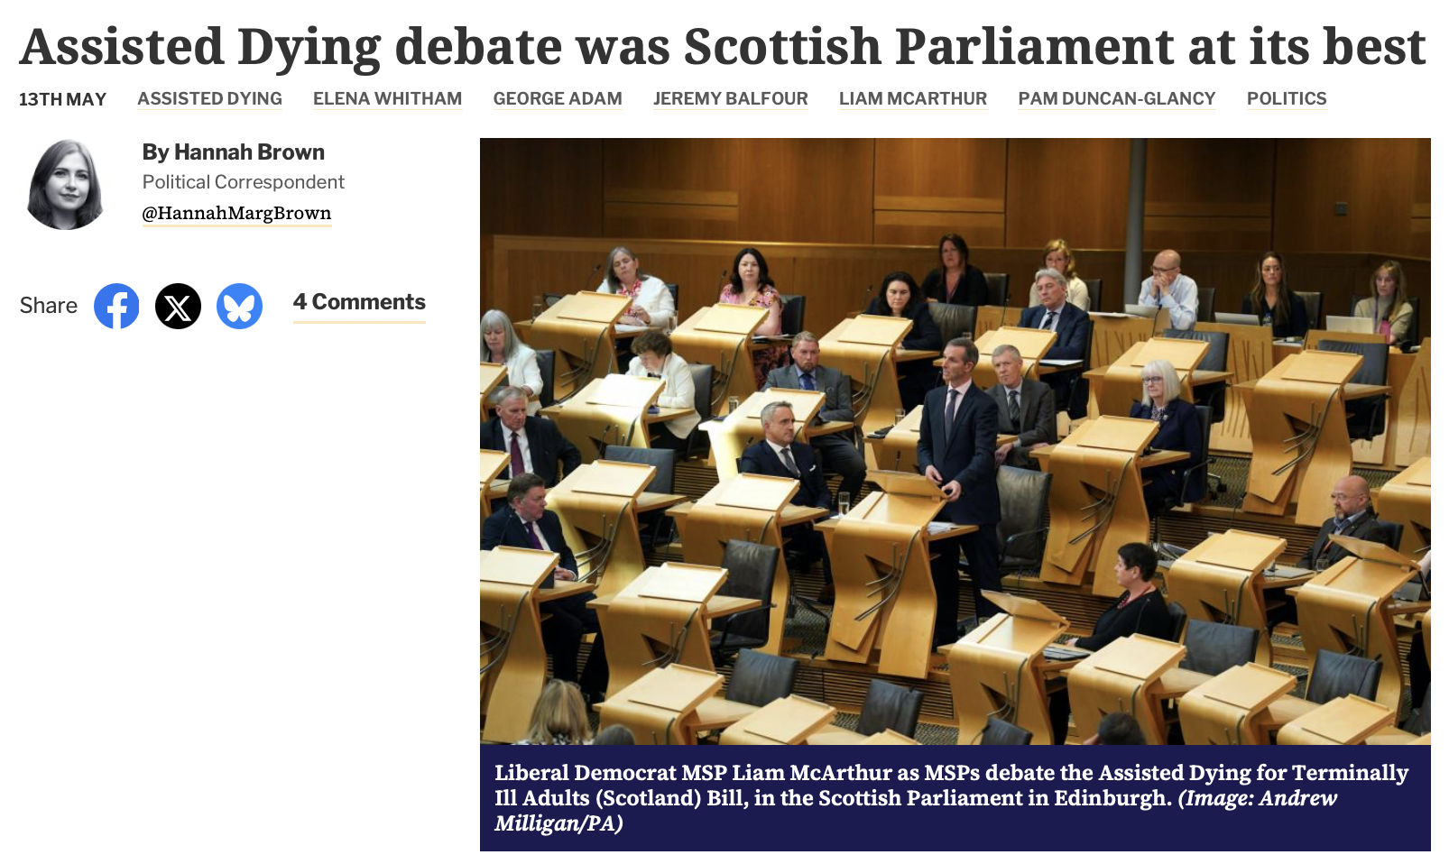
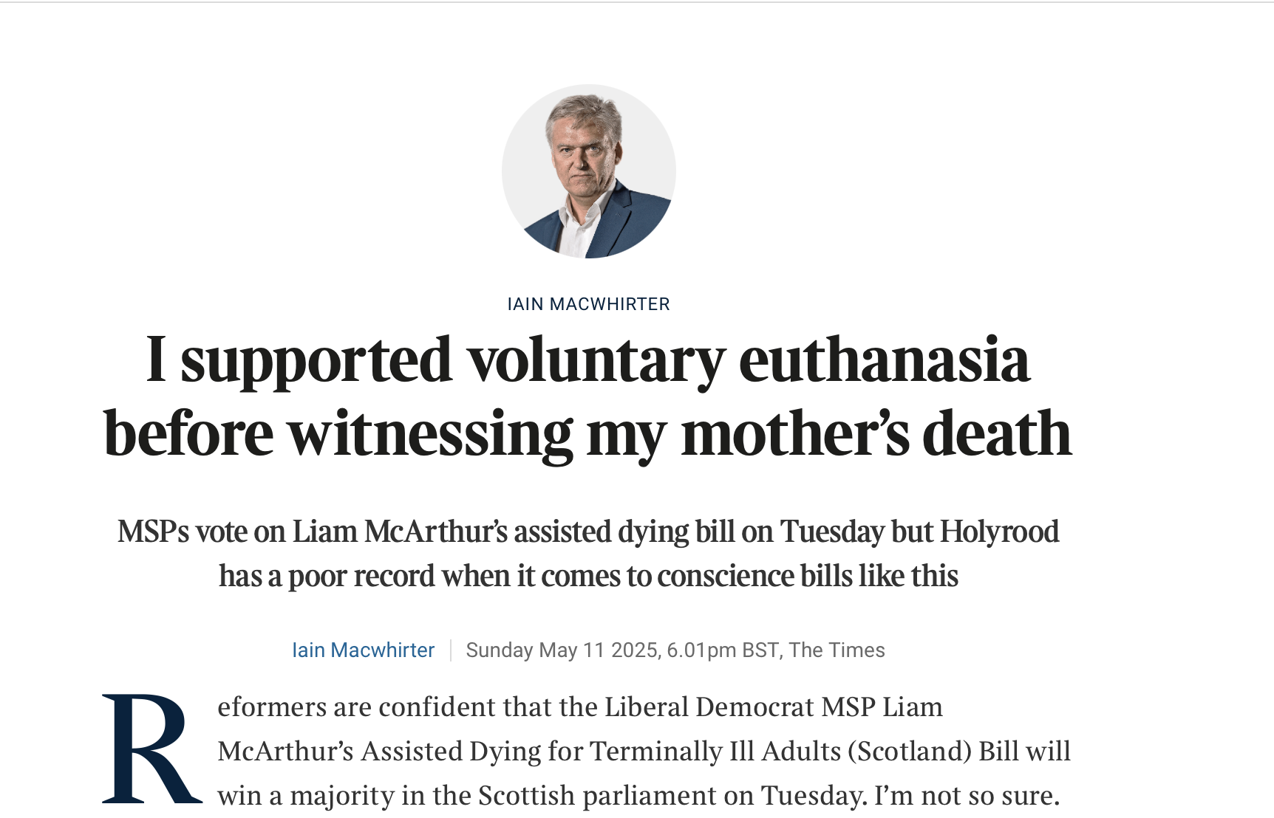
Notes:
* Assisted dying: Providing terminally ill people the means to end their lives at their choosing
* Topic of intense debate globally for many years
* Active discussions in Scotland for over a decade
* Scottish Parliament has considered multiple proposed laws since 2010
* Currently examining a new bill (2024-2025) introduced by Liam McArthur MSP, Liberal Democrat MSP for the Orkney Islands Orkney, it should be said, belongs to Scotland because in 1468 a Norwegian king said we could have Orkney should he not pay his daughter’s dowry when she was betrothed to James III of Scotland, and he didn’t pay so we took Orkney in 1472. Norway in the 17th century tried to pay us 210kg of gold for them but we said no.
* 2010: First bill introduced by Margo MacDonald MSP (lived with Parkinson's Disease)
* Failed by 85 votes to 16 (2 abstentions)
* 2013: Second attempt by MacDonald, who died in 2014
* Voted down in 2015 by 82 votes to 36
* Note: not a lot of support then, but the "yes" votes doubled between attempts
* Common objections: Safeguarding concerns, drug regulation, healthcare staff conscience
13 May : Assisted Dying Bill passed the first stage of becoming law. First stage means MSPs have considered and approved the “general principles” of it, and they have allowed it to move on to stage 2 – the detailed scrutiny and amendment phase. After MSPs have made and agreed any amendments, the Bill will come back for a final vote to determine whether or not it will become law.
On 16 May (Friday) in England, Kim Leadbeater MP’s Terminally Ill Adults (End of Life) Bill is due to return to the House of Commons.

Slide 7
Fully supportive §§ I worked in the NHS for 35 years and saw the passing of many people( including having sat at the bedside of 3 of my family when they died). Whilst hospice care and palliative care has improved greatly over the last years, I have still seen deaths that were not peaceful or painfree, people asking why they were being kept alive, when they wanted to pass away on their own terms. We treat animals with more dignity and compassion sometimes, and deny people their basic human right of a good death. If people can refuse treatment /medication, why cant they not choose how they die? Years ago a woman had to have their husbands consent to have a hysterectomy, this smacks of the same thing, someone unable to make a choice about their life and body, and how they choose to end it. surely this is a fundamental abuse of someone's human rights....... I also strongly believe that religious belief has NO place in medicine......it is unethical for people to impose suffering on others because of their religious beliefs about assisted suicide( in an increasingly secular society, how relevant is this now, and I speak as a religious practitioner)
For 26 years I worked in the emergency service […] I have witnessed at first hand and close up the sheer desperation and suffering caused by terminal illness. I have had to examine bodies and scenes where the person has died alone and in obvious agony. People with cancer who have vomited and excreted blood and body matter into bowls, coal scuttles, sinks, beds, floors etc.. before finally dying, often over a period of days and weeks […] I was also called to all suicides and lost count of the number of people I have had to cut down from their nooses whilst their grieving family cried in the adjacent room. […] In April 2020 I was diagnosed with inoperable pancreatic cancer and given 6-12 months to live if I chose not to have palliative chemotherapy, and possibly 18 months if I chose to undertake it. My world fell apart and I had to break the news to my wife and two sons. […] I am a proud and private individual who does not want to spend my final days, weeks, or god forbid months, in a hospital or hospice, in pain with no quality of life and having to be lifted off a bed pan or worse! I do not want to be forced into ending my life alone, maybe in my car with the embers of a disposable BBQ smouldering in the boot, or hanging in a lonely wood waiting for some poor unsuspecting member of the public to find me-but with no compassionate alternative that is what I will do,
Fully supportive §§ I feel very strongly that I should have a right to a dignified death and end of life experience and that others should have this right too, should they wish it. Palliative care although very important is not enough . My elderly and terminally ill mother is dying very very slowly ! She is in constant pain and although heartbreaking and distressing for me, for her, it is thoroughly exhausting, depressing and at times utterly terrifying. The strong medications for the pain cause hallucinations and she has nightmares and the other medications to mitigate the side effects means her body is constantly under attack not just from her illnesses but the drugs. I can’t begin to describe the impact other than she has serious problems with eating, sleeping and toileting and weighs around 28kilos .Her quality of life is so reduced and utterly miserable she just so wants these ‘dark times’ to end. And why shouldn’t she ? why should this woman have to suffer like this and for so long when she feels overall that she has had a good life but really now desperately wants it to end . I believe my mother should be able to have medical assistance to die.
Notes:
21%

Slide 8
Why Is This Interesting?
A rich dataset (separate to social media) with citizens writing persuasive texts
Shows profound disagreements between citizens, and is linguistically highly oppositional
Broad societal implications of outcomes

Slide 9
Current Situation
September 2021: Assisted Dying for Terminally Ill Adults (Scotland) Bill
Key differences from previous attempts:
Limited to terminally ill, mentally competent adults
Scottish residency requirement (12+ months)
Requires evaluation by two independent doctors
Multiple decision points and waiting periods
Self-administration requirement
Notes:
* Structured with safeguards:
* Initial request
* Reflection period
* Final request
* Explicitly addresses previous MSP concerns
* Currently progressing through parliamentary scrutiny
* Will be treated as "conscience vote" (no party mandate)

Slide 10
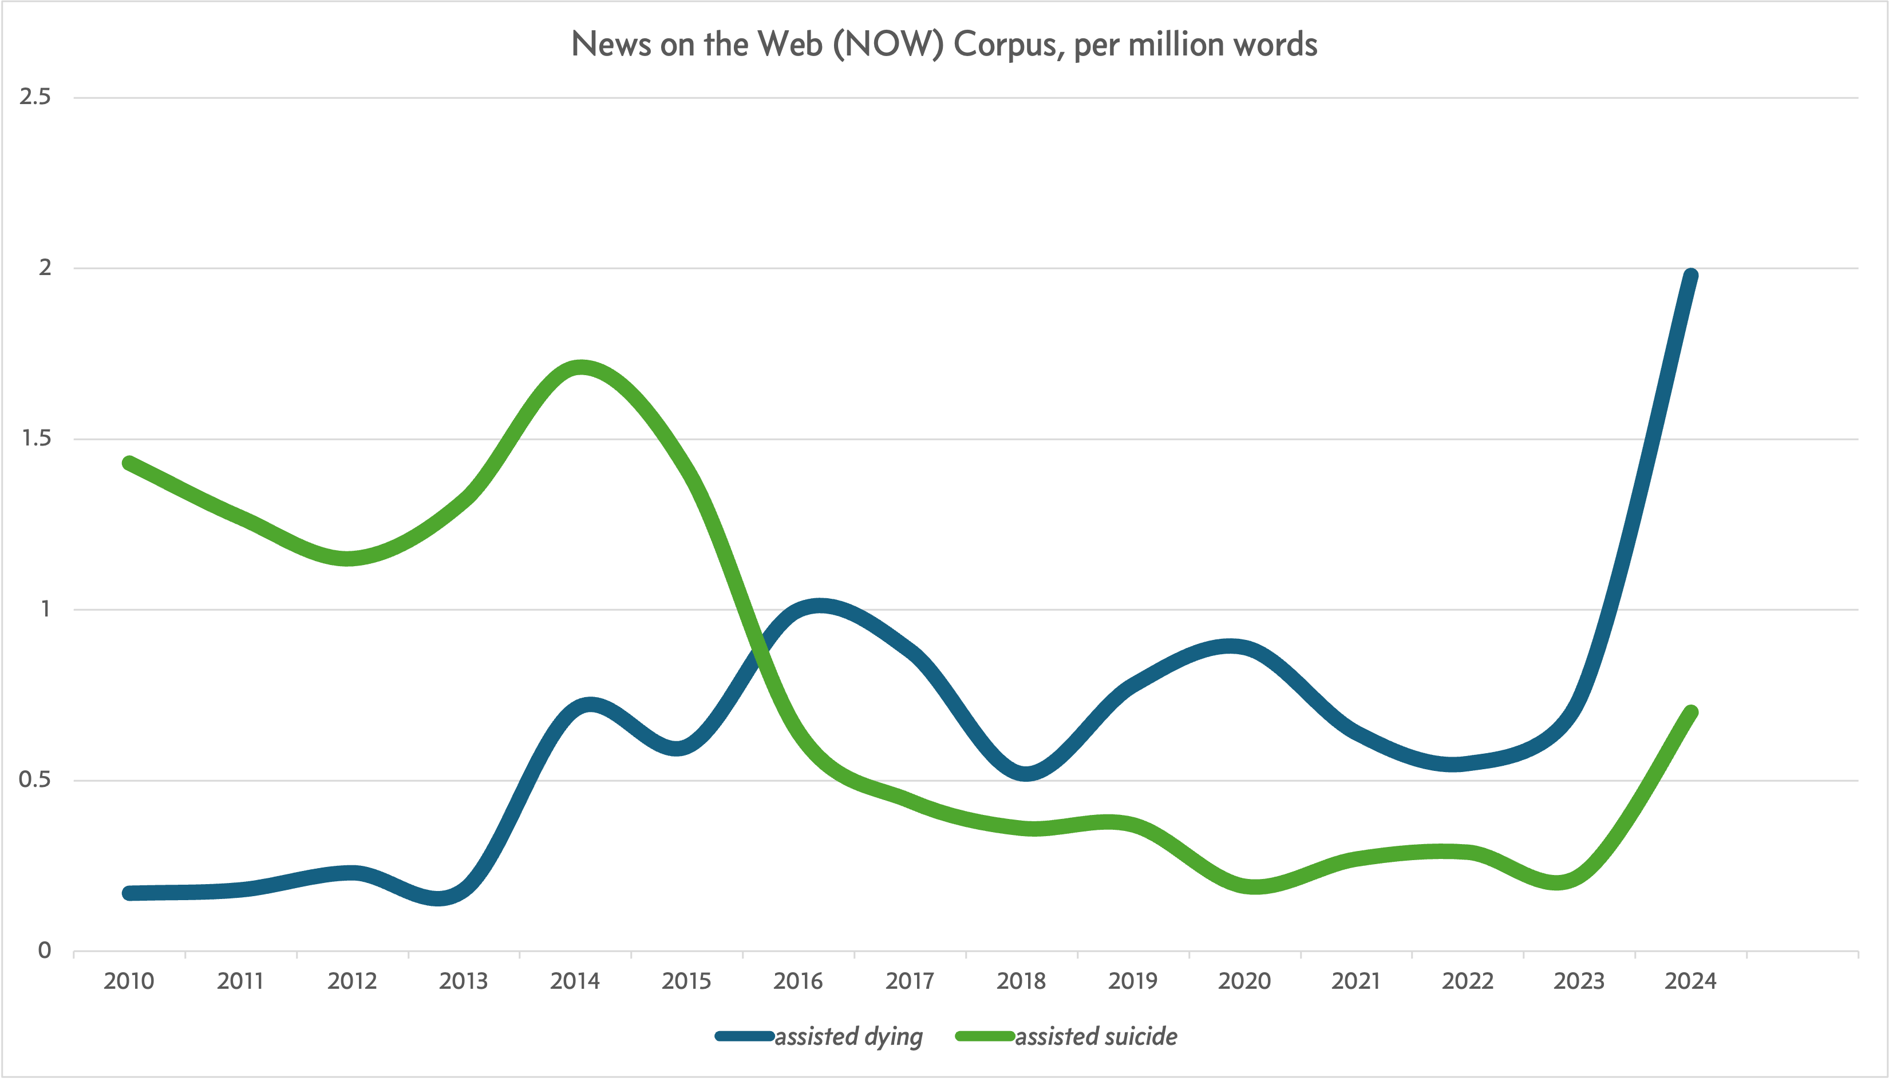

Slide 11
Terminology
No terminology choice is neutral in this debate
“Assisted Dying”
Term used in current bill’s title
“Assisted Suicide”
“Euthanasia”
Not accurate for current bill (euthanasia is physician-administered and this bill requires self-administration)

Slide 12
2. Our Corpora

Slide 13
Consultation Corpus
Free text entries from two public consultations
Metadata includes self-reported closed question on support/opposition to the bill
2021: 2m words across 12,255 written responses
2024: 1.1m words across 7,122 written responses
Press Corpus
Press articles in the UK from the months surrounding the two consultations
Obtained through a set of seed search terms
2021: 2.3m words across 1,668 articles
2024: 2.6m words across 2,969 articles

Slide 14
Consultation Corpus
Free text entries from two public consultations
Metadata includes self-reported closed question on support/opposition to the bill
2021: 2m words across 12,255 written responses
2024: 1.1m words across 7,122 written responses
Press Corpus
Press articles in the UK from the months surrounding the two consultations
Obtained through a set of seed search terms
2021: 2.3m words across 1,668 articles
2024: 2.6m words across 2,969 articles

Slide 15
Consultations
Two consultation stages:
First (2021): Conducted by McArthur during bill formulation
Largest consultation ever for a Scottish bill (12,255 responses)
Second (2024): By Health, Social Care and Sport Committee
A ’call for views‘ must take place as part of Stage 1 consideration (7,122 responses)

Slide 16
Consultation One
23 September 2021 – 22 December 2021
Individual available responses 12,255
Word count 2,018,421
9,651 fully or partially supportive, 1.2m words
2,554 fully or partially opposed, 0.8m words
50 neutral or unsure, 18k words
Ranges from 0 to 9,759 words per response (average 182, median 99)
Notes:
Organisations 59 (plus 21 emails) = 80
Today for time we’re going to look at one question of the individual responses
Five part scale, by the way, and only 3% of respondents expressed a view other than full support or full opposition
26% of all submissions were anonymous
Another 1,322 (9.5% of all submissions) submissions that the respondent marked “not for publication”.

Slide 17
Consultation Two
7 June 2024 – 16 August 2024
Individual available responses 7,122
Word count 805,755
(1,082,534 when including "Other" responses to multiple-choice questions)
425 fully or partially supportive, 81,353 words
6,681 fully or partially opposed, 714,729 words

Slide 20
2021 Questions
Question 1: Support for the proposed Bill
Question 2: Do you think legislation is required
Question 3: Views of the proposed process
Question 4: Views on safeguards
Question 5: Should a body collect data on assisted dying
Question 6: Views on conscientious objections
Question 7: Impact on public finances
Question 8: Impact on protected characteristics
Question 9: Impact on sustainability
Question 10: Additional comments or suggestions
Notes:
protected characteristics (under the Equality Act 2010): age, disability, gender re-assignment, marriage and civil partnership, pregnancy and maternity, race, religion or belief, sex, sexual orientation

Slide 21
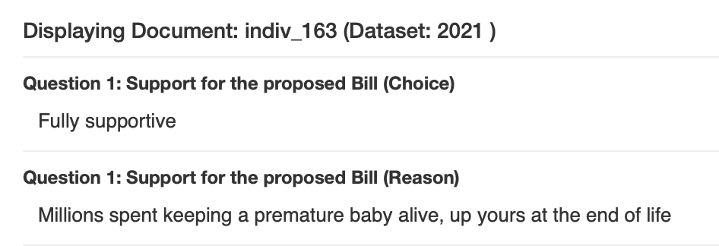

Slide 22
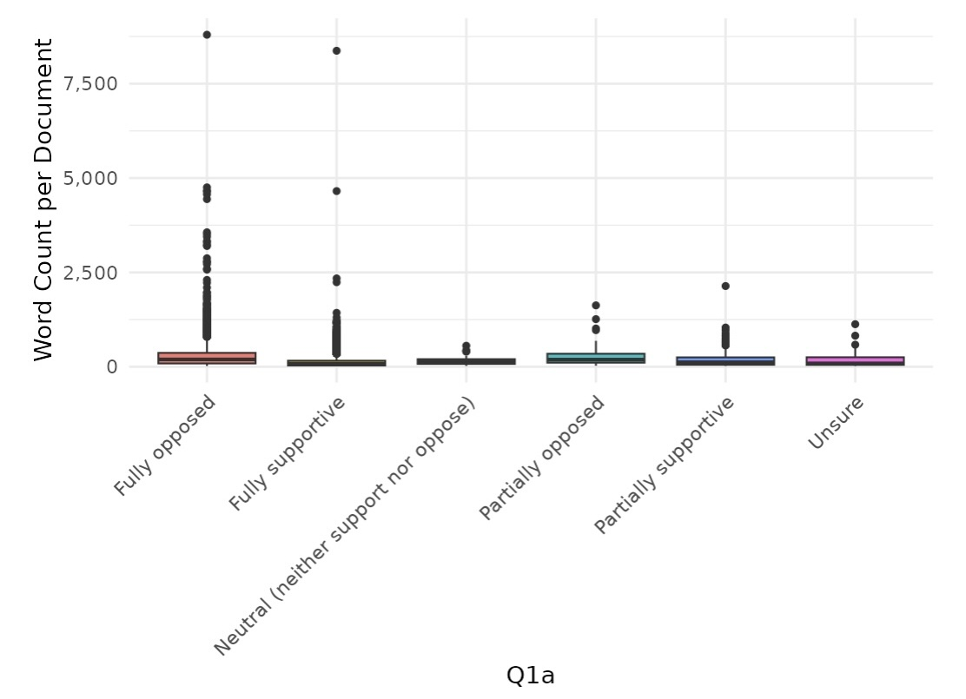
Notes:
protected characteristics (under the Equality Act 2010): age, disability, gender re-assignment, marriage and civil partnership, pregnancy and maternity, race, religion or belief, sex, sexual orientation

Slide 23
3. Polarization and Entrenchment

Slide 24
What is Death?
Collocates of death:
2021 Supportive |  |  |  | 2021 Opposed
collocation | count | score |  | collocation | count | score
assisted death | 581 | 3.2 |  | cause death | 120 | 4.38
dignified death | 198 | 4.51 |  | natural death | 81 | 4.67
painful death | 190 | 4.1 |  | death (is) final | 45 | 4.55
bad death | 59 | 4.35 |  | early death | 42 | 4.34
manner death | 67 | 3.69 |  | premature death | 41 | 5.3
good death | 86 | 2.64 |  | choose death | 51 | 3.37
undignified death | 37 | 4.06 |  | listed death | 31 | 5.17
peaceful death | 39 | 3.67 |  | physician-assisted death | 29 | 4.86

Slide 25
What is Death?
Collocates of death:
2021 Supportive |  |  |  | 2021 Opposed
collocation | count | score |  | collocation | count | score
assisted death | 581 | 3.2 |  | cause death | 120 | 4.38
dignified death | 198 | 4.51 |  | natural death | 81 | 4.67
painful death | 190 | 4.1 |  | death (is) final | 45 | 4.55
bad death | 59 | 4.35 |  | early death | 42 | 4.34
manner death | 67 | 3.69 |  | premature death | 41 | 5.3
good death | 86 | 2.64 |  | choose death | 51 | 3.37
undignified death | 37 | 4.06 |  | listed death | 31 | 5.17
peaceful death | 39 | 3.67 |  | physician-assisted death | 29 | 4.86
Death is something to be judged and part of medical care? |  |  |  | Death is something with its own timescale, a threshold to be respected?

Slide 26
Key Concepts
USAS-tagged 2021 corpus (Wmatrix)
Log-likelihood against BE21 (Paul Baker)

Slide 27
Q1 USAS (‘key concepts’) against BE21, LL
Supportive
Opposed
USAS | USAS Gloss
L1- | Dead
B2- | Disease
E4.1- | Sad
L1+ | Alive
X7+ | Wanted
S6+ | Strong obligation or necessiry
Z8 | Pronouns
S7.4+ | Allowed
S7.2+ | Respected
S2 | People
S8+ | Helping
B3 | Medicines and medical treatment
T2- | Time: Ending
Z6 | Negative
A3+ | Existing
A9+ | Getting and possession
S4 | Kin
Z7 | If
X9.1+ | Able/intelligent
A7+ | Likely
X2.1 | Thought, belief
X6+ | Decided
T1.3++ | Time period: long
E2+ | Like
S6- | No obligation or necessity
USAS | USAS Gloss
L1- | Dead
L1+ | Alive
S8+ | Helping
S1.2.5- | Weak
B3 | Medicines and medical treatment
I1.3 | Money: Cost and price
B2- | Disease
S2 | People
T2- | Time: Ending
A7+ | Likely
N3.5 | Measurement: Weight
A12- | Difficult
X2.1 | Thought, belief
A3+ | Existing
T3+++ | Time: Old; grown up
S6+ | Strong obligation or necessity
Z6 | Negative
N3.8 | Measurement: Speed
A15+ | Safe
S8- | Hindering
S7.2+ | Respected
E6- | Worry
G2.1+ | Lawful
T1.1.3 | Time: Future
E4.1- | Sad

Slide 28
Q1 USAS (‘key concepts’) against BE21, LL
Supportive
Opposed
L1- (Dead)
B2- (Disease)
E4.1- (Sad)
L1+ (Alive)
X7+ (Wanted)
S6+ (Strong obligation or necessity)
Z8 (Pronouns)
S7.4+ (Allowed)
S7.2+ (Respected)
S2 (People)
S8+ (Helping)
B3 (Medicines and medical treatment)
T2- (Time: Ending)
Z6 (Negative)
A3+ (Existing)
A9+ (Getting and possession)
S4 (Kin)
Z7 (If)
X9.1+ (Able/intelligent)
A7+ (Likely)
X2.1 (Thought, belief)
X6+ (Decided)
T1.3++ (Time period: long)
E2+ (Like)
S6- (No obligation or necessity)
L1- (Dead)
L1+ (Alive)
S8+ (Helping)
S1.2.5- (Weak)
B3 (Medicines and medical treatment)
I1.3 (Money: Cost and price)
B2- (Disease)
S2 (People)
T2- (Time: Ending)
A7+ (Likely)
N3.5 (Measurement: Weight)
A12- (Difficult)
X2.1 (Thought, belief)
A3+ (Existing)
T3+++ (Time: Old; grown up)
S6+ (Strong obligation or necessity)
Z6 (Negative)
N3.8 (Measurement: Speed)
A15+ (Safe)
S8- (Hindering)
S7.2+ (Respected)
E6- (Worry)
G2.1+ (Lawful)
T1.1.3 (Time: Future)
E4.1- (Sad)

Slide 29
Q1 USAS (‘key concepts’) against BE21, LL
Supportive
Opposed
L1- (Dead)
B2- (Disease)
E4.1- (Sad)
L1+ (Alive)
X7+ (Wanted)
S6+ (Strong obligation or necessity)
Z8 (Pronouns)
S7.4+ (Allowed)
S7.2+ (Respected)
S2 (People)
S8+ (Helping)
B3 (Medicines and medical treatment)
T2- (Time: Ending)
Z6 (Negative)
A3+ (Existing)
A9+ (Getting and possession)
S4 (Kin)
Z7 (If)
X9.1+ (Able/intelligent)
A7+ (Likely)
X2.1 (Thought, belief)
X6+ (Decided)
T1.3++ (Time period: long)
E2+ (Like)
S6- (No obligation or necessity)
L1- (Dead)
L1+ (Alive)
S8+ (Helping)
S1.2.5- (Weak)
B3 (Medicines and medical treatment)
I1.3 (Money: Cost and price)
B2- (Disease)
S2 (People)
T2- (Time: Ending)
A7+ (Likely)
N3.5 (Measurement: Weight)
A12- (Difficult)
X2.1 (Thought, belief)
A3+ (Existing)
T3+++ (Time: Old; grown up)
S6+ (Strong obligation or necessity)
Z6 (Negative)
N3.8 (Measurement: Speed)
A15+ (Safe)
S8- (Hindering)
S7.2+ (Respected)
E6- (Worry)
G2.1+ (Lawful)
T1.1.3 (Time: Future)
E4.1- (Sad)

Slide 30
2021 “Easy Read Consultation Summary”:
“Over three quarters supportive”
“Lots of these people thought:
it would be kind to let adults who are terminally ill have a safe assisted death if they wanted it.
it would stop their pain and suffering.
assisted dying should be allowed in Scotland because it’s allowed in some other countries.”
Notes:
“Easy Read Consultation Summary”
1.5 million people in the UK have learning disabilities. Easy Read is a method of making information easier to understand for this group.
78% pro (76 very and 2 somewhat)

Slide 31
Fully supportive §§ For 26 years I worked in the emergency service and when on shift I was tasked to investigate any sudden or unexpected reported death in my area. This included all suicides. I have witnessed at first hand and close up the sheer desperation and suffering caused by terminal illness. I have had to examine bodies and scenes where the person has died alone and in obvious agony. People with cancer who have vomited and excreted blood and body matter into bowls,coal scuttles, sinks, beds, floors etc.. before finally dying, often over a period of days and weeks, alone in their property which by that time often resembled a crime scene. I was also called to all suicides and lost count of the number of people I have had to cut down from their nooses whilst their grieving family cried in the adjacent room. People who often had terminal illnesses and who were forced into bringing their death forward to avoid further awful suffering.I have over the years collected up body parts from railway lines, shorelines and farmers’ fields were the victims had to end their lives alone with the added burden of bringing shock and despair to their loved ones. In April 2020 I was diagnosed with inoperable pancreatic cancer and given 6-12 months to live if I chose not to have palliative chemotherapy, and possibly 18 months if I chose to undertake it. My world fell apart and I had to break the news to my wife and two sons. I have had to give up the job I loved and have undergone chemotherapy and subsequent surgery. The prognosis for anyone with pancreatic cancer is extremely bleak with only a very small percentage of suffered living beyond five years from diagnosis. Only those receiving Whipple surgery have any chance if this survival and a large proportion of sufferers are diagnosed too late for this to be viable. I am a proud and private individual who does not want to spend my final days, weeks, or god forbid months, in a hospital or hospice, in pain with no quality of life and having to be lifted off a bed pan or worse! I do not want to be forced into ending my life alone, maybe in my car with the embers of a disposable BBQ smouldering in the boot, or hanging in a lonely wood waiting for some poor unsuspecting member of the public to find me-but with no compassionate alternative that is what I will do, The pain and suffering that this will cause to my family I don’t want to think about but I know it will be a little bit less than them watching helpless while I die slowly in front of them in hospital. I think we currently treat animals at the end of their lives better than we do humans. Death comes to us all. We cannot escape it and as our bodies age and fail, who would want to? As a developed nation we spend millions trying to keep the dying alive. This is how it should be if the individual still enjoys a quality of life but there comes a time when the individual should be able to decide that enough is enough.
Fully supportive §§ I feel very strongly that I should have a right to a dignified death and end of life experience and that others should have this right too, should they wish it. Palliative care although very important is not enough . My elderly and terminally ill mother is dying very very slowly ! She is in constant pain and although heartbreaking and distressing for me, for her, it is thoroughly exhausting, depressing and at times utterly terrifying. The strong medications for the pain cause hallucinations and she has nightmares and the other medications to mitigate the side effects means her body is constantly under attack not just from her illnesses but the drugs. I can’t begin to describe the impact other than she has serious problems with eating, sleeping and toileting and weighs around 28kilos .Her quality of life is so reduced and utterly miserable she just so wants these ‘dark times’ to end. And why shouldn’t she ? why should this woman have to suffer like this and for so long when she feels overall that she has had a good life but really now desperately wants it to end . I believe my mother should be able to have medical assistance to die.
Fully supportive §§ I worked in the NHS for 35 years and saw the passing of many people( including having sat at the bedside of 3 of my family when they died). Whilst hospice care and palliative care has improved greatly over the last years, I have still seen deaths that were not peaceful or painfree, people asking why they were being kept alive, when they wanted to pass away on their own terms. We treat animals with more dignity and compassion sometimes, and deny people their basic human right of a good death. If people can refuse treatment /medication, why cant they not choose how they die? Years ago a woman had to have their husbands consent to have a hysterectomy, this smacks of the same thing, someone unable to make a choice about their life and body, and how they choose to end it. surely this is a fundamental abuse of someone's human rights....... I also strongly believe that religious belief has NO place in medicine......it is unethical for people to impose suffering on others because of their religious beliefs about assisted suicide( in an increasingly secular society, how relevant is this now, and I speak as a religious practitioner)
It's about choice. Currently, other people's choices prevent those who are terminally ill from dying when they wish to. That's cruel and unfair. It's rarely seen in this way because it is the status quo, but the fact is people are currently being coerced into dying in ways they do not wish to, at a time when they are at their weakest and most vulnerable. I have direct personal experience of close family members dying in hospital. My only wish is that individuals are given a choice in ways that have been proven safe and ethical from experiences in other countries. It's about compassion and autonomy. I have medical knowledge and know that some natural deaths can never be made 'good'. Drugs have their limits. Some hugely distressing processes of dying cannot be controlled without very heavy sedation or general anaesthetic which must be permanent and constantly monitored. The prospect of some of these symptoms - the distress and loss of dignity they entail - is a terrifying prospect for people (the majority in Scotland, going by surveys) and for those that they love. The current situation is cruel and unnecessary. Those campaigning against change are campaigning to stop people having what they desperately want. We will surely look back and wonder why it took so very long and why so many people had to yield to a process which denies them control, autonomy and dignity, because we were not brave enough to approach this subject in a calm, rational and compassionate way.
I had to watch my dad die of pancreatic cancer. He was in a hospice but he didn't want to be there. From the minute he got diagnosed he wanted to go out on his own terms. He ended up talking to my partner and I about suicide. I had to look into the best method of suicide for him. I had to get myself on the dark web and research drugs. I was fully prepared to put myself at risk and buy him drugs from teh dark web so that he could stop the pain. However, my daddy told me it was too risky for me, as I work in teh legal sector. So I didn't take it any further. But in what world should this be allowed to happen? People should not have to be doing stuff like this when they're already coping with the impending death of a loved one. It felt so surreal for me, I never thought I would be in that position. And how many other people out there in Scotland have found themselves in a similar position? More than you know. Watching my lovely, strong daddy die broke my heart and instead of happy memories of my dad, I just want to cry every time I think about him. It's too raw just now I know, but it didn't need to be like this. I'm sitting here in tears thinking about him. I just wish I hadn't listened to him and got him the drugs. Even in the hospice he was still saying if there was an injection or a pill, he would take it. Nobody should need to go through this. It's killing me. He should have been able to leave on his own terms. He shouldn't have had to suffer and waste away. We don't treat dugs like this. Why are we more compassionate to animals than humans? This bill would come too late for my dad, but not for so many others who are going to find themselves in the position I did.
Notes:
21%

Slide 32
Fully supportive §§ For 26 years I worked in the emergency service and when on shift I was tasked to investigate any sudden or unexpected reported death in my area. This included all suicides. I have witnessed at first hand and close up the sheer desperation and suffering caused by terminal illness. I have had to examine bodies and scenes where the person has died alone and in obvious agony. People with cancer who have vomited and excreted blood and body matter into bowls,coal scuttles, sinks, beds, floors etc.. before finally dying, often over a period of days and weeks, alone in their property which by that time often resembled a crime scene. I was also called to all suicides and lost count of the number of people I have had to cut down from their nooses whilst their grieving family cried in the adjacent room. People who often had terminal illnesses and who were forced into bringing their death forward to avoid further awful suffering.I have over the years collected up body parts from railway lines, shorelines and farmers’ fields were the victims had to end their lives alone with the added burden of bringing shock and despair to their loved ones. In April 2020 I was diagnosed with inoperable pancreatic cancer and given 6-12 months to live if I chose not to have palliative chemotherapy, and possibly 18 months if I chose to undertake it. My world fell apart and I had to break the news to my wife and two sons. I have had to give up the job I loved and have undergone chemotherapy and subsequent surgery. The prognosis for anyone with pancreatic cancer is extremely bleak with only a very small percentage of suffered living beyond five years from diagnosis. Only those receiving Whipple surgery have any chance if this survival and a large proportion of sufferers are diagnosed too late for this to be viable. I am a proud and private individual who does not want to spend my final days, weeks, or god forbid months, in a hospital or hospice, in pain with no quality of life and having to be lifted off a bed pan or worse! I do not want to be forced into ending my life alone, maybe in my car with the embers of a disposable BBQ smouldering in the boot, or hanging in a lonely wood waiting for some poor unsuspecting member of the public to find me-but with no compassionate alternative that is what I will do, The pain and suffering that this will cause to my family I don’t want to think about but I know it will be a little bit less than them watching helpless while I die slowly in front of them in hospital. I think we currently treat animals at the end of their lives better than we do humans. Death comes to us all. We cannot escape it and as our bodies age and fail, who would want to? As a developed nation we spend millions trying to keep the dying alive. This is how it should be if the individual still enjoys a quality of life but there comes a time when the individual should be able to decide that enough is enough.
Fully supportive §§ I feel very strongly that I should have a right to a dignified death and end of life experience and that others should have this right too, should they wish it. Palliative care although very important is not enough . My elderly and terminally ill mother is dying very very slowly ! She is in constant pain and although heartbreaking and distressing for me, for her, it is thoroughly exhausting, depressing and at times utterly terrifying. The strong medications for the pain cause hallucinations and she has nightmares and the other medications to mitigate the side effects means her body is constantly under attack not just from her illnesses but the drugs. I can’t begin to describe the impact other than she has serious problems with eating, sleeping and toileting and weighs around 28kilos .Her quality of life is so reduced and utterly miserable she just so wants these ‘dark times’ to end. And why shouldn’t she ? why should this woman have to suffer like this and for so long when she feels overall that she has had a good life but really now desperately wants it to end . I believe my mother should be able to have medical assistance to die.
Fully supportive §§ I worked in the NHS for 35 years and saw the passing of many people( including having sat at the bedside of 3 of my family when they died). Whilst hospice care and palliative care has improved greatly over the last years, I have still seen deaths that were not peaceful or painfree, people asking why they were being kept alive, when they wanted to pass away on their own terms. We treat animals with more dignity and compassion sometimes, and deny people their basic human right of a good death. If people can refuse treatment /medication, why cant they not choose how they die? Years ago a woman had to have their husbands consent to have a hysterectomy, this smacks of the same thing, someone unable to make a choice about their life and body, and how they choose to end it. surely this is a fundamental abuse of someone's human rights....... I also strongly believe that religious belief has NO place in medicine......it is unethical for people to impose suffering on others because of their religious beliefs about assisted suicide( in an increasingly secular society, how relevant is this now, and I speak as a religious practitioner)
It's about choice. Currently, other people's choices prevent those who are terminally ill from dying when they wish to. That's cruel and unfair. It's rarely seen in this way because it is the status quo, but the fact is people are currently being coerced into dying in ways they do not wish to, at a time when they are at their weakest and most vulnerable. I have direct personal experience of close family members dying in hospital. My only wish is that individuals are given a choice in ways that have been proven safe and ethical from experiences in other countries. It's about compassion and autonomy. I have medical knowledge and know that some natural deaths can never be made 'good'. Drugs have their limits. Some hugely distressing processes of dying cannot be controlled without very heavy sedation or general anaesthetic which must be permanent and constantly monitored. The prospect of some of these symptoms - the distress and loss of dignity they entail - is a terrifying prospect for people (the majority in Scotland, going by surveys) and for those that they love. The current situation is cruel and unnecessary. Those campaigning against change are campaigning to stop people having what they desperately want. We will surely look back and wonder why it took so very long and why so many people had to yield to a process which denies them control, autonomy and dignity, because we were not brave enough to approach this subject in a calm, rational and compassionate way.
I had to watch my dad die of pancreatic cancer. He was in a hospice but he didn't want to be there. From the minute he got diagnosed he wanted to go out on his own terms. He ended up talking to my partner and I about suicide. I had to look into the best method of suicide for him. I had to get myself on the dark web and research drugs. I was fully prepared to put myself at risk and buy him drugs from teh dark web so that he could stop the pain. However, my daddy told me it was too risky for me, as I work in teh legal sector. So I didn't take it any further. But in what world should this be allowed to happen? People should not have to be doing stuff like this when they're already coping with the impending death of a loved one. It felt so surreal for me, I never thought I would be in that position. And how many other people out there in Scotland have found themselves in a similar position? More than you know. Watching my lovely, strong daddy die broke my heart and instead of happy memories of my dad, I just want to cry every time I think about him. It's too raw just now I know, but it didn't need to be like this. I'm sitting here in tears thinking about him. I just wish I hadn't listened to him and got him the drugs. Even in the hospice he was still saying if there was an injection or a pill, he would take it. Nobody should need to go through this. It's killing me. He should have been able to leave on his own terms. He shouldn't have had to suffer and waste away. We don't treat dugs like this. Why are we more compassionate to animals than humans? This bill would come too late for my dad, but not for so many others who are going to find themselves in the position I did.
Notes:
21%

Slide 33
Excerpts

Slide 34
Fully supportive §§ For 26 years I worked in the emergency service and when on shift I was tasked to investigate any sudden or unexpected reported death in my area. This included all suicides. I have witnessed at first hand and close up the sheer desperation and suffering caused by terminal illness. I have had to examine bodies and scenes where the person has died alone and in obvious agony. People with cancer who have vomited and excreted blood and body matter into bowls,coal scuttles, sinks, beds, floors etc.. before finally dying, often over a period of days and weeks, alone in their property which by that time often resembled a crime scene. I was also called to all suicides and lost count of the number of people I have had to cut down from their nooses whilst their grieving family cried in the adjacent room. People who often had terminal illnesses and who were forced into bringing their death forward to avoid further awful suffering.I have over the years collected up body parts from railway lines, shorelines and farmers’ fields were the victims had to end their lives alone with the added burden of bringing shock and despair to their loved ones. In April 2020 I was diagnosed with inoperable pancreatic cancer and given 6-12 months to live if I chose not to have palliative chemotherapy, and possibly 18 months if I chose to undertake it. My world fell apart and I had to break the news to my wife and two sons. I have had to give up the job I loved and have undergone chemotherapy and subsequent surgery. The prognosis for anyone with pancreatic cancer is extremely bleak with only a very small percentage of suffered living beyond five years from diagnosis. Only those receiving Whipple surgery have any chance if this survival and a large proportion of sufferers are diagnosed too late for this to be viable. I am a proud and private individual who does not want to spend my final days, weeks, or god forbid months, in a hospital or hospice, in pain with no quality of life and having to be lifted off a bed pan or worse! I do not want to be forced into ending my life alone, maybe in my car with the embers of a disposable BBQ smouldering in the boot, or hanging in a lonely wood waiting for some poor unsuspecting member of the public to find me-but with no compassionate alternative that is what I will do, The pain and suffering that this will cause to my family I don’t want to think about but I know it will be a little bit less than them watching helpless while I die slowly in front of them in hospital. I think we currently treat animals at the end of their lives better than we do humans. Death comes to us all. We cannot escape it and as our bodies age and fail, who would want to? As a developed nation we spend millions trying to keep the dying alive. This is how it should be if the individual still enjoys a quality of life but there comes a time when the individual should be able to decide that enough is enough.
Fully supportive §§ I feel very strongly that I should have a right to a dignified death and end of life experience and that others should have this right too, should they wish it. Palliative care although very important is not enough . My elderly and terminally ill mother is dying very very slowly ! She is in constant pain and although heartbreaking and distressing for me, for her, it is thoroughly exhausting, depressing and at times utterly terrifying. The strong medications for the pain cause hallucinations and she has nightmares and the other medications to mitigate the side effects means her body is constantly under attack not just from her illnesses but the drugs. I can’t begin to describe the impact other than she has serious problems with eating, sleeping and toileting and weighs around 28kilos .Her quality of life is so reduced and utterly miserable she just so wants these ‘dark times’ to end. And why shouldn’t she ? why should this woman have to suffer like this and for so long when she feels overall that she has had a good life but really now desperately wants it to end . I believe my mother should be able to have medical assistance to die.
Fully supportive §§ I worked in the NHS for 35 years and saw the passing of many people( including having sat at the bedside of 3 of my family when they died). Whilst hospice care and palliative care has improved greatly over the last years, I have still seen deaths that were not peaceful or painfree, people asking why they were being kept alive, when they wanted to pass away on their own terms. We treat animals with more dignity and compassion sometimes, and deny people their basic human right of a good death. If people can refuse treatment /medication, why cant they not choose how they die? Years ago a woman had to have their husbands consent to have a hysterectomy, this smacks of the same thing, someone unable to make a choice about their life and body, and how they choose to end it. surely this is a fundamental abuse of someone's human rights....... I also strongly believe that religious belief has NO place in medicine......it is unethical for people to impose suffering on others because of their religious beliefs about assisted suicide( in an increasingly secular society, how relevant is this now, and I speak as a religious practitioner)
It's about compassion and autonomy. I have medical knowledge and know that some natural deaths can never be made 'good'. Drugs have their limits. […] We will surely look back and wonder why it took so very long and why so many people had to yield to a process which denies them control, autonomy and dignity, because we were not brave enough to approach this subject in a calm, rational and compassionate way.
I had to watch my dad die of pancreatic cancer. […] I was fully prepared to put myself at risk and buy him drugs from teh dark web so that he could stop the pain. However, my daddy told me it was too risky for me, as I work in teh legal sector. So I didn't take it any further. But in what world should this be allowed to happen? […] I'm sitting here in tears thinking about him. I just wish I hadn't listened to him and got him the drugs. Even in the hospice he was still saying if there was an injection or a pill, he would take it. Nobody should need to go through this. It's killing me. He should have been able to leave on his own terms. He shouldn't have had to suffer and waste away. We don't treat dugs like this.
Notes:
21%

Slide 35
2021 “Easy Read Consultation Summary”:
“Just under a quarter not supportive”
“Some people thought:
it was wrong for a person to take their own life, or to get help to end their life.
it wouldn’t be safe because you wouldn’t know for sure if the person was making the choice for themselves.
older people or disabled people might feel worried about other people trying to choose for them. They might feel less important.”
Notes:
21%

Slide 36
Please add my contribution to the consideration of the Assisted Suicide Bill Scotland. Authority is not given to any human being to take the life of another. This is true whether approached from the point of view of God’s Law or from the perspective of human morality. Whilst we have the right to life, this is a gift and we have no "right to death" - there is no UN "Human Right to die", this is not a right under the US constitution, the Magna Carta or The Declaration of Arbroath. It is the highest form of human arrogance and hubris to make law that deprives an equal of continued existence. Politicians who support this measure whether through a misguided sense of compassion or for other reasons have lost their moral compass and I ask you to examine your conscience. Do you truly have authority to decide whether to take life?Are you wise enough to decide to take life? Did you openly and honestly explain publicly and repeatedly to voters that you supported state sponsored suicide BEFORE you were elected? Are you comfortable for someone to decide for your life to be ended if you are incapacitated? The argument in favour of assisted suicide is often to save suffering. Every creature suffers and suffering defines the human condition. Although difficult to understand at the time, there is often value in suffering for us to grow as people spiritually and for others to learn from example that human beings can transcend pain. I fear that great and small contributions to humankind will be lost because life is taken before it’s biological end - consider for example if Stephen Hawking in a fit of depression or simply being overwhelmed when understanding his future life trajectory decided he wanted to end his life. It is not in helping its citizens to die that the greatness of a society or civilisation is determined, it is in how it helps them to live - this is where resources should be channelled. Resources for palliative care - yes; assisted suicide - no. Every human life has value.
This is a huge issue – massive. Why does anyone want to change what has been there in society since the days of creation? Does society now think we should perhaps do this? Society has never asked for or demanded such a decision. This is a radical change attacking the very roots of welfare and wellbeing – and trust – and would change society. We were created in the Image of God – and if this goes forward, we are challenging LIFE – and VALUES and STANDARDS. Does LIFE mean we have a new meaning of LIFE? Parts of society decided to take life in the womb before life was born into the world – now some want to end life before life is over. The only occasion we are permitted to take life is when a life has been taken – i.e.-Capital Punishment. That Command has never been changed – withdrawn or modified. In the Army a command remains in force until it is rescinded. One day each of us has to stand before Almighty God – and answer for the decisions we have made – whether we believe it or not – whether we want to or not. This is one reason why we must be very very careful indeed.
a] Gradual expansion of the boundaries. Although the initial physician assisted suicide legislation in a country usually has clear boundaries, in practice it has been found that these boundaries are gradually widened through time. Thus Belgium's initial law in 2002 expanded from almost exclusively terminally ill cancer patients to patients with psychological illnesses such as severe depression or personality disorder and more recently to competent minors. In Canada, the 2016 law which allowed medical assisted dying for physical health reasons was expanded in 2021 to include patients with mental health conditions. b] Reasons for choosing assisted dying. Legalising assisted suicide may result in vulnerable patients being pressured into assisted dying rather than becoming a financial, emotional or care burden on their families. In Oregon, 5 % of patients dying by assisted suicide gave financial reasons for their decision. Those giving as the reason the '' becoming a burden on family, friends or caregivers'' increased from 13% in 1998 to 55% in 2017. c] The medical professionals involved in caring for the terminally ill patients and in palliative care do not support legalising assisted dying. The British Geriatrics Society, the Association for Palliative Medicine of Great Britain and Ireland, the majority of the British Medical Association members who are involved in palliative care or geriatric medicine oppose the legalisation of assisted dying. In England, 1689 doctors wrote to the Health Secretary opposing assisted dying legislation: ''The shift from preserving life to taking life is enormous and should not be minimised. It is impossible for any government to draft assisted suicide laws which include legal protection from future extension and expansion of those laws''
Fully opposed §§ Doctors work to save and preserve life. They should not be called upon to act as executioners. As a society we should be providing care to those who are suffering and not trying to dodge that duty by promoting euthanasia. If this is allowed to become law we will have crossed a threshold which will open up all sorts of perverse incentives for promoting the practice and greatly broadening the category of individuals who can be euthanased. We need only remember that the holocaust began with euthanising children with severe mental and physical handicaps. Modern palliative care is highly effective in relieving suffering at the end of life. How a person dies is part of the legacy they leave their loved ones. It is often a time for precious communication. Courage can be displayed. There is such a thing as a good death. Dying by suicide or euthanasia will leave a scar on the bereaved family. Not only would there be a constant onus on the sick person to opt for euthanasia but politicians working with a limited healthcare budget or local councillors will quickly realise that they could save a lot of money by euthanising those with high ongoing care costs. One of the purposes of the law is to protect the vulnerable from abuse and exploitation. There is a great risk that this bill will do the opposite. The majority of UK doctors remain opposed to legislation in favour of assisted suicide. It is explicitly forbidden in the Hippocratic Oath.
Notes:
21%

Slide 37
Please add my contribution to the consideration of the Assisted Suicide Bill Scotland. Authority is not given to any human being to take the life of another. This is true whether approached from the point of view of God’s Law or from the perspective of human morality. Whilst we have the right to life, this is a gift and we have no "right to death" - there is no UN "Human Right to die", this is not a right under the US constitution, the Magna Carta or The Declaration of Arbroath. It is the highest form of human arrogance and hubris to make law that deprives an equal of continued existence. Politicians who support this measure whether through a misguided sense of compassion or for other reasons have lost their moral compass and I ask you to examine your conscience. Do you truly have authority to decide whether to take life?Are you wise enough to decide to take life? Did you openly and honestly explain publicly and repeatedly to voters that you supported state sponsored suicide BEFORE you were elected? Are you comfortable for someone to decide for your life to be ended if you are incapacitated? The argument in favour of assisted suicide is often to save suffering. Every creature suffers and suffering defines the human condition. Although difficult to understand at the time, there is often value in suffering for us to grow as people spiritually and for others to learn from example that human beings can transcend pain. I fear that great and small contributions to humankind will be lost because life is taken before it’s biological end - consider for example if Stephen Hawking in a fit of depression or simply being overwhelmed when understanding his future life trajectory decided he wanted to end his life. It is not in helping its citizens to die that the greatness of a society or civilisation is determined, it is in how it helps them to live - this is where resources should be channelled. Resources for palliative care - yes; assisted suicide - no. Every human life has value.
This is a huge issue – massive. Why does anyone want to change what has been there in society since the days of creation? Does society now think we should perhaps do this? Society has never asked for or demanded such a decision. This is a radical change attacking the very roots of welfare and wellbeing – and trust – and would change society. We were created in the Image of God – and if this goes forward, we are challenging LIFE – and VALUES and STANDARDS. Does LIFE mean we have a new meaning of LIFE? Parts of society decided to take life in the womb before life was born into the world – now some want to end life before life is over. The only occasion we are permitted to take life is when a life has been taken – i.e.-Capital Punishment. That Command has never been changed – withdrawn or modified. In the Army a command remains in force until it is rescinded. One day each of us has to stand before Almighty God – and answer for the decisions we have made – whether we believe it or not – whether we want to or not. This is one reason why we must be very very careful indeed.
a] Gradual expansion of the boundaries. Although the initial physician assisted suicide legislation in a country usually has clear boundaries, in practice it has been found that these boundaries are gradually widened through time. Thus Belgium's initial law in 2002 expanded from almost exclusively terminally ill cancer patients to patients with psychological illnesses such as severe depression or personality disorder and more recently to competent minors. In Canada, the 2016 law which allowed medical assisted dying for physical health reasons was expanded in 2021 to include patients with mental health conditions. b] Reasons for choosing assisted dying. Legalising assisted suicide may result in vulnerable patients being pressured into assisted dying rather than becoming a financial, emotional or care burden on their families. In Oregon, 5 % of patients dying by assisted suicide gave financial reasons for their decision. Those giving as the reason the '' becoming a burden on family, friends or caregivers'' increased from 13% in 1998 to 55% in 2017. c] The medical professionals involved in caring for the terminally ill patients and in palliative care do not support legalising assisted dying. The British Geriatrics Society, the Association for Palliative Medicine of Great Britain and Ireland, the majority of the British Medical Association members who are involved in palliative care or geriatric medicine oppose the legalisation of assisted dying. In England, 1689 doctors wrote to the Health Secretary opposing assisted dying legislation: ''The shift from preserving life to taking life is enormous and should not be minimised. It is impossible for any government to draft assisted suicide laws which include legal protection from future extension and expansion of those laws''
Fully opposed §§ Doctors work to save and preserve life. They should not be called upon to act as executioners. As a society we should be providing care to those who are suffering and not trying to dodge that duty by promoting euthanasia. If this is allowed to become law we will have crossed a threshold which will open up all sorts of perverse incentives for promoting the practice and greatly broadening the category of individuals who can be euthanased. We need only remember that the holocaust began with euthanising children with severe mental and physical handicaps. Modern palliative care is highly effective in relieving suffering at the end of life. How a person dies is part of the legacy they leave their loved ones. It is often a time for precious communication. Courage can be displayed. There is such a thing as a good death. Dying by suicide or euthanasia will leave a scar on the bereaved family. Not only would there be a constant onus on the sick person to opt for euthanasia but politicians working with a limited healthcare budget or local councillors will quickly realise that they could save a lot of money by euthanising those with high ongoing care costs. One of the purposes of the law is to protect the vulnerable from abuse and exploitation. There is a great risk that this bill will do the opposite. The majority of UK doctors remain opposed to legislation in favour of assisted suicide. It is explicitly forbidden in the Hippocratic Oath.
Notes:
21%

Slide 38
Please add my contribution to the consideration of the Assisted Suicide Bill Scotland. Authority is not given to any human being to take the life of another. This is true whether approached from the point of view of God’s Law or from the perspective of human morality. Whilst we have the right to life, this is a gift and we have no "right to death" - there is no UN "Human Right to die", this is not a right under the US constitution, the Magna Carta or The Declaration of Arbroath. It is the highest form of human arrogance and hubris to make law that deprives an equal of continued existence. Politicians who support this measure whether through a misguided sense of compassion or for other reasons have lost their moral compass and I ask you to examine your conscience. Do you truly have authority to decide whether to take life?Are you wise enough to decide to take life? Did you openly and honestly explain publicly and repeatedly to voters that you supported state sponsored suicide BEFORE you were elected? Are you comfortable for someone to decide for your life to be ended if you are incapacitated? The argument in favour of assisted suicide is often to save suffering. Every creature suffers and suffering defines the human condition. Although difficult to understand at the time, there is often value in suffering for us to grow as people spiritually and for others to learn from example that human beings can transcend pain. I fear that great and small contributions to humankind will be lost because life is taken before it’s biological end - consider for example if Stephen Hawking in a fit of depression or simply being overwhelmed when understanding his future life trajectory decided he wanted to end his life. It is not in helping its citizens to die that the greatness of a society or civilisation is determined, it is in how it helps them to live - this is where resources should be channelled. Resources for palliative care - yes; assisted suicide - no. Every human life has value.
This is a radical change attacking the very roots of welfare and wellbeing – and trust – and would change society. We were created in the Image of God – and if this goes forward, we are challenging LIFE – and VALUES and STANDARDS. Does LIFE mean we have a new meaning of LIFE? Parts of society decided to take life in the womb before life was born into the world – now some want to end life before life is over.
Thus Belgium's initial law in 2002 expanded from almost exclusively terminally ill cancer patients to patients with psychological illnesses such as severe depression or personality disorder and more recently to competent minors. In Canada, the 2016 law which allowed medical assisted dying for physical health reasons was expanded in 2021 to include patients with mental health conditions. […] The British Geriatrics Society, the Association for Palliative Medicine of Great Britain and Ireland, the majority of the British Medical Association members who are involved in palliative care or geriatric medicine oppose the legalisation of assisted dying.
Fully opposed §§ Doctors work to save and preserve life. They should not be called upon to act as executioners. As a society we should be providing care to those who are suffering and not trying to dodge that duty by promoting euthanasia. If this is allowed to become law we will have crossed a threshold which will open up all sorts of perverse incentives for promoting the practice and greatly broadening the category of individuals who can be euthanased. We need only remember that the holocaust began with euthanising children with severe mental and physical handicaps. Modern palliative care is highly effective in relieving suffering at the end of life. How a person dies is part of the legacy they leave their loved ones. It is often a time for precious communication. Courage can be displayed. There is such a thing as a good death. Dying by suicide or euthanasia will leave a scar on the bereaved family. Not only would there be a constant onus on the sick person to opt for euthanasia but politicians working with a limited healthcare budget or local councillors will quickly realise that they could save a lot of money by euthanising those with high ongoing care costs. One of the purposes of the law is to protect the vulnerable from abuse and exploitation. There is a great risk that this bill will do the opposite. The majority of UK doctors remain opposed to legislation in favour of assisted suicide. It is explicitly forbidden in the Hippocratic Oath.
Notes:
21%

Slide 39
4. Argumentation and Authority

Slide 40
Unique lexis in supportive subcorpus
suffering
abject, agonies, brutal, crying, hideous, starve, tears, thirst, torment, torture, traumatising, tumours
humiliation
bladder, cleaned, drip, eating, humiliation, incontinence, limbs, nappy, urine, vegetable, wash, wearing
prolonging
drag, dragged, endless, endlessly, lasted, linger

Slide 41
Unique lexis in supportive subcorpus
I have seen first hand the unnecessary pain and torment that is caused by this horrific disease.
If you’d seen your Parent with advanced Alzheimer’s, needing to be fed, washed, nappy changed, YOU WOULDN’T NEED TO ASK!

Slide 42
positive for Huntington’s Disease I’ve | watched my | 3 older siblings deteriorate slowly
I | watched my | dad die slowly and painfully
I sadly | watched my | young brother suffer horrendous pain
position More than you know | Watching my | lovely strong daddy die broke
I | watched my | father die a very horrible
I | watched my | mother die horribly from terminal
I | watched my | daughter die from cancer with
When I was 19 I | watched my | mother waste away and die
I | watch my | father die of cancer slowly
I had to | watch my | mother suffer excruciating daily pain
I | watched my | mum suffer a prolonged and
before the experience we had | watching my | dad suffer for months
I | watched my | husband in agony for months
nothing noble about suffering I | watched my | husband die of pancreatic cancer
I had to | watch my | husband die slowly of MND
I | watched my | Mom's slow and gruelling death
I experienced a harrowing time | watching my | father dying in a physically
I have | watched my | 2 lovely sisters and my
I | watched my | Gran slowly die piece by
Having | watched my | father suffer terribly during the
no quality of life I | watched my | mother suffer when you wouldn’t
After | watching my | family members in their final
fluids it was horrendous to | watch my | partner who was only 41
| Watched my | mum die a horrendous ending
I | watched my | grandfather father and best friend
I | watched my | mother die a horrible death
I | watch my | terminally ill mum dye from
I had to | watch my | mum in absolute agony for
I had to | watch my | mother slowly and painfully die
watch* my
Notes:
Watch* my

Slide 43
pain endured I have whatched | first hand | my granny suffer greatly and
adult life I have witnessed | first hand | many deaths with many causes
and MND and have seen | first hand | their suffering at not being
should end I have seen | first hand | my Father endure an unnecessarily
living is I have had | first hand | experience of the long protracted
living I have witnessed at | first hand | the pain and suffering experienced
family not machines I have | first hand | experience of deaths that were
consultation document I have seen | first hand | a relative age 55 who
so I have seen at | first hand | the physical and psychological damage
her comfortable I’ve seen it | first hand | You will be asking Doctors
in our land Having witnessed | first hand | the torture that is suffered
longer worth living I've witnessed | first hand | the misery of watching someone
worth living I have seen | first hand | the pain and suffering that
previous page I have seen | first hand | the difficulties and pain which
Personal experience I have watched | first hand | terminally ill family and friends
premature death I have witnessed | first hand | with my grandfather how horrible
cancer I have seen at | first hand | the unnecessary pain and torment
traumatisation of their families Having | first hand | experience of my mum having
or medics I have seen | first hand | the awfulness of vulnerable people
their lives I have seen | first hand | the anxiety of some patients
families And I have witnessed | first hand | a patient's relatives who wanted
same situation or similar Having | first hand | experience of my wife s
terminally ill I had seen | first hand | the suffering associated with MND
religious organisations I have witnessed | first hand | horrific deaths of my parents
writing from a position of | first hand | experience as my Mum felt
older people i have seen | first hand | unscrupulous families creating an environment
of life I have seen | first hand | how for the wrong reasons
parties I have seen at | first hand | the suffering of sick people
go through this Having experienced | first hand | the distress and pain of
it all I have seen | first hand | the agonies people go through
end our suffering Having had | first hand | experience of relatives suffering terribly
of family members I know | first hand | what it's like to watch
professional carers I have experienced | first hand | the embarrassment and desperation double
assisted dying I am witnessing | first hand | how someone suffers right til
to Dignitas and have seen | first hand | how one can leave this
ill people I have witnessed | first hand | the weeks of upset and
the helpless I have experienced | first hand | close family members going through
dying process I have seen | first hand | the suffering of end of
experience of my mother's death | First hand | knowledge of the inhumane suffering
intolerable pain and suffering My | first hand | experience with 4 dying elderly
of death I have watched | first hand | someone who has always been
As explained earlier I have | first hand | experience of watching people dying
their side I have experienced | first hand | the agony families go through
suicides I have witnessed at | first hand | and close up the sheer
and that's wrong I have | first hand | experience of my mums slow
palliative care I have witnessed | first hand | the torturous suffering that can
inflict on an animal Seen | first hand | the utter misery caused to
act now I have witnessed | first hand | the traumatic weeks and months
first hand
Notes:
Add for JB:
Copy-paste for opposing “message” in opposed, message is key word, usually in phrase send a message
Watch* my

Slide 44
Unique lexis in opposed subcorpus
bill as slippery slope
eroded, implies, message, normalisation, normalise, opens, promoting, reinforce, sends, signal, subtle, wedge, widen, widened
value of human life
burden, burdensome, contradiction, devalue, undermine, undermines
appealing to authority
American, BMJ, cited, commandments, God’s, journal, Mr, professor, shalt, thou

Slide 45
Unique lexis in opposed subcorpus
The Bill would send a signal that some lives are no longer worth living.
We are also disobeying one of the 10 commandments which states “thou shalt not kill”.

Slide 46
“clear message”
society This bill sends a | clear message | that some lives have actually
and it would send a | clear message | to our frail elderly and
Assisted suicide sends a | clear message | to frail elderly disabled people
suffering Assisted suicide sends a | clear message | to frail elderly and disabled
suffering It also sends a | clear message | to frail elderly and disabled
Assisted suicide sends a | clear message | to frail elderly and disabled
suffering Assisted suicide sends a | clear message | to frail elderly and disabled
suffering Assisted suicide sends a | clear message | to frail elderly and disabled
Assisted suicide sends a | clear message | to frail elderly and disabled
Assisted suicide sends a | clear message | to frail elderly and disabled
person Additionally it sends a | clear message | to frail elderly and disabled
Assisted suicide sends a | clear message | to frail elderly and disabled
suffering It potentially sends a | clear message | to frail elderly and disabled
Assisted suicide sends a | clear message | to frail elderly and disabled
Assisted suicide sends a | clear message | to the frail elderly and
the patient It sends a | clear message | to the elderly and infirm
person Assisted suicide sends a | clear message | to frail elderly and disabled
and it would send a | clear message | to our frail elderly and
reduced Assisted suicide sends a | clear message | to frail elderly and disabled
Assisted suicide sends a distinctively | clear message | from authorities figures and from
Notes:
“clear message”

Slide 47
Comparative USAS (‘key concepts’), >10 uses, Log Ratio
Supportive vs Opposed
Opposed vs Supportive
USAS | LL | Log Ratio | USAS Gloss
L2 | 96.53 | 4.89 | Living creatures: animals, birds, etc
F1 | 24.41 | 4.06 | Food
N3.8- | 22.74 | 3.98 | Speed: Slow
F1- | 13.88 | 3.86 | Lack of food
M8 | 15.51 | 3.54 | Stationary
T4- | 14.22 | 3.45 | Time: Late
B4 | 9.26 | 3.28 | Cleaning and personal care
A1.4 | 21.91 | 3.17 | Chance, luck
H5 | 9.63 | 3.03 | Furniture and household fittings
A1.4+ | 6.76 | 2.82 | Lucky
O1.2 | 6.58 | 2.66 | Substances and materials: Liquid
A1.2 | 5.7 | 2.57 | Suitability
N5.1+++ | 5.55 | 2.51 | Entire; maximum
S6- | 25.57 | 2.28 | No obligation or necessity
S7.2- | 7.83 | 2.2 | No respect
USAS | LL | Log Ratio | USAS Gloss
N3.8 | 152.06 | 6.6 | Measurement: Speed
N3.5 | 180.04 | 3.81 | Measurement: Weight
S1.2.5- | 285.71 | 3.44 | Weak
T3+++ | 71.26 | 3.22 | Time: Old; grown-up
T4+ | 51.78 | 2.79 | Time: Early
I1.3+ | 17.47 | 2.75 | Expensive
A12- | 196.1 | 2.68 | Difficult
S2.2 | 33.39 | 2.66 | People: Male
N3.7- | 26.13 | 2.62 | Short and narrow
A15- | 40.74 | 2.12 | Danger
Z3 | 135.43 | 2.11 | Other proper names
A11.1- | 11.84 | 2.1 | Unimportant
T3++ | 12.78 | 2.08 | Time: Old; grown-up
I1.3 | 151.19 | 1.87 | Money: Cost and price
G2.1+ | 23.1 | 1.75 | Lawful

Slide 48
Comparative USAS (‘key concepts’), >10 uses, Log Ratio
Supportive vs Opposed
Opposed vs Supportive
USAS | LL | Log Ratio | USAS Gloss
L2 | 96.53 | 4.89 | Living creatures: animals, birds, etc
F1 | 24.41 | 4.06 | Food
N3.8- | 22.74 | 3.98 | Speed: Slow
F1- | 13.88 | 3.86 | Lack of food
M8 | 15.51 | 3.54 | Stationary
T4- | 14.22 | 3.45 | Time: Late
B4 | 9.26 | 3.28 | Cleaning and personal care
A1.4 | 21.91 | 3.17 | Chance, luck
H5 | 9.63 | 3.03 | Furniture and household fittings
A1.4+ | 6.76 | 2.82 | Lucky
O1.2 | 6.58 | 2.66 | Substances and materials: Liquid
A1.2 | 5.7 | 2.57 | Suitability
N5.1+++ | 5.55 | 2.51 | Entire; maximum
S6- | 25.57 | 2.28 | No obligation or necessity
S7.2- | 7.83 | 2.2 | No respect
USAS | LL | Log Ratio | USAS Gloss
N3.8 | 152.06 | 6.6 | Measurement: Speed
N3.5 | 180.04 | 3.81 | Measurement: Weight
S1.2.5- | 285.71 | 3.44 | Weak
T3+++ | 71.26 | 3.22 | Time: Old; grown-up
T4+ | 51.78 | 2.79 | Time: Early
I1.3+ | 17.47 | 2.75 | Expensive
A12- | 196.1 | 2.68 | Difficult
S2.2 | 33.39 | 2.66 | People: Male
N3.7- | 26.13 | 2.62 | Short and narrow
A15- | 40.74 | 2.12 | Danger
Z3 | 135.43 | 2.11 | Other proper names
A11.1- | 11.84 | 2.1 | Unimportant
T3++ | 12.78 | 2.08 | Time: Old; grown-up
I1.3 | 151.19 | 1.87 | Money: Cost and price
G2.1+ | 23.1 | 1.75 | Lawful
Dogs and animals are ‘treated better’

Slide 49
Comparative USAS (‘key concepts’), >10 uses, Log Ratio
Supportive vs Opposed
Opposed vs Supportive
USAS | LL | Log Ratio | USAS Gloss
L2 | 96.53 | 4.89 | Living creatures: animals, birds, etc
F1 | 24.41 | 4.06 | Food
N3.8- | 22.74 | 3.98 | Speed: Slow
F1- | 13.88 | 3.86 | Lack of food
M8 | 15.51 | 3.54 | Stationary
T4- | 14.22 | 3.45 | Time: Late
B4 | 9.26 | 3.28 | Cleaning and personal care
A1.4 | 21.91 | 3.17 | Chance, luck
H5 | 9.63 | 3.03 | Furniture and household fittings
A1.4+ | 6.76 | 2.82 | Lucky
O1.2 | 6.58 | 2.66 | Substances and materials: Liquid
A1.2 | 5.7 | 2.57 | Suitability
N5.1+++ | 5.55 | 2.51 | Entire; maximum
S6- | 25.57 | 2.28 | No obligation or necessity
S7.2- | 7.83 | 2.2 | No respect
USAS | LL | Log Ratio | USAS Gloss
N3.8 | 152.06 | 6.6 | Measurement: Speed
N3.5 | 180.04 | 3.81 | Measurement: Weight
S1.2.5- | 285.71 | 3.44 | Weak
T3+++ | 71.26 | 3.22 | Time: Old; grown-up
T4+ | 51.78 | 2.79 | Time: Early
I1.3+ | 17.47 | 2.75 | Expensive
A12- | 196.1 | 2.68 | Difficult
S2.2 | 33.39 | 2.66 | People: Male
N3.7- | 26.13 | 2.62 | Short and narrow
A15- | 40.74 | 2.12 | Danger
Z3 | 135.43 | 2.11 | Other proper names
A11.1- | 11.84 | 2.1 | Unimportant
T3++ | 12.78 | 2.08 | Time: Old; grown-up
I1.3 | 151.19 | 1.87 | Money: Cost and price
G2.1+ | 23.1 | 1.75 | Lawful
Prolonged death

Slide 50
Comparative USAS (‘key concepts’), >10 uses, Log Ratio
Supportive vs Opposed
Opposed vs Supportive
USAS | LL | Log Ratio | USAS Gloss
L2 | 96.53 | 4.89 | Living creatures: animals, birds, etc
F1 | 24.41 | 4.06 | Food
N3.8- | 22.74 | 3.98 | Speed: Slow
F1- | 13.88 | 3.86 | Lack of food
M8 | 15.51 | 3.54 | Stationary
T4- | 14.22 | 3.45 | Time: Late
B4 | 9.26 | 3.28 | Cleaning and personal care
A1.4 | 21.91 | 3.17 | Chance, luck
H5 | 9.63 | 3.03 | Furniture and household fittings
A1.4+ | 6.76 | 2.82 | Lucky
O1.2 | 6.58 | 2.66 | Substances and materials: Liquid
A1.2 | 5.7 | 2.57 | Suitability
N5.1+++ | 5.55 | 2.51 | Entire; maximum
S6- | 25.57 | 2.28 | No obligation or necessity
S7.2- | 7.83 | 2.2 | No respect
USAS | LL | Log Ratio | USAS Gloss
N3.8 | 152.06 | 6.6 | Measurement: Speed
N3.5 | 180.04 | 3.81 | Measurement: Weight
S1.2.5- | 285.71 | 3.44 | Weak
T3+++ | 71.26 | 3.22 | Time: Old; grown-up
T4+ | 51.78 | 2.79 | Time: Early
I1.3+ | 17.47 | 2.75 | Expensive
A12- | 196.1 | 2.68 | Difficult
S2.2 | 33.39 | 2.66 | People: Male
N3.7- | 26.13 | 2.62 | Short and narrow
A15- | 40.74 | 2.12 | Danger
Z3 | 135.43 | 2.11 | Other proper names
A11.1- | 11.84 | 2.1 | Unimportant
T3++ | 12.78 | 2.08 | Time: Old; grown-up
I1.3 | 151.19 | 1.87 | Money: Cost and price
G2.1+ | 23.1 | 1.75 | Lawful
Personal narratives of suffering and humiliation
Notes:
Maximum is the word “extreme”

Slide 51
Comparative USAS (‘key concepts’), >10 uses, Log Ratio
Supportive vs Opposed
Opposed vs Supportive
USAS | LL | Log Ratio | USAS Gloss
L2 | 96.53 | 4.89 | Living creatures: animals, birds, etc
F1 | 24.41 | 4.06 | Food
N3.8- | 22.74 | 3.98 | Speed: Slow
F1- | 13.88 | 3.86 | Lack of food
M8 | 15.51 | 3.54 | Stationary
T4- | 14.22 | 3.45 | Time: Late
B4 | 9.26 | 3.28 | Cleaning and personal care
A1.4 | 21.91 | 3.17 | Chance, luck
H5 | 9.63 | 3.03 | Furniture and household fittings
A1.4+ | 6.76 | 2.82 | Lucky
O1.2 | 6.58 | 2.66 | Substances and materials: Liquid
A1.2 | 5.7 | 2.57 | Suitability
N5.1+++ | 5.55 | 2.51 | Entire; maximum
S6- | 25.57 | 2.28 | No obligation or necessity
S7.2- | 7.83 | 2.2 | No respect
USAS | LL | Log Ratio | USAS Gloss
N3.8 | 152.06 | 6.6 | Measurement: Speed
N3.5 | 180.04 | 3.81 | Measurement: Weight
S1.2.5- | 285.71 | 3.44 | Weak
T3+++ | 71.26 | 3.22 | Time: Old; grown-up
T4+ | 51.78 | 2.79 | Time: Early
I1.3+ | 17.47 | 2.75 | Expensive
A12- | 196.1 | 2.68 | Difficult
S2.2 | 33.39 | 2.66 | People: Male
N3.7- | 26.13 | 2.62 | Short and narrow
A15- | 40.74 | 2.12 | Danger
Z3 | 135.43 | 2.11 | Other proper names
A11.1- | 11.84 | 2.1 | Unimportant
T3++ | 12.78 | 2.08 | Time: Old; grown-up
I1.3 | 151.19 | 1.87 | Money: Cost and price
G2.1+ | 23.1 | 1.75 | Lawful
Logical argumentation

Slide 52
Comparative USAS (‘key concepts’), >10 uses, Log Ratio
Supportive vs Opposed
Opposed vs Supportive
USAS | LL | Log Ratio | USAS Gloss
L2 | 96.53 | 4.89 | Living creatures: animals, birds, etc
F1 | 24.41 | 4.06 | Food
N3.8- | 22.74 | 3.98 | Speed: Slow
F1- | 13.88 | 3.86 | Lack of food
M8 | 15.51 | 3.54 | Stationary
T4- | 14.22 | 3.45 | Time: Late
B4 | 9.26 | 3.28 | Cleaning and personal care
A1.4 | 21.91 | 3.17 | Chance, luck
H5 | 9.63 | 3.03 | Furniture and household fittings
A1.4+ | 6.76 | 2.82 | Lucky
O1.2 | 6.58 | 2.66 | Substances and materials: Liquid
A1.2 | 5.7 | 2.57 | Suitability
N5.1+++ | 5.55 | 2.51 | Entire; maximum
S6- | 25.57 | 2.28 | No obligation or necessity
S7.2- | 7.83 | 2.2 | No respect
USAS | LL | Log Ratio | USAS Gloss
N3.8 | 152.06 | 6.6 | Measurement: Speed
N3.5 | 180.04 | 3.81 | Measurement: Weight
S1.2.5- | 285.71 | 3.44 | Weak
T3+++ | 71.26 | 3.22 | Time: Old; grown-up
T4+ | 51.78 | 2.79 | Time: Early
I1.3+ | 17.47 | 2.75 | Expensive
A12- | 196.1 | 2.68 | Difficult
S2.2 | 33.39 | 2.66 | People: Male
N3.7- | 26.13 | 2.62 | Short and narrow
A15- | 40.74 | 2.12 | Danger
Z3 | 135.43 | 2.11 | Other proper names
A11.1- | 11.84 | 2.1 | Unimportant
T3++ | 12.78 | 2.08 | Time: Old; grown-up
I1.3 | 151.19 | 1.87 | Money: Cost and price
G2.1+ | 23.1 | 1.75 | Lawful
Slippery slope re: suicide rates and pressure on elderly/sick
Notes:
Weight: pressure
Speed: rate
Short and narrow: thin, as in thin end of the wedge

Slide 53
Comparative USAS (‘key concepts’), >10 uses, Log Ratio
Supportive vs Opposed
Opposed vs Supportive
USAS | LL | Log Ratio | USAS Gloss
L2 | 96.53 | 4.89 | Living creatures: animals, birds, etc
F1 | 24.41 | 4.06 | Food
N3.8- | 22.74 | 3.98 | Speed: Slow
F1- | 13.88 | 3.86 | Lack of food
M8 | 15.51 | 3.54 | Stationary
T4- | 14.22 | 3.45 | Time: Late
B4 | 9.26 | 3.28 | Cleaning and personal care
A1.4 | 21.91 | 3.17 | Chance, luck
H5 | 9.63 | 3.03 | Furniture and household fittings
A1.4+ | 6.76 | 2.82 | Lucky
O1.2 | 6.58 | 2.66 | Substances and materials: Liquid
A1.2 | 5.7 | 2.57 | Suitability
N5.1+++ | 5.55 | 2.51 | Entire; maximum
S6- | 25.57 | 2.28 | No obligation or necessity
S7.2- | 7.83 | 2.2 | No respect
USAS | LL | Log Ratio | USAS Gloss
N3.8 | 152.06 | 6.6 | Measurement: Speed
N3.5 | 180.04 | 3.81 | Measurement: Weight
S1.2.5- | 285.71 | 3.44 | Weak
T3+++ | 71.26 | 3.22 | Time: Old; grown-up
T4+ | 51.78 | 2.79 | Time: Early
I1.3+ | 17.47 | 2.75 | Expensive
A12- | 196.1 | 2.68 | Difficult
S2.2 | 33.39 | 2.66 | People: Male
N3.7- | 26.13 | 2.62 | Short and narrow
A15- | 40.74 | 2.12 | Danger
Z3 | 135.43 | 2.11 | Other proper names
A11.1- | 11.84 | 2.1 | Unimportant
T3++ | 12.78 | 2.08 | Time: Old; grown-up
I1.3 | 151.19 | 1.87 | Money: Cost and price
G2.1+ | 23.1 | 1.75 | Lawful
Danger of ‘saving money’ through assisted dying
Notes:
Weight: pressure
Speed: rate

Slide 54
Comparative USAS (‘key concepts’), >10 uses, Log Ratio
Supportive vs Opposed
Opposed vs Supportive
USAS | LL | Log Ratio | USAS Gloss
L2 | 96.53 | 4.89 | Living creatures: animals, birds, etc
F1 | 24.41 | 4.06 | Food
N3.8- | 22.74 | 3.98 | Speed: Slow
F1- | 13.88 | 3.86 | Lack of food
M8 | 15.51 | 3.54 | Stationary
T4- | 14.22 | 3.45 | Time: Late
B4 | 9.26 | 3.28 | Cleaning and personal care
A1.4 | 21.91 | 3.17 | Chance, luck
H5 | 9.63 | 3.03 | Furniture and household fittings
A1.4+ | 6.76 | 2.82 | Lucky
O1.2 | 6.58 | 2.66 | Substances and materials: Liquid
A1.2 | 5.7 | 2.57 | Suitability
N5.1+++ | 5.55 | 2.51 | Entire; maximum
S6- | 25.57 | 2.28 | No obligation or necessity
S7.2- | 7.83 | 2.2 | No respect
USAS | LL | Log Ratio | USAS Gloss
N3.8 | 152.06 | 6.6 | Measurement: Speed
N3.5 | 180.04 | 3.81 | Measurement: Weight
S1.2.5- | 285.71 | 3.44 | Weak
T3+++ | 71.26 | 3.22 | Time: Old; grown-up
T4+ | 51.78 | 2.79 | Time: Early
I1.3+ | 17.47 | 2.75 | Expensive
A12- | 196.1 | 2.68 | Difficult
S2.2 | 33.39 | 2.66 | People: Male
N3.7- | 26.13 | 2.62 | Short and narrow
A15- | 40.74 | 2.12 | Danger
Z3 | 135.43 | 2.11 | Other proper names
A11.1- | 11.84 | 2.1 | Unimportant
T3++ | 12.78 | 2.08 | Time: Old; grown-up
I1.3 | 151.19 | 1.87 | Money: Cost and price
G2.1+ | 23.1 | 1.75 | Lawful
Appeal to authority and other countries
Notes:
Weight: pressure
Speed: rate

Slide 55
Comparative USAS (‘key concepts’), >10 uses, Log Ratio
Supportive vs Opposed
Opposed vs Supportive
USAS | LL | Log Ratio | USAS Gloss
L2 | 96.53 | 4.89 | Living creatures: animals, birds, etc
F1 | 24.41 | 4.06 | Food
N3.8- | 22.74 | 3.98 | Speed: Slow
F1- | 13.88 | 3.86 | Lack of food
M8 | 15.51 | 3.54 | Stationary
T4- | 14.22 | 3.45 | Time: Late
B4 | 9.26 | 3.28 | Cleaning and personal care
A1.4 | 21.91 | 3.17 | Chance, luck
H5 | 9.63 | 3.03 | Furniture and household fittings
A1.4+ | 6.76 | 2.82 | Lucky
O1.2 | 6.58 | 2.66 | Substances and materials: Liquid
A1.2 | 5.7 | 2.57 | Suitability
N5.1+++ | 5.55 | 2.51 | Entire; maximum
S6- | 25.57 | 2.28 | No obligation or necessity
S7.2- | 7.83 | 2.2 | No respect
USAS | LL | Log Ratio | USAS Gloss
N3.8 | 152.06 | 6.6 | Measurement: Speed
N3.5 | 180.04 | 3.81 | Measurement: Weight
S1.2.5- | 285.71 | 3.44 | Weak
T3+++ | 71.26 | 3.22 | Time: Old; grown-up
T4+ | 51.78 | 2.79 | Time: Early
I1.3+ | 17.47 | 2.75 | Expensive
A12- | 196.1 | 2.68 | Difficult
S2.2 | 33.39 | 2.66 | People: Male
N3.7- | 26.13 | 2.62 | Short and narrow
A15- | 40.74 | 2.12 | Danger
Z3 | 135.43 | 2.11 | Other proper names
A11.1- | 11.84 | 2.1 | Unimportant
T3++ | 12.78 | 2.08 | Time: Old; grown-up
I1.3 | 151.19 | 1.87 | Money: Cost and price
G2.1+ | 23.1 | 1.75 | Lawful
Too soon and not something to be ‘legalized’
Notes:
Weight: pressure
Speed: rate

Slide 56
Overall
Supportive: animals, prolonged death, personal narratives of suffering and humiliation, logical argumentation: experiential-based
Opposed: slippery slope, danger of seeing it as ‘saving money’, appeals to authority, too soon: principle-based

Slide 57
5. Implications and Democracy

Slide 58
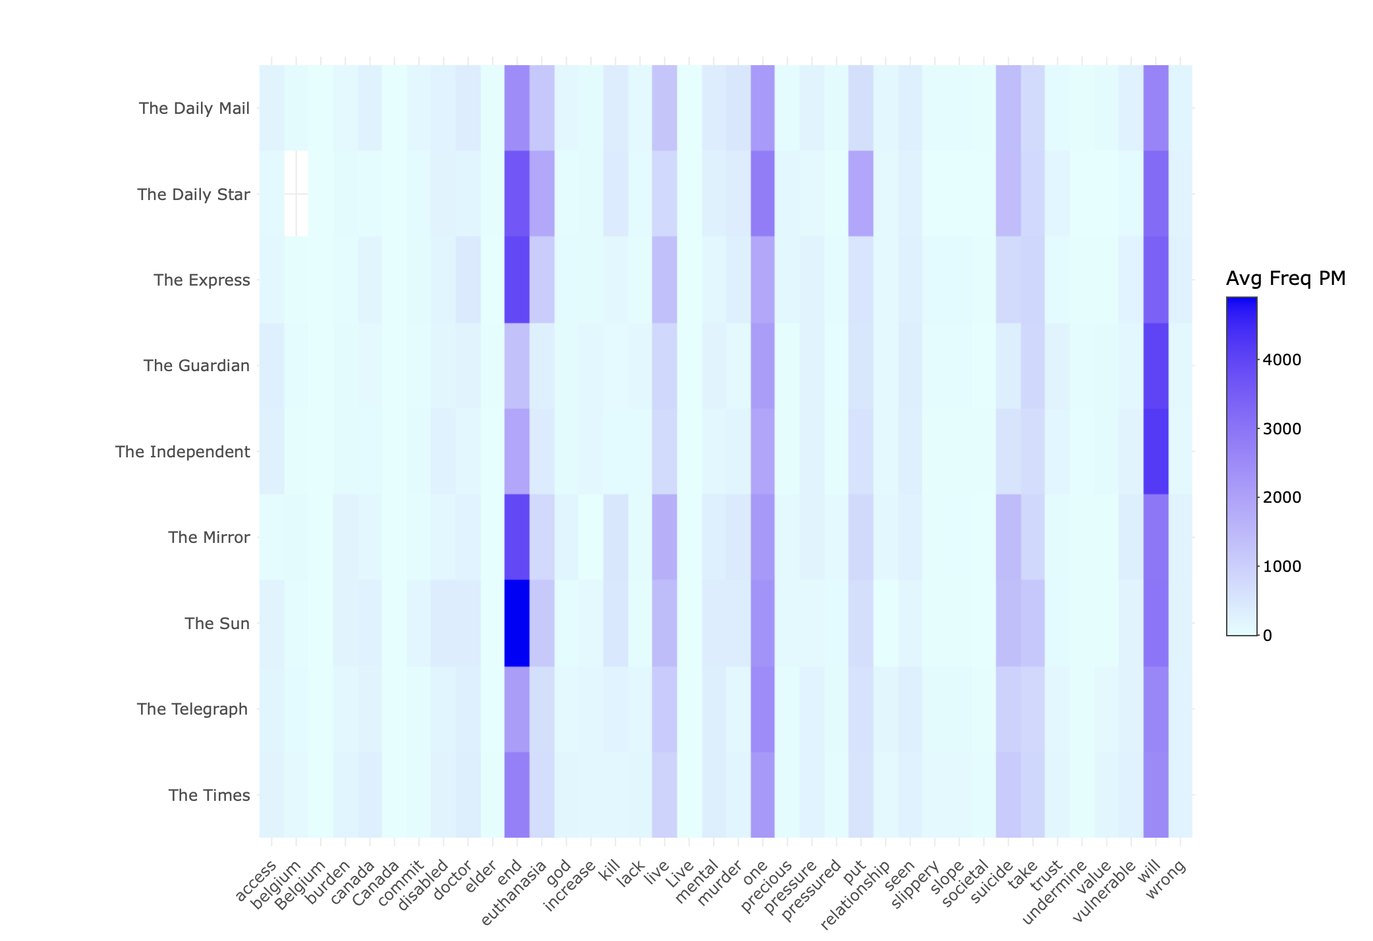

Slide 59
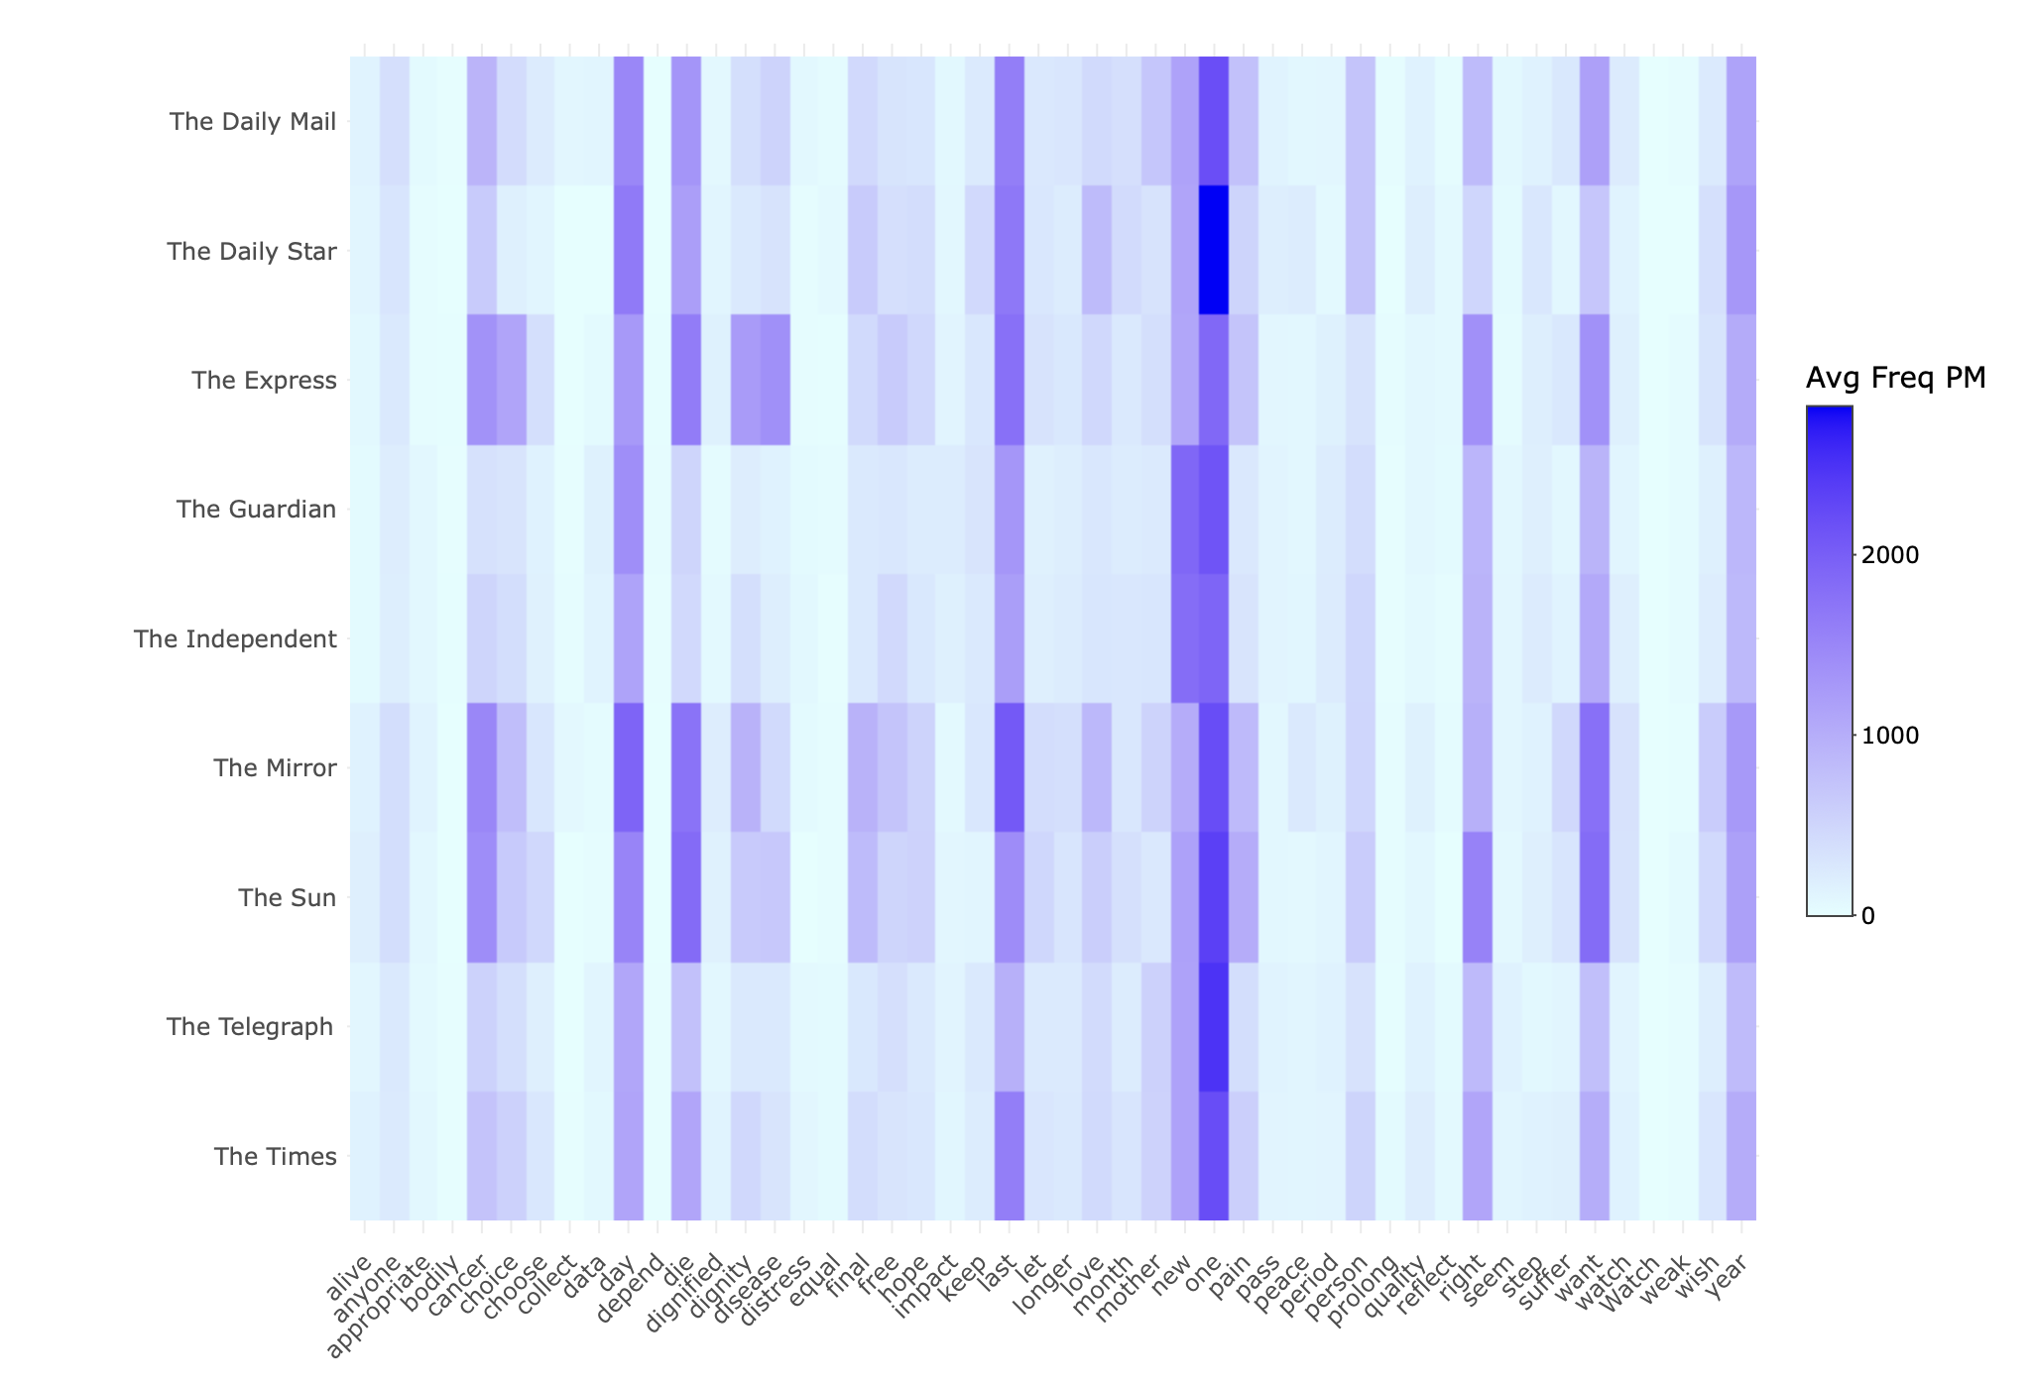

Slide 60
Mail on Sunday (26 December 2023)
CRISPIN COLEGATE, Pontardawe, Neath Port Talbot. I watched my mother-in-law slowly dying for nearly a year, kept alive by medicines and morphine. She asked me to help her die and I nearly did. Looking back, I wish I had helped her, it would have been worth a prison sentence.
KEITH McCREADY, Bishop's Stortford, Herts. IF I had let any of my pets suffer as Sarah Vine's grandmother did in her last days (Mail), I would be prosecuted for cruelty.

Slide 61
Mirror (23 October 2021)
Critics fear it could leave vulnerable people exposed to unwanted pressure. Opponents include the Archbishop of Canterbury, the Most Rev Justin Welby. He said that while the safeguards in the bill are stronger than in previous attempts, they still do not go far enough. "What we want is assisted living, not assisted dying," he said.

Slide 62
Political Opinions
Traditionally:
Left
“Left Wing”
Collective protection of the weak and vulnerable in society
Progressive values
“Right Wing”
Individual responsibility and personal freedom
Conservative values

Slide 63
Political Opinions
Traditionally:
Left
“Left Wing”
Collective protection of the weak and vulnerable in society
Progressive values
“Right Wing”
Individual responsibility and personal freedom
Conservative values
But:
Discourse supporting AD is about personal responsibility and freedom
Discourse opposing AD is about collective protection of the weak

Slide 64
“clear message”
society This bill sends a | clear message | that some lives have actually
and it would send a | clear message | to our frail elderly and
Assisted suicide sends a | clear message | to frail elderly disabled people
suffering Assisted suicide sends a | clear message | to frail elderly and disabled
suffering It also sends a | clear message | to frail elderly and disabled
Assisted suicide sends a | clear message | to frail elderly and disabled
suffering Assisted suicide sends a | clear message | to frail elderly and disabled
suffering Assisted suicide sends a | clear message | to frail elderly and disabled
Assisted suicide sends a | clear message | to frail elderly and disabled
Assisted suicide sends a | clear message | to frail elderly and disabled
person Additionally it sends a | clear message | to frail elderly and disabled
Assisted suicide sends a | clear message | to frail elderly and disabled
suffering It potentially sends a | clear message | to frail elderly and disabled
Assisted suicide sends a | clear message | to frail elderly and disabled
Assisted suicide sends a | clear message | to the frail elderly and
the patient It sends a | clear message | to the elderly and infirm
person Assisted suicide sends a | clear message | to frail elderly and disabled
and it would send a | clear message | to our frail elderly and
reduced Assisted suicide sends a | clear message | to frail elderly and disabled
Assisted suicide sends a distinctively | clear message | from authorities figures and from
Notes:
“clear message”

Slide 65
Most Frequent Shared Sentences
Shared Sentence Text | Docs | Supportive | Opposed | Neutral
no safeguards are good enough . | 26 | 0 | 26 | 0
creating a body responsible for reporting and collecting data can not address possible abuse . | 25 | 0 | 24 | 1
terminal illness diagnoses can be unreliable . | 24 | 0 | 23 | 1
this is coercive and has no place in a civilised society . | 23 | 0 | 22 | 1
in the absence of the bill , such pressure would not exist . | 22 | 0 | 22 | 0
life is precious . | 21 | 0 | 21 | 0
life is sacred . | 21 | 0 | 21 | 0
it is also individuals in these categories who are most likely to feel pressurised into considering assisted dying . | 20 | 0 | 20 | 0
many disabled people fear assisted suicide . | 19 | 0 | 19 | 0
" achieving a sustainable economy " in relation to assisted suicide implies that dying or ill people should take the cost of their treatment into consideration | 18 | 0 | 17 | 1
Notes:
Coordinated identical responses raises important questions about 'astroturfing' versus genuine grassroots participation. When 26 respondents use exactly the same sentence 'no safeguards are good enough', it challenges our understanding of consultation as democratic engagement.
Does digitally-enabled coordination strengthen or undermine public debate?
The patterns suggest that opponents have been more organised in their messaging strategy, while supporters rely more on individualised narrative experiences.

Slide 66
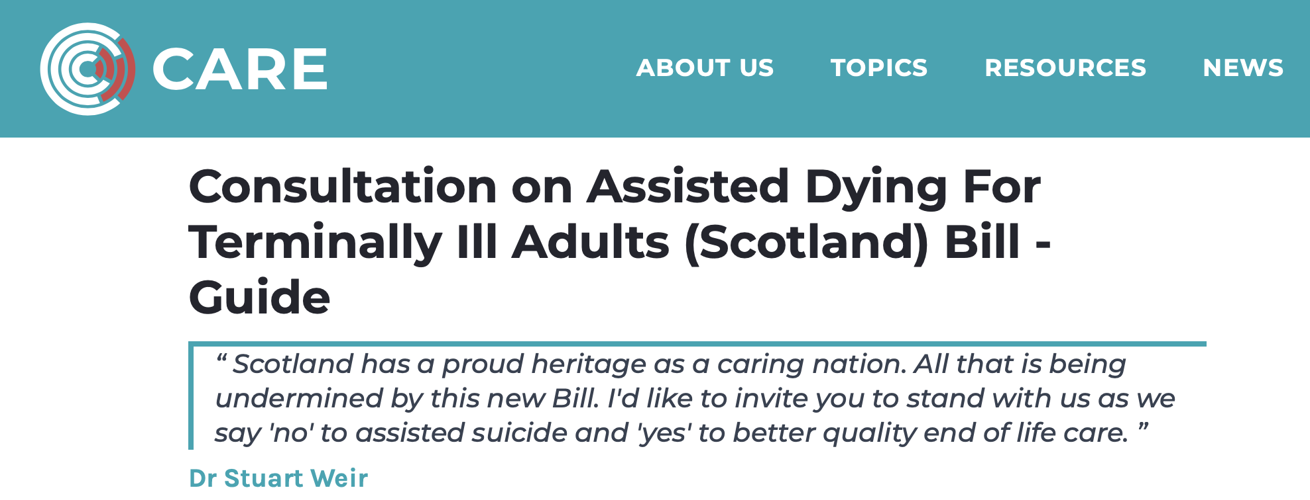
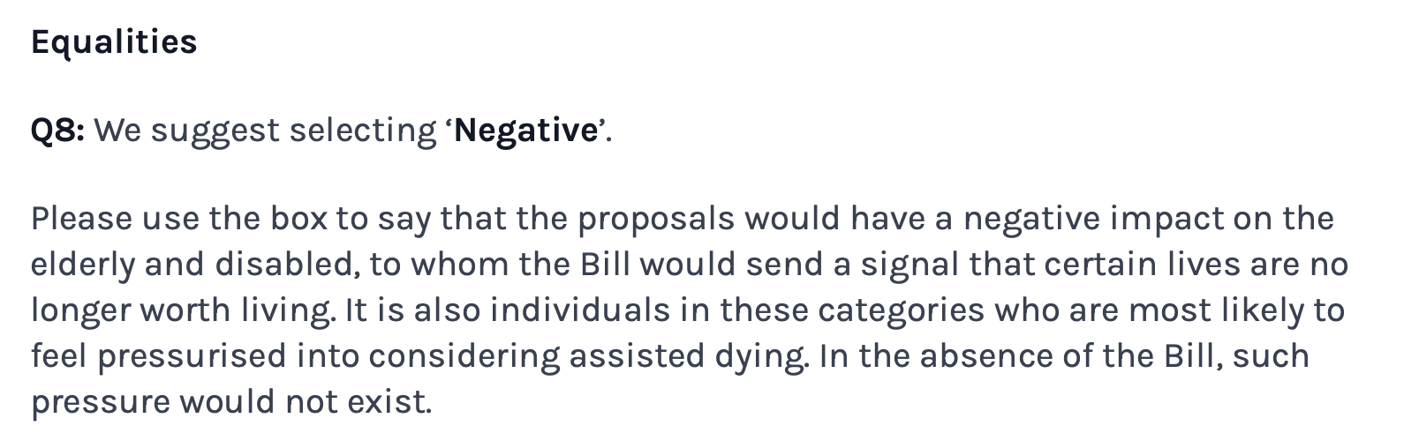
Most Frequent Shared Sentences
Shared Sentence Text | Docs | Supportive | Opposed | Neutral
no safeguards are good enough . | 26 | 0 | 26 | 0
creating a body responsible for reporting and collecting data can not address possible abuse . | 25 | 0 | 24 | 1
terminal illness diagnoses can be unreliable . | 24 | 0 | 23 | 1
this is coercive and has no place in a civilised society . | 23 | 0 | 22 | 1
in the absence of the bill , such pressure would not exist . | 22 | 0 | 22 | 0
life is precious . | 21 | 0 | 21 | 0
life is sacred . | 21 | 0 | 21 | 0
it is also individuals in these categories who are most likely to feel pressurised into considering assisted dying . | 20 | 0 | 20 | 0
many disabled people fear assisted suicide . | 19 | 0 | 19 | 0
" achieving a sustainable economy " in relation to assisted suicide implies that dying or ill people should take the cost of their treatment into consideration | 18 | 0 | 17 | 1

Slide 67
• In Oregon in 2020, a majority (53.1%) of people killed by assisted suicide cited a fear of being a "burden on family, friends/caregivers" as a reason to end their lives.1 • In Washington State in 2018, 51% of people who were killed by assisted suicide said that being a burden on family, friends and caregivers was a reason to end their lives.2 In one study, researchers also identified a range of pressures on vulnerable people who desire assisted suicide, leading to a choice "strongly influenced by fears, sadness and loneliness". The researchers were concerned about the development of a culture that would "increase social pressure on older people and reinforce negative ideas surrounding old age".3 It is estimated that between 7% and 9% of older people in Scotland are victims of at least one form of abuse, with over 40% of victims suffering more than one kind of abuse.
• In Oregon in 2020, a majority (53.1%) of people killed by assisted suicide cited a fear of being a "burden on family, f riends/caregivers" as a reason to end their lives.1 • In Washington State in 2018, 51% of people who were killed by assisted suicide said that being a burden on family, f riends and caregivers was a reason to end their lives.2 In one study, researchers also identified a range of pressures on vulnerable people who desire assisted suicide, leading to a choice "strongly influenced by fears, sadness and loneliness". The researchers were concerned about the development of a culture that would "increase social pressure on older people and reinforce negative ideas surrounding old age".3 It is estimated that between 7% and 9% of older people in Scotland are victims of at least one form of abuse, with over 40% of victims suffering more than one kind of abuse.
178758994.txt_y2021_r2092
(3,758 words)
181505748.txt_y2021_r11499 (3,991 words)

Slide 69
6. Conclusion

Slide 70
Our Questions
We began with three questions:
What is linguistically polarized in this debate?
How do these polarized ideas lead to contested meanings?
What are some societal implications?

Slide 71
Elusive Consensus
These linguistic polarisations show societal and ethical divisions. The use of a fundamentally different ethical language means three things are contested in these debates:
Contested conceptualization of death: is death conceptualized as part of medical care (to be optimised) or as a moral threshold (to be respected)?
Contested linguistic authority: experiential-based versus principle-based language: “I watched my mother die” versus “life is always sacred”/“doctors should never kill”; choice/dignity/decide versus vulnerable/pressure/safeguards; crafting individual moral reasoning versus amplifying that of others.
Contested meaning of the vulnerable: those facing painful death or those facing pressure to end their own lives?

Slide 72
“up yours at the end of life” Opposition, Emotion, and Overlap in a Corpus of Scottish Debates on Assisted Dying
Marc Alexander and James Balfour
marc.alexander@glasgow.ac.uk, james.balfour@glasgow.ac.uk
CILC16, Salamanca
May 2025

Slide 73
Topic Modelling
Structural Topic Model (STM) fitted to the combined free-text responses from the 2021 and 2024 consultations
Respondents classified as 'Supportive' or 'Opposed' based on their answers to initial multiple-choice question
Preprocessing (lowercasing, removing punctuation/numbers/stopwords, stemming)
Modelled using STM to identify 60 distinct topics

Slide 74
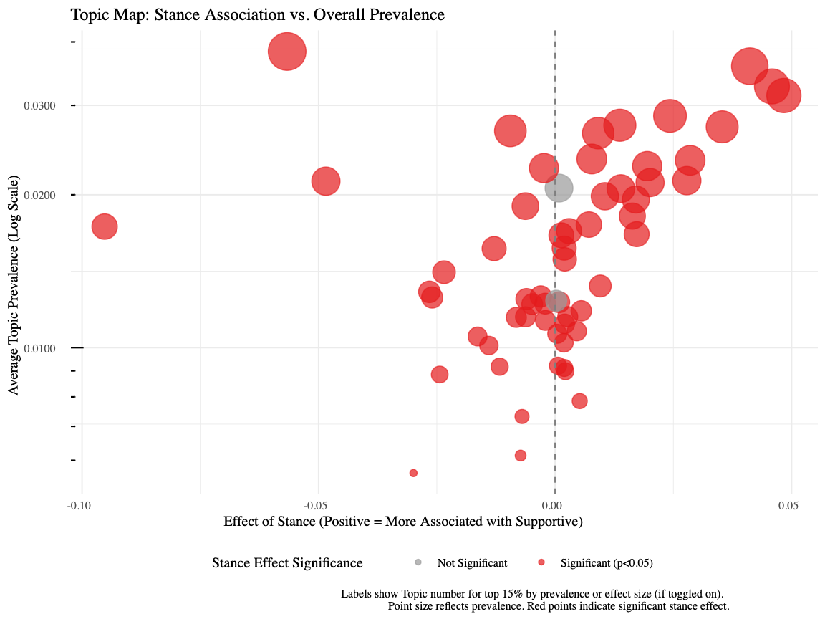

Slide 75
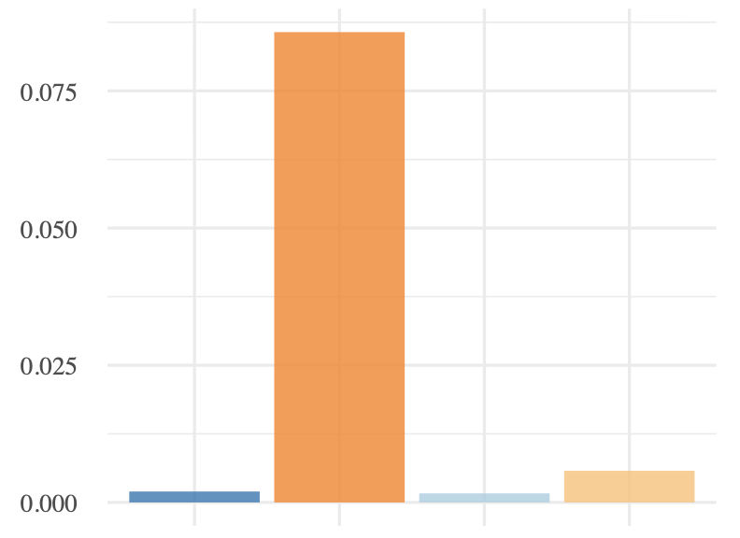
8: live, elder*, worth, pressu*, end

Slide 76
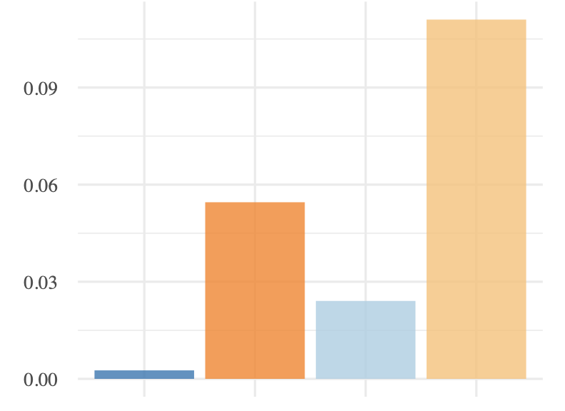
32: kill, god, take, murder, one, wrong, precious

Slide 77
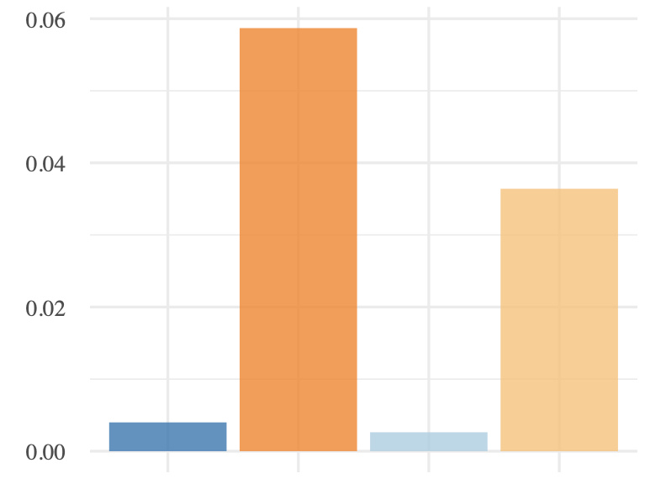
50: vulner*, pressure, burden, elder*, disabl*

Slide 78
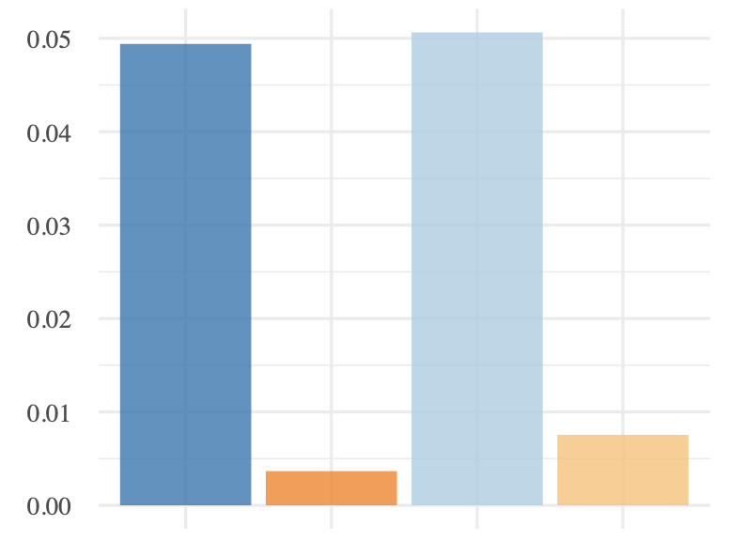
29: watch, die, cancer, mother, pass, let

Slide 79
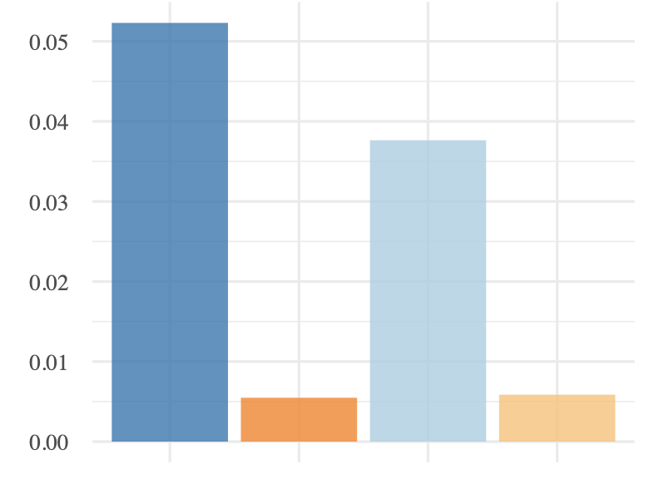
40: choice, right, choose, dignity, person, dignif*

Slide 80
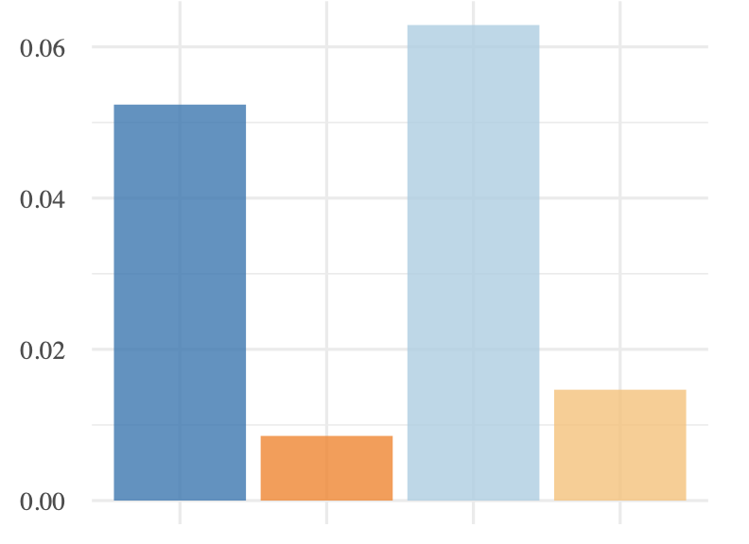
16: suffer, pain, one, love, peace, hope, distress

Slide 81
Press Corpora
UK press articles which meet the following criteria:
Available on LexisNexis.
Between 23 March and 22 December 2021 or 7 December 2023 and 16 August 2024.
Matching search terms “assisted suicide” OR “assisted dying” OR “euthanasia” OR “assisted to die” OR “assisted death” OR “assisted in dying” OR “assisted end to life” OR “death with dignity” OR “die with dignity” OR “die in dignity” OR “right to die” OR “end of life choice” OR “end of life assistance”

Slide 82
Terminology
No terminology choice is neutral in this debate
“Assisted Dying”:
Term used in current bill's title
Prevalent in consultations and media
Primarily used by supporters
Distinguished from suicide by supporters of the term as “people in question are not choosing death over a healthy life”
Relatively new term (last 15 years in UK)
Can emphasise disease/death “process” underway

Slide 83
Terminology
“Assisted Suicide”:
Primarily used by opponents
Argued to be more legally/practically accurate
Critics say "assisted dying" is a euphemism
Retains the moral/religious stigma of “suicide”
Can emphasise individual’s action

Slide 84
Terminology
“Euthanasia”:
Greek “good death”
Not technically accurate for current bill as euthanasia is physician-administered and this bill requires self-administration

Slide 86
Fully supportive §§ I worked in the NHS for 35 years and saw the passing of many people( including having sat at the bedside of 3 of my family when they died). Whilst hospice care and palliative care has improved greatly over the last years, I have still seen deaths that were not peaceful or painfree, people asking why they were being kept alive, when they wanted to pass away on their own terms. We treat animals with more dignity and compassion sometimes, and deny people their basic human right of a good death. If people can refuse treatment /medication, why cant they not choose how they die? Years ago a woman had to have their husbands consent to have a hysterectomy, this smacks of the same thing, someone unable to make a choice about their life and body, and how they choose to end it. surely this is a fundamental abuse of someone's human rights....... I also strongly believe that religious belief has NO place in medicine......it is unethical for people to impose suffering on others because of their religious beliefs about assisted suicide( in an increasingly secular society, how relevant is this now, and I speak as a religious practitioner)
For 26 years I worked in the emergency service and when on shift I was tasked to investigate any sudden or unexpected reported death in my area. This included all suicides. I have witnessed at first hand and close up the sheer desperation and suffering caused by terminal illness. I have had to examine bodies and scenes where the person has died alone and in obvious agony. People with cancer who have vomited and excreted blood and body matter into bowls,coal scuttles, sinks, beds, floors etc.. before finally dying, often over a period of days and weeks, alone in their property which by that time often resembled a crime scene. I was also called to all suicides and lost count of the number of people I have had to cut down from their nooses whilst their grieving family cried in the adjacent room. People who often had terminal illnesses and who were forced into bringing their death forward to avoid further awful suffering.I have over the years collected up body parts from railway lines, shorelines and farmers’ fields were the victims had to end their lives alone with the added burden of bringing shock and despair to their loved ones. In April 2020 I was diagnosed with inoperable pancreatic cancer and given 6-12 months to live if I chose not to have palliative chemotherapy, and possibly 18 months if I chose to undertake it. My world fell apart and I had to break the news to my wife and two sons. I have had to give up the job I loved and have undergone chemotherapy and subsequent surgery. The prognosis for anyone with pancreatic cancer is extremely bleak with only a very small percentage of suffered living beyond five years from diagnosis. Only those receiving Whipple surgery have any chance if this survival and a large proportion of sufferers are diagnosed too late for this to be viable. I am a proud and private individual who does not want to spend my final days, weeks, or god forbid months, in a hospital or hospice, in pain with no quality of life and having to be lifted off a bed pan or worse! I do not want to be forced into ending my life alone, maybe in my car with the embers of a disposable BBQ smouldering in the boot, or hanging in a lonely wood waiting for some poor unsuspecting member of the public to find me-but with no compassionate alternative that is what I will do, The pain and suffering that this will cause to my family I don’t want to think about but I know it will be a little bit less than them watching helpless while I die slowly in front of them in hospital. I think we currently treat animals at the end of their lives better than we do humans. Death comes to us all. We cannot escape it and as our bodies age and fail, who would want to? As a developed nation we spend millions trying to keep the dying alive. This is how it should be if the individual still enjoys a quality of life but there comes a time when the individual should be able to decide that enough is enough.
Fully supportive §§ I feel very strongly that I should have a right to a dignified death and end of life experience and that others should have this right too, should they wish it. Palliative care although very important is not enough . My elderly and terminally ill mother is dying very very slowly ! She is in constant pain and although heartbreaking and distressing for me, for her, it is thoroughly exhausting, depressing and at times utterly terrifying. The strong medications for the pain cause hallucinations and she has nightmares and the other medications to mitigate the side effects means her body is constantly under attack not just from her illnesses but the drugs. I can’t begin to describe the impact other than she has serious problems with eating, sleeping and toileting and weighs around 28kilos .Her quality of life is so reduced and utterly miserable she just so wants these ‘dark times’ to end. And why shouldn’t she ? why should this woman have to suffer like this and for so long when she feels overall that she has had a good life but really now desperately wants it to end . I believe my mother should be able to have medical assistance to die.
Notes:
21%

Slide 87
Fully supportive §§ I worked in the NHS for 35 years and saw the passing of many people( including having sat at the bedside of 3 of my family when they died). Whilst hospice care and palliative care has improved greatly over the last years, I have still seen deaths that were not peaceful or painfree, people asking why they were being kept alive, when they wanted to pass away on their own terms. We treat animals with more dignity and compassion sometimes, and deny people their basic human right of a good death. If people can refuse treatment /medication, why cant they not choose how they die? Years ago a woman had to have their husbands consent to have a hysterectomy, this smacks of the same thing, someone unable to make a choice about their life and body, and how they choose to end it. surely this is a fundamental abuse of someone's human rights....... I also strongly believe that religious belief has NO place in medicine......it is unethical for people to impose suffering on others because of their religious beliefs about assisted suicide( in an increasingly secular society, how relevant is this now, and I speak as a religious practitioner)
For 26 years I worked in the emergency service and when on shift I was tasked to investigate any sudden or unexpected reported death in my area. This included all suicides. I have witnessed at first hand and close up the sheer desperation and suffering caused by terminal illness. I have had to examine bodies and scenes where the person has died alone and in obvious agony. People with cancer who have vomited and excreted blood and body matter into bowls,coal scuttles, sinks, beds, floors etc.. before finally dying, often over a period of days and weeks, alone in their property which by that time often resembled a crime scene. I was also called to all suicides and lost count of the number of people I have had to cut down from their nooses whilst their grieving family cried in the adjacent room. People who often had terminal illnesses and who were forced into bringing their death forward to avoid further awful suffering.I have over the years collected up body parts from railway lines, shorelines and farmers’ fields were the victims had to end their lives alone with the added burden of bringing shock and despair to their loved ones. In April 2020 I was diagnosed with inoperable pancreatic cancer and given 6-12 months to live if I chose not to have palliative chemotherapy, and possibly 18 months if I chose to undertake it. My world fell apart and I had to break the news to my wife and two sons. I have had to give up the job I loved and have undergone chemotherapy and subsequent surgery. The prognosis for anyone with pancreatic cancer is extremely bleak with only a very small percentage of suffered living beyond five years from diagnosis. Only those receiving Whipple surgery have any chance if this survival and a large proportion of sufferers are diagnosed too late for this to be viable. I am a proud and private individual who does not want to spend my final days, weeks, or god forbid months, in a hospital or hospice, in pain with no quality of life and having to be lifted off a bed pan or worse! I do not want to be forced into ending my life alone, maybe in my car with the embers of a disposable BBQ smouldering in the boot, or hanging in a lonely wood waiting for some poor unsuspecting member of the public to find me-but with no compassionate alternative that is what I will do, The pain and suffering that this will cause to my family I don’t want to think about but I know it will be a little bit less than them watching helpless while I die slowly in front of them in hospital. I think we currently treat animals at the end of their lives better than we do humans. Death comes to us all. We cannot escape it and as our bodies age and fail, who would want to? As a developed nation we spend millions trying to keep the dying alive. This is how it should be if the individual still enjoys a quality of life but there comes a time when the individual should be able to decide that enough is enough.
Fully supportive §§ I feel very strongly that I should have a right to a dignified death and end of life experience and that others should have this right too, should they wish it. Palliative care although very important is not enough . My elderly and terminally ill mother is dying very very slowly ! She is in constant pain and although heartbreaking and distressing for me, for her, it is thoroughly exhausting, depressing and at times utterly terrifying. The strong medications for the pain cause hallucinations and she has nightmares and the other medications to mitigate the side effects means her body is constantly under attack not just from her illnesses but the drugs. I can’t begin to describe the impact other than she has serious problems with eating, sleeping and toileting and weighs around 28kilos .Her quality of life is so reduced and utterly miserable she just so wants these ‘dark times’ to end. And why shouldn’t she ? why should this woman have to suffer like this and for so long when she feels overall that she has had a good life but really now desperately wants it to end . I believe my mother should be able to have medical assistance to die.
Notes:
21%

Slide 88
For 26 years I worked in the emergency service and when on shift I was tasked to investigate any sudden or unexpected reported death in my area. This included all suicides. I have witnessed at first hand and close up the sheer desperation and suffering caused by terminal illness. I have had to examine bodies and scenes where the person has died alone and in obvious agony. People with cancer who have vomited and excreted blood and body matter into bowls,coal scuttles, sinks, beds, floors etc.. before finally dying, often over a period of days and weeks, alone in their property which by that time often resembled a crime scene. I was also called to all suicides and lost count of the number of people I have had to cut down from their nooses whilst their grieving family cried in the adjacent room. People who often had terminal illnesses and who were forced into bringing their death forward to avoid further awful suffering.I have over the years collected up body parts from railway lines, shorelines and farmers’ fields were the victims had to end their lives alone with the added burden of bringing shock and despair to their loved ones. In April 2020 I was diagnosed with inoperable pancreatic cancer and given 6-12 months to live if I chose not to have palliative chemotherapy, and possibly 18 months if I chose to undertake it. My world fell apart and I had to break the news to my wife and two sons. I have had to give up the job I loved and have undergone chemotherapy and subsequent surgery. The prognosis for anyone with pancreatic cancer is extremely bleak with only a very small percentage of suffered living beyond five years from diagnosis. Only those receiving Whipple surgery have any chance if this survival and a large proportion of sufferers are diagnosed too late for this to be viable. I am a proud and private individual who does not want to spend my final days, weeks, or god forbid months, in a hospital or hospice, in pain with no quality of life and having to be lifted off a bed pan or worse! I do not want to be forced into ending my life alone, maybe in my car with the embers of a disposable BBQ smouldering in the boot, or hanging in a lonely wood waiting for some poor unsuspecting member of the public to find me-but with no compassionate alternative that is what I will do, The pain and suffering that this will cause to my family I don’t want to think about but I know it will be a little bit less than them watching helpless while I die slowly in front of them in hospital. I think we currently treat animals at the end of their lives better than we do humans. Death comes to us all. We cannot escape it and as our bodies age and fail, who would want to? As a developed nation we spend millions trying to keep the dying alive. This is how it should be if the individual still enjoys a quality of life but there comes a time when the individual should be able to decide that enough is enough.
Fully supportive §§ I worked in the NHS for 35 years and saw the passing of many people( including having sat at the bedside of 3 of my family when they died). Whilst hospice care and palliative care has improved greatly over the last years, I have still seen deaths that were not peaceful or painfree, people asking why they were being kept alive, when they wanted to pass away on their own terms. We treat animals with more dignity and compassion sometimes, and deny people their basic human right of a good death. If people can refuse treatment /medication, why cant they not choose how they die? Years ago a woman had to have their husbands consent to have a hysterectomy, this smacks of the same thing, someone unable to make a choice about their life and body, and how they choose to end it. surely this is a fundamental abuse of someone's human rights....... I also strongly believe that religious belief has NO place in medicine......it is unethical for people to impose suffering on others because of their religious beliefs about assisted suicide( in an increasingly secular society, how relevant is this now, and I speak as a religious practitioner)
Fully supportive §§ I feel very strongly that I should have a right to a dignified death and end of life experience and that others should have this right too, should they wish it. Palliative care although very important is not enough . My elderly and terminally ill mother is dying very very slowly ! She is in constant pain and although heartbreaking and distressing for me, for her, it is thoroughly exhausting, depressing and at times utterly terrifying. The strong medications for the pain cause hallucinations and she has nightmares and the other medications to mitigate the side effects means her body is constantly under attack not just from her illnesses but the drugs. I can’t begin to describe the impact other than she has serious problems with eating, sleeping and toileting and weighs around 28kilos .Her quality of life is so reduced and utterly miserable she just so wants these ‘dark times’ to end. And why shouldn’t she ? why should this woman have to suffer like this and for so long when she feels overall that she has had a good life but really now desperately wants it to end . I believe my mother should be able to have medical assistance to die.
Notes:
21%

Slide 89
For 26 years I worked in the emergency service and when on shift I was tasked to investigate any sudden or unexpected reported death in my area. This included all suicides. I have witnessed at first hand and close up the sheer desperation and suffering caused by terminal illness. I have had to examine bodies and scenes where the person has died alone and in obvious agony. People with cancer who have vomited and excreted blood and body matter into bowls,coal scuttles, sinks, beds, floors etc.. before finally dying, often over a period of days and weeks, alone in their property which by that time often resembled a crime scene. I was also called to all suicides and lost count of the number of people I have had to cut down from their nooses whilst their grieving family cried in the adjacent room. People who often had terminal illnesses and who were forced into bringing their death forward to avoid further awful suffering.I have over the years collected up body parts from railway lines, shorelines and farmers’ fields were the victims had to end their lives alone with the added burden of bringing shock and despair to their loved ones. In April 2020 I was diagnosed with inoperable pancreatic cancer and given 6-12 months to live if I chose not to have palliative chemotherapy, and possibly 18 months if I chose to undertake it. My world fell apart and I had to break the news to my wife and two sons. I have had to give up the job I loved and have undergone chemotherapy and subsequent surgery. The prognosis for anyone with pancreatic cancer is extremely bleak with only a very small percentage of suffered living beyond five years from diagnosis. Only those receiving Whipple surgery have any chance if this survival and a large proportion of sufferers are diagnosed too late for this to be viable. I am a proud and private individual who does not want to spend my final days, weeks, or god forbid months, in a hospital or hospice, in pain with no quality of life and having to be lifted off a bed pan or worse! I do not want to be forced into ending my life alone, maybe in my car with the embers of a disposable BBQ smouldering in the boot, or hanging in a lonely wood waiting for some poor unsuspecting member of the public to find me-but with no compassionate alternative that is what I will do, The pain and suffering that this will cause to my family I don’t want to think about but I know it will be a little bit less than them watching helpless while I die slowly in front of them in hospital. I think we currently treat animals at the end of their lives better than we do humans. Death comes to us all. We cannot escape it and as our bodies age and fail, who would want to? As a developed nation we spend millions trying to keep the dying alive. This is how it should be if the individual still enjoys a quality of life but there comes a time when the individual should be able to decide that enough is enough.
Fully supportive §§ I worked in the NHS for 35 years and saw the passing of many people( including having sat at the bedside of 3 of my family when they died). Whilst hospice care and palliative care has improved greatly over the last years, I have still seen deaths that were not peaceful or painfree, people asking why they were being kept alive, when they wanted to pass away on their own terms. We treat animals with more dignity and compassion sometimes, and deny people their basic human right of a good death. If people can refuse treatment /medication, why cant they not choose how they die? Years ago a woman had to have their husbands consent to have a hysterectomy, this smacks of the same thing, someone unable to make a choice about their life and body, and how they choose to end it. surely this is a fundamental abuse of someone's human rights....... I also strongly believe that religious belief has NO place in medicine......it is unethical for people to impose suffering on others because of their religious beliefs about assisted suicide( in an increasingly secular society, how relevant is this now, and I speak as a religious practitioner)
Fully supportive §§ I feel very strongly that I should have a right to a dignified death and end of life experience and that others should have this right too, should they wish it. Palliative care although very important is not enough . My elderly and terminally ill mother is dying very very slowly ! She is in constant pain and although heartbreaking and distressing for me, for her, it is thoroughly exhausting, depressing and at times utterly terrifying. The strong medications for the pain cause hallucinations and she has nightmares and the other medications to mitigate the side effects means her body is constantly under attack not just from her illnesses but the drugs. I can’t begin to describe the impact other than she has serious problems with eating, sleeping and toileting and weighs around 28kilos .Her quality of life is so reduced and utterly miserable she just so wants these ‘dark times’ to end. And why shouldn’t she ? why should this woman have to suffer like this and for so long when she feels overall that she has had a good life but really now desperately wants it to end . I believe my mother should be able to have medical assistance to die.
Notes:
21%

Slide 90
For 26 years I worked in the emergency service and when on shift I was tasked to investigate any sudden or unexpected reported death in my area. This included all suicides. I have witnessed at first hand and close up the sheer desperation and suffering caused by terminal illness. I have had to examine bodies and scenes where the person has died alone and in obvious agony. People with cancer who have vomited and excreted blood and body matter into bowls,coal scuttles, sinks, beds, floors etc.. before finally dying, often over a period of days and weeks, alone in their property which by that time often resembled a crime scene. I was also called to all suicides and lost count of the number of people I have had to cut down from their nooses whilst their grieving family cried in the adjacent room. People who often had terminal illnesses and who were forced into bringing their death forward to avoid further awful suffering.I have over the years collected up body parts from railway lines, shorelines and farmers’ fields were the victims had to end their lives alone with the added burden of bringing shock and despair to their loved ones. In April 2020 I was diagnosed with inoperable pancreatic cancer and given 6-12 months to live if I chose not to have palliative chemotherapy, and possibly 18 months if I chose to undertake it. My world fell apart and I had to break the news to my wife and two sons. I have had to give up the job I loved and have undergone chemotherapy and subsequent surgery. The prognosis for anyone with pancreatic cancer is extremely bleak with only a very small percentage of suffered living beyond five years from diagnosis. Only those receiving Whipple surgery have any chance if this survival and a large proportion of sufferers are diagnosed too late for this to be viable. I am a proud and private individual who does not want to spend my final days, weeks, or god forbid months, in a hospital or hospice, in pain with no quality of life and having to be lifted off a bed pan or worse! I do not want to be forced into ending my life alone, maybe in my car with the embers of a disposable BBQ smouldering in the boot, or hanging in a lonely wood waiting for some poor unsuspecting member of the public to find me-but with no compassionate alternative that is what I will do, The pain and suffering that this will cause to my family I don’t want to think about but I know it will be a little bit less than them watching helpless while I die slowly in front of them in hospital. I think we currently treat animals at the end of their lives better than we do humans. Death comes to us all. We cannot escape it and as our bodies age and fail, who would want to? As a developed nation we spend millions trying to keep the dying alive. This is how it should be if the individual still enjoys a quality of life but there comes a time when the individual should be able to decide that enough is enough.
Fully supportive §§ I worked in the NHS for 35 years and saw the passing of many people( including having sat at the bedside of 3 of my family when they died). Whilst hospice care and palliative care has improved greatly over the last years, I have still seen deaths that were not peaceful or painfree, people asking why they were being kept alive, when they wanted to pass away on their own terms. We treat animals with more dignity and compassion sometimes, and deny people their basic human right of a good death. If people can refuse treatment /medication, why cant they not choose how they die? Years ago a woman had to have their husbands consent to have a hysterectomy, this smacks of the same thing, someone unable to make a choice about their life and body, and how they choose to end it. surely this is a fundamental abuse of someone's human rights....... I also strongly believe that religious belief has NO place in medicine......it is unethical for people to impose suffering on others because of their religious beliefs about assisted suicide( in an increasingly secular society, how relevant is this now, and I speak as a religious practitioner)
Fully supportive §§ I feel very strongly that I should have a right to a dignified death and end of life experience and that others should have this right too, should they wish it. Palliative care although very important is not enough . My elderly and terminally ill mother is dying very very slowly ! She is in constant pain and although heartbreaking and distressing for me, for her, it is thoroughly exhausting, depressing and at times utterly terrifying. The strong medications for the pain cause hallucinations and she has nightmares and the other medications to mitigate the side effects means her body is constantly under attack not just from her illnesses but the drugs. I can’t begin to describe the impact other than she has serious problems with eating, sleeping and toileting and weighs around 28kilos .Her quality of life is so reduced and utterly miserable she just so wants these ‘dark times’ to end. And why shouldn’t she ? why should this woman have to suffer like this and for so long when she feels overall that she has had a good life but really now desperately wants it to end . I believe my mother should be able to have medical assistance to die.
Notes:
21%

Slide 91
For 26 years I worked in the emergency service and when on shift I was tasked to investigate any sudden or unexpected reported death in my area. This included all suicides. I have witnessed at first hand and close up the sheer desperation and suffering caused by terminal illness. I have had to examine bodies and scenes where the person has died alone and in obvious agony. People with cancer who have vomited and excreted blood and body matter into bowls,coal scuttles, sinks, beds, floors etc.. before finally dying, often over a period of days and weeks, alone in their property which by that time often resembled a crime scene. I was also called to all suicides and lost count of the number of people I have had to cut down from their nooses whilst their grieving family cried in the adjacent room. People who often had terminal illnesses and who were forced into bringing their death forward to avoid further awful suffering.I have over the years collected up body parts from railway lines, shorelines and farmers’ fields were the victims had to end their lives alone with the added burden of bringing shock and despair to their loved ones. In April 2020 I was diagnosed with inoperable pancreatic cancer and given 6-12 months to live if I chose not to have palliative chemotherapy, and possibly 18 months if I chose to undertake it. My world fell apart and I had to break the news to my wife and two sons. I have had to give up the job I loved and have undergone chemotherapy and subsequent surgery. The prognosis for anyone with pancreatic cancer is extremely bleak with only a very small percentage of suffered living beyond five years from diagnosis. Only those receiving Whipple surgery have any chance if this survival and a large proportion of sufferers are diagnosed too late for this to be viable. I am a proud and private individual who does not want to spend my final days, weeks, or god forbid months, in a hospital or hospice, in pain with no quality of life and having to be lifted off a bed pan or worse! I do not want to be forced into ending my life alone, maybe in my car with the embers of a disposable BBQ smouldering in the boot, or hanging in a lonely wood waiting for some poor unsuspecting member of the public to find me-but with no compassionate alternative that is what I will do, The pain and suffering that this will cause to my family I don’t want to think about but I know it will be a little bit less than them watching helpless while I die slowly in front of them in hospital. I think we currently treat animals at the end of their lives better than we do humans. Death comes to us all. We cannot escape it and as our bodies age and fail, who would want to? As a developed nation we spend millions trying to keep the dying alive. This is how it should be if the individual still enjoys a quality of life but there comes a time when the individual should be able to decide that enough is enough.
Fully supportive §§ I worked in the NHS for 35 years and saw the passing of many people( including having sat at the bedside of 3 of my family when they died). Whilst hospice care and palliative care has improved greatly over the last years, I have still seen deaths that were not peaceful or painfree, people asking why they were being kept alive, when they wanted to pass away on their own terms. We treat animals with more dignity and compassion sometimes, and deny people their basic human right of a good death. If people can refuse treatment /medication, why cant they not choose how they die? Years ago a woman had to have their husbands consent to have a hysterectomy, this smacks of the same thing, someone unable to make a choice about their life and body, and how they choose to end it. surely this is a fundamental abuse of someone's human rights....... I also strongly believe that religious belief has NO place in medicine......it is unethical for people to impose suffering on others because of their religious beliefs about assisted suicide( in an increasingly secular society, how relevant is this now, and I speak as a religious practitioner)
Fully supportive §§ I feel very strongly that I should have a right to a dignified death and end of life experience and that others should have this right too, should they wish it. Palliative care although very important is not enough . My elderly and terminally ill mother is dying very very slowly ! She is in constant pain and although heartbreaking and distressing for me, for her, it is thoroughly exhausting, depressing and at times utterly terrifying. The strong medications for the pain cause hallucinations and she has nightmares and the other medications to mitigate the side effects means her body is constantly under attack not just from her illnesses but the drugs. I can’t begin to describe the impact other than she has serious problems with eating, sleeping and toileting and weighs around 28kilos .Her quality of life is so reduced and utterly miserable she just so wants these ‘dark times’ to end. And why shouldn’t she ? why should this woman have to suffer like this and for so long when she feels overall that she has had a good life but really now desperately wants it to end . I believe my mother should be able to have medical assistance to die.
Notes:
21%

Slide 92
Fully supportive §§ I worked in the NHS for 35 years and saw the passing of many people( including having sat at the bedside of 3 of my family when they died). Whilst hospice care and palliative care has improved greatly over the last years, I have still seen deaths that were not peaceful or painfree, people asking why they were being kept alive, when they wanted to pass away on their own terms. We treat animals with more dignity and compassion sometimes, and deny people their basic human right of a good death. If people can refuse treatment /medication, why cant they not choose how they die? Years ago a woman had to have their husbands consent to have a hysterectomy, this smacks of the same thing, someone unable to make a choice about their life and body, and how they choose to end it. surely this is a fundamental abuse of someone's human rights....... I also strongly believe that religious belief has NO place in medicine......it is unethical for people to impose suffering on others because of their religious beliefs about assisted suicide( in an increasingly secular society, how relevant is this now, and I speak as a religious practitioner)
For 26 years I worked in the emergency service and when on shift I was tasked to investigate any sudden or unexpected reported death in my area. This included all suicides. I have witnessed at first hand and close up the sheer desperation and suffering caused by terminal illness. I have had to examine bodies and scenes where the person has died alone and in obvious agony. People with cancer who have vomited and excreted blood and body matter into bowls,coal scuttles, sinks, beds, floors etc.. before finally dying, often over a period of days and weeks, alone in their property which by that time often resembled a crime scene. I was also called to all suicides and lost count of the number of people I have had to cut down from their nooses whilst their grieving family cried in the adjacent room. People who often had terminal illnesses and who were forced into bringing their death forward to avoid further awful suffering.I have over the years collected up body parts from railway lines, shorelines and farmers’ fields were the victims had to end their lives alone with the added burden of bringing shock and despair to their loved ones. In April 2020 I was diagnosed with inoperable pancreatic cancer and given 6-12 months to live if I chose not to have palliative chemotherapy, and possibly 18 months if I chose to undertake it. My world fell apart and I had to break the news to my wife and two sons. I have had to give up the job I loved and have undergone chemotherapy and subsequent surgery. The prognosis for anyone with pancreatic cancer is extremely bleak with only a very small percentage of suffered living beyond five years from diagnosis. Only those receiving Whipple surgery have any chance if this survival and a large proportion of sufferers are diagnosed too late for this to be viable. I am a proud and private individual who does not want to spend my final days, weeks, or god forbid months, in a hospital or hospice, in pain with no quality of life and having to be lifted off a bed pan or worse! I do not want to be forced into ending my life alone, maybe in my car with the embers of a disposable BBQ smouldering in the boot, or hanging in a lonely wood waiting for some poor unsuspecting member of the public to find me-but with no compassionate alternative that is what I will do, The pain and suffering that this will cause to my family I don’t want to think about but I know it will be a little bit less than them watching helpless while I die slowly in front of them in hospital. I think we currently treat animals at the end of their lives better than we do humans. Death comes to us all. We cannot escape it and as our bodies age and fail, who would want to? As a developed nation we spend millions trying to keep the dying alive. This is how it should be if the individual still enjoys a quality of life but there comes a time when the individual should be able to decide that enough is enough.
Fully supportive §§ I feel very strongly that I should have a right to a dignified death and end of life experience and that others should have this right too, should they wish it. Palliative care although very important is not enough . My elderly and terminally ill mother is dying very very slowly ! She is in constant pain and although heartbreaking and distressing for me, for her, it is thoroughly exhausting, depressing and at times utterly terrifying. The strong medications for the pain cause hallucinations and she has nightmares and the other medications to mitigate the side effects means her body is constantly under attack not just from her illnesses but the drugs. I can’t begin to describe the impact other than she has serious problems with eating, sleeping and toileting and weighs around 28kilos .Her quality of life is so reduced and utterly miserable she just so wants these ‘dark times’ to end. And why shouldn’t she ? why should this woman have to suffer like this and for so long when she feels overall that she has had a good life but really now desperately wants it to end . I believe my mother should be able to have medical assistance to die.
Notes:
21%

