Slide 1

Ensembl Compara
Perl API
compara
Matthieu Muffato
API workshop - Cambridge
Dec 2013

Slide 2
Outline of the course
Introduction about Compara
  Resources
  API
Base objects
  Genes, peptides, RNAs
  Multiple / pairwise alignments
Data objects
  Families
  Gene trees
  Homologies

Slide 3
Outline of the course
Introduction about Compara
  Resources
  API
Base objects
  Genes, peptides, RNAs
  Multiple / pairwise alignments
Data objects
  Families
  Gene trees
  Homologies

Slide 4
What is Ensembl Compara?
A single database which contains precalculated comparative genomics data and which is linked to all the Ensembl Species databases.
Access via perl API and mysql
A production system for generating that database
(not in this presentation)‏

Slide 5
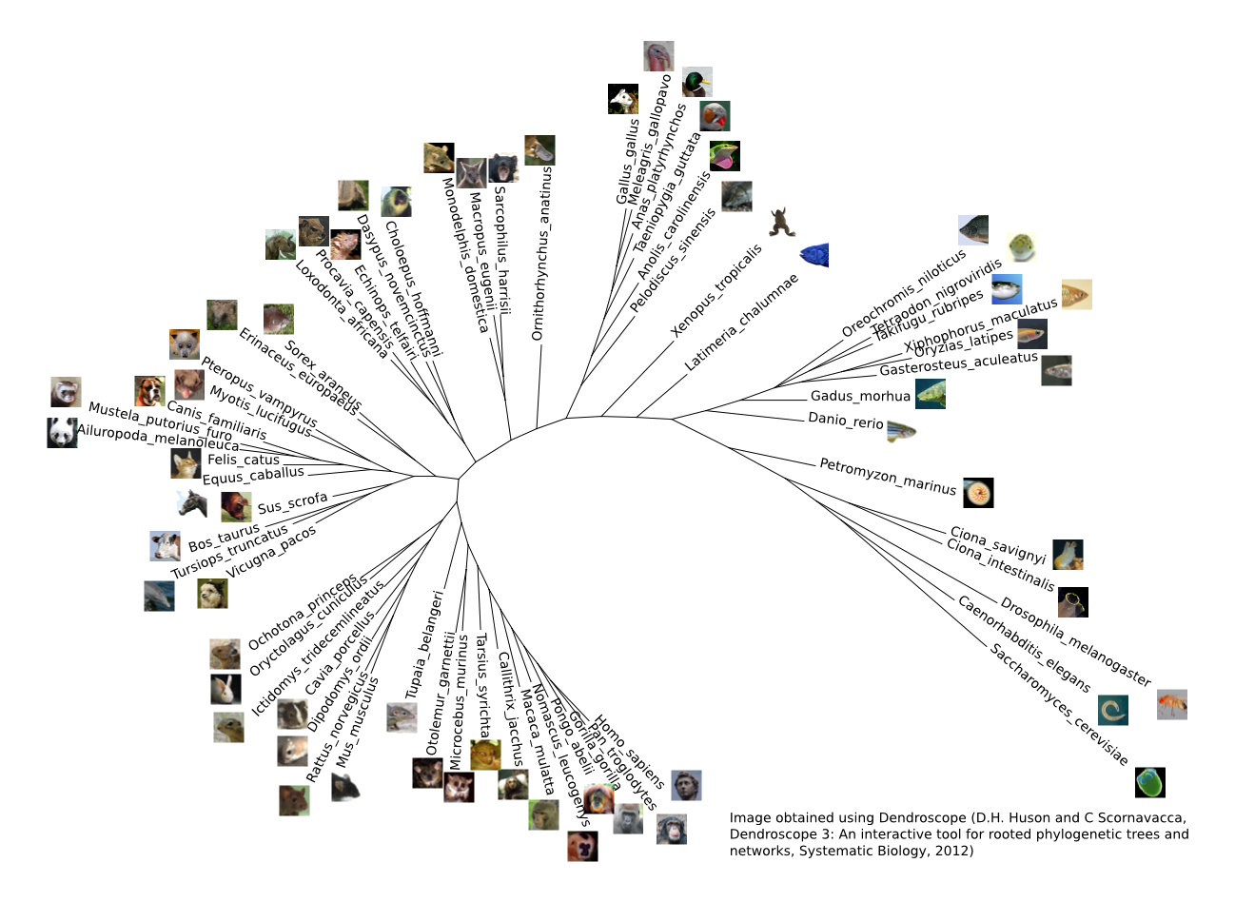
The genomes in Ensembl

Slide 6
Compara data
Genome level (this afternoon)
Whole genome alignments (pairwise and multiple)‏
Syntenic regions (based on pair-wise align.)
Gene level (now !)
Families (clusters of proteins + multiple align.)
Gene trees (proteins, non-coding RNAs)
Gene orthology / paralogy predictions

Slide 7
Gene analyses
Families
Clusters of similar peptides
+ multiple alignment
Multiple-species
comparisons
Gene Trees
Clusters of similar peptides / ncRNAs
+ multiple alignment
+ gene history (duplication, losses)
Homologies
Pairs of genes from the same tree
+ multiple alignment
+ natural selection analysis (dN, dS)
Pairwise comparisons

Slide 8
Families
Families are clusters of similar peptides
Ensembl
(all transcripts)
Uniprot/SWISSPROT
Uniprot/SPTREMBL
All vs. all BlastP
MCL (Markov CLustering algorithm)
Mafft multiple alignment
Mafft
Mafft
Mafft

Slide 9
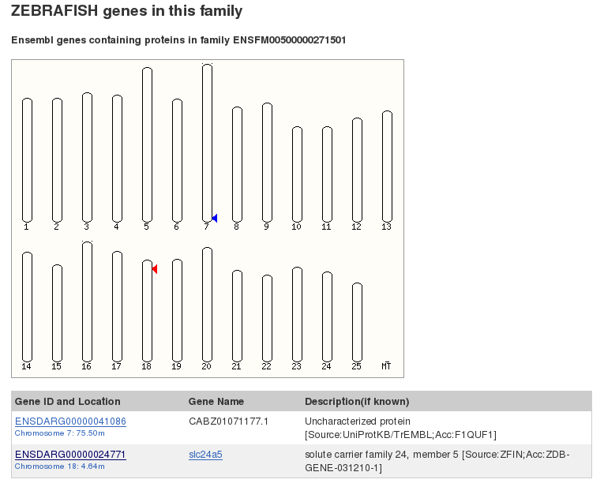
Example on the web: ENSFM00500000271501 in Zebrafish

Slide 10
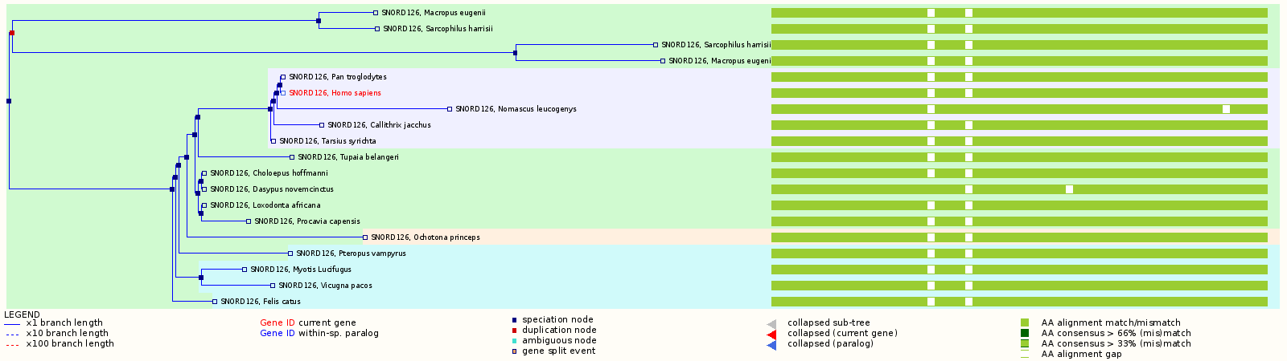
GeneTree example on the website
Tree
Multiple alignment

Slide 11
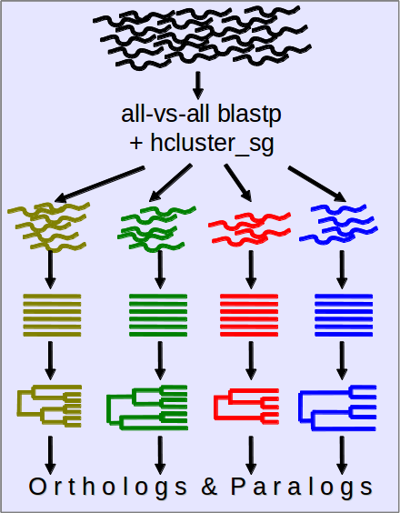
Protein-Tree pipeline overview
All e! genes – canonical prot.
BLAST
hcluster_sg
MCoffee: MSA
TreeBeST: (+ reconciliation)
Ortholog/Paralog inference
Vilella et al., Genome Res. 2009

Slide 12
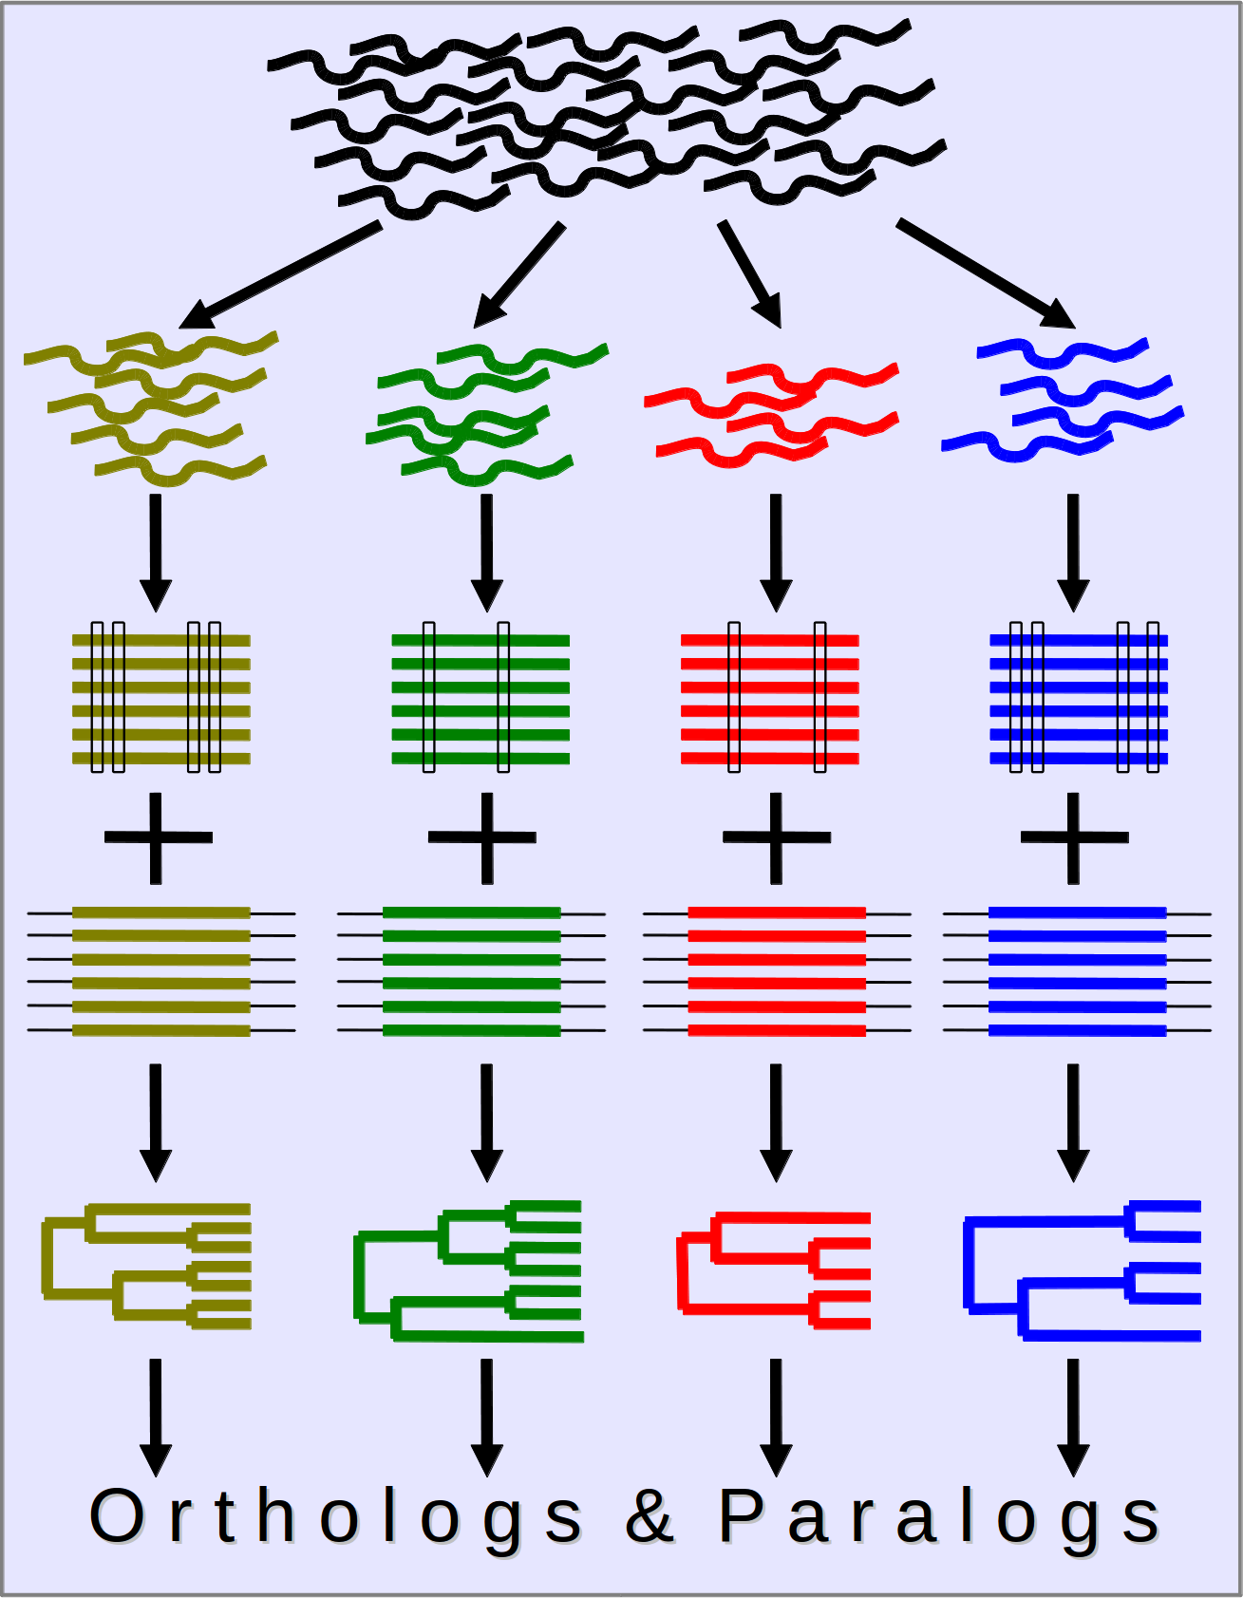
ncRNA-Tree pipeline overview
All e! ncRNA genes
Grouped in Family Models - RFAM
Infernal alignment + RaxML trees
PRANK alignment + NJ/ML trees
TreeBeST (tree reconciliation)
Ortholog/Paralog inference
Pignatelli et al., in preparation

Slide 13
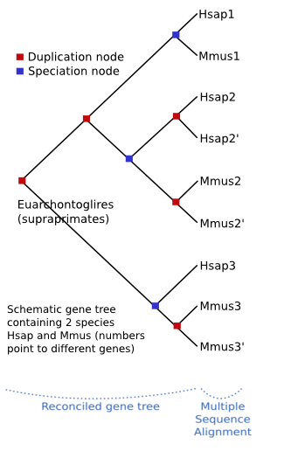
Homology inference
Consists in tagging the pairs of genes of all the trees with a relation type, depending on the tree topology.

Slide 14
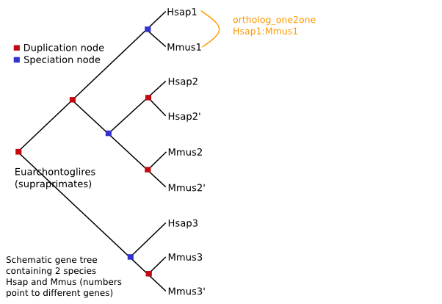
Homology inference

Slide 15
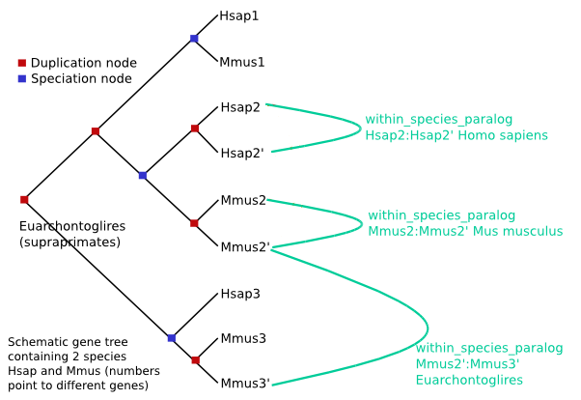
Homology inference

Slide 16
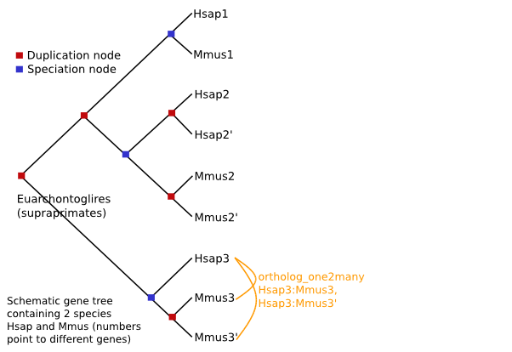
Homology inference

Slide 17
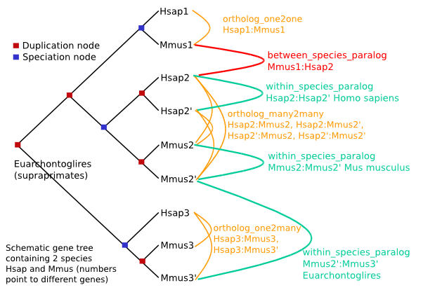
Homology inference

Slide 18
Gene analyses
Families
Clusters of similar peptides
+ multiple alignment
Multiple-species
comparisons
Gene Trees
Clusters of similar peptides / ncRNAs
+ multiple alignment
+ gene history (duplication, losses)
Homologies
Pairs of genes from the same tree
+ multiple alignment
+ natural selection analysis (dN, dS)
Pairwise comparisons

Slide 19
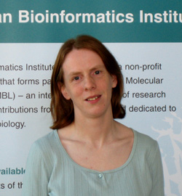
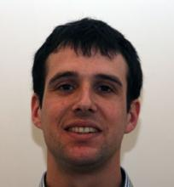
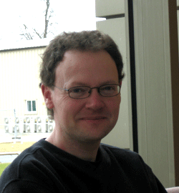
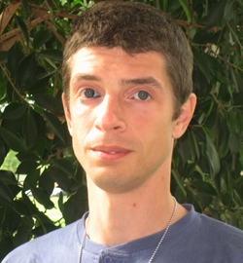
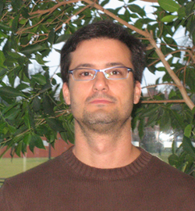
Who is in Ensembl Compara?
Kathryn Beal
Daniel Zerbino
Stephen Fitzgerald
+ me ! :)
Leo Gordon
Miguel Pignatelli

Slide 20
Outline of the course
Introduction about Compara
  Resources
  API
Base objects
  Genes, peptides, RNAs
  Multiple / pairwise alignments
Data objects
  Families
  Gene trees
  Homologies

Slide 21
The Compara Perl API
Written in Object-Oriented Perl
Used to retrieve data from and store data into the Ensembl Compara database
Links species together for Ensembl website
Generalized to extend to non-Ensembl genomic data (Uniprot)‏
Follows same ‘Data Object’ & ‘Object Adaptor’ DBAdaptor design as the other Ensembl APIs

Slide 22
Compara template script
use strict;
use Bio::EnsEMBL::Registry;
my $reg = "Bio::EnsEMBL::Registry";
# Auto-configure the registry
$reg->load_registry_from_db(
-host => "ensembldb.ensembl.org",
-user => "anonymous"
);
# Get the adaptor object for the data type you want
# e.g. GeneTree
my $xx_adaptor = $reg->get_adaptor("Multi", "compara", "XX");
# Fetch the data objects using the adaptor
# e.g. get all the genes in a given gene tree
my $all_interesting_xx = $xx_adaptor->fetch_all_by_YY();
print "All XX objects from E!Compara :\n";
foreach my $this_xx (@$all_interesting_xx) {
# Do some stuff with the data object
print "\t", $this_xx->stable_id, "\n";
}

Slide 23
Help & Useful documentation
perldoc – Viewer for inline API documentation
  shell> perldoc Bio::EnsEMBL::Compara::GenomeDB
  shell> perldoc Bio::EnsEMBL::Compara::DBSQL::MemberAdaptor
Online documents (website)
  http://e73.ensembl.org/info/docs/Doxygen/compara-api/index.html
  http://e73.ensembl.org/info/docs/api/compara/index.html
CVS
  ensembl-compara/docs/protein_schema.png
  ensembl-compara/docs/genomic_schema.png
ensembl-dev mailing list:
  dev@ensembl.org
  helpdesk@ensembl.org

Slide 24
Compara object model overview
PRIMARY DATA
NCBITaxon
species
GenomeDB
chromosomes
scaffolds
genes
proteins
transcripts
DnaFrag
Member
AlignedMemberSet
GenomicAlignBlock
ConservationScore
Family
RESULTS
GeneTree
SyntenyRegion
ConstrainedElement
Homology

Slide 25
Links between Compara and Core
Compara only stores references to the Core objects
The full data lies in the core databases

Slide 26
Outline of the course
Introduction about Compara
  Resources
  API
Base objects
  Genes, peptides, RNAs
  Multiple / pairwise alignments
Data objects
  Families
  Gene trees
  Homologies

Slide 27
GeneMember and SeqMember
GeneMember for genes
  source_name: ENSEMBLGENE
SeqMember for RNAs and proteins
  source_name: ENSEMBLPEP, ENSEMBLTRANS, Uniprot/SPTREMBL, Uniprot/SWISSPROT
Attributes | Methods
Stable ID | $member->stable_id()
Coordinates | $member->chr_name() $member->chr_start() …
Sequence (SeqMember only) | $member->sequence()
Function | $member->description()
Adaptor methods
$seq_member_adaptor->fetch_by_source_stable_id(…)
$gene_member_adaptor->fetch_all_by_source_taxon(…)

Slide 28
Links between Compara and Core
Compara
Core
GeneMember:
ENSEMBLGENE
Gene
Transcript
SeqMember:
ENSEMBLPEP
ENSEMBLTRANS
Translation
DnaFrag
Slice

Slide 29
HOWTO: get an Ensembl ID from a gene symbol
Compara only references genes by their Ensembl stable ID
From a gene symbol, you first have to use the core API to get the stable id(s)
Gene symbols may not be unique (for instance: U6)
# Get the Human gene adaptor
my $hg_adaptor = $reg->get_adaptor("human", "core", "Gene");
# Get all the genes
my $all_genes = $hg_adaptor->fetch_all_by_external_name(XX);
# For each gene
foreach my $gene (@{$all_genes}) {
do some stuff with $gene->stable_id();
}

Slide 30
Exercises - Member
Print the sequence of the Member corresponding to SwissProt protein O93279
Find and print the sequence of all the peptide Members corresponding to the human protein-coding gene(s) FRAS1

Slide 31
Outline of the course
Introduction about Compara
  Resources
  API
Base objects
  Genes, peptides, RNAs
  Multiple / pairwise alignments
Data objects
  Families
  Gene trees
  Homologies

Slide 32
AlignedMemberSet object
Base object that represents a set of members aligned together, e.g. a multiple alignment of peptides / ncRNAs
“Applied” in gene trees, families, and homologies
No specific adaptor
Attributes | Methods
List of members | $aln->get_all_Members()
Alignment (BioPerl object) | $aln->get_SimpleAlign()
Description (if available) | $aln->description()
Stable ID (if available) | $aln->stable_id()

Slide 33
HOWTO: print a BioPerl alignment
Compara objects return alignments as BioPerl instances
    $aln->get_SimpleAlign()
BioPerl provides an AlignIO object to format the actual output in various formats (fasta, clustalw, phylip … )
use Bio::AlignIO;
# Get the alignIO object from BioPerl
my $alignIO = Bio::AlignIO->newFh(-format => "fasta");
# Print the alignment
print $alignIO $aln;

Slide 34
Outline of the course
Introduction about Compara
  Resources
  API
Base objects
  Genes, peptides, RNAs
  Multiple / pairwise alignments
Data objects
  Families
  Gene trees
  Homologies

Slide 35

Family object
(almost) the same methods as in AlignedMemberSet
Alternative transcripts can belong to different families !
Families contain both SeqMembers and GeneMembers
Attributes | Methods
Alignment | $family->get_SimpleAlign()
Biological function | $family->description() $family->description_score()
Gene content | $family->get_all_Members()
Adaptor methods
$family_adaptor->fetch_all_by_Member(…)
$family_adaptor->fetch_by_stable_id(…)

Slide 36
Exercises - Families
Get the multiple alignment corresponding to the family with the stable id ENSFM00250000006121
Get the families predicted for the human gene ENSG00000139618. What do you notice ?

Slide 37
Outline of the course
Introduction about Compara
  Resources
  API
Base objects
  Genes, peptides, RNAs
  Multiple / pairwise alignments
Data objects
  Families
  Gene trees
  Homologies

Slide 38
GeneTree object
fetch_all* methods may require some more arguments:
    -clusterset_id => 'default'
    -tree_type => 'tree'
    -member_type => 'protein' or 'ncrna'
Attributes | Methods
Alignment | $family->get_SimpleAlign()
Tree export | $tree->newick_format('simple') $tree->nhx_format('full') $tree->print_tree()
Stable ID | $tree->stable_id()
Adaptor methods
$genetree_adaptor->fetch_by_stable_id(…)
$genetree_adaptor->fetch_default_for_Member(…)

Slide 39
Exercises – Protein and ncRNA trees
Print the protein tree with the stable id ENSGT00390000003602
Print all the members of the tree containing the human ncRNA gene ENSG00000238344

Slide 40
Outline of the course
Introduction about Compara
  Resources
  API
Base objects
  Genes, peptides, RNAs
  Multiple / pairwise alignments
Data objects
  Families
  Gene trees
  Homologies

Slide 41
Homology object
An Homology object links two genes together
One-to-many relationships are split:
  “H ortholog to M1” and “H ortholog to M2” are different objects
Attributes | Methods
Alignment | $homology->get_SimpleAlign()
Natural selection | $homology->dn() / $homology->ds()
Gene content | $homology->get_all_GeneMembers()
Homology characteristics | $homology->description() $homology->taxonomy_level()
Adaptor methods
$homology_adaptor->fetch_all_by_Member(…)
$homology_adaptor->fetch_all_by_MethodLinkSpeciesSet(…)
$homology_adaptor->fetch_all_by_Member_paired_species(…)

Slide 42
Exercises - Homologies
Get all the homologues for the human gene ENSG00000229314
Count the number of “one2one” homologues between human and mouse
Find the human orthologues of ENSMUSG00000004843 and ENSMUSG00000025746. For each homology, display the alignment and the dn value. Comment on the divergence

Slide 43
Extra exercise: SAFB
Get the GeneMember for SAFB
Get the (relevant) family for this gene
Get the gene tree for this gene
Compare the list of genes. Which are common / specific ?
Get the SAFB subtree for the taxon Sarcopterygii, and compare the list of genes to the family
In this subtree, list the duplications, their taxon names, and their confidence scores
Still in this subtree, list, for each non-human species, the closest orthologue

Slide 44
GeneTreeNode object
The actual tree structure is a hierarchy of GeneTreeNode objects
root node
leaf 1 (node)
int. node
GeneTree
internal node
leaf 2 (node)
leaf 3 (node)

Slide 45
GeneTreeNode object
The actual tree structure is a hierarchy of GeneTreeNode objects
root()
is_leaf() == 0
root node
parent()
children()
is_leaf() == 0
leaf 1 (node)
int. node
GeneTree
parent()
internal node
is_leaf() == 1
children()
leaf 2 (node)
leaf 3 (node)
is_leaf() == 1
is_leaf() == 1
Extra information
    $node->node_type() $node->duplication_confidence_score()
    $node->taxon()->name() $node->bootstrap()

Slide 46
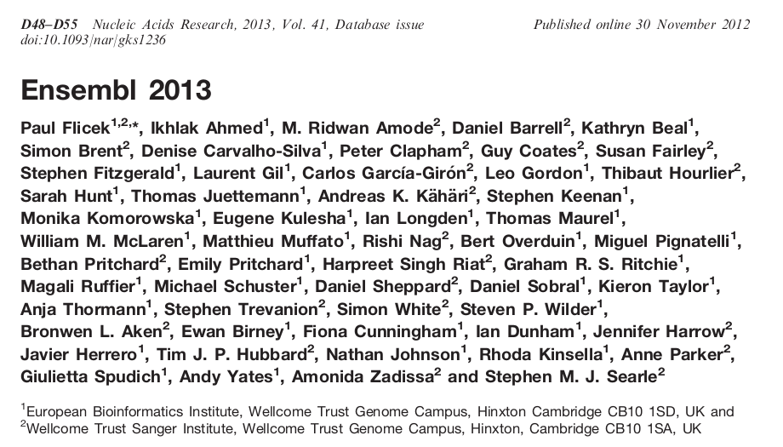
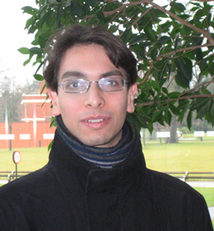
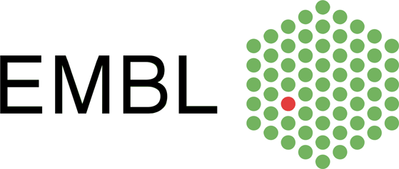







Acknowledgements
Compara Team
Matthieu
Kathryn
Stephen
Leo
European Commission Framework Programme 7
Daniel
Miguel

