Slide 1
NCBI PowerScripting

Slide 2
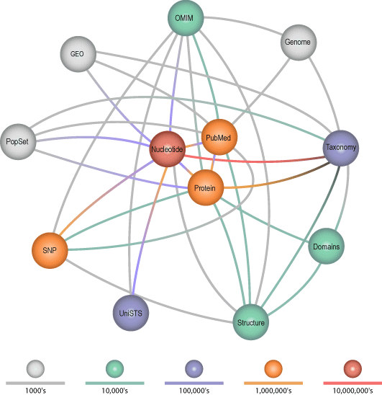
The Entrez System at NCBI

Slide 3
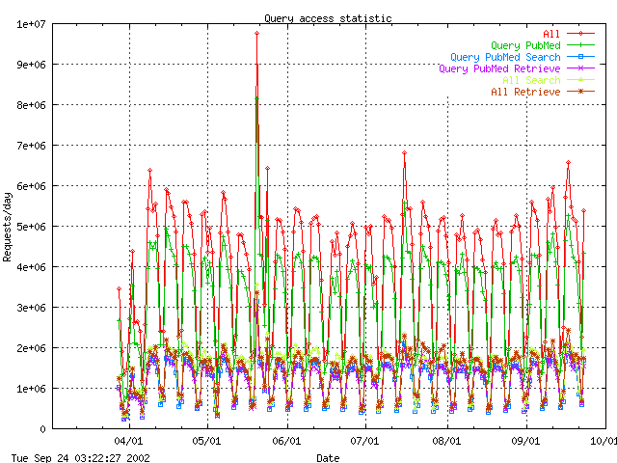
Entrez Hits per day

Slide 4
Entrez Functions
Search one or all of 28 databases.
Generate brief “document summaries” for a list of records.
Link from one list of records to another.
Perform boolean operations on lists of records.
Format records for display and download.

Slide 5
Links Between and Within Nodes
Word weight
Computational
PubMed abstracts
3-D Structure
Taxonomy
3 -D Structures
VAST
Phylogeny
Computational
Genomes
BLAST
Nucleotide sequences
Protein sequences
BLAST
Computational
Computational

Slide 6
Entrez Transactions
Each record in an Entrez database is assigned an integer called a UID, or “unique identifier”.
Entrez transactions are performed on lists of UIDs.
Transactions include boolean operations and the tracking of links within and between database records.

Slide 7
Searching
Entrez supports text searches with field restrictions and boolean operators.
Field restrictions vary among the databases.
Separate search history is maintained for each database.
Previous searches can be recalled and combined using a query key and a cookie, called a “WebEnv”.

Slide 8
DocSums
Brief summaries of database records are generated quickly on frontend servers.
Full records are retrieved from backend machines.

Slide 9
Overview of The 28 Entrez Databases
Pubmed protein nucleotide
Structure genome books
Cancerchromosomes cdd domains
Gene genomeprj gensat
geo gds homologene
Journals mesh ncbisearch
Nlmcatalog omim pmc
popset pccompound pcassay
Pcsubstance snp taxonomy
Unigene unists

Slide 10
Nucleotide 48153782 Records
Nucleotide sequence records
Terms ALL UID FILT WORD TITL KYWD AUTH JOUR VOL ISS PAGE ORGN ACCN PACC GENE PROT ECNO PDAT MDAT SUBS PROP SQID SLEN FKEY
Term Variety 3
Links genome nucleotide gene geo homologene omim pmc popset protein pubmed snp structure taxonomy unigene unists

Slide 11
Pubmed 15345404 Records
PubMed bibliographic records
Links books cancerchromosomes cdd domains gds gene genome geo homologene nucleotide omim pmc popset protein pubmed snp structure unists
Terms ALL UID FILT TITL WORD MESH MAJR AUTH JOUR AFFL ECNO SUBS PDAT EDAT VOL PAGE PTYP LANG ISS SUBH SI MHDA TIAB OTRM INVR COLN CNTY PAPX GRNT
Term Variety 2

Slide 12
Protein 5756814 Records
Protein sequence records
Terms ALL UID FILT WORD TITL KYWD AUTH JOUR VOL ISS PAGE ORGN ACCN PACC GENE PROT ECNO PDAT MDAT SUBS PROP SQID SLEN MLWT
Term Variety 3
Links cdd domains gene genome homologene nucleotide omim pmc popset protein pubmed snp structure taxonomy unigene

Slide 13
Gene 1372180 Records
Gene database
Terms ALL UID FILT TITL WORD ORGN MDAT CHR MV GENE EC MIM DIS ACCN UGEN PROP PDAT NCAC NUID PACC PUID PMID TID LLID GO
Term Variety 12
Links books geo homologene nucleotide omim protein pubmed snp taxonomy unigene unists

Slide 14
The Entrez System
Entrez Core Engine
Finds Unique Identifiers (UIDs) that match a text query
Displays Document Summaries for each matching UID
User
Entrez Databases
Entrez History Server
Provides formatted data records indexed by UID to the Core Engine
Provides Entrez links for each UID
Stores separate search histories for each Entrez database

Slide 15
The Entrez Core
Entrez Core Engine
EGQuery
Finds Unique Identifiers (UIDs) that match a text query
Displays Document Summaries for each matching UID
ESearch
ESummary
These work for ALL DATABASES!!!
text query
EGQuery
count of UIDs
text query
ESearch
set of UIDs
set of UIDs
ESummary
DocSums

Slide 16
The Base URL
http://eutils.ncbi.nlm.nih.gov/entrez/eutils/
eutil.fcgi?
esearch.fcgi?
egquery.fcgi?
esummary.fcgi?
einfo.fcgi?
elink.fcgi?
efetch.fcgi?
epost.fcgi?

Slide 17
URL Parameters
BASE/
esearch.fcgi?
db=nucleotide&term=mouse[orgn]
Parameters are separated by & symbols
db = nucleotide
term = mouse[orgn]
We need to know the following:
What parameters are available
What values they accept

Slide 18
EGQuery
Performs a global Entrez search across all databases
http://eutils.ncbi.nlm.nih.gov/entrez/eutils/egquery.fcgi
INPUT
term
Entrez text query
BASE/
egquery.fcgi?
term=mouse[orgn]
OUTPUT
XML
Number of records matching the query in
each database

Slide 19
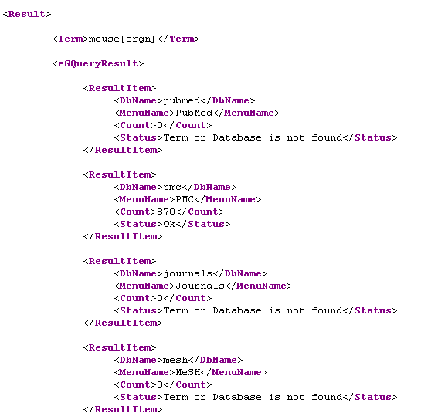
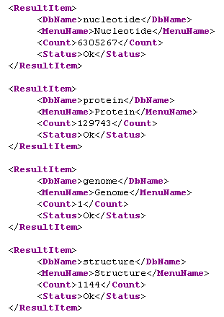
EGQuery Output

Slide 20
ESearch
Performs an Entrez search in one specified database
http://eutils.ncbi.nlm.nih.gov/entrez/eutils/esearch.fcgi
INPUT
db
Entrez database to search
term
Entrez text query
BASE/
esearch.fcgi?
db=nucleotide&term=mouse[orgn]
OUTPUT
XML
Total number of records matching the query
Partial list of matching UIDs
Term translations

Slide 21
Retrieval Parameters
retstart
First record to retrieve from UID set (default = 0)
retmax
Number of records to retrieve from UID set
&retmax=4
(84, 23, 19, 55, 20, 96, 73)
(84, 23, 19, 55)
&retstart=2&retmax=4
(84, 23, 19, 55, 20, 96, 73)
(19, 55, 20, 96)

Slide 22
Look at the Time!
Date format: YYYY/MM/DD
reldate=n
Retrieve UIDs with dates less than n days prior to today
mindate
Retrieves UIDs in this date range
These parameters must be used together!
maxdate
datetype
Type of date to examine:
Most Entrez databases only support two of these date types!
mdat Modification date: date the record was last touched
pdat Publication date: date the record was made public
edat Entrez date: date the record entered Entrez
cdat Creation date: date the record was created

Slide 23
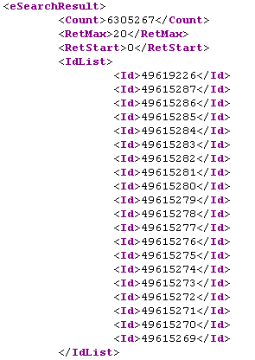
ESearch Output – UIDs
Total number of records found
&retmax
&retstart
Matching UIDs

Slide 24
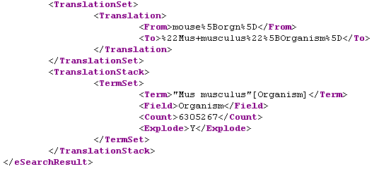
ESearch Output – Translations
Term translations: equivalent to the Details link on the web
mouse[orgn]
“Mus musculus”[Organism]

Slide 25
ESummary
Retrieves Document Summaries matching a set of UIDs
http://eutils.ncbi.nlm.nih.gov/entrez/eutils/esummary.fcgi
INPUT
db
Entrez database to search
id
Set of UIDs
BASE/
esummary.fcgi?
db=nucleotide&id=49619226,49615287
OUTPUT
XML
DocSums, often with more data than web
Entrez provides

Slide 26
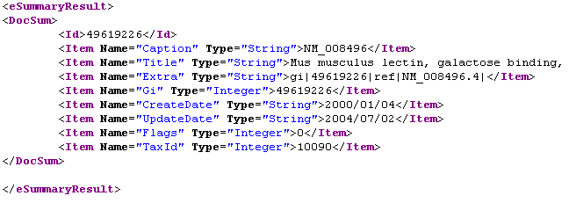
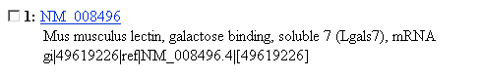
ESummary Output

Slide 27
EInfo
Provides indexing fields and overall statistics for an Entrez database
http://eutils.ncbi.nlm.nih.gov/entrez/eutils/einfo.fcgi
INPUT
db
Entrez database to search
BASE/
einfo.fcgi?
db=nucleotide
OUTPUT
XML
General indexing statistics
List of indexing fields and counts of records
List of available Entrez links for the database

Slide 28
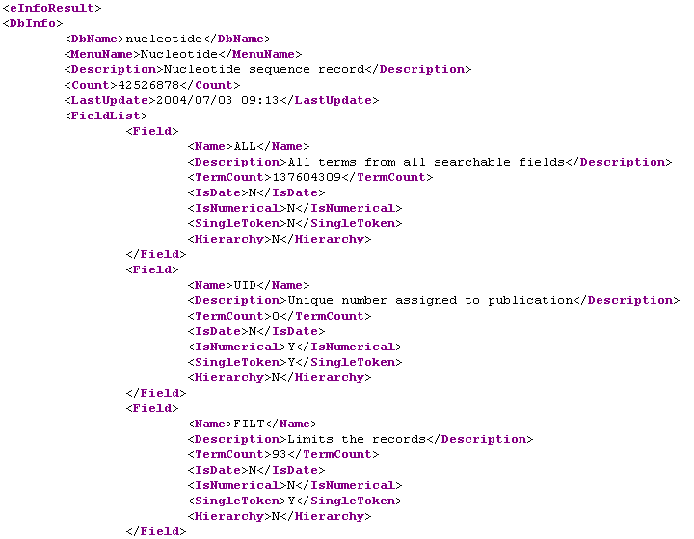
EInfo Output - Fields

Slide 29
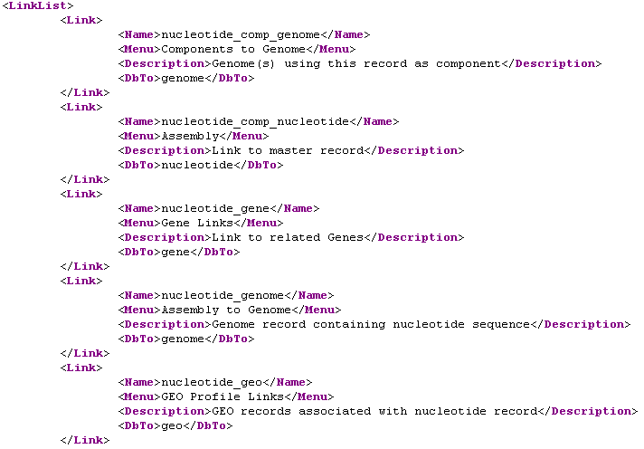
EInfo Output - Links

Slide 30
EFetch
Retrieves formatted data records matching a set of UIDs
http://eutils.ncbi.nlm.nih.gov/entrez/eutils/efetch.fcgi
INPUT
db
Entrez database to search
id
Set of UIDs
BASE/
efetch.fcgi?
db=nucleotide&id=49619226,49615287
OUTPUT
Varied
Formatted data records

Slide 31
Databases that Support EFetch
Literature
PubMed
Journals
PubMed Central
Sequences
Nucleotide
Protein
Genome
Popset
SNP
Other
Gene
Taxonomy

Slide 32
Retrieving Batches
A single EFetch URL can download a maximum of 500 records!
&retstart=0&retmax=500
Retrieve successive batches
of 500 records until the entire
dataset is downloaded
&retstart=500&retmax=500
&retstart=1000&retmax=500
…
Batch retrieval is easily implemented using a for loop:
for ($retstart=0; $retstart < $total; $retstart+=$retmax) {
… &retstart=$retstart&retmax=$retmax…
}

Slide 33
EFetch Formatting Parameters
rettype
Determines the type of data record returned
(flat file, FASTA, EST, accession, etc.)
retmode
Determines the format (mode) of data record returned
(text, HTML, XML)
Retrieves formatted data records matching a set of UIDs
Be warned!
These settings are very dependent on the database
These settings interact with one another
Not all possible combinations are supported

Slide 34
EFetch for PubMed
rettype
retmode
 | text | default / HTML | XML | asn.1
default | text asn.1 | asn.1 in HTML | full XML | full ASN.1
medline | text medline | medline in HTML | full XML | medline ASN.1
citation | text citation | citation in HTML | full XML | full ASN.1
abstract | text abstract | abstract in HTML | full XML | full ASN.1
uilist | text UID list | UID list in HTML | UID list in XML | full ASN.1

Slide 35
EFetch for Sequences
rettype
retmode
 | default / text | HTML | XML
default | text asn.1 | asn.1 in HTML | full XML
gb, gp, gbwithparts | text flat file | hyperlinked flat file in HTML | GBSeqXML
est, gss | text EST/GSS flat file | hyperlinked EST/GSS flat file | N/A
fasta | text FASTA | FASTA in HTML | TinySeqXML
seqid | text seqid | text seqid | N/A
acc | text accessions | accessions in HTML | N/A

Slide 36
EFetch Examples
BASE/
efetch.fcgi?
db=nucleotide&id=49619226
To retrieve XML:
&retmode=xml
To retrieve a GenBank flat file:
&rettype=gb
To retrieve a GenBank flat file with active hyperlinks:
&rettype=gb&retmode=html
To retrieve TinySeqXML:
&rettype=fasta&retmode=xml

Slide 37
ELink
Retrieves UIDs in database B linked to a set of UIDs in database A
http://eutils.ncbi.nlm.nih.gov/entrez/eutils/elink.fcgi
INPUT
dbfrom
Entrez database to link from
db
Entrez database(s) to link to; can be a list!
id
List of UIDs
cmd
ELink command mode (default = neighbor)
BASE/
elink.fcgi?
dbfrom=nucleotide&db=protein&id=49619226
OUTPUT
XML
Set(s) of linked UIDs

Slide 38
Computational Neighbors in ELink
Retrieves UIDs linked to other UIDs in the same database
dbfrom
=
db
BASE/
elink.fcgi?
dbfrom=protein&db=protein&id=15718680
term
Entrez query that ELink uses to limit the set of neighbors
Supported databases:
pubmed cdd
nucleotide geo
protein gds

Slide 39
Passing Multiple UID Sets to ELink
dbfrom=gene&db=protein&id=G1,G2,G3
G1
G2
G3
P1
P2
P3
P4
P5
P6

Slide 40
Passing Multiple UID Sets to ELink
dbfrom=gene&db=protein&id=G1&id=G2&id=G3
G1
G2
G3
P1
P2
P3
P4
P5
P6

Slide 41
Passing Multiple UID Sets to ELink
dbfrom=gene&db=protein&id=G1,G2&id=G3
G1
G2
G3
P1
P2
P3
P4
P5
P6

Slide 42
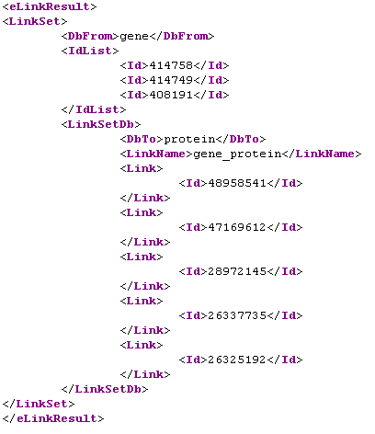
ELink Output
dbfrom=gene&db=protein&id=414758,414749,408191

Slide 43
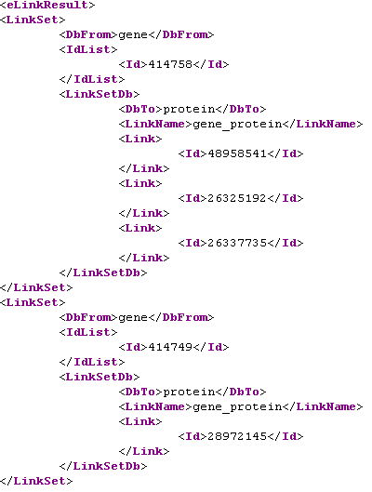
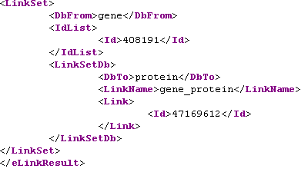
ELink Output
dbfrom=gene&db=protein&id=414758&id=414749&id=408191

Slide 44
The Entrez History Server
Entrez History Server
EPost
Stores separate search histories for each Entrez database
ESearch
The History Server represents the location of stored UID sets with two parameters:
WebEnv
A string specifying a cookie assigned by the History Server
query_key
An integer equivalent to the History number on the web
EPost
outputs exclusively to the History Server
ESearch
outputs to the History Server if
usehistory=y

Slide 45
EPost
Stores a list of UIDs on the History Server
http://eutils.ncbi.nlm.nih.gov/entrez/eutils/epost.fcgi
INPUT
db
Entrez database containing UIDs
id
List of UIDs
BASE/
epost.fcgi?
&db=nucleotide&id=49619226,49615287
OUTPUT
XML
WebEnv
query_key

Slide 46
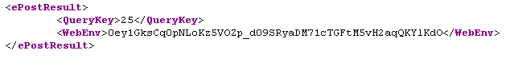
EPost Output
query_key
WebEnv
UIDs can be passed to EPost in two ways:
In the &id parameter in a URL (limited to ~500)
In the &id parameter using the POST method (can post thousands)
Using method 2, UIDs can be posted from a file, and EPost becomes
the equivalent of Batch Entrez on the web

Slide 47
Why Use the History Server?
To retrieve these 6,305,267 records…
Collect the 6,305,267 UIDs with 12,611 ESearch URLs, each with &retmax=500
Parse the UIDs and assemble into lists
Retrieve these batches with 12,611 EFetch URLs
Total URLs: 25,222
OR
Allow ESearch to store the 6,305,267 UIDs on the History Server
Retrieve these in batches of 500 with 12,611 EFetch URLs
Total URLs: 12,612

Slide 48
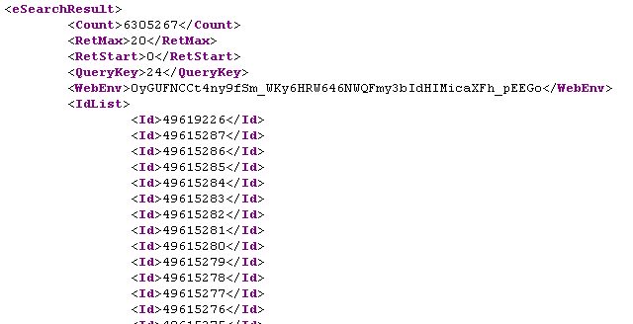
Using ESearch to Post Results
BASE/
esearch.fcgi?
db=nucleotide&term=mouse[orgn]&usehistory=y
query_key
WebEnv

Slide 49
Using Sets Stored in History
Use &WebEnv and &query_key instead of &id
Always use the most recent &WebEnv returned!
BASE/
esummary.fcgi?
db=nucleotide&WebEnv=A1B2&query_key=3
BASE/
efetch.fcgi?
db=nucleotide&WebEnv=A1B2&query_key=3
BASE/
elink.fcgi?
dbfrom=gene&db=protein&WebEnv=A1B2&query_key=3

Slide 50


The Big Picture
Entrez
query
ESearch
usehistory=y
ESummary
UID List
Entrez History Server
EFetch
EPost
WebEnv
ELink
UID List
query_key

Slide 51

Finally, Now for Your UID!
Please use both of these parameters in your URLs in case there are problems
tool
a unique name for your software package
email
your email address, so NCBI can contact you…
&tool=geneling&email=smartSDEV@vt.edu
Don’t forget the 3 sec rule!!!!

Slide 52
The General eUtil Pipeline
Entrez
query
DocSums
ESearch
ESummary
!$%*@$#!
EFetch
EPost
Formatted
Data
UID List

Slide 53
The Twelve Elements
ESearch
ESummary
EPost
ESummary
ESearch
EFetch
EPost
EFetch
ESearch
ELink
EPost
ELink
ESearch
ESearch
EPost
ESearch
ELink
ESearch
ELink
EFetch
ELink
ESummary
ELink
ELink

Slide 54
What’s in the Arrows?
Parameter values from the XML output of eUtil 1 must be assigned to parameters in the URL of eUtil 2
post URL
parse XML
post URL
parse XML

Slide 55
Points to Remember About History
Query keys are unique within a given database, but not across databases
  Each database has a unique History
The combination of WebEnv and query key is unique across databases
  Always keep track of the pair
The query key is constant; but a new WebEnv is returned with every URL
  Always use the most recent WebEnv from each database!

Slide 56
A General Design Approach
Know what you want before you begin
  Do I need the full record? (EFetch)
  Will a DocSum be sufficient? (ESummary)
Know what Entrez database contains the data you want
  If it’s not in Entrez, the eUtils can’t access it
Try your pipeline in interactive web Entrez first
  Some Entrez queries may surprise you
  Some Entrez data may surprise you
  Some Entrez links may surprise you
Build your pipeline from the paired eUtil elements

Slide 57
Programmer’s Song
100 little bugs in the code
100 little bugs in the code
Fix one bug and recompile
101 little bugs in the code
(repeat until bugs=0)

Slide 58
Real Life Application
Creating a gene database for AT
Creating a protein database for AT
Creating an upstream regions database for AT

Slide 59
Acknowledgements
Dr. Eric Sawyer (NCBI)
Dr. Lenwood S Heath

