Slide 1
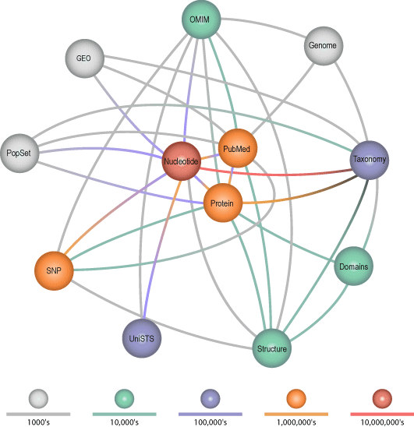
The Entrez System at NCBI

Slide 2
Entrez Functions
Search one or all of 29 databases.
Generate brief “document summaries” for a list of records.
Link from one list of records to another.
Perform boolean operations on lists of records.
Format records for display and download.

Slide 3
Links Between and Within Nodes
Word weight
Computational
PubMed abstracts
3-D Structure
Taxonomy
3 -D Structures
VAST
Phylogeny
Computational
Genomes
BLAST
Nucleotide sequences
Protein sequences
BLAST
Computational
Computational

Slide 4
Entrez Transactions
Each record in an Entrez database is assigned an integer called a UID, or “unique identifier”.
Entrez transactions are performed on lists of UIDs.
Transactions include boolean operations and the tracking of links within and between database records.

Slide 5
Searching
Entrez supports text searches with field restrictions and boolean operators.
Field restrictions vary among the databases.
Separate search history is maintained for each database.
Previous searches can be recalled and combined using a query key and a cookie, called a “WebEnv”.

Slide 6
DocSums
Brief summaries of database records are generated quickly on frontend servers.
Full records are retrieved from backend machines.

Slide 7
Overview of The 29 Entrez Databases

Slide 8
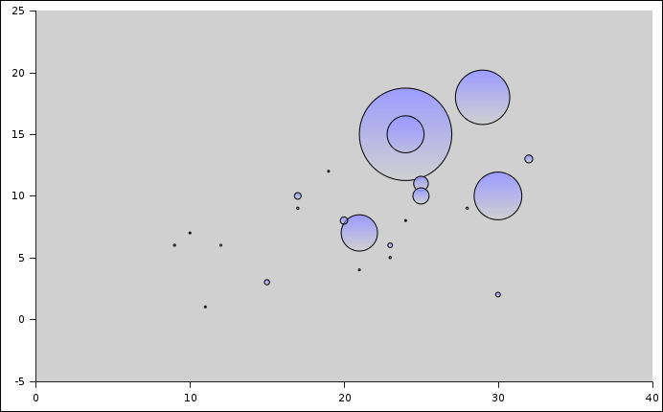
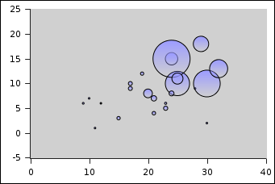
The Entrez Bubblegram: via einfo.fcgi
Nucleotide
PubMed
Protein
Gene
PMC
# Database Links
SNP
Unigene
Geo
# Indexed Fields

Slide 9
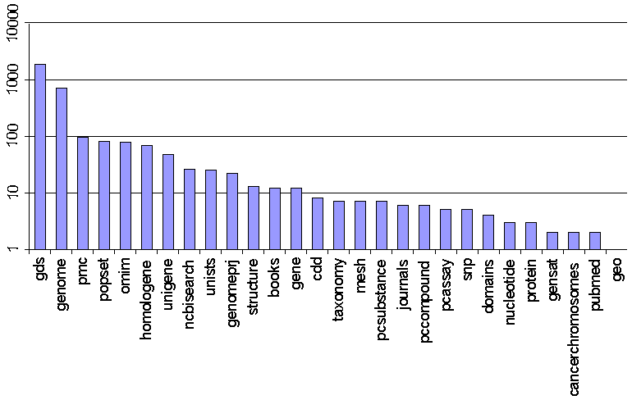
Term Variety For 28 Entrez Databases

Slide 10
Nucleotide 52,351,669 Records
Nucleotide sequence records
Fields ALL UID FILT WORD TITL KYWD AUTH JOUR VOL ISS PAGE ORGN ACCN PACC GENE PROT ECNO PDAT MDAT SUBS PROP SQID SLEN FKEY
Term Variety 3
Links genome nucleotide gene geo homologene omim pmc popset protein pubmed snp structure taxonomy unigene unists

Slide 11
Nucleotide Fields
ALL All Fields from all searchable fields
UID Unique number assigned to publication
FILT Limits the records
WORD Free text associated with record
TITL Words in definition line
KYWD Nonstandardized Fields provided by submitter
AUTH Author(s) of publication
JOUR Journal abbreviation of publication
VOL Volume number of publication
ISS Issue number of publication
PAGE Page number(s) of publication
ORGN Scientific and common names of organism, and all higher levels of taxonomy
ACCN Accession number of sequence
PACC Does not include retired secondary accessions
GENE Name of gene associated with sequence
PROT Name of protein associated with sequence
ECNO EC number for enzyme or CAS registry number
PDAT Date sequence added to GenBank
MDAT Date of last update
SUBS CAS chemical name or MEDLINE Substance Name
PROP Classification by source qualifiers and molecule type
SQID String identifier for sequence
SLEN Length of sequence
FKEY Feature annotated on sequence

Slide 12
Snp 18,882,606 Records
Single Nucleotide Polymorphisms
Fields ALL UID FILT RS CHR GENE HAN ACCN LLID ORGN FXN GTYP HETZ MPWT VALI SRAT CBID UBID CDAT UDAT PCLS MCLS SS SID VARI SCLS GDSC CPOS GPOS WORD
Term Variety 5
Links gene nucleotide omim pmc protein pubmed structure taxonomy unigene unists

Slide 13
Snp Fields
ALL All Fields from all searchable fields
UID Unique number assigned to publication
FILT Limits the records
RS Clustered SNP ID (rs)
CHR chromosomes
GENE locus link symbol
HAN Submitter Handle
ACCN nucleotide accessions
LLID locus link UID
ORGN Organism
FXN Function class
GTYP Genotype info
HETZ Heterozygosity
MPWT Map weight
VALI Validation status
SRAT Success rate
CBID Original Build ID
UBID Update Build ID
PDAT SNP Publication date
MDAT SNP modification date
PCLS Population classification based on geographic location
MCLS Assay Method
SS Submitter ID
SID Local SNP ID
VARI Allele
SCLS SNP class
GDSC description of gene
CPOS Chromosome base position
GPOS Contig base position
WORD Free text associated with record

Slide 14
Pubmed 15,502,839 Records
PubMed bibliographic records
Fields ALL UID FILT TITL WORD MESH MAJR AUTH JOUR AFFL ECNO SUBS PDAT EDAT VOL PAGE PTYP LANG ISS SUBH SI MHDA TIAB OTRM INVR COLN CNTY PAPX GRNT
Term Variety 2
Links books cancerchromosomes cdd domains gds gene genome geo homologene nucleotide omim pmc popset protein pubmed snp structure unists

Slide 15
Pubmed Fields
ALL All Fields from all searchable fields
UID Unique number assigned to publication
FILT Limits the records
TITL Words in title of publication
WORD Free text associated with publication
MESH Medical Subject Headings assigned to publication
MAJR MeSH Fields of major importance to publication
AUTH Author(s) of publication
JOUR Journal abbreviation of publication
AFFL Author's institutional affiliation and address
ECNO EC number for enzyme or CAS registry number
SUBS CAS chemical name or MEDLINE Substance Name
PDAT Date of publication
EDAT Date publication first accessible through Entrez
VOL Volume number of publication
PAGE Page number(s) of publication
PTYP Type of publication (e.g., review)
LANG Language of publication
ISS Issue number of publication
SUBH Additional specificity for MeSH term
SI Cross-reference from publication to other databases
MHDA Date publication was indexed with MeSH Fields
TIAB Free text associated with Abstract/Title
OTRM Other Fields associated with publication
INVR Investigator
COLN Corporate Author of publication
CNTY Country of publication
PAPX MeSH pharmacological action pre-explosions
GRNT NIH Grant Numbers
MDAT Date of last modification
CDAT Date of completion
PID Publisher ID
FAUT First Author of publication
FULL Full Author Name(s) of publication

Slide 16
Geo 11,288,275 Records
Genes Expression Profiles
Fields ALL UID FILT ORGN ACCN GDST GEOT RTYP ETYP VTYP NSAM SRC ID NAME GDSC RSTD RMAX RMIN FINF FTYP GI
Term Variety 1
Links gds gene geo homologene nucleotide pubmed unigene

Slide 17
Geo Fields
ALL All Fields from all searchable fields
UID Unique number assigned to publication
FILT Limits the records
ORGN exploded organism names
ACCN accession for GDS (DataSet), GPL (Platform), GSM (Sample), GSE (Series)
GDST GDS text from title and description
GEOT Sample text
RTYP platform reporter type
ETYP experiment type
VTYP type of values, e.g. log ratio, count
NSAM Number of samples
SRC sample source
ID Spot ID from GEO Platform, SAGE tag, Affy ProbeSet ID
NAME name or identifier for the spot, e.g. GenBank, UniGene ID, Locus Link ID etc.
GDSC Gene Description
RSTD Ranked standard deviation
RMAX percentile rank of the maximal values within each sample
RMIN percentile rank of the minimal values within each sample
VMIN minimal values the profile
VMAX maximal values the profile
PMED median value in the profile
GMED median value in the dataset
MFLD maximal observed fold or log diff in a profile
FINF indicates an interesting or notable uid in the GDS context
FTYP type of flag that indicates a uid of interest, or outliers etc.
GI GenBank Identifier

Slide 18
Protein 5,982,939 Records
Protein sequence records
Fields ALL UID FILT WORD TITL KYWD AUTH JOUR VOL ISS PAGE ORGN ACCN PACC GENE PROT ECNO PDAT MDAT SUBS PROP SQID SLEN MLWT
Term Variety 3
Links cdd domains gene genome homologene nucleotide omim pmc popset protein pubmed snp structure taxonomy unigene

Slide 19
Protein Fields
ALL All Fields from all searchable fields
UID Unique number assigned to publication
FILT Limits the records
WORD Free text associated with record
TITL Words in definition line
KYWD Nonstandardized Fields provided by submitter
AUTH Author(s) of publication
JOUR Journal abbreviation of publication
VOL Volume number of publication
ISS Issue number of publication
PAGE Page number(s) of publication
ORGN Scientific and common names of organism, and all higher levels of taxonomy
ACCN Accession number of sequence
PACC Does not include retired secondary accessions
GENE Name of gene associated with sequence
PROT Name of protein associated with sequence
ECNO EC number for enzyme or CAS registry number
PDAT Date sequence added to GenBank
MDAT Date of last update
SUBS CAS chemical name or MEDLINE Substance Name
PROP Classification by source qualifiers and molecule type
SQID String identifier for sequence
SLEN Length of sequence
MLWT Molecular Weight

Slide 20
Unigene 1,509,101 Records
Transcript clusters
Fields ALL UID FILT ORGN TITL LIBR TISS CLON NCAC NUID PRAC PUID KYWD WORD CHR GENE GDSC LLID TXID ESTC MRNA SEQC CID EXPR REXP
Term Variety 47
Links gene geo homologene nucleotide omim protein snp taxonomy unigene unists

Slide 21
Unigene Fields
ALL All Fields from all searchable fields
UID Unique number assigned to publication
FILT Limits the records
ORGN scientific and common names of organism
TITL title of cluster
LIBR dbEST library names
TISS tissue sources of libraries
CLON clone ids, with and without IMAGE
NCAC nucleotide accessions of seqeunces
NUID nucleotide uids of sequences
PRAC protein accessions
PUID protein uids
KYWD various flags
WORD titles of sequences, vectors
CHR chromosomes
GENE locus link symbol
GDSC description of gene
LLID locuslink ID
TXID taxonomy id
ESTC number of ests per cluster
MRNA number of mrna per cluster
SEQC total number of sequences per cluster
CID Cluster ID
EXPR library description of all member sequences
REXP library description of the majority of member sequences

Slide 22
Gene 1,487,488 Records
Gene database
Fields ALL UID FILT TITL WORD ORGN MDAT CHR MV GENE EC MIM DIS ACCN UGEN PROP PDAT NCAC NUID PACC PUID PMID TID LLID GO
Term Variety 12
Links books geo homologene nucleotide omim protein pubmed snp taxonomy unigene unists

Slide 23
Gene Fields
ALL All Fields from all searchable fields
UID Unique number assigned to a gene record
FILT Limits the records
TITL gene or protein name
WORD Free text associated with record
ORGN scientific and common names of organism
MDAT The last date on which the record was updated
CHR Chromosome number or numbers; also 'mitochondrial', 'unknown' properties
MV Chromosomal map location as displayed in MapViewer
GENE Symbol or symbols of the gene
ECNO EC number for enzyme or CAS registry number
MIM MIM number from OMIM
DIS Name(s) of diseases associated with this gene. When available, OMIM name will be used
ACCN Nucleotide or protein accession(s) associated with this gene
UGEN UniGene cluster number for this gene
PROP Properties of Gene record
CDAT The date on which this record first appeared
NCAC nucleotide accessions of seqeunces
NUID nucleotide uids of sequences
PACC protein accessions
PUID protein uids
PMID PubMed ids of accessions linked to the record
TID taxonomy id
LLID LocusLink ID
GO Gene Ontology
DOM Domain Name
DDAT The date on which the record was discontinued

Slide 24
NLM Catalog 1,216,423 Records
NLM Catalog Database
FieldsALL
UID FILT ITAG AUTH FAUT CALL CNAM ITEM JOUR LANG RTYP MESH MAJR SUBH OLIO OTHR OTRM PERS FPER CNTY PDAT
PSTA PTYP PUBL SERI TITL URL NID EDAT
Term Variety 9
Links

Slide 25
NLM Catalog Fields
ALL All Fields from all searchable fields
UID Unique number assigned to publication
FILT Limits the records
ITAG Abstract/Index Tags
AUTH Author(s) of publication
FULL Full Names of Authors
CALL Call Number
CNAM Corporate/Conference Name
ITEM Item Type
JOUR Journal
LANG Language of publication
RTYP Resource Type
MESH Medical Subject Headings assigned to publication
MAJR MeSH Fields of major importance to publication
SUBH Additional specificity for MeSH term
OLIO Olio
OTHR Other Number
OTRM Other Fields associated with publication
PERS Personal Name as Subject
FPER Full Personal Name as Subject
CNTY Country of publication
PDAT Year of publication
PSTA Status of publication
PTYP Type of publication (e.g., review)
PUBL Publisher
SERI Series
TITL Words in title of publication
URL URL
NID NLM Unique ID
EDAT Date publication first accessible through Entrez

Slide 26
PC Substance 829,042 Records
Chemicals screened for bioactivity
Fields ALL UID FILT SRC OID SRD DDAT CC BAID RN SNAM CMT NAM ELMT MF MW TFC UPAC XLGP TSLP CPLX RBC HBDC HBAC HAC ACC ACDC ACUC BCC BCDC BCUC IAC TC CIG CID
Term Variety 7
Links pcassay pcsubstance pcccompound pmc protein pubmed structure

Slide 27
PC Substance Fields
ALL All Fields from all searchable fields
UID Unique number assigned to publication
FILT Limits the records
SRC SourceName
SRID SourceID
SRCC SourceClass
SRD SourceReleaseDate
DDAT DepositDate
BAID BioAssayID
AA ActiveAid
IA InactiveAid
CSYN CompleteSynonym
SYNO Synonym
MSHT MeSHTerm
MSHN MeSHTreeNode
PHMA PharmAction
CMT Comment
MHD MeSHDescription
ELMT Element
MW MolecularWeight
TFC TotalFormalCharge
UPAC IUPACName
XLGP XLogP
CPLX Complexity
RBC RotatableBondCount
HBDC HydrogenBondDonorCount
HBAC HydrogenBondAcceptorCount
HAC HeavyAtomCount
ACC AtomChiralCount
ACDC AtomChiralDefCount
ACUC AtomChiralUndefCount
BCC BondChiralCount
BCDC BondChiralDefCount
BCUC BondChiralUndefCount
IAC IsotopeAtomCount
CUC CovalentUnitCount
TC TautomerCount
AC ActiveAidCount
IC InactiveAidCount
TAC TotalAidCount
AAR ActiveAidRatio
SCID StandardizedCID
CCID ComponentCID
NCID NeutralizedCID
CID CompoundID

Slide 28
PC Compound 636,360 Records
Small Molecule Structures
Fields ALL UID FILT SRC OID SRD DDAT CC BAID RN SNAM CMT NAM ELMT MF MW TFC UPAC XLGP TSLP CPLX RBC HBDC HBAC HAC ACC ACDC ACUC BCC BCDC BCUC IAC TC CIG SID
Term Variety 6
Links pcassay pcsubstance pcccompound pmc protein pubmed structure

Slide 29
PC Compound Fields
ALL All Fields from all searchable fields
UID Unique number assigned to publication
FILT Limits the records
SRC SourceName
SRID SourceID
SRCC SourceClass
DDAT DepositDate
BAID BioAssayID
AA ActiveAid
IA InactiveAid
CSYN CompleteSynonym
SYNO Synonym
MSHT MeSHTerm
MSHN MeSHTreeNode
PHMA PharmAction
MHD MeSHDescription
ELMT Element
MW MolecularWeight
TFC TotalFormalCharge
UPAC IUPACName
XLGP XLogP
CPLX Complexity
RBC RotatableBondCount
HBDC HydrogenBondDonorCount
HBAC HydrogenBondAcceptorCount
HAC HeavyAtomCount
ACC AtomChiralCount
ACDC AtomChiralDefCount
ACUC AtomChiralUndefCount
BCC BondChiralCount
BCDC BondChiralDefCount
BCUC BondChiralUndefCount
IAC IsotopeAtomCount
CUC CovalentUnitCount
TC TautomerCount
AC ActiveAidCount
IC InactiveAidCount
TAC TotalAidCount
AAR ActiveAidRatio
SID SubstanceID

Slide 30
Unists 466,607 Records
Unique Sequence Tagged Sites
Fields ALL UID FILT USID MRKN ORGN TXID CHR MNAM ALIA KYWD LLID GENE GDSC UGID UGDS NCAC NUID NUDL PRIM
Term Variety 25
Links gene nucleotide omim pmcpubmed snp taxonomy unigene

Slide 31
Unists Fields
ALL All Fields from all searchable fields
UID Unique number assigned to publication
FILT Limits the records
USID UniSTS ID
MRKN marker name
ORGN scientific name of organism
TXID taxonomy id
CHR chromosomes
MNAM map name
ALIA UniSTS Alias
KYWD various flags
LLID locuslink UID
GENE locus link symbol
GDSC description of gene
UGID unigenegene identifier
UGDS description of unigene
NCAC nucleotide accessions
NUID nucleotide uids of sequences
NUDL nucleotide defline
PRIM primer
WORD Free text associated with publication

Slide 32
Pmc 365,688 Records
PubMed Central
Fields ALL UID FILT PMID AUTH TITL PDAT ABST CAPT SECT REFR REFA RPID JOUR VOL ISS PAGE EDAT WORD ARTI KWD METH MESH MAJR SUBH ECNO SUBS AFFL MDAT ORGN ONSN ACCN
Term Variety 96
Links books cdd genome nucleotide omim pmc popset protein pubmed snp structure taxonomy unists

Slide 33
Pmc Fields
ALL All Fields from all searchable fields
UID Unique number assigned to publication
FILT Limits the records
PMID Unique identifier from PubMed
AUTH Author(s) of publication
TITL A short descriptive name
PDAT Date of publication
ABST Abstract
CAPT Caption
SECT Section Title
REFR Reference
REFA Name of Reference author(s)
RPID Reference Unique identifier from PubMed
JOUR Source journal of publication
VOL Volume number of publication
ISS Issue number of publication
PAGE Page number(s) of publication
EPDT Date publication first accessible through Entrez
WORD Free text associated with publication
ARTI Article Body
KWD Keyword
METH Keyword in the Methods Section
MESH Medical Subject Headings assigned to publication
MAJR Medical Fields of major importance assigned to publication
SUBH Additional specificity for MeSH Fields
ECNO EC number for enzyme or CAS registry number
SUBS CAS chemical name or MEDLINE Substance Name
AFFL Author's institutional affiliation and address
LDAT PMC live date
ORGN scientific and common names of organism
ONSN unsynonymized organism names
ACCN Accession number of sequence
EDAT Entrez date

Slide 34
Taxonomy 256,913 Records
Organisms and lineages
Fields ALL UID FILT SCIN COMN TXSY ALLN NXLV SBTR LNGE GC MGC TXDV RANK EDAT PROP WORD
Term Variety 7
Links cdd domains gds homologene pmc popset pubmed snp unigene unists

Slide 35
Taxonomy Fields
ALL All Fields from all searchable fields
UID Unique number assigned to publication
FILT Limits the records
SCIN Scientific name of organism
COMN Common name of organism
TXSY Synonym of organism name
ALLN All aliases for organism
NXLV Immediate parent in taxonomic hierarchy
SBTR Any parent node in taxonomic hierarchy
LNGE Lineage in taxonomic hierarchy
GC Nuclear genetic code
MGC Mitochondrial genetic code
TXDV GenBank division
RANK Hierarchical position (e.g., order, genus)
EDAT Date record first accessible through Entrez
PROP Property defined on particular node (e.g., terminal node)
WORD Free text associated with record

Slide 36
Mesh 174,286 Records
Medical subject headings
Fields ALL UID FILT TN MESH WORD ALSO PREV NOTE
Term Variety 7
Links genome nucleotide pmc popset protein pubmed

Slide 37
Mesh Fields
ALL All Fields from all searchable fields
UID Unique number assigned to publication
FILT Limits the records
TN Tree Number
MESH MeSH Fields
SUBS Substance Name
WORD Free text
ALSO See Also
PREV Previous Indexing
NOTE Scope Note
REG Registry Number
MULT Multi
TYPE Record type - main heading, subheading, pharmacological action, substance name, publication type

Slide 38
Domains 128,073 Records
3D Protein Domains
Fields ALL UID FILT MID ACCN TITL AUTH PCLA PSRC PDSC PCOM PRD MPRC DNUM CDN HCNT SCNT RCNT MLWT ORGN NAME MDAT PDAT
Term Variety 4
Links cdd domains protein pubmed structure taxonomy

Slide 39
Domains Fields
ALL All Fields from all searchable fields
UID sdi
FILT Limits the records
MID MmdbId
ACCN PdbAcc
TITL Title
AUTH Author
PCLA PdbClass
PSRC PdbSource
PDSC PdbDescr
PCOM PdbComment
PRD PdbReleaseDate
MPRC ModResCount
DNUM DomainNo
CDN CumulDomainNo
HCNT HelixCount
SCNT StrandCount
RCNT ResCount
MLWT Molecular Weight
ORGN Organism
DOM Domain name
MDAT MmdbDate
PDAT Publication Date
CHN PdbChainCode

Slide 40
Cancerchromosomes 110,114 Records
SKY/CGH Database
Fields ALL UID FILT TXID GEND DSST TISS TREA HERD AUTH SUBM CASE SFKY BKPT JUNC NCHR ACHR BAND DIAG SITE STGE RODT CLNM ICDO COMM TECH DB CSID PSEU VIEW
Term Variety 2
Links cancerchromosomes pubmed

Slide 41
Cancerchromosomes Fields
ALL All Fields from all searchable fields
UID Unique number assigned to publication
FILT Limits the records
TXID Taxonomy ID
GEND Gender
DSST Disease Status
TISS Tissue
TREA Treatment performed
HERD Hereditary Syndrome
AUTH Citation
SUBM Submitter's Name
CASE Case Name
SFKY Short Form Karyotype
BKPT Breakpoints from SKY, Deduced for CGH Analysis
JUNC Junctions
NCHR Normal Chromosomes Increased/Decreased
ACHR Abnormal Chromosomes
BAND Bands involved in an amplification/deletion
DIAG Diagnosis/Morphology
SITE Site/Topography
STGE Disease Stage
RODT Strain/Genotype/Addn Information found in Rodent(s)
CLNM Name of any Cell Line
ICDO ICD-0-3 code for Diagnosis/Site
COMM Any other information
TECH Which Cytogenetic Technique used
DB Which database -Mitelman or Skycgh
CSID case identifiers from source database
PSEU PseudDoc Cytogenetic/Clinical
VIEW Either case docsum view/cell view

Slide 42
Books 110,017 Records
Online textbooks
Fields ALL UID FILT AUTH TITL TYPE STXT CONP BOOK PMID RID TOP PUBN PDAT ISBN
Term Variety 12
Links gene pmc pubmed

Slide 43
Books Fields
ALL All Fields from all searchable fields
UID Unique number assigned to publication
FILT Limits the records
AUTH Section's author
TITL Section's title
TYPE Section's type
STXT Special text word
CONP Generated keywords
BOOK ID of the book that contains the document
PMID PubMed ID
RID Book internal ID
TOP Book's Topic
PUBN Publisher's name
PDAT Year of publication
ISBN ISBN

Slide 44
Homologene 40,446 Records
Gene homologs in 18 organisms
Fields ALL UID FILT TITL WORD PROP ORGN GNID GENE GDSC PUID PRAC NUID NCAC UGID ANCS DOM
Term Variety 68
Links cdd gene geo nucleotide omim protein pubmed taxonomy unigene

Slide 45
Homologene Fields
ALL All Fields from all searchable fields
UID Unique number assigned to publication
FILT Limits the records
TITL Words in title of publication
WORD Free text associated with record
PROP Properties (formerly Keyword)
ORGN scientific and common names of organism
GNID Gene ID
GENE Gene Name
GDSC Description of gene
PUID protein uids
PRAC protein accessions
NUID nucleotide uids of sequences
NCAC nucleotide accessions of seqeunces
UGID UniGene ID
ANCS scientific and common names of ancestor organism
DOM Domain Name

Slide 46
Structure 29,873 Records
Three-dimensional molecular structures
Fields ALL UID FILT ACCN EC RESO EXPM TITL AUTH PDAT MDAT PCLA PSRC PDSC PCOM PRD LCOD LNAM LDES ORGN MPRC MDRC MRRC PCC DCC RCC LCOU JOUR CHN
Term Variety 13
Links domains genome nucleotide omim pcassay pccompound pcsubstance pmc protein pubmed snp taxonomy

Slide 47
Structure Fields
ALL All Fields from all searchable fields
UID mmdbId
FILT Limits the records
ACCN PdbAcc
ECNO EC
RESO Resolution
EXPM ExpMethod
TITL Title
AUTH Author
PDAT Publication Date
MDAT MmdbDate
PCLA PdbClass
PSRC PdbSource
PDSC PdbDescr
PCOM PdbComment
PRD PdbReleaseDate
LCOD LigCode
LNAM LigName
LDES LigDescr
ORGN Organism
MPRC ModProteinResCount
MDRC ModDNAResCount
MRRC ModRNAResCount
PCC ProteinChainCount
DCC DNAChainCount
RCC RNAChainCount
LCOU LigCount
JOUR Source journal of structure
CHN PdbChainCode

Slide 48
Gensat 29,842 Records
Brain Images
Fields ALL UID FILT IMID GENE GSYM GALI GI ACCN ORGN BAC BCMK MGID TECH STAN AGE SEX SECP SECL REGN CTYP STYP EXPT EXPL
Term Variety 2
Links gene gensat nucleotide pubmed taxonomy

Slide 49
Gensat Fields
ALL All Fields from all searchable fields
UID Unique number assigned to publication
FILT Limits the records
IMID Image ID
GENE Gene Name
GSYM Gene Symbol
GALI Gene Alias or Synonym
GI Gi
ACCN GenBank Accession
ORGN Exploded organism names
BAC BAC Address
BCMK BAC Marker
MGID MGI ID
TECH Technique
STAN Stain
AGE Age
SEX Sex
SECP Section plane
SECL Section level
REGN Region
CTYP Cell type
STYP Cell Subtype
EXPT Expression pattern
EXPL Expression level

Slide 50
Popset 28,391 Records
Population set sequences and alignments
Fields ALL UID FILT WORD TITL KYWD AUTH JOUR VOL ISS PAGE ORGN ACCN PACC GENE PROT ECNO PDAT MDAT SUBS PROP SQID FKEY
Term Variety 80
Links nucleotide pmc protein pubmed taxonomy

Slide 51
Popset Fields
ALL All Fields from all searchable fields
UID Unique number assigned to publication
FILT Limits the records
WORD Free text associated with record
TITL Words in definition line
KYWD Nonstandardized Fields provided by submitter
AUTH Author(s) of publication
JOUR Journal abbreviation of publication
VOL Volume number of publication
ISS Issue number of publication
PAGE Page number(s) of publication
ORGN Scientific and common names of organism, and all higher levels of taxonomy
ACCN Accession number of sequence
PACC Does not include retired secondary accessions
GENE Name of gene associated with sequence
PROT Name of protein associated with sequence
ECNO EC number for enzyme or CAS registry number
PDAT Date sequence added to GenBank
MDAT Date of last update
SUBS CAS chemical name or MEDLINE Substance Name
PROP Classification by source qualifiers and molecule type
SQID String identifier for sequence
FKEY Feature annotated on sequence

Slide 52
Journals 20,434 Records
Journals Database
Fields ALL UID FILT TITL ESSN PSSN ISSN MABR ISOA MULT ID ALIA
Term Variety 6
Links genome nucleotide pmc popset protein pubmed

Slide 53
Journals Fields
ALL All Fields from all searchable fields
UID Unique number assigned to publication
FILT Limits the records
TITL Document title
ESSN eISSN
PSSN pISSN
ISSN ISSN
MABR MedAbbr
ISOA IsoAbbr
MULT Multi
ID NlmId
ALIA Alias

Slide 54
Omim 16,642 Records
Online Mendelian Inheritance in Man
Fields ALL UID FILT TITL WORD AUTH CLIN MDAT ALVR MDHS REFR GMAP DSDR GENE ECNO CHR EDTR PROP PDAT
Term Variety 77
Links gene genome homologene nucleotide omim pmc protein pubmed snp structure unigene unists

Slide 55
Omim Fields
ALL All Fields from all searchable fields
UID Unique number assigned to OMIM record
FILT Limits the records
TITL Words in title of record
WORD Free text associated with record
AUTH Contributor to OMIM record
CLIN Clinical features of disorder
MDAT The last date on which the record was updated
ALVR A subset of disease-producing mutations
MDHS All dates on which the record was updated
REFR Authors and titles of citations
GMAP Chromosomal map location
DSDR Text word in disorder
GENE Name of gene associated with record
ECNO EC number for enzyme or CAS registry number
CHR Chromosome number; also 'mitochondrial', 'unknown' properties
EDTR A username of an OMIM record Editor
PROP Properties of OMIM record
PDAT The date on which this record first appeared

Slide 56
CDD 10,991 Records
Conserved protein domains
Fields ALL UID FILT ACCN DB TITL WORD ORGN PDAT MDAT
Term Variety 8
Links cdd domains homologene pmcprotein pubmed taxonomy

Slide 57
CDD Fields
ALL All Fields from all searchable fields
UID Unique number assigned to publication
FILT Limits the records
ACCN Unique text identifier for a CD
DB Which database CD is from (pfam, smart ...)
TITL The short descriptive name of a CD, e.g. Rho
WORD The long description of the CD
ORGN The root taxonomy node of a CD
PDAT The date a CD was published
MDAT The date a CD was last modified

Slide 58
Ncbisearch 6,556 Records
NCBI web pages
Fields ALL UID FILT TITL KYWD DESC WORD CAT MDAT HOME HURL
Term Variety 26
Links ncbisearch

Slide 59
Ncbisearch Fields
ALL All Fields from all searchable fields
UID Unique number assigned to publication
FILT Limits the records
TITL Document title
KYWD Keyword from meta tag
DESC Description from meta tag
WORD Free text from page
CAT Category assigned to page
MDAT Date of last update
HOME Home page title
HURL Home page URL

Slide 60
Genome 4,360 Records
Genomic sequences, contigs, and maps
Fields ALL UID FILT WORD TITL KYWD AUTH JOUR VOL ISS PAGE ORGN ACCN PACC GENE PROT ECNO PDAT MDAT SUBS PROP SQID SLEN FKEY
Term Variety 701
Links genome nucleotide omim pmc protein pubmed structure taxonomy

Slide 61
Genome Fields
ALL All Fields from all searchable fields
UID Unique number assigned to publication
FILT Limits the records
WORD Free text associated with record
TITL Words in definition line
KYWD Nonstandardized Fields provided by submitter
AUTH Author(s) of publication
JOUR Journal abbreviation of publication
VOL Volume number of publication
ISS Issue number of publication
PAGE Page number(s) of publication
ORGN Scientific and common names of organism, and all higher levels of taxonomy
ACCN Accession number of sequence
PACC Does not include retired secondary accessions
GENE Name of gene associated with sequence
PROT Name of protein associated with sequence
ECNO EC number for enzyme or CAS registry number
PDAT Date sequence added to GenBank
MDAT Date of last update
SUBS CAS chemical name or MEDLINE Substance Name
PROP Classification by source qualifiers and molecule type
SQID String identifier for sequence
SLEN Length of sequence
FKEY Feature annotated on sequence

Slide 62
Genomeprj 1,536 Records
Genome Project & Biological Summaries
Fields ALL UID FILT ORGN CEN SEQS GSIZ ACCN CHGI WORD PROP GRAM SHAP SPOR MOTI OXYR OPTT TMPR GCCO HOST DISE HABI CDT RDT
Term Variety 22
Links genome genomeprj nucleotide popset protein pubmed taxonomy

Slide 63
Genomeprj Fields
ALL All Fields from all searchable fields
UID Unique number assigned to publication
FILT Limits the records
ORGN Organism
CEN Sequencing Center(s)
SEQS Sequencing status
GSIZ Genome Size
ACCN Space delimited GenBank or RefSeq Accessions
CHGI Uid of a chromosome in Genome DB
WORD Organism/Project Description
PROP Project/Organism Properties
GRAM Gram-type
SHAP Organism shape
SPOR Endospores
MOTI Organism Motility
OXYR Oxygen Requirements
OPTT Optimal Growth Temperature
TMPR Growth Temperature Range
GCCO GC Content
HOST Pathogenic in
DISE Disease
HABI Habitat
CDT Create Date
RDT Release Date

Slide 64
Gds 851 Records
GEO DataSets
Fields ALL UID FILT ORGN ACCN GDST GEOT RTYP ETYP VTYP NSAM SRC AUTH INST NPRO SSTP SSDE GEID PDAT UDAT GSMT
Term Variety 1866
Links gds geo pubmed taxonomy

Slide 65
Gds Fields
ALL All Fields from all searchable fields
UID Unique number assigned to publication
FILT Limits the records
ORGN exploded organism names
ACCN accession for GDS (DataSet), GPL (Platform), GSM (Sample), GSE (Series)
GDST GDS text from title and description
GEOT Sample text
RTYP platform reporter type
ETYP experiment type
VTYP type of values, e.g. log ratio, count
NSAM Number of samples
SRC sample source
AUTH author of the GEO Sample, Platform or Series
INST institute, or organization affiliatedd with contributers
NPRO number of platform probes
SSTP subset variable type
SSDE subset description
GEID name or identifier for the spot, e.g. GenBank, UniGene ID, Locus Link ID etc.
PDAT publication date from the GEO related entities
UDAT date
GSMT GEO sample title

Slide 66
PC Bioassay 173 Records
Bioactivity Screens of Chemicals
Fields ALL UID FILT ANAM ADES APRD TNAM TDES SNME RDAT MDAT
Term Variety 5
Links pcassay pcsubstance pcccompound pmc protein pubmed structure

Slide 67
PC Bioassay Fields
ALL All Fields from all searchable fields
UID Unique number assigned to publication
FILT Limits the records
ANAM Assay Name
ADES Assay Description
APRD Assay Procedure
TNAM Tid Name
TDES Tid Description
SNME Source Name
RDAT Release Date
MDAT Modification Date

Slide 68
Eutilities
A set of eight server-side programs.
Support a uniform URL syntax.
Translate a standard set of URL-encoded input parameters for the array of programs comprising the Entrez system.

Slide 69
Entrez Functions and Eutils
Searches: esearch.fcgi
DocSums: esummary.fcgi
Links: elink.fcgi
Uploads: epost.fcgi
Downloads: efetch.fcgi
Global Query: egquery.fcgi
Spelling: espell.fcgi
Information: einfo.fcgi

Slide 70
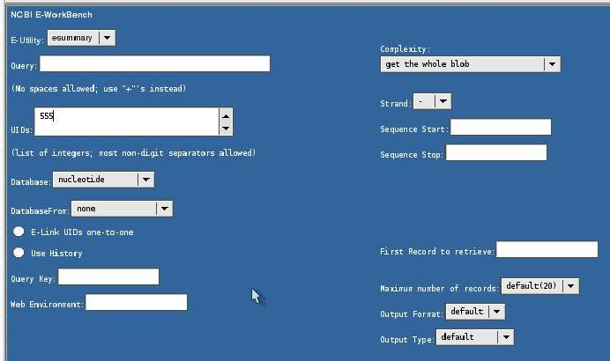
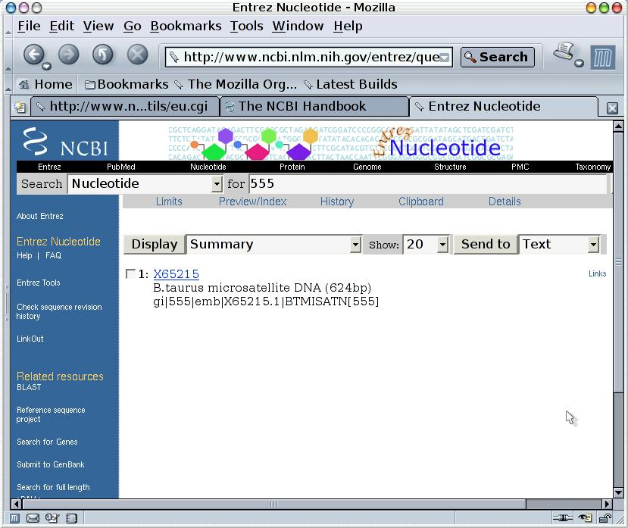
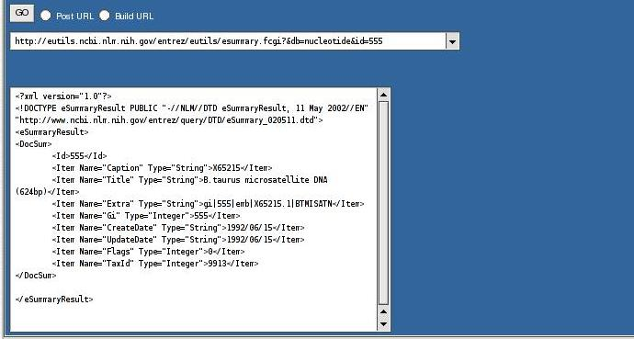
A Docsum via esummary.fcgi and via the Web

Slide 71
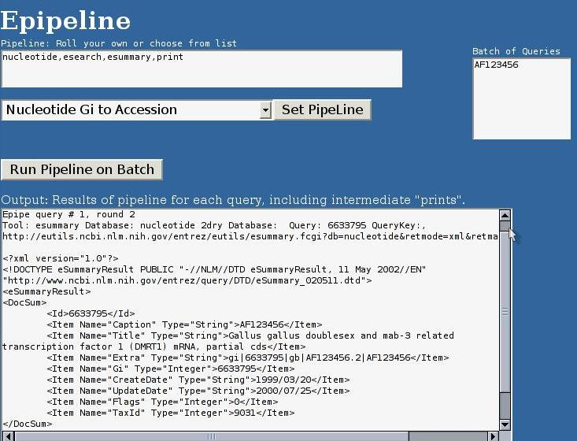
A Simple Eutilities Pipeline

Slide 72
An Esearch Followed by Multiple Rounds of Efetch
http://eutils.ncbi.nlm.nih.gov/entrez/eutils/esearch.fcgi?usehistory=y&db=gene&term=mammalia[orgn]
Elapsed time: 0 seconds 0%, 0 records of 161815 retrieved. Tue Jan 25 20:46:32 EST 2005
http://eutils.ncbi.nlm.nih.gov/entrez/eutils/efetch.fcgi?tool=datahog&db=gene&retmax=500&retstart=0&rettype=native&WebEnv=0ImHxGDH2zI93UMwxrTRTh-nretlso4ZBZO_FNE7AFZXOOxNd9Rz@Qfb2dYIOFhUAABd9ei4&query_key=1&retmode=xmlElapsed time: 40 seconds 0.3%, 500 records of 161815 retrieved. Tue Jan 25 20:47:09 EST 2005
http://eutils.ncbi.nlm.nih.gov/entrez/eutils/efetch.fcgi?tool=datahog&db=gene&retmax=500&retstart=500&rettype=native&WebEnv=0ImHxGDH2zI93UMwxrTRTh-nretlso4ZBZO_FNE7AFZXOOxNd9Rz@Qfb2dYIOFhUAABd9ei4&query_key=1&retmode=xmlElapsed time: 79 seconds 0.61%, 1000 records of 161815 retrieved. Tue Jan 25 20:47:48 EST 2005
http://eutils.ncbi.nlm.nih.gov/entrez/eutils/efetch.fcgi?tool=datahog&db=gene&retmax=500&retstart=1000&rettype=native&WebEnv=0ImHxGDH2zI93UMwxrTRTh-nretlso4ZBZO_FNE7AFZXOOxNd9Rz@Qfb2dYIOFhUAABd9ei4&query_key=1&retmode=xmlElapsed time: 118 seconds 0.92%, 1500 records of 161815 retrieved. Tue Jan 25 20:48:27 EST 2005
http://eutils.ncbi.nlm.nih.gov/entrez/eutils/efetch.fcgi?tool=datahog&db=gene&retmax=500&retstart=1500&rettype=native&WebEnv=0ImHxGDH2zI93UMwxrTRTh-nretlso4ZBZO_FNE7AFZXOOxNd9Rz@Qfb2dYIOFhUAABd9ei4&query_key=1&retmode=xmlElapsed time: 158 seconds 1.23%, 2000 records of 161815 retrieved. Tue Jan 25 20:49:07 EST 2005
http://eutils.ncbi.nlm.nih.gov/entrez/eutils/efetch.fcgi?tool=datahog&db=gene&retmax=500&retstart=2000&rettype=native&WebEnv=0ImHxGDH2zI93UMwxrTRTh-nretlso4ZBZO_FNE7AFZXOOxNd9Rz@Qfb2dYIOFhUAABd9ei4&query_key=1&retmode=xmlElapsed time: 204 seconds 1.54%, 2500 records of 161815 retrieved. Tue Jan 25 20:49:53 EST 2005
http://eutils.ncbi.nlm.nih.gov/entrez/eutils/efetch.fcgi?tool=datahog&db=gene&retmax=500&retstart=2500&rettype=native&WebEnv=0ImHxGDH2zI93UMwxrTRTh-nretlso4ZBZO_FNE7AFZXOOxNd9Rz@Qfb2dYIOFhUAABd9ei4&query_key=1&retmode=xml

Slide 73
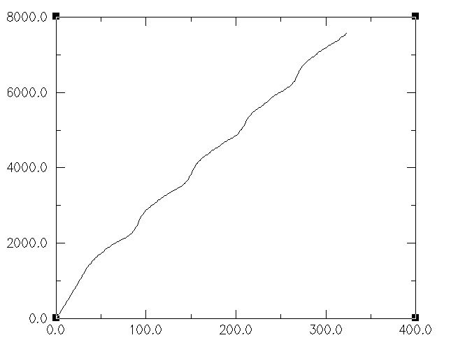
A Download of 161825 Mammalian Entrez Gene Records
S
E
C
O
N
D
S
Efetch calls

