Slide 1
Website development 2

Slide 2
Website Development 2
Description of Module / Aims
In this module, the student will develop the core technical skills necessary for a complete understanding of client side web development. This module will examine the concepts involved in front-end user interface design and client side scripting. The module will focus on the development of dynamic interactive client side web applications. The use of client side frameworks, client side libraries and plugins will also be examined.

Slide 3
Website Development 2
Learning Outcomes:
On successful completion of this module a student will be able to:
Plan and construct dynamic websites incorporating client side scripts.
Construct dynamic interactive websites that support user interaction, feedback, and validation.
Use client side libraries and plugins in the design of dynamic websites.
Apply a client web framework in the design of interactive websites.
Employ the client side components in a web application.

Slide 4
Website Development 2
Syllabus Content:
Basic Scripting: Variables; Functions; Conditions; Loops and Repetition; Arrays.
The Document Object Model: Nodes; Manipulation; Scripting; Event Handling.
Storing and transporting data with JavaScript Object Notation (JSON).
Use of libraries and plugins.
Forms Enhancements and Validation.
Role of Client Web Frameworks & Cascading Style Sheets (CSS) meta languages.
Dynamic Web: Combining Content; Presentation; and Behaviour.

Slide 5
Website Development 2
Essential Texts:
Ara Pehlivanain & Don Nguyen, (2013) Jump Start JavaScript, Sitepoint
David Sawyer McFarland, (2014) JavaScript (The Missing Manual), 3rd, O’Reilly Press
"Tutorialspoint." http://www.tutorialspoint.com
"w3schools." http://www.w3schools.com

Slide 6
Website Development 2
Assessment Methods:
Continuous Assessment: 100%
Part One
Interactive Assignment using JavaScript and the jQuery library
Part Two
Assignment using the AngularJS framework
On a weekly basis, you will complete work set out in the computer-based practical. Failure to complete this work will lead to failure of the module.

Slide 7
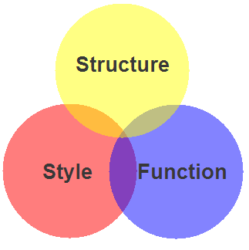
Website Development 2
STRUCTURE
HTML
STYLE
CSS
BOOTSTRAP
FUNCTION
JAVASCRIPT
LIBRARY (jQuery)
Frameworks (Angular, Backbone)

Slide 8
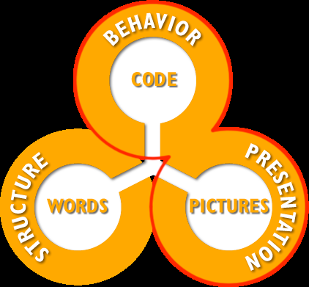
Website Development 2

Slide 9
Website Development 2
JavaScript is required for all the basic programming tasks:
Assignment,
Calculations,
Loops,
Control,
String Manipulation,
Functions,
Arrays, etc..

Slide 10
Website Development 2
JavaScript can also be used for adding interactivity to the web page through Document Object Manipulation (DOM) manipulation. This involves:
Selecting elements,
Updating elements,
Adding new elements,
Applying actions.

