Slide 1
Assignment 1

Slide 2
Assignment 1
Build an interactive information site about a club, band, society, shop, etc.. that is of interest to you.
Deadline: Sunday 25th March 11pm

Slide 3
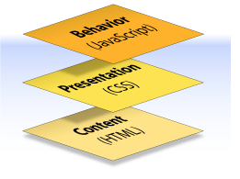
Assignment 1
The project is to include the three pillars of web design:
  Content
  Presentation
  Behaviour

Slide 4
Assignment 1
The site is to utilise Bootstrap for the layout and must include the following pages:
  A welcome (home) page
  An about page
  An image gallery, which includes a lightbox, or image replacement, or carousel, or some other plugin
  A form where elements are validated using h5validate and may (or may not) include a calculation

Slide 5
Assignment 1
Each page is to include some interactivity whether it is a button to click, an image to mouse over, todays date displayed, etc…
The site must include a plugin that has not been covered in class
In the about page, you are to include a description of the plugin (files required and code needed to execute the plugin)

Slide 6
Assignment 1 Schedule
Assignment 1 specification given out Week 7 (March 5)
Assignment 1 due (March 25 11pm)

