Slide 1
Handlebars 1

Slide 2
What is handlebars
Handlebars is a templating engine for JavaScript.
It is a JavaScript library that you include in your page just as you include any other JavaScript file.
With it, you can add templates to your HTML page that will be parsed and interpolated (values of properties inserted in place) with the values from the data (JSON object) you passed to the Handlebars function.

Slide 3
Why Handlebars
We are building apps, not web sites
We want to separate presentation from logic
We don’t want to put any HTML element into JavaScript code

Slide 4
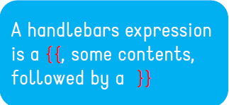
Example of Template
<div class="userEntry">
<h1>
{{username}}
</h1>
<img>
{{profilePic}}
</img>
<div class="status">
{{status}}
</div>
</div>

Slide 5
Values Escaping
Handlebars HTML-escapes all the values returned by an {{expression}}
If you don't want Handlebars to escape a value, use the "triple-stash"
<div class="userEntry">
<h1>{{username}}</h1>
<div class="status">
{{{status}}}
</div>
</div>

Slide 6
Template Context
A context is a Javascript object used to populate a template
var context = {
username: "Ivano",
profilePic: "./images/pic.png",
status: "feeling good"
};

Slide 7
Compiling a Template
Templates are defined within a <script> tag or in external files
<script id="user-template"
type="text/x-handlebars-template">
// template content
</script>

Slide 8
Compiling a Template
Handlebars.compile is used to compile a template
var source = $("#user-template").html();
var template = Handlebars.compile(source);
Compiling = obtaining a JS object representing the template

Slide 9
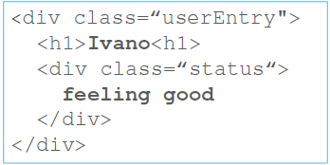
Obtaining the final HTML code
You have to execute a template with a context in order to get its corresponding HTML code
var context = {
username: "Ivano",
status: "feeling good"
};
var html =
template(context);

Slide 10
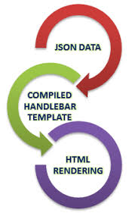

Slide 11
Expressions
The simplest expression is a simple identifier
<h1>{{title}}</h1>
This expression means "look up the title property in the current context"

Slide 12
Expressions
Handlebars expressions can also be dot-separated paths
<h1>{{user.username}}</h1>
This expression means "look up the user property in the current context, then look up the username property in the result"

Slide 13
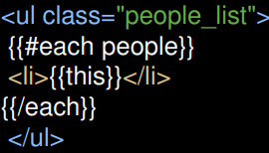
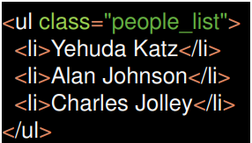

Built-in Helpers
Each
To iterate over a list inside the block, you can use this to reference the element being iterated

Slide 14

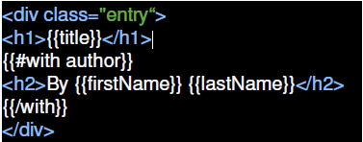
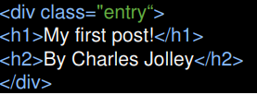
Built-in Helpers
With
It shifts the context for a section of a template

Slide 15
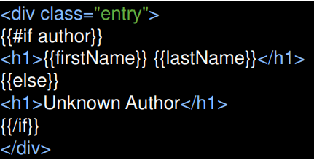
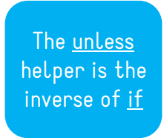
Built-in Helpers
If - Else
To conditionally render a block
It will render the block if its argument is not equal to false, undefined, null, []

Slide 16
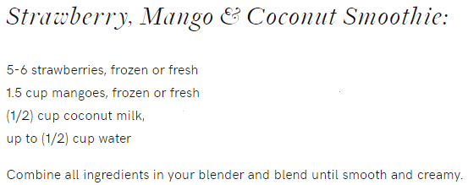
Example (From a Book)

Slide 17
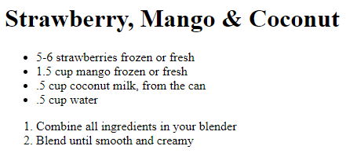
Example (produced with handlebars & Json object)

