Slide 1
INTRODUCTION TO JAVASCRIPT Part Three

Slide 2
Introduction to javascript - 3
Document Object Model
Accessing Elements
Accessing Form Elements
Events

Slide 3
Document object model
The Document Object Model (DOM) specifies how browsers should create a model of an HTML page and how JavaScript can access and update the contents of a web page while it is in the browser window.

Slide 4
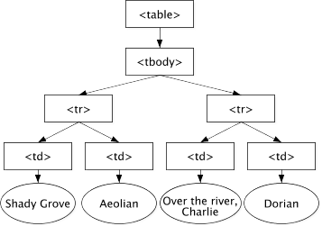
Document object model

Slide 5
Document object model
The document node
Every element, attribute, and piece of text in the HTML is represented by its own DOM node.
At the top of the tree a document node is added; it represents the entire page.
Element nodes
HTML elements describe the structure of an HTML page (For example, the <h1>-<h6> elements describe what parts are headings).

Slide 6
Document object model
Attribute nodes
The opening tags of HTML elements can carry attributes and these are represented by attribute nodes in the DOM tree.
Attributes nodes are not children of the element that carries them; they are part of that element.
Text nodes
Once you have accessed an element node, you can then reach the text within that element. This is stored in its own text node.

Slide 7
Introduction to javascript - 3
Document Object Model
Accessing Elements
Accessing Form Elements
Events

Slide 8
Accessing elements
DOM queries may return one element, or they may return a NodeList, which is a collection of nodes.
Return a Single Element Node
Sometimes you will want to access one individual element (or a fragment of the page that is stored within that one element).
Return one or more Elements
You may also want to select a group of elements, for example, every <h1> element in the page or every <h1> element within a particular list.

Slide 9
Accessing elements
<h1 id="header">List King</h1>
<h2>Buy groceries</h2>
<ul>
<li id="one" class="hot"><em>fresh</em>figs
</li>
<li id="two" class="hot">pine nuts</li>
<li id="three" class="hot">honey</li>
<li id="four">balsamic vinegar</li>
</ul>

Slide 10
Accessing elements
Return a Single Element Node
getElementById()
Selects an individual element given the value of its attribute. The HTML must have an id atrribute in order for it to be selectable.
var el = document.getElementById('one');
querySelector()
Uses CSS selector syntax that would select one or more elements. This method returns only the first of the matching elements.
var el = document.querySelector('li.hot');

Slide 11
Accessing elements
Return one or more Elements
getElementsByTagName()
Select all elements on the page with the specified tag name.
var elements = document.getElementsByTagName('li');
getElementsByClassName()
Selects one or more elements given the value of their class attribute. The HTML must have a class attribute for it to be selectable.
var elements = document.getElementsByClassName('hot');

Slide 12
Accessing elements
Return one or more Elements
querySelectorAll()
Uses CSS selector syntax to select one or more elements and returns all of those that match.
var els = document.querySelectorAll('li.hot');
getElementsByTagName(), getElementsByClassName(), and querySelectorAll() return more than one element as a NodeList.
For example, return the first element from the above example use:
els[0]
If we want to traverse all the elements returned in the NodeList, we will need a loop.

Slide 13
Introduction to javascript - 3
Document Object Model
Accessing Elements
Accessing Form Elements
Events

Slide 14
Accessing form elements
Text Box
Returning the value of a text box
To get the value from a specific text box, you need to know it's id in order to use document.getElementById(). You also need the value attribute as this returns the value in the text box.
numdays=document.getElementById("days").value;
Setting the value of a text box
To put a value into a text box, again you need to know it's id. To put the value of 2 into the text box (days):
document.getElementById("days").value=2;

Slide 15
Accessing form elements
Radio/Option buttons
Because radio/option buttons only allow the selection of one option and they all have the same name, we will need a loop to process all the options. You determine if a radio/option button is selected by testing the checked attribute.
travels = document.getElementsByName("travel");
for (i in travels)
{
if (travels[i].checked) {
cost = parseInt(travels[i].value);
break;
}
}

Slide 16
Accessing form elements
Checkbox
We need to check each checkbox individually and you also need the checked attribute.
if(document.getElementById("friDinner").checked)
{
meal=parseInt(document.getElementById ("friDinner").value;
}

Slide 17
Accessing form elements
Pull down menu/Select
For a pull down menu, we need to ascertain which option(s) have been selected. You also need the selectedIndex and value attributes.
selectedIndex records the index of the chosen menu option.

Slide 18
Accessing form elements
rentals=document.getElementById("rentalPackage");
if(rentals.selectedIndex===0)
{ rental=0; }
else if(rentals.selectedIndex===1)
{ rental = parseInt(rentals.value); }
else if(rentals.selectedIndex===2)
{ rental = parseInt(rentals.value);
}

Slide 19
Introduction to javascript - 3
Document Object Model
Accessing Elements
Accessing Form Elements
Events

Slide 20
events
What is an Event?
JavaScript's interaction with HTML is handled through events that occur when the user or the browser manipulates a page.
When the page loads, it is called an event. When the user clicks a button, that click too is an event. Other examples include events like pressing any key, closing a window, resizing a window, etc.

Slide 21
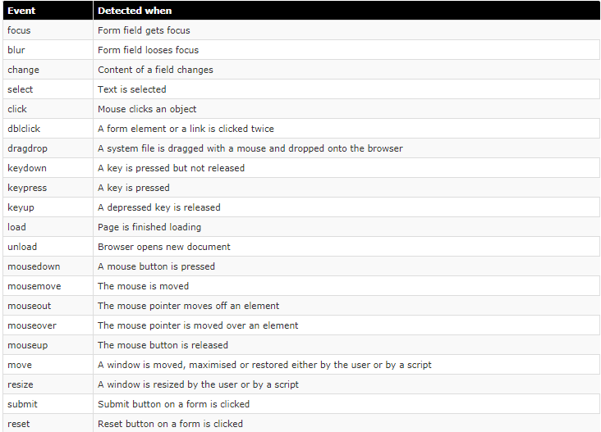
events

Slide 22
events
When an event has occurred, it is often described as having fired or been raised.
Events are said to trigger a function or script.

Slide 23
events
Event Handling
When the user interacts with the HTML on a web page, there are three steps involved in getting it to trigger some JavaScript code. Together these steps are known as Event Handling.
Select the element node(s) you want the script to respond to.
Indicate which event on the selected node(s) will trigger the response.
State the code you want to run when the event occurs.

Slide 24
events
Using Event Listeners
The addEventListener() method attaches an event handler to the specified element.
var myBtn = document.getElementById("btnClickMe");
myBtn.addEventListener("click",handleClick,false);
Parameter One is required. This is a String that specifies the name of the event. Do not use the "on" prefix. For example, use "click" instead of "onclick".
Parameter Two is required. This specifies the function to run when the event occurs.
Parameter Three is optional. This is a Boolean value that specifies whether the event should be executed in the capturing (true) or in the bubbling (false) phase.

Slide 25
events
<form method="post" action="">
<label for="username">Create a username: </label>
<input type="text" id="username" autofocus>
<div id="feedback"></div>
<input type="submit" value="sign up">
</form>

Slide 26
events
var elUsername = document.getElementById('username');
elUsername.addEventListener('blur', checkUsername, false);

Slide 27
events
function checkUsername() {
var elMsg = document.getElementById('feedback');
if (this.value.length < 5) {
elMsg.textContent = 'Username must be 5 characters or more';
this.value=""; this.focus();
} else {
elMsg.textContent = '';
}
}

