Slide 1
Handlebars 2

Slide 2
Handlebars 2
Custom Helpers
Partials
Adding New Data

Slide 3
Custom Helpers
Handlebars has some built in helpers such as #each, #if, etc...
Handlebars also gives you the ability to create your own custom helper by writing code to do something that you want (like converting names to sentence case).
Simply register your function into Handlebars, and any template you compile afterwards can access your helper.
Custom block helpers are also registered with the Handlebars.registerHelper method.

Slide 4

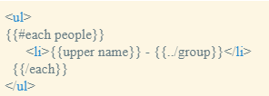
Custom Helpers Example One
Create the Helper
Reference the Helper (upper) in the template

Slide 5
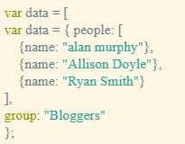
Custom Helpers Example One
JSON object (data source)

Slide 6

Custom Helpers Example One

Slide 7
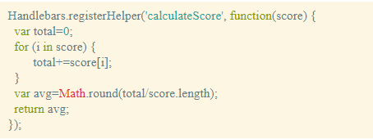
Custom Helpers Example Two

Slide 8
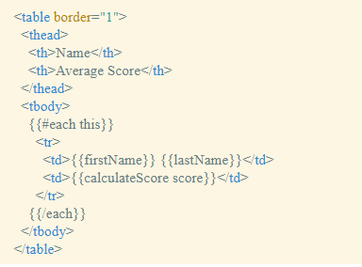
Custom Helpers Example Two

Slide 9
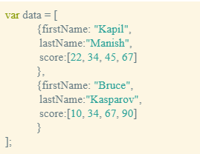
Custom Helpers Example Two

Slide 10

Custom Helpers Example Two

Slide 11
Partials
Partials come in handy when you have a chunk of a Handlebars.js template that you need to use in a few different contexts.
The Handlebars.registerPartial method registers a partial.
It takes the name of the partial as its first argument and either a template source string or a compiled template as its second argument.
To use a partial from a template, simply include {{> partialName}}.

Slide 12
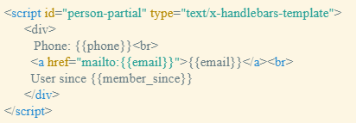
Partials example
Partial template
Register the Partial

Slide 13

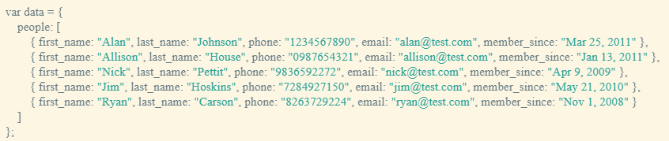
Partials example
Include (call) the Partial (person) in the template
JSON object

Slide 14
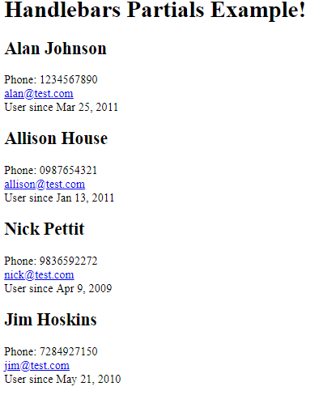
Partials example

Slide 15
Adding New Data
If you want to add data to a JSON object, you can create a form with text boxes, select options, option buttons, etc.. and a submit button.
The submit button will package the data and send it for processing.
Code will need to be written to handle (process) the submit event.

Slide 16
Adding New Data
The code to handle the submit event will take the data (name/value pairs) and put it into an object.
This new object is then added (pushed) onto the JSON object.

Slide 17
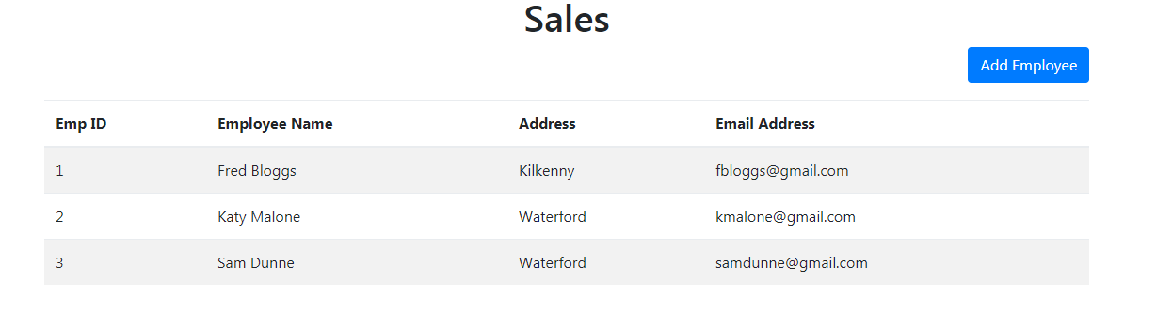
Adding New Data

Slide 18
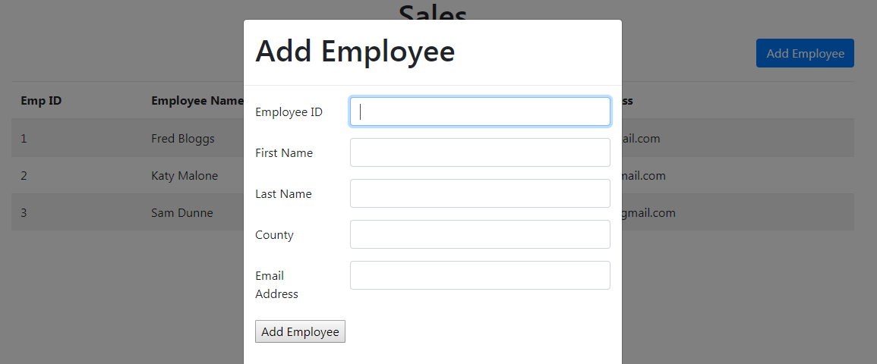
Adding New Data

Slide 19
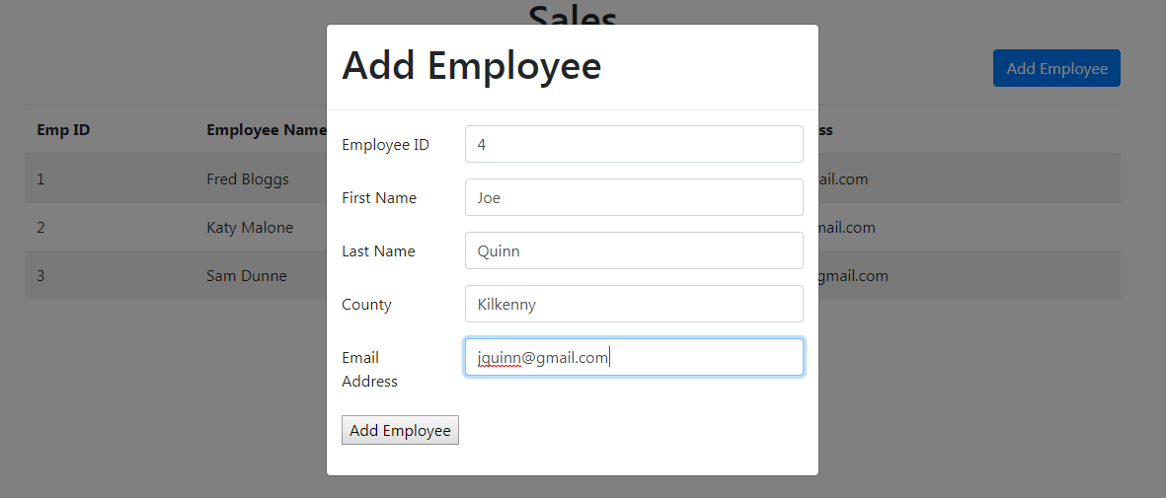
Adding New Data

Slide 20
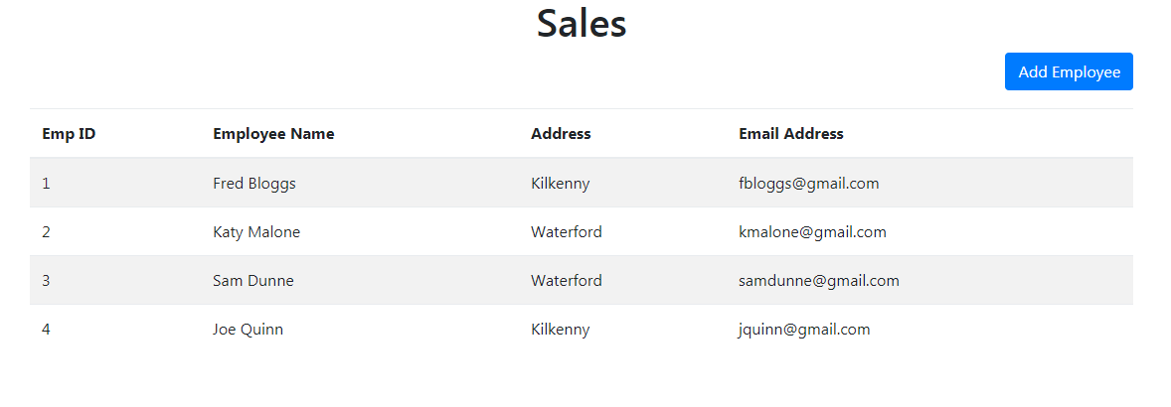
Adding New Data

