Slide 1


Data Science virtual internship
Project: Presentation of
Week 02 use case
03/20/202303/20/2023

Slide 2
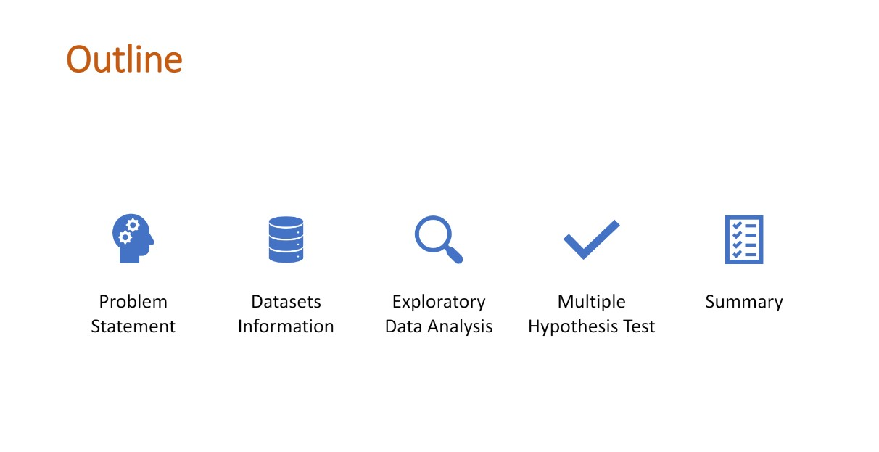

Slide 3
Problem Statement
XYZ is a private equity firm in the US. Due to remarkable growth in the Cab industry in the last few years and multiple key players in the market, it is planning for an investment in the cab industry.
Objective: Provide actionable insights to help XYZ Firm in identifying the right company for making an investment.
Analysing parts: Data understanding and Visualization, fiding the most User’s Cab Companies, Finding the most profitable company, multiple hypothesis and investigate.

Slide 4
Data Information
Cab_Data.csv – This file includes the transaction details of 2 cab companies
Customer_ID.csv – This files includes customer demographic details
Transaction_ID.csv – This file contains customers transactions and payment mode
City.csv – This files contains details of major US cities and their population and NO of cab users.

Slide 5
Actors
XYZ - A private firm in the US that is interested in investing in the Cab Industry.
Cab Industry - The industry that XYZ is interested in investing in. This industry includes multiple key players.
Market - The target market that XYZ is interested in understanding before making a final investment decision.
Customers - The target customers of the Cab Industry, whose preferences and behavior may impact the market demand and profitability.
Competitors - The key players in the Cab Industry who are XYZ's potential competitors in the market.
Government - The regulatory authorities that may impose rules and regulations that affect the Cab Industry and XYZ's investment plans.

Slide 6
EDA

Slide 7
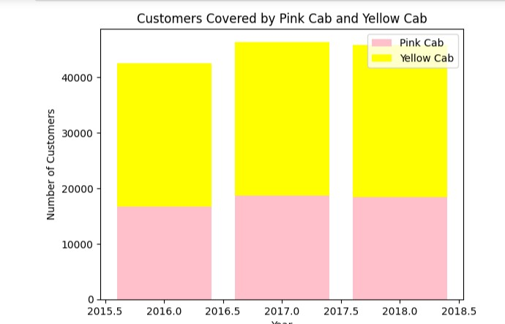
Which Company has more users
Yellow Can company has more users

Slide 8
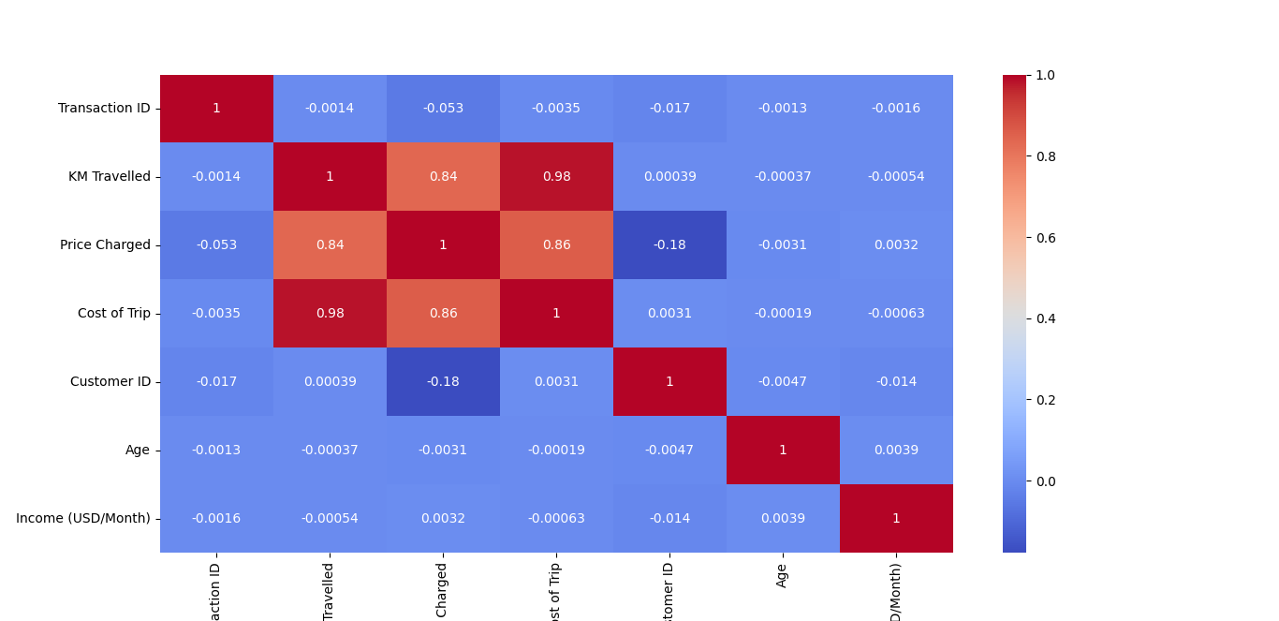
Relationship between data

Slide 9
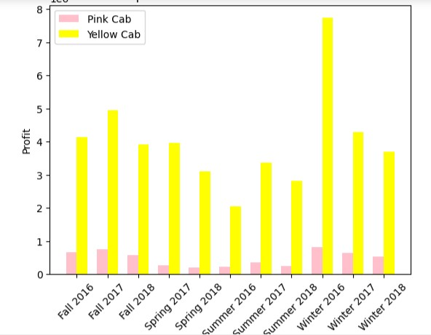
Which company has higher seasonal profit
Yellow Cab company has highest seasonal profit

Slide 10
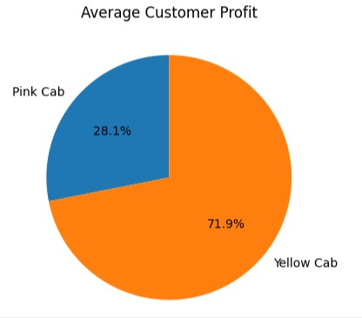
Which company has high average customer profit
Yellow company has a high average customer profit

Slide 11
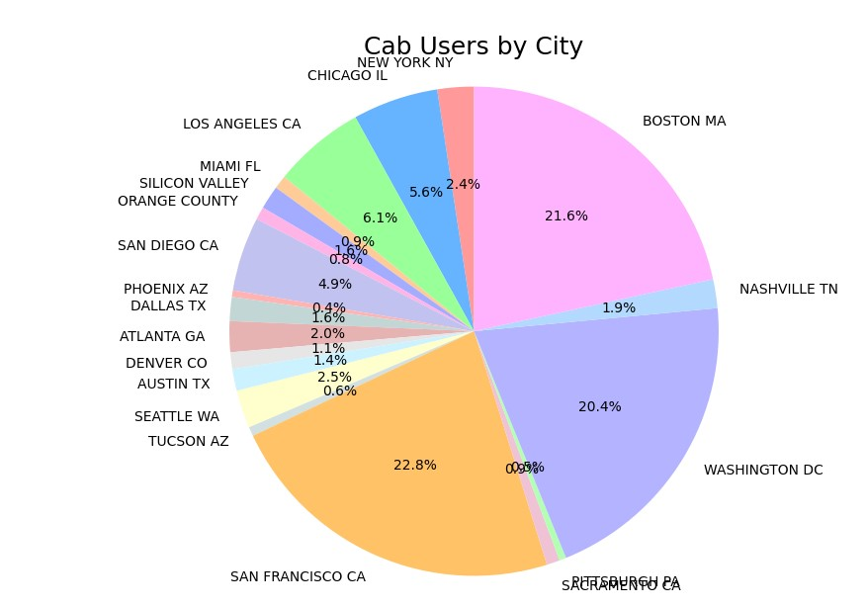
Which cities has high percentage of cab using population
San Francisco CA
Washington DC
Nashville TN

Slide 12
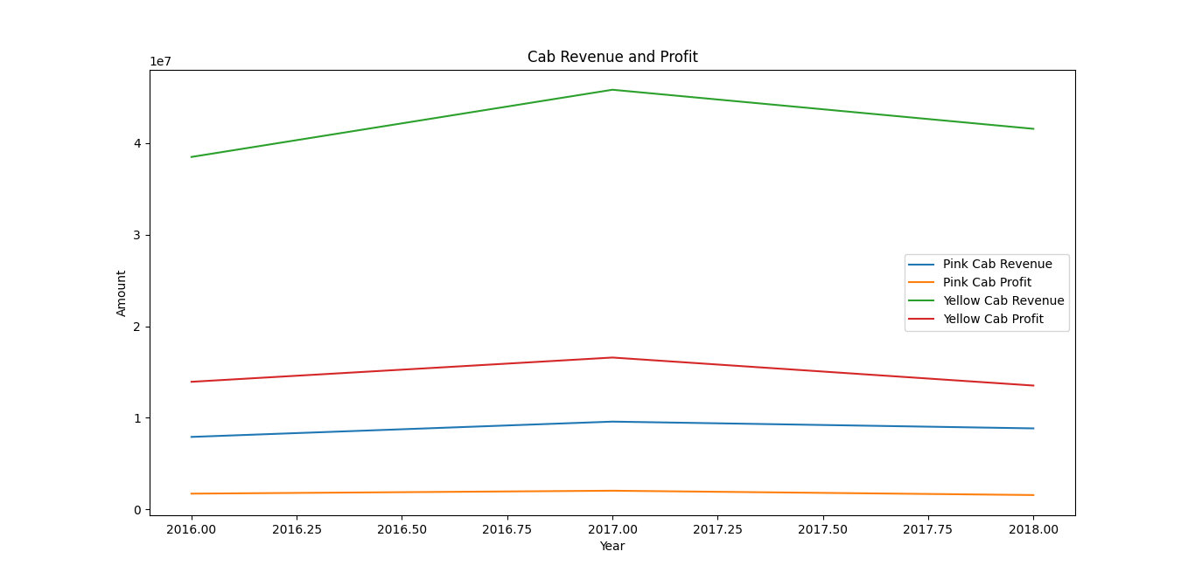
Is Year Company got positive growth and negative growth
2016 -2017 positive growth
2017 -2018 negative growth

Slide 13
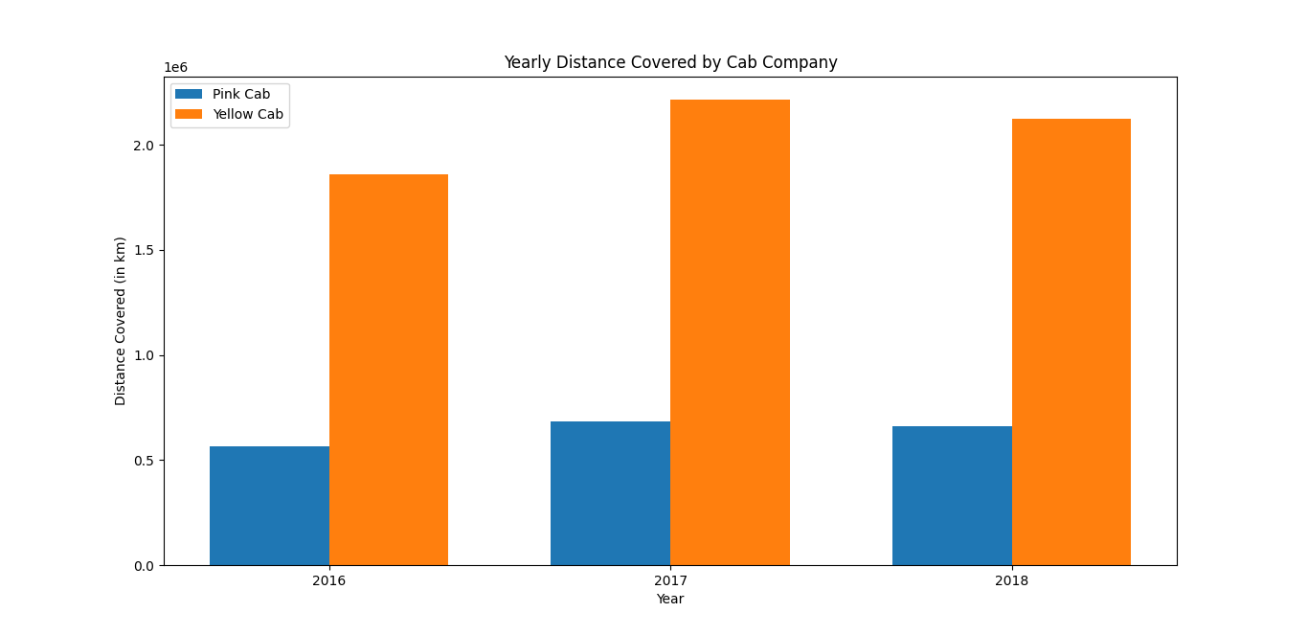
Which company covered more distance
Yellow Cab company

Slide 14
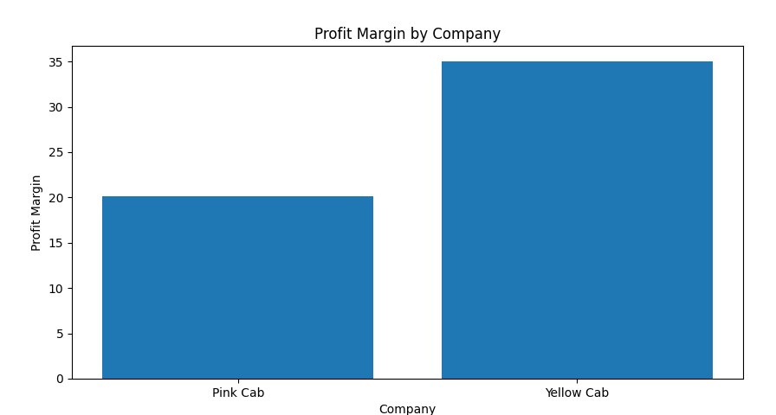
Which company has high profit margin
Yellow cab has high profit margin

Slide 15
Hypothesis 01: Is there any difference in profit by gender
Yes Male customers providing more profit shares for both companies then female customers

Slide 16
Hypothesis 02: is there any difference in profit based on ride distance
On average, Pink Cab generates higher profit per KM for long-range distances.

Slide 17
Hypothesis 03: is there any difference in profit by payment mode
Average profit for card payment mode: 137.08646100025985
Average profit for cash payment mode: 137.5029244996108
No, not at all. very small difference

Slide 18
recommendation
Customer Reach: Yellow cab has more customers in 16 cities then Pink cab Companies
Total profit and revenue: Yellow cab has higher profit and Revenue
Profit margin: Yellow cab has a greater profit margin

Slide 19

conclution
Yellow cab company is great to invest

Slide 20
Thank you

