Slide 1
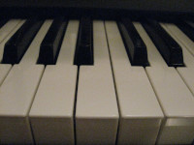
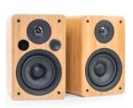
Keyboard
Ondes – Object Diagram
Maps from MIDI channel
to Program
MidiMonitor
PatchMap
Voice
MIDI
Messages
Program
Synth
VoiceFactory
WaveGen
EnvGen
VoiceMix
DeltaListeners
List<DeltaListener>
Instant
Tight timing
loop
WaveGen
EnvGen
PhaseClocks
+ Other components
void next() {
instant.next();
wires.next();
mainMix.next();
}
Wires
List<Wire>
Connections in
magenta are
“Wire” objects
MainMix
Audio Receivers

