Slide 1
Recent Work
Would cover:
current result
what have been done
main problem
Next

Slide 2
What have been done
Last time
Wavelet preprocess
Memory Unit
Wavelet Unit
Magnitude Unit
This time
Use Acc information
Better linear combination of previous hr and current hr
Smart detect sharp increase trend

Slide 3
Current Result
Data set No 1: error: 4.07%
Data set No 2: error: 9.45%
Data set No 3: error: 1.53%
Data set No 4: error: 2.69%
Data set No 5: error: 1.02%
Data set No 6: error: 4.84%
Data set No 7: error: 1.43%
Data set No 8: error: 1.95%
Data set No 9: error: 1.29%
Data set No 10: error: 5.89%
Data set No 11: error: 1.33%
Data set No 12: error: 3.90%

Slide 4
Use ACC
Cluster the LPC parameter of ACC frames into two cluster
Then Pattern founded

Slide 5
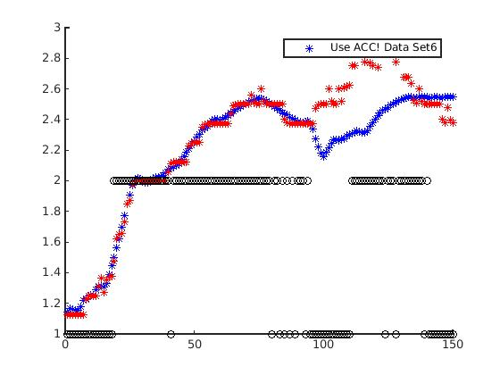
ACC Pattern

Slide 6
Better Linear Combination
Take into account of closeness, magnitude and previous result
Not just magnitude
The Rule is very simple
I even don't know why it could help the algorithm
But it works.....

Slide 7
Smart Detect Sharp Increase
We have very low resolution
0.125 hz = very rough measure for heartrate
Terrible when the heartrate is in a sharp increase
For example
  Estm 1.5 Real 1.56
  Estm 1.5 Real 1.59
  Estm 1.5 Real 1.61
  Estm Loss Real 1.65
But 1.5 is already the second best estimation

Slide 8
Use ACC to help
The sharp change in ACC class means potential increase in hr
If ACC change, Then estimation goes into aggressive mode

Slide 9
Not Enough
Good for some signals
But maybe there is mistake in ACC
Use rule to learn and determine whether a sharp increase is coming.

Slide 10
Learning Rule
If the start point of previous sharp rise is far from the current heart rate, then don't go.
If no previous reference, listen to ACC, and use this “sharp rise”, as reference.

Slide 11
Main Problem
Sampling rate is too low
Wavelet unit is not exactly reliable

