Slide 2
Cloud Native Load Balancing From Scratch
Fangyuan Li, VMware

Slide 3
Why do we need Load Balancing
Reliability and Availability
Multiple backends for one “service”
Scalability
Horizontal scalability, improves throughput
Deployment strategy
Notes:
3. Rolling update, blue/green deployment;

Slide 4
What does Load Balancing mean
Availability
Health check
Service discovery
Scalability
Software defined
As stateless as possible
Connection persistence
Deployment Strategy
Configurability
Notes:
Service discovery: what backend servers are available? What are their addresses?
Scalability is generally constrained by the maximum capacity of a single unit;
Cannot meet HA requirement: 1+1 redundancy is not good enough;
Lack the flexibility and programmability for quick iteration;
Costly to upgrade;
Purchasing new hardware;
Deploying it;
Software:
Scale out model;
Deployment is simplified: the system uses only existing servers inside the clusters;
Can divide services between multiple shards of load balancers in the same cluster in order to achieve performance isolation;

Slide 5
What does Cloud Native mean
Container native
Container is the first class of citizen
Interoperability
Each to be integrated with other cloud services
Configurability
Scalability
Responsive Self-service
No manual provisioning of Iaas resources
Notes:
Think of Load balancer itself as a software that needs to meet all the requirements of cloud native applications;
3. Updates happen all the time in the cloud native environment as containers come and go;
5. No manual provisioning of infrastructure level resources;

Slide 6
All about a “Name”
Provides an abstraction: name
DNS
L4: IP+Port;
L7: url path etc;
Wherever traffic exists;

Slide 7
Travel of a packet
clients
Load Balancer
server
server
server

Slide 8
Travel of a packet
clients
Load Balancer
server
service
service
server
server
server
server
server
server

Slide 9
Where is load from: client LB
When you have control over clients:
gRPC
Directly Routing
Lookaside
grpclb
Universal Data Plane API
Sidecar Proxy
Envoy

Slide 10
Travel of a packet
proxy
proxy
proxy
clients
clients
clients
server
server
server

Slide 11
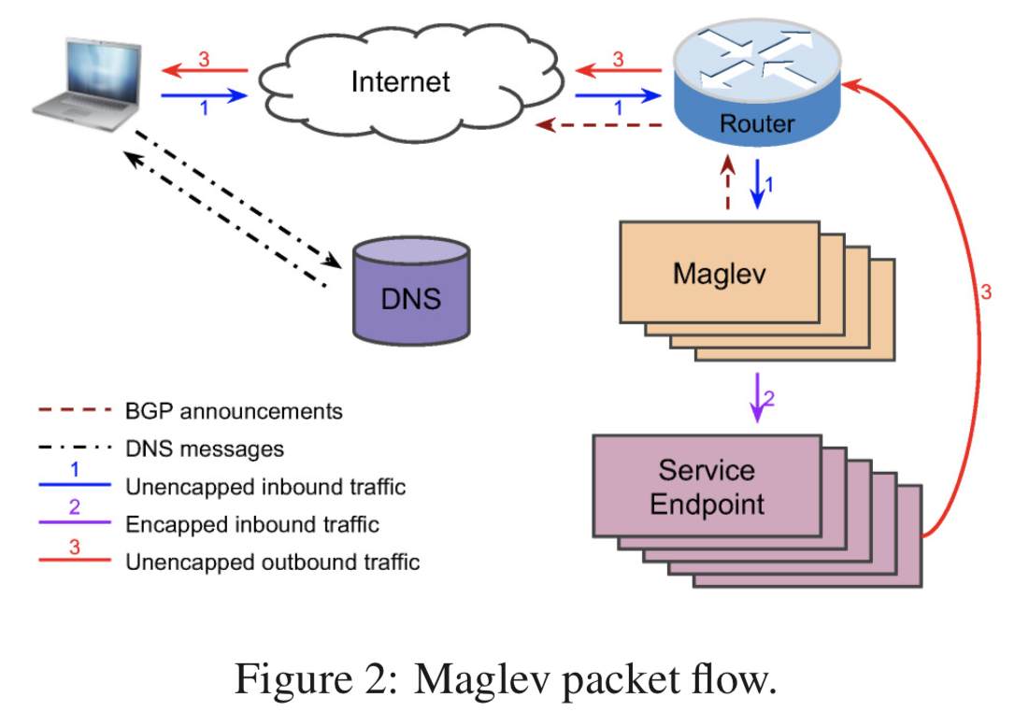
Where is load from: middle LB
DNS/Anycast
VIP
ECMP/BGP
Consistent Hashing
Reduce disruption
Tunneling/Encapsulation
Scale beyond L2
Maglev paper: https://www.usenix.org/system/files/conference/nsdi16/nsdi16-paper-eisenbud.pdf

Slide 12
Where is load from: service LB
DNS
VIP/ClusterIP
IPtable
NodePort/Routing Mesh
IPVS
Service Mesh
Envoy

Slide 13
IP Virtual Server
In linux kernel for over a decade;
Widely used:
K8s;
Docker;
Functionalities:
L4 LB;
Many algorithms;
States sync;
Reference: https://linux.die.net/man/8/ipvsadm
Notes:
Algorithm: rr: round-robin lc: least connection dh: destination hashing sh: source hashing sed: shortest expected delay nq: never queue
Sync: multicast, only supports IPv4;

Slide 14
DEMO
Extend an IP
IPVS
Dummy interface
BGP

Slide 15
NAT mode
Router
192.168.33.1
IPVS
VIP: 192.168.161.123
Port: 12345
192.168.33.2
NAT
client
192.168.33.3
Ip r a default via 192.168.33.2
Ip r a 192.168.161.123 via 192.168.33.2

Slide 16
NAT mode
Router
192.168.33.1
VIP: 192.168.161.123
Port: 12345
IPVS
All the packets need to go through IPVS;
Extra overhead
192.168.33.2
NAT
client
192.168.33.3
Ip r a default via 192.168.33.2
Ip r a 192.168.161.123 via 192.168.33.2
Notes:
Responses are generally heavier than requests

Slide 17
DR mode
Router
192.168.33.1
IPVS
VIP: 192.168.161.123
Port: 12345
192.168.33.2
NAT
server
client
192.168.33.3
Direct Routing
Ip r a 192.168.161.123 via 192.168.33.2
server
192.168.33.4

Slide 18
DR mode
Router
192.168.33.1
VIP: 192.168.161.123
Port: 12345
IPVS
Have to be in the same L2 network;
192.168.33.2
NAT
server
client
192.168.33.3
Direct Routing
ip r a 192.168.161.123 via 192.168.33.2
server
Direct Server Return
192.168.33.4
ip r a default via 192.168.33.1 src VIP

Slide 19
Tunnel mode
192.168.33.1
Router
192.168.34.1
VIP: 192.168.161.123
Port: 12345
192.168.34.2
Encapsulated
IPVS
server
Encapsulation can be done in hardware;
DPDK
192.168.33.2
NAT
ip l set tunl0 up;
ip a add VIP dev tunl0;
server
client
192.168.33.3
Direct Routing
ip r a 192.168.161.123 via 192.168.33.2
server
Direct Server Return
192.168.33.4
Direct Server Return

Slide 20
192.168.36.1
192.168.33.1
Router
192.168.35.1
192.168.34.1
192.168.34.2
192.168.35.2
192.168.36.2
Encapsulated
IPVS
server
server
server
192.168.33.2
NAT
server
client
192.168.33.3
Direct Routing
ip r a 192.168.161.123 via 192.168.33.2
server
Direct Server Return
192.168.33.4
Encapsulated
Direct Server Return
IPVS
192.168.33.5
Direct Server Return

Slide 21
192.168.36.1
192.168.33.1
Router
192.168.35.1
192.168.34.1
192.168.34.2
192.168.35.2
192.168.36.2
Encapsulated
IPVS
server
server
server
192.168.33.2
NAT
server
client
192.168.33.3
Direct Routing
ip r a 192.168.161.123 via 192.168.33.5
server
Direct Server Return
192.168.33.4
Encapsulated
Direct Server Return
IPVS
192.168.33.5
Direct Server Return

Slide 22
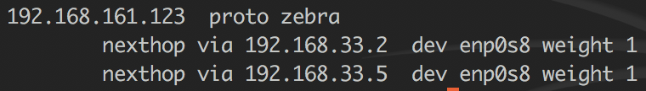
192.168.36.1
GoBGP
+
Zebra
192.168.33.1
Router
192.168.35.1
192.168.33.6
192.168.34.1
192.168.34.2
192.168.35.2
192.168.36.2
Encapsulated
IPVS
server
server
server
GoBGP
192.168.33.2
NAT
server
client
192.168.33.3
Direct Routing
ip r a 192.168.161.123 via 192.168.33.6
server
Direct Server Return
192.168.33.4
Encapsulated
Direct Server Return
IPVS
GoBGP
192.168.33.5
Direct Server Return

Slide 23
Questions?
Demo setup: https://github.com/maplain/devsetup/tree/master/vagrant
Email: fangyuanl@vmware.com
Linkedin: https://www.linkedin.com/in/maplainfly/

