Slide 2
Deep dive: Rook / EdgeFS
Dmitry Yusupov, CTO, Nexenta by DDN

Slide 3
What is Rook?
Cloud-Native Storage Orchestrator
Extends Kubernetes with custom types and controllers
Automates deployment, bootstrapping, configuration, provisioning, scaling, upgrading, migration, disaster recovery, monitoring, and resource management
Framework for many storage providers and solutions
Open Source (Apache 2.0)
Hosted by the Cloud-Native Computing Foundation (CNCF)

Slide 4
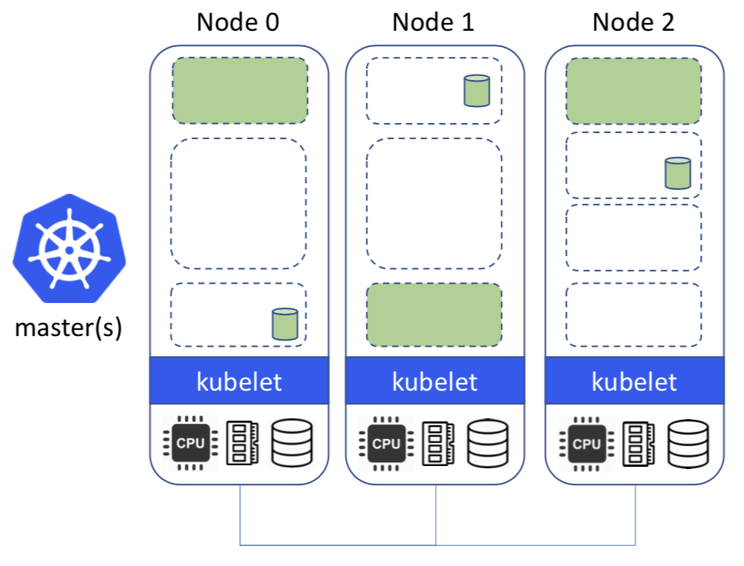
Storage ON Kubernetes
Deploy storage systems INTO the cluster
Harness the power of Kubernetes
Automated management by smart software
Portable abstractions for all our storage needs

Slide 5
Rook is a Framework
Rook is more than just a collection of Operators and CRDs
Framework for storage providers to integrate their solutions into cloud-native environments
Storage resource normalization
Operator patterns/plumbing
Common policies, specs, logic
Testing effort
EdgeFS, Ceph, CockroachDB, Minio, NFS, Cassandra, and more…

Slide 6
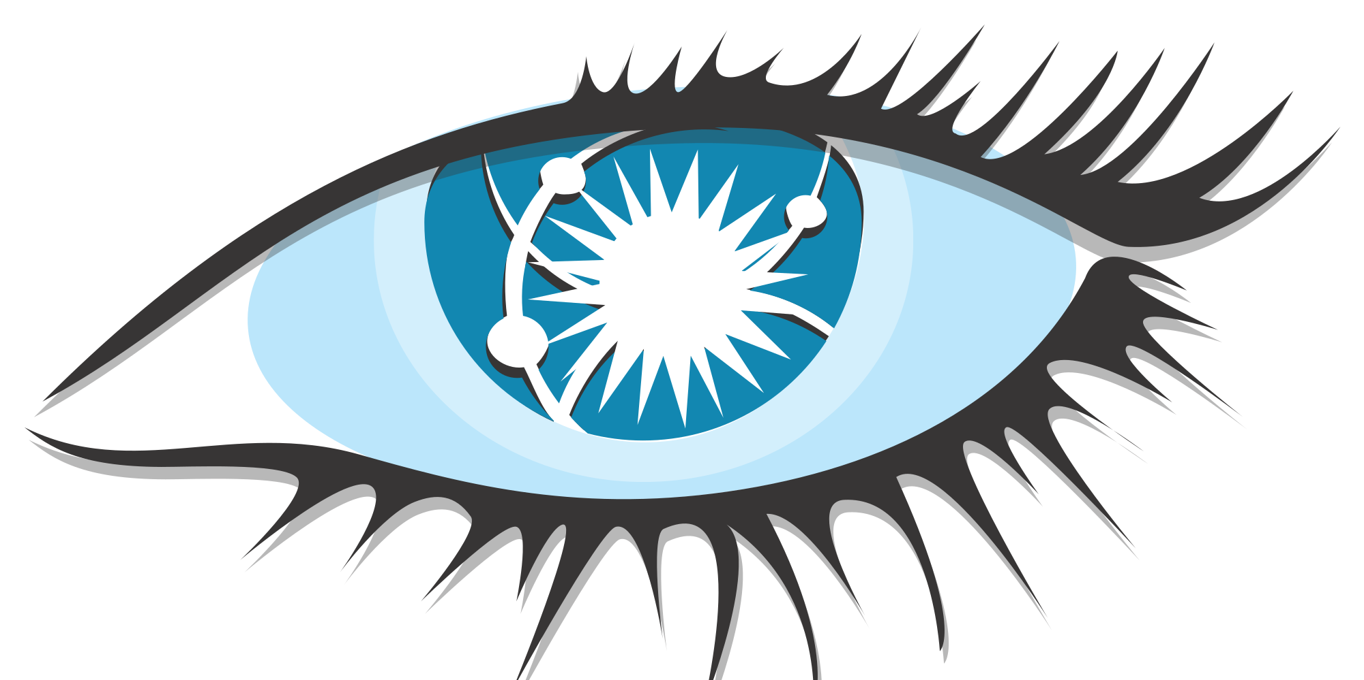
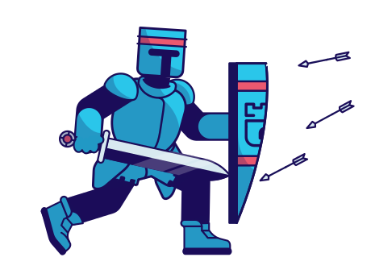
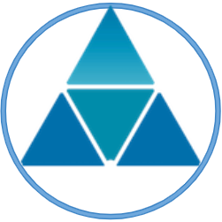
New Rook Operators
Apache Cassandra
Nexenta EdgeFS

Slide 7
What is EdgeFS?
Git like architecture
Reference from Git documentation:
“””All object primitives are referenced by a SHA, a 40-digit object identity, which has the following properties:
● If two objects are identical they will have the same SHA.
● if two objects are different they will have different SHAs.
● If an object was only copied partially or another form of data corruption occurred, recalculating the SHA of the current object will identify such corruption. The first two properties of the SHA, relating to identity of the objects, is most useful in enabling Git's distributed model (the second goal of Git). The latter property enables some safeguards against corruption (the third goal of Git).”””
EdgeFS objects (any) always cryptographically self-validated, and therefore globally unique
Same as in Git, any modification (or stream of modifications) are fully versioned
It is Scale-Out and Protocol Unified Object Storage solution designed for Geo-Transparency and Edge/IoT Use cases

Slide 8
Rook EdgeFS
Deployed as Kubernetes Operator
Full service life-cycle management: install, update, rolling-upgrade, uninstall, re-install
Monitoring with Prometheus and Grafana
Easy of use built-in GUI with CRD Wizard!
Runs in Embedded environments: < 1GB DRAM, 2 CPU cores!
Consumes Locally connected raw disks or directories
Provides Globally available Data protocols
S3 and S3X (NoSQL and POSIX-like extension)
Scale-Out High-Performance NFS
Scale-Out iSCSI Block Devices

Slide 9
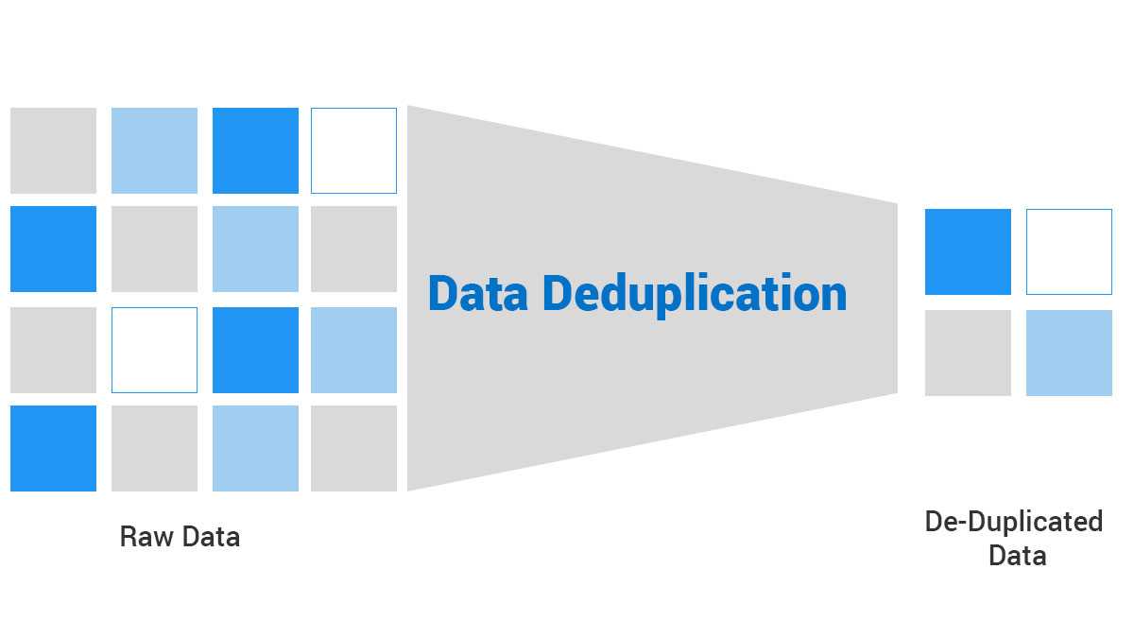
EdgeFS Connected Data
Global Deduplication
Clouds Connectivity
Geo-Transparency
Global Namespace
Protocol Transparency
S3, S3X, NFS, iSCSI
Segment 1
NFS GW
S3 GW
Up to 50x bandwidth savings!
MySpace/Work
ISGW Link
HDD0
HDDN
SSD0
Segment N
NFS GW
S3 GW
MySpace/Home
ISGW Link
* Block-level Geo-Deduplication
* Metadata-Only Transfers
* Local Caching
* Intelligent Prefetching
HDD0
HDDN
SSD0

Slide 10
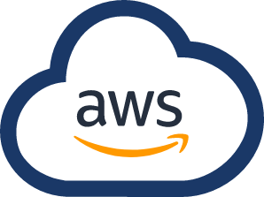
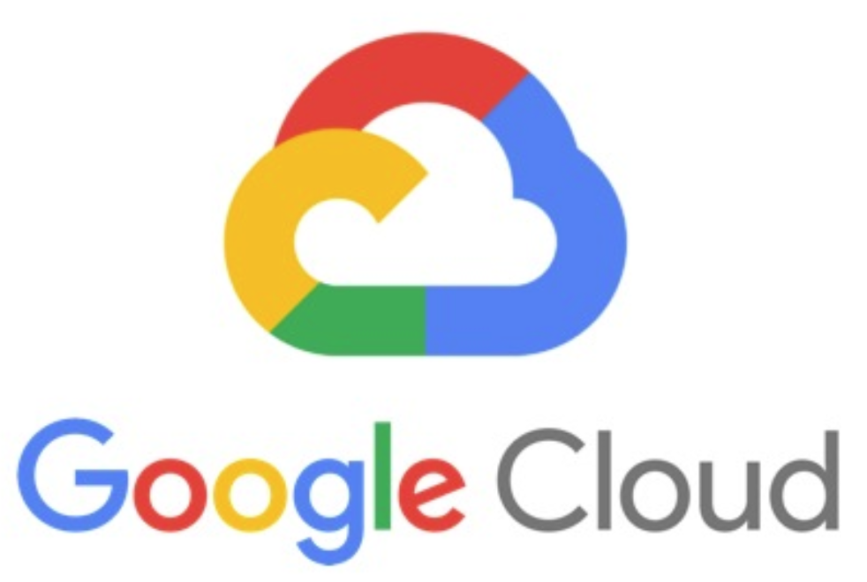
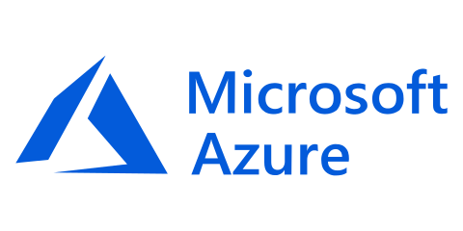
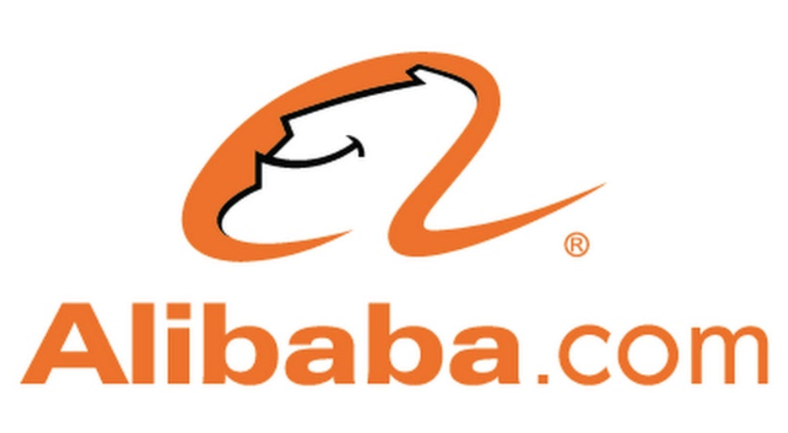
EdgeFS Cloud Connectors
Presents S3 Everywhere, Transparently syncing regions!
Metadata-Only synchronization with Local Caching and Prefetching. Globally de-duplicates cross-site calls.
Operates with unmodified, native objects
Supported connectors as of EdgeFS v1.2
AWS S3: Stable
Alibaba OSS: Beta
GCP GS: Beta
Azure Blob: Alpha

Slide 11
EdgeFS Multi-Cloud Layer
Geo-Scalability
Spans a network of geographically distributed sites, connected as one global namespace
Git-like architecture with fault-tolerance and immutable, versioned metadata design
Scales equally well for Object, File, Built-In NoSQL or Block devices
Geo-Transparency
Always ON, bi-directional access to same S3 bucket, NFS export
Automatic “Last-Writer-Wins” update strategy for S3, Snapview Groups for NFS/iSCSI
Geo-Consistency
Snapview groups “floating” within connected geo-namespace
Any granularity of protection: Files, Directories, Buckets, LUNs, NoSQL Databases
Geo-Locality and Active E-LRU Caching
Metadata is always replicated, data is prefetched on-demand and cached locally
Modifications synchronized asynchronously, thus geographically eventual

Slide 12
EdgeFS Use Cases
Multi-Cloud CDN Workflow
Efficient distribution of content with advanced local caching features
Avoid full replication, with optional pin/unpin/clone of locally cached content
Synchronization of primary source content on AWS, Azure, Alibaba, GCP and others
Cloud High-Availability
Automatic failover of failed cloud links to redundant dataset in a different region
Operate in offline mode for up to 7 days, synchronizing eventually
Edge/IoT To or From Cloud
Capture edge data in local cache and private clouds for AI/ML processing
Improve link utilization by sending de-duplicated data asynchronously
Access global namespace transparently, while avoiding the need to do full replication
Kubernetes Persistent Volumes across clouds
Bi-directional PVs with geo-transparent synchronization across regions
CSI managed File or Block PVs, Consistency groups
Data segmentation and region awareness

Slide 13
Rook Networking
1G, 10G, 25G, 40G, 100G … Great.
But, it is sharing same Pod network
with the converged Apps?
Not anymore!

Slide 14
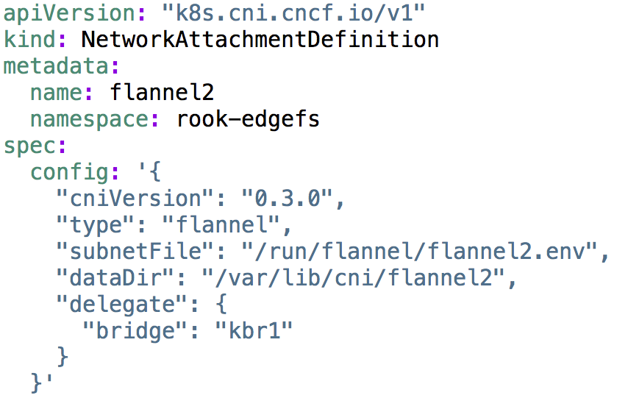
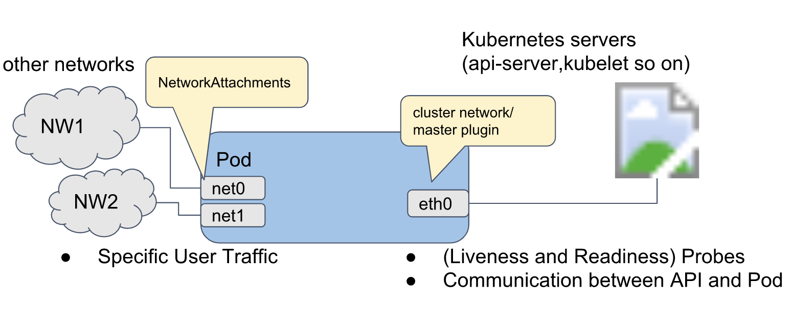
Multi-Homed Network
Selecting Multus-CNI
Backed by Intel, leading the space
Flexible selection of SDNs
Enables Namespace Isolation
Future alternatives on the Roadmap
CNI-Genie
Knitter
Multus NetworkAttachmentDefinition for Backend:

Slide 15
Multi-Homed EdgeFS
Benefits of transitioning to Isolated Multi-Homed Network:
Improved Performance characteristics
Improved Data Security
Improved QoS and SLA
Ingress
Egress
Ingress
Egress
App
App
App
Persistent Volume
App
Persistent Volume
Frontend Isolation
App
App
Pod Switch Network, MTU=9000
App
Persistent Volume
App
Persistent Volume
Pod Switch Network, MTU=9000
S3X
Storage Pod
S3X
Storage Pod
One Flat Pod Network
S3X
Storage Pod
S3X
Storage Pod
Backend Switch Network, MTU=9000
Backend Isolation
Storage Pod
Storage Pod
Storage Pod
Storage Pod

Slide 16
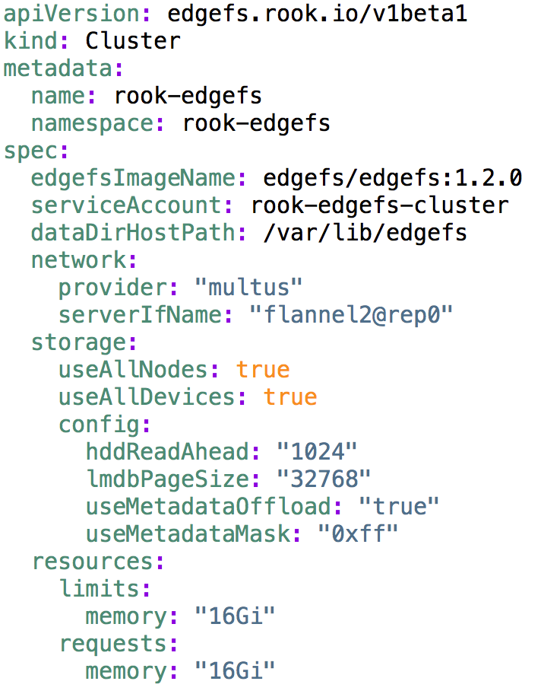
Demo Setup
Rook EdgeFS Cluster CRD:
Physical Characteristics:
4-nodes Kubernetes cluster v1.14, 1 SSD per 4 HDD, 15% SSD of total HDD capacity, 64GB RAM per Host, CPU E5-2630, 2.2GHz
10G Pod Network, 10G Backend Network, both Jumbo MTU
Rook S3X Deployment and COS Bench work generator runs on separate hosts
COS Bench
S3X Deployment
Worker
Target Pod 0 (4TB)
SSD
HDD
HDD
HDD
HDD
Host1
S3X
Target Pod 1 (4TB)
SSD
HDD
HDD
HDD
HDD
Host2
Target Pod 2 (4TB)
SSD
HDD
HDD
HDD
HDD
Host3
Target Pod 3 (4TB)
SSD
HDD
HDD
HDD
HDD
Host4

Slide 17
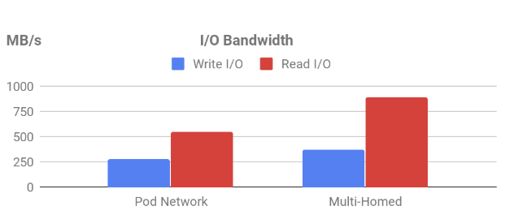
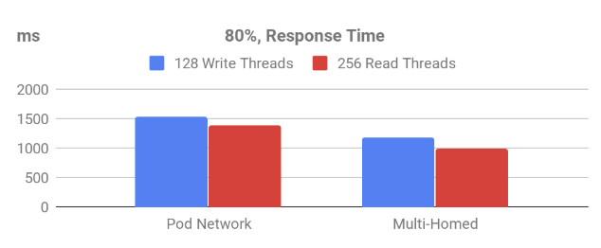
Performance Analysis
25-29% better response time!
39-43% better bandwidth!
Test was designed to compare Pod vs. Multi-Homed Networks
Single 10G connected multi-threaded app, 2MB S3 object transfers, 3 sync replicas, 6TB random I/O dataset

Slide 18
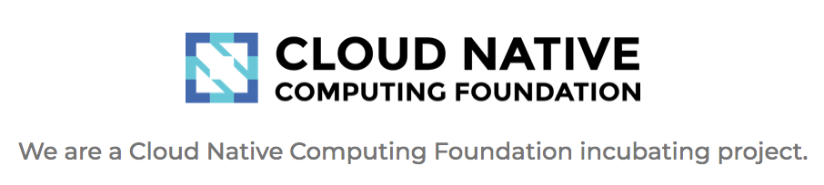
Summary
Rook Community is growing!
Top Contributors: Upbound.io, RedHat, Nexenta/DDN, SUSE, Cloudability, more is coming!
EdgeFS is emerging to address Multi-Cloud and Edge/IoT needs
Multi-Homed network is going to be available in upcoming 1.1 release

Slide 19
Thank you!
https://github.com/rook/rook
https://rook.io/
https://edgefs.io/

