Slide 1

DEBUGGING
Debugging is twice as hard as writing the code

Slide 2
Error
Errors refer to the mistake or faults which occur during program development or execution. If you don't find them and correct them, they cause a program to produce wrong results.

Slide 3
Compilation errors
Compilation error refers to a state when a compiler fails to compile a piece of computer program source code, either due to errors in the code.
Example:
Missing semicolons.
Mismatched brackets
Method is undefined.
Variable already defined.
Variable not initialized.
Type mismatch: cannot convert.

Slide 4
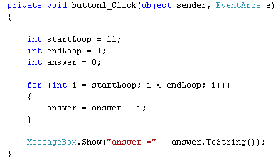
Logical errors
This type of error causes unexpected and unusual results due to the fault in the logic or algorithm.
Example:

Slide 5
Example: Object reference not set to an instance
class Program
{
static void Main(string[] args)
{
string message = null;
int length = message.Length;
Console.WriteLine(length);
}
}
class Program
{
static void Main(string[] args)
{
string message = "Hello, world!";
int length = message.Length;
Console.WriteLine(length);
}
}

Slide 6
How to debug
Find out what values are stored in the variables at different points in time. Never assume anything.
Don't just say that a variable contains a certain value. Prove it! Use popup boxes to display the variable or watch the variable in the debugger.
Narrow down the location of the problematic code.
Use the debugger go line by line.
Make sure you understand what every single line does.

Slide 7
Understanding Error Message
Read the error message carefully
Look for keywords
Identify the error type
Check the line number
Search for solutions online

Slide 8
Breakpoint
Intentional stopping or pausing place in a program, put in place for debugging purposes
it allows the developers to see how the code works in a step-by-step manner, how the values of the variables change, how the objects are created and destroyed, etc.
Step Into (F11): Moves the debugger to the next line of code, entering method calls if any.
Step Over (F10): Moves the debugger to the next line of code without entering method calls.
Step Out (Shift+F11): Exits the current method and returns to the calling method.

Slide 9
Immediate window
Immediate window is used to debug and evaluate expressions, execute statements, and print variable values.
To display the Immediate window, open a project and then choose Debug > Windows > Immediate or press Ctrl+Alt+I.

Slide 10
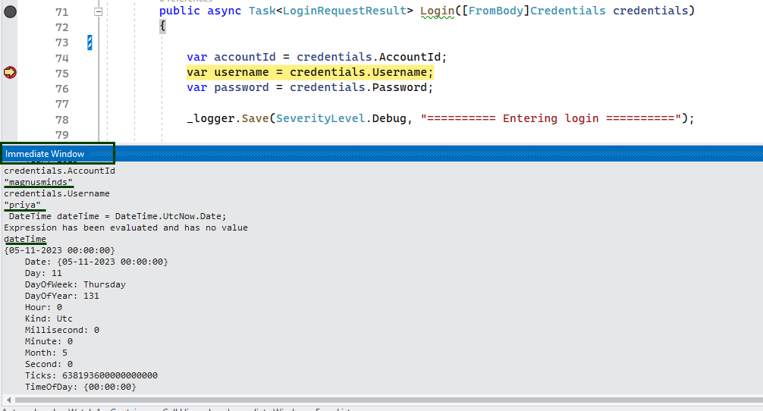

Slide 11
Autos & Locals
The Autos and Locals windows show variable values while you are debugging. The windows are only available during a debugging session. The Autos window shows variables used around the current breakpoint. The Locals window shows variables defined in the local scope, which is usually the current function or method.
Locals Windows ( Debug –> Windows –> Locals)
Autos Windows ( Debug –> Windows –> Autos)

Slide 12
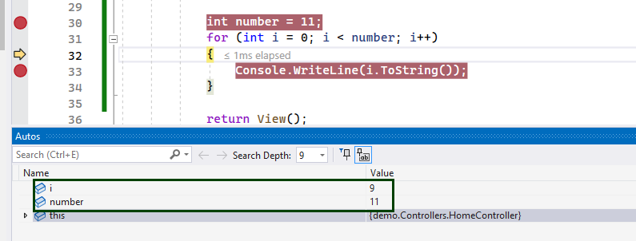
Autos

Slide 13
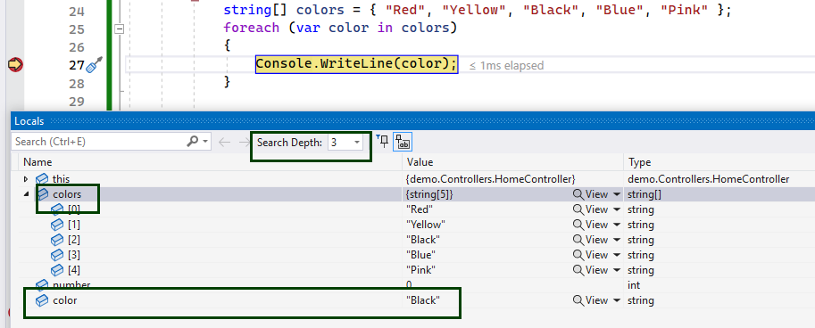
Locals

Slide 14
JavaScript
The debugger keyword stops the execution of JavaScript, and calls (if available) the debugging function.
You can use the console.log() method to debug the code. You can pass the value you want to check into the console.log() method and verify if the data is correct.

Slide 15
Rules for Naming JavaScript Variables
Variable names must start with either a letter, an underscore _, or the dollar sign $.
Variable names cannot start with numbers.
JavaScript is case-sensitive. So y and Y are different variables.
Keywords cannot be used as variable names.
In JavaScript, the variable names are generally written in camelCase if it has multiple words. For example, firstName.

Slide 16
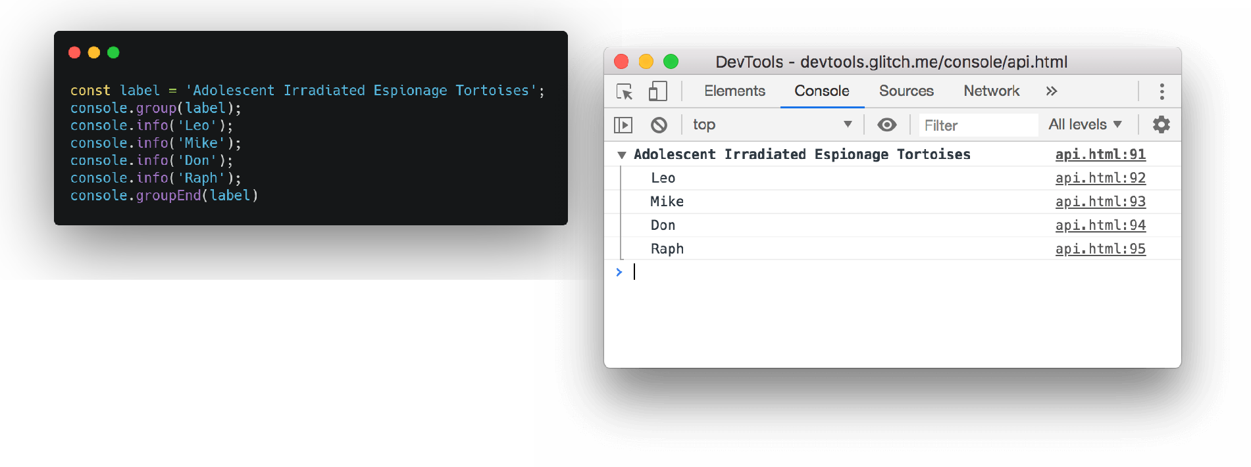
Console Group

Slide 17
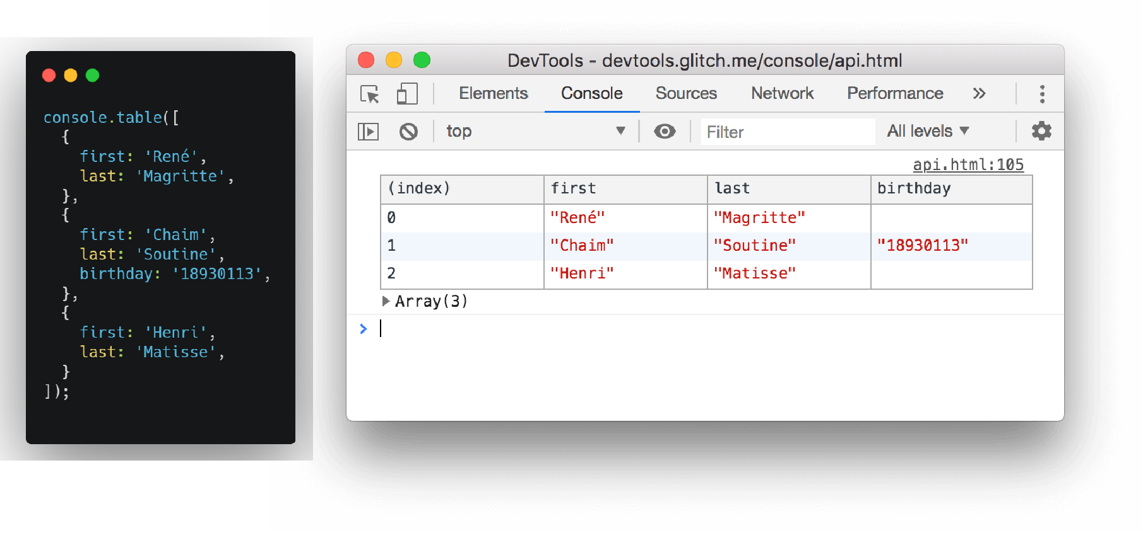
Console Table

Slide 18
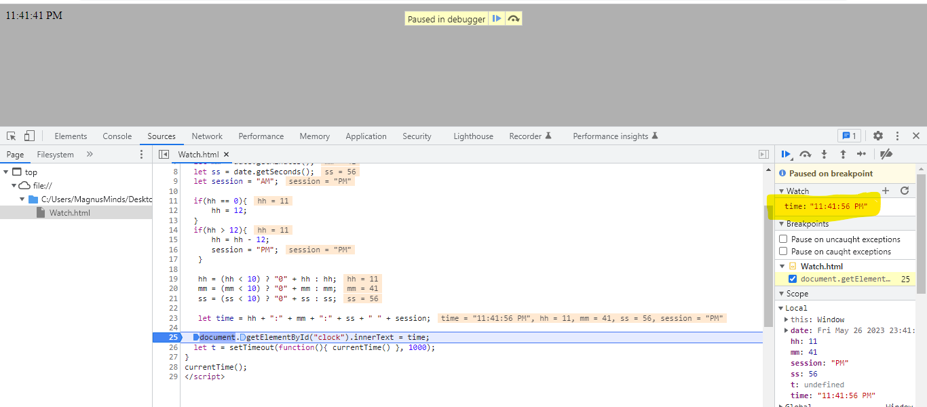
Sources Watch

Slide 19
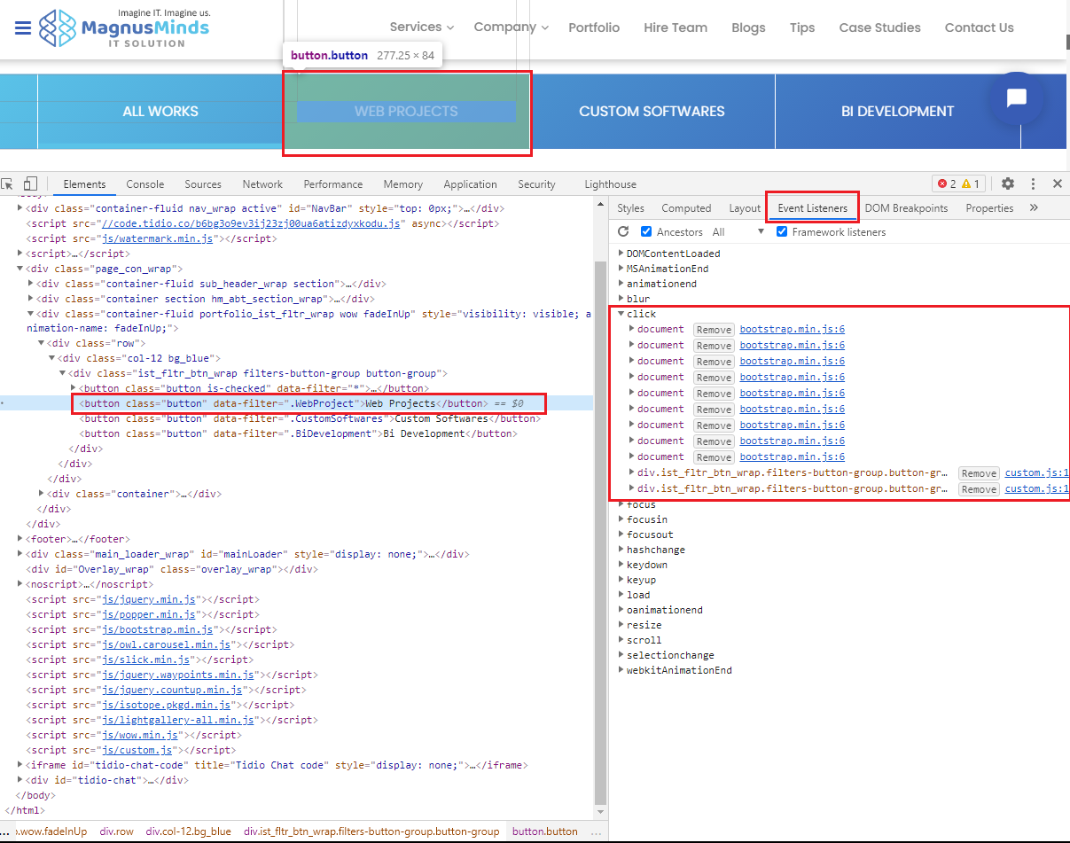
Element Event

Slide 20


