Slide 1
Before we start:
The sentence in the other panel is false
The sentence in the other panel is true.

Slide 2
Mathematical Thinking
Paradoxes, probability, logic
Some definitions Infinity – Zeno et al
Probability – Monty Hall, Medicine
Logic and incompleteness
Chris Thompson V1.5
Ray Adams, Alan Richardson
Notes:
A mathematician is a blind man in a dark room looking for a black cat which isn't there.^{[20]} Charles Darwin^{[21]}
Mathematics is the art of giving the same name to different things.^{[10]} Henri Poincaré

Slide 3
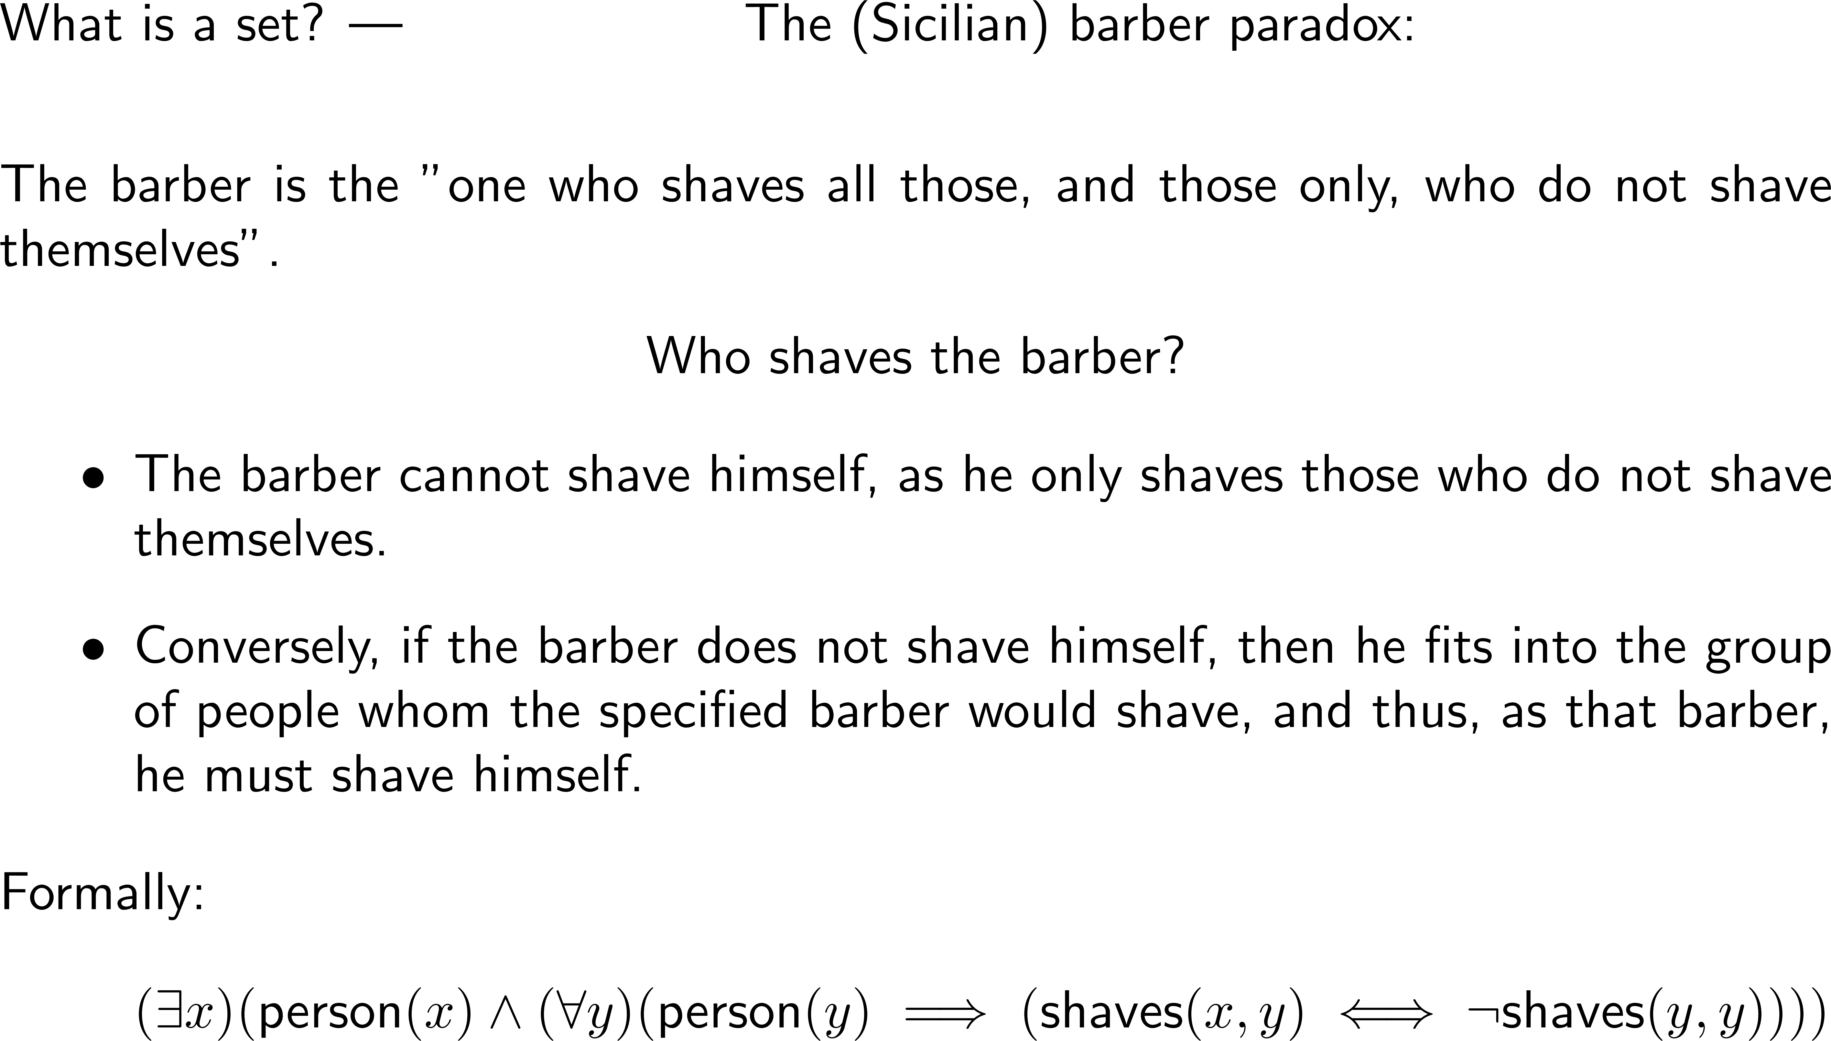
Fundamentals – set theory
Notes:
There exists an x satisfying
x is a person and
FOR ALL y
If y is a person then
x shaves y AND y does NOT shave themselves
AND
If y does not shave themselves then they are shaved by x.

Slide 4
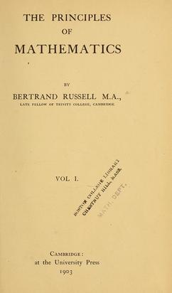
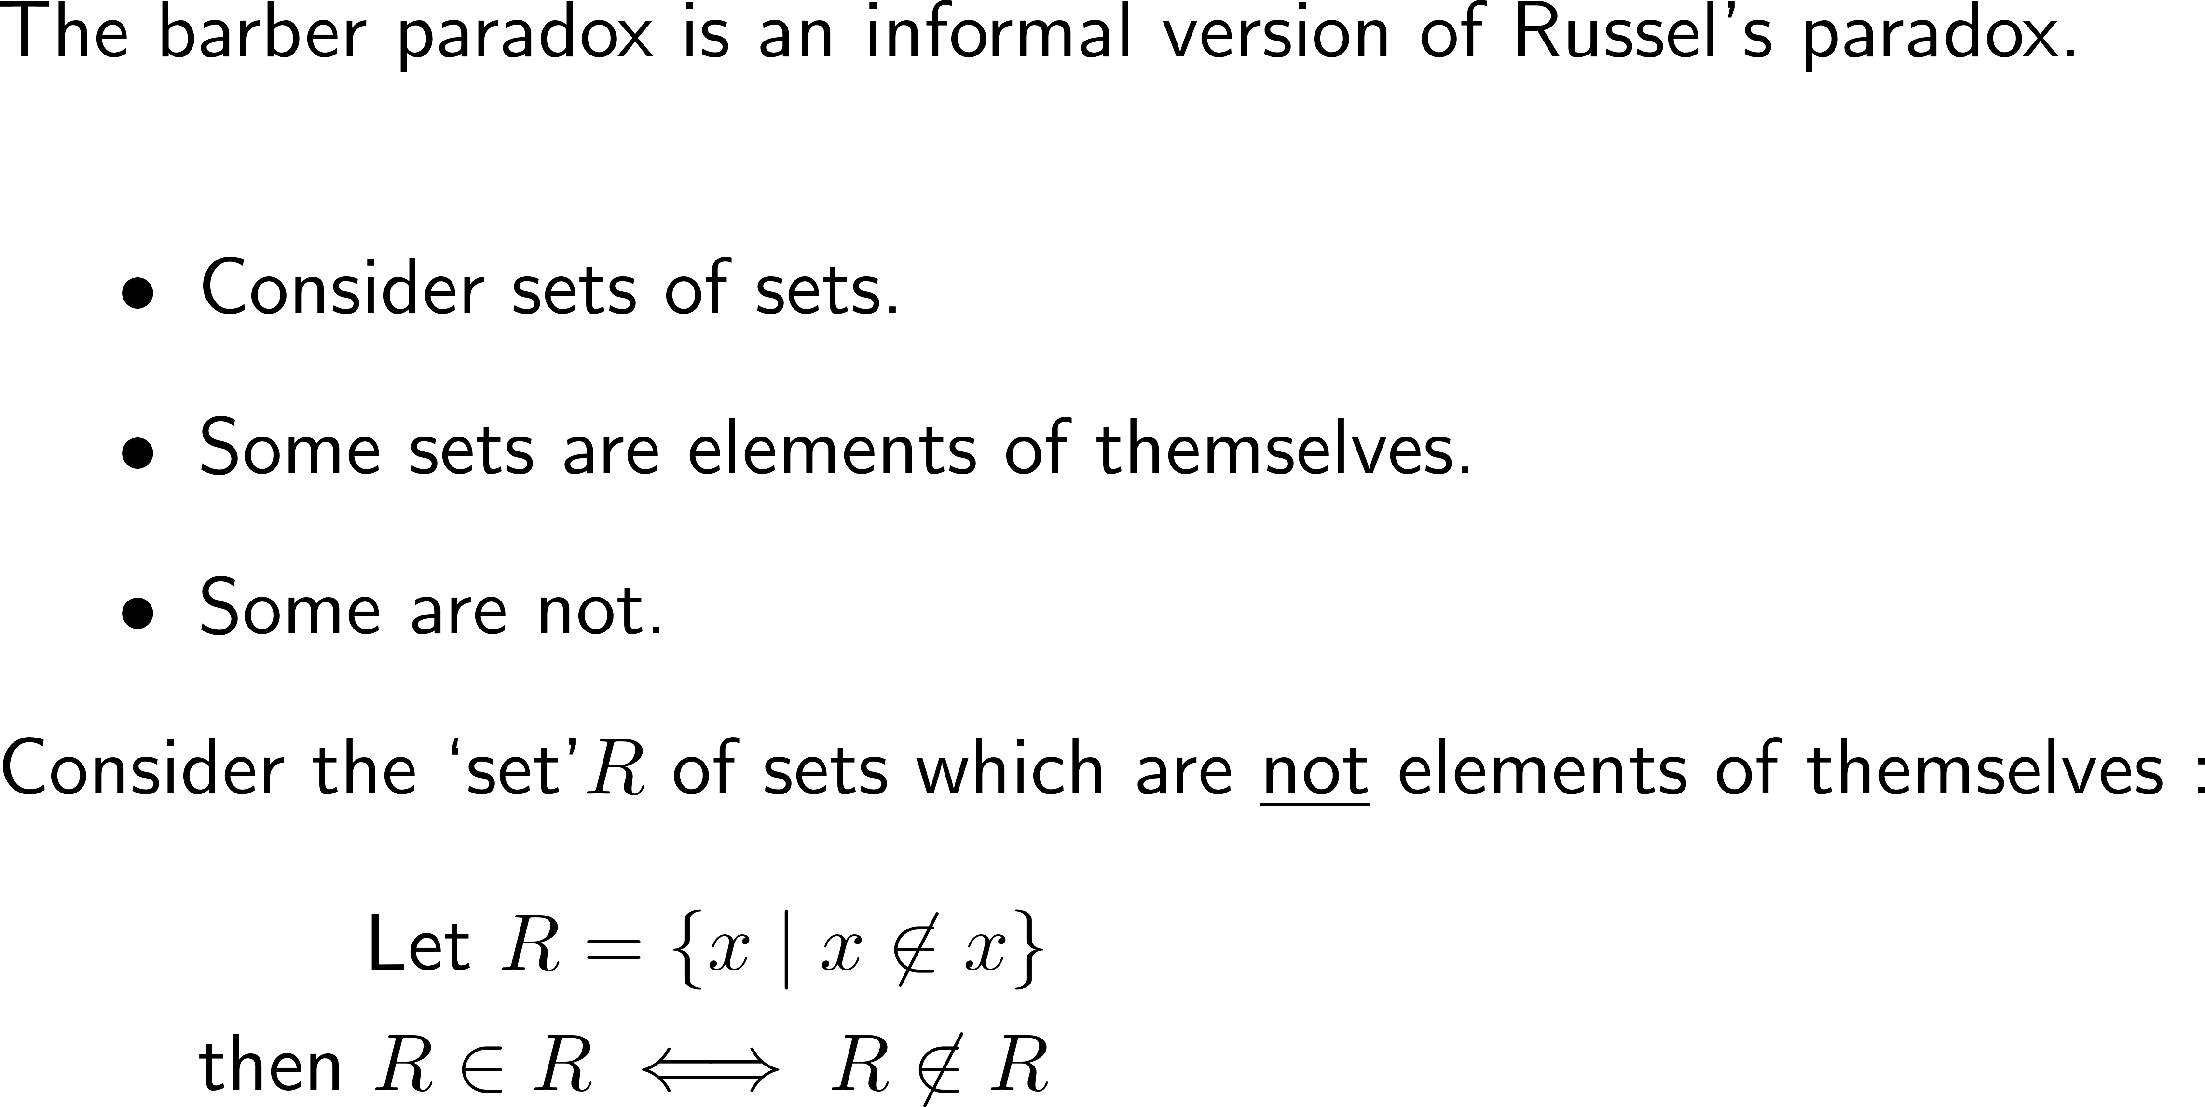
Fundamentals – set theory
Notes:
By https://covers.openlibrary.org/b/id/7213097-L.jpg, Fair use, https://en.wikipedia.org/w/index.php?curid=52094181

Slide 5
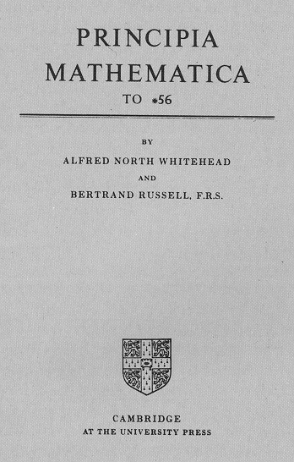
Fundamentals – set theory
Notes:
By https://covers.openlibrary.org/b/id/7213097-L.jpg, Fair use, https://en.wikipedia.org/w/index.php?curid=52094181

Slide 6
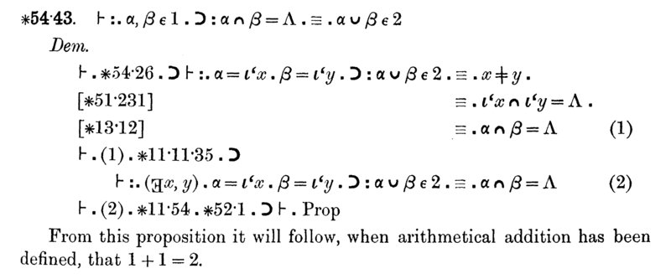
Fundamentals – set theory
Notes:
By https://covers.openlibrary.org/b/id/7213097-L.jpg, Fair use, https://en.wikipedia.org/w/index.php?curid=52094181
What it means: The extract from Principia Mathematica on slide 5 establishes that two sets, each containing one item, together contain two items if they share nothing. Its final sentence says this will support 1 + 1 = 2 once addition has been defined.
Why it’s included: The dense proof beside such a simple result shows how much logical groundwork even basic arithmetic requires. Alongside Russell’s paradox, it illustrates the need for careful foundations rather than trusting what seems obvious.
Godel uses an adaptation of the axiomatic system from Principia Mathematica
How it fits: It connects the opening set-theory paradoxes with the later Hilbert and Gödel section (slides 29–32): can mathematics rest on rules that avoid contradictions and settle every question? This supports the deck’s closing message that paradoxes push mathematical understanding forward.

Slide 7
Achilles and the tortoise (i)
Notes:
1 rod = 16.5ft a good arrow shot!

Slide 8
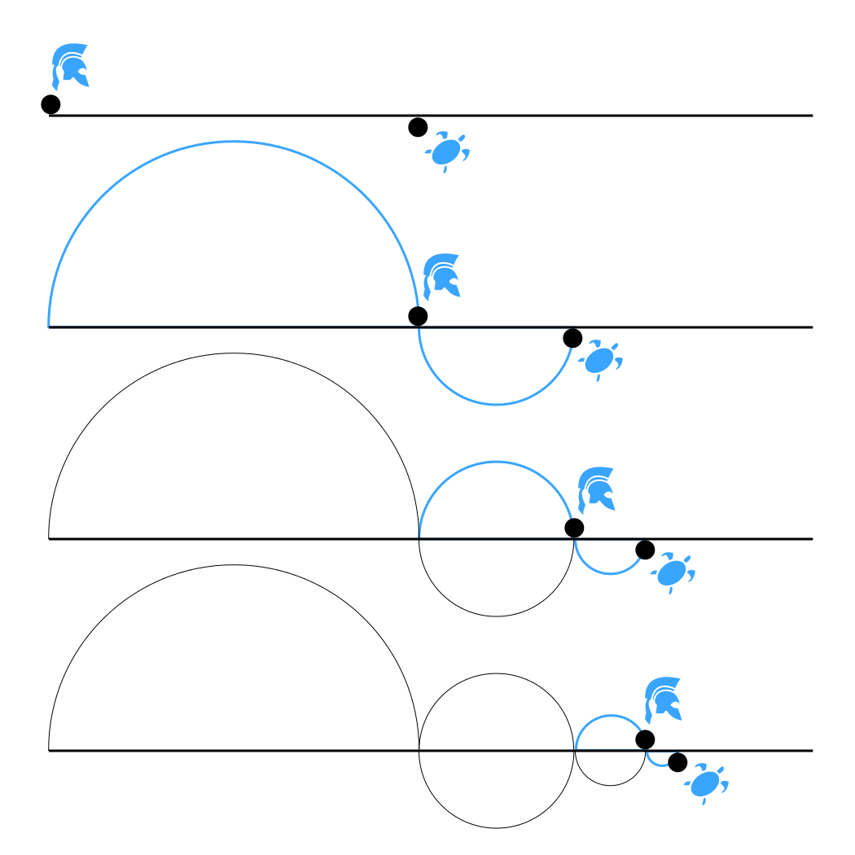
Achilles and the tortoise (ii)
Martin Grandjean
Notes:
There was some argument about this.
Aristotle, in particular, argued that the sum of positive values did not have to be infinite.
It took a while for us really to construct the rigorous argument.

Slide 9
Achilles and the tortoise (iii)
Notes:
We probably remember that from school.

Slide 10
Rational numbers: dense & sparse on the line (i)
Notes:
Infinities remain tricky…
Ray gave us the mnemonic: Nine Zulu Queens Rule
There is no largest natural number – the axion of Archimedes.

Slide 11
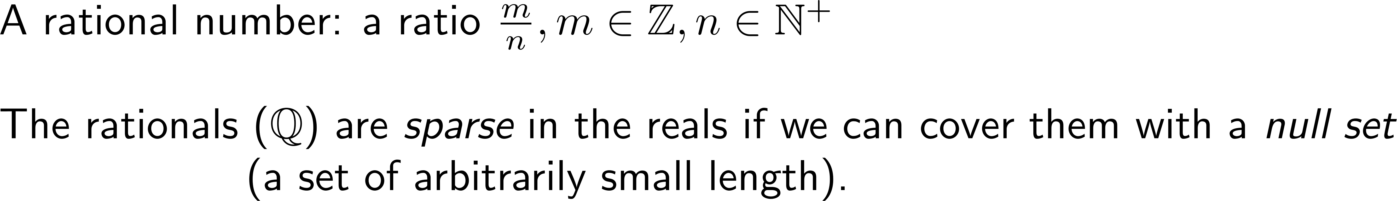
Rational numbers: dense & sparse on the line (ii)
Notes:
Countability – a set is countable if it can be put in a 1-1 correspondence with the natural numbers.
(Are there enough chairs in the hall? Everyone please sit down: people match the chairs – or not!)
Can we count the rationals? Diagonal line proof – Cantor (1845-1918)

Slide 12
A standard series
Notes:
Choose n=2 S(2) = \pi^2/6

Slide 13
The Basel problem
By Cmglee
Notes:
By Cmglee - Own work, CC BY-SA 4.0, https://commons.wikimedia.org/w/index.php?curid=168287114

Slide 14
The Basel problem
Notes:
https://en.wikipedia.org/wiki/Basel_problem
By Cmglee - Own work, CC BY-SA 4.0, https://commons.wikimedia.org/w/index.php?curid=168287114
Finite Elements were widely ued by engineers before the mathematics was proven.
Engineers – we all use it and we get the right answer.

Slide 15
A divertissement

Slide 16
A divertissement
Notes:
Interactive Linear Algebra - Mendeley

Slide 17
A divertissement
Notes:
S_1 is known as Grandi’s series.
It is Cesaro summable.
This manipulation is questionable (at best).
Before we were dealing with finite sums, then bounding them, then taking limits.
The formal manipulation of these series is much harder to justify.

Slide 18
A divertissement
Notes:
Interactive Linear Algebra - Mendeley

Slide 19
A divertissement
Srinivasa Ramanujan 1887 - 1920
Notes:
-1/12: https://www.qedcat.com/misc/String_theory_book.jpg
String Theory, J S Polchinski (2005)
Page 22 “This leads to the odd result:”
An example of Casimir energy, coming from the fact that the string has finite length.

Slide 20
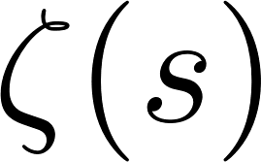
A divertissement – the maths of
Notes:
Ray (might) be going to talk about this further.
Georg Friedrich Bernhard Riemann, 1826-1866.
-1/12: https://www.qedcat.com/misc/String_theory_book.jpg
String Theory, J S Polchinski (2005)
Page 22 “This leads to the odd result:”
An example of Casimir energy, coming from the fact that the string has finite length.
Monatsberichte der Berliner Akademie, November 1859

Slide 21
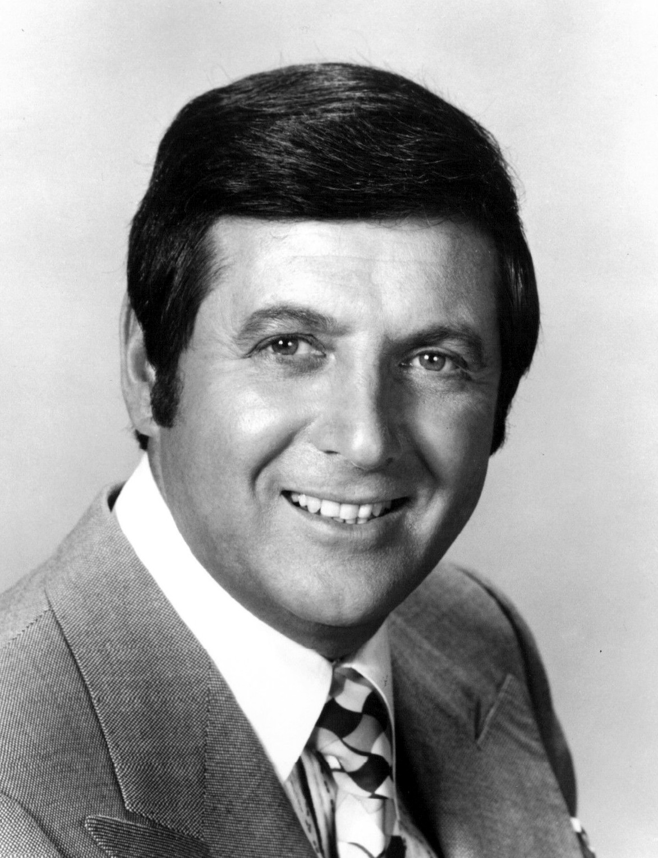
Probabilities – The Monty Hall Problem
Notes:
The show: Let’s make a deal.
Hall was host, co-creator and co-producer.
It was first broadcast in 1963

Slide 22
Probabilities – The Monty Hall Problem
Notes:
http://marilynvossavant.com/game-show-problem/
PARADE magazine 1990 & 1991
So much vitriol!!
[Nothing compared to what we have today… vos Savant thought it was pretty terrible.]
Hall would deviate from the idealized rules. He sometimes did not offer the choice of switching but opened the door immediately.
Sometimes he offered money to not switch.
The game got through more goats than it should have done.

Slide 23
Probabilities – Medical testing (i)
Notes:
http://marilynvossavant.com/game-show-problem/
PARADE magazine 1990 & 1991
So much vitriol!!
Hall would deviate from the idealized rules. He sometimes did not offer the choice of switching but opened the door immediately.
Sometimes he offered money to not switch.
The game got through more goats than it should have done.

Slide 24
Probabilities – Medical testing (ii)
Notes:
http://marilynvossavant.com/game-show-problem/
PARADE magazine 1990 & 1991
So much vitriol!!
Hall would deviate from the idealized rules. He sometimes did not offer the choice of switching but opened the door immediately.
Sometimes he offered money to not switch.
The game got through more goats than it should have done.

Slide 25
Probabilities – Medical testing (ii)

Slide 26
Probabilities – Medical testing (ii)

Slide 27
Probabilities – Medical testing (iii)
Notes:
http://marilynvossavant.com/game-show-problem/
PARADE magazine 1990 & 1991
So much vitriol!!
Hall would deviate from the idealized rules. He sometimes did not offer the choice of switching but opened the door immediately.
Sometimes he offered money to not switch.
The game got through more goats than it should have done.

Slide 28
Bayes Theorem

Slide 29
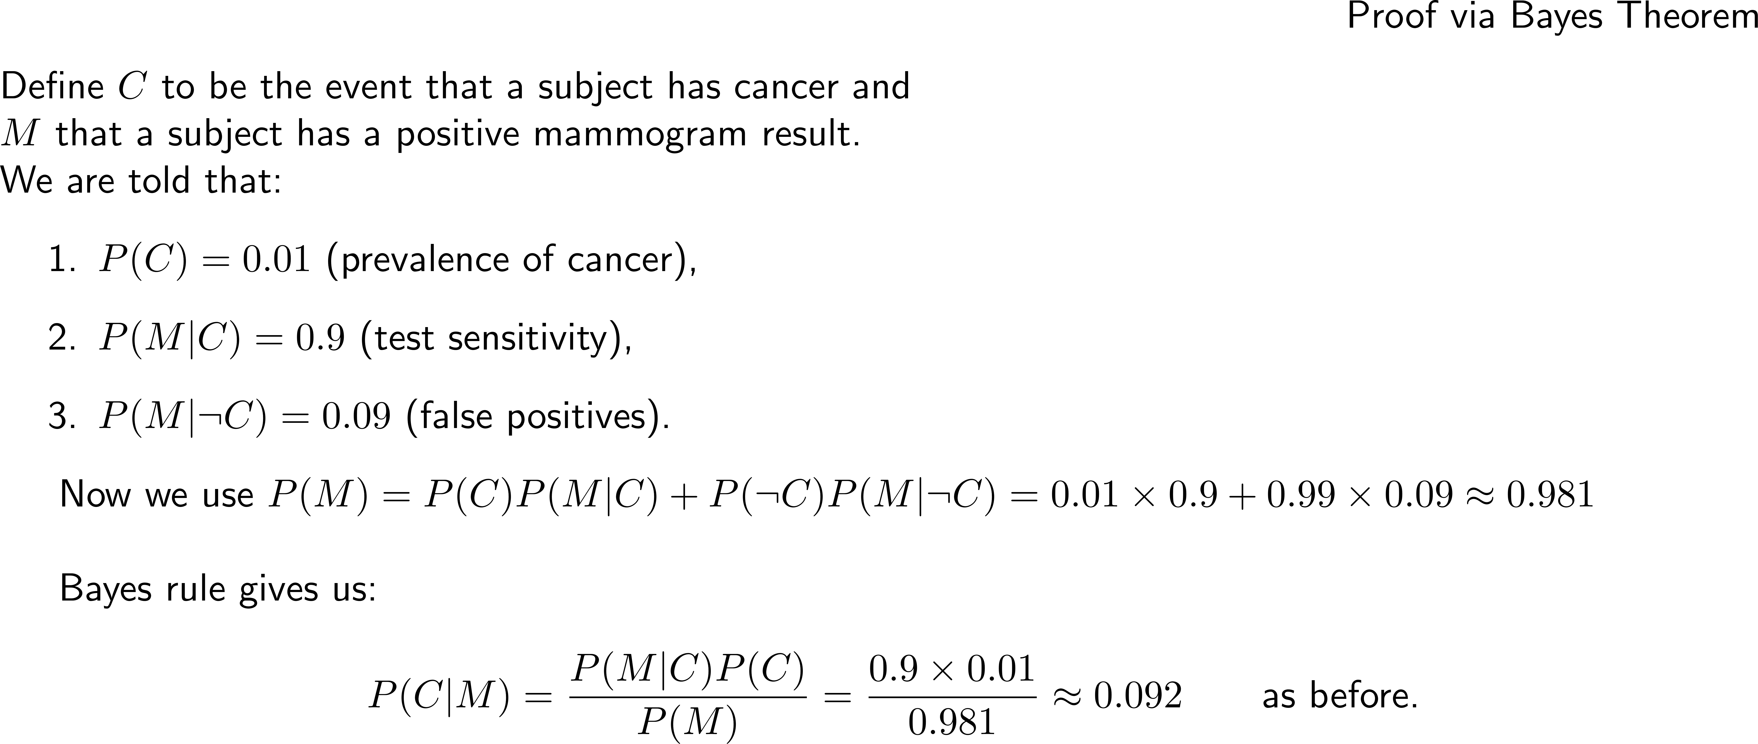
Probabilities – Medical testing (iv)

Slide 30
The search for completeness and solvability
1872 Congress of German Scientists and Physicians (Königsburg)
  Emil du Bois-Reymond: The Limits of Science
  ignoramus et ignorabimus -- "we do not know and will not know"
1900 Second International Congress of Mathematicians
  David Hilbert – he of the Problems, Spaces and the Grand Hotel
    Decidability – can any well-formed formula (wff) be proved (or disproved) from the axioms of a mathematical theory in a finite number of steps
    Not contradictory – no finite number of logical steps based on the axioms will lead to a contradictory result.
1930 Congress of German Scientists and Physicians (Königsburg)
  Hilbert’s address
  Wir müssen wissen – wir werden wissen --"We must know – we will know"
Notes:
https://ima.org.uk/29760/historical-notes-the-rise-and-fall-of-the-consistency-programme/
Between 1900 and 1930 there was opposition to Hilbert’s campaign but Hilbert’s office politics is better.

Slide 31
The search for completeness and solvability (ii)
1872 Congress of German Scientists and Physicians (Königsburg)
  Emil du Bois-Reymond: The Limits of Science
  ignoramus et ignorabimus -- "we do not know and will not know"
1900 Second International Congress of Mathematicians
  David Hilbert – he of the problems and spaces
    Decidability – any well-formed formula (wff) can be proved from the axioms of a mathematical theory
    Not contradictory – no finite number of logical steps based on the axioms will lead to a contradictory result.
1930 Congress of German Scientists and Physicians (Königsburg)
  Hilbert’s address
  Wir müssen wissen – wir werden wissen --"We must know – we will know"
However,
One day earlier
In Königsburg
Kurt Gödel announces a proof that:
Any system strong enough to produce Peano arithmetic
is essentially incomplete.
Notes:
https://ima.org.uk/29760/historical-notes-the-rise-and-fall-of-the-consistency-programme/
Between 1900 and 1930 there was opposition to Hilbert’s campaign but Hilbert’s office politics is better.

Slide 32
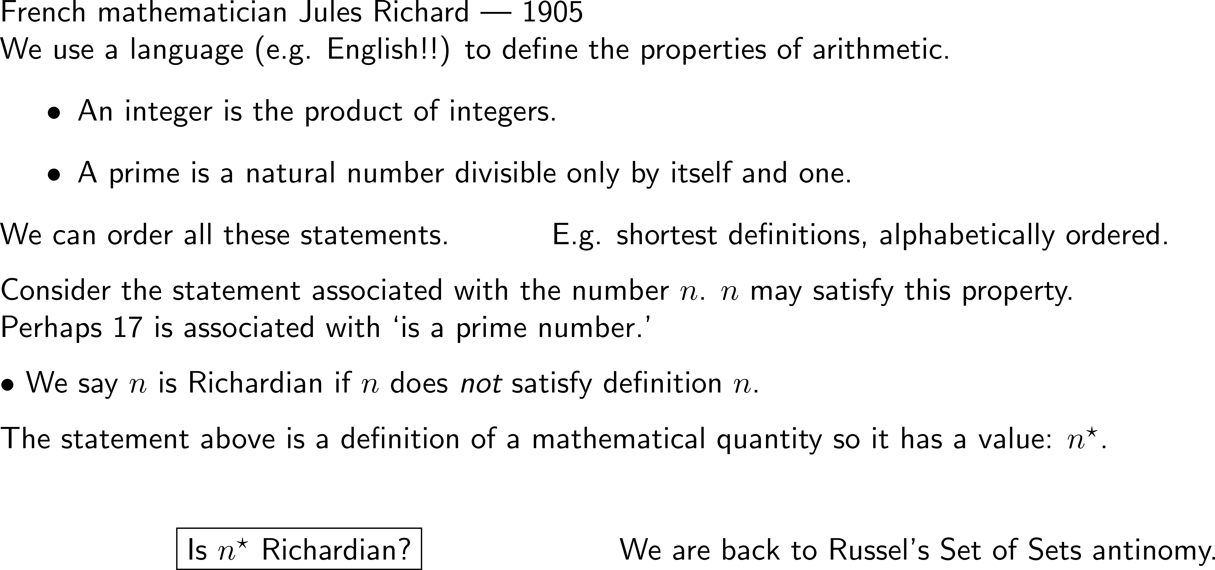
Richard’s Paradox
Gödel’s Proof, Nagel and Newman (U Florida)(1958)
Gödel’s Incompleteness Theorems, Smullyan (1992)
Notes:
https://ima.org.uk/29760/historical-notes-the-rise-and-fall-of-the-consistency-programme/
Not to be confused with the lustrous grey metal.

Slide 33
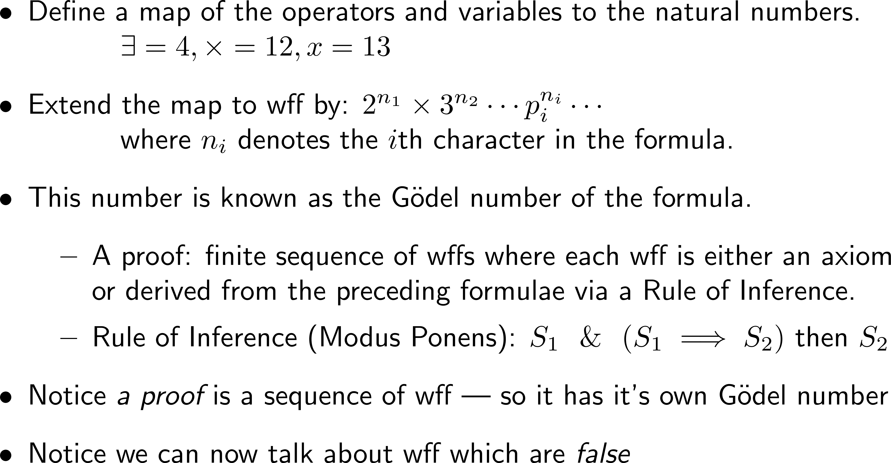
The search for completeness and solvability
Notes:
https://ima.org.uk/29760/historical-notes-the-rise-and-fall-of-the-consistency-programme/

Slide 34
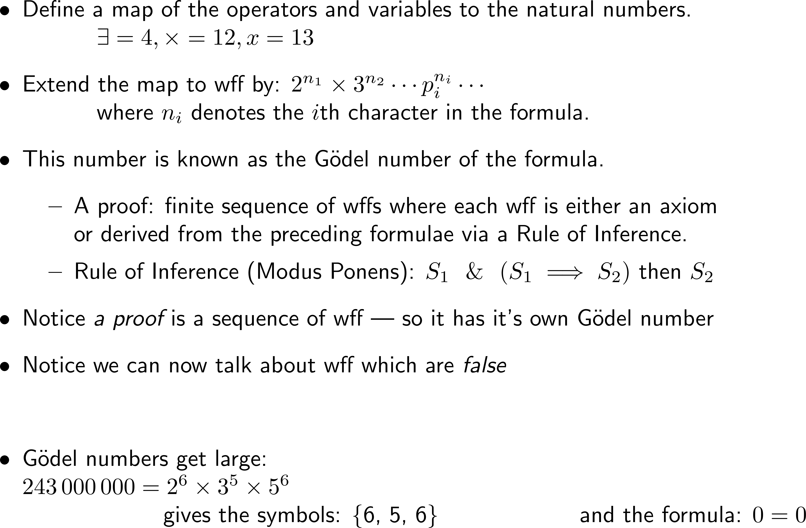
The search for completeness and solvability
Notes:
https://ima.org.uk/29760/historical-notes-the-rise-and-fall-of-the-consistency-programme/
Under this mapping if a proof uses an axiom then the Godel number for the axiom has the Godel number of the axiom as a factor.

Slide 35
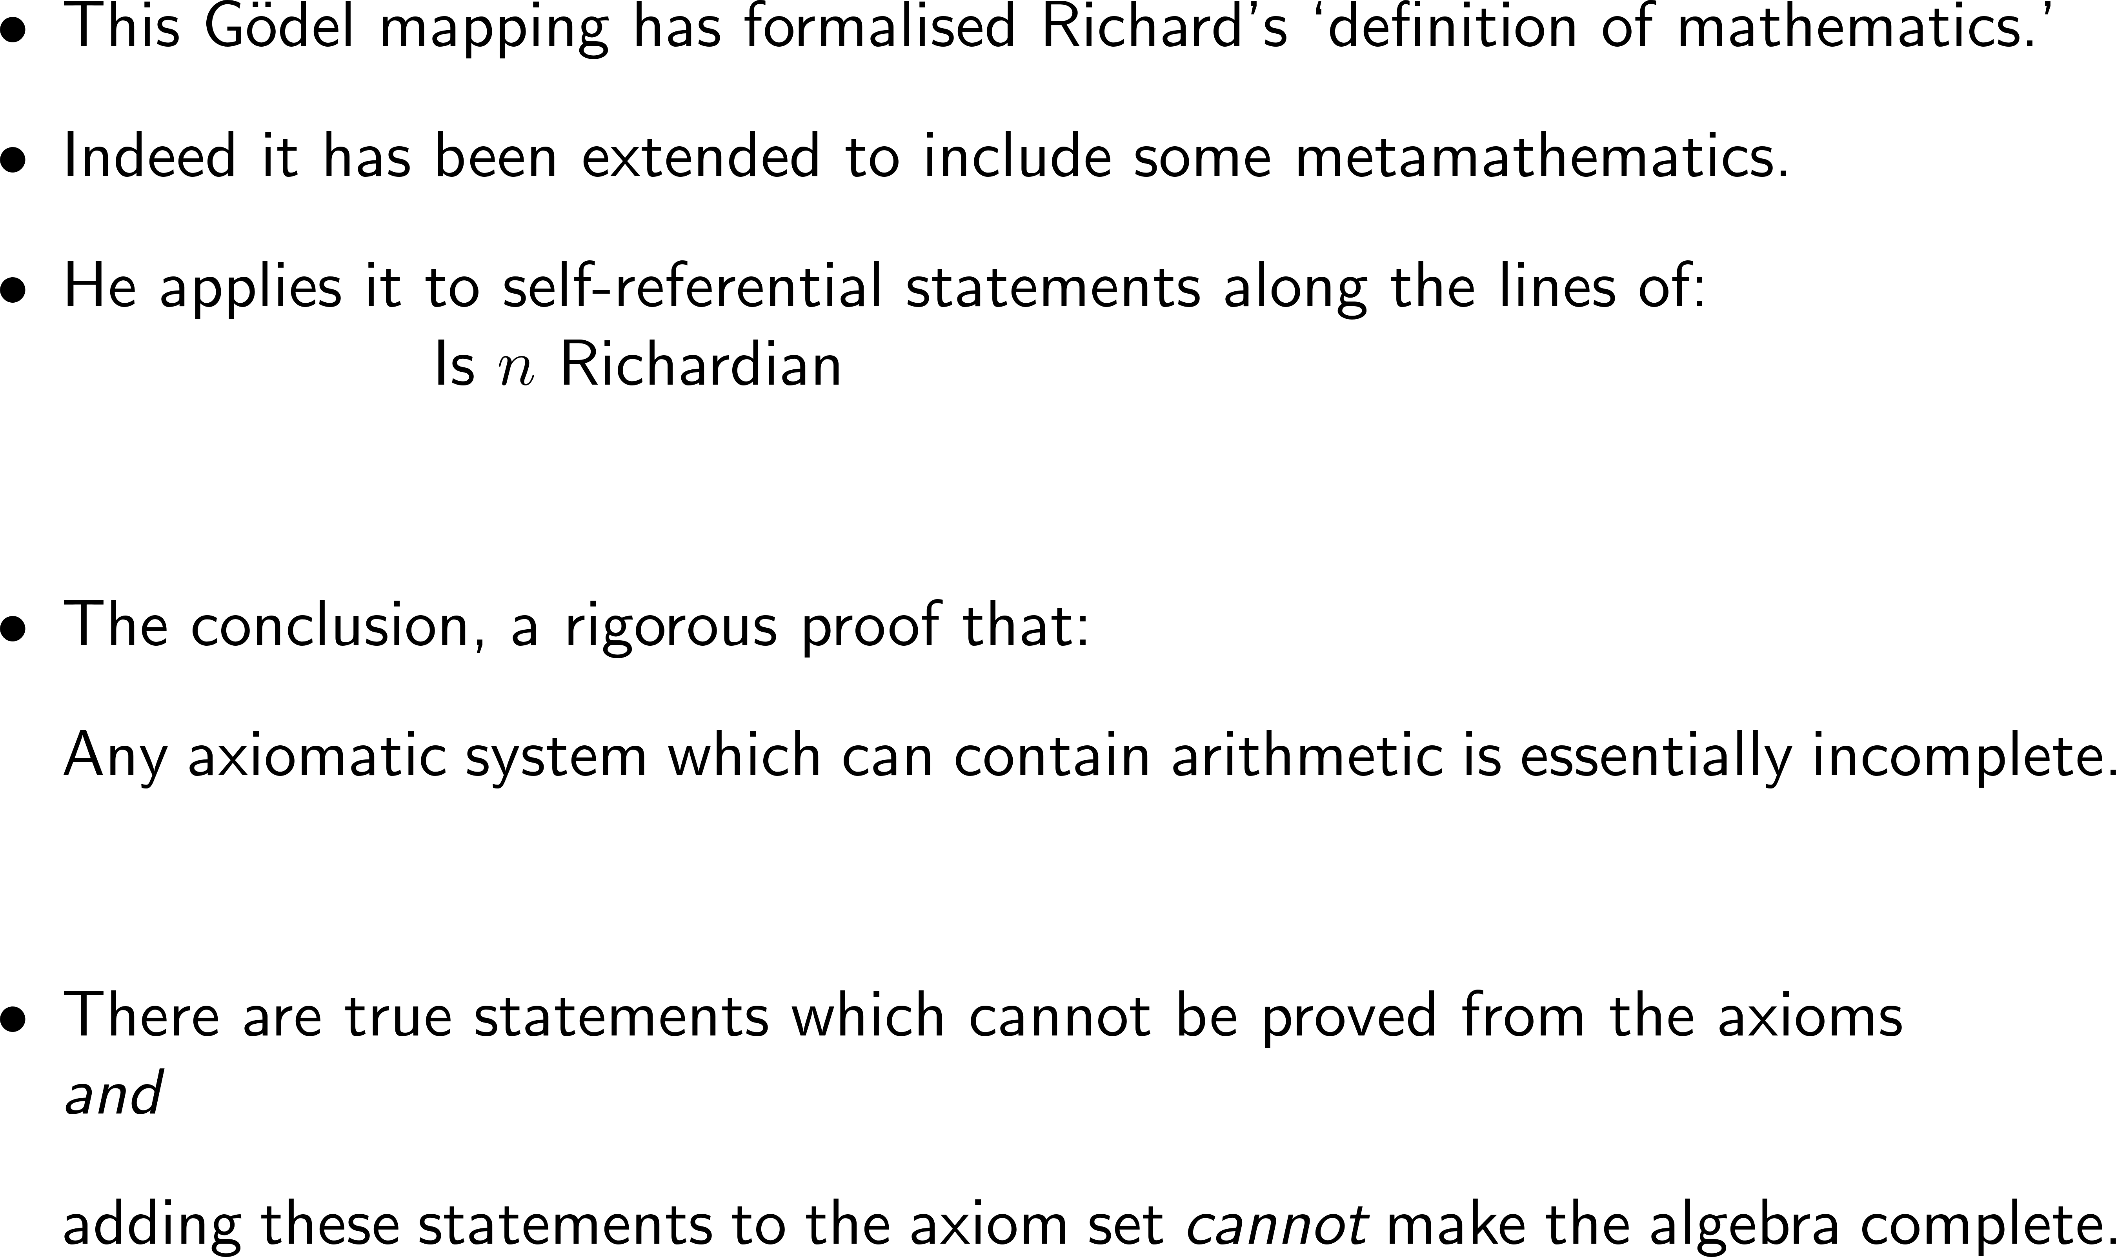
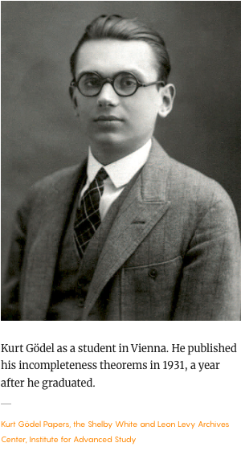
The search for completeness and solvability
Notes:
https://ima.org.uk/29760/historical-notes-the-rise-and-fall-of-the-consistency-programme/

Slide 36
Summary
Discussed a few paradoxes
These drive forward our understanding of concepts:
  Sets
  Sums
  Infinity
Quantitative paradoxes force us to review our expectation of probability
We ended with Hilbert’s drive to complete knowledge
  and it’s defeat by Gödel

Slide 37
Fundamentals – set theory
I can remember Bertrand Russell telling me of a horrible dream. He was in the top floor of the University Library, about A.D. 2100. A library assistant was going round the shelves carrying an enormous bucket, taking down books, glancing at them, restoring them to the shelves or dumping them into the bucket. At last he came to three large volumes which Russell could recognize as the last surviving copy of Principia Mathematica. He took down one of the volumes, turned over a few pages, seemed puzzled for a moment by the curious symbolism, closed the volume, balanced it in his hand and hesitated....
— G. H. Hardy, A Mathematician's Apology (1940)
Notes:
By https://covers.openlibrary.org/b/id/7213097-L.jpg, Fair use, https://en.wikipedia.org/w/index.php?curid=52094181

Slide 38
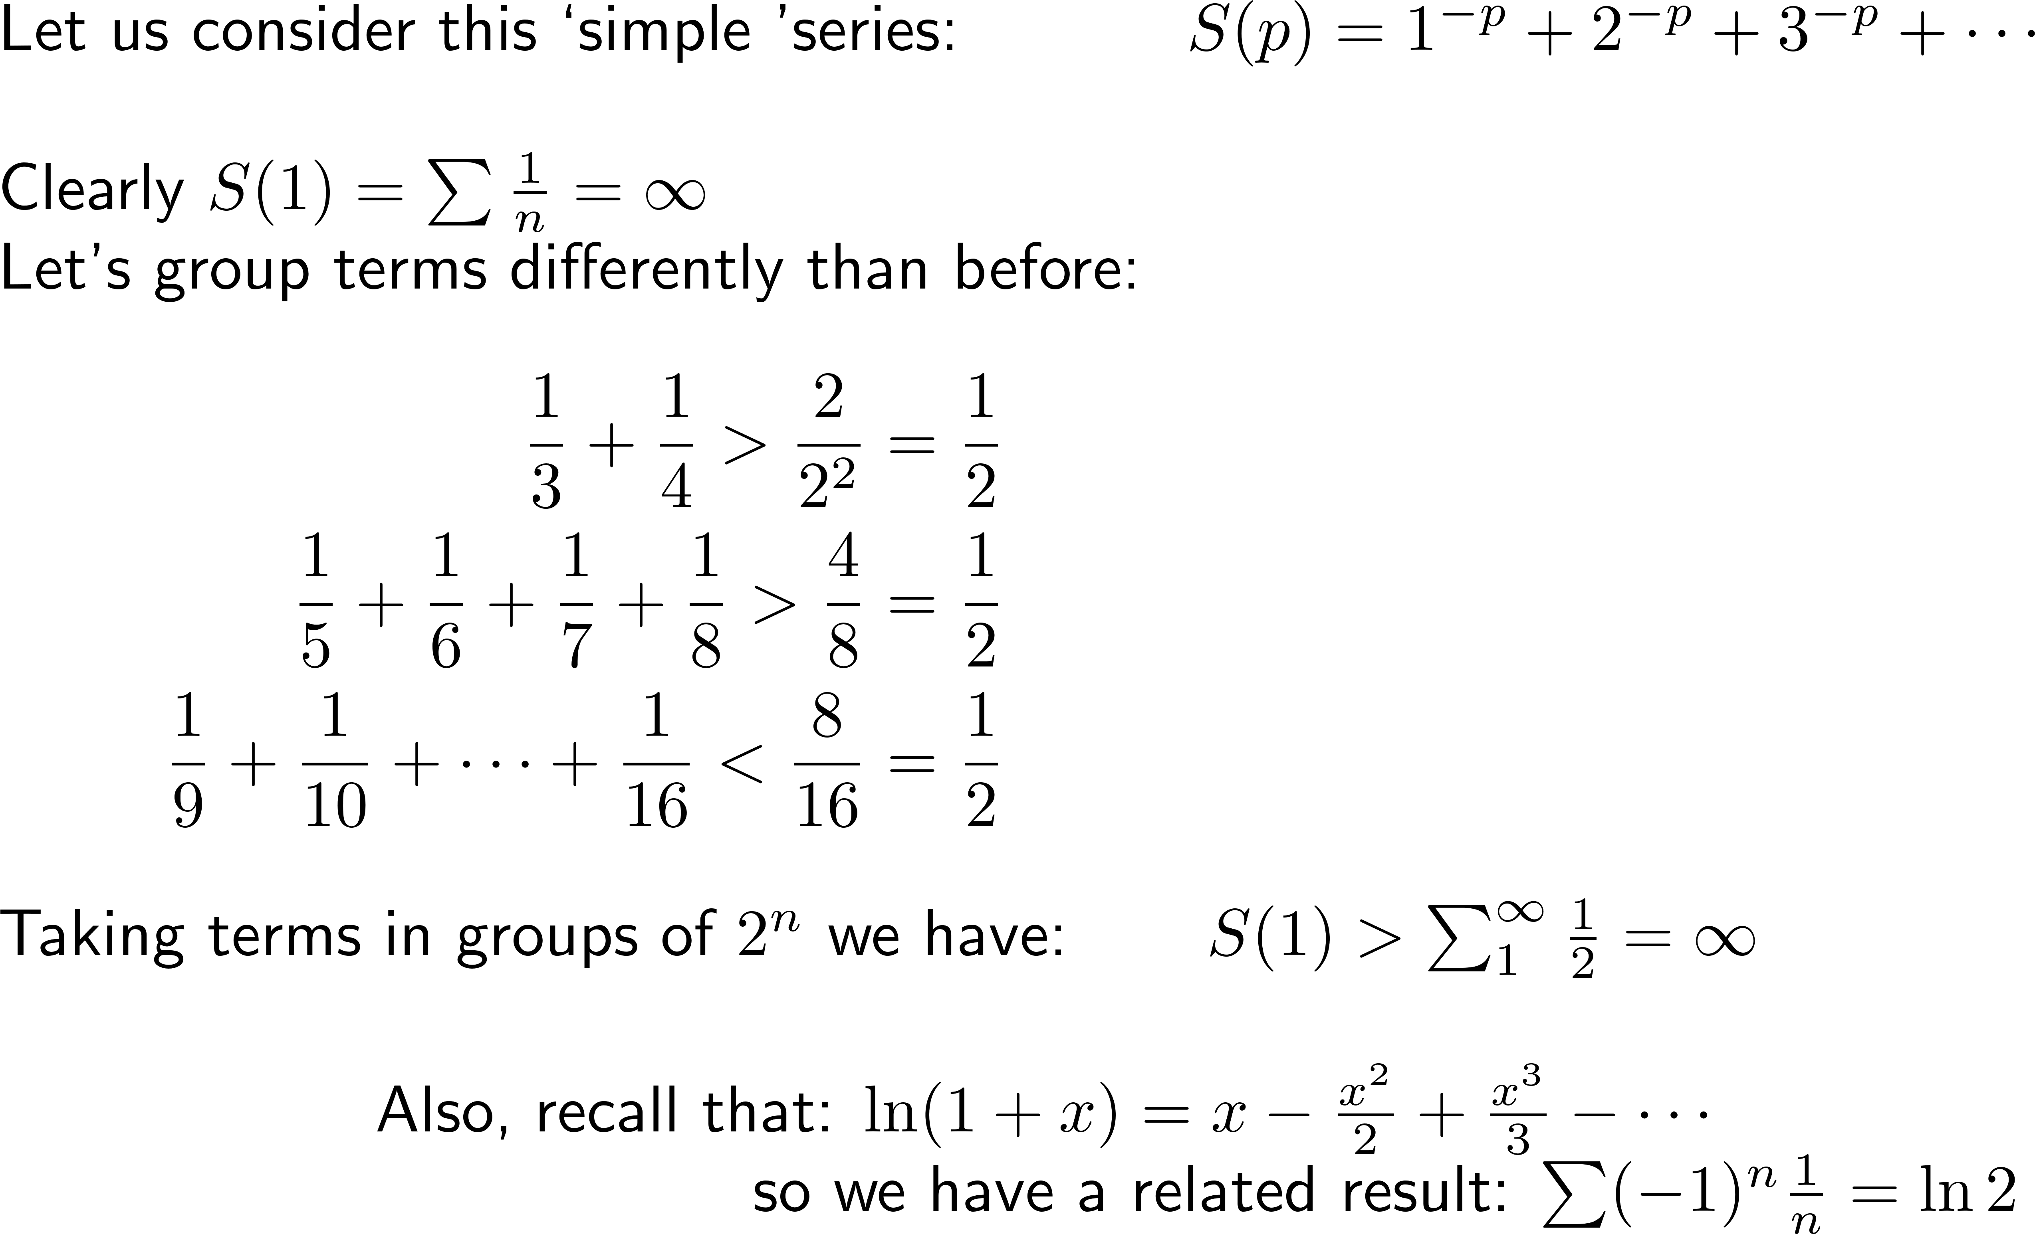
A standard series
Notes:
Choose n=2 S(2) = \pi^2/6
Another bit of mathematical thinking:
Is the result the best it can be?
We showed that S(p) converges for p<1
What happens for p = 1?
So we have the earlier, counter-intuitive result S(1) = -1/12 and here we have S(1) = \infty
And we have emphasized the importance of understanding absolute convergence.

Slide 39
Thank you for your attention
Notes:
https://cs357.cs.illinois.edu/textbook/notes/condition.html
Hilbert matrix (Wikipedia) - \kappa BIG

Slide 40
Mathematical thinking: Lecture 3
The sentence in the right half of this slide is false.
The sentence on the left half of this slide is true.

Slide 41
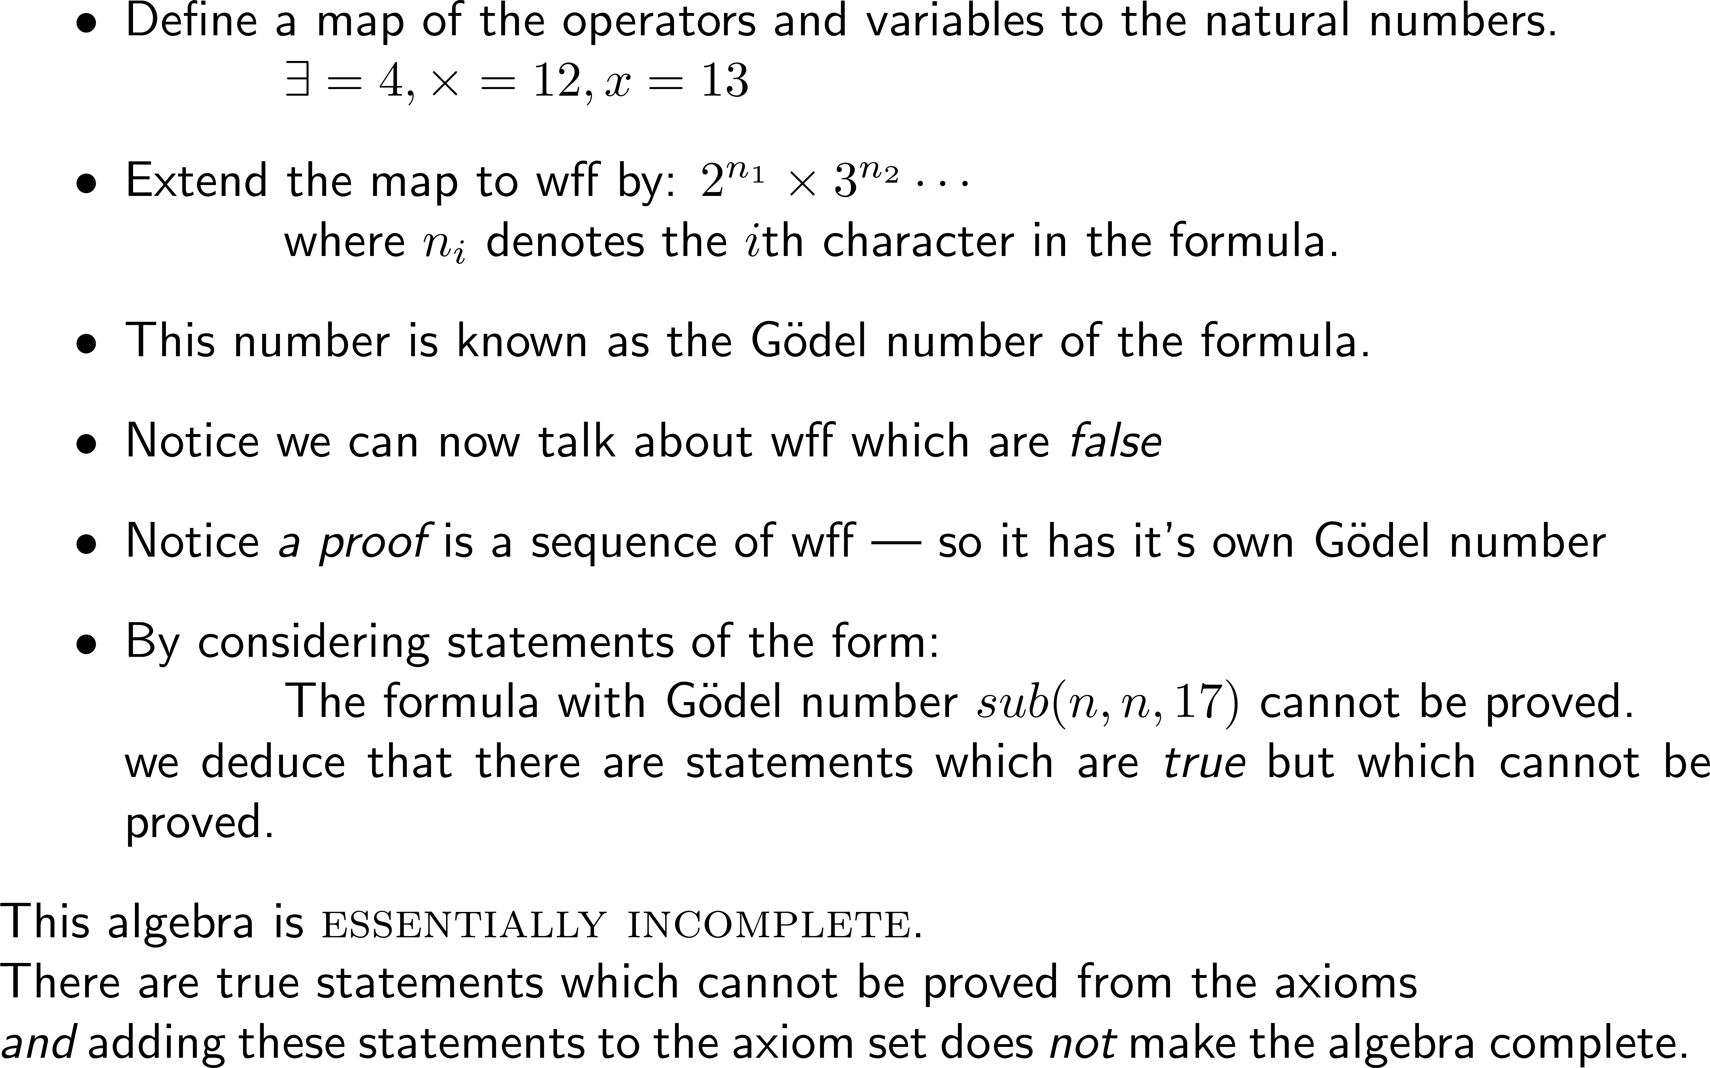
The search for completeness and solvability
Notes:
https://ima.org.uk/29760/historical-notes-the-rise-and-fall-of-the-consistency-programme/

