Slide 1
Anti-icing Capability
in ICECREMO

Slide 2
Contents
Objective of the anti-icing module
Main features
Water Film Flow under shear stress on a flat substrate
Flat substrate under uniform heat input: Q=20kW/m²
NACA0012 under uniform heat input: Q=40kW/m²
NACA0012 under uniform heat input: Q=10kW/m²

Slide 3
Work in progress
Potential extensions

Slide 4
Objective of the anti-icing module
Allows the user to perform the required tests in order to optimise the heater mat distribution in an anti-icing system
Main features
Heat conduction in the substrate is coupled to the flow and evaporation of the water film
Explicit integration with respect to time is used
Temperature in the substrate can be updated at intervals of several time steps of the film flow calculation

Slide 5
There are two possibilities for the modelling of heat input from the anti-icing equipment:
- prescribed heat flux (kW/m²)
- convection with hot air
(air temperature + heat transfer coefficient)
An interactive capability for generating heater zones is available

Slide 6
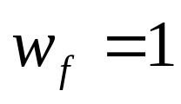
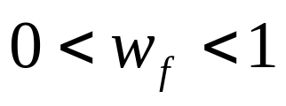
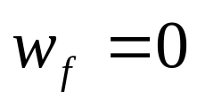
On the top surface of the substrate boundary conditions depend on the wettedness factor w_{f}
- wet region under impingement
- wet region, no impingement
- dry region
Heat balance at the surface of the substrate:

Slide 7
Two approaches are available for the integration of the transient heat conduction in the system substrate-water film
- Semi-analytical:
ignores convection of heat by the film flow
Discretisation of the water film:
convection taken into account (more time- consuming)

Slide 8
The substrate mesh is extruded over the substrate thickness along the normals to the nodes of the surface mesh
- Several mesh layers can be generated over the substrate thickness
- Currently, the substrate material is assumed homogeneous

Slide 9
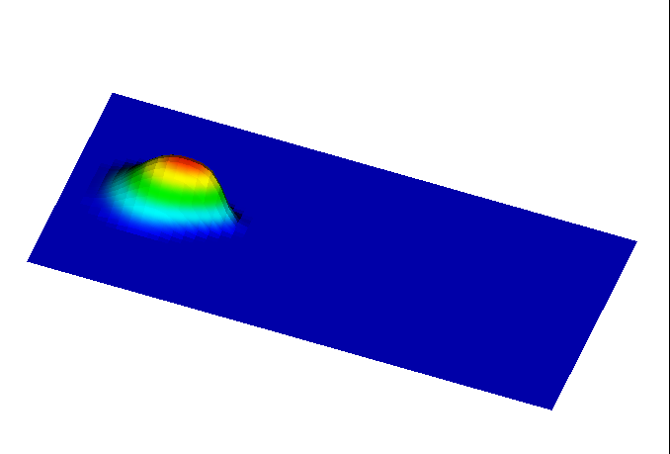
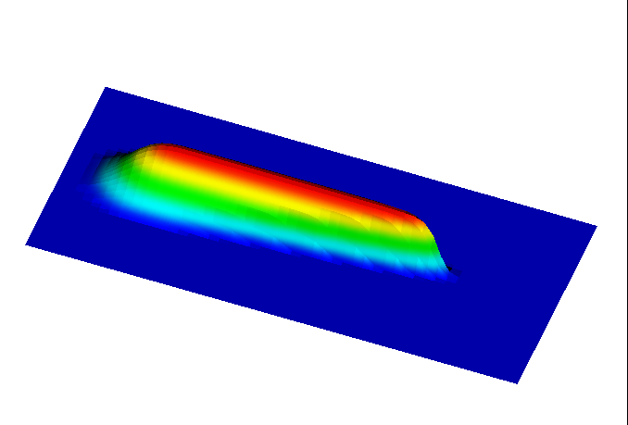
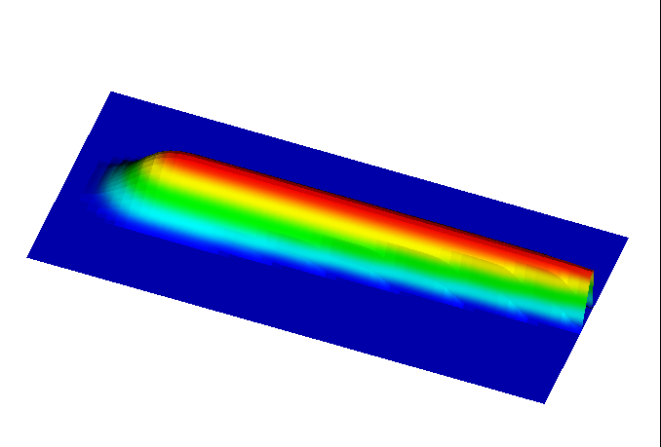
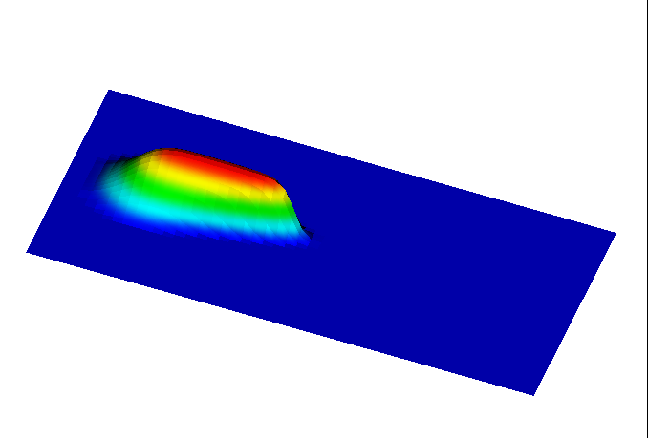
Water Film Flow under shear stress on a flat substrate
t=5s
h=0.120mm
h=0.126mm
t=20s
t=10s
h=0.126mm
t=30s
h=0.126mm

Slide 10
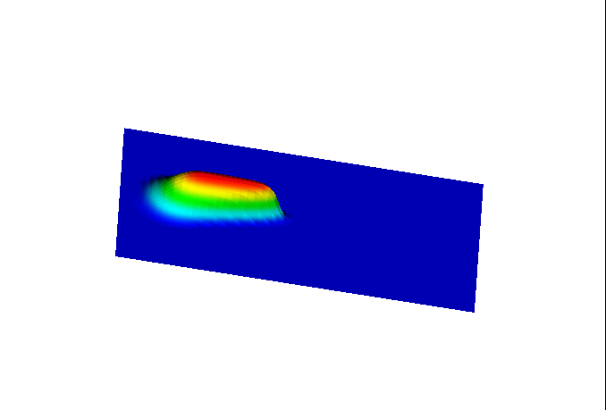
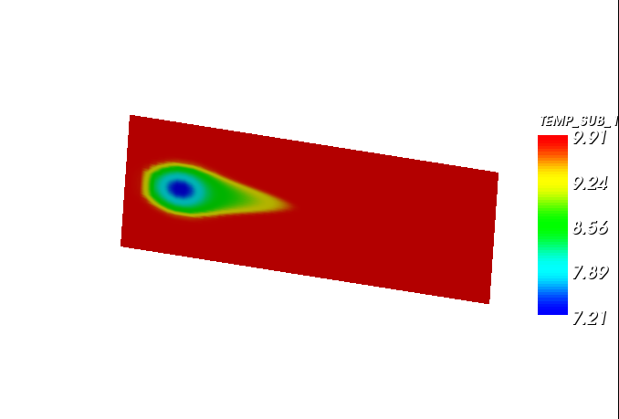
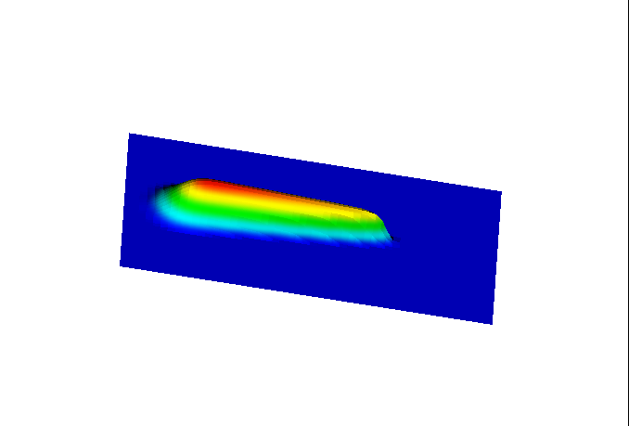
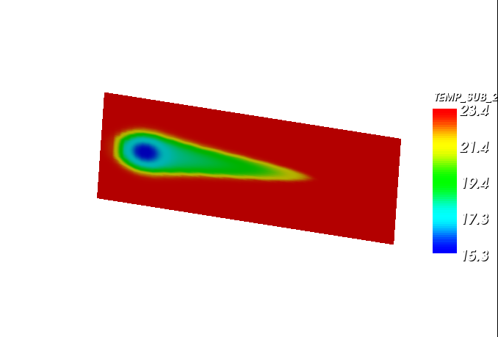
Flat substrate under uniform heat input: Q=20kW/m²
t=10s
h_{max}=0.122mm
t=20s
h_{max}=0.122mm

Slide 11
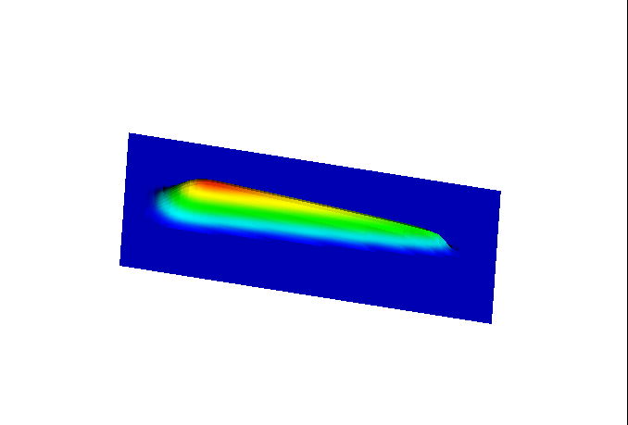
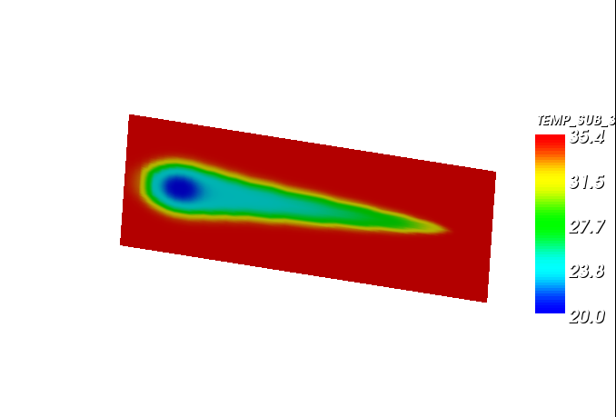
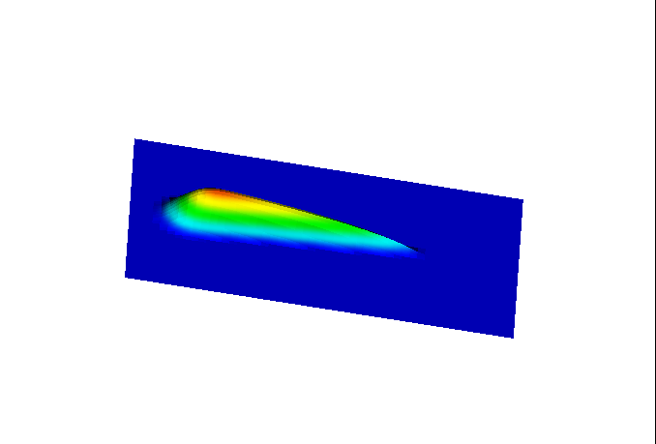
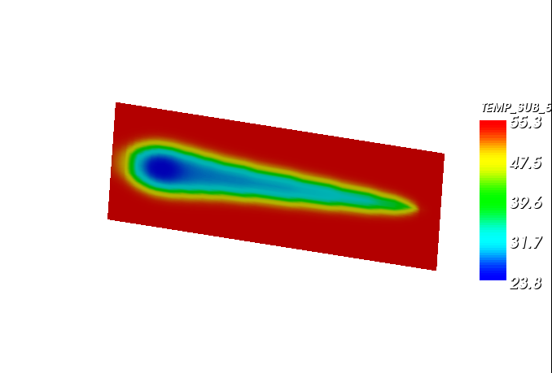
t=30s
h_{max}=0.122mm
t=50s
h_{max}=0.122mm

Slide 12
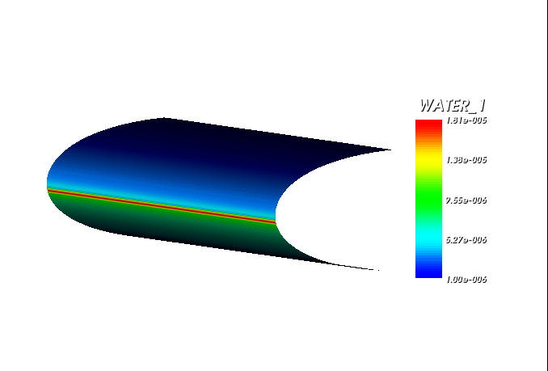
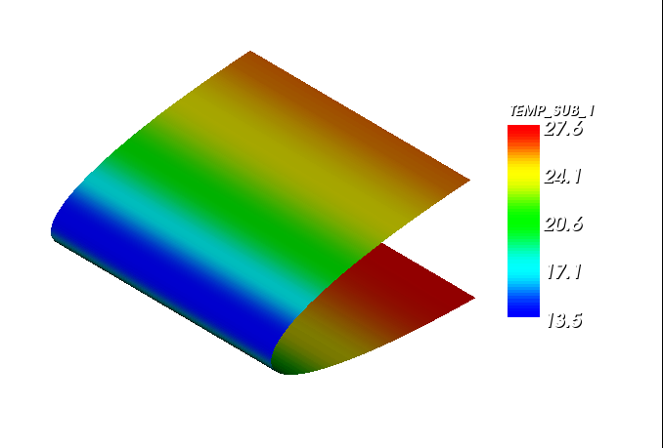
NACA0012 under uniform heat input: Q=40kW/m²

Slide 13
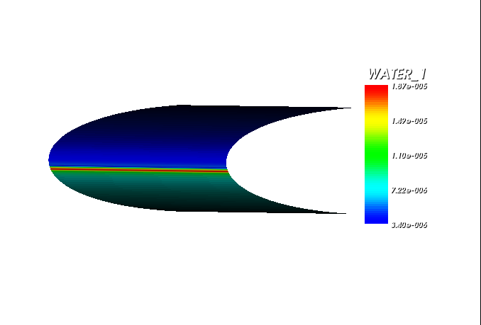
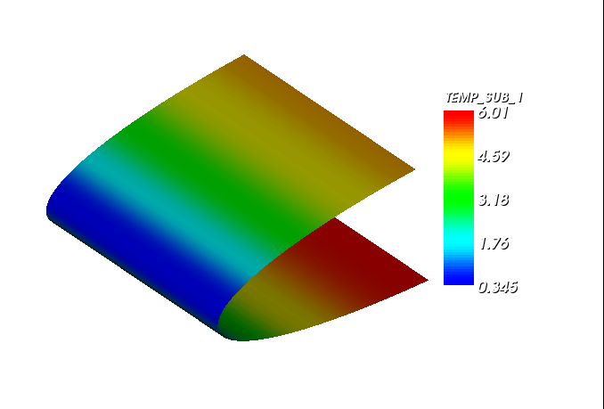
NACA0012 under uniform heat input: Q=10kW/m²

Slide 14
Work in progress
Validation against experimental tests performed at the Cranfield University icing tunnel
Implementation of a de-icing module which allows for ice accretion and melting

Slide 15
Potential extensions
Modelling of the substrate as a composite material
Heat sources applied at individual layers within the substrate
Computation of the wettedness factor based on the modelling of the formation of rivulets
Implicit integration of the heat conduction in the system substrate-water-ice with the possibility to keep the film flow integration explicit

