Slide 1
CRANFIELD UNIVERSITY
Applied Mathematics and Computing Group (AMAC)
Multi-stepping procedure
ICECREMO
Patrick Verdin & Chris Thompson
Bristol, 27 February 2006

Slide 2
Review Multi-stepping
ICECREMO 1
    Procedure successfully implemented
    Fully automated
    UNIX operating system
    Language: FORTRAN77
    Criterion for Restart based on Time

Slide 3
ALGORITHM ICECREMO1
Start
Define Substrate
Create Mesh (GAMBIT)
Geometry
Update
Solve Flow (FLUENT)
Int. FLUENT/ICECREMO1
yes
Predict Ice (ICECREMO1)
Multi-step
Restart File
no
End

Slide 4
Limitations Multi-Stepping Procedure
ICECREMO 1
    Slow process (mesh, flow, interface Fluent/Icecremo)
    Difficulties to set-up droplets starting point
    Problems with the particle tracking routine (SPLAT)
    Difficulties with the automatic re-meshing in GAMBIT
    No update of the water height between steps
    No update of the surface temperature

Slide 5

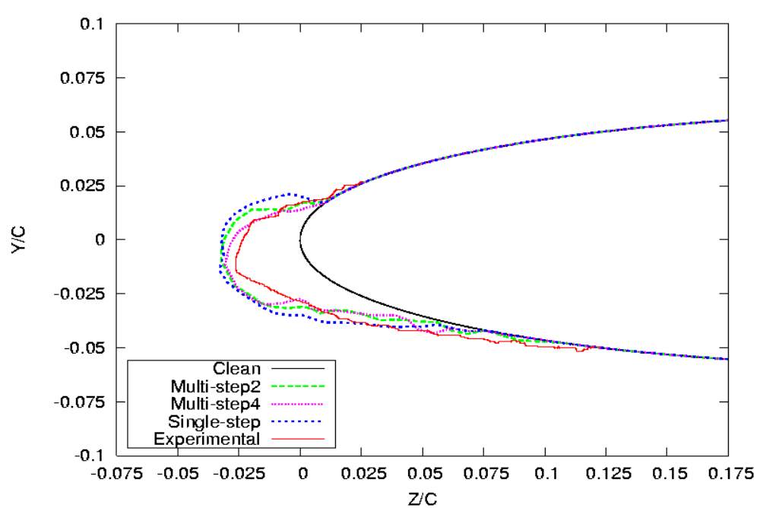
NACA 0012 – Ts = -26 C – Texp = 6min

Slide 6
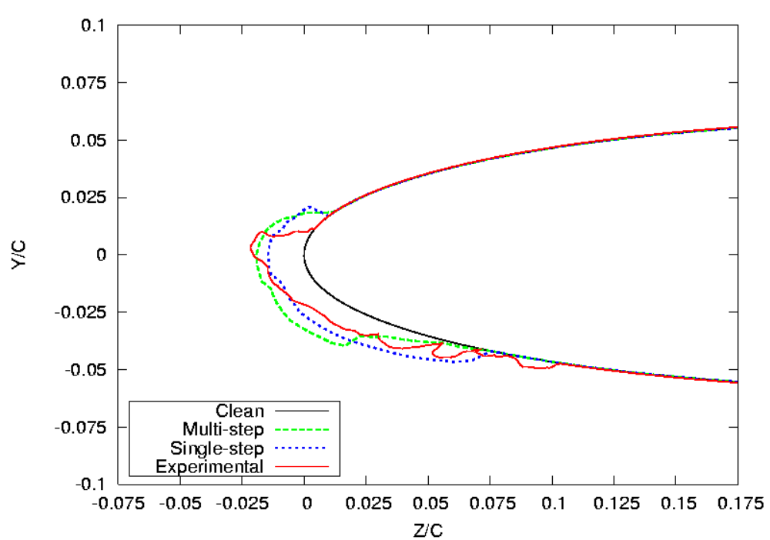
NACA 0012 – Ts = - 5.6 C – Texp = 6 min – 3 steps

Slide 7
Conclusion
Multi-stepping ICECREMO 1
    Results encouraging
    Validation report written
    Problems identified and addressed in unstructured version:
        Improve meshing and re-meshing
        Update water and ice heights, surface temperature between the steps
        Define criterion trigger new flow calculation
        Speed-up multi-stepping procedure

Slide 8
Review Multi-stepping
ICECREMO 2
    Two procedures successfully implemented
      Restart with flow update
      Restart without flow update (internal process)
    Fully automated
    Linux operating system
    Languages: C++ / Fortran
    3 criteria for Restart based on:
      Time (time-step defined by user)
      Ice height (ice height max defined by user)
      Automatic (determined automatically and based
      on chord length or cylinder diameter)

Slide 9
Start
ALGORITHM ICECREMO2
Define Substrate
Multi-stepping with Flow Update
Create Mesh (GAMBIT)
Geometry
Update
Solve Flow (FLUENT)
Predict Ice (ICECREMO2)
Temperature Update
Water height Update
yes
Multi-Step
Restart File
no
Internal Multi-stepping (same Flow)
End

Slide 10
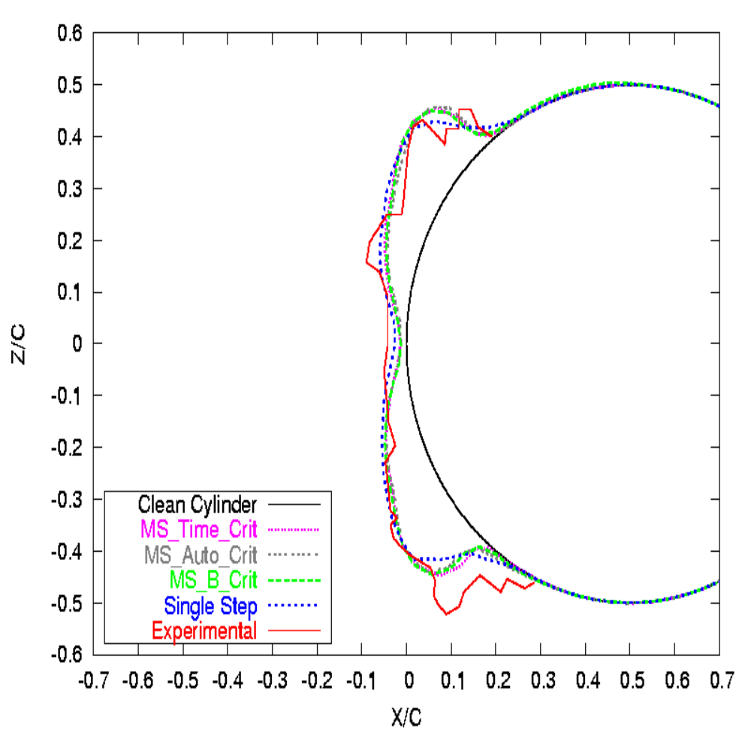
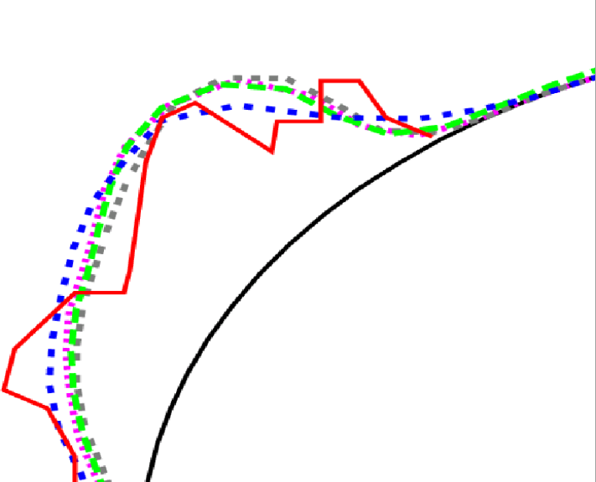
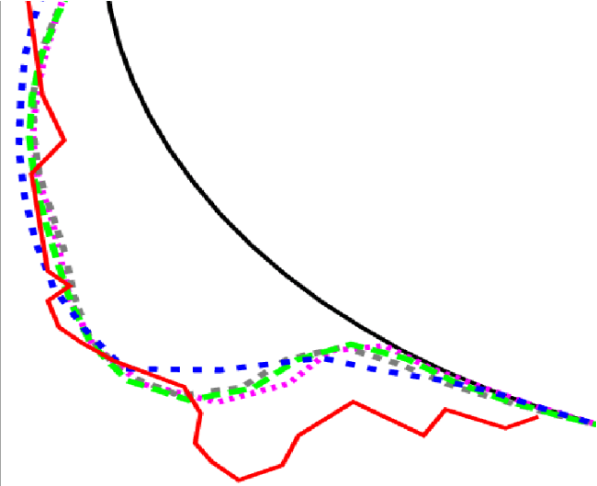
CASE O5 - NATO/RTO – Ts=270.2K – Texp=330 s
Time crit: 20 steps
Ice crit: 10 steps
Auto crit: 20 steps

Slide 11
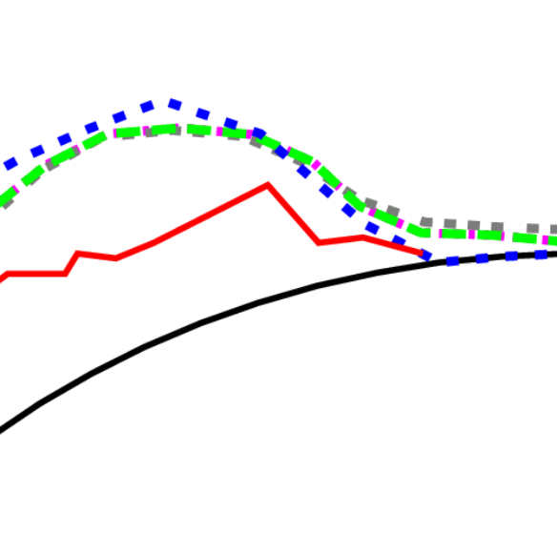
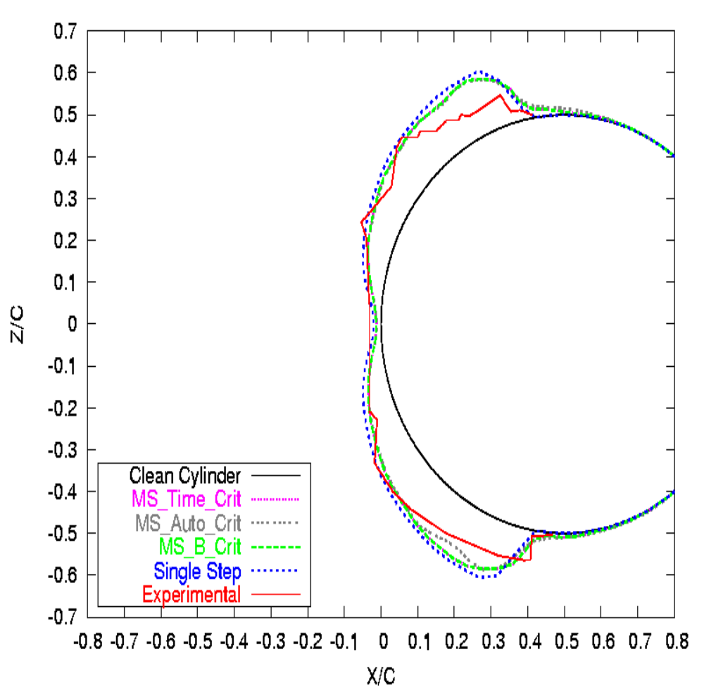
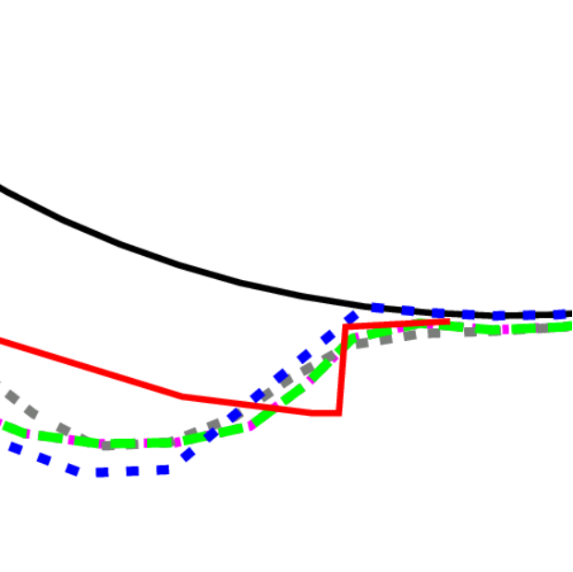
CASE O6 - NATO/RTO – Ts=270.6K Texp=330s
Time crit: 20 steps
Ice crit: 10 steps
Auto crit: 17 steps

Slide 12
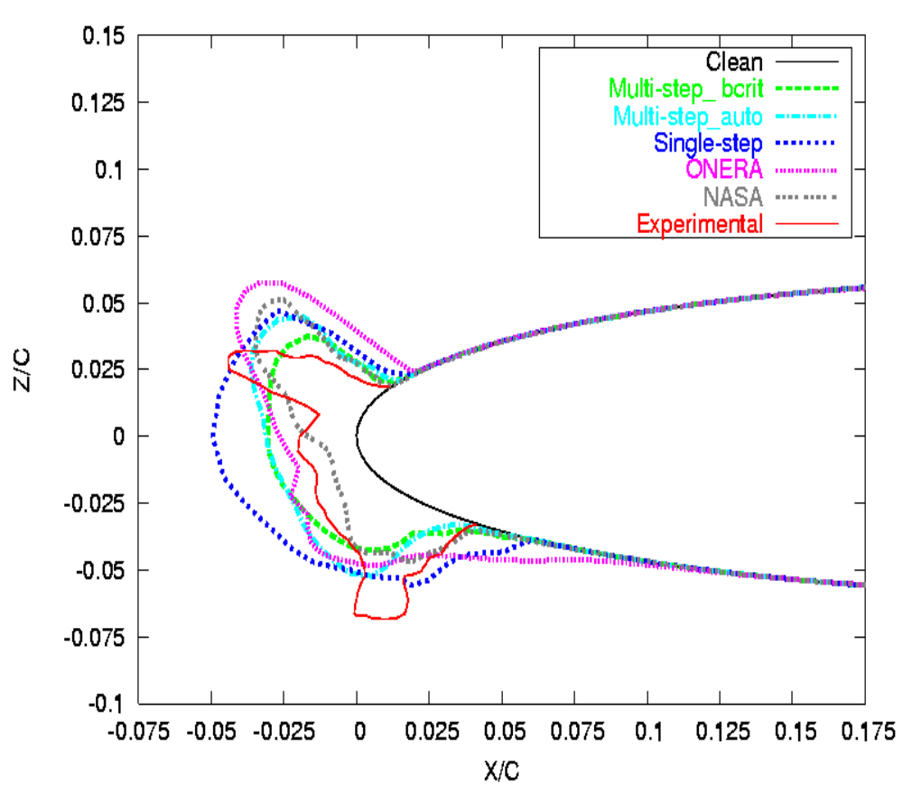
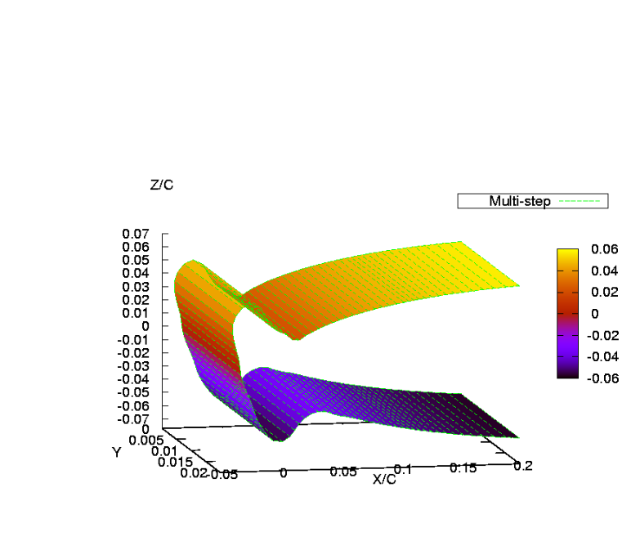
NACA 0012 - NATO/RTO - C17 – Ts= -7 C – Texp=20min
Ice crit: 4 steps
Auto crit:10 steps

Slide 13
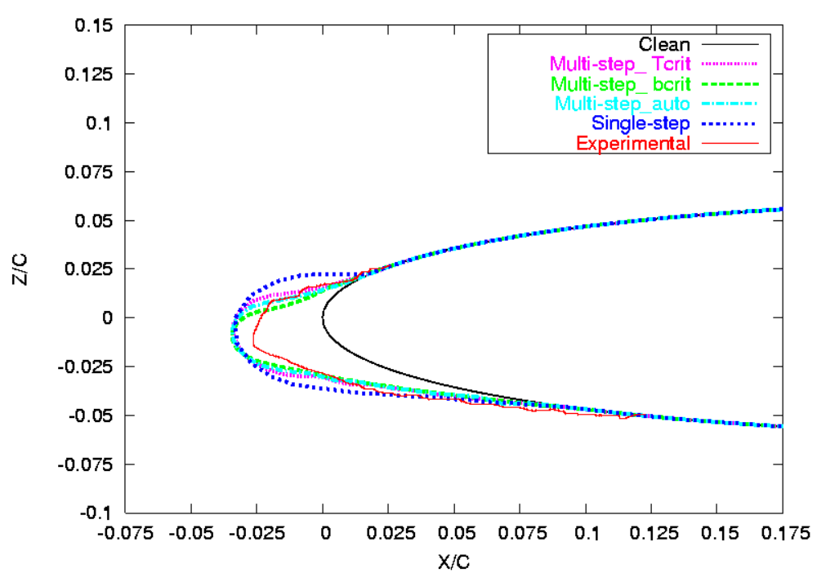
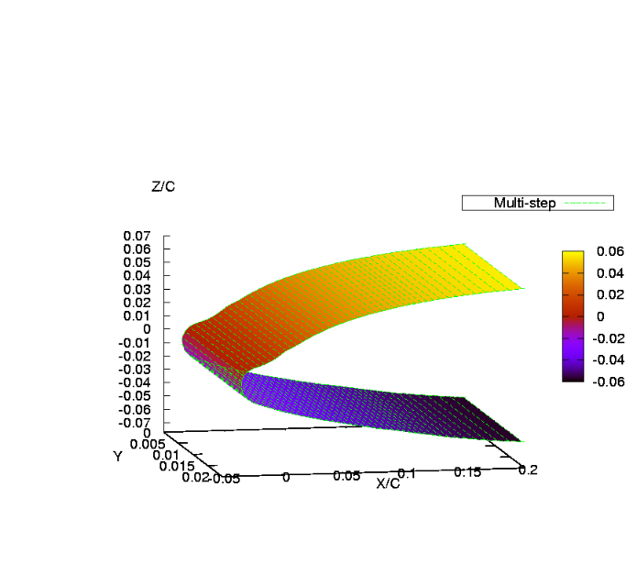
NACA0012 – Ts = -26 C – Texp = 6min
Time crit: 3 steps
Ice crit: 20 steps
Auto crit: 6 steps

Slide 14
Limitations Multi-Stepping Procedure
ICECREMO 2
    Current procedure limited to cylinders and airfoils studies
    Loss of precision due to the interpolation Faces/Nodes for multi-stepping with Flow update
    Solving grid has to be structured (rectangles) due to Gambit’s limitations
    Procedure only adapted to CFD suite FLUENT

Slide 15
Conclusion
Multi-stepping ICECREMO 2
Implementation successful
Fully automated
Problems from structured version fixed:
  Improved automated process
  Updates of water and ice heights
  Update of surface temperature
  3 Criteria trigger new flow calculation
      Automatic criterion appeared to produce the most accurate results
  Good validation results
  Software delivered August 2005
  User-Guide written

Slide 16
Potential Future Work
Multi-stepping ICECREMO 2
    Coupling with de-icing procedure
    Coupling with adaptive mesh refinement
    Adapt to other geometries
    Adapt to other CFD packages
    Speed-up the whole procedure using parallel calculations

