Slide 1
Developments in the prediction
of Aircraft Icing
Professor Chris Thompson
Applied Mathematics and Computing (AMAC)
Dr Patrick Verdin
Dr Karl Jenkins
Dr Yves Soufflet
Naveed Akram
Power and Propulsion
Dr David Hammond
Notes:
This is us ...

Slide 2
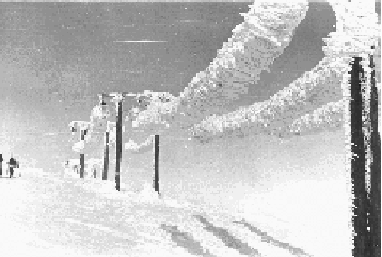
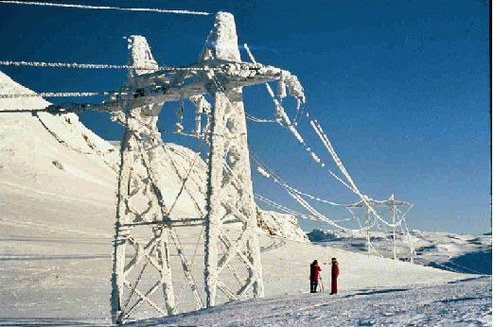
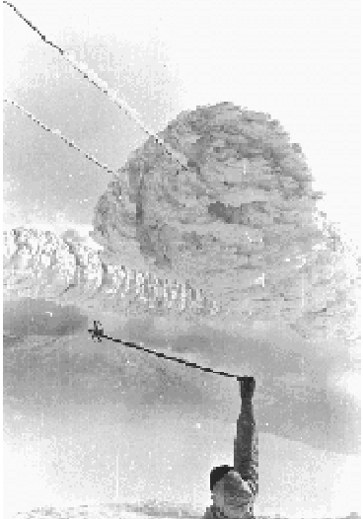
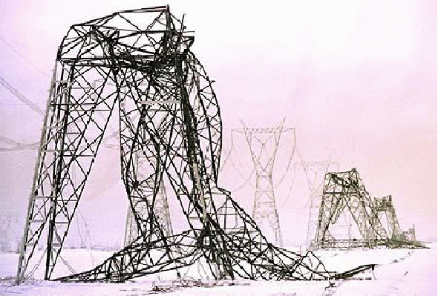
AMAC modelling research activities
Structural icing
Pylons in
Norway and
Canada
Iced power supply
for TV mast in
Norway
Notes:
Structural accretion is a major problem - the Great Ice Storm in Canada 1998 caused over Ca$2 billion worth of damage.
Possible world record ice accretion on cables in Norway, 1961. A 1m section weighed over 500 kilos.
Iced pylons and cables in Norway and Canada. The Canadian one is most likely to have fallen due to interaction between the air flow and the ice accretion - not the ice weight.

Slide 3
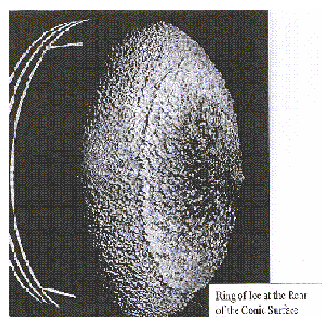
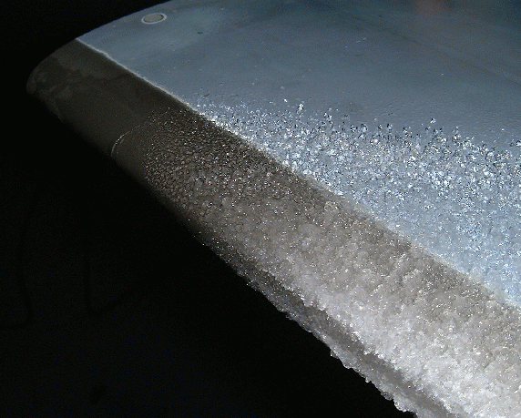

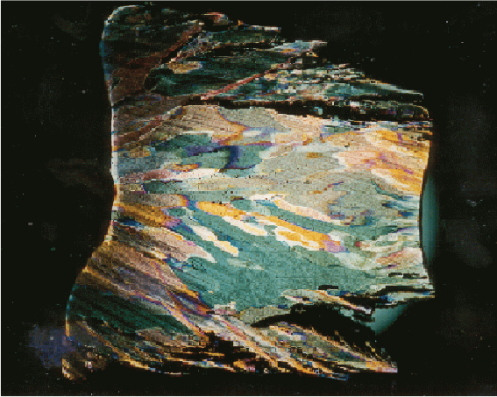
Aircraft icing
Spinner from turbofan
engine
Aerofoil leading
edge
Helicopter engine
inlet scoop
Thin section
of ice
Notes:
Aircraft icing is more difficult to record than structural icing. It is much thinner - a 0.4mm accretion at the leading edge of the an aerofoil may reduce lift by 25%.
Ice on spinners and engine inlets is likely to break off and damage downstream components.
This aerofoil is in icing windtunnel - these are cheaper and safer than inflight testing but still v. expensive - Rolls-Royce tunnel cost 20,000 pounds an hour on average tunnels cost this per day.
Thin section is taken from an aerofoil with a strong polarised light behind - this shows the ice crystal structure.

Slide 4
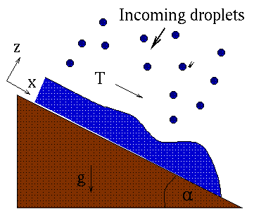
Examples Thin film flows
Coating, painting, viscous flow
Drying
Aircraft icing
Lubrication
Notes:
Thin films appear in numerous industrial problems - in particular coating applications. We have used it in projects on leakage in pumps, water motion on turbofan blades, motion of radioactive waste in cracks in clay, compact heat exchangers and aircraft icing.
The figure shows a typical confguration for fluid moving over dry surface.

Slide 5
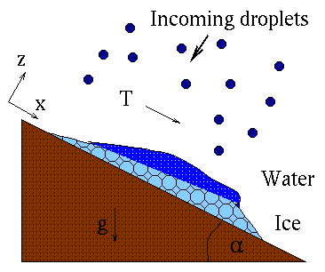
Phase change with flow
Aircraft/structural icing
Evaporation
Hydrate build-up in pipelines
Lava flow
Notes:
Phase change problems with flow arise in ... see list. We have investigated ice accretion on aircraft, evaporation due to anti-icing systems, condensation in heat exchangers and waxing of oil pipelines. Our main project is ICECREMO and industrial collaboration with BAE, Rolls-Royce, GKN-Westland Helicopters, DERA and Dunlop Aviation - to develop a 3D aircraft icing code. We produced all the icing and water flow models, the code subroutines and carried out a lot of the testing. The code is now being used commercially.

Slide 6
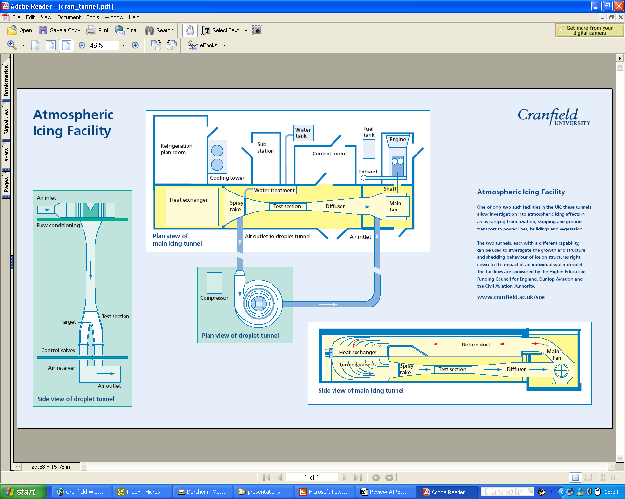

Slide 7
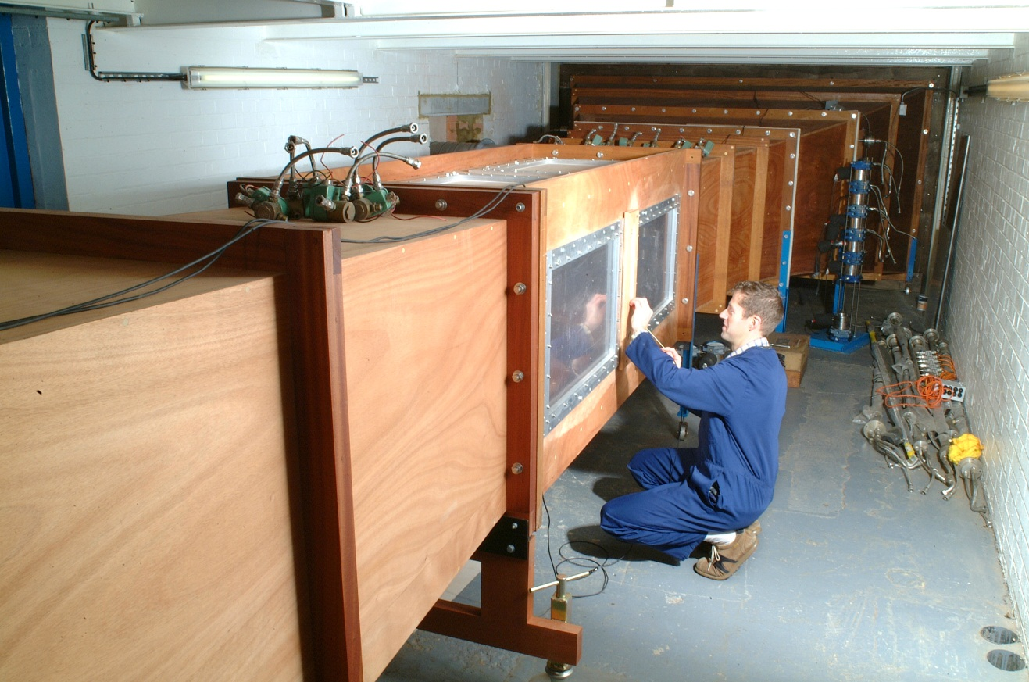
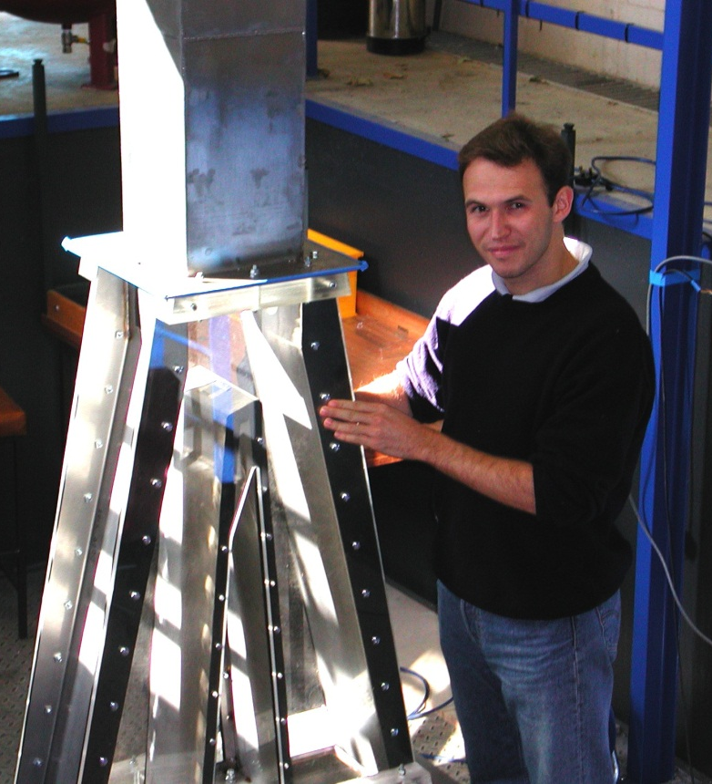
Icing Facilities at Cranfield
Vertical Icing Tunnel
216 x 216 working section
Mach 0.4
100 KW cooling capacity
+ 30 to − 40 ºC (total)
SLD friendly shape
Mono dispersed droplets
Main Icing Tunnel
761 x 761 mm main section
Mach 0.4
500 KW cooling capacity
+ 30 to – 40 ºC (total)
SLD friendly shape
Range of nozzles

Slide 8

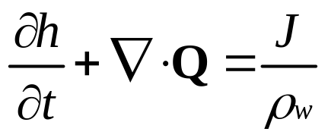
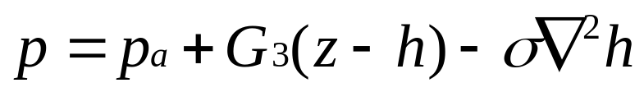
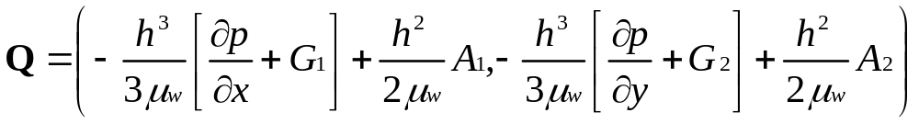
Thin film flows
Mass balance
Fluid film height
Incoming mass rate
Fluid density
Gravity component
Fluid pressure
Surface tension
Fluid viscosity
Air shear stress
Fluid flux
Notes:
Since the film is thin the governing equations for flow may be simplified considerably.
The problem is governed by a single equation for the fluid film height. Solving this allows fluid velocities and pressure to be obtained.

Slide 9
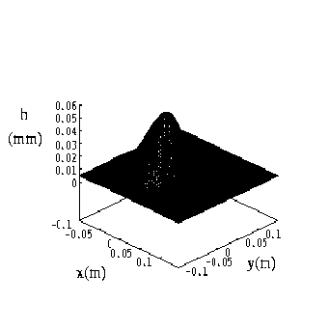
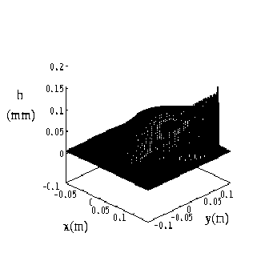
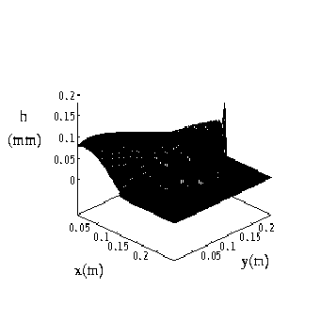
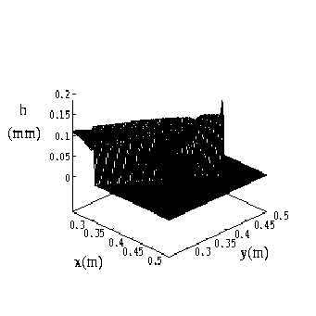
Thin film flow
Fluid layer developing from an incoming
Gaussian source near x=0, at times t=1,5,7,15s.
Air shear is the main driving force.
Notes:
The figures show the evolution of a water film from an incoming Gaussian (exp(-x^2+y^2)) fluid source (i.e. rain). Initially the water is too thin to notice the overlying air flow, subsequently it is pushed along. A ridge forms at the front which finally breaks free and flows as a rivulet ahead of the bulk fluid.
Note the scale is mm and m.

Slide 10
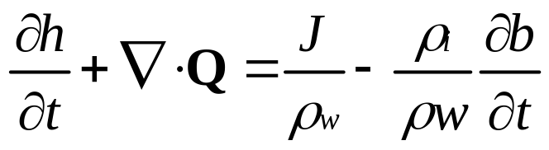
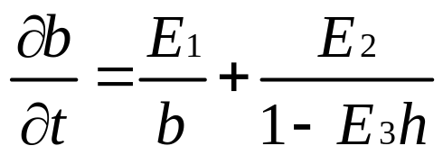
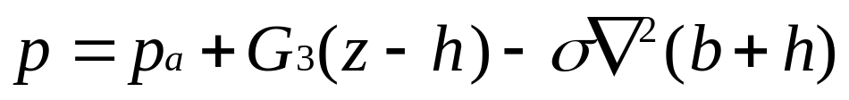
Phase change with flow
Mass balance
Fluid film height
Solid height
Fluid flux
Incoming mass rate
Energy balance
Fluid density
Energy coefficient
Gravity component
Fluid pressure
Surface tension
Notes:
The problem is governed by coupled mass and energy balances to determine the solid and water layer heights. We assume the water layer is thin so the thin film theory is applicable. The models are therefore applicable for structural and aircraft icing, but not for icing large bodies such as lakes.

Slide 11
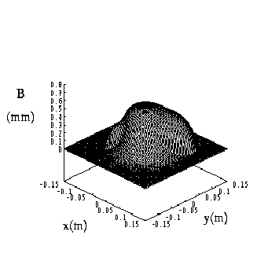
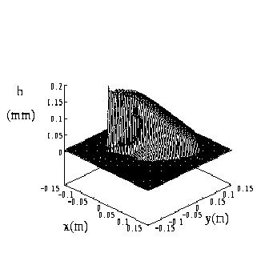
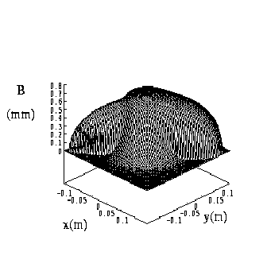
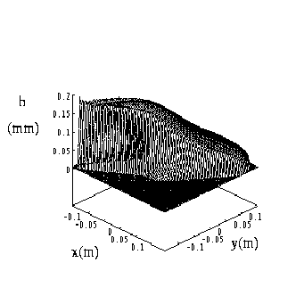
Phase change with flow
Ice
Water
Ice
Water
Ice accretion from incoming
Gaussian fluid source, t=30,60s.
Gravity and air shear driving flow.
Notes:
Fluid enters near x=0 and builds up mainly here. The bumps at the side are due to air shear and gravity driven water flow. The water layer is also shown.

Slide 12
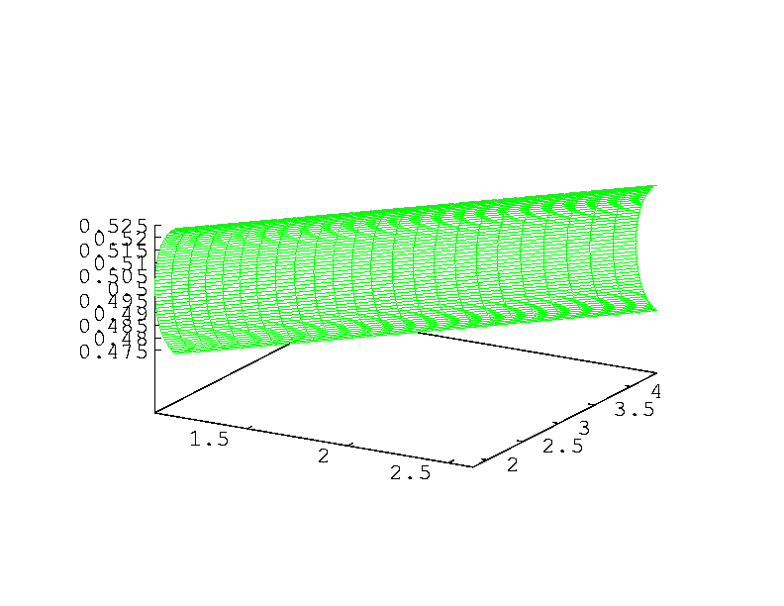
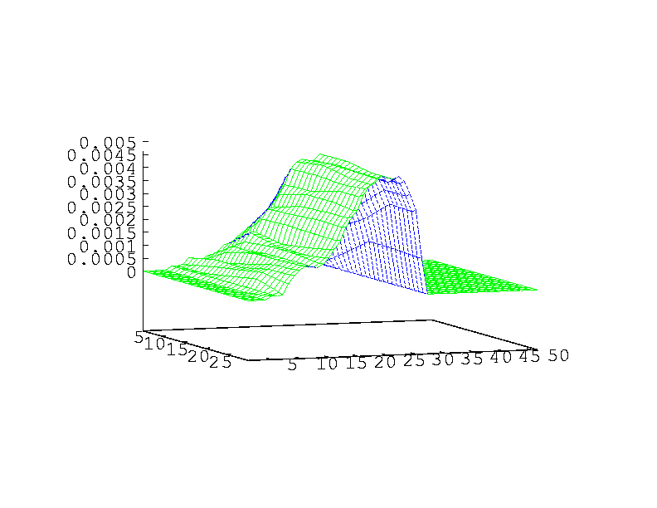
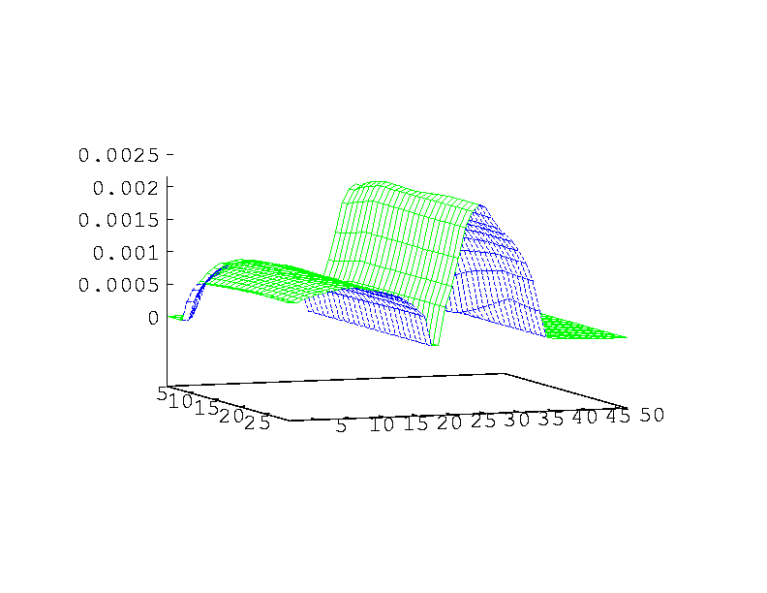
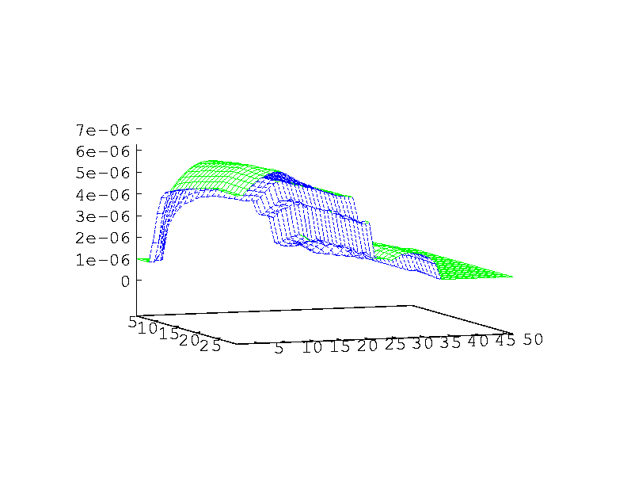
Aircraft icing
Swept wing
Rime ice accretion
Glaze ice accretion
Water layer
Notes:
Results from ICECREMO program. Swept wing geometry.
In cold weather rime ice forms. The figure shows the rime ice shape that would form (with the wing surface unwrapped for clarity), however the program is run at a relatively high temperature and glaze ice forms (this has a water layer on top). The true ice shape is significantly different to the rime ice one. It is half the height and has ice horns (which are seen in practice), the water layer is also shown.

Slide 13
Aircraft icing
Aerofoil leading
edge
Thin section of ice:
Note rime ice region
Notes:
Aircraft icing is more difficult to record than structural icing. It is much thinner - a 0.4mm accretion at the leading edge of the an aerofoil may reduce lift by 25%.
Ice on spinners and engine inlets is likely to break off and damage downstream components.
This aerofoil is in icing windtunnel - these are cheaper and safer than inflight testing but still v. expensive - Rolls-Royce tunnel cost 20,000 pounds an hour on average tunnels cost this per day.
Thin section is taken from an aerofoil with a strong polarised light behind - this shows the ice crystal structure.

Slide 14
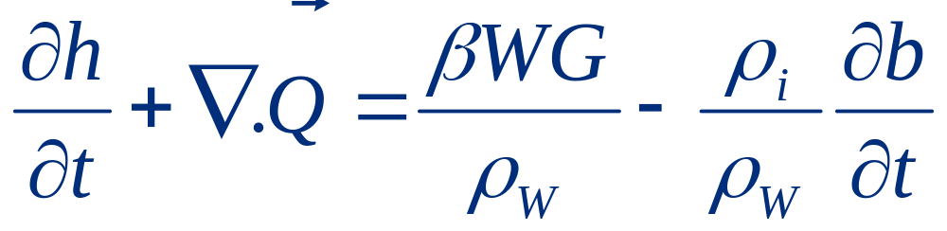
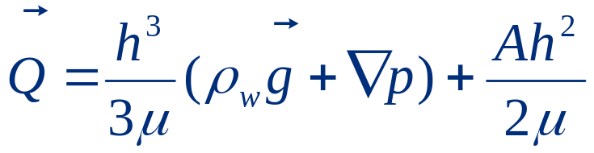
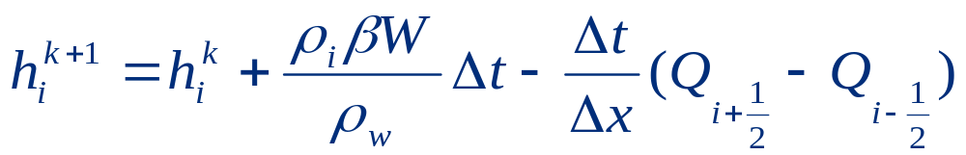
Icing model
Equation modelling the ice growth and the water flux:
Where:
Conservative scheme:
(explicit)

Slide 15
Error control - Objectives
Enhance robustness of code
  Stability
Improve accuracy
Provide error control
Fully automatic

Slide 16
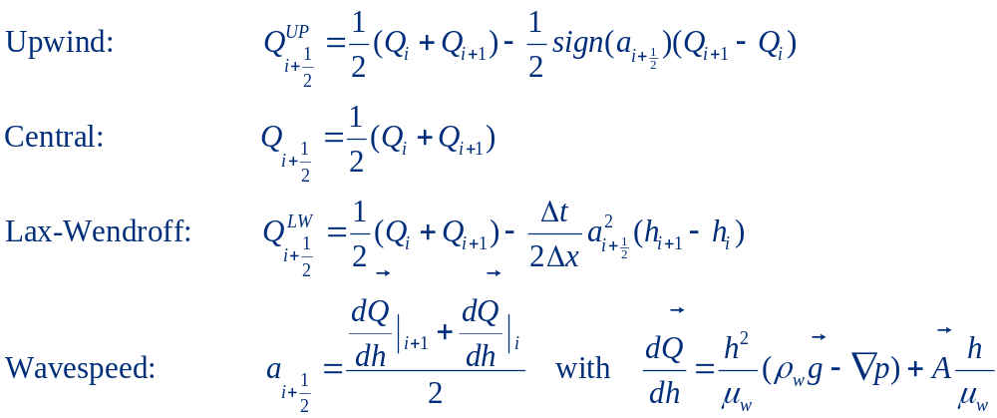
Numerical Schemes:

Slide 17
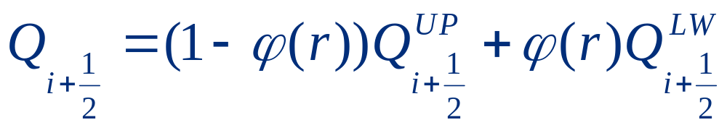
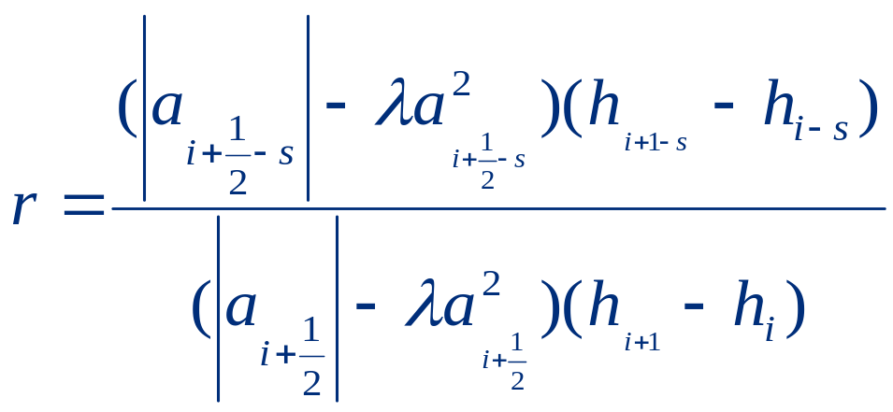
Flux Limiter
Superbee limiter:
      with :
and:

Slide 18
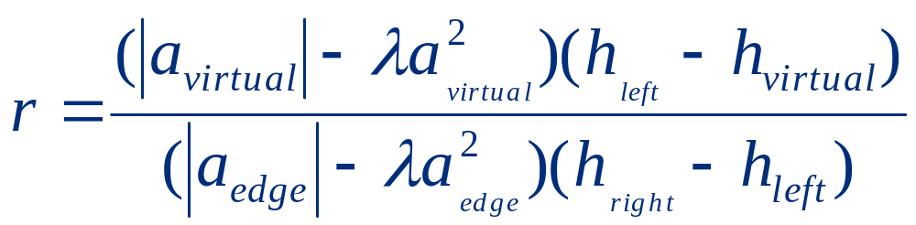
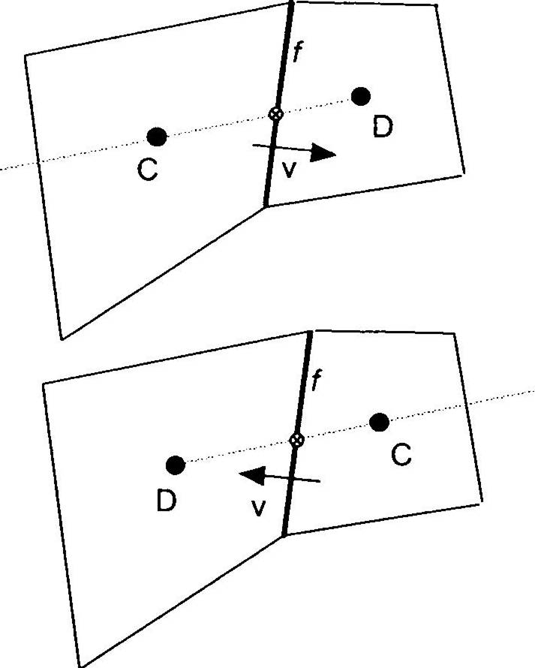
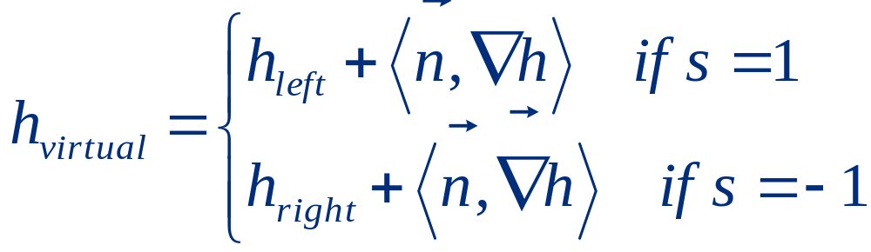
Unstructured formulation
Edge-based formulation: (case where s=1)
Estimation of h:

Slide 19
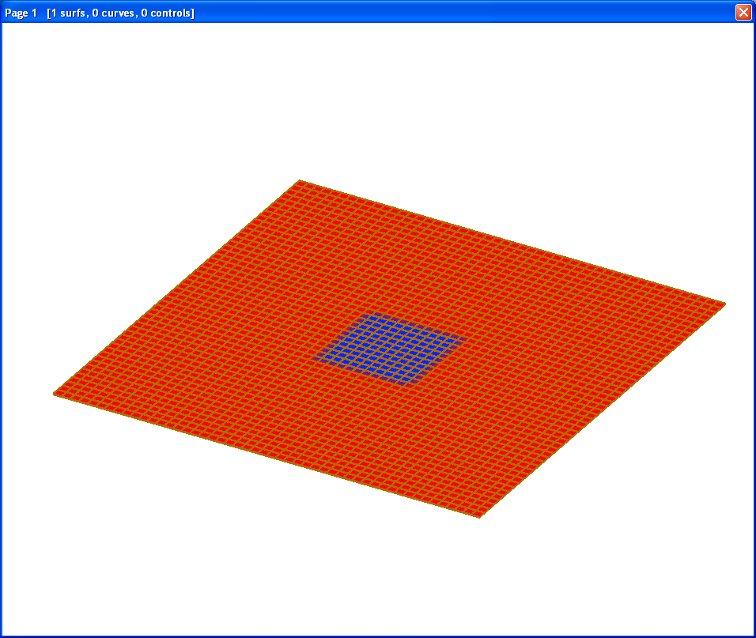
Rotation (Press)
W=200 rads/sec
Upwind – unstable
Central – unstable
Lax-Wendroff – OK?

Slide 20
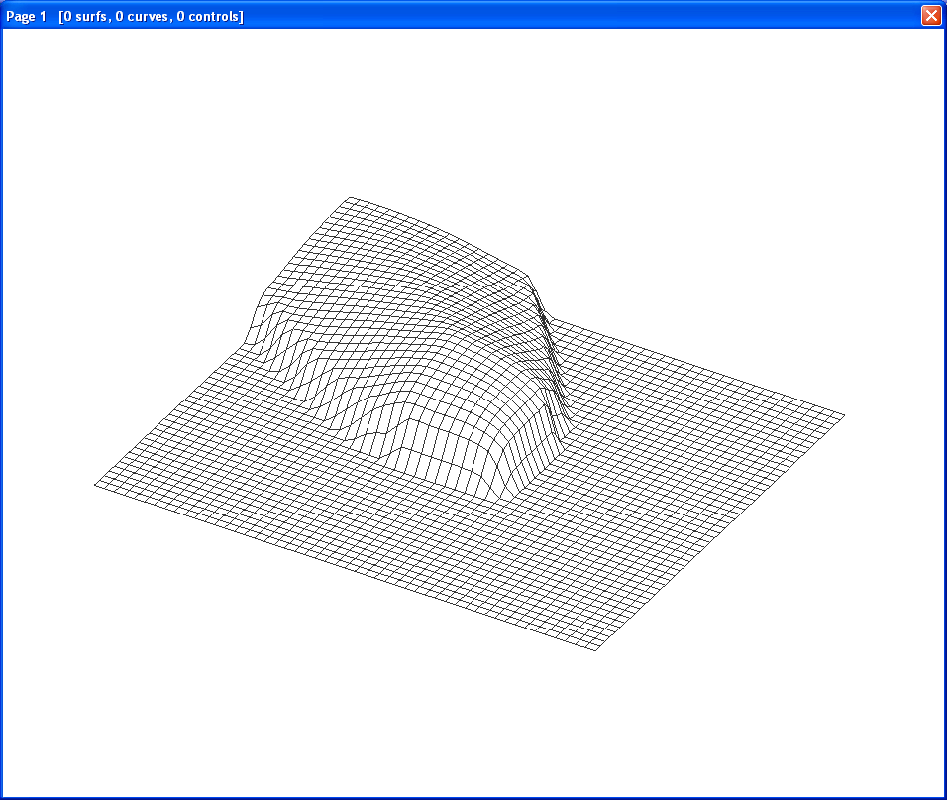
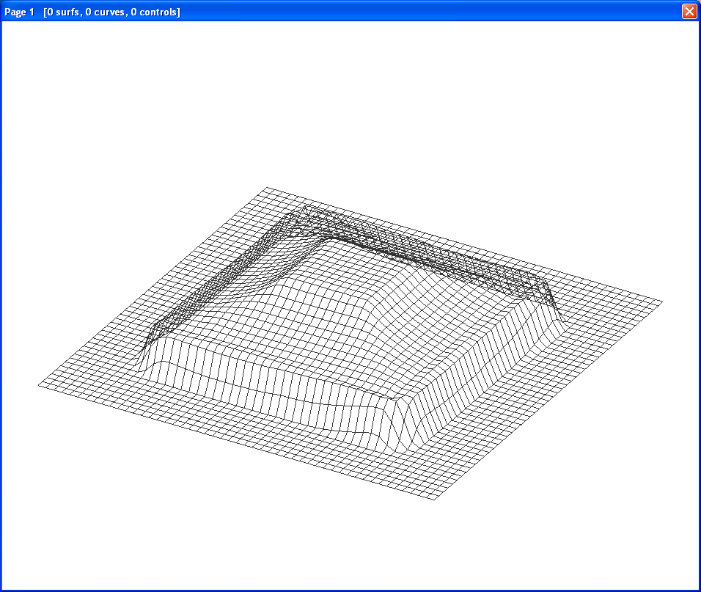
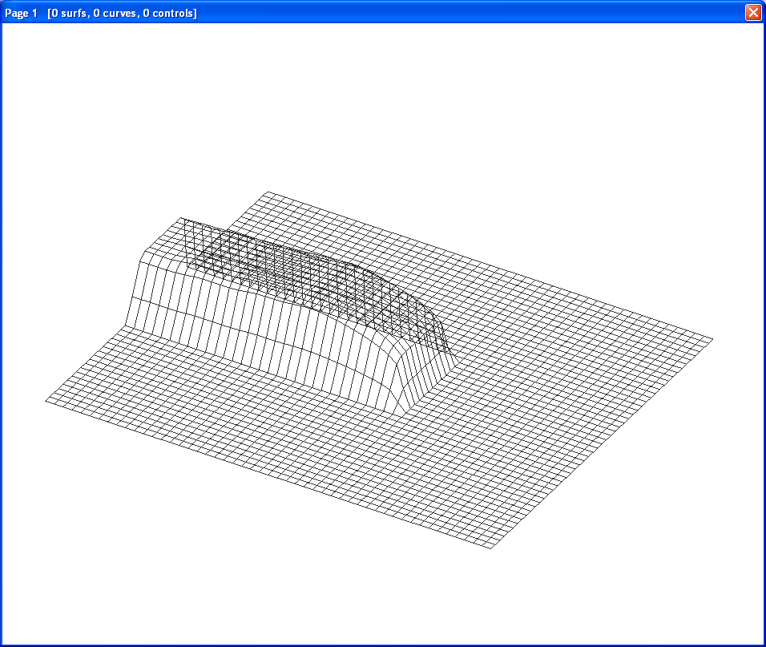
Rotation results
Film heights are
~15-20 microns

Slide 21
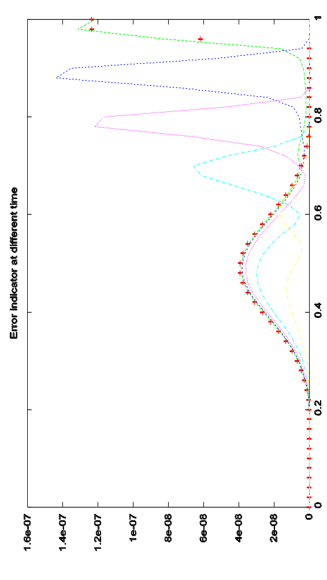
Error estimation: dual discretisation
Numerical schemes:
  Lax-Wendroff + Flux limiter O(h²)
  Upwind O(h)
  Error estimator based on dual discretisation
  Detects advancing
  fronts

Slide 22
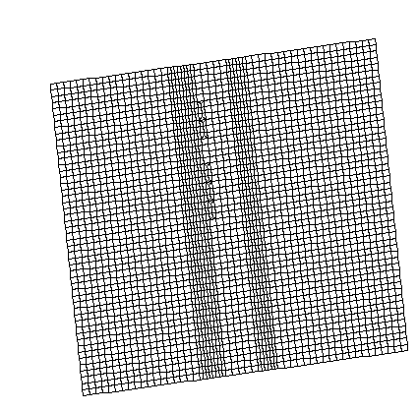
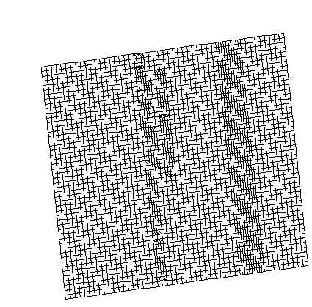
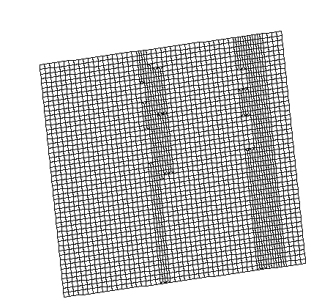
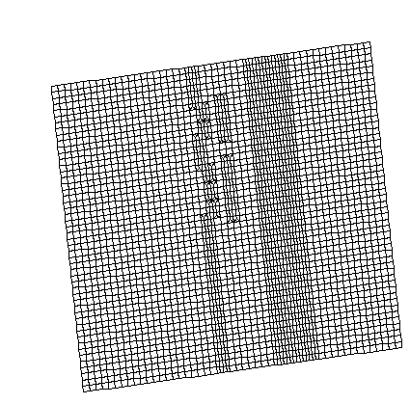
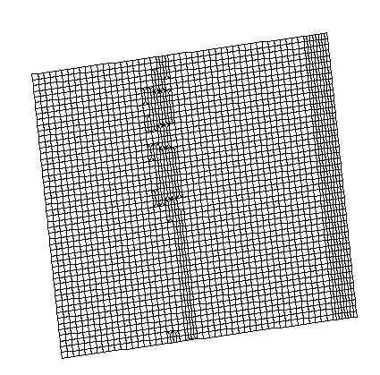
Refined Grid
Advancing with Front

Slide 23
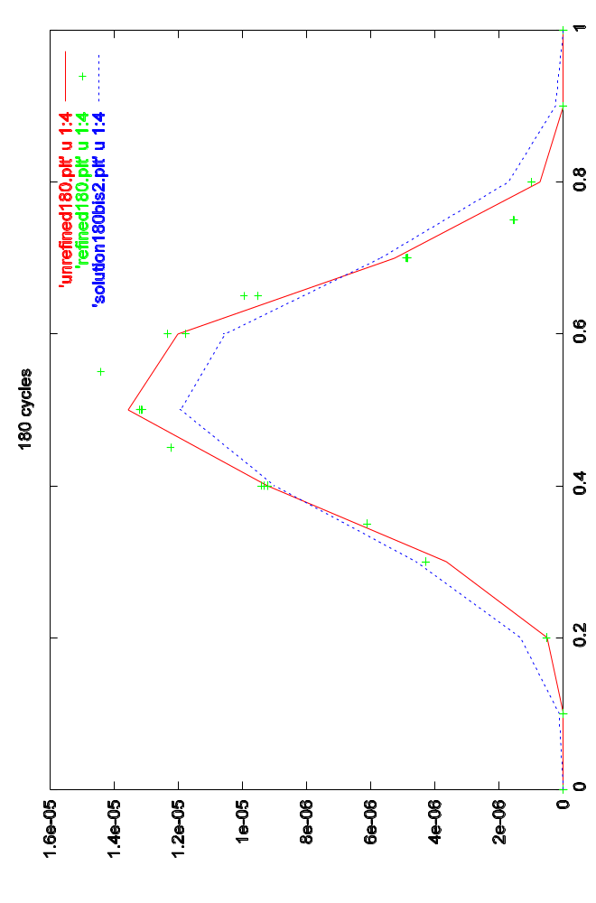

Smart inter-grid interpolation scheme

Slide 24


Coarse/fine/adapted solutions

Slide 25
L-times
Error Estimator
Base Grid B
B
Edge subdivision
V (B)
Interpolate
Variables
New (Refined) Grid G_{N+1}
G_{N+1}
V (G_{N})
Next time-step
Current (Refined) Grid G_{N}
V (G_{N+1})
V (G_{N})
Interpolate
Variables
Accuracy
Failure
Grid refinement & coarsening

Slide 26
Error Control : Results
    Good accuracy achieved comparing coarse/adapted/fine calculations.
    Good recovery of fine-scale features after coarsening and refinement.
    Improved mesh structures after refinement.
    Arbitrary levels of refinement (de-refinement to base grid)

Slide 27


Icing on Cylinder
Results before the water film reach the steady state.
Result after a long exposure time

Slide 28

Refinement

Slide 29

Refinement criterion based on the gradient of b (ice height)

Slide 30
Geometry variation:
Multi-stepping methods

Slide 31
Start
Define Substrate
Create Mesh
Solve Flow (CFD)
SINGLE STEP ALGORITHM
Internal CFD ICING
Predict Ice

Slide 32
MULTI-STEP ALGORITHM
Start
Define Substrate
Create Mesh
Geometry
Update
Solve Flow (CFD)
Internal CFD ICING
yes
Predict Ice
Multi-step
Restart File
no
End

Slide 33
Limitations Multi-Stepping Procedure
    Slow process (mesh, flow, interface CFD/Ice Code)
    Difficulties to set-up droplets starting point
    Problems with the particle tracking routine
    Difficulties with the automatic re-meshing
    No update of the water height between steps
    No update of the surface temperature

Slide 34

NACA 0012 – Ts = -26 C – Texp = 6min

Slide 35

NACA 0012 – Ts = - 5.6 C – Texp = 6 min – 3 steps

Slide 36
Start
Multi-stepping with Flow Update
Define Substrate
Create Mesh (GAMBIT)
Geometry
Update
Solve Flow (FLUENT)
Predict Ice (ICECREMO2)
Temperature Update
Water height Update
yes
Multi-Step
Restart File
no
Internal Multi-stepping (same Flow)
End

Slide 37



CASE O5 - NATO/RTO – Ts=270.2K – Texp=330 s
Time crit: 20 steps
Ice crit: 10 steps
Auto crit: 20 steps

Slide 38



CASE O6 - NATO/RTO – Ts=270.6K Texp=330s
Time crit: 20 steps
Ice crit: 10 steps
Auto crit: 17 steps

Slide 39



NACA 0012 - NATO/RTO - C17 – Ts= -7 C – Texp=20min
Ice crit: 4 steps
Auto crit:10 steps

Slide 40


NACA0012 – Ts = -26 C – Texp = 6min
Time crit: 3 steps
Ice crit: 20 steps
Auto crit: 6 steps

Slide 41
Multi-step Ice Accretion Calculation
Advanced updating
As ice accretes on an airfoil it significantly disturbs the smooth flow of air around the airfoil.
Parameters such as the collection efficiency (β), heat transfer coefficient (HTC), velocity field and shear stress are affected and need to be periodically recalculated.
A multi-step ice calculation is where a large ice exposure time is divided into smaller time-steps and the key ice parameters are updated after each time-step.
However, after each time-step the geometry and mesh needs to be updated to account for the accreted ice which is a tedious, time consuming and difficult procedure.

Slide 42
Multi-step Ice Accretion Calculation Without Updating Geometry Or Mesh
Current research entails development of a multi-step ice accretion algorithm without the need to re-mesh the updated iced geometry.
The flow field is calculated using the computational fluid dynamics (CFD) package called OpenFOAM v1.5. The ice shapes are calculated using the icing software called ICECREMO 2.
The original mesh is used for the duration of the ice calculation.
After each time-step the grid cells that are occupied within the ice region are selected and removed from the global mesh. The boundary patches are then updated.

Slide 43


Ice shape
Original mesh and ice shape
Updated geometry and mesh for next time-step

Slide 44


Ice Accretion Study On A Three-Dimensional Wing
Ice shapes were calculated on the DLR-F4 three-dimensional wing at four different span-wise locations.
The purpose of this study is to determine the mass of ice and its affect on aircraft flight as no previous ice accretion studies have been carried out on a three-dimensional wing.

Slide 45

Ice Shapes At Different Span-Wise Locations at 0-Degree AOA

Slide 46

Ice Shapes At Different Span-Wise Locations at 6-Degree AOA

Slide 47
Anti-icing Modelling

Slide 48
Contents
Objective of the anti-icing module
Main features
Water Film Flow under shear stress on a flat substrate
Flat substrate under uniform heat input: Q=20kW/m²
NACA0012 under uniform heat input: Q=40kW/m²
NACA0012 under uniform heat input: Q=10kW/m²

Slide 49





Heat balance in cell - ideal
Cell temperature
Heat amount
Fig. 3.2. Cell temperature in the ice layer as a function of heat supply/release

Slide 50
Heat balance in cell
Cell temperature
Heat amount
Fig. 3.2. Cell temperature in the ice layer as a function of heat supply/release

Slide 51
Objective of the anti-icing module
Allows the user to perform the required tests in order to optimise the heater mat distribution in an anti-icing system
Main features
Heat conduction in the substrate is coupled to the flow and evaporation of the water film
Explicit integration with respect to time is used
Temperature in the substrate can be updated at intervals of several time steps of the film flow calculation

Slide 52
There are two possibilities for the modelling of heat input from the anti-icing equipment:
- prescribed heat flux (kW/m²)
- convection with hot air
(air temperature + heat transfer coefficient)

Slide 53



Partially wetted surfaces
On the top surface of the substrate boundary conditions depend on the wettedness factor w_{f}
- wet region under impingement
- wet region, no impingement
- dry region
Heat balance at the surface of the substrate:

Slide 54
Two approaches are available for the integration of the transient heat conduction in the system substrate-water film
- Semi-analytical:
ignores convection of heat by the film flow
Discretisation of the water film:
convection taken into account (more time- consuming)

Slide 55
The substrate mesh is extruded over the substrate thickness along the normals to the nodes of the surface mesh
- Several mesh layers can be generated over the substrate thickness
- Currently, the substrate material is assumed homogeneous

Slide 56




Water Film Flow under shear stress on a flat substrate
t=5s
h=0.120mm
h=0.126mm
t=20s
t=10s
h=0.126mm
t=30s
h=0.126mm

Slide 57




Flat substrate under uniform heat input: Q=20kW/m²
t=10s
h_{max}=0.122mm
t=20s
h_{max}=0.122mm

Slide 58




t=30s
h_{max}=0.122mm
t=50s
h_{max}=0.122mm

Slide 59


NACA0012 under uniform heat input: Q=40kW/m²

Slide 60


NACA0012 under uniform heat input: Q=10kW/m²

Slide 61

Experimental validation

Slide 62



Slide 63



Slide 64



Slide 65



Slide 66
Summary
Practical Ice model
  Based on lubrication theory
  Rime ice and Glaze ice
Error estimation and control
  Dual discretization
  Grid refinement
Multi-stepping
  Outer
  Inner
  Continuous
Anti-icing

