Slide 1
Operating Systems Programming Assignment #5
Working set optimization

Slide 2
Introduction
Working set refers to the set of pages that a process accesses
Large working set may result in memory contention and decrease the degree of multiprogramming
The design of data structure is closely related to the working set size
Reducing working set size → improving memory locality

Slide 3
Original Materials
data.txt
Key, value pairs
test.txt
queries
search.c
A program execute queries
data.txt
test.txt
search.c

Slide 4

data.txt
A large file of sorted records
4-byte key
4091-byte data
1-byte ‘\n’
ordered

Slide 5
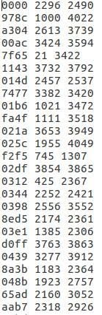
test.txt format
index
start
end
<key> <start> <end>\n
<key> <start > <end>\n
<key> <start > <end>\n
……
E.g., f2f5 645 660
Find key f2f5 and print characters between byte positions <start> and <end>

Slide 6
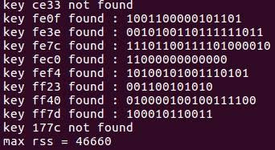
search.c
Map data.txt to memory using mmap()
Answer queries in test.txt using binary search
Output:
For each query
Found → printf(“key %s found : %s\n”, key, buffer);
Not found→printf(“key %s not found\n” , key);
Last output
printf(“max rss = %lu KB\n”, ru_maxrss);

Slide 7
Problem Statement
Write two programs
convert.c
Convert data.txt to new_data.txt
new_search.c
Search new_data.txt using the test cases in test.txt
Your new program (new_search.c) should have smaller working set compared to the search.c!
At least 2000 KB reduction

Slide 8
Procedure
data.txt
test.txt
search.c
convert.c
Your work!
new_data.txt
test.txt
new_search.c
RSS (Resident Set Size):
How much physical memory is occupied by a process

Slide 9
convert.c
Generate new_data.txt
Convert data.txt into your own file format
Do not modify the keys and values in data.txt!

Slide 10
new_search.c
Implement your search for new_data.txt
Search in the memory space mapped to new_data.txt as the original search.c does
mmap(), munmap()
Output format must be the same as search.c
Refer to slide No. 6
Must produce a reduced rss

Slide 11
Useful APIs
<resources.h>
getrusage()
long ru_maxrss; /* maximum resident set size , unit : KB*/
<sys/mman.h>
mmap(), munmap()
Mapping a file into the logical memory space

Slide 12
Grading Policy
Output Correctness
Must be the same format as search.c (slide No. 6)
TAs will test your code with another testcase.
Search in the memory space mapped to new_data.txt
mmap(), munmap()
RSS reduction
ru_max rss should be decreased by at least 2000KB!

Slide 13
Grading Policy
Uploaded File to E3
student_number.zip
convert.c/cpp
new_search.c/cpp
Please follow the naming convention
Wrong file formats incur -10 pts score penalty
Do not plagiarize

Slide 14
Testing OS Environment
Ubuntu 16.04, Ubuntu 14.04 or CS linux work station
gcc convert.c -o convert
gcc new_search.c -o new_search
Your code should compile successfully in one of the above OS environments

