Slide 1
Introduction
HUDK 4029: Human Cognition and Learning

Slide 2
General Information
Professor: Dr Lauren Young
Email: lay2108@tc.columbia.edu
Office Location: GDH 470; mailbox in main office (GDH 461)
Office Hours (tentatively): Tuesday 11:30-12:30pm; Thursday 11:30-12:30; on Zoom by appointment
Course Assistant: Guido Cilio
Email: gac2149@tc.columbia.edu
You can take this course for 2 or 3 credits, but that is between you and the registrar. It does NOT impact your workload.

Slide 3
Course Materials
Recommended class textbook.
J.R. Anderson (2022) Cognitive Psychology and Its Implications, Ninth Edition, Worth Publishers.
All of the readings will be available from the Canvas website of the course.

Slide 4
Assessment
10% Class Participation (attendance and discussion participation)
40% Three short written assignments (500- 600 words each)
40% Cognition Study Project. See project document on Canvas for more information.
10% Participation in 3 hours of research studies
(grading scale in syllabus)

Slide 5
Class Participation
This is a combination of attendance and participation in class discussion
Absences - 2 without penalty. Please email Dr Young

Slide 6
Research Participation
3 hours of study participation AS A PARTICIPANT ONLY.
Studies need to be approved by Dr Young. Send studies that you find/know about and we will post them to Canvas.
There may be an alternative assignment.

Slide 7
Writing Assignments
Roughly 2 pages (500-600 words) and will cover topics and ideas from the previous weeks
FOLLOW THE WRITING GUIDELINES POSTED TO CANVAS!
40% of your grade

Slide 8
Cognition Observation Project
Goal is to examine the cognition of 2-3 individuals in the area of your choice. You will be tasked with making observations regarding the cognition of your participants and grounding your assessment in both the literature and the specific observations that can be seen on the video.

Slide 9
Cognition Observation Project
You will:
Develop a research question and hypotheses
Administer an appropriate task for your participants
Record the data collection sessions
Analyze your video and data
Write the results in a report 8-10 pages
Due December 8

Slide 10
Expectations
These are in the syllabus, but the main ones boil down to this:
Come to class, talk at least occasionally, pay attention, and don’t have AI participate in the creation of your writing (and follow the writing guidelines!).
And AI Writing Tools Policy

Slide 11
Fill out the intro survey and sign the course expectations on Canvas (due 9/19)

Slide 12
The Original Sin of Cognitive Science

Slide 13
So what was the original sin?
Ignoring diversity of the human experience
Why?
As a species, we depend on accumulated cultural information (how to find food, make shelter, care for infants)

Slide 14
So how can we think of culture?
Culture can represent the “information stored in people’s heads that got there via cultural learning or direct experience induced by various cultural products, like norms, technologies, languages or institutions.”
Our large brains have helped us adapt to operating within the constraints, affordances and incentives of our world (which is culturally constructed)
Henrich, J., Blasi, D. E., Curtin, C. M., Davis, H. E., Hong, Z., Kelly, D., & Kroupin, I. (2023). A cultural species and its cognitive phenotypes: implications for philosophy. Review of Philosophy and Psychology, 14(2), 349-386.

Slide 15
How much does this really matter?

Slide 16
WEIRD people dominate social science research
Western, Educated, Industrialized, Rich, Democratic (small-d)
Over 90% of all social science research is done with samples drawn from WEIRD populations
The Problem:
They are not representative of the majority of populations of the world. In fact, they are often found on the extreme ends
Culture shapes humans.
Henrich, J., Heine, S. J., & Norenzayan, A. (2010). Most people are not WEIRD. Nature, 466(7302), 29-29.

Slide 17
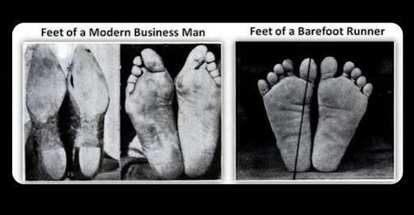
Feet
Hard-soled shoes contribute to feet which are shape differently, with fallen arches

Slide 18
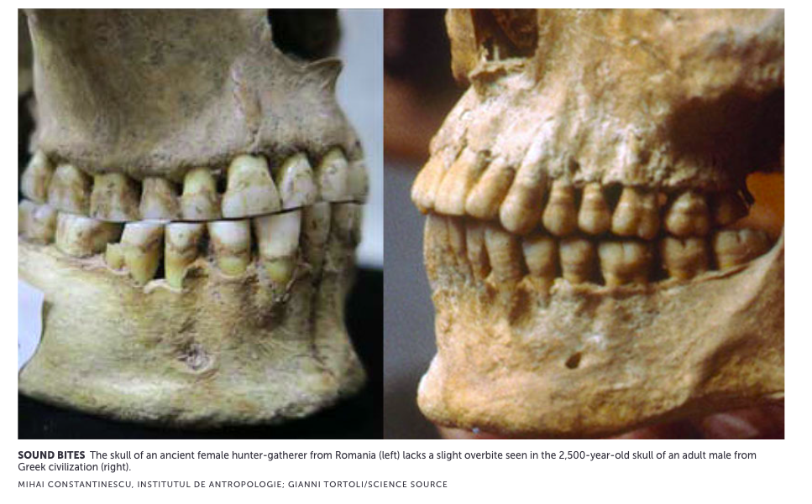
Teeth Configuration
The slight overbite is considered normal and healthy. It appears early in childhood
HOWEVER, researchers working with forager populations are that our species historical bite is likely edge-to-edge
Probably a response to heavy wear diets

Slide 19
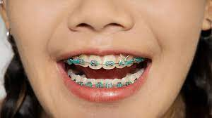
The Consequences?
Braces!!: tougher food and using teeth for working materials likely encouraged straighter teeth
Ability to produce new sounds, which shifted how we talk (labiodental sounds like f and v)
Emergence of cavities

Slide 20
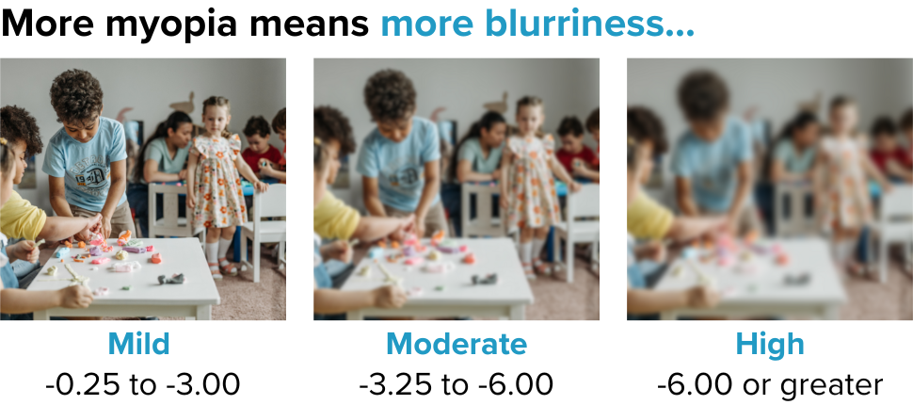
Where does Myopia come from?

Slide 21
Myopia
Often considered genetic because WEIRD researchers were studying WEIRD people (25% of population is myopic)
Myopia is almost unheard of in traditional hunter-gatherer societies
It is entirely the product of gene-enviroment interaction
Environmetal factors that seem to contribute: urban environments, time indoors, reading in childhood
Henrich, J., Blasi, D. E., Curtin, C. M., Davis, H. E., Hong, Z., Kelly, D., & Kroupin, I. (2023). A cultural species and its cognitive phenotypes: implications for philosophy. Review of Philosophy and Psychology, 14(2), 349-386.

Slide 22
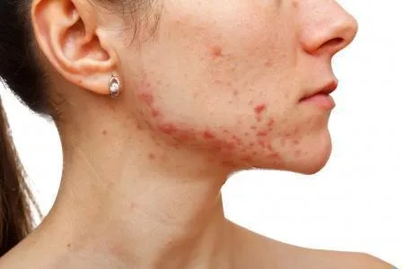
Acne
When do we usually see acne? What is the lifetime progression?
We usually think of acne as a normal occurrence in adolescence (because the science of acne is WEIRD)
Facial acne appearance varies in populations from 0% to 95% (WEIRD societies)
Most likely, acne was rare our human history and there is some WEIRD risk factor responsible for its prevalence.
Campbell, C. E., & Strassmann, B. I. (2016). The blemishes of modern society? Acne prevalence in the Dogon of Mali. Evolution, medicine, and public health, 2016(1), 325-337.

Slide 23
Navigation
WEIRD people are actually really terrible navigators compared to individuals from traditional societies
The pressure that results from needing to remember the details of home ranges shapes navigation abilities from early in childhood
Observed sex differences in spatial abilities seems to be related to sex-specific tasks (range size related to work responsibilities and mate-seeking) however when mobility patterns vary by age, not gender, sex differences are difficult to find
Language also plays a role - people who speak languages that require tracking of absolute direction develop a sense of reference that is challenging to acquire later.
Henrich, J., Blasi, D. E., Curtin, C. M., Davis, H. E., Hong, Z., Kelly, D., & Kroupin, I. (2023). A cultural species and its cognitive phenotypes: implications for philosophy. Review of Philosophy and Psychology, 14(2), 349-386.

Slide 24
Can you think of any universalities of cognition?

