Slide 1

PROBLEM-BASED LEARNING MODULE · PHASE 2
Smart Noise Cancellation
A Fuzzy Logic Controller — System Design
Noise Level + Noise Frequency → Filter Strength
2 Inputs · 1 Output · Mamdani Fuzzy Inference
Phase: Phase 2 – System Design
Course: Fuzzy Logic & Genetic Programming
Presented by: Mathukiya Maitri Prafulbhai- 240280111070
Ramotiya Krupal Vinodbhai- 240280111064
Mistry Meet Pragneshbhai- 250283111012
Modh Aarchi Chetan- 250283111013

Slide 2
THE PROBLEM
Why Does a Noise-Cancellation Controller Need Fuzzy Logic?
KEY OBSERVATIONS
DESIGN TASK
Noise is not always simply ON or OFF. It can be low, medium, or high.
Build a fuzzy controller that reads:
• Noise Level
• Noise Frequency
and produces:
• Filter Strength
1
2
Different frequencies can require different filter strengths.
3
A fixed threshold may produce abrupt changes in filter operation.
GOAL
Smooth and interpretable control — filter strength should change gradually with conditions, not jump abruptly.
4
Fuzzy logic lets the controller reason using terms such as “low noise,” “medium frequency,” and “strong filtering.”
The Problem
2

Slide 3
SYSTEM ARCHITECTURE
Four Main Stages of the Fuzzy Controller
1
2
3
4
Crisp Inputs
Fuzzification
Rule Base &
Inference
Defuzzification
Noise Level (dB) and Noise Frequency (kHz) read from sensors.
→
Convert crisp readings into fuzzy membership degrees.
→
Apply IF–THEN rules; combine antecedents with min / max.
→
Convert the fuzzy output set into a crisp Filter Strength (%).
Noise Level (dB) + Noise Frequency (kHz) → fuzzy memberships → IF–THEN rules → fuzzy output → crisp Filter Strength (%)
System Architecture
3

Slide 4
PHASE 2 · STEP 1
Identify Inputs, Output & Ranges
Variable | Role | Range | Linguistic Values
Noise Level | Input | 0–100 dB | Low, Medium, High
Noise Frequency | Input | 0–10 kHz | Low, Medium, High
Filter Strength | Output | 0–100 % | Weak, Medium, Strong
Universe of discourse defines the full numerical range used by each fuzzy variable — every membership function for that variable is defined somewhere inside this range.
Noise Level
Noise Frequency
Filter Strength
0 dB
100 dB
0 kHz
10 kHz
0 %
100 %
Fuzzification
4

Slide 5
PHASE 2 · STEP 2
Linguistic Variables & Membership Functions
Variable | Term | MF Type | Parameters (a, b, c)
Noise Level | Low | Triangular | (0, 0, 50)
Noise Level | Medium | Triangular | (25, 50, 75)
Noise Level | High | Triangular | (50, 100, 100)
Noise Frequency | Low | Triangular | (0, 0, 5)
Noise Frequency | Medium | Triangular | (2.5, 5, 7.5)
Noise Frequency | High | Triangular | (5, 10, 10)
Filter Strength | Weak | Triangular | (0, 0, 50)
Filter Strength | Medium | Triangular | (25, 50, 75)
Filter Strength | Strong | Triangular | (50, 100, 100)
Triangular MFs are selected because they are simple, easy to calculate, and easy to explain in Phase 2.
Fuzzification
5

Slide 6
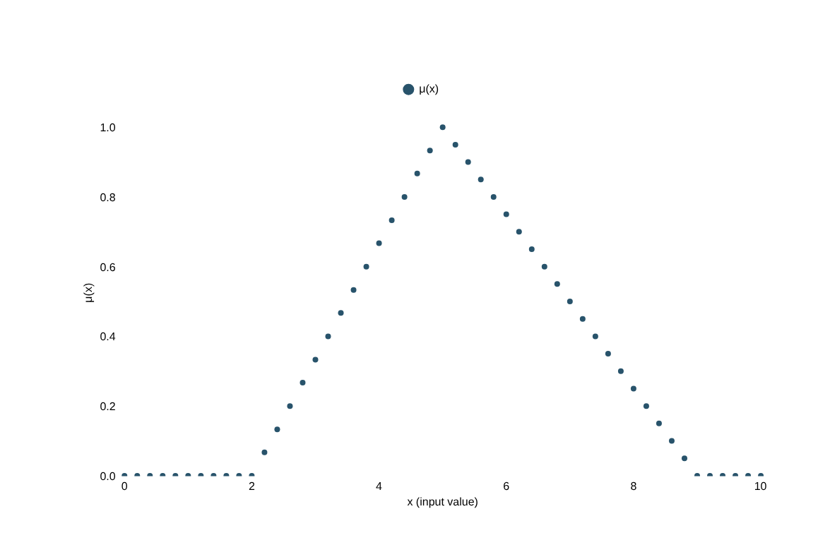
CORE THEORY
The Triangular Membership Function
FORMULA
μ(x) = max( min( (x−a)/(b−a), (c−x)/(c−b) ), 0 )
PARAMETERS
a = left foot (μ = 0)
b = peak (μ = 1)
c = right foot (μ = 0)
Membership value μ(x) always lies between 0 and 1.
Core Theory
6

Slide 7
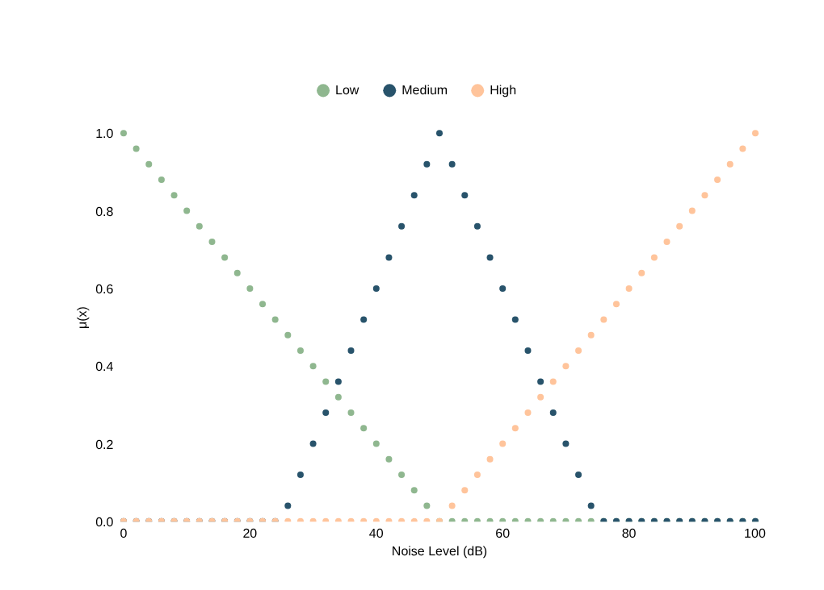

PHASE 2 · STEP 2 (CONTINUED)
Membership Functions: Inputs
Noise Level (dB)
Noise Frequency (kHz)
Both inputs use the same 3-term pattern (Low / Medium / High) with overlapping triangles — this overlap is what allows a reading to belong to two terms at once.
Fuzzification
7

Slide 8
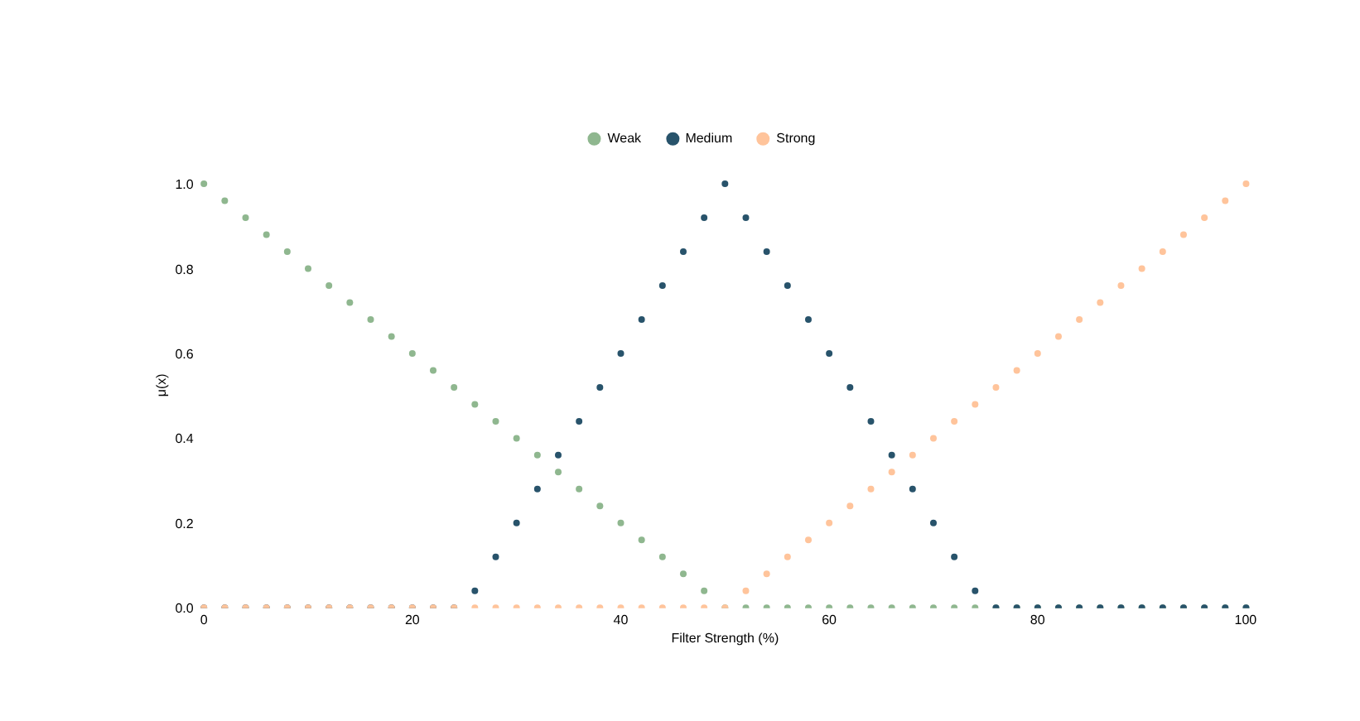
PHASE 2 · STEP 2 (CONTINUED)
Membership Function: Filter Strength (Output)
The output variable is fuzzified in exactly the same way as the inputs — this is what lets the inference engine and defuzzifier work with it.
Fuzzification
8

Slide 9
PHASE 2 · STEP 3
Construct the Fuzzy Rule Base
# | Noise Level | Noise Frequency | → Filter Strength
R1 | Low | Low | Weak
R2 | Low | Medium | Weak
R3 | Low | High | Medium
R4 | Medium | Low | Medium
R5 | Medium | Medium | Medium
R6 | Medium | High | Strong
R7 | High | Low | Medium
R8 | High | Medium | Strong
R9 | High | High | Strong
Example: IF Noise Level is High AND Noise Frequency is High THEN Filter Strength is Strong.
Rule Base
9

Slide 10
PHASE 2 · STEP 4
Sample Input for Fuzzification
SAMPLE SENSOR READING
OBJECTIVE
Input | Value
Noise Level | 70 dB
Noise Frequency | 7 kHz
Calculate the membership degree of the sample in Low, Medium and High fuzzy sets for both inputs, then identify the rules that fire.
Firing operator: AND = minimum
Worked Example
10

Slide 11
FUZZIFICATION RESULT
Membership Values for the Sample
Input | Low | Medium | High
Noise Level = 70 dB | 0.00 | 0.20 | 0.40
Noise Frequency = 7 kHz | 0.00 | 0.20 | 0.40
Therefore, the sample belongs partly to the Medium and High categories for both inputs — both terms fire and will contribute to the rule evaluation.
0.20
0.40
0.20
0.40
Noise Level → Medium
Noise Level → High
Frequency → Medium
Frequency → High
Worked Example
11

Slide 12
RULE EVALUATION
Identify Fired Rules and Firing Strengths
Rule | Calculation (AND = min) | Firing Strength | Output
R5 | min(0.20, 0.20) | 0.20 | Medium
R6 | min(0.20, 0.40) | 0.20 | Strong
R8 | min(0.40, 0.20) | 0.20 | Strong
R9 | min(0.40, 0.40) | 0.40 | Strong
Rules with zero membership do not contribute.
Three of the four fired rules recommend “Strong” — with R9 (min = 0.40) carrying the strongest vote. This concentration toward Strong previews the defuzzified result on the next slide.
Worked Example
12

Slide 13
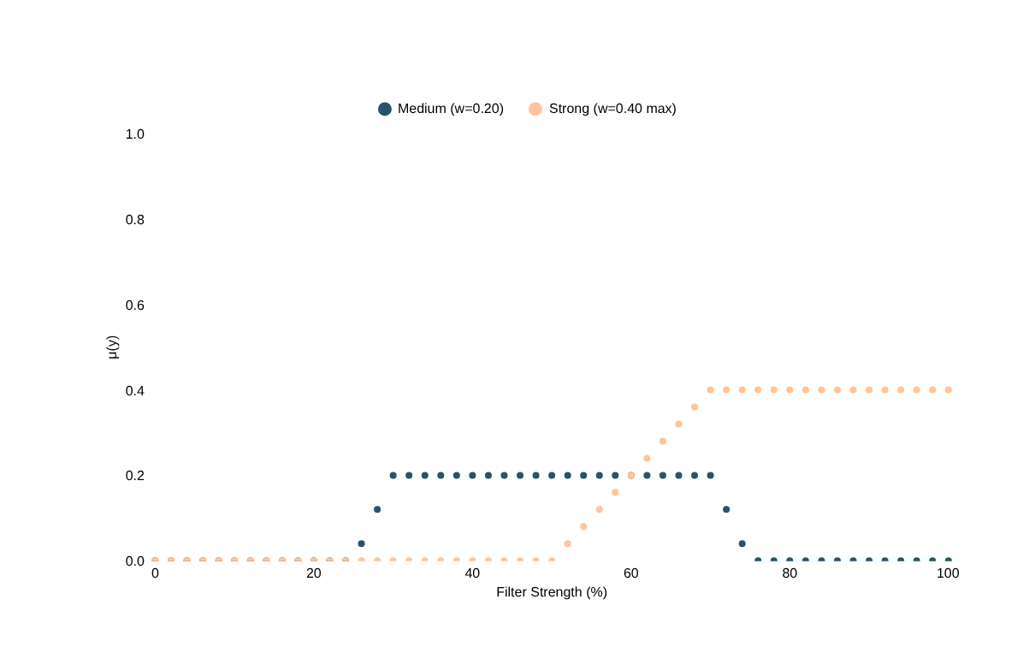
DEFUZZIFICATION
Weighted-Average Method
Weighted-Average Table
Term | w | Value | w×value
Medium | 0.20 | 50 | 10
Strong | 0.20 | 75 | 15
Strong | 0.20 | 75 | 15
Strong | 0.40 | 75 | 30
= 70%
Filter Strength ≈ 70% → Strong noise cancellation
Crisp Output = Σ(w × value) / Σw
Worked Example
13

Slide 14
FINAL SYSTEM DESIGN
Complete Phase-2 Flow
1
2
3
4
5
Noise Level
→
Noise Frequency
→
Fuzzification
→
9 IF–THEN
Rules
→
Weighted Average
Defuzzification
0–100 dB
0–10 kHz
Triangular MF
Rule Base
Crisp Output
Sample: 70 dB + 7 kHz → fired rules → Filter Strength ≈ 70% → Strong
System Design
14

Slide 15
IMPLEMENTATION PLAN
Google Colab Implementation
1
Define triangular membership functions for the two inputs and one output.
2
Plot the membership functions using Matplotlib.
3
Enter sample values: Noise Level = 70 dB and Noise Frequency = 7 kHz.
4
Calculate membership degrees and rule firing strengths.
5
Apply the 9-rule fuzzy rule base.
6
Defuzzify using weighted average and display the crisp filter strength.
7
Use the generated graphs and tables directly in the project PPT / report.
Implementation tool: Google Colab + Python + NumPy + Matplotlib
Implementation
15

Slide 16
CONCLUSION
Expected Phase-2 Outcome
Fuzzy Inputs
Membership Functions
1
The controller accepts Noise Level and Noise Frequency as fuzzy inputs.
2
Triangular membership functions represent Low, Medium and High conditions.
Rule Base
Worked Example
3
A 9-rule IF–THEN knowledge base maps input conditions to Filter Strength.
4
The sample calculation demonstrates fuzzification, rule firing and weighted-average defuzzification.
For 70 dB and 7 kHz, the calculated filter strength is approximately 70%, indicating strong cancellation. This design is ready to be implemented and demonstrated in Google Colab.
Conclusion
16

Slide 17
Thank You
REFERENCES
  J. M. Sousa, C. A. Silva, and J. M. Sá da Costa, “Fuzzy Active Noise Modeling and Control,” International Journal of Approximate Reasoning, Vol. 33, Issue 1, 2003, pp. 51–70. 
  C. Y. Chang and K. K. Shyu, “Active Noise Cancellation with a Fuzzy Adaptive Filtered-X Algorithm,” IEE Proceedings – Circuits, Devices and Systems, Vol. 150, No. 5, 2003, pp. 416–422. 
  T. Peng, Q. Zhu, M. O. Tokhi, and Y. Yao, “Fuzzy Logic Feedforward Active Noise Control with Distance Ratio and Acoustic Feedback Using Takagi–Sugeno–Kang Inference,” Journal of Vibration and Control, 2020. 
  S. Kurczyk and M. Pawelczyk, “Active Noise Control Using a Fuzzy Inference System Without Secondary Path Modelling,” Archives of Acoustics. 
  M.-C. Huynh and C.-Y. Chang, “Novel Adaptive Fuzzy Feedback Neural Network Controller for Narrowband Active Noise Control System,” IEEE Access, Vol. 10, 2022, pp. 41740–41747.
Fuzzy Logic & Genetic Programming · Phase 2 – System Design
17

