Slide 1
PAS: Scaling Agile – A real life experience
November 4, 2009

Slide 2
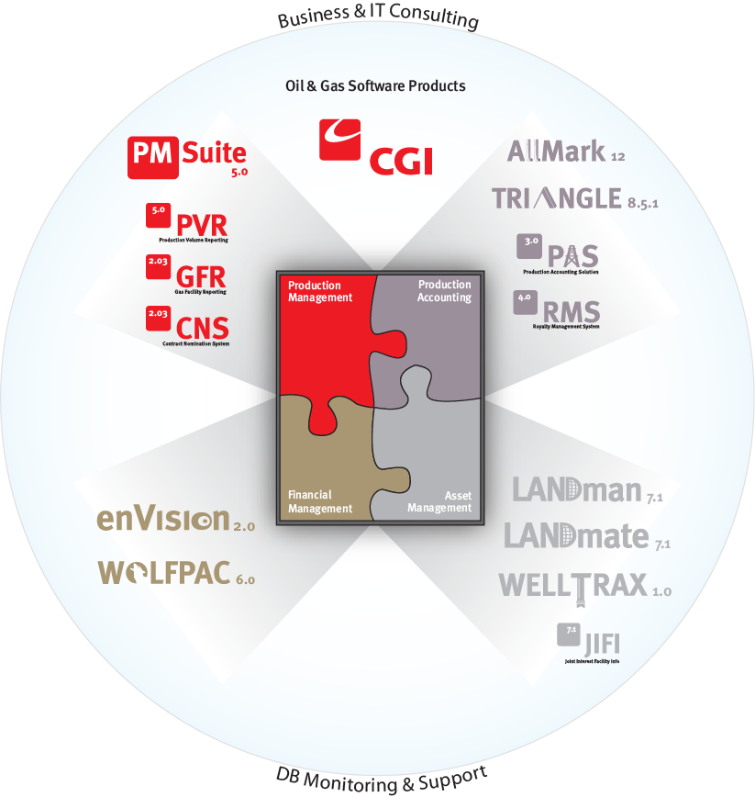
CGI – A Quiet Canadian Success Story
Largest Independent Canadian IT Services Company
25,000 Staff, 16,000 in Canada
  350 members in Calgary
  1100 in Western Canada

Slide 3
What is Production Accounting?
Starts with molecules and ends with $$$
Revenue and Royalties for the Oil and Gas Industry (Multi Billions dollars per month)
The Landscape
  100,000 to 150,000 active wells in Western Canada
    Each well has: 1 operator + 4 joint venture partners (on average)
  Monthly requirement for reporting to operators, joint venture partners, government, pipeline operators
    Volumes – oil, gas, water, NGL
    Expenses – processing, facility, trucking, treating, admin
    Royalties – crown, freehold, override
    Revenue based on multiple sales contracts
Oil Pipeline
W
E
L
L
Oil Treatment
Oil Battery
W
E
L
L
Gas Pipeline
W
E
L
L
Separator
Gas Plant
Gas Treatment
Water Treatment
Disposal

Slide 4
What was the PAS Project
Software Development Project
4 Oil and Gas Companies
  Devon
  Encana
  Husky
  Talisman
12 business resources
90 resources
4 development teams 2 support
11 major applications
Supported: 5 implementation teams
Tests: 30568 Rapid All, 154 GUI, 372 Scenario tests

Slide 5
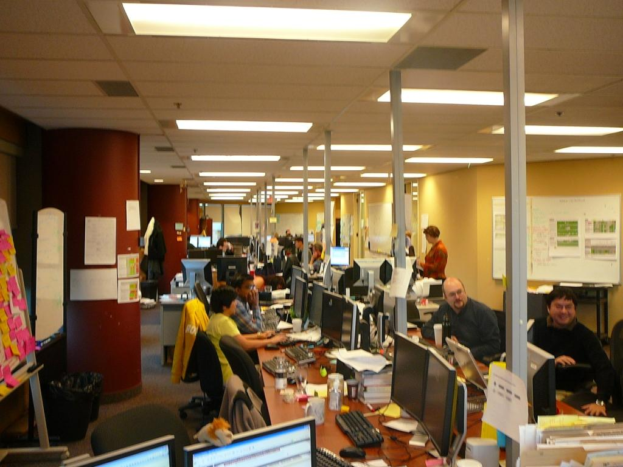
Looking to the left

Slide 6
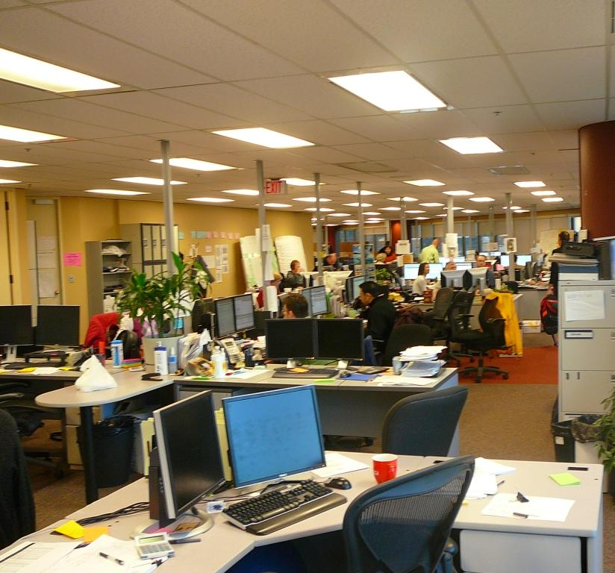
Looking to the right

Slide 7
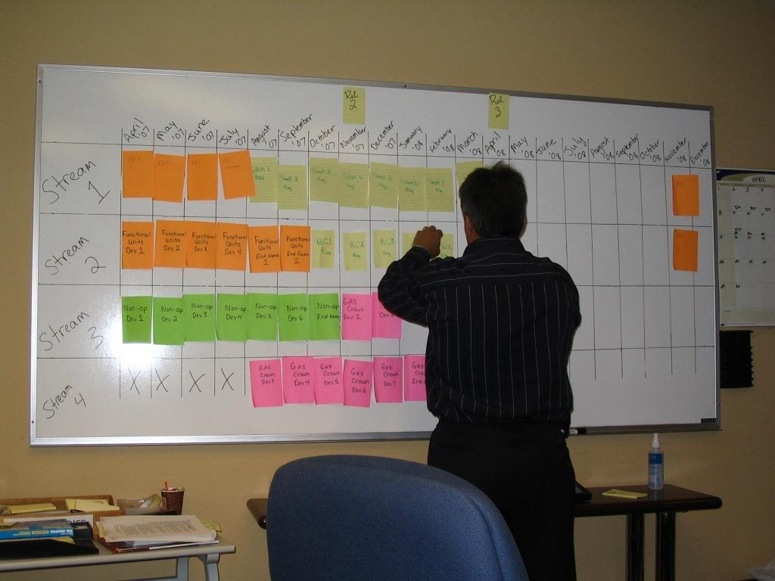
Planning

Slide 8
Objective → Success
All major stakeholders are satisfied
  Users like the system
  Sponsors received value
  Development team would do it again
Predictable
  Revised Budget Met
  Revised Schedule Met

Slide 9
Formula for Success
  Transparency
  Governance Structure
  Key users assigned to the team worked with development team
  Constant Feedback
  Continuous Improvement

Slide 10
Where did we start?
Started XP and Scrum
  Verbatim from the book
  External Mentors
  Development leads had agile experience
  Built team slowly and hired carefully
    Team was hired for project and specifically to do agile
  On site customers

Slide 11
What do we still do?
Incremental design
Customer drives priorities
Test First Development
Work in a pit
Pair programming
Morning stand-ups
Retrospectives

Slide 12
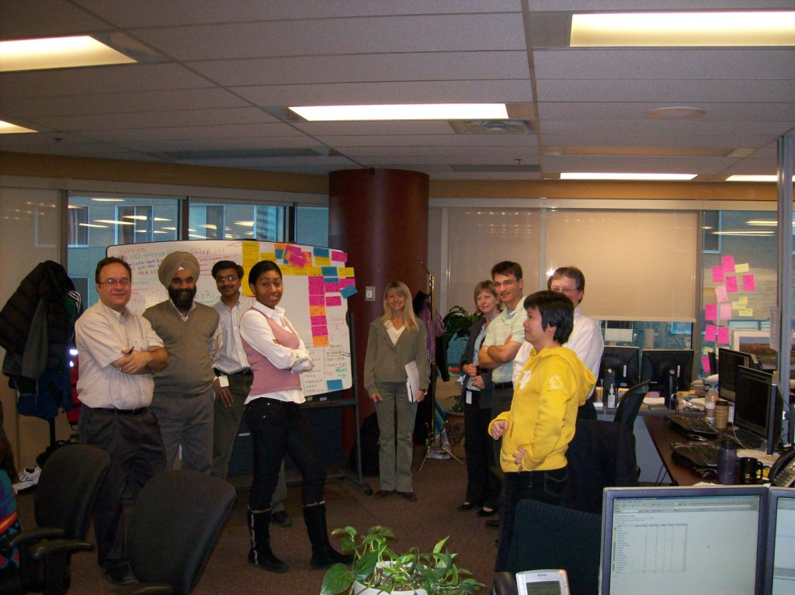
Morning Standup

Slide 13
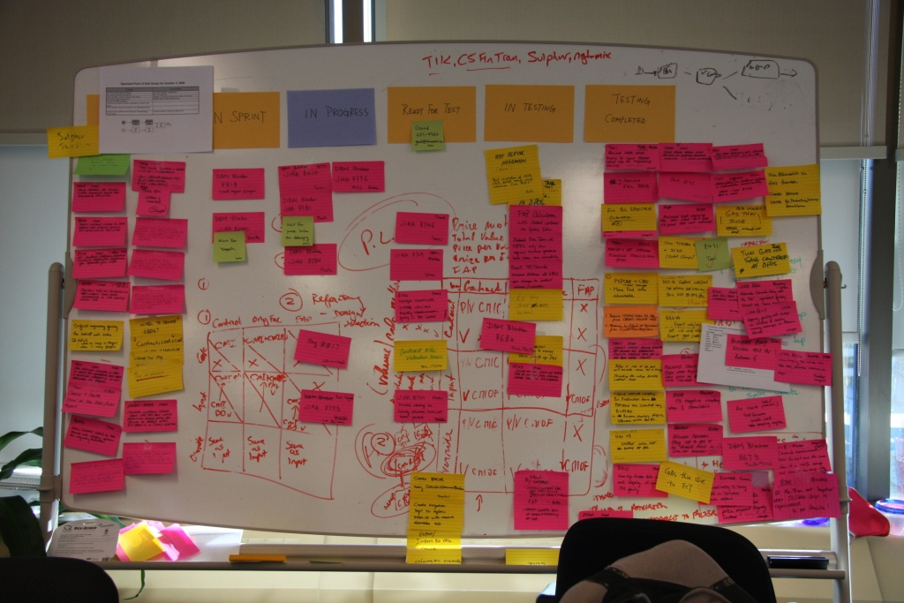
Story Board

Slide 14
Techniques that stood the test of time
Testing patterns from Gerard Meszaros
  Create Anonymous
  Test Fixtures
  Fake Database - 30,000+ tests are on checkin
Team ideas from Eric Evans
  Five Ideas - Create communication, empowered developers to design
  Ubiquitous language - developers, testers, business, talk the same language
  Domain Driven Design
TopLink
  Allowed a domain driven design
  Quick to learn for newbies
  Many levels for performance optimization available
  Worked closely with us to resolve bugs in TopLink
Business and Technical sitting together
  They worked as a team rather than two teams
Persistence and Calmness (Most important)
  Still lots of problems and frustrations that just need willpower to get through

Slide 15
What did we change?
Shape of the Sprint
  Moved from 4 weeks to 2
  Writing of stories before the sprint
    Calculations mean tests take long to write
    Consensus between customers
  Testing continued after end of Sprint
  Monthly convergence
  End Game
Development
  Don’t pair all of the time
  Paid attention to data migration

Slide 16
What did we change - 2
Team Composition
  Split into business functionality related teams
    Teams became specialized
      Each had own product backlog
    Scrum of Scrums
  Brought in a business lead
    Longer term business vision
    Negotiate compromise
  Evolution in how teams monitored sprints
    Sprint backlog only for the PM

Slide 17
What did we change - 3
Business Testing – Evolving process
  Started with story writers testing their own stories
    now we have specialized testers
  Introduced Scenario testing
    Start with FIT, evolved our own framework
  When do bugs get fixed?
  How to log bugs

Slide 18
Issues on a Large Project
Story Boards → Distribution of Status
Sprint Backlogs
Refactoring
Technical debt
Concurrent Check in

Slide 19
What did we learn
Business team needs help to adapt to Agile process
  We were better at helping developers
Difficult to get the correct balance
  Once the balance is set, it becomes part of your culture
  Features vs quality
  Object design vs Database design
  Story testing vs exploratory testing
  Rotating team members vs keeping teams whole
Prioritization is hard for business
  They want to have that influence
  Mining existing systems for requirements can help

Slide 20
What did we learn
Splitting teams introduced communication overhead
  Difficult to have knowledge distributed throughout the team
  It was not as bad as we feared

Slide 21

Questions

Slide 22
Thank You

