Slide 1
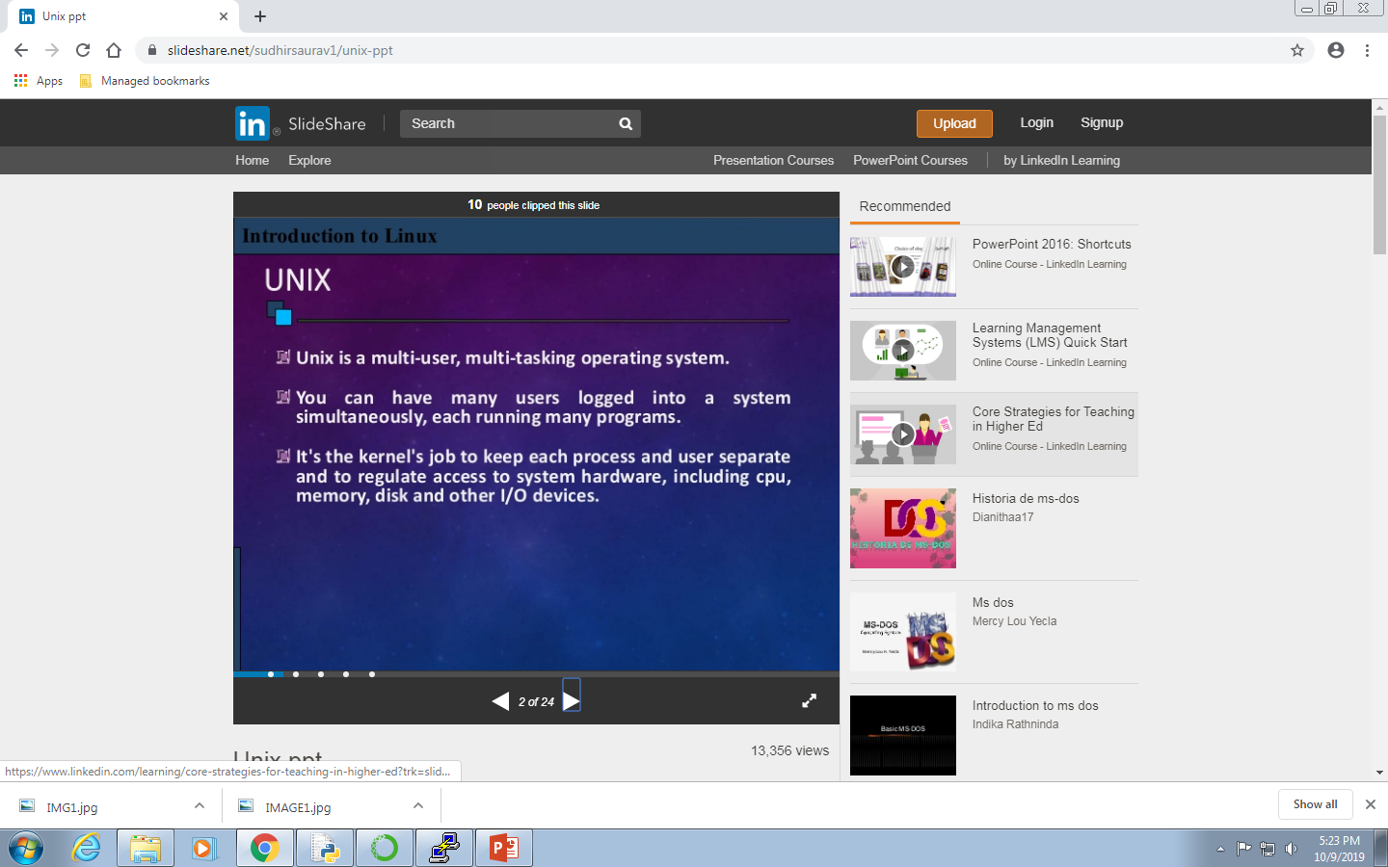

UNIX

Slide 2
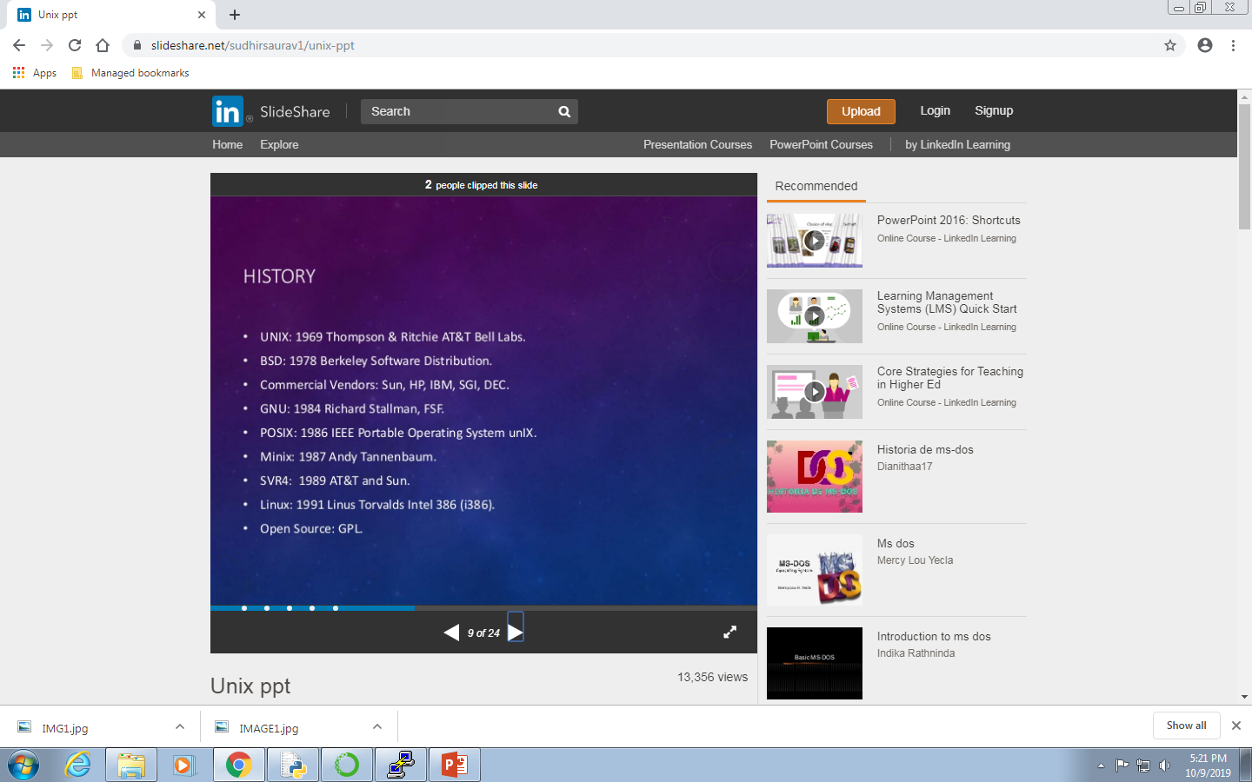



Slide 3
Why is Unix better than other OS?
UNIX has the following advantages compared with other operating systems:
excellent use and control of system resources
very high reliability (long uptimes between reboots)
tools for customizing the system are either native and bundled with the operating system or are easily available free
in the case of open source systems such as Linux, no software licensing hassles for commonly used software
far better scalability than any other OS, save (maybe) for mainframe systems
readily available, searchable, complete documentation both on the system and online via the Internet
massive stores of free software available for downloading and building

Slide 4
