Slide 1

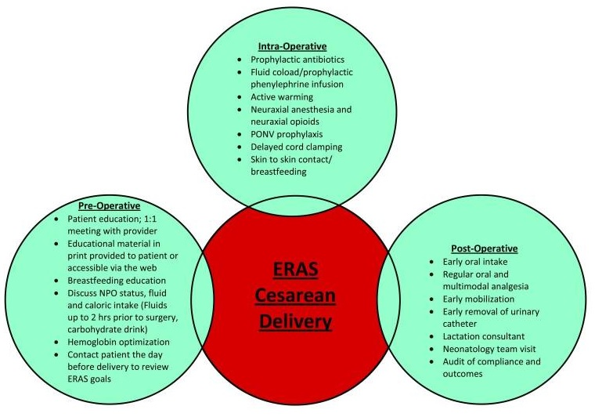
(ERACD) Enhanced Recovery After Cesarean Delivery
Muhammad M Al Hennawy
First Consultant Obstetrician & Gynacologist
Ras El Bar Central Hospital ,
Dumyat Specialised Hospital ,
Egypt

Slide 2
Enhanced Recovery After Surgery (ERAS)
Standardizes care (protocols of evidence-based interventions and best practices)
-before (preoperative),
-during (intraoperative )and
-after surgery(postoperative, Post discharge!!!).
Of patients undergoing a variety of major surgeries
That have been grouped together
with, primarily, a maternal focus.

Slide 3
From------TO
The focused pathway process for scheduled and unscheduled cesarean delivery for this ERAS Cesarean Delivery Guideline will consider from the time from decision to operate (starting with the 30–60 minutes before skin incision) to hospital discharge

Slide 4
Pre-operative -pre-admission -long – antenatal care
- short – 1 day before surgery
-post-admission – 2 hour before surgery
Intra-operative
Post-operative - recovery room (first hour)
- maternity unit ( 4-6 hours)
Discharge - same day of operation
- second day after operation
Post-discharge - first 24 hour
- first visit after 5-7 day
- schedule visits

Slide 5
Goals
With the goals of minimizing the physiologic changes associated with surgery.
Patient benefits associated with ERAS include lower hospital stays, recovery time and postoperative complication rates.

Slide 6
Recovery
Recovery is The moment when a patient has reached her preoperative functional level
Can take months!
Based on patient’s expectations , Social circumstances
Accelerated recovery
Length of stay, readmission rates, health care costs
Early discharge may not equal improved functional recovery at home
Our focus should be COMPLETE recovery and should include postdischarge care and follow-up

Slide 7
Names
Enhanced recovery after surgery (ERAS)
Enhanced recovery protocols (ERP)
Fast-track surgery (FTS)

Slide 8
The ERAS protocols were first introduced
15 years ago
by Wilmore and Kehlet
for colorectal surgery
They are now successfully applied in other surgical disciplines like breast, urological, pancreatectomy, liver resection, obstetric and gynecologic surgery.

Slide 9
The specific components of ERAS protocols differ among surgical specialties and institutions, but the core principles remain the same.

Slide 10
A cesarean delivery is classified as major surgery with a much longer recovery than after a vaginal delivery because a mother's abdomen has been surgically opened to safely remove the baby.
A part of a combined effort by
-anesthesiologists,
-maternal fetal medicine specialists,
-obstetricians,
-neonatologists,
-pharmacists, and
-labor and delivery nurses

Slide 11
Traditional Management
•Restricted PO intake
–Pre and postop
•Aggressive IVF replacement
•Narcotic pain control
•Routine bowel preps,
• NGTs,
• urinary catheters
•Restricted mobility

Slide 12
Benefits
–Reduced length of stay (LoS)
- Accelerate patient recovery
–Decrease in complication rates
–Earlier return of bowel function
–Decreased analog pain scores
–No increase in mortality
- Improve patient satisfaction
-reduce readmissions
-reduce reoperation
–Reduced hospital cost

Slide 13
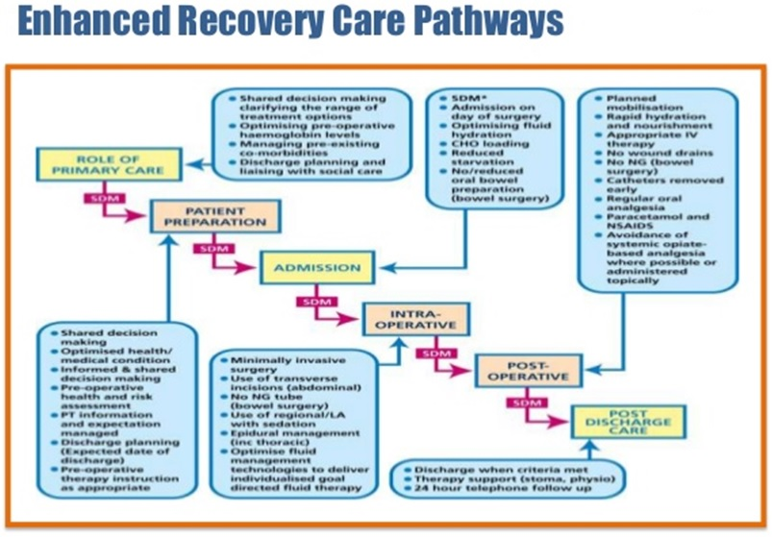

Slide 14
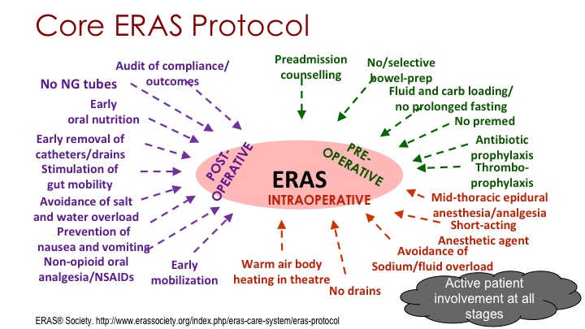
Preoperative preparation - Preadmission - Postadmission

Slide 15
Patient Education
Patient education and counselling and a shared decision-making model are required for the successful implementation of an ERAS program.
Patient education should include information on the procedure and what to expect during surgery, a pain management plan, and goals for early feeding and mobilization.
Information should also be provided on breastfeeding, including lactation support services available, length of stay, and the criteria for discharge.
Patients can be given a checklist with actions and goals which they can use to keep track of their progress in the recovery process

Slide 16
Contact with patient 24 hours before elective Cesarean Delivery

Slide 17
Nil per os status, preoperative fluid, and caloric intake
Six-hour fasting for solids and
clear oral fluid intake up to two hours before the induction of anesthesia
(up to 800 mL at bedtime the night before surgery and 400 mL until 2 hours before surgery)
The intake of a high-caloric carbohydrate drink up to two hours before surgery has been shown to reduce preoperative thirst, hunger, and anxiety in patients undergoing abdominal surgery
It has also been associated with a reduction in insulin resistance and a higher anabolic state postoperatively

Slide 18
Preoperative hemoglobin optimization
Pregnant women are routinely screened for anemia and are referred to an anemia clinic for optimization of hemoglobin if anemic or if they have an increased risk of obstetric hemorrhage.
Furthermore, preoperative anemia is a significant predictor of severe postpartum anemia, which has been linked to various morbidities such as depression and fatigue

Slide 19
Patient Arrives 2 Hours Prior To Surgery
Confirm compliance with ERAS educational material
IV placement
Use of antacids and histamine H2 receptor antagonists
Obestetric check
Transfer to operating room after checklist med
Active warming

Slide 20
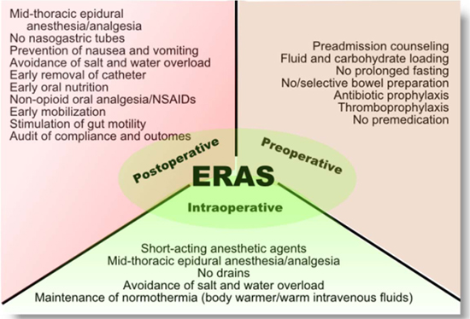
Intraoperative Care

Slide 21
Skin Preparations
IV antibiotics within 1 hour of incision,
Hair clipped,
Chlorhexidine-alcohol preferred over Iodine

Slide 22
Prophylactic antibiotics
Prophylactic antibiotics administered within 60 minutes before skin incision significantly reduce the incidence of maternal postpartum infection compared to administration after cord clamping
The current recommendation is a single dose of a broad-spectrum antibiotic in the non-laboring patient prior to skin incision

Slide 23
Thromboprophylaxis
Pneumatic compression devices are recommended for all women undergoing cesarean delivery and not already receiving pharmacologic thromboprophylaxis
The compression devices should be continued until the patient is fully ambulatory.
In women with one or more additional risk factors, pharmacological thromboprophylaxis is recommended

Slide 24
Fluids and Blood Pressure Management
Hypotension occurs commonly in women undergoing cesarean delivery under spinal anesthesia, and it can be detrimental to the mother and the fetus.
Hypotension can trigger intraoperative nausea and vomiting (IONV) in the mother and decrease uteroplacental blood flow, which impairs fetal oxygenation.
Both fluids and vasopressors have been used to counteract spinal anesthesia-induced hypotension.
Fluid loading strategies alone have limited efficacy in reducing the incidence of hypotension . However, when used in conjunction with a prophylactic phenylephrine infusion, a rapid crystalloid load of 2 L was associated with a significant reduction in the incidence of hypotension compared to maintenance fluid administration

Slide 25
Temperature Management
Maintaining perioperative normothermia(preoperative , intraoperative and postoperative ) in the general surgical population reduces the risk of postoperative wound infection, coagulopathy, blood loss, and transfusion requirement
The incidence of hypothermia in women undergoing cesarean delivery under spinal anesthesia is estimated to be >60%.
Temperature autoregulation is impaired during spinal anesthesia by the inhibition of vasomotor and shivering responses and a redistribution of heat from the core to the peripheral tissues. Hypothermia associated with spinal anesthesia might be under-appreciated
The best strategy for active warming is unclear.
Most strategies have limited efficacy in isolation, and a combination of preoperative and intraoperative forced air warming with warmed intravenous fluids may be more effective and should be implemented as part of all ERAS protocols

Slide 26
Neuraxial anesthesia including neuraxial opioids for analgesia
Neuraxial anesthesia (mainly spinal anesthesia) is the anesthetic technique of choice for elective cesarean delivery
Neuraxial anesthesia decreases the hypothalamo-pituitary response to surgical stress and has been shown to reduce the duration of postoperative ileus in the general surgical population
Neuraxial anesthesia also allows the woman to witness the birth of her child, allows for early skin-to-skin contact with the newborn, and facilitates the presence of a support person in the operating room.
Opioids are usually added to local anesthetic mixture because they improve intraoperative anesthesia, prolong its duration, decrease local anesthesia requirements, and provide postoperative analgesia

Slide 27
Pain Management Strategies
Preoperative:
- PO acetaminophen
- rectal acetaminophen
Intraoperative:
GOLD STANDARD:
-Neuraxial morphine
IF General Anasthesia or morphine allergy:
-Transversus Abdominis Plexus Block
- Local wound infiltration
- Ketorolac
Postoperative
Acetaminophen PO 1000 mg Q6 + with Ketorolac 15mg Q6 hours
Acetaminophen 650 mg Q8 hours + Ibuprofen 800mg Q 8hours
Acetaminophen 650mg TID and Ibuprofen BID
oxycodone for breakthrough pain
IV narcotic for severe pain
Consider Gabapentin for chronic opioid users

Slide 28
Postoperative nausea and vomiting prophylaxis
Postoperative nausea and vomiting (PONV) can delay early oral intake, a key objective of ERAS. PONV occurs frequently after cesarean delivery, especially in parturients who received neuraxial opioids
Use of combination therapy of non-sedating agents such as ondansetron with dexamethasone should be an integral part of an ERAS protocol.
During cesarean delivery under spinal anesthesia ⁻⁻ Avoidance of hypotension with a prophylactic phenylephrine infusion, administration of metoclopramide, and avoidance of uterine exteriorization and fluid irrigation have been associated with a reduced incidence of IONV

Slide 29
Minimally Invasive Surgical Technique
Minimally invasive transeverse Joel-Cohen surgical technique, early catheter removal and post-operative antibiotic prophylaxis
skin preparation with chlorhexidine-alcohol
Reduced (LoS) length of stay after CS most significantly by around half to 1 and a half days

Slide 30
Blunt expansion of the transverse uterine hysterotomy,
Skin closure with subcuticular sutures

Slide 31
Delayed Cord Clamping
Delay in clamping of the umbilical cord for at least 30 seconds was initially recommended in preterm newborns because it is associated with a reduction in risk of intraventricular hemorrhage, an increase in hematocrit, and a decrease in need for volume resuscitation
However, current data suggest that it may also be beneficial in term infants without evidence of significant harm that delayed cord clamping was associated with higher hemoglobin concentration and iron reserves up to six months after birth compared to early clamping
There was, however, a higher risk of jaundice requiring phototherapy in infants who had delayed cord clamping.
The current recommendation from ACOG is delayed cord clamping in vigorous term and preterm infants for at least 30–60 seconds after birth

Slide 32
Skin to Skin
There are reported benefits for both the newborn and the mother of early skin-to-skin contact. Early skin to skin has been associated with increased rates and duration of breastfeeding and a decrease in maternal anxiety and postpartum depression
A concept termed “natural” cesarean delivery that the woman can have a “natural” experience comparable to a vaginal birth
These modifications include using a transparent surgical drape, allowing the mother and her partner to witness the birth, and initiating immediate skin-to-skin contact and breastfeeding after birth.

Slide 33
Oxytocin management
A prophylactic low-dose oxytocin infusion (15–18 U/hour) should be commenced to prevent postpartum hemorrhage
A low dose reduces the occurrence of adverse effects such as hypotension and myocardial ischemia
Carbetocin, a long-acting oxytocin receptor agonist can also be used as a first-line prophylactic uterotonic instead of oxytocin

Slide 34
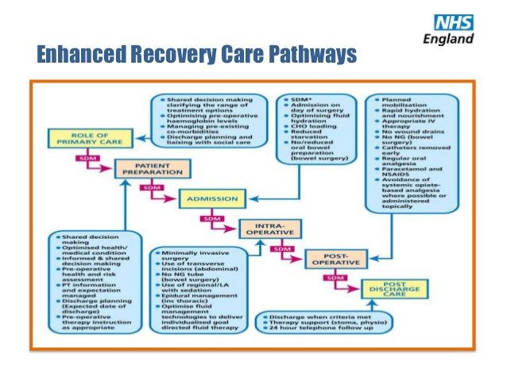
Postoperative Care

Slide 35
Sugar-Free Chewing Gum
Use of it to Reduce Postoperative Ileus
The use of chewing gum has been described as a form of sham feeding should be encouraged starting 1 hour after surgery till pass flatus or stool
Each patient should chew one stick of gum, for at least 30 minutes, ≥ 3 times per day
Increase cephalo-vagal stimulation, leading to increased gastric motility and reduced inhibitory inputs from the sympathetic nervous system
Gastrointestinal hormones, such as gastrin, neurotensin, cholecystokinin and pancreatic polypeptide, are also increased and result in vagal stimulation of smooth muscle fibres.
Chewing gum also increases secretion of saliva and pancreatic juices
sorbitol and hexitol found in sugar-free gum may also play a role in the reduction of postoperative ileus.

Slide 36
Early Oral Intake within 2 hours
Traditionally, oral intake has been delayed after abdominal surgery until the return of bowel function is confirmed by bowel sounds or passage of flatus or stools.
This is contrary to the current evidence indicating that early oral fluid intake within 2 hours provided they are awake, alert and capable of swallowing
Promotes the return of bowel function and early ambulation, decreases the risk of sepsis, reduces the time to breastfeeding, and shortens the length of stay
Once patient start get out of bed , she will start eating soft fluid food
Once patient start passing gas, she will start eating solid food

Slide 37
Tight capillary glucose control

Slide 38
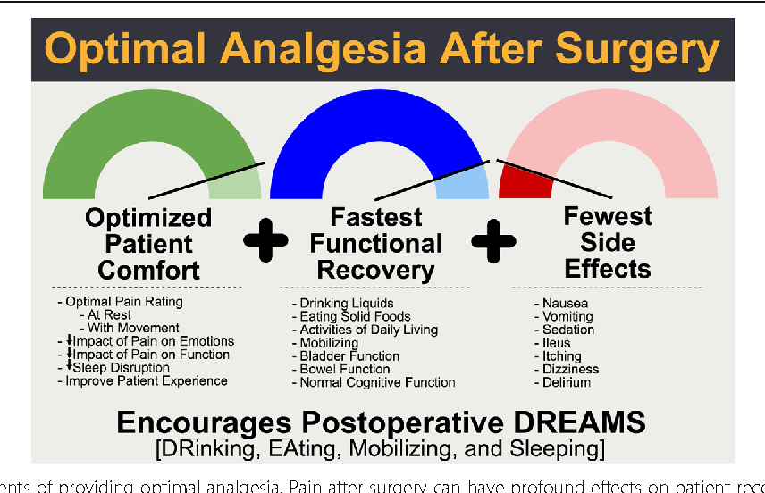
Regular Oral And Multimodal Analgesia
Suboptimal analgesia is associated with delayed functional recovery, delayed mobilization which could increase the risk of thromboembolic complications, poor maternal bonding with the newborn, breastfeeding difficulties, and an increase in the risk of persistent pain and postpartum depression
ERAS protocols recommend a multimodal analgesic regimen using a combination of drugs with different mechanisms of action with the goal of optimizing analgesia, minimizing side effects, and providing opioid sparing
This can be achieved through the combination of neuraxial opioid analgesia, oral analgesia, and peripheral nerve blockade.
Neuraxial morphine was discussed earlier in this review and is considered the gold standard for post cesarean analgesia
Acetaminophen PO 1000 mg Q6 + with Ketorolac 15mg Q6 hours
Acetaminophen 650 mg Q8 hours + Ibuprofen 800mg Q 8hours
Acetaminophen 650mg TID and Ibuprofen BID
oxycodone for breakthrough pain
IV narcotic for severe pain
Consider Gabapentin for chronic opioid users

Slide 39
Early Mobilization
Early mobilization improves pulmonary function and tissue oxygenation, improves insulin resistance, reduces risk of thromboembolism, and shortens length of stay
Effective postoperative analgesia is a key factor in facilitating early postoperative mobilization.

Slide 40
Consultation with a lactational expert
Complete neonatal evaluation by the neonatal team

Slide 41
Tubes and Drains
Whenever possible,
the routine use of postoperative nasogastric or orogastric tube, urinary catheters, and abdominal and pelvic drains without clear indications
should also be avoided

Slide 42
Early Removal Of Urinary Catheter
It is recommended that urinary catheters are removed within 24 hours in ERAS protocols. There are few data on the timing of urinary catheter removal in women who have cesarean delivery under spinal anesthesia.
In a published audit of an ERAS protocol for cesarean delivery, urinary catheters were removed 7 hours after the procedure to facilitate early ambulation with no complications reported

Slide 43
Early Removal Of IV Catheter
Decannulate IV 12-24 hours

Slide 44
Early Removal Of Drains
Surgical drains should be removed as early as possible after surgery

Slide 45
Discharge Phase (Same Day Discharge)
These criteria may include:
• Hemodynamically stable within 20 percent of admission vital signs or as determined by the facility.
• Ability to drink, without nausea or vomiting.
•Adequate pain control with oral analgesia (pain score less than 3)
•Independently mobile able to get out of bed
• voiding trial complete
•No signs of delirium( orinted to time , person, place)
•No complications requiring extended hospital care

Slide 46
Prior to discharge
The patient, family or caregiver also receive written information that includes
instructions,
symptoms to monitor for that need to be reported and who to report them to,
emergency contact information,
strategies to aid recovery (e.g., how to control pain with medicine, how to care for the incisions)
The patient is scheduled for follow-up appointments, as necessary, with the surgeon,

Slide 47
Follow-up post discharge ...
Outpatient clinic:
- Open telephone line (phone call)
- Open access to the clinic 7:00-23:00
post-operative emergency department visit
Home visit of health visitor (nurse)

Slide 48
Follow-up appointments
First visit to their surgeon's office
through 5-7 days postdischarge
Further schedules visits

Slide 49
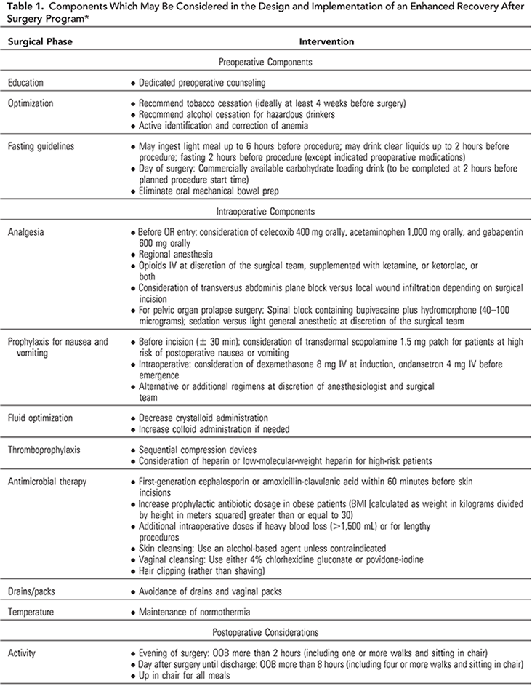

Slide 50
Recommendations against the element use
They were made for
Preoperative (maternal sedation, bowel preparation),
Intraoperative (neonatal oral suctioning or increased inspired oxygen), and
Postoperative (heparin should not be used routinely venous thromboembolism prophylaxis).
Because these ERAS cesarean delivery pathway recommendations (elements/processes) are studied, implemented, audited, evaluated, and optimized by the maternity care teams, this will create an opportunity for the focused and optimized areas of care research with further enhanced care and recommendation.

Slide 51
Conclusion
An enhanced recovery program for cesarean delivery should consist of the best evidence in perioperative care of the parturient.
There is wide variability in components of published ERAS protocols for cesarean delivery.
Future studies on developing and evaluating the impact of various components are needed.

